Slide 1
Applied Mathematics
Computer engineering Department
lecture Five
POITIVE TERMS SERIES TESTE
Test of Convergence and Divergence
1. Ratio test:
Let ∑ 𝑎_{𝑛} be a series with positive terms, and suppose that
𝐥𝐢𝐦 ^{𝒂𝒏+𝟏} =ρ
𝒏→∞
𝒂_{𝒏}
Then:
1. ρ < 1 → 𝐶𝑜𝑛𝑣𝑒𝑟𝑔𝑒𝑛𝑐𝑒
2. ρ > 1 → 𝐷𝑖𝑣𝑒𝑟𝑔𝑒𝑛𝑐𝑒
3. ρ = 1 → 𝐹𝑎𝑖𝑙
The Ratio Test is often effective when the terms of the series contain contain factorials of expressions involving n.
Example (1): Test the following series:
∞
_{𝑛}2
∑ _{3𝑛}
𝑛=1
(𝑛 + 1)²
₃𝑛+1
^{𝑎}𝑛+1 ⁼
𝜌 = 𝑙𝑖𝑚 ^{𝑎𝑛+1} = 𝑙𝑖𝑚 ^{(𝑛+1)2} ∗ ^{3𝑛}= 𝑙𝑖𝑚 ^{𝑛2+2𝑛+1}=¹<1
₃𝑛+1 _{𝑛}2
𝑎_{𝑛} 3𝑛² 3
𝑛→∞ 𝑛→∞ 𝑛→∞
So, it is Conv.
1
Assist. Lecturer weaam T. Ali
2

Slide 2
Applied Mathematics
Computer engineering Department
lecture Five
Example (2): Test the following series:∑∞
(𝑛+4)!
^{𝑛=1} 4! 𝑛!4^{𝑛}
Solution:
(𝑛 + 4)!
𝑎 =
𝑛
4! 𝑛! 4^{𝑛}
And
𝑎 =
(𝑛 + 5)!
4! (𝑛 + 1)! 4^{𝑛+1}
𝑛+1
Thus,
𝜌 = lim ^{𝑎𝑛+1} = lim
𝑛 + 5 1
= < 1
𝑛→∞
𝑎_{𝑛} 𝑛→∞ 4(𝑛 + 1) 4
Therefore;
∞
(𝑛 + 4)!
∑ 4! 𝑛! 4^{𝑛}
𝑖𝑠 𝐶𝑜𝑛𝑣𝑒𝑟𝑔𝑒𝑛𝑐𝑒
𝑛=1
Exercies
Test the series:
∞
_{∑ 𝑛}70_{𝑒}−𝑛
𝑛=1
Ans/ Conv.
2
Assist. Lecturer weaam T. Ali

Slide 3
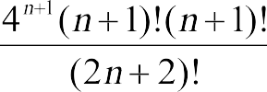
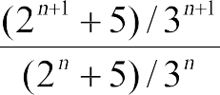
Five
3
Asst.Lec. Weaam T. Ali

Slide 4
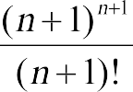
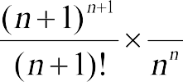
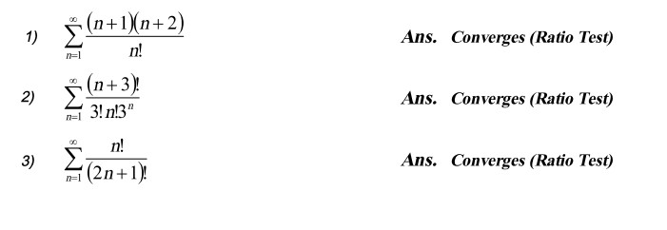
Five
4
Asst.Lec. Weaam T. Ali

