Slide 1
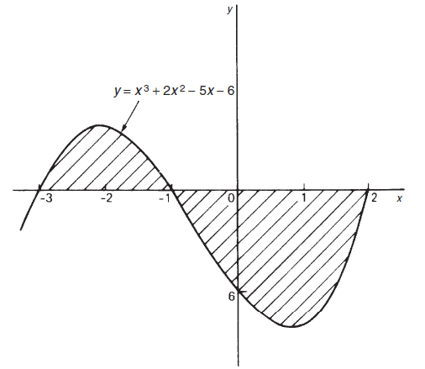
Application of the Definite Integral
1- Area Under The Curve
The area A of the figure bounded by the curve y = f(x) and the x-axis from x = a to x = b (b>a)
y
is given by:
y = f(x)
b b
A = ∫ dA = ∫ y dx = ∫ f (x) dx
x = a a
dA
x = a dx
x = b
x
Ex1: Find the area enclosed by the curve y = 4 − x² and the x-axis.
Solution
When y = 0, then 0 = 4 − x²
∴ x = ±2
∴ dA = y dx = (4 − x² )dx
5
4
dA
3
2
2
⎡
2
3 ⎤
1
∴ A = ∫ (4 − x ² )dx = ⎢4x − ^{x} ⎥
X=−2
⎣
³ ⎦−2
-2
-1
0
0
1
2
⎡
∴ A = 8 − ^{8⎤} − ⎡− 8 − ^{− 8⎤} = 16 − ¹⁶ = ³² unit ²
⎢_{⎣ 3}⎥⎦ ⎢_{⎣ 3} ⎥⎦
3 3
Ex2: Sketch the graph y =x³+ 2x²- 5x- 6 between x= -3 and x= 2 and determine the area enclosed by the curve and the x-axis.
Solution

Slide 2
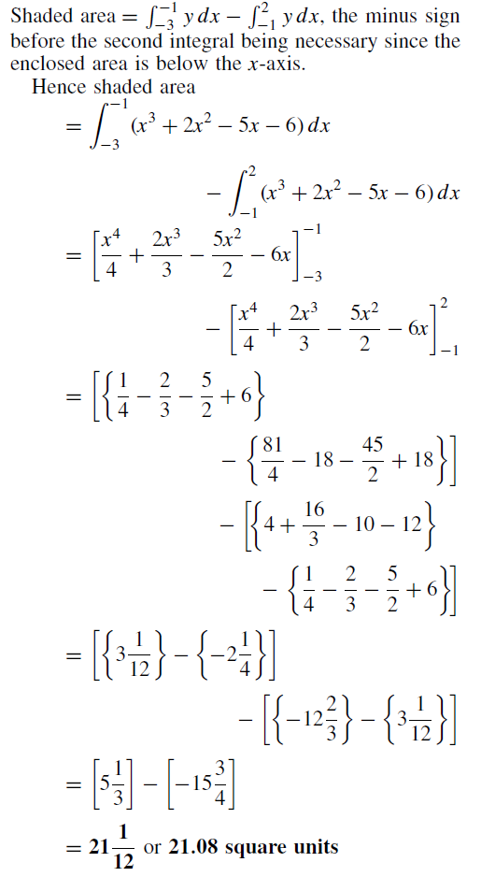

Slide 3
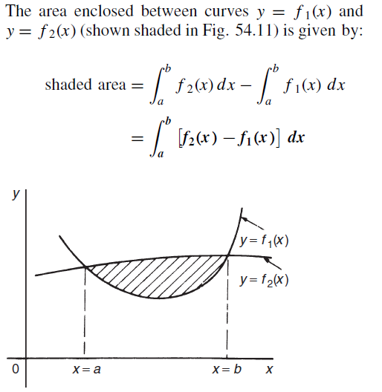
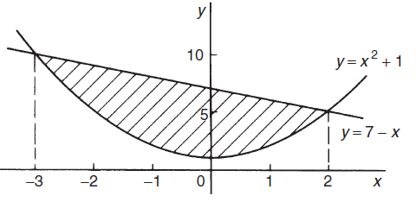
2- Area Between Two Curves
Example 1: determine the area enclosed between the curves
\
Solution:

Slide 4
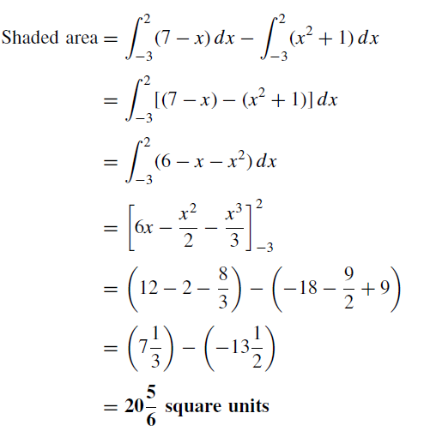
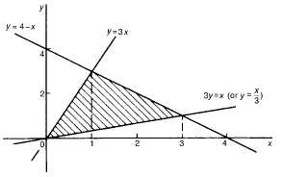
Example 2; determine the area bounded by the three straight lines Solution:

Slide 5
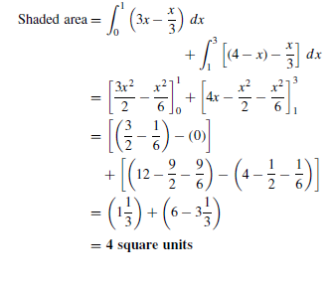
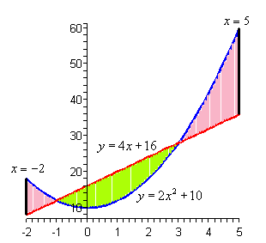
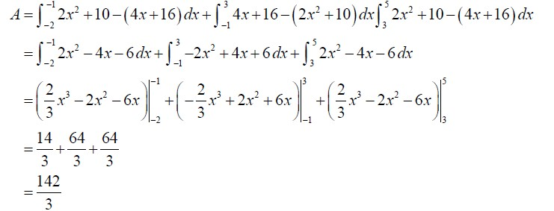
Example 4 Determine the area of the region bounded by y = 2x² +10 , y = 4x +16,
x = −2 and x = 5

Slide 6
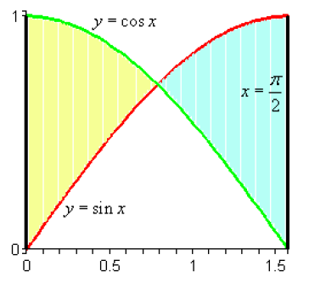
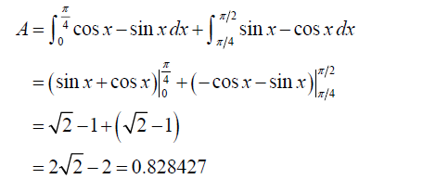
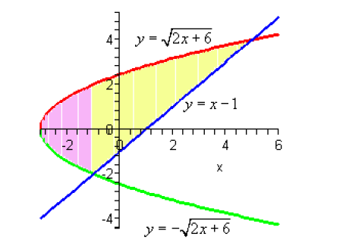

Slide 7
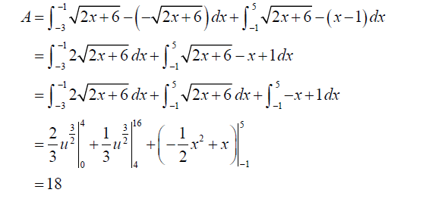
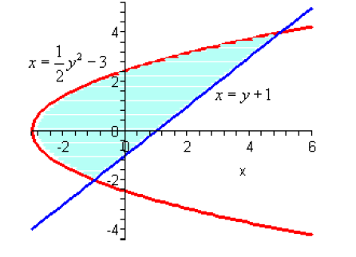
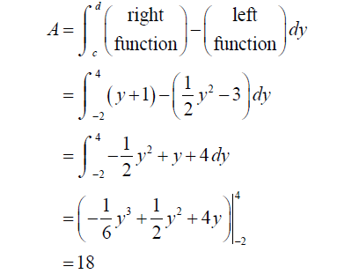

Slide 8
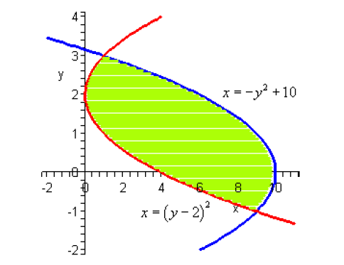
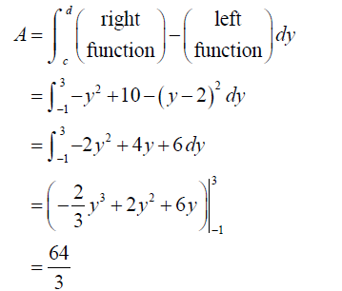

Slide 9
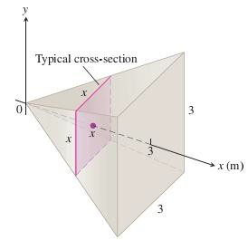
VOLUMES
To apply the formula in the definition to calculate the volume of a solid, take the following steps:
EXAMPLE
A pyramid 3 m high has a square base that is 3 m on a side. The cross-section of the pyramid perpendicular to the altitude x m down from the vertex is a square x
m on a side. Find the volume of the pyramid.
A sketch the pyramid with its altitude along the x-axis and its vertex at the origin and include a typical cross-section.
A formula for A(x). The cross-section at x is a square x meters on
a side, so its area is
The limits of integration. The squares lie on the planes from
Integrate to find the volume
Solids of Revolution: The Disk Method
The solid generated by rotating a plane region about an axis in its plane is called a solid of
revolution.

Slide 10
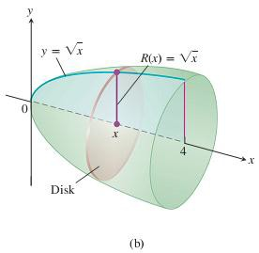
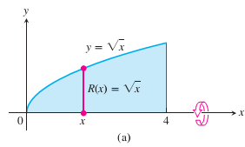
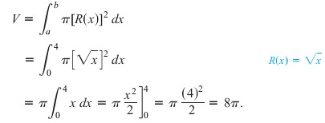
To find the volume of a solid like the one shown below ,
We need only observe that the cross-sectional area A(x) is the area of a disk of radius R(x), the distance of the planar region’s boundary from the axis of
revolution.
EXAMPLE
The region between the curve
axis to generate a solid. Find its volume
Solution The volume is
and the x-axis is revolved about the x-
EXAMPLE
The circle is rotated about the x-axis to generate a sphere. Find its volume. Solution we imagine the sphere cut into thin slices by planes perpendicular to the x-axis .The cross-sectional area at a typical point x between -a and a is
- 11 -

Slide 11
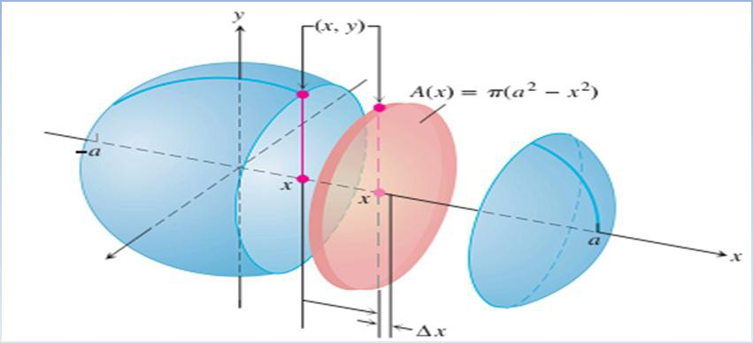
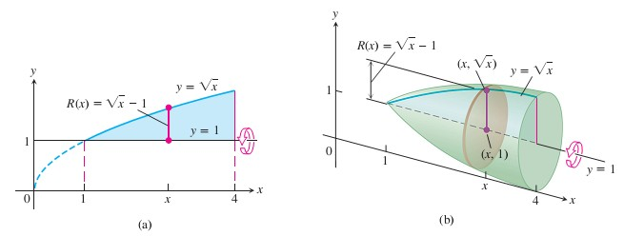
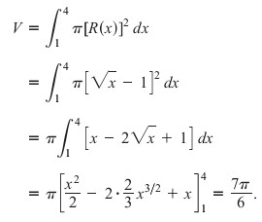
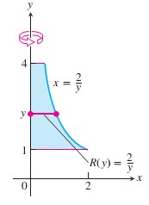
EXAMPLE A Solid of Revolution (Rotation About the Line )
Find the volume of the solid generated by revolving the region bounded by lines about the line y=1 .
Solution
and the
EXAMPLE 7 Rotation About the y-Axis
Find the volume of the solid generated by revolving the region between the y-axis and the curve x=2/y , 1≤ y ≤ 4 about the y-axis.
Solution
- 11 -

Slide 12
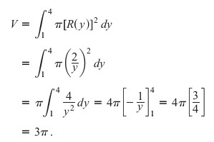
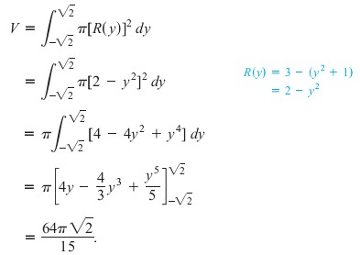
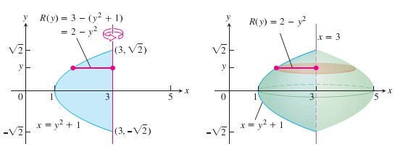

Slide 13
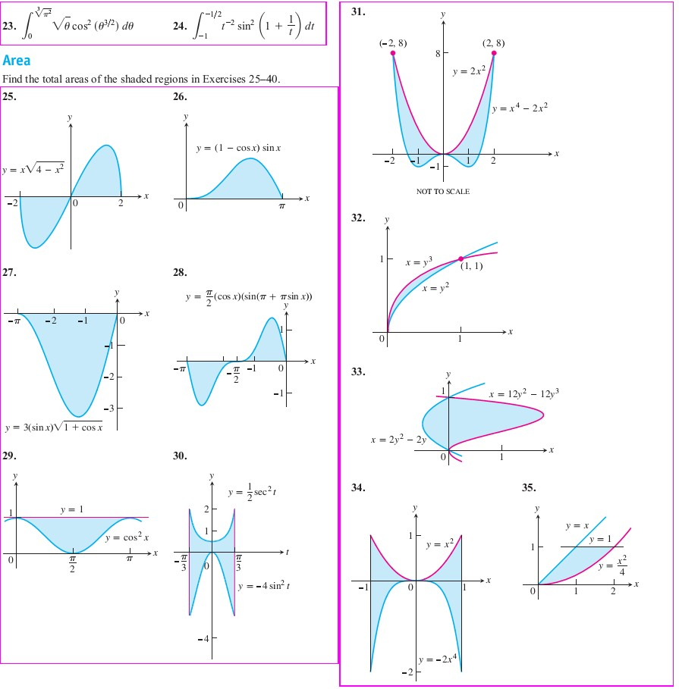
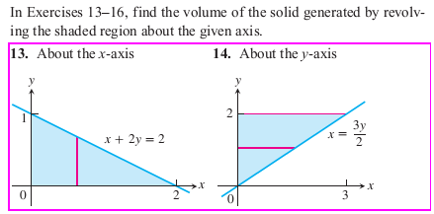
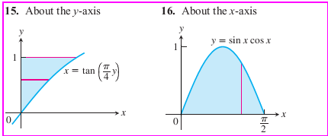
Problemes
Volumes

Slide 14
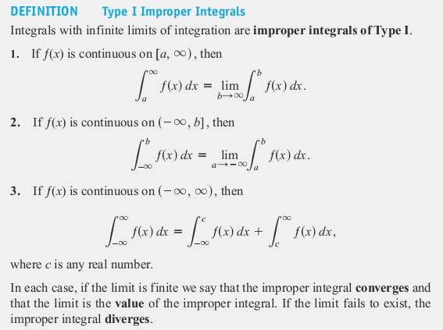
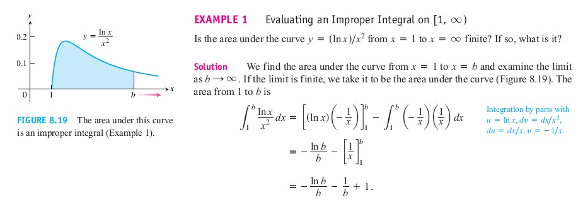
IMPROPER INTEGRALS
Definite integrals require firstly that the domain of integration [a, b] to be finite and
Secondly that the range of the integrand to be finite over the domain.
For example, the integral of (ln x/x²) over [1,∞), or the integral of (1/√x) over (0; 1]. Those integrals are said to be improper.

Slide 15
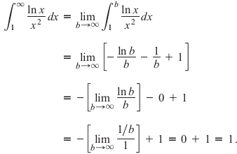
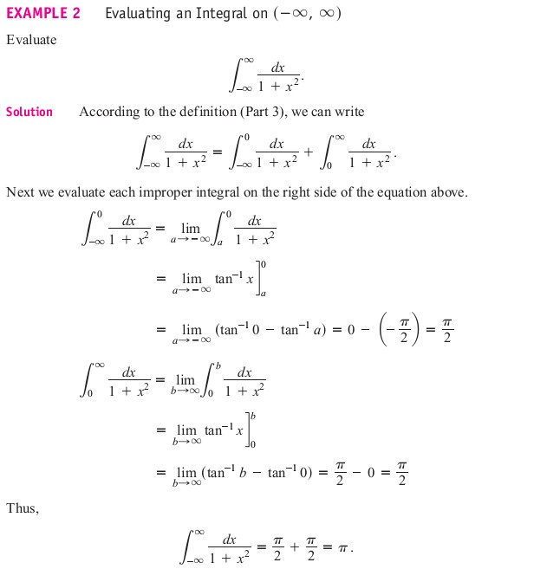
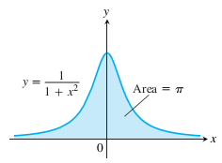

Slide 16
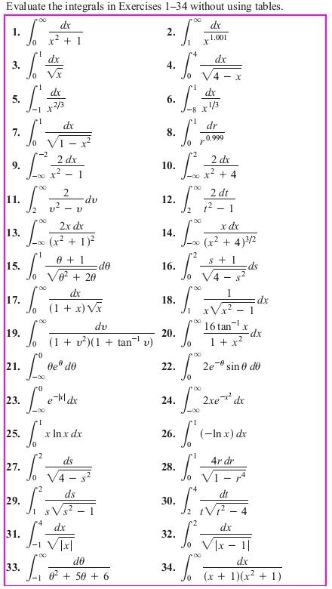
EXERCISES 8.8

