Slide 1
Mechanical Design of Overhead Transmission Lines
University of Diyala -College of Engineering
Dept. of Power and Electrical Machines
Subject: Power System Engineering
Last Up date 2015-2016
CHAPTER THREE
INSULATORS
Prepared by
Lecturer: Husham I. Hussein

Slide 2
Insulators
The overhead line conductors should be supported on the poles or towers in such a way that currents from conductors do not flow to earth through supports i.e., line conductors must be properly insulated from supports.
The insulators provide necessary insulation between line conductors and supports and thus prevent any leakage current from conductors to earth.

Slide 3
The insulators should have the following desirable properties :
High mechanical strength in order to withstand conductor load, wind load etc.
High electrical resistance of insulator material in order to avoid leakage currents to earth.
High relative permittivity of insulator material in order that dielectric strength is high.
The insulator material should be non-porous, free from impurities and cracks otherwise the permittivity will be lowered.
High ratio of puncture strength to flashover.
The most commonly used material for insulators of overhead line is porcelain , but glass and special composition materials are also used to a limited extent.

Slide 4
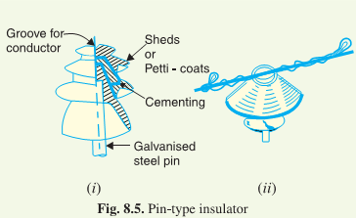
Types of Insulators
There are several types of insulators but the most commonly used are pin type, suspension type, strain insulator and shackle insulator
1. Pin type insulators. The part section of a pin type insulator is shown in Fig. below, As the name suggests, the pin type insulator is secured to the cross-arm on the Pin type insulators are used for transmission and distribution of electric power at voltages up to 33 kV. Beyond operating voltage of 33 kV, the pin type insulators become too bulky and hence uneconomical.

Slide 5
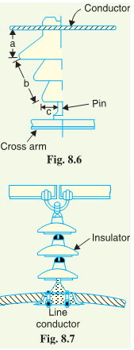
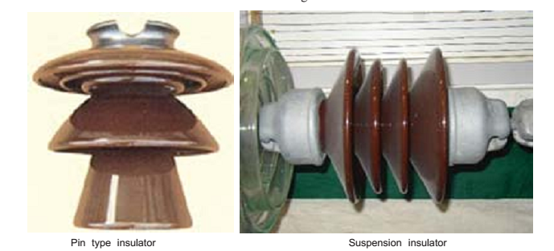
Causes of insulator failure.
Insulators are required to withstand both mechanical and electrical stresses.
The electrical breakdown of the insulator can occur either by flash-over or puncture.
In flashover, an arc occurs between the line conductor and insulator pin (i.e., earth) and the discharge jumps across the air gaps, following shortest distance. Fig. 8.6 shows the arcing distance (i.e. a+ b+ c) for the insulator.
In case of flash-over, the insulator will continue to act in its proper capacity unless extreme heat produced by the arc destroys the insulator.

Slide 6

In case of puncture, the discharge occurs from conductor to pin through the body of the insulator. When such breakdown is involved, the insulator is permanently destroyed due to excessive heat.
The ratio of puncture strength to flashover voltage is known as safety factor i.e.,
Suspension type insulators.
The cost of pin type insulator increases rapidly as the working voltage is increased. Therefore, this type of insulator is not economical beyond 33 kV.
For high voltages (>33 kV), it is a usual practice to use suspension type insulators shown in Fig. 8.7.
They consist of a number of porcelain discs connected in series by metal links in the form of a string.
The conductor is suspended at the bottom end of this string while the other end of the string is secured to the cross-arm of the tower.
Each unit or disc is designed for low voltage, say 11 kV.
The number of discs in series would obviously depend upon the working voltage. For instance, if the working voltage is 66 kV, then six discs in series will be provided on the string.

Slide 7
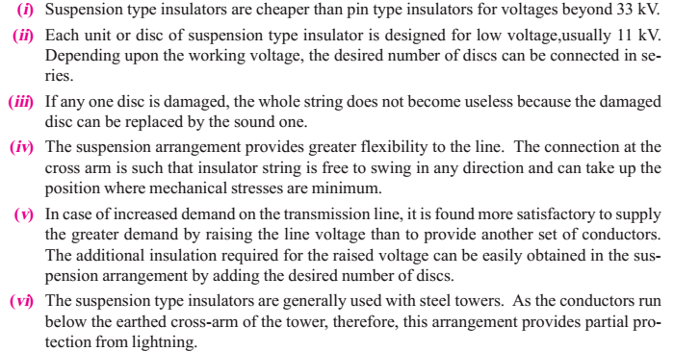
Advantages

Slide 8
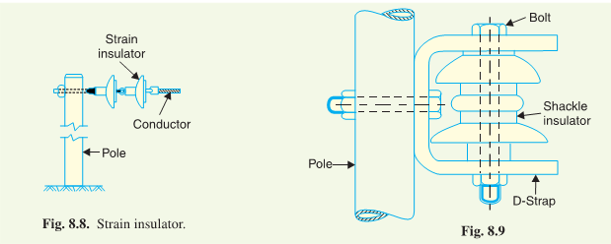
3. Strain insulators:
When there is a dead end of the line or there is corner or sharp curve, the line is subjected to greater tension. In order to relieve the line of excessive tension, strain insulators are used.
For low voltage lines (< 11 kV), shackle insulators are used as strain insulators. However, for high voltage transmission lines, strain insulator consists of an assembly of suspension insulators as shown in Fig. 8.8. The discs of strain insulators are used in the vertical plane. When the tension in lines is exceedingly high, as at long river spans, two or more strings are used in parallel.

Slide 9
4- Shackle insulators:
In early days, the shackle insulators were used as strain insulators.
But now a days, they are frequently used for low voltage distribution lines.
Insulators can be used either in a horizontal position or in a vertical position.
They can be directly fixed to the pole with a bolt or to the cross arm.
Fig. 8.9 shows a shackle insulator fixed to the pole. The conductor in the groove is fixed with a soft binding wire.
Potential Distribution over Suspension Insulator String:
A string of suspension insulators consists of a number of porcelain discs connected in series through metallic links. Fig. 8.10 (i) shows 3-disc string of suspension insulators. The porcelain portion of each disc is in between two metal links. Therefore, each disc forms a capacitor C as shown in Fig. 8.10 (ii). This is known as mutual capacitance or self-capacitance.

Slide 10
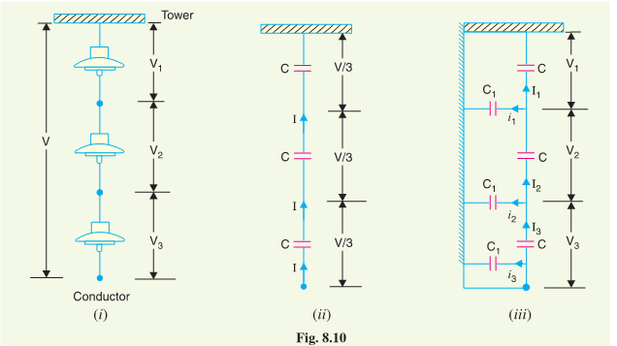

Slide 11
If there were mutual capacitance alone, then charging current would have been the same through all the discs and consequently voltage across each unit would have been the same i.e., V/3 as shown in Fig. 8.10 (ii).
In actual practice, capacitance also exists between metal fitting of each disc and tower or earth. This is known as shunt capacitance C 1.
Due to shunt capacitance, charging current is not the same through all the discs of the string [See Fig. 8.10 (iii)].
Therefore, voltage across each disc will be different. Obviously, the disc nearest to the line conductor will have the maximum voltage. Thus referring to Fig. 8.10 (iii), V3 will be much more than V2 or V1.

Slide 12
Notes regarding the potential distribution over a string of suspension insulators :
(i) The Voltage impressed on a string of suspension insulators does not distribute itself uniformly across the individual discs due to the presence of shunt capacitance.
(ii) The disc nearest to the conductor has maximum voltage across it. As we move towards the cross-arm, the voltage across each disc goes on decreasing.
(iii) The unit nearest to the conductor is under maximum electrical stress and is likely to be punctured. Therefore, means must be provided to equalize the potential across each unit.
(iv) If the voltage impressed across the string were D.C, then voltage across each unit would be the same. It is because insulator capacitances are ineffective for D.C.

Slide 13

String Efficiency:
As stated above, the voltage applied across the string of suspension insulators is not uniformly distributed across various units or discs. The disc nearest to the conductor has much higher potential than the other discs.
The ratio of voltage across the whole string to the product of number of discs and the voltage across the disc nearest to the conductor is known as string efficiency i.e.,
String efficiency is an important consideration since it decides the potential distribution along the string. The greater the string efficiency, the more uniform is the voltage distribution.

Slide 14
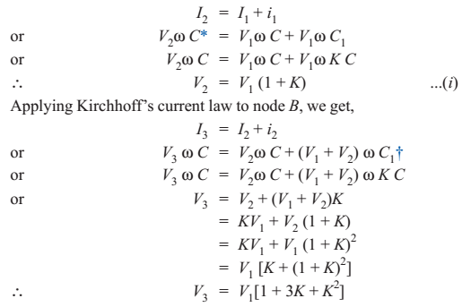
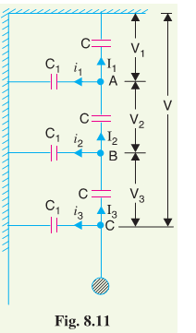

Mathematical expression:
Fig. 8.11 shows the equivalent circuit for a 3-disc string. Let us suppose that self capacitance of each disc is C. Let us further assume that shunt capacitance C1 is some fraction K of self capacitance i.e., C1 = KC.
Starting from the cross-arm or tower, the voltage across each unit is V1,V2 and V3 respectively as shown. Applying Kirchhoff’s current law to node A, we get,

Slide 15
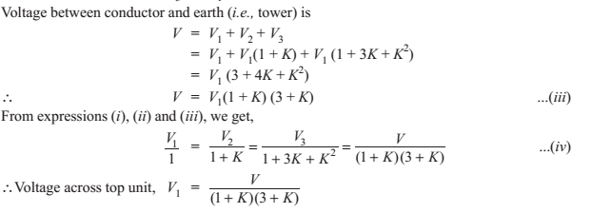

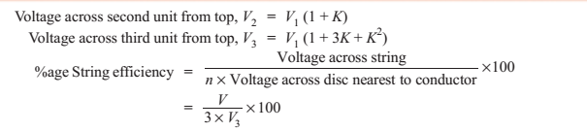

Slide 16
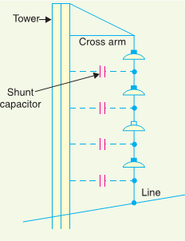
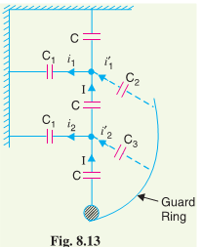
Methods of Improving String Efficiency:
Using longer cross-arms(reducing K).
By grading the insulators.
Using a guard ring.

Slide 17
Important Points:
The maximum voltage appears across the disc nearest to the conductor (i.e., line conductor).
The voltage across the string is equal to phase voltage i.e., Voltage across string = Voltage between line and earth = Phase Voltage.
Line Voltage = √3×Voltage across string

Slide 18
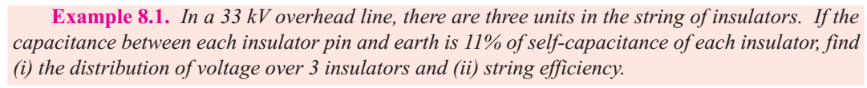
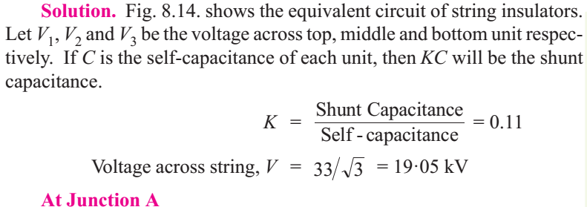
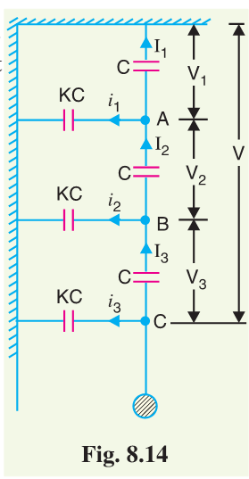
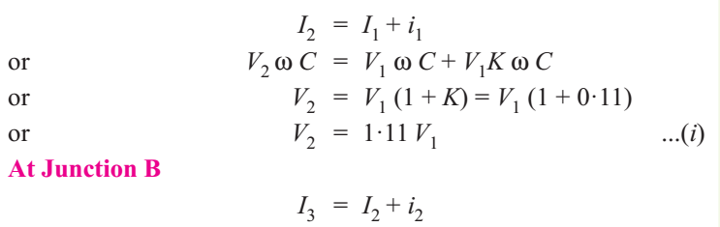

Slide 19
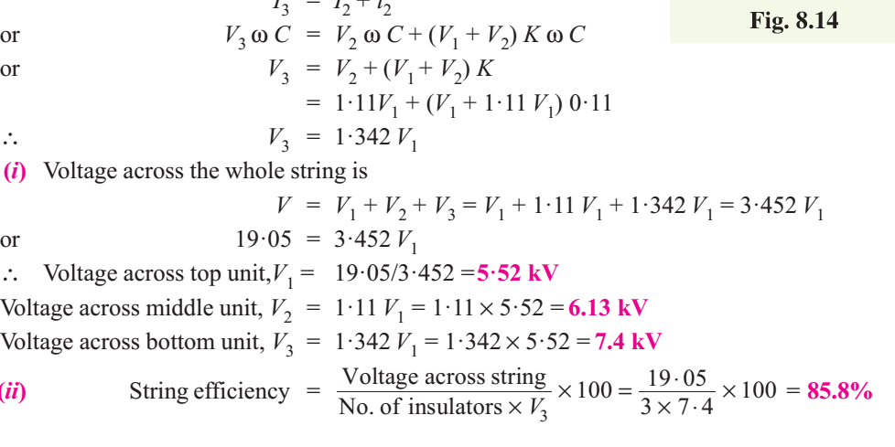

Slide 20
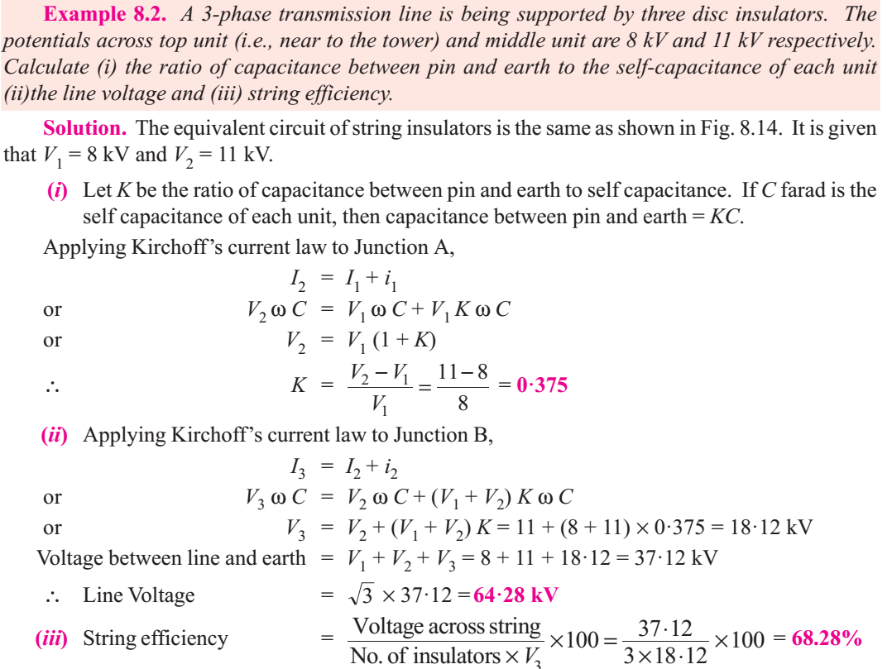

Slide 21
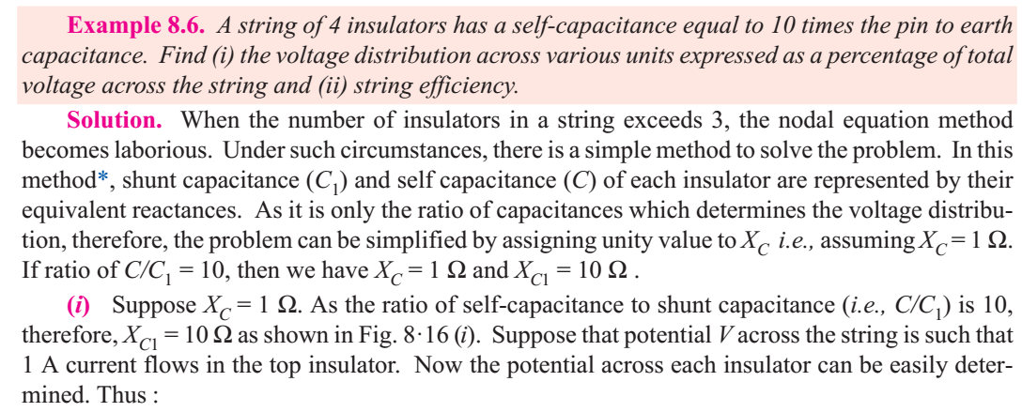
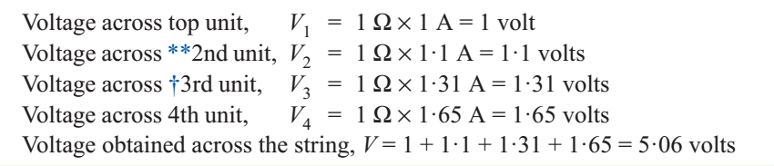

Slide 22
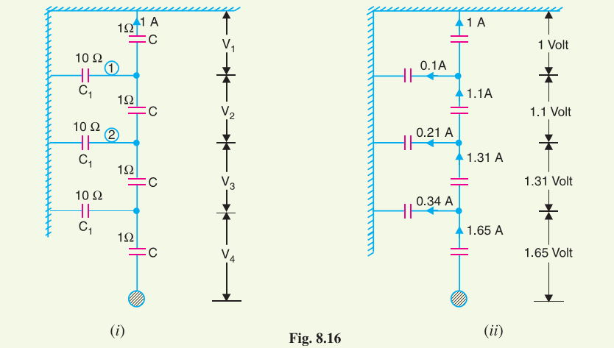
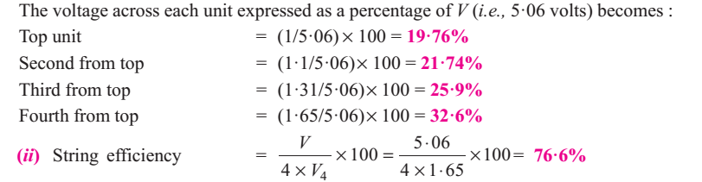

Slide 23
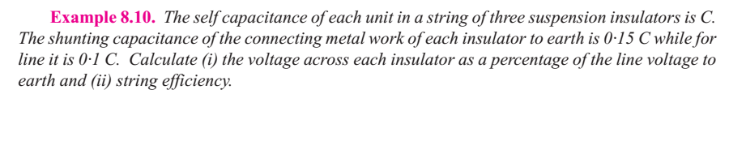

Slide 24
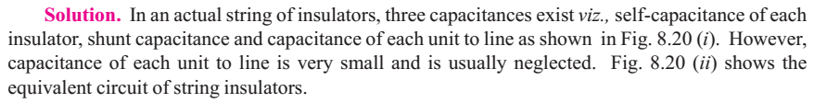
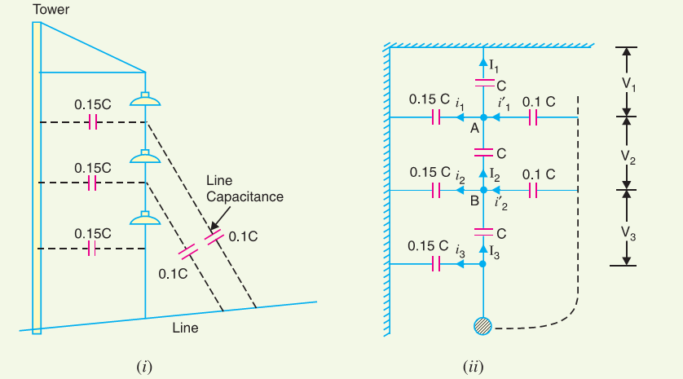

Slide 25
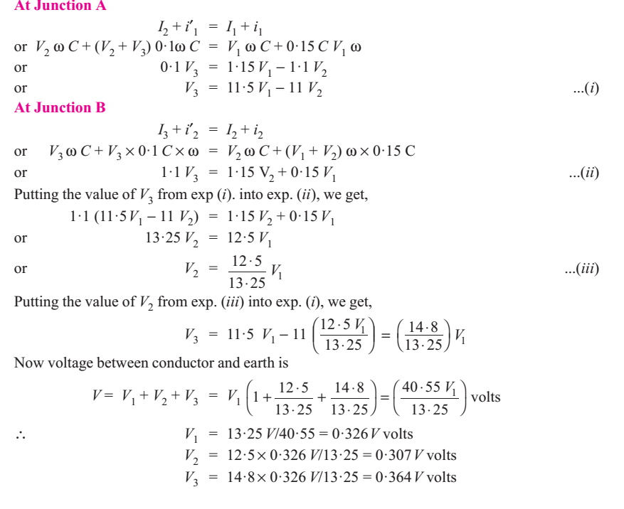
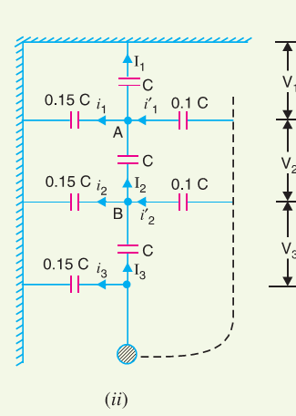

Slide 26

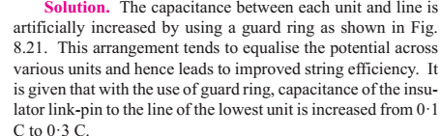
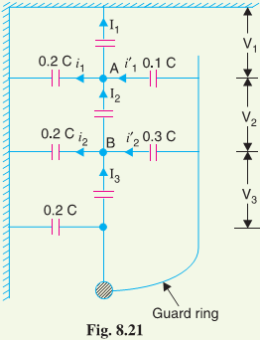
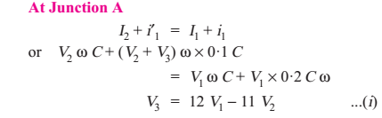

Slide 27
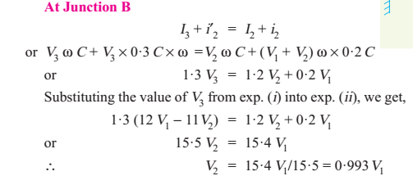

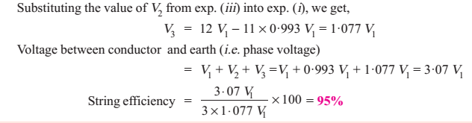

Slide 28
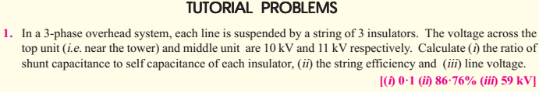
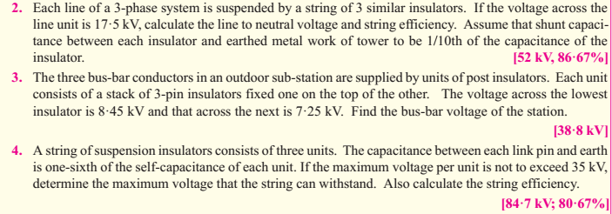

Slide 29
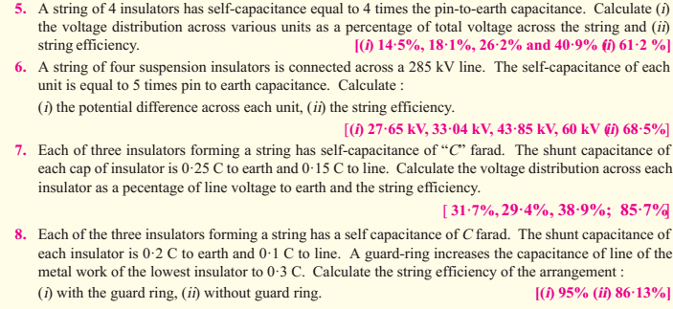

Slide 30
References
PRINCIPLES OF POWER SYSTEMS MEHTA.
POWER SYSTEM ANALYSIS BY HADI SADATT.
POWER SYSTEM ANALYSIS AND DESIGN BY GLOVER.
POWE SYSTEM ANALYSIS BY GRAINGER.
ELECTRICAL POWER SYSTEMS BY A.E. GUILE, W. PATERSON.
ELEMENTS OF POWER SYSTEM ANALYSIS BYWILLIAM STEVENSON.
ELECTRICAL POWER SYSTEMS BY WEEDY, B.M.

