Slide 2
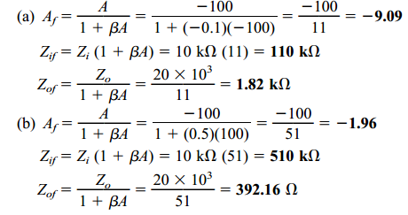
Example 18.1 demonstrates the trade-off of gain for improved input and output resistance. Reducing the gain by a factor of 11 (from 100 to 9.09) is complemented by a reduced output resistance and increased input resistance by the same factor of 11. Reducing the gain by a factor of 51 provides a gain of only 2 but with input resistance feedback connection.
increased by the factor of 51 (to over 500 k) and output resistance reduced from 20 kto under 400 . Feedback offers the designer the choice of trading away some of the available amplifier gain for other improved circuit features

Slide 3
Reduction in Frequency Distortion
For a negative-feedback amplifier having $β$A>>1, the gain with feedback is Af $≅$1/$β$.
It follows from this that if the feedback network is purely resistive, the gain with feedback is not dependent on frequency even though the basic amplifier gain is frequency dependent.
Practically, the frequency distortion arising because of varying amplifier gain with frequency is considerably reduced in a negative-voltage feedback amplifier circuit.

Slide 4
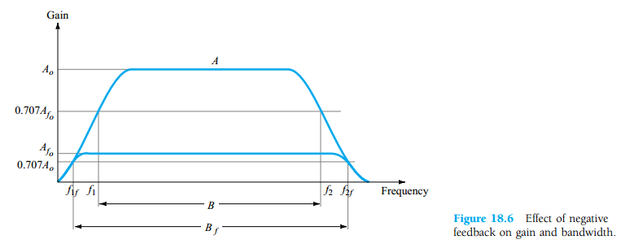
Effect of Negative Feedback on Gain and Bandwidth

Slide 5
PRACTICAL FEEDBACK CIRCUITS

Slide 6
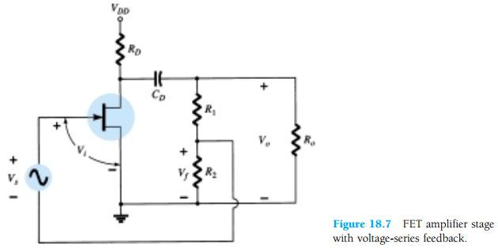
Voltage-Series Feedback
Fig.18.7 shows an FET amplifier stage with voltage-series feedback. A part of the output signal (Vo) is obtained using a feedback network of resistors R1 and R2. The feedback voltage Vf is connected in series with the source signal Vs, their difference being the input signal Vi.
Without feedback the amplifier gain is:
Where RL is the parallel combination of resistors:

Slide 7
Using the values of A and β above in Equation
A_{f} is the gain with negative feedback

Slide 8
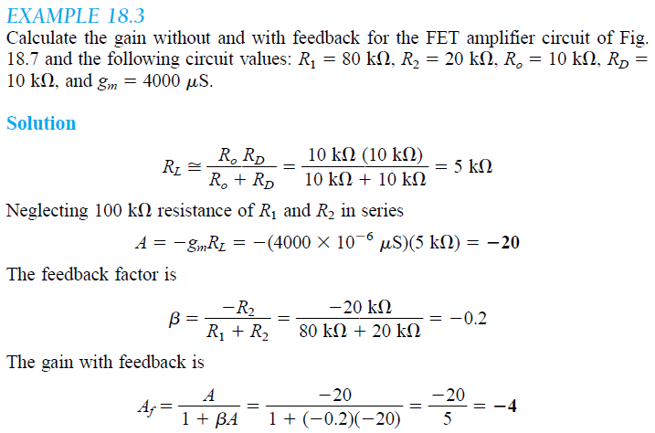
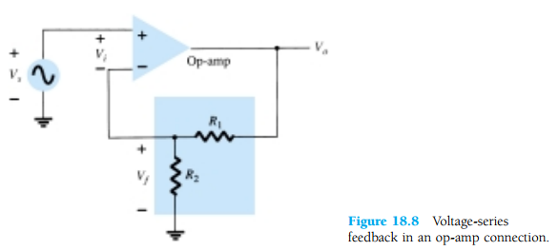
Fig.18.8 shows a voltage-series feedback connection using an op-amp. The gain of the op-amp, A, without feedback, is reduced by the feedback factor

Slide 9
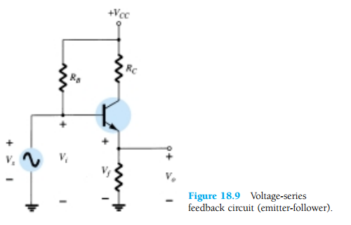
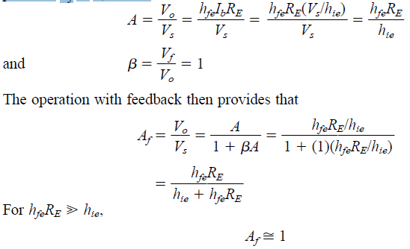
Fig.18.9 provides voltage-series feedback. The signal voltage, Vs, is the input voltage, Vi. The output voltage, Vo, is also the feedback voltage in series with the input voltage.
The amplifier, as shown in Fig.18.9, provides the operation with feedback. The operation of the circuit without feedback provides Vf = 0, so that

Slide 10
Current-Series Feedback
Another feedback technique is to sample the output current (Io) and return a proportional voltage in series with the input. While stabilizing the amplifier gain, the current- series feedback connection increases input resistance. Fig.18.10 shows a single transistor amplifier stage. Since the emitter of this stage has an unbypassed emitter, it effectively has current-series feedback. The current through resistor RE results in a feedback voltage that opposes the source signal applied so that the output voltage Vo is reduced. To remove the current-series feedback, the emitter resistor must be either removed or bypassed by a capacitor (as is usually done).

Slide 12
WITHOUT FEEDBACK
WITH FEEDBACK

Slide 13
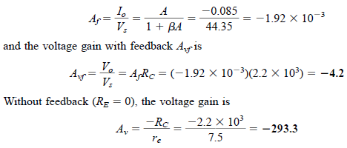

Slide 18
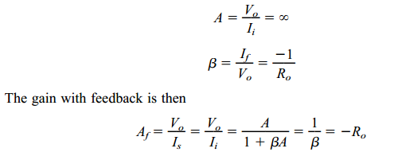
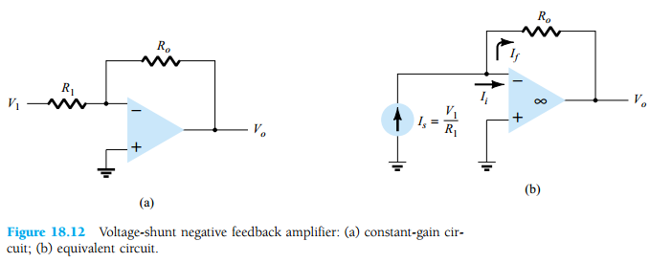
Voltage-Shunt Feedback

Slide 19
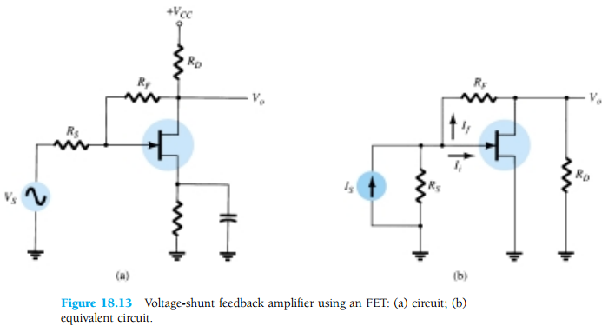
This is a transfer resistance gain. The more usual gain is the voltage gain with feedback,
The circuit of Fig. 18.13 is a voltage-shunt feedback amplifier using an FET with

Slide 20
Calculate the voltage gain with and without feedback for the circuit of Fig. 18.13a

