Slide 1
Chapter Eight Magnetic Forces, Materials, Inductance and Devices

Slide 2
8.1 INTRODUCTION
8.2 FORCES DUE TO MAGNETIC FIELDS
There are many ways in which force due to magnetic fields can be experienced.
due to a moving charged particle in a B field,
on a current element in an external B field, or
between two current elements.

Slide 3
8.2.1 Force on a Charged Particle (Moving Charge)
The electric force $\overset{⃑}{F_{e}}$ on a stationary or moving electric charge $Q$ in an electric field $E$ is given by: $$\overset{⃑}{F_{e}}=Q E$$
The magnetic force $\overset{⃑}{F_{m}}$ by a charge $Q$ moving with a velocity $u$ in a magnetic field B is
$$\overset{⃑}{F_{m}}=Qu×B$$

Slide 4
A comparison between the electric force and the magnetic force can be made.
The electric force $\overset{⃑}{F_{e}}$ is independent of the velocity of the charge.
The electric force $\overset{⃑}{F_{e}}$ can perform work on the charge and change its kinetic energy.
The magnetic force $\overset{⃑}{F_{m}}$ depends on the charge velocity and is normal to it.
The magnetic force $\overset{⃑}{F_{m}}$ cannot perform work because it is at right angles to the direction of motion of the charge; it does not cause an increase in kinetic energy of the charge.
The magnitude of $\overset{⃑}{F_{m}}$ is generally small compared to $\overset{⃑}{F_{e}}$ except at high velocities.

Slide 5
For a moving charge $Q$ in both electric and magnetic fields, the total force on the charge is given by.
$$\overset{⃑}{F}=\overset{⃑}{F_{e}}+\overset{⃑}{F_{m}}=Q E+Qu×B=Q \left(E+u×B\right)$$
Lorentz force equation relates mechanical force to electrical force. If the mass of the charged particle moving in $E$ and $B$ fields is (m), by Newton's second law of motion.
Lorentz force equation
$$\overset{⃑}{F}=m\frac{du}{dt}=ma=Q \left(E+u×B\right)$$

Slide 6
8.2.2 Force on a Differential Current Element.
The force on a moving charge in a magnetic field can be written as the differential force exerted on a differential element of charge [1].
$$dF=dQu×B$$
For convection current density.
$$\overset{⃑}{J}=ρ_{v} u$$
$$\text{Thus} dQ=ρ_{v}dv$$
$$dF=dQu×B=ρ_{v}dv u×B=\overset{⃑}{J}×B dv$$

Slide 7
The relationship between differential current elements is:
$$IdL=KdS=\overset{⃑}{J}dv$$
Therefore;
$$IdL=\overset{⃑}{J}dv=ρ_{v} u dv=ρ_{v}dv u=dQ u$$
or
$$IdL=\frac{dQ}{dt} dL=dQ \frac{dL}{dt}=dQ u$$
Hence,
$$IdL=dQu$$

Slide 8
The force on a current element $IdL$ in a magnetic field B is found by using equation ($\overset{⃑}{F_{m}}=Qu×B$) with replace $Qu$ by $IdL$; that is.
$$dF=IdL×B$$
If the current $I$ is through a closed path $L$ or circuit, the force on the circuit is given by
$$F=\oint{IdL×B}$$

Slide 9
Notes
The magnetic field produced by the current element $IdL$ does not exert force on the element itself.
The $B$ field that exerts force on $IdL$ must be due to another element (external to the current element $IdL$).
If we have surface current elements $KdS$ or a volume current element $\overset{⃑}{J}dv$, thus the Lorentz force equation become:
$$dF=KdS×BF=\int_{s}{KdS×B}$$
$$dF=\overset{⃑}{J}dv×B or F=\int_{v}{\overset{⃑}{J}dv×B}$$

Slide 10
and
$$F=\oint{IdL×B}=−I\oint{dL×B}$$
$$F=IL×B$$
The magnitude of the force is given by the familiar equation
$$F=BILsinθ$$
Where, $θ$ is the angle between the vectors representing the direction of the current flow and the direction of the magnetic flux density.

Slide 11
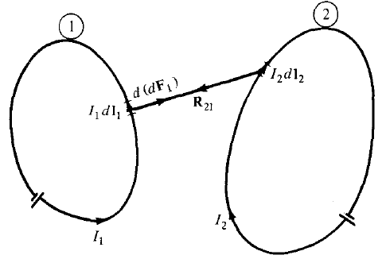
8.2.3 Force between Two Current Elements
Consider the force between two elements $I_{1}{dL}_{1}$ and $I_{2}{dL}_{2}$. both current elements produce magnetic fields.
We find the force $d({dF}_{1})$ on element $I_{1}{dL}_{1}$ due to the field ${dB}_{2}$ produced by element $I_{2}{dL}_{2}$ as shown in Figure.
By using equation
$$dF=IdL×B$$
$$d({dF}_{1})=I_{1}{dL}_{1}×{dB}_{2}$$

Slide 12
from Biot-Savart's law,
$${dB}_{2}=\frac{µ_{o}I_{2}{dL}_{2}×a_{R_{21}}}{4πR_{21}^{2}}$$
Hence,
$$d({dF}_{1})=\frac{µ_{o}I_{1} {dL}_{1}×\left(I_{2} {dL}_{2}×a_{R_{21}}\right)}{4π R_{21}^{2}}$$
The total force $F_{1}$, on current loop 1 due to current loop 2 shown in Figure as
$$F_{1}=\frac{µ_{o}I_{1}I_{2}}{4π}\oint_{L_{1}}{\oint_{L_{2}}{\frac{ {dL}_{1}×\left( {dL}_{2}×a_{R_{21}}\right)}{ R_{21}^{2}}}}$$

Slide 13
8.3 MAGNETIC TORQUE AND MOMENT
The torque or mechanical moment of force on the loop is the vector product of the force $\overset{⃑}{F}$ and the moment arm r. That is,
$$T=r×F in \left(N.m\right)$$
If we used a rectangular loop placed in a uniform magnetic field B Fig. (8.5a). The $dL$ is parallel to B along sides 1-2 and 3-4 of the loop and no force is exerted on those sides. Thus
$$F=I\int_{2}^{3}{dL×B}+I\int_{4}^{1}{dL×B}=I\int_{0}^{𝓁}{dz a_{z}×B}+I\int_{𝓁}^{0}{dz a_{z}×B}$$
$$F=F_{o}−F_{o}=0$$

Slide 14
where $\left|F_{o}\right|=IB𝓁,$B is uniform.
no force is exerted on the loop.
$F_{o}$ and ${−F}_{o}$ act at different points on the loop, thereby creating a couple
if the normal to the plane of the loop makes an angle $α$ with B, as in Fig. (8.5b).
The torque on the loop is $\left|T\right|=|F_{o}|w\sin{α}$
Or $T=BI𝓁w\sin{α}$

Slide 15
But $𝓁w=S$, the area of the loop. Hence,
We define the quantity
This magnetic dipole moment ($in A/m^{2}$).
The magnetic dipole moment: is the product of current and area of the loop; its direction is normal to the loop. Thus,
$$T=BIS\sin{α}$$
$$m=ISa_{n}$$
$$T=m×B$$

Slide 16
This applicable in determining the torque on a planar loop.
The magnetic field must be uniform.
the torque is in the direction of the axis of rotation, it is directed such as to reduce $α$ so that m and $B$ are in the same direction.
In an equilibrium position (when $m$ and $B$ are in the same direction), the loop is perpendicular to the magnetic field and the torque will be zero as well as the sum of the forces on the loop.

Slide 17
8.4 A MAGNETIC DIPOLE
A bar magnet or a small filamentary current loop is usually referred to as a magnetic dipole. We determined the magnetic field $B$ at point $P(r, θ, φ)$ due to a circular loop carrying current $I$ as in Figure. The magnetic vector potential at $P$ is:
$$A=\frac{µ_{o}I}{4π}\oint{\frac{dL}{r}}$$
At far field ($r>>a$, so that the loop appears small at the observation point), $A$ has only $φ$-component and it is given by
$$A=\frac{µ_{o}Iπa^{2}\sin{θ}a_{φ}}{4π r^{2}}$$

Slide 18
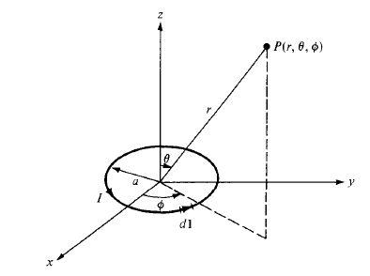
$$A=\frac{µ_{o}m×a_{r}}{4π r^{2}}$$
$$Iπa^{2}a_{z}$$
$$a_{z}×a_{r}=\sin{θ}a_{φ}$$
determined the magnetic flux density $B$ from $B=∇×A$ as
$$B=\frac{µ_{o}m}{4π r^{3}}\left(2\cos{θ}a_{r}+\sin{θ}a_{θ}\right)$$

Slide 19
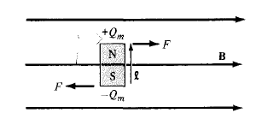
For the bar magnet of Fig. 8.8. If $Q_{m}$ is an isolated magnetic charge and $𝓁$ is the length of the bar, the bar has a dipole moment $Q_{m}𝓁$. When the bar is in a uniform magnetic field B, the torque
$$T=m×B=Q_{m}𝓁×B$$
The force acting on the magnetic charge is given by
$$F=Q_{m}B$$
Figure 8.8

Slide 20
Notes
Both a small current loop and a bar magnet produce magnetic dipoles, they are equivalent if they produce the same torque in a given B field; that is, when
$$T=Q_{m}𝓁B=ISB$$
Hence, showing that they must have the same dipole moment.
$$Q_{m}𝓁=IS$$

Slide 21
8.5 MAGNETIZATION IN MATERIALS
The material is composed of atoms. Each atom may be regarded as consisting of electrons orbiting about a central positive nucleus; the electrons also rotate (or spin) about their own axes. An internal magnetic field is produced by (electronic motions) electrons orbiting around the nucleus or electrons spinning as in Figure (8.9a,b), that are similar to the magnetic field produced by a current loop of Figure (8.10). The equivalent current loop has a magnetic moment of $m=I_{b}S a_{n}$, where $S$ is the area of the loop and $I_{b}$ is the bound current (bound to the atom).

Slide 22
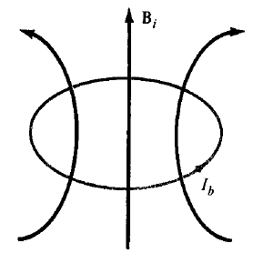

Slide 23
Without an external B field applied to the material, the sum of m's is zero due to random orientation as in Figure (8.11a).
When an external $B$ field is applied, the magnetic moments of the electrons more or less align themselves with $B$ so that the net magnetic moment is not zero, as illustrated in Figure (8.11b).

Slide 25
The magnetization M (in amperes$/$meter) is the magnetic dipole moment per unit volume.
If there are $N$ atoms in a given volume $Δv$ and the $k^{th}$ atom has a magnetic moment $m_{k}$,
$$m=\lim_{Δv→0}{\frac{\sum_{k=1}^{N}{m_{k}}}{Δv}}$$
the magnetic moment is $dm=Mdv′$. From eq. ($8.23a$), the vector magnetic potential due to $dm$ is
$$dA=\frac{µ_{o}M×a_{R}}{4π R^{2}}dv^{′}=\frac{µ_{o}M×R}{4π R^{3}}dv^{′}$$

Slide 26
$$\frac{R}{R^{3}}=∇^{′}\frac{1}{R}$$
hence,
$$A=\frac{µ_{o}}{4π}\int{M×∇^{′}\frac{1}{R}}dv^{′}$$
$$M×∇^{′}\frac{1}{R}=\frac{1}{R}∇^{′}×M−∇^{′}×\frac{M}{R}$$
Substituting this into eq. (8.30) yields
$$A=\frac{µ_{o}}{4π}\int_{v^{′}}{\frac{∇^{′}×M}{R}}dv^{′}−\frac{µ_{o}}{4π}\int_{v^{′}}{∇^{′}×\frac{M}{R}}dv^{′}$$
Applying the vector identity
$$\int_{v^{′}}{∇^{′}×F}dv^{′}=−\oint_{s^{′}}{F×dS}$$

Slide 27
to the second integral, we obtain
$$A=\frac{µ_{o}}{4π}\int_{v^{′}}{\frac{∇^{′}×M}{R}}dv^{′}+\frac{µ_{o}}{4π}\oint_{s^{′}}{\frac{M×a_{n}}{R}}dS^{′}$$
$$A=\frac{µ_{o}}{4π}\int_{v^{′}}{\frac{{\overset{⃑}{J}}_{b}}{R}}dv^{′}+\frac{µ_{o}}{4π}\oint_{s^{′}}{\frac{K_{b}}{R}}dS^{′}$$
hence,
$${\overset{⃑}{J}}_{b}=∇×M$$
And
$$K_{b}=M×a_{n}$$

Slide 28
where ${\overset{⃑}{J}}_{b}$ is the bound volume current density or magnetization volume current density (in $A/m^{2}$), $K_{b}$ is the bound surface current density (in $A/m$).
The vector M is analogous to the polarization P in dielectrics and is sometimes called the magnetic polarization density of the medium.
In another sense, M is analogous to H and they both have the same units. In this respect, as $\overset{⃑}{J}=∇×H$, so is ${\overset{⃑}{J}}_{b}=∇×M$.
In free space, $M=0$ and we have
$$∇×H={\overset{⃑}{J}}_{f} or ∇×\left(\frac{B}{µ_{o}}\right)={\overset{⃑}{J}}_{f}$$

Slide 29
In a material medium $M≠0$, and as a result, B changes so that
$$∇×\left(\frac{B}{µ_{o}}\right)={\overset{⃑}{J}}_{f}+{\overset{⃑}{J}}_{b}=\overset{⃑}{J}=∇×H+∇×M$$
or
$$B=µ_{o}(H+M)$$
For linear materials, M (in $A/m$) depends linearly on H such that
$$M=χ_{m} H$$
Where, $χ_{m}$ is a dimensionless quantity (ratio of M to H) called magnetic susceptibility of the medium.

Slide 30
$$B=µ_{o}\left(H+χ_{m} H\right)$$
$$B=µ_{o}\left(1+χ_{m} \right)H=µ_{o}µ_{r} H$$
or
$$B=µH$$
Where
$$µ_{r}=\left(1+χ_{m} \right)=\frac{µ}{µ_{o}}$$
$$µ=µ_{o}µ_{r}$$
The quantity $µ=µ_{o}µ_{r}$ is called the permeability of the material in H$/$m.
The dimensionless quantity $µ_{r}$ is the ratio of the permeability of a given material to that of free space and is known as the relative permeability of the material.

Slide 31
8.6 CLASSIFICATION OF MAGNETIC MATERIALS
By using the magnetic susceptibility $χ_{m}$ or the relative permeability $µ_{r}$ to classify materials in terms of their magnetic property or behavior.
A material is said to be nonmagnetic if $χ_{m}=0$ (or $µ_{r}=1$). Free space, air, and materials with $χ_{m}=0$ are regarded as nonmagnetic.
A material is said to be magnetic otherwise
Magnetic materials can be grouped into three major classes:
diamagnetic.
paramagnetic.
ferromagnetic.

Slide 32
This classification is depicted in Figure 8.12.
Fig. 8.12 Classification of magnetic materials.

Slide 33
Diamagnetism: occurs in materials where the magnetic fields due to electronic motions of orbiting and spinning completely cancel each other. For most diamagnetic materials ( bismuth, lead, copper, silicon, diamond, sodium chloride).
Paramagnetism: occurs in materials where the magnetic fields produced by orbital and spinning electrons do not cancel completely. For most paramagnetic materials (air, platinum, tungsten, potassium).
Ferromagnetism: occurs in materials whose atoms have relatively large permanent magnetic moment. They are called ferromagnetic materials because the best known member is iron. Other members are cobalt, nickel, and their alloys.

Slide 34
8.7 MAGNETIC BOUNDARY CONDITIONS
the magnetic boundary conditions as the conditions that H (or B) field must satisfy at the boundary between two different media.
By using Gauss's law for magnetic fields and Ampere's circuit law
$$\oint_{s}{B .dS}=0 \left(8.41\right)$$
$$\oint_{L}{E .dL}=I (8.42)$$
The boundary between two magnetic media 1 and 2, characterized, respectively, by $µ_{1}$ and $µ_{2}$ as in Fig. 8.13. Applying eq. (8.41) to the pillbox (Gaussian surface) of Fig. 8.13(a) and allowing $Δh→0$, we obtain
$$B_{1n}ΔS−B_{2n}ΔS=0 (8.43)$$

Slide 35
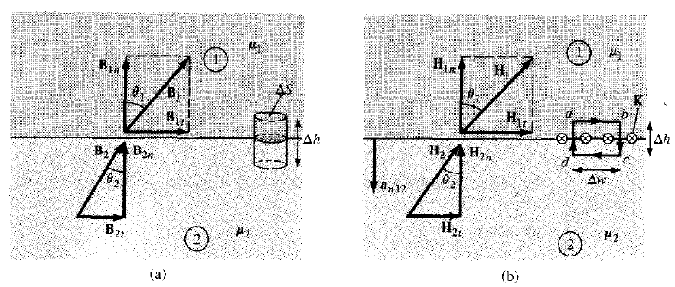
Thus,
$$B_{1n}=B_{2n} (8.44a)$$
$$µ_{1}H_{1n}=µ_{2}H_{2n} (8.44b)$$

Slide 36
Equation (8.44) shows that the normal component of B is continuous at the boundary and the normal component of H is discontinuous at the boundary.
Applying eq. (8.42) to the closed path (abcda) of Fig. 8.13(b) where surface current $K$ on the boundary is assumed normal to the path. We obtain
$$K.ΔW=H_{1t}.ΔW+H_{1n}.\frac{Δh}{2}+H_{2n}.\frac{Δh}{2}−H_{2t}.ΔW−H_{2n}.\frac{Δh}{2}−H_{1n}.\frac{Δh}{2} (8.45)$$
as $Δh→0$, eq. (8.45) leads to
$$H_{1t}−H_{2t}=K (8.46)$$
This shows that the tangential component of $H$ is also discontinuous. Equation (8.46) may be written in terms of $B$ as
$$\frac{B_{1t}}{µ_{1}}−\frac{B_{2t}}{µ_{2}}=K (8.47)$$
In the general case, eq. (8.46) becomes
$$\left(H_{1}−H_{2}\right)×a_{n12}=K (8.48)$$

Slide 37
$a_{n12}$ is a unit vector normal to the interface from medium 1 to medium 2. If the boundary is free of current or the media are not conductors (for $K$ is free current density), $K=0$ and eq. (8.46) becomes
$$H_{1t}=H_{2t} (8.49)$$
or
$$\frac{B_{1t}}{µ_{1}}=\frac{B_{2t}}{µ_{2}} (8.50)$$
In this the tangential component of H is continuous while that of B is discontinuous at the boundary.

Slide 38
If the fields make an angle $θ$ with the normal to the interface, eq. (8.44) results in
$$B_{1}\cos{θ_{1}}=B_{1n}=B_{2n}=B_{2}\cos{θ_{2}} (8.51a)$$
while eq. (8.50) produces
$$\frac{B_{1}}{µ_{1}}\sin{θ_{1}}=H_{1t}=H_{2t}=\frac{B_{2}}{µ_{2}}\sin{θ_{2}} (8.51b)$$
Dividing eq. (8.51b) by eq. (8.51a) gives
$$\frac{\tan{θ_{1}}}{\tan{θ_{2}}}=\frac{µ_{1}}{µ_{2}} (8.52)$$

