Slide 1
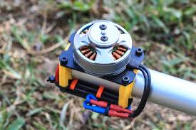
First Course of Special Machine
Department of Electrical Power and Machine Engineering
By Qasim Al Azze 2018

Slide 2
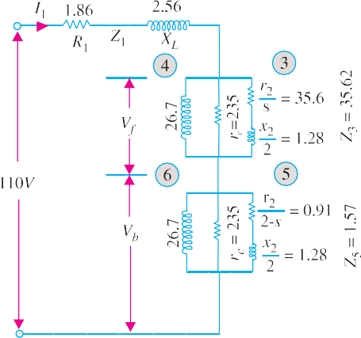
1376
Electrical Technology
admittance of ‘motor’ I is Y_{f} = 0.00426 − j 0.0374 + 0.028 − j 0.00101
= 0.03226 − j 0.03841 S
impedance Z_{f} = 1/Y_{f} = 12.96 + j 15.2 or 19.9 Ω
Motor II
r₂
2 − s
j x
admittance of branch 5 =
⎞2
2
= ^{0.91 − j 1.28} = 0.369 − j 0.517
⎛ r
2
2.469
2
x₂
⎜ ⎟
⎝
2 − s ⎠
admittance of ‘motor’ II, Y_{b} = 0.00426 − j 0.0374 + 0.369 − j 0.517
= 0.3733 − j 0.555 S
Impedance of ‘motor’ II, Z_{b} =1/Y_{b} = 0.836 + j 1.242 or 1.5 Ω
Impedance of entire motor (Fig. 36.16) Z₀₁ = Z₁ + Z_{f} + Z_{b} = 15.66 + j 19
I₁ = V /Z₀₁ = 110/24.7 = 4.46 A
V_{f} = I₁ Z_{f} = 4.46 × 19.9 = 88.8 V
V_{b} = 4.46 × 1.5 = 6.69 V
or 24.7 Ω
I₃ = 88.8/35.62 = 2.5 A
I₅ = 6.69/1.57 = 4.25 A
T = I ²(r /s) = 222 synch. watt
f 3 2
r₂
T = I ^{2 ⎛}
⎞
⎜ = 16.5 synch. watt
b 5
2 − s
⎟
⎝ ⎠
T = T_{f} − T_{b} = 205.5 synch. watt Watts converted = synch. watt (1 − s)
= 205.5 × 0.95 = 195 W
Net output = 195 − 13.5 = 181.5 W.
Example 36.3. A 250- W, 230-V, 50-Hz
capacitor-start motor has the following constants for the main and auxiliary windings: Main winding, Z_{m} = (4.5 + j 3.7) ohm. Auxiliary winding Z_{a}= (9.5
+ j 3.5) ohm. Determine the value of the starting
Fig. 36.16
capacitor that will place the main and auxiliary winding currents in quadrature at starting.
(Electrical Machines-III, South Gujarat Univ. 1985)
Solution. Let X_{C} be the reactance of the capacitor connected in the auxiliary winding.
Then
Z_{a} = 9.5 + j 3.5 − j X_{C} = (9.5 + j X)
where X is the net reactance.
Z_{m} = 4.5 + j 3.5 = 5.82 ∠ 39.4º ohm
Now,
Obviously, I_{m} lags behind V by 39.4º
Since, time phase angle between I_{m} and I_{a} has to be 90º, I_{a} must lead V by (90º − 39.4º) = 50.6º.
For auxiliary winding, tan φ_{a} = X /R or tan 50.6º = X /9.5
or
∴
X = 9.5 × 1.217 = 11.56 Ω (capacitive)
X_{C} = 11.56 + 3.5 = 15.06 Ω
∴ 15.06 = 1/314 C; C = 211 μF.

Slide 3
Single-phase Motors
1377
Tutorial Problem No. 36.1.
A 1-φ, induction motor has stator windings in space quadrature and is supplied with a single-phase voltage of 200 V at 50 Hz. The standstill impedance of the main winding is (5.2 + j 10.1) and of the auxiliary winding is (19.7 + j 14.2). Find the value of capitance to be inserted in the auxiliary winding for maximum starting torque. (Electrical Machines-III, Indore Univ. July, 1977)
A 230-V, 50-Hz, 6-pole, single-phase induction motor has the following constants.
r₁ = 0.12 Ω, r₂ = 0.14 Ω, x₁ = x₂ = 0.25 Ω, x_{m} = 15 Ω.
If the core loss is 250 W and friction and windage losses are 500 W, determine the efficiency and torque at s = 0.05. (Electrical Machines-IV, Bangalore Univ. Aug. 1978)
Explain how the pulsating mmf of a single-phase induction motor may be considered equivalent to two oppositely-rotating fields. Develop an expression for the torque of the motor.
A 125-W, 4-pole, 110-V, 50-Hz single-phase induction motor has the no-load rotational loss of 25 watts and total rotor copper loss at rated load of 25 watts at a slip of 0.06. The rotor I²R loss may be neglected.
At a slip s = 0.06, what is the power input to the machine ?
(Electrical Machines-III, Indore Univ. July 1977)
36.7. Types of Capacitor–start Motors
Some of the important types of such motors are given below :
Single-voltage, externally-reversible type
In this motor, four leads are brought outside its housing; two from the main winding and two from the starting-winding circuit. These four leads are necessary for external reversing. As usual, internally, the starting winding is connected in series with the electrolytic capacitor and a centrifugal switch. The direction of rotation of the motor can be easily reversed externally by reversing the starting winding leads with respect to the running winding leads.
Single-voltage, non-reversible type
In this case, the starting winding leads are connected internally to the leads of the running wind- ing. Consequently, there are only two external leads in such motors. Obviously, direction of rotation cannot be reversed unless the motor is taken apart and leads of the starting winding reversed.
Single-voltage reversible and with thermostat type
Many motors are fitted with a device called thermostat which provides protection against over- load, overheating, and short-circuits etc. The thermostat usually consists of a bimetallic element that is connected in series with the motor and is often mounted on the outside of the motor.
The wiring diagram of a capacitor-start motor fitted with this protective device is shown in Fig.
36.17. When due to some reasons, excessive current flows through the motor, it produces abnormal heating of the bimetallic strip with the result that it bends and opens the contact points thus discon- necting the motor from the supply lines. When the thermostat element cools, it automatically closes the contacts*.
In the case of capacitor-start motors used for refrigerators, generally a terminal block is attached to the motor. Three out of the four block terminals are marked T, TL and L as shown in Fig. 36.18. Thermostat is connected to T and T L, capacitor between L and the unmarked terminal and the supply lines to TL and L.
* However, in some thermal units, a reset button has to be operated manually to restore the motor to operation.
In certain types of thermal units, a heating element is used for heating the bimetallic strip. In that case, the heating element is connected in the line and the element or bimetallic strip is placed either inside the heating unit or besides it.

