Slide 1
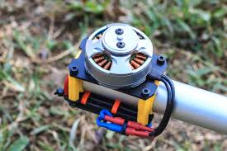
First Course of Special Machine
Department of Electrical Power and Machine Engineering
By Qasim Al Azze 2018

Slide 2
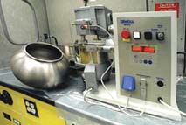
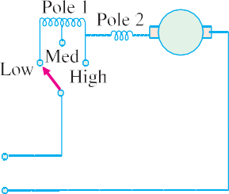
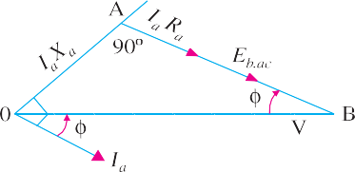
Single-phase Motors
1393
(iii) Centrifugal Mechanism. Universal motors, particularly those used for home food and
drink mixers, have a number of speeds.Selection is made by a centrifugal device located inside the motor and connected, as shown in Fig. 36.52. The switch is adjustable by means of an external lever. If the motor speed rises above that set by the lever, the centrifugal device opens two contacts and inserts resistance R in the circuit, which causes the motor speed to decrease. When motor runs slow, the two contacts close and short-circuit the resistance, so that the motor speed rises. This process is repeated so rapidly that variations in speed are not noticeable.
Universal motor used for home food and drink mixers
Fig. 36.50 Fig. 36.51 Fig.36.52
The resistance R is connected across the governor points as shown in Fig. 36.52. A capacitor C is used across the contact points in order to reduce sparking produced due to the opening and closing of these points. Moreover, it prevents the pitting of contacts.
Example 36.4. A 250-W, single-phase, 50-Hz, 220-V universal motor runs at 2000 rpm and takes 1.0 A when supplied from a 220-V dc. supply. If the motor is connected to 220-V ac supply and takes 1.0 A (r.m.s), calculate the speed, torque and power factor. Assume R_{a} = 20 Ω and L_{a} = 0.4 H.
Solution. DC Operation : E_{b.dc} = V − I_{a} R_{a}
= 220 − 20 × 1 = 200 V
AC Operation
X_{a} = 2 π × 50 × 0.4 = 125.7 Ω.
As seen from Fig.36.53.
V ² = (E + I R )² + (I × X )²
∴ E_{b.ac} = − I_{a} R_{a} +
= − 1 × 20 +
b.ac a a a a
V ² − (I X )²
a a
Fig. 36.53
220² − (125.7 × 1)² = 160.5 V
Since armature current is the same for both dc and ac excitations, hence
^{E}b.dc ^{N}dc ;
=
∴ N = 2000 × ^{160.5} =1605 rpm
^{E}b.ac ^{N}ac
ac
200
cos φ = A B/OB =(E_{b.ac} + I_{a} R_{a}) / V = (160.5 + 20)/220 = 0.82 lag

Slide 3
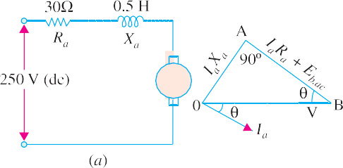
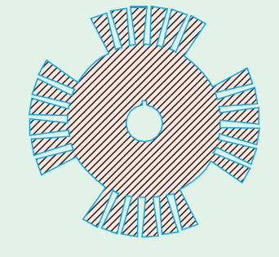
1394
Electrical Technology
P_{mech} = E_{b.ac} . I_{a} = 160.5 × 1 = 160.5 W
T = 9.55 × 160.5/1605 = 0.955 N-m
Example 36.5. A universal series motor has resistance of 30 Ω and an inductance of 0.5 H. When connected to a 250 V d.c. supply and loaded to take 0.8 A, it runs at 2000 r.p.m. Estimate its speed and power factor, when connected to a 250-V, 50-Hz a.c. supply and loaded to take the same current. (Elect. Machine, A.M.I.E. Sec. B, 1992)
Solution. A.C. Operation
X_{a} = 2 π × 50 × 0.5 = 157 Ω,
R_{a} = 30 Ω
I_{a} R_{a} = 0.8 × 30 = 24 Ω
I_{a} X_{a} = 0.8 × 157 = 125.6 V
The phasor diagram is shown in Fig. 36.54 (b)
V ² = (E + I R )² + (I X )²
b.ac a a a a
250² = (E + 24)² + 125.6²
∴
^{E}b.as
b.ac
= 192.6
Fig. 36.54
DC Operation
E_{b.dc} = 250 − 0.8 × 30 = 226 V
Now, ^{Eb.ac} =
^{N}ac
^{N}dc
or
192.12 ₌ Nac
;
^{E}b.dc
= 1700 rpm
226 2000
^{N}ac
cos φ = (E_{b.ac} + I_{a} R_{a} )/V = 236.12/250 = 0.864 lag
Unexcited Single- phase Synchronous Motors
These motors
operate from a single-phase a.c. supply
run at a constant speed – the synchronous speed of the revolving flux
need no d.c. excitation for their rotors (that is why they are called unexcited)
are self-starting.
These are of two types (a) reluctance motor and (b) hysteresis motor.
36.20. Reluctance Motor
It has either the conventional split-phase stator and a centrifu- gal switch for cutting out the auxiliary winding (split-phase type reluctance motor) or a stator similar to that of a permanent-split capacitor-run motor (capacitor-type reluctance motor). The stator produces the revolving field.
The squirrel-cage rotor is of unsymmetrical magnetic construc- tion. This type of unsymmetrical construction can be achieved by removing some of the teeth of a symmetrical squirrel-cage rotor punching. For example, in a 48-teeth, four-pole rotor following teeth may be cut away :
Fig. 36.55
1, 2, 3, 4, 5, 6 – 13, 14, 15, 16, 17, 18 – 25, 26, 27, 28, 29, 30 – 37, 38, 39, 40, 41, 42.
This would leave four projecting or salient poles (Fig. 36.55) consisting of the following sets of teeth : 7–12; 19–24; 31–36 and 43 – 48. In this way, the rotor offers variable magnetic reluctance to the stator flux, the reluctance varying with the position of the rotor.

Slide 4
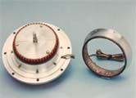
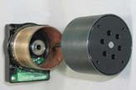
Single-phase Motors
1395
Working
For understanding the working of such a motor one basic fact must be kept in mind. And it is that when a piece of magnetic material is located in a magnetic field, a force acts on the material, tending to bring it into the most dense portion of the field. The force tends to align the specimen of material in such a way that the reluc- tance of the magnetic path that lies through the material will be minimum.
When the stator winding is energised, the revolving magnetic field exerts reluctance torque on the unsym-
Reluctance brushless motor
metrical rotor tending to align the salient pole axis of the rotor with the axis of the revolving magnetic field (because in this position, the reluctance of the magnetic path is minimum). If the reluctance torque is sufficient to start the motor and its load, the rotor will pull into step with the revolving field and continue to run at the speed of the revolving field.*
However, even though the rotor revolves synchronously, its poles lag behind the stator poles by a certain angle known as torque angle, (something similar to that in a synchronous motor). The reluctance torque increases with increase in torque angle, attaining maximum value when α = 45º. If
α increases beyond 45º, the rotor falls out of synchronism. The average value of the reluctance torque is given by T = K (V /f)² sin2 δ where K is a motor constant.
It may be noted that the amount of load which a reluctance motor could carry at its constant speed would only be a fraction of the load that the motor could normally carry when functioning as an induction motor. If the load is increased beyond a value under which the reluctance torque cannot maintain synchronous speed, the rotor drops out of step with the field. The speed, then, drops to some value at which the slip is sufficient to develop necessary torque to drive the load by induction-motor action.
The constant-speed characteristic of a reluctance motor makes it very suitable for such applica- tions as signalling devices, recording instruments, many kinds of timers and phonographs etc.
36.21. Hysteresis Motor
The operation of this motor depends on the presence of a continuously-revolving magnetic flux. Hence, for the split-phase operation, its stator has two wind- ings which remain connected to the single-phase sup- ply continuously both at starting as well as during the running of the motor. Usually, shaded-pole principle is employed for this purpose giving shaded-pole hys- teresis motor. Alternatively, stator winding of the type used in capacitor-type motor may be used giving ca- pacitor-type shaded-pole motor. Obviously, in either type, no centrifugal device is used.
The rotor is a smooth chrome-steel cylinder** having
Stator
Housing (Rotor)
Hysteresis motor
* Actually, the motor starts as an induction motor and after it has reached its maximum speed as an induction, motor, the reluctance torque pulls its rotor into step with the revolving field so that the motor now runs as a synchronous motor by virtue of its saliency.
** Rotors of ceramic permanent magnet material are used whose resistivity approaches that of an insulator. Consequently, it is impossible to set up eddy currents in such a rotor. Hence, there is no eddy current loss but only hysteresis loss.

