Slide 1
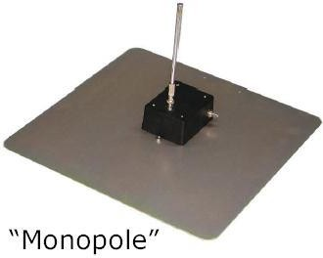
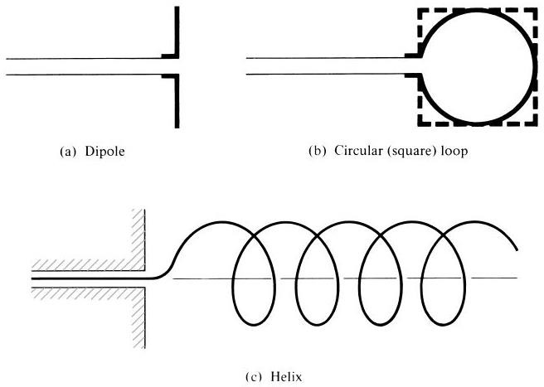
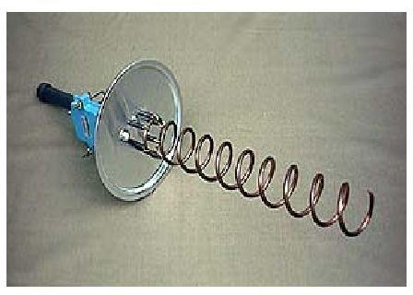
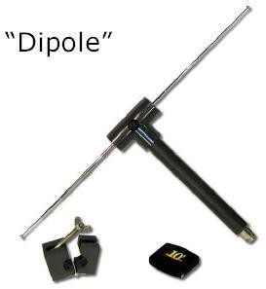
Antenna and Wave Propagation Electromagnetic Spectrum
General Types of Antennas
In this lecture, we will introduce and briefly discuss some forms of the various antenna types.
Wire Antennas
Wire antennas are familiar to the layman because they are seen virtually everywhere on automobiles, buildings, ships, aircraft, spacecraft, and so on. There are various shapes of wire antennas such as a straight wire (dipole), loop, and helix which are shown below:
Aperture Antennas
Aperture antennas may become more familiar to the layman today than in the past because of the increasing demand for more sophisticated forms of antennas and the utilization of higher frequencies. Some forms of aperture antennas are shown in figure.
Antennas of this type are very useful for aircraft and spacecraft applications, because they can be very conveniently flush-mounted on the skin of the aircraft or

Slide 2
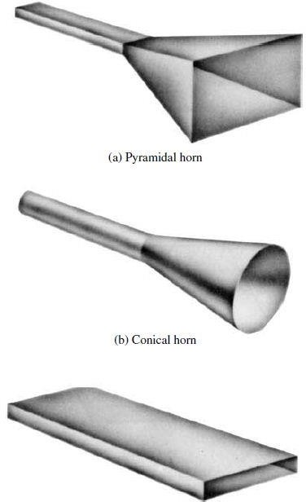
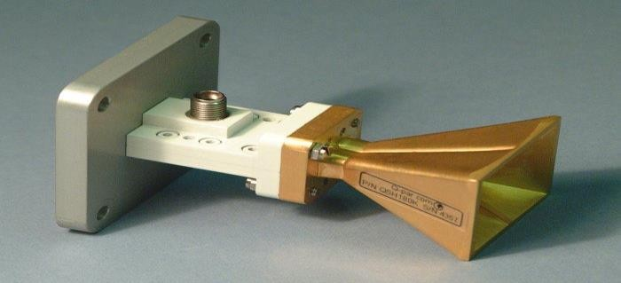
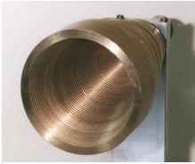
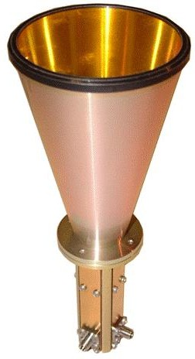
Antenna and Wave Propagation Electromagnetic Spectrum
spacecraft. In addition, they can be covered with a dielectric material to protect them from hazardous conditions of the environment.
Micro-strip Antennas
Microstrip antennas became very popular in the 1970s primarily for space-borne applications. Today they are used for government and commercial applications. These antennas consist of a metallic patch on a grounded substrate. The metallic patch can take many different configurations, as shown in Figure below. However, the rectangular and circular patches are the most popular because of ease of analysis and fabrication, and their attractive radiation characteristics, especially low cross- polarization radiation. The Microstrip antennas are low profile, comfortable to planar and nonplanar surfaces, simple and inexpensive to fabricate using modern printed- circuit technology, mechanically robust when mounted on rigid surfaces, compatible with MMIC (?) designs, and very versatile in terms of resonant frequency, polarization, pattern, and impedance.
These antennas can be mounted on the surface of high-performance aircraft, spacecraft, satellites, missiles, cars, and even handheld mobile telephones.

Slide 3
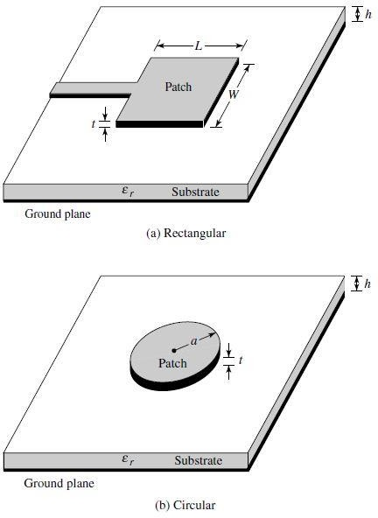
Antenna and Wave Propagation Electromagnetic Spectrum
Array Antennas
Many applications require radiation characteristics that may not be achievable by a single element. It may, however, be possible that an aggregate of radiating elements in an electrical and geometrical arrangement (an array) will result in the desired radiation characteristics. The arrangement of the array may be such that the radiation from the elements adds up to give a radiation maximum in a particular direction or directions, minimum in others, or otherwise as desired. Typical examples of arrays are shown in Figure.

Slide 4
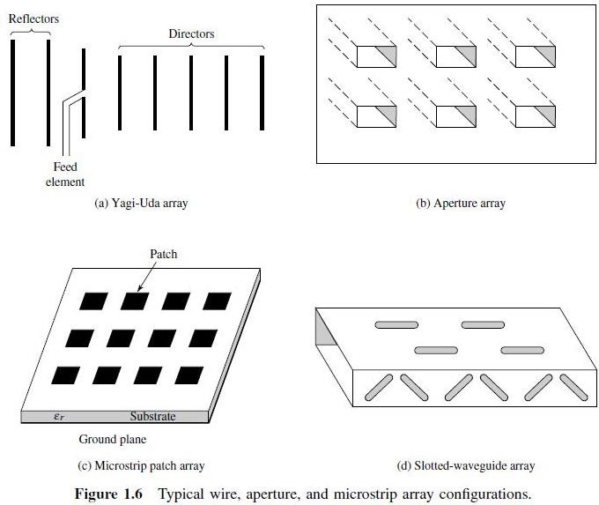
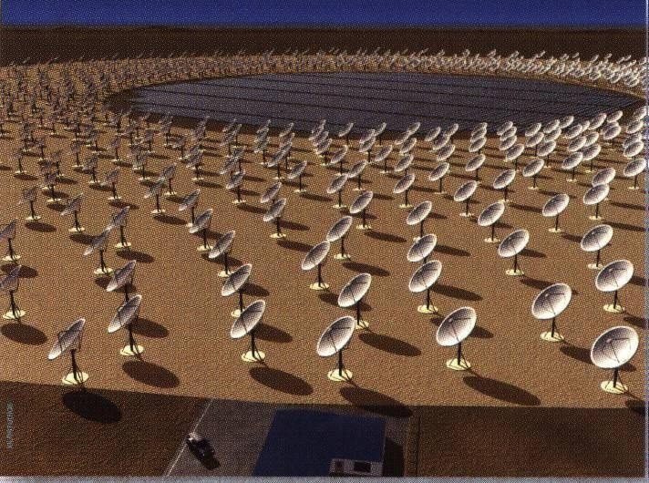
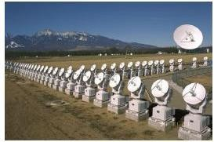
Antenna and Wave Propagation Electromagnetic Spectrum
Usually the term array is reserved for an arrangement in which the individual radiators are separate as shown. However the same term is also used to describe an assembly of radiators mounted on a continuous structure.

Slide 5
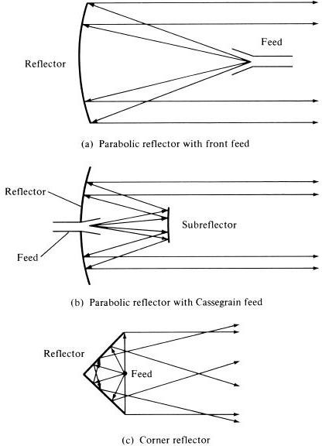
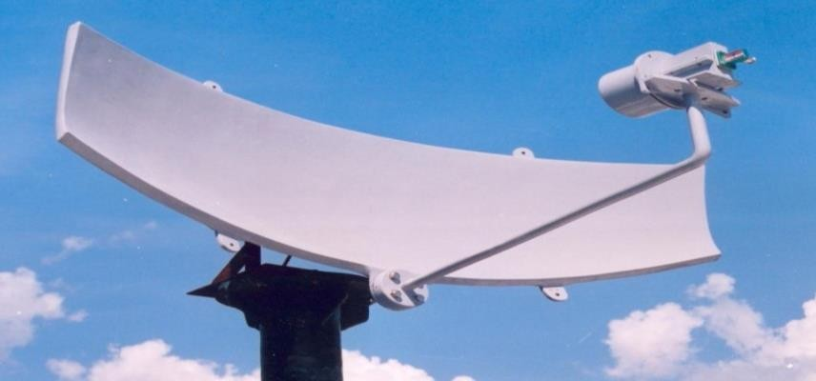
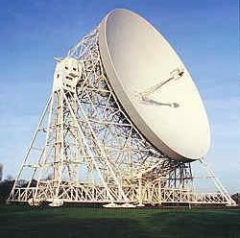
Antenna and Wave Propagation Electromagnetic Spectrum
Reflector Antennas
The success in the exploration of outer space has resulted in the advancement of antenna theory. Because of the need to communicate over great distances, sophisticated forms of antennas had to be used in order to transmit and receive signals that had to travel millions of miles. A very common antenna form for such an application is a parabolic reflector shown in Figures below. Antennas of this type have been built with diameters as large as 305 m. Such large dimensions are needed to achieve the high gain required to transmit or receive signals after millions of miles of travel. Another form of a reflector, although not as common as the parabolic, is the corner reflector.

Slide 6
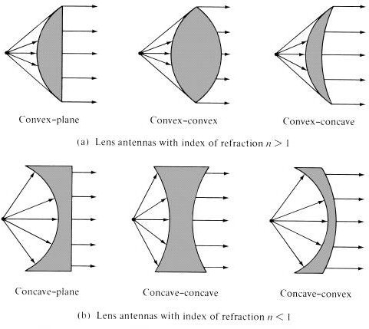
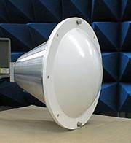
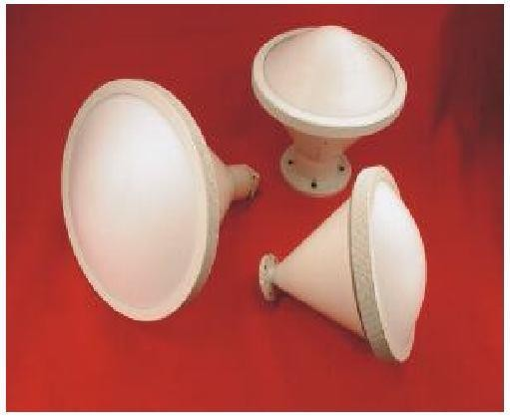
Antenna and Wave Propagation Electromagnetic Spectrum
Lens Antennas
Lenses are primarily used to collimate incident divergent energy to prevent it from spreading in undesired directions. By properly shaping the geometrical configuration and choosing the appropriate material of the lenses, they can transform various forms of divergent energy into plane waves. They can be used in most of the same applications as are the parabolic reflectors, especially at higher frequencies. Their dimensions and weight become exceedingly large at lower frequencies. Lens antennas are classified according to the material from which they are constructed, or according to their geometrical shape. Some forms are shown in Figure below.
In summary, an ideal antenna is one that will radiate all the power delivered to it from the transmitter in a desired direction or directions. In practice, however, such ideal performances cannot be achieved but may be closely approached. Various types of antennas are available and each type can take different forms in order to achieve the desired radiation characteristics for the particular application.

