Slide 1
Lecturer 13 Submerged Arc Welding

Slide 2
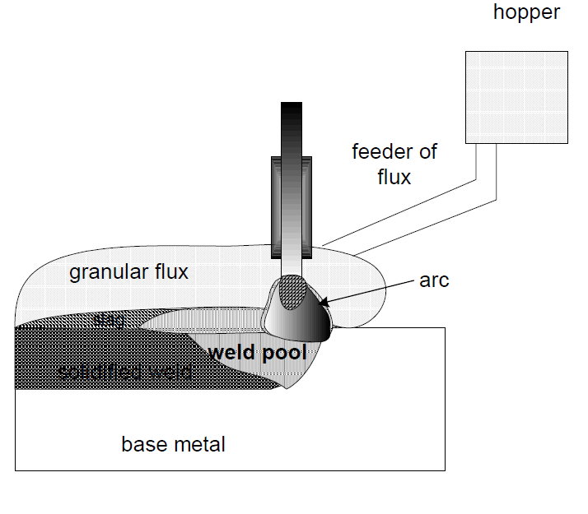
Submerged Arc Welding
-In this process weld pool are completely submerged under cover of granular fusible and molten flux therefore it is called so.
-During welding, granular flux is melted using heat generated by arc and forms cover of molten flux layer which in turn avoids spatter tendency and prevents accessibility of atmospheric gases to the arc zone and the weld pool.
-The molten flux reacts with the impurities in the molten weld metal to form slag which floats over the surface of the weld metal.
-Layer of slag over the molten weld metal results:

Slide 3
Submerged Arc Welding
1.Increased protection of weld metal from atmospheric gas contamination and so improved properties of weld joint
2.Reduced cooling rate of weld metal and HAZ owing to shielding of the weld pool by molten flux and solidified slag in turn leads to:
a) smoother weld bead and
b) reduced the cracking tendency of hardenable steel

Slide 4
Components of SAW System
-SAW is known to be a high current (sometimes even greater 1000A) welding process that is mostly used for joining of heavy sections and thick plates as is offers deep penetration with high deposition rate and so high welding speed.
-High welding current can be applied in this process owing to three reason:
a)absence of spatter, b) reduced possibility of air entrainment in arc zone as molten flux and slag form shield the weld metal
c) large diameter electrode.
-Continuous feeding of granular flux around the weld arc from flux hopper provides shielding to the weld pool from atmospheric gases and control of weld metal composition through presence of alloying element in flux.
-Complete cover of the molten flux around electrode tip and the welding pool during the actual welding operation produces weld joint without spatter and smoke.

Slide 5
Power Source and Electrode
-Generally, submerged arc welding process uses power source at 100 % duty cycle; which means that the welding is done continuously for minimum 5 min without a break or more.
-Depending upon the electrode diameter, type of flux and electrical resistivity submerged arc welding can work with both AC and DC.
-DCEN polarity are generally used with large diameter electrode (>4mm). DC with constant voltage power source provides good control over bead shape, penetration, and welding speed.
-DCEP offers advantage of self regulating arc in case of small diameter electrodes (< 2.4mm) and high deposition rate while DCEN produces shallow penetration.
-The diameter of electrodes ranges 1–5 mm. Electrode wire of steel is generally copper coated for two reasons a) to protect it from atmospheric corrosion and b) to increase their current carrying capacity. However, stainless steel wires are not coated with copper.

Slide 6
SAW Flux
-Role of fluxes in SAW is largely similar that of coating in stick electrodes of SMAW
-There are four types of common SAW fluxes namely: fused flux, agglomerated flux, bonded flux and mechanical fluxes.
-The composition of fluxes usually consist of different types of halides (Binary components contained Fluorine or chlorine, bromine, iodine ) and oxides such as MnO, SiO2, CaO, MgO, Al2O3, TiO2, FeO, CaF2sodium/potassium silicate.
-Halide fluxes are used for high quality weld joints of high strength steel to be used for critical applications while oxide fluxes are used for developing weld joints of non-critical applications.
-Used flux(slag) can be recycled thus reduce production cost appreciably without any compromise on the quality of the weld.
-Manufacturing steps, Specific characteristics and composition of each type of these fluxes are given in following pdf file.

Slide 7
Welding Parameters-Welding Current
-Welding parameters namely electrode wire size, welding voltage, welding current and welding speed are four most important parameters(apart from flux) that play a major role on soundness and performance of the weld
-Welding current is the most important because it:
determines the melting rate of electrode, penetration depth and weld bead geometry.
-However, too high current may lead to burn through owing to deep
penetration, excessive reinforcement , increased residual stresses and high heat input related problems like weld distortion.
-Very low current is known to cause lack of penetration & lack of fusion and unstable arc.
- Selection of welding current is primarily determined by thickness of plates to be welded and accordingly electrode of proper diameter is selected for sound weld with requisite deposition rate and penetration

Slide 8
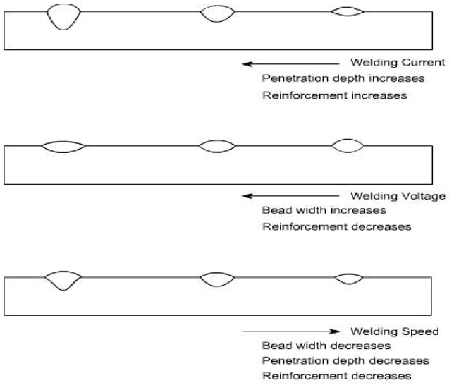
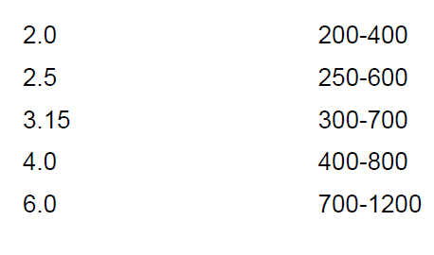
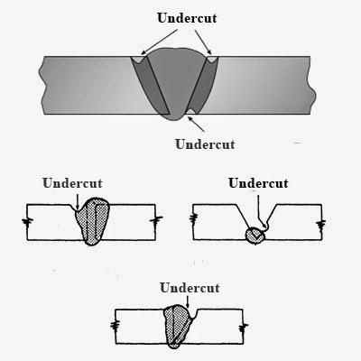
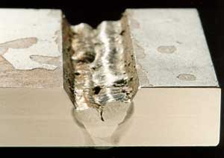
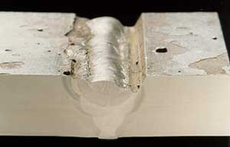
Welding Parameters
slag inclusion

Slide 9
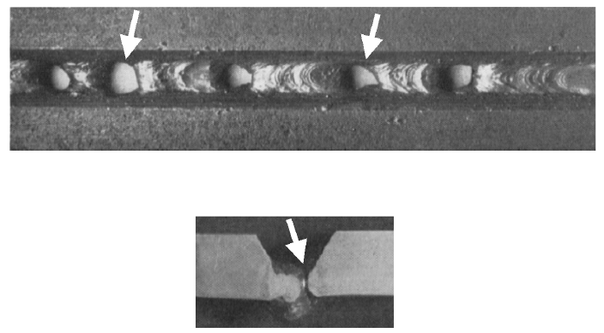
Melt through: Hole through the weld metal (weld root)

Slide 10
Welding Parameters-Welding Voltage, Speed
-Welding voltage used in SAW ranges from 20-35 V
-Too high welding voltage (more arc length) leads to flatter and wider weld bead, higher flux
consumption, and increased gap bridging capability under poor fit-up conditions
-Low welding voltage produces narrow & peaked bead and poor slag
-Welding speed
-Required bead geometry and penetration in a weld joint are obtained only with an
optimum speed of welding arc during SAW.
-Speed higher than optimum one reduces heat input per unit length which in turn results in low deposition rate of weld metal, decreased weld reinforcement and shallow
penetration .
-Too high welding speed increases tendency for a) undercut in weld owing to reduced heat input, b) arc blow due to higher relative movement of arc with respect to ambient gases and c) porosity as air pocket are entrapped due to rapid solidification of the weld metal.
- Low welding speed increases heat input per unit length which in turn may lead to
increased tendency of melt through and reduction in tendency for development of
porosity and slag inclusion( non metallic solid martials entrapped in weld metal or between weld etal and base metal .

Slide 11
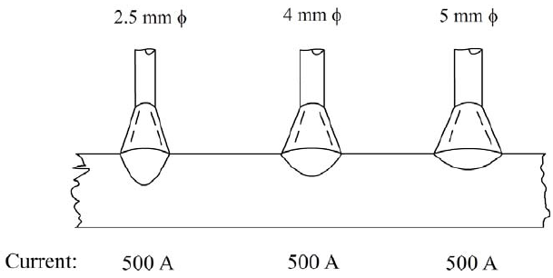
Effect of Welding Parameters on Bead Geometry
-Bead geometry and depth of penetration are two important characteristics of the weld bead that are influenced by size of the electrode for a given welding current setting.
-An increase in size of the
electrode decreases the
depth of penetration and
increases width of weld
bead for a given welding
current
-Large diameter electrodes are primarily selected to take two advantages:
a)higher deposition rate owing to their higher current carrying capacity and b) good gap bridging capability under poor fit-up conditions of the plates to be welded due to wider weld bead.

Slide 12
SAW Advantage and Limitations
-SAW offers following important advantages:
1-High productivity due to high deposition rate of the welding metal
capability weld continuously without interruptions as electrode
is fed from spool, and the process works under 100% duty cycle.
2-High depth of penetration allows welding of thick sections
3-Smooth weld bead is produced without stresses raisers as SAW is
carried out without sparks, smoke and spatter
-Limitations of SAW:
1-invisibility of welding arc during welding,
2-difficulty in maintaining mound of the flux cover around the arc in odd
positions of welding and cylindrical components of small diameter and
3- increased tendency of melt through when welding thin sheet.

Slide 13
SAW Advantage and Limitations
-Applications of SAW process are mainly limited to flat position, odd position and circumferential welds are difficult to weld
-Plates of thickness less than 5 mm are generally not welded due to risk of burn through.
-Further, SAW process is known as high heat input process. High heat input however is not considered good for welding of many steels as it leads to significant grain growth in weld and HAZ owing to low cooling rate experienced
by them during welding.
-Low cooling rate increases the effective transformation temperature which in turn lowers nucleation rate and increases the growth rate during solid state transformation.
-A combination of low nucleation rate and high the growth rate results in coarse grain structure. Coarse grain structure in deteriorate the mechanical properties of the weld joint specifically toughness. Therefore, SAW weld joints are sometime normalized to refine the grain structure and enhanced the mechanical properties so as to reduce the adverse effect of high input of SAW process on mechanical properties of the weld joints.

Slide 14
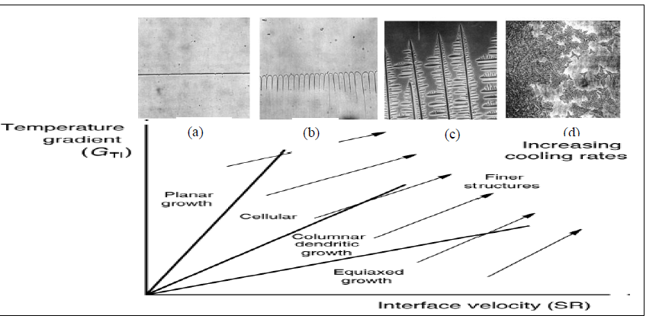
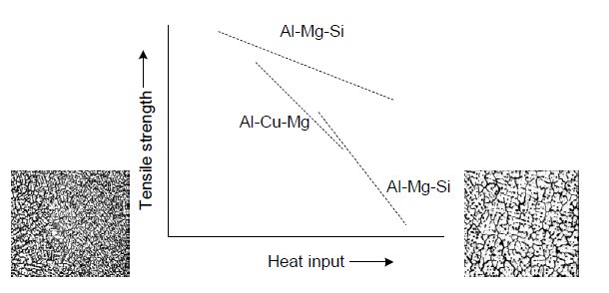
Effect of Cooling Rate(Heat Input) on Grain Structure during Solidification

Slide 15
SAW Applications
-Submerged arc welding is used for welding of different grades of steels in many sectors such as shipbuilding, pressure vessel industries, pipes, and bridge girders.
-SAW is also used for surfacing of worn out parts of large surface area for different purposes such as reclamation, hard facing and cladding.
-The typical application of submerged arc welding for weld surfacing includes surfacing of roller barrels and wear plates.
- Submerged arc welding is widely used for cladding carbon and alloy steels with stainless steel and nickel alloy deposits

