Slide 1
Arc Welding Power Source I

Slide 2
Arc Welding Power Source
-Power-Sources generate and maintain the electric arc.
-Arc Welding Power Sources transform the power to controlled values of voltage and of current suitable to the intended uses.
-A welding power source deliver controllable current at a voltage desired according to the requirements of the welding process.
-Each welding process may be recognized from other processes in the form of process controls required. Thus arc welding power sources play very important role in successful welding.
-For most of welding purposes, welding voltage ranges from 20 to 80 volts (V) and current (with the exception of micro welding) from 30 to 1500 Amperes (A).

Slide 3
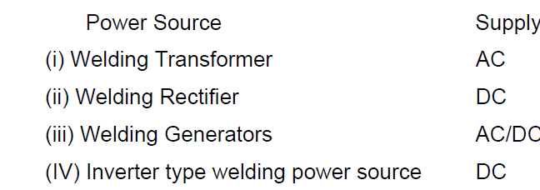
Arc Welding Power Source
-The conventional welding power sources are:
-Welding transformers, rectifiers and DC generators are used in shops while engine coupled DC and AC generators are used at site where domestic line supply is not available.
-Rectifiers and transformers are usually preferred because of lower noise, higher efficiency and lower maintenance as compared to generators.

Slide 4
Arc Welding Power Source
-The inverter type welding power source first transforms the AC into DC. The DC power is then fed into a step-down transformer to produce the desired welding voltage/current.
-The pulse of high voltage and high frequency DC is fed to the main step-down transformer and there it is transformed into low voltage and high frequency DC suitable for welding.
- Finally, low voltage and high frequency DC is passed through filters and for rectification
-The switching on and off is performed by solid state switches at frequencies above 10,000. The high switching frequency reduces
the volume of the step down transformer

Slide 5
Arc Welding Power Source
-The inverter type of power source provides better control for the power and better protection overload.
-These systems are found more efficient and better in respect of control of welding parameters than other welding system.
-The invertors with microcontrollers allow changes in electrical characteristics of the welding power by software in real time.
-This can be done even on a cycle by cycle basis so as to provide pulsing the welding current, variable ratios and current densities, stepped variable frequencies.

Slide 6
Selection of a Power Source
-Selection of a power source mainly depends on the welding process and welding consumables to be used for arc welding.
.In case of welding transformers voltage ranges between 70-90 V
.In case of rectifiers voltage varies from 20-60 V.
-Power sources can be classified based on different parameters related with them as below:
1.Type of current: A.C., D.C. or both.
2.Cooling medium: Air, water, oil cooled.
3.Cooling system: Forced or natural cooling
4.Static characteristics: Constant current, constant voltage, rising
characteristics.

Slide 7
Characteristics of Power Source
-Each welding power source has set of characteristics indicating the capability and quality of the power source.
-These characteristics help in selection of suitable welding power source for a given welding condition.
-Basic characteristics of a welding power source are given below:
1.Open circuit voltage (OCV)
2.Power factor (pf)
3.Static characteristics
4.Dynamic characteristics
5.Current rating and duty cycle
6.Class of Insulation

Slide 8
Open Circuit Voltage (OCV)
- No-load or OCV shows the potential difference between the two terminals of the power source when there is no load.
-Setting up of correct open circuit voltage is important for stability of welding arc especially when AC is used.
-The selection of an optimum value of OCV (50-100V) depends on:
1.type of base metal,
2.composition of electrode coating,
3. type of welding current and polarity,
4.type of welding process etc.
-Base metal of low ionization potential (indicating ease of emitting free of electrons) needs lower OCV than that of high ionization potential metal.
-Presence of low ionization potential elements such as K, Na and Ca in
electrode coating/flux in optimum amount reduces OCV setting required for
welding.

Slide 9
Open Circuit Voltage (OCV)
-AC welding needs higher OCV compared with DC owing to problem of arc stability as in case of AC welding current continuously changes its direction and magnitude .
-GTAW needs lower OCV than GMAW and other welding processes like SMAW and SAW because GTAW uses tungsten electrode which has good free electron emitting capability by thermal and field emission mechanism.
-Too high OCV may cause electric shock
-OCV is generally found to be different from arc voltage.

Slide 10
Open Circuit Voltage (OCV)
-Arc voltage is potential difference between the electrode tip and work piece surface when there is flow of current.
-Any fluctuation in arc length affects the resistance to flow of current through plasma and hence arc voltage is also affected.
-Increase in arc length or electrode extension increases the arc voltage. Further, electrical resistance heating of electrode increases with electrode extension for given welding parameters.

Slide 11
Power factor (pf)
-Power factor of a power source is defined as a ratio of actual power (KW) used to produce the rated load (which is registered on the power meter) and apparent power drawn from the supply line (KVA) during welding.
-It is always desired to have high power factor (pf).
-Low power factor indicates unnecessary wastage of power and less efficient utilization of power for welding.
-Welding transformers usually offer higher power factor than other power sources.
-However, sometimes low power factor is intentionally used with welding transformers to increase the stability of AC welding arc.

Slide 12
Power factor (pf)
-Application of a welding power source with high power factor offers many advantages such as:
1.Reduction of the reactive power in a system, which in turn reduces the
2.Power consumption and so drop in cost of power
3.More economic operations at an electrical installation (higher effective power for the same apparent power)
4.Improved voltage quality and fewer voltage drops
5.Use of low cable cross-section
6.Smaller transmission losses

Slide 13
Static Characteristic of Power Source
-Static characteristic of a welding source shows variation in voltage with current when power source is connected to pure resistive load.
-This variation may be of three types, namely:
constant current (CC),
constant voltage(CV),
rising voltage (RV).

Slide 14
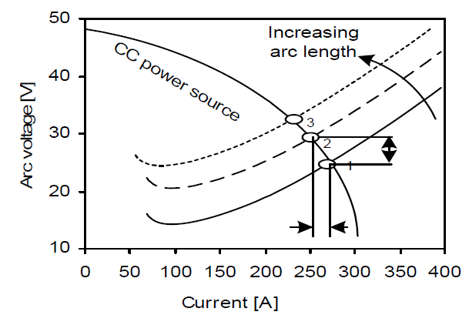
Constant Current Power Source
-The volt ampere output curves for constant current power source are called ‘drooper’ because of substantial downward of the curves.
-In constant current power source, variation in welding current with arc voltage(due to fluctuations in arc length) is very small therefore welding current remains more or less constant in spite of of fluctuations in arc voltage / length.
-Hence, this type of power source
is also found suitable for all those
welding processes where large
fluctuation in arc length is likely
to take place

Slide 15
Constant Current Power Source
-With a change in arc voltage, the variation in welding current is small and, therefore, with a consumable electrode welding process, electrode melting rate remains fairly constant even with a minor change in arc length .
-These power sources are required for processes that use relatively thicker consumable electrodes which may sometimes get stuck to workpiece .
-Or with non-consumable tungsten electrode where touching of electrode with base metal for starting of arc may lead to damage of electrode if current is unlimited.
-Under these conditions, the short circuiting current shall be limited which would provide safety to power source and the electrode.

Slide 16
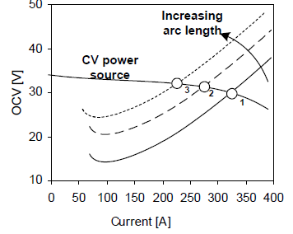
Constant Voltage Power Source
-In CV power sources(CVPS), a small variation in arc voltage (due to fluctuations in arc length) causes significant change in welding current.
-Since arc voltage remains almost constant
during welding this type of power source is
called constant voltage type.
-Constant voltage power sources shows
slightly downward slope current voltage
relationship curve and this is due to internal
electrical resistance and inductance in the
welding circuit that causes a minor droop in
the output volt-ampere characteristics of the
power source (Fig. 9.2).
Fig. Static characteristics of CVPS

Slide 17
Constant Voltage Power Source
-These power sources are found suitable for all those welding processes where fluctuations in arc length during welding is limited like in semiautomatic welding process MIG, SAW

Slide 18
Self Regulation
changing the current) so that feed rate becomes equal to melting rate for maintaining the arc length.
-For example, increase in arc length due
to any reason shifts the operating point
From 2 to 3 thus increases the arc voltage
Fig.
Fig. Static characteristics of constant voltage
welding power showing operating points with
increasing arc length
Operating point is the point of intersection of power source characteristics with
arc characteristics. Rise in arc voltage decreases the welding current
significantly. Decrease in welding current lowers the melting rate (see melting
rate equation) of the electrode thus decreases the arc gap if electrode is fed at
constant speed. Reverse phenomenon happens if arc length decreases (shifting
the operating point from 2 to 1).

Slide 19
Self Regulation
-Operating point is the point of intersection of power source characteristics with arc characteristics.
-Rise in arc voltage decreases the welding current significantly which lowers the melting rate (see melting rate equation) of the electrode thus decreases the arc gap if electrode is fed at constant speed.
-Reverse phenomenon happens if arc length decreases (shifting the operating point from 2 to 1).

