Slide 1
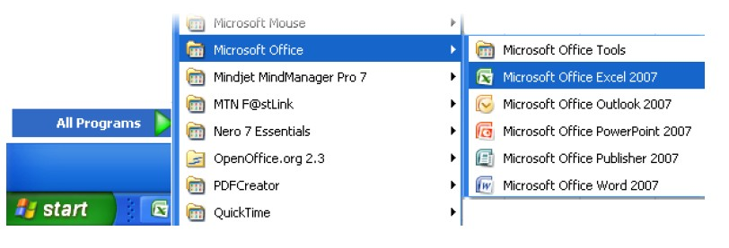
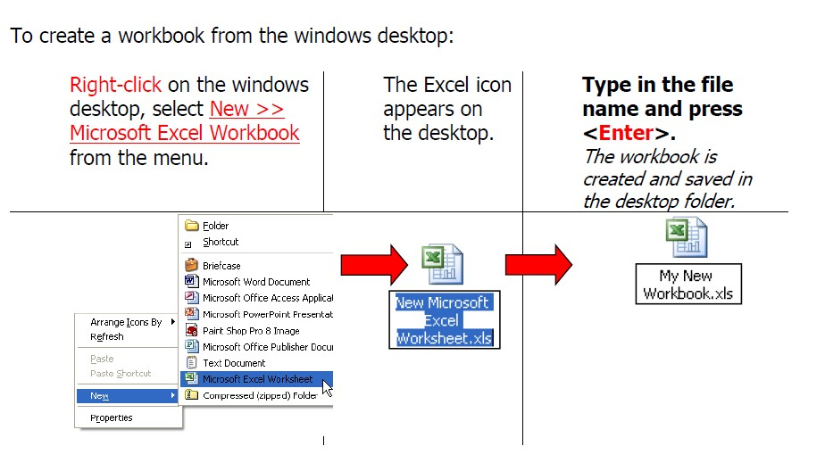
Closing Excel
Close Excel by clicking the X on the far right of the title bar

Slide 2
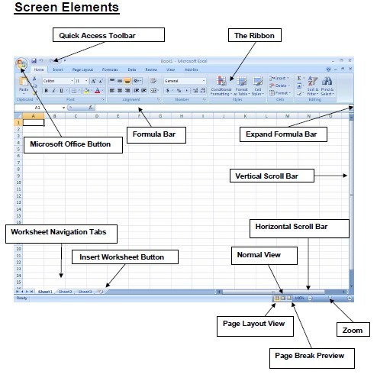
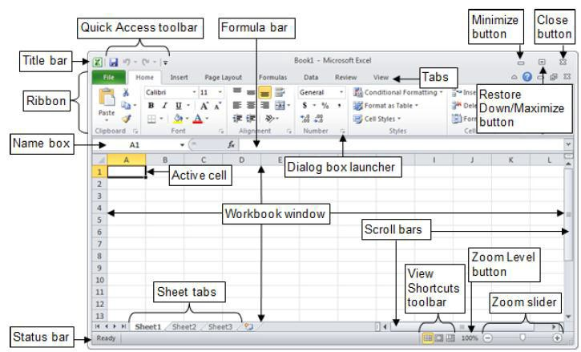
FIRST LOOK AT EXCE
L

Slide 3
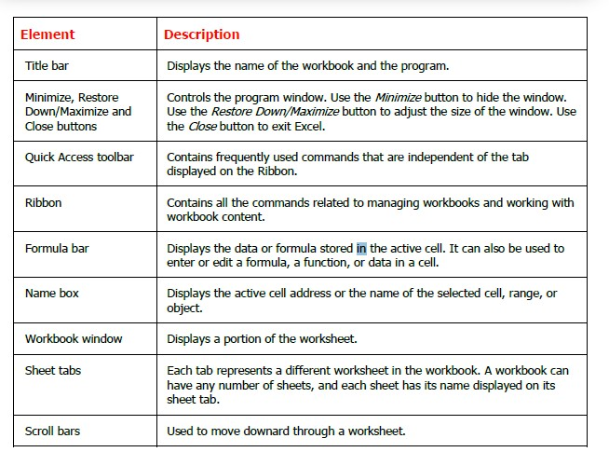
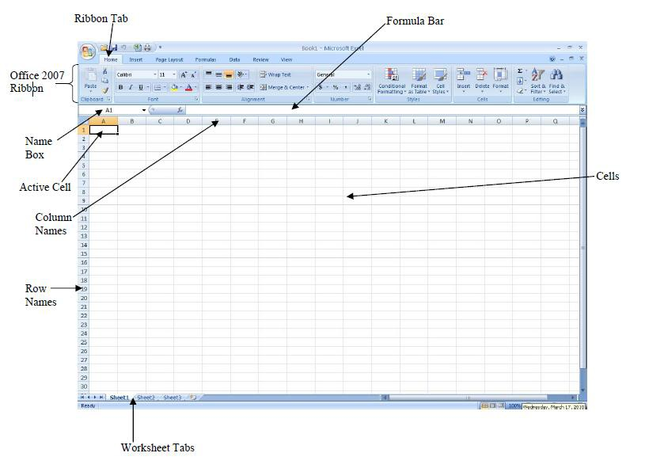

Slide 4
Cells –The gray boxes that make up the Excel grid are called cells. Cells are arranged in rows and columns. They are used to store data. Data can be numbers, text and formulas, such as mathematical calculations. Active Cell – The active cell is the cell you are currently working with. There is always an active cell on your worksheet. You can identify the active cell on your worksheet because it has a thicker border than the other cells and its name is listed in the cell name box. To change which
cell is the active cell, simply click on it or move to it using the arrow keys on your keyboard.
Name Box –The cell name box, located below the clipboard group in the
ribbon identifies the name of the active cell. Cells are named by giving the column letter and then the row number. For example, B3 means the active cell is located in column B and is in the third row.
Formula Bar –The formula bar displays the contents of the active cell. This could be a formula, data or just text.
Workbook – An Excel file is called a workbook. It is helpful to think of a workbook as being like a notebook containing many sheets.
Worksheets –The individual pages in the workbook are called worksheets. They are often referred to as simply “sheets.” In addition to data, worksheets can also contain graphical objects, such as charts.

Slide 5
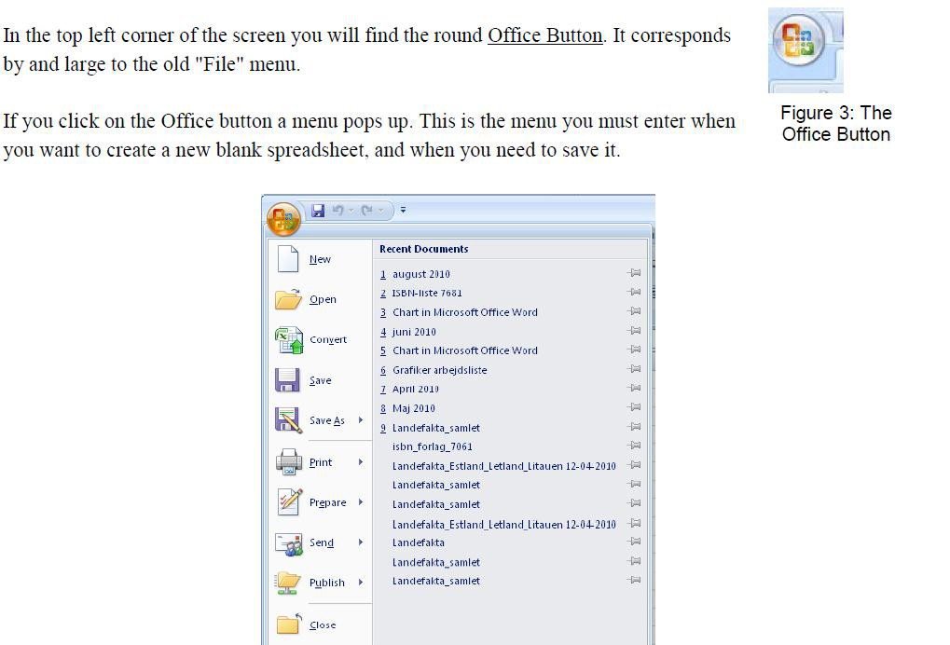
Creating a New Document
1.
When creating a new document click the Office Button and then select New
To create a blank document, simply select New. Choose a Blank Workbook for

Slide 6
The Quick Access Toolbar
The Quick Access Toolbar is located in the upper left of the Excel 2007 screen, just to the right
of the Office menu button. By default, the Quick Access Toolbar holds three buttons (Save, Undo and Redo).
Adding Buttons
To add a button to the Quick Access Toolbar:
_ Right-click the button you wish to add to the toolbar
_ Click the Add to Quick Access Toolbar option.
If you wish, you can add a group of buttons to the Quick Access Toolbar at once. To do this:
_ Right-click on the word that defines the group (such as Font).
_ Click the Add to Quick Access Toolbar option to add the button group
Removing Buttons
It is very easy to remove a button or a button group from the Quick Access Toolbar.
_ Right-click on button
_ Click the Remove from Quick Access Toolbar option.

Slide 7
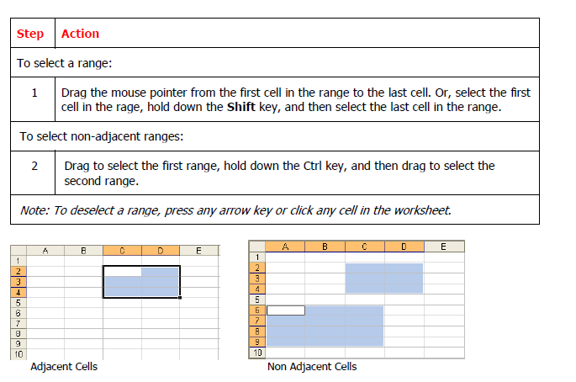
Selecting Cells Range in Workbook
You must select the cell (activate the cell) before you add information to it. Once you have selected a cell or range, you may make changes to all selected cells simultaneously.
A group of selected cells is called a range. A range can contain a block of cells, a complete column, a complete row or a non-adjacent range. .

Slide 8
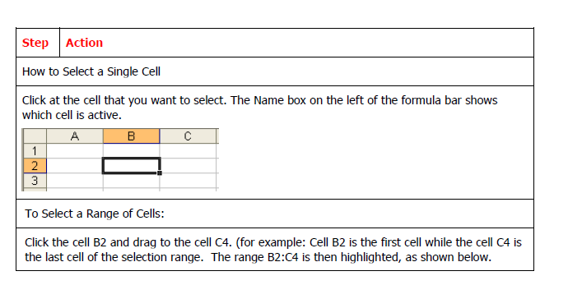
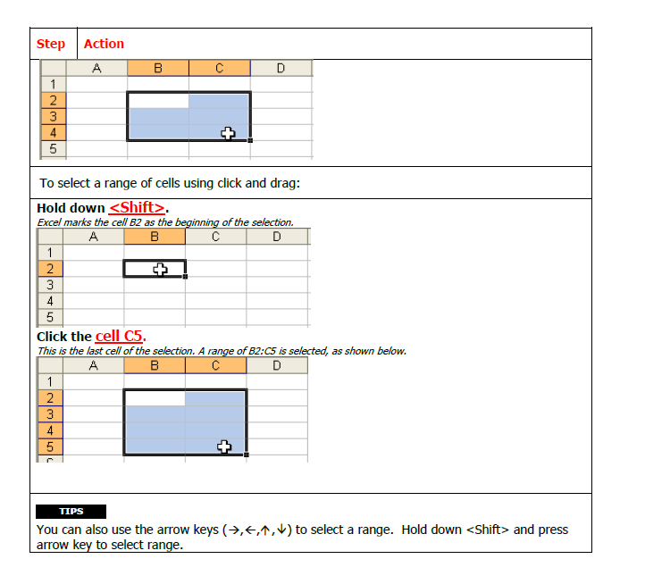

Slide 9
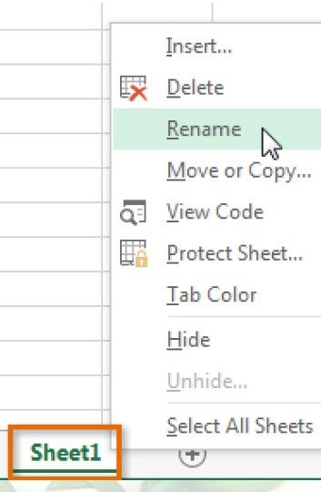
Moving around in a range of cells – shortcut keys
Move between worksheets
Use the shortcut keys <Ctrl>+<Page Down> to move to the next worksheet and press <Ctrl>+<Page Up> to move to the previous worksheet.
Renaming Worksheets
It is a good idea to rename the sheets to reflect what kind of information can be found on that sheet. To rename the sheet do one of the following:
Double click on the Sheet1 tab.
-OR
Right click on the sheet tab and select rename.
Any of these actions will cause the name in the sheet tab to be highlighted. Once it is highlighted, you simply type in the new name and hit the Enter key.

Slide 10
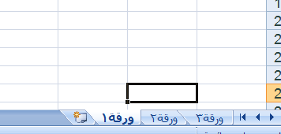
Adding Worksheets
If you need more than three sheets you can easily add more.
Click on Insert in the Cells group and click insert sheet.
-OR
Click the New Sheet button to the right of the rightmost worksheet tab.
A new sheet will be added to your list of sheets
Entering Data into a cell
To enter data into a cell, simply do the following:
Select the cell by clicking on it. The cursor will not blink (as it does in Microsoft Word), but instead the cell will be outlined in a thick black line and it will be listed in the cell name field below the ribbon. These two things tell you that the cell is active and ready to accept a formula or text.
Type numbers, text, or a combination of both into the cell.
Press the Enter key OR click on the green check mark to the left of the Formula bar.
Pressing Enter will enter the information into that cell and move you down to the next cell. Pressing the green check mark will enter your data but keep the same cell active.
Editing a cell:
If you discover that you made a mistake when entering data into a cell, you can correct them within the formula bar or the cell itself.
Formula Bar: Select the cell, then click in the formula bar. Make the needed correction. Then press Enter or click on the green check mark in the Formula bar.
In the Cell:
Either:
o Select the cell and begin typing. What you type will erase the current information in the cell.
-OR-

Slide 11
o Double click on the cell. A cursor will appear in the cell. Move the cursor to where you need to make your changes. Make the changes. Then press Enter.
Canceling/Undoing Changes
Cancelling actions
If you haven't yet pressed Enter while entering or editing information in a cell, press the Esc key or click on the “X” button on the formula bar.
Undo/Redo Actions
To Undo Your Most Recent Action
Click the Undo button
on the Standard Toolbar.
To Cancel Your Most Recent Undo
Click on the Redo
button on the Standard Toolbar
Clearing a Cell
Clearing a cell removes any data that is entered into the cell. The quickest way to clear a cell is to select one or more cells, then press the Delete key or the Backspace key. This clears the contents, but leaves formatting and other cell contents intact.
To delete the cell entirely, click Edit on the main menu and select Delete. It will then ask you which way you would like to shift the other cells.
Hide rows and columns
Hiding data serves the purpose of allowing you to temporarily make column or rows from your spreadsheet invisible.
To hide data:
_ Right-click the row or column header for the row/column you wish to hide
_ Select Hide from the menu

Slide 12
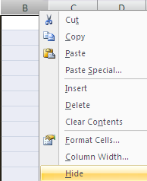
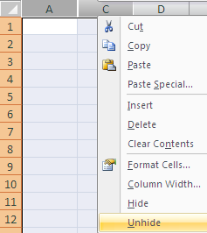
To unhide data:
_ Highlight rows / columns either side of the hidden one/s
_ Right-click and select Unhide from the menu
or

Slide 13
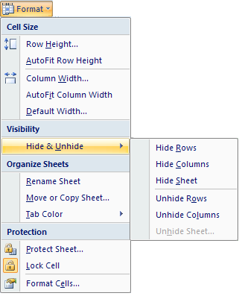
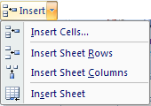
Inserting or deleting cells
You can insert a new cell above the current active cell, in which case the active cell and those below it will each move down one row. You can also insert a new
cell to the left of the current active cell, in which case the active cell and those on its right will each move one column to the right.
To insert a cell:
Select the cell next to which you want to insert a new cell.
On the Home ribbon, find the Cells group and click Insert followed by Insert Cells.
A dialog box will open. Click the direction in which you want the surrounding cells to
shift.

