Slide 1
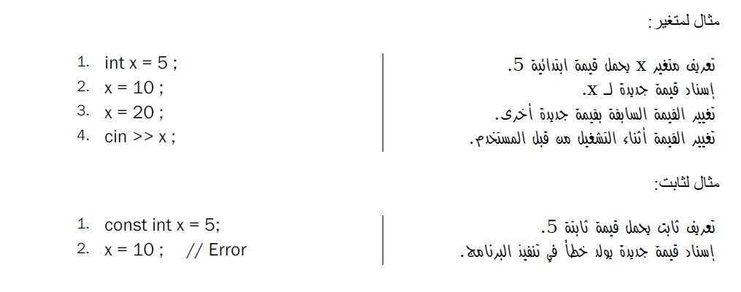
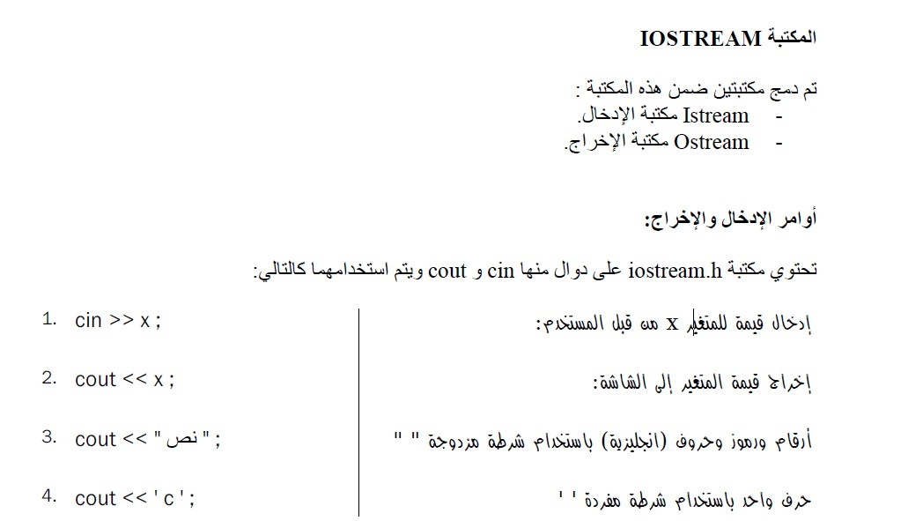
C++ lecture
Assistant lecture:Mayyadah S. Abrahim

Slide 2
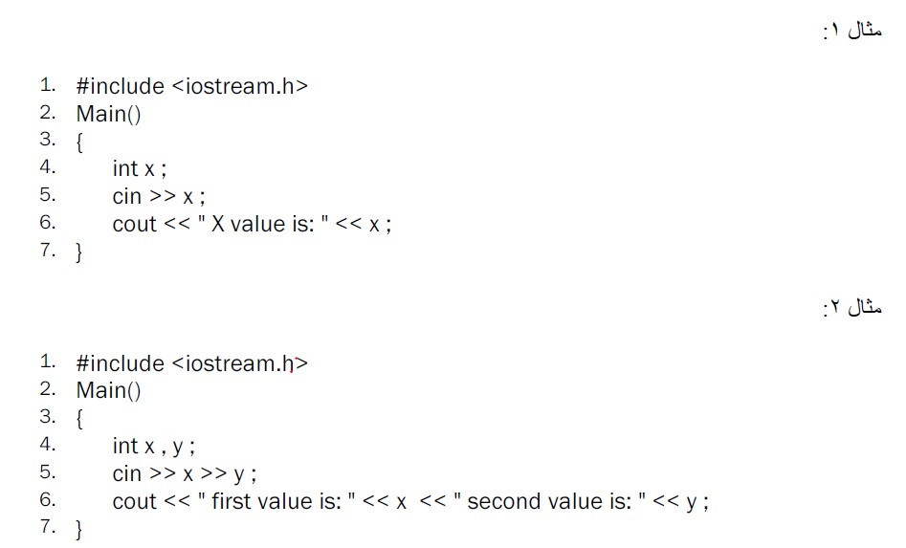
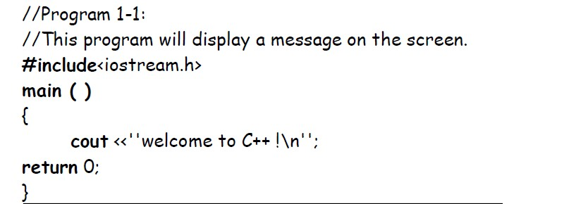

C++ lecture
Assistant lecture:Mayyadah S. Abrahim

Slide 3
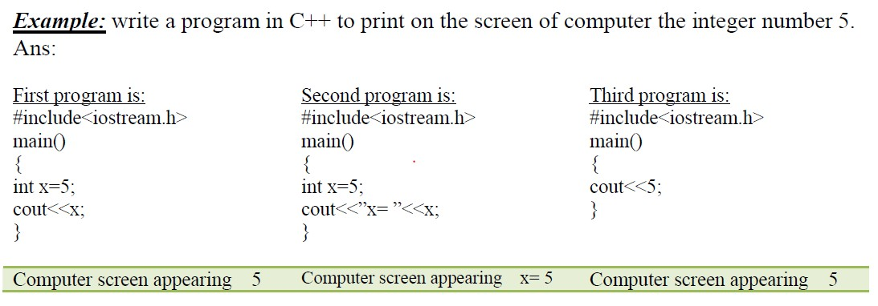
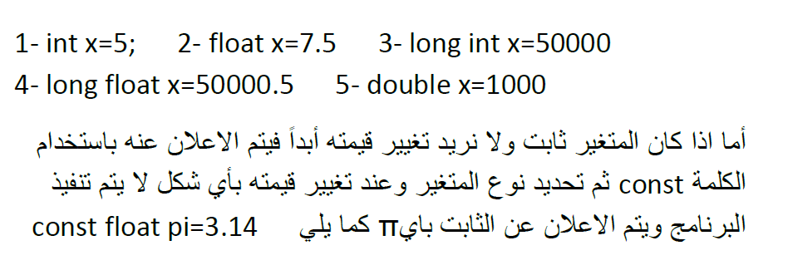
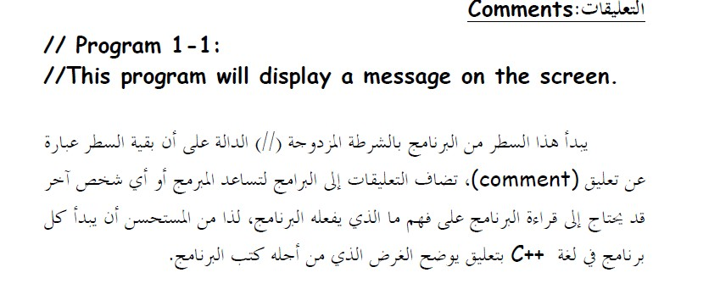
C++ lecture
Assistant lecture:Mayyadah S. Abrahim

Slide 4
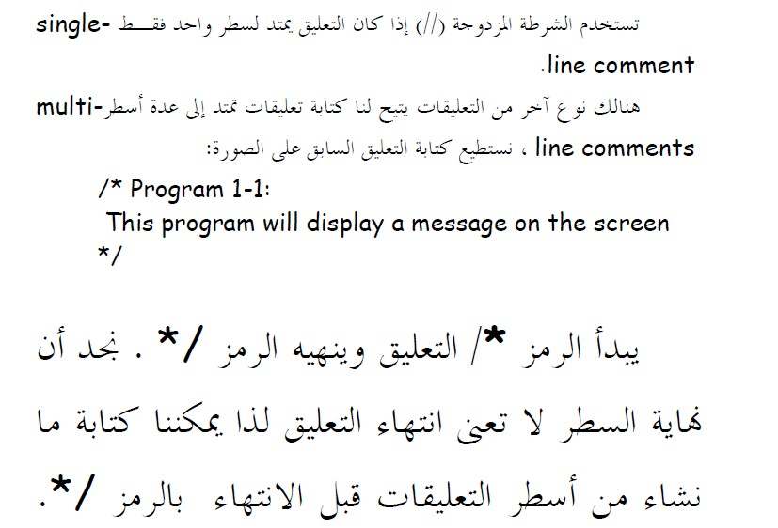



C++ lecture
Assistant lecture:Mayyadah S. Abrahim
-

Slide 5
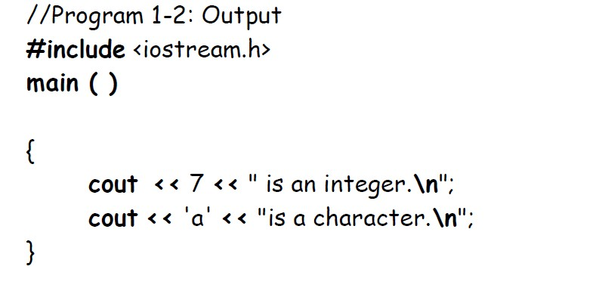

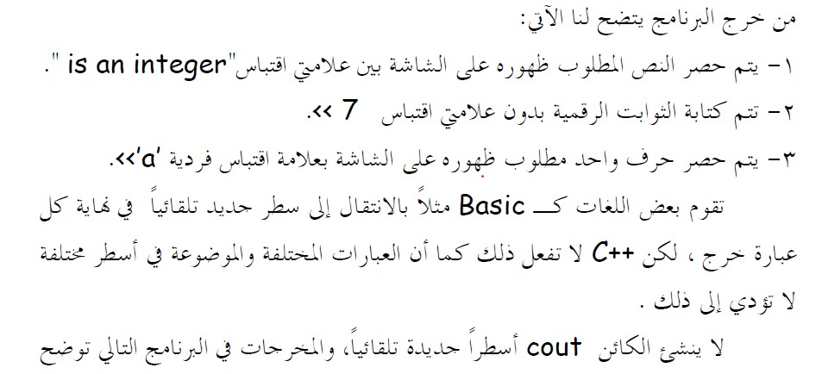
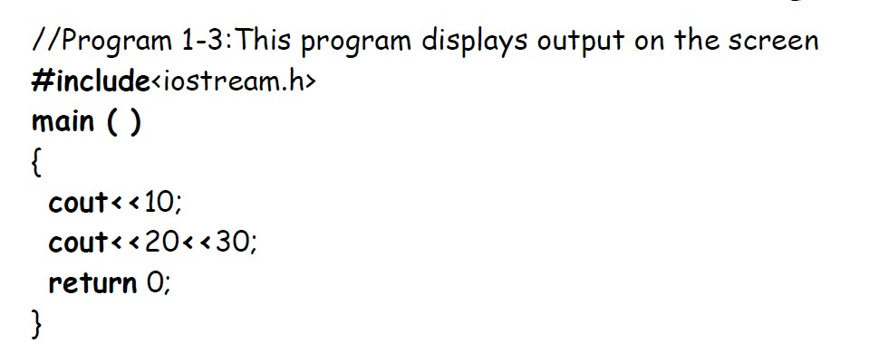
C++ lecture
Assistant lecture:Mayyadah S. Abrahim

Slide 6

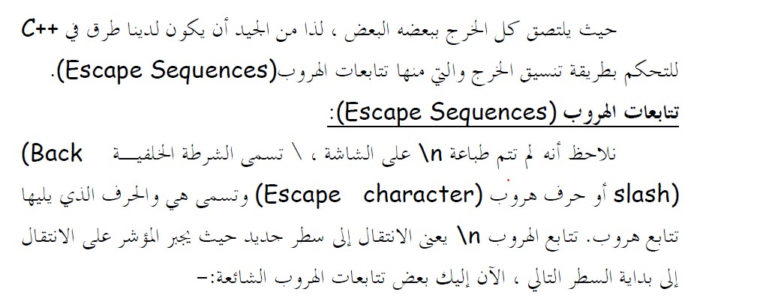
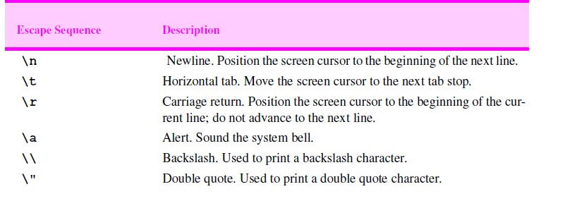
C++ lecture
Assistant lecture:Mayyadah S. Abrahim

Slide 7
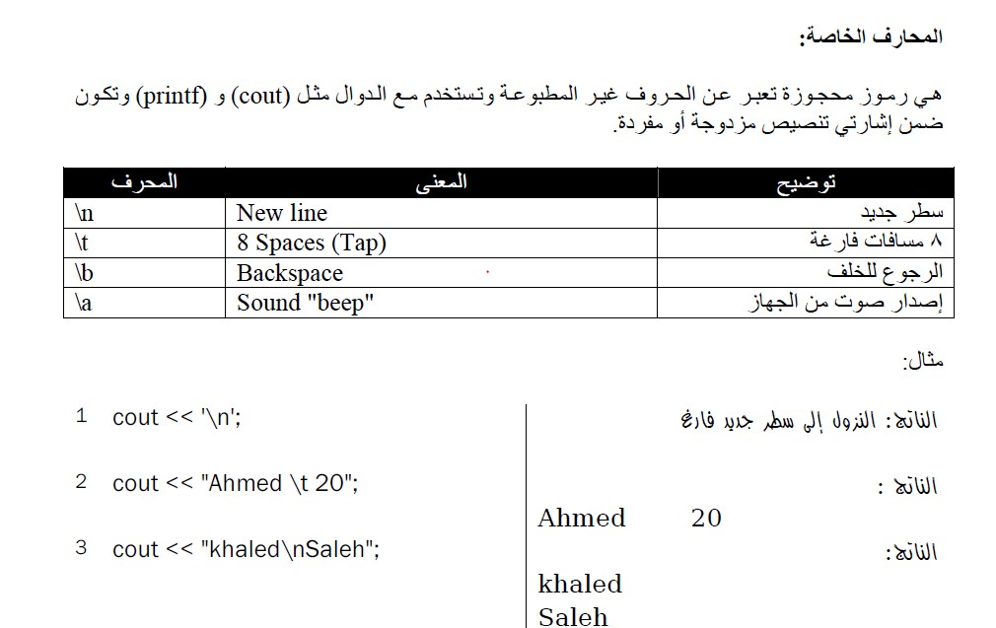
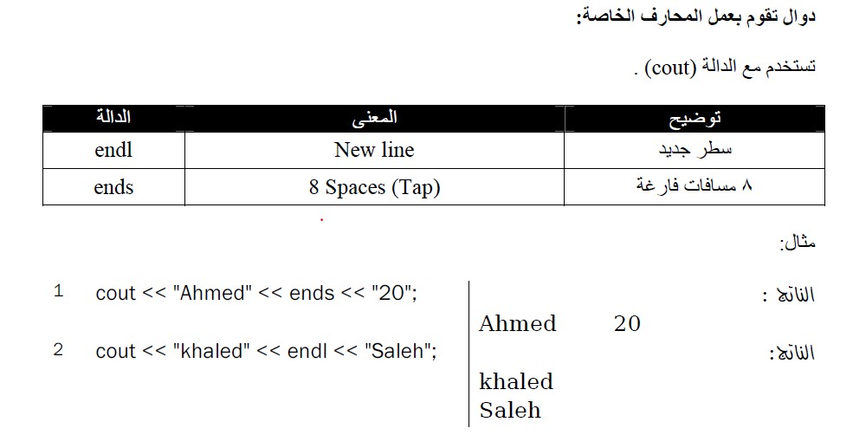

C++ lecture
Assistant lecture:Mayyadah S. Abrahim

Slide 8
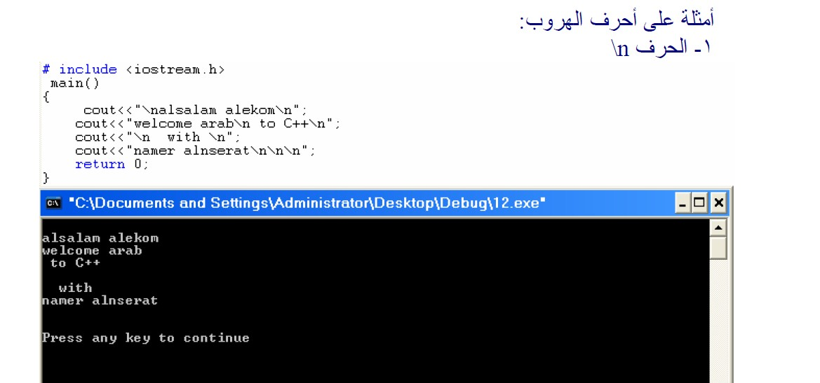
C++ lecture
Assistant lecture:Mayyadah S. Abrahim

Slide 9
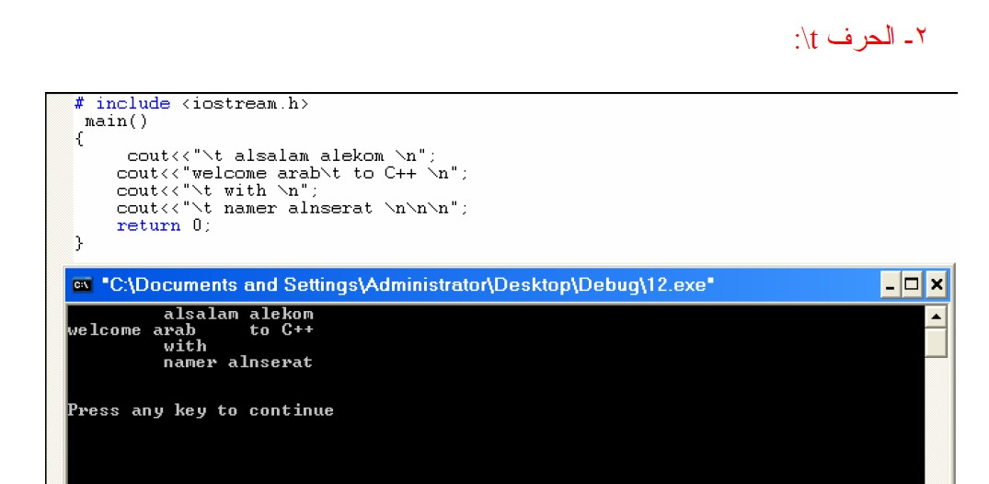

C++ lecture
Assistant lecture:Mayyadah S. Abrahim

Slide 10

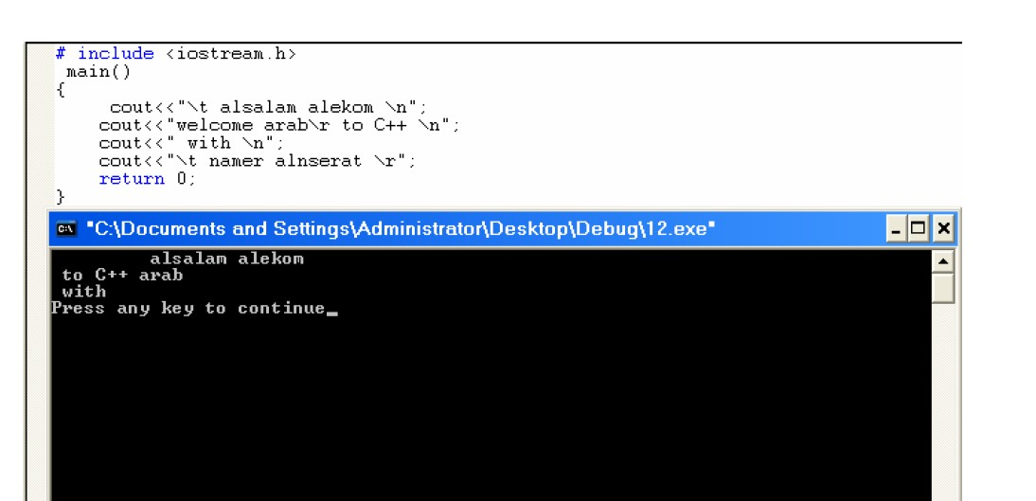
C++ lecture
Assistant lecture:Mayyadah S. Abrahim

