Slide 1
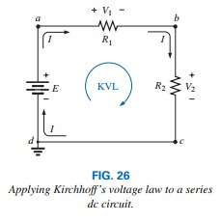
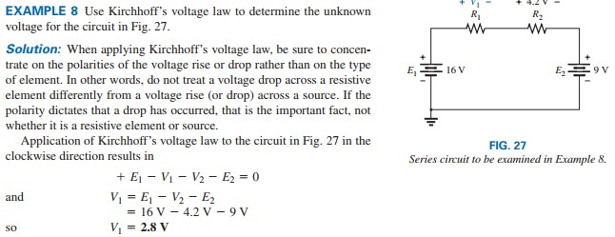
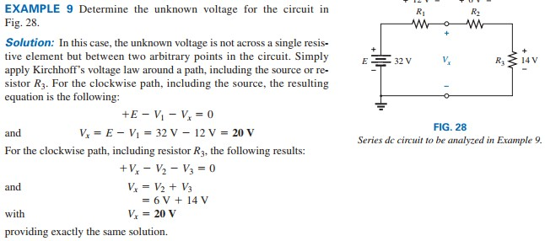
College of Engineering Dept. of the electrical power and Machine engineering
Subject / Electrical Eng. Fundamental I
stage / first Date: 28/11/2017 Lecture:5
Time/ 2 hours
KIRCHHOFF’S VOLTAGE LAW
the algebraic sum of the potential rises and drops around a closed path (or closed loop) is zero
Kirchhoff’s voltage law can also be written in the following form
the sum of the voltage rises around a closed path will always equal the sum of the voltage drops.

Slide 2
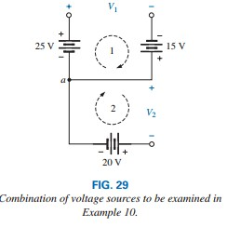
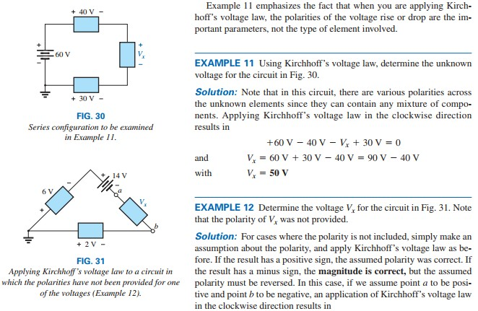
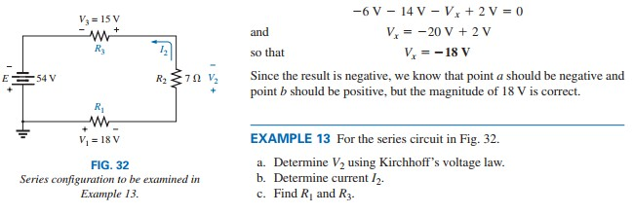
College of Engineering Dept. of the electrical power and Machine engineering
Subject / Electrical Eng. Fundamental I
stage / first Date: 28/11/2017 Lecture:5
Time/ 2 hours
EXAMPLE 10 :Using Kirchhoff’s voltage law, determine voltages V1 and V2 for the network in Fig. 29.
Solution: For path 1, starting at point a in a clockwise direction, +25 V -V1 +15 V =0 V.so V1=25 For path 2, starting at point a in a clockwise direction, -V2- 20 V =0. so V2 = -20 V

Slide 3
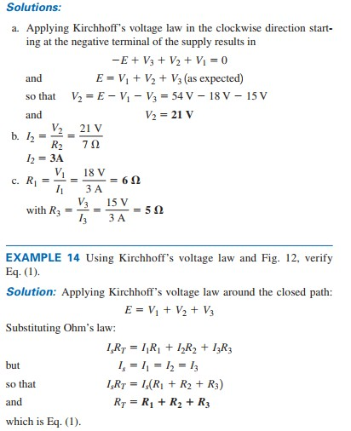
College of Engineering Dept. of the electrical power and Machine engineering
Subject / Electrical Eng. Fundamental I
stage / first Date: 28/11/2017 Lecture:5
Time/ 2 hours

Slide 4
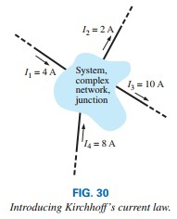
College of Engineering Dept. of the electrical power and Machine engineering
Subject / Electrical Eng. Fundamental I
stage / first Date: 28/11/2017 Lecture:5
Time/ 2 hours
KIRCHHOFF’S CURRENT LAW
Kirchhoff’s current law (KCL): The algebraic sum of the currents entering and leaving a junction (or region) of a network is zero.
The law can also be stated in the following way: The sum of the currents entering a junction (or region) of a network must equal the sum of the currents leaving the same junction (or region).

Slide 5
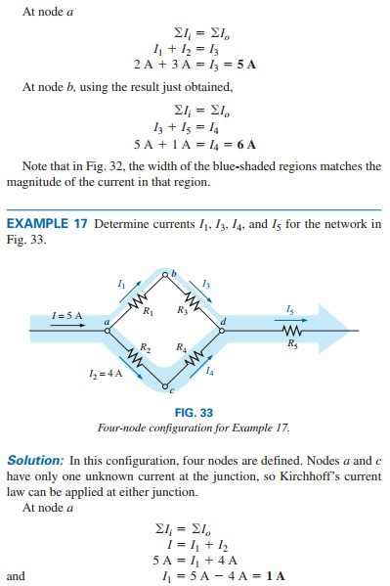
College of Engineering Dept. of the electrical power and Machine engineering
Subject / Electrical Eng. Fundamental I
stage / first Date: 28/11/2017 Lecture:5
Time/ 2 hours
VOLTAGE DIVISION IN A SERIES CIRCUIT
the voltage across series resistive elements will divide as the magnitude of the resistance levels. In other words,
in a series resistive circuit, the larger the resistance, the more of the applied voltage it will capture.
In addition,

Slide 6
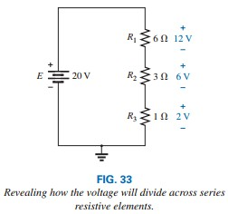
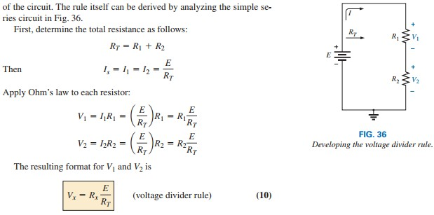
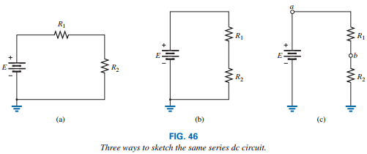
College of Engineering Dept. of the electrical power and Machine engineering
Subject / Electrical Eng. Fundamental I
stage / first Date: 28/11/2017 Lecture:5
Time/ 2 hours
the ratio of the voltages across series resistors will be the same as the ratio of their resistance levels.
Voltage Divider Rule (VDR)
the voltage across a resistor in a series circuit is equal to the value of that resistor times the total applied voltage divided by the total resistance of the series configuration.
Voltage Sources and Ground

Slide 7
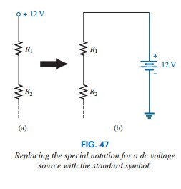
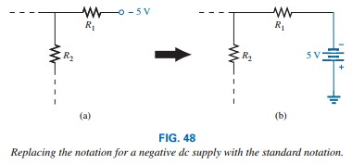
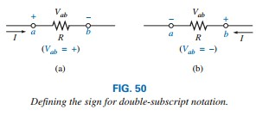
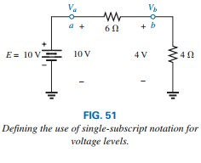
College of Engineering Dept. of the electrical power and Machine engineering
Subject / Electrical Eng. Fundamental I
stage / first Date: 28/11/2017 Lecture:5
Time/ 2 hours
Double-Subscript Notation
The double-subscript notation Vab specifies point a as the higher potential. If this is not the case, a negative sign must be associated with the magnitude of Vab.
Single-Subscript Notation
The single-subscript notation Va specifies the voltage at point a with respect to ground (zero volts). If the voltage is less than zero volts, a negative sign must be associated with the magnitude of Va
VOLTAGE REGULATION AND THE INTERNAL RESISTANCE OF VOLTAGE SOURCES
every practical (real-world) supply has an internal resistance in series with idealized voltage source

Slide 8
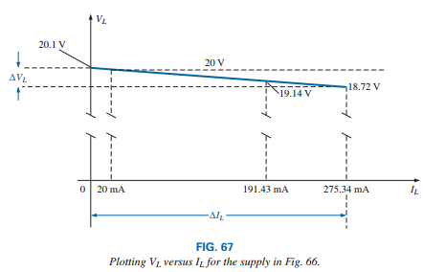
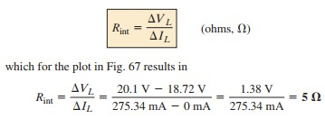
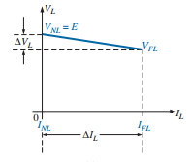
College of Engineering Dept. of the electrical power and Machine engineering
Subject / Electrical Eng. Fundamental I
stage / first Date: 28/11/2017 Lecture:5
Time/ 2 hours
voltage regulation (abbreviated VR; often called load regulation on specification sheets)
CURRENT DIVIDER RULE
For two parallel elements of equal value, the current will divide equally.
For parallel elements with different values, the smaller the resistance, the greater is the share of input current.

Slide 9
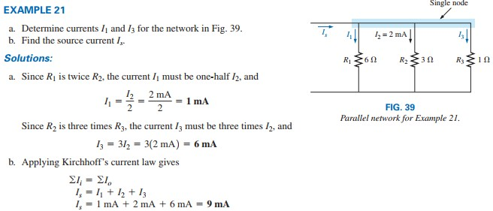
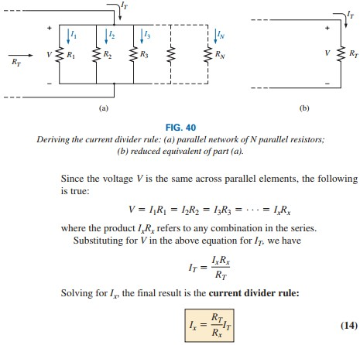
College of Engineering Dept. of the electrical power and Machine engineering
Subject / Electrical Eng. Fundamental I
stage / first Date: 28/11/2017 Lecture:5
Time/ 2 hours
For parallel elements of different values, the current will split with a ratio equal to the inverse of their resistance values.
the current through any branch of a parallel resistive network is equal to the total resistance of the parallel network divided by the resistance of the resistor of interest and multiplied by the total current entering the parallel configuration.

Slide 10
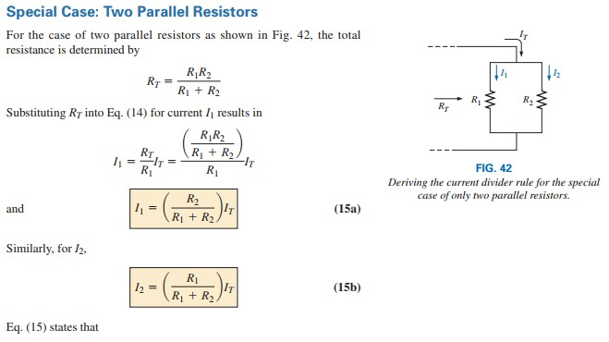
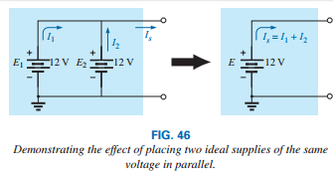
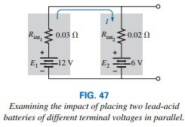
College of Engineering Dept. of the electrical power and Machine engineering
Subject / Electrical Eng. Fundamental I
stage / first Date: 28/11/2017 Lecture:5
Time/ 2 hours
VOLTAGE SOURCES IN PARALLEL
voltage sources can be placed in parallel only if they have the same voltage
it is always recommended that when you are replacing batteries in series or parallel, replace all the batteries.
OPEN AND SHORT CIRCUITS
an open circuit can have a potential difference (voltage) across its terminals, but the current is always zero amperes.

Slide 11
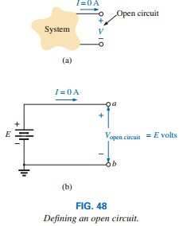
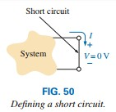
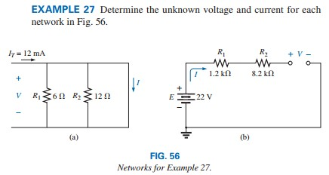
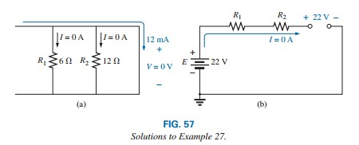
College of Engineering Dept. of the electrical power and Machine engineering
Subject / Electrical Eng. Fundamental I
stage / first Date: 28/11/2017 Lecture:5
Time/ 2 hours
a short circuit can carry a current of a level determined by the external circuit, but the potential difference (voltage) across its terminals is always zero volts.

