Slide 1
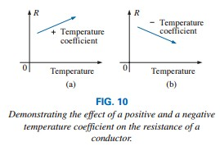
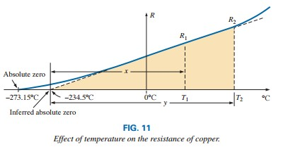
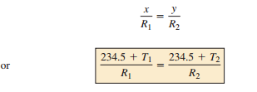
College of Engineering Dept. of the electrical power and Machine engineering
Subject / Electrical Eng. Fundamental I
stage / first Date: 8/11/2018 Lecture:2
Time/ 2 hours
TEMPERATURE EFFECTS
Conductors
For good conductors, an increase in temperature results in an increase in the resistance level. Consequently, conductors have a positive temperature coefficient.
Semiconductors
for semiconductor materials, an increase in temperature results in a decrease in the resistance level. Consequently, semiconductors have negative temperature coefficients.
Insulators
As with semiconductors, an increase in temperature results in a decrease in the resistance of an insulator. The result is a negative temperature coefficient.
Inferred Absolute Temperature
where |T1| indicates that the inferred absolute temperature of the material

Slide 2
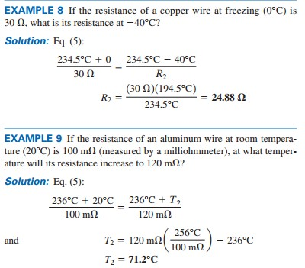
College of Engineering Dept. of the electrical power and Machine engineering
Subject / Electrical Eng. Fundamental I
stage / first Date: 8/11/2018 Lecture:2
Time/ 2 hours
Temperature Coefficient of Resistance
as the temperature coefficient of resistance at a temperature of 20°C and R20 as the resistance of the sample at 20°C, we determine the resistance R1 at a temperature T1 by
or
R₂ = R₁(1+ α₂₀(T₂-T₁))
the higher the temperature coefficient of resistance for a material, the more sensitive is the resistance level to changes in temperature.
PPM/°C; The specification is normally provided in parts per million per degree Celsius (PPM/°C), providing an immediate indication of the sensitivity level of the resistor to temperature.
where
Rnominal
is the nameplate value of the resistor at room
temperature and ΔT is the change in temperature from the reference level of 20°C.

Slide 3
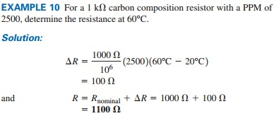
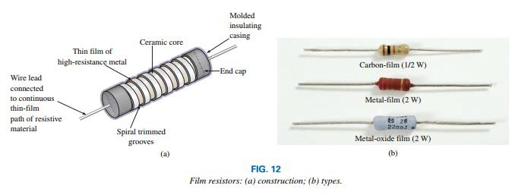
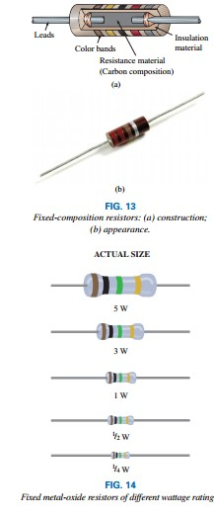
College of Engineering Dept. of the electrical power and Machine engineering
Subject / Electrical Eng. Fundamental I
stage / first Date: 8/11/2018 Lecture:2
Time/ 2 hours
TYPES OF RESISTORS
Fixed Resistors
For a particular style and manufacturer, the size of a resistor increases with the power or wattage rating.
the size of a resistor does not define its resistance level

Slide 4
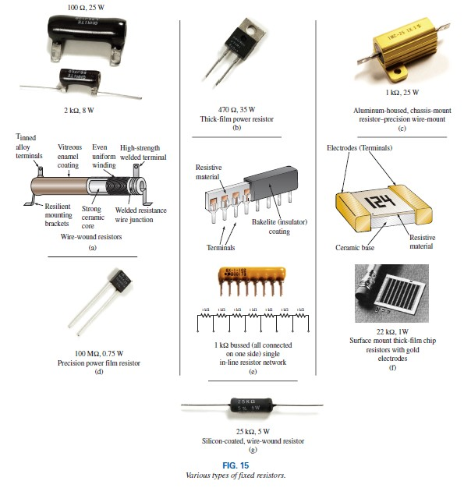
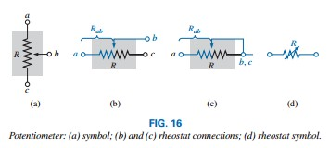
College of Engineering Dept. of the electrical power and Machine engineering
Subject / Electrical Eng. Fundamental I
stage / first Date: 8/11/2018 Lecture:2
Time/ 2 hours
Variable Resistors

Slide 5
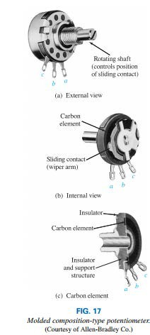
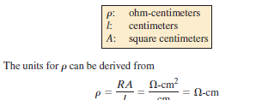
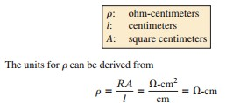
College of Engineering Dept. of the electrical power and Machine engineering
Subject / Electrical Eng. Fundamental I
stage / first Date: 8/11/2018 Lecture:2
Time/ 2 hours
The resistance between the outside terminals a and c in Fig.
18(a) (and Fig. 17) is always fixed at the full rated value of the potentiometer, regardless of the position of the wiper arm b.
The resistance between the wiper arm and either outside terminal can be varied from a minimum of 0 to a maximum value equal to the full rated value of the potentiometer.
CONDUCTANCE: we have a measure of how well the material conducts electricity, has the symbol G, and is measured in siemens (S).
RESISTANCE: METRIC UNITS

Slide 6
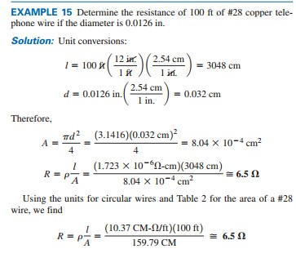
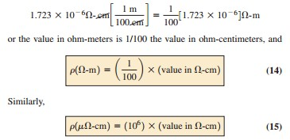
College of Engineering Dept. of the electrical power and Machine engineering
Subject / Electrical Eng. Fundamental I
stage / first Date: 8/11/2018 Lecture:2
Time/ 2 hours
The conversion factor between resistivity in circular mil-ohms per foot and ohm-centimeters is the following;
EX: A coil of insulated copper wire has a resistance of 150 ohm at 20 C. when the coil is connected across 240 V supply, the current after several hours is 1.25A. a) By assuming the temperature coefficient of resistance of copper at 20 C to be 0.0039 /C, find the average temperature throughout the coil. b) find the temperature coefficient of resistance for copper at 0 C and 50 C c) What the resistance at -5 C, 5 C,0 C and 45 C.
Solution:
a) R₂ = 240/1.25 = 192 ohm R₂ = R₂₀ (1+α₂₀ ΔT )
192 = 150 (1+0.0039 *ΔT) , So ΔT = 71.795 ͦC
T₂ = 20+71.795 =91.795 ͦC
b ) α_{y} = α₀ /(1+ α₀ T_{y}) where α_{y} = α₂₀ =0.0039/ͦC. α₀ = α_{y} /(1- α_{y} T_{y} ) = 0.0039/(1- (0.0039*20)) = 4.23*10^-3 /ͦC
α₅₀ = 4.23*10^-3 /(1+(4.23*10^-3*50) = 3.492*10^-3/ͦC

Slide 7
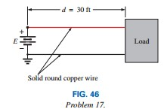
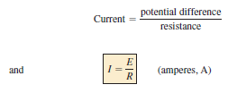
College of Engineering Dept. of the electrical power and Machine engineering
Subject / Electrical Eng. Fundamental I
or α_{y} = α_{N} /(1+ α_{N}ΔT) , So α₅₀= α₂₀ /(1+ α₂₀(50-20)= 3.49*10^-3
or
stage / first Date: 8/11/2018 Lecture:2
Time/ 2 hours
c) R₋₅ = R₂₀(1+ α₂₀ΔT) R₅ = R₂₀(1+ α₂₀ΔT) R₄₅ = R₂₀(1+ α₂₀ΔT)
Homework
17. a. For the system in Fig. 46, the resistance of each line cannot exceed 6 mΩ, and the maximum current drawn by the load is 110 A. What minimum size gage wire should be used? b. Repeat (a) for a maximum resistance of 3 mΩ, d= 30 ft, and a maximum current of 110 A.
21. The resistance of a copper wire is 4 at room temperature (68°F). What is its resistance at a freezing temperature of 32°F?
23. a. The resistance of a copper wire is 1 at 4°C. At what temperature (°C) will it be 1.1 ? b. At what temperature will it be 0.1 ?
Q: A coil made of copper at 20 °C is supplied with 10V and the current is 1A. After few seconds the current decreased to 0.95 A with the same voltage source. Find the new temperature coefficient of the coil. Assume the temperature coefficient of the coil at 0 °C is 4.28* 10^-3 /°C. Find also the temperature coefficient at the new temperature.
Ohm’s Law, Power, and Energy OHM’S LAW

Slide 8
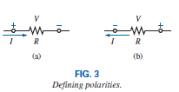
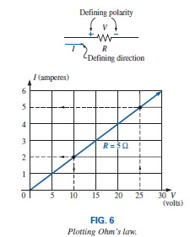
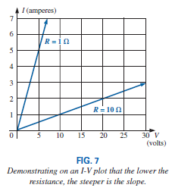
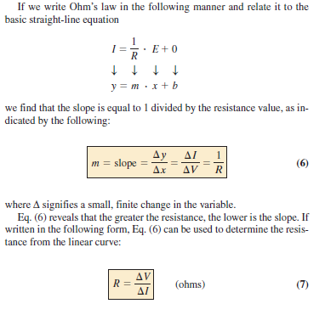
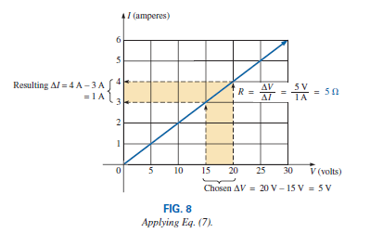
College of Engineering Dept. of the electrical power and Machine engineering
Subject / Electrical Eng. Fundamental I
stage / first Date: 8/11/2018 Lecture:2
Time/ 2 hours
PLOTTING OHM’S LAW

