Slide 1
CLASS B,C,D
Page 702-714

Slide 2
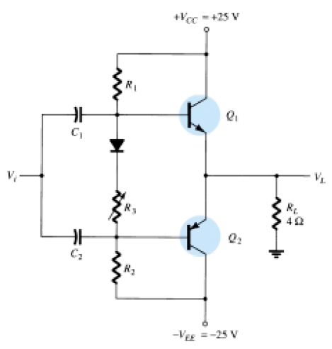

Slide 3
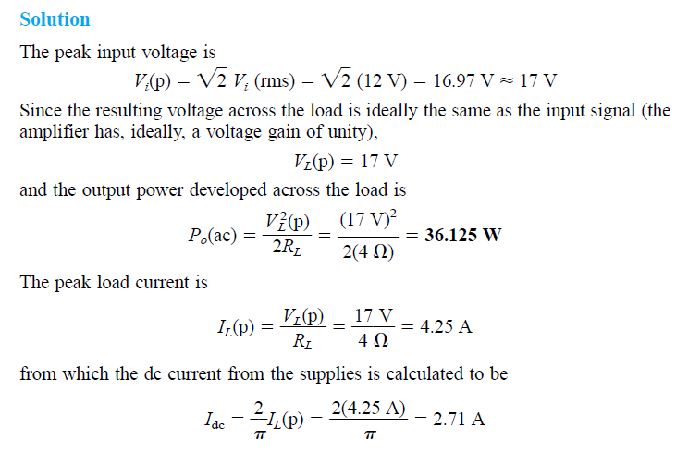

Slide 4
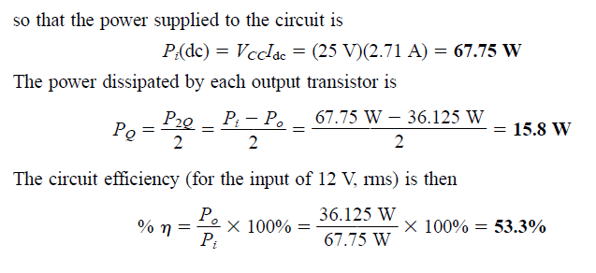

Slide 5
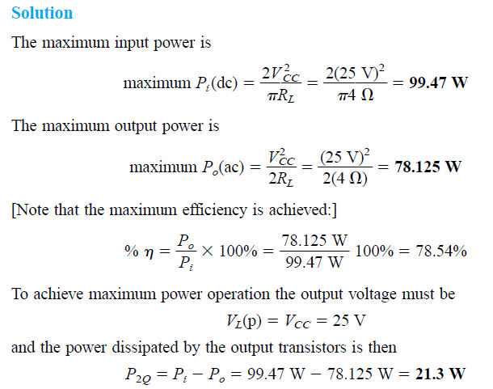

Slide 6
POWER TRANSISTOR HEAT SINKING
Improvements in production techniques have provided higher power ratings in small-sized packaging cases,
have increased the maximum transistor breakdown voltage,
and have provided faster-switching power transistors.
heatsinking techniques will allow operation of a device at about one-half its maximum power rating.

Slide 7
We should note that of the two types of bipolar transistors—germanium and silicon— silicon transistors provide greater maximum temperature ratings.
Typically, the maximum junction temperature of these types of power transistors is
Silicon: 150–200°C
Germanium: 100–110°C

Slide 8
For many applications the average power dissipated may be approximated by
PD = VCE/IC
This power dissipation, however, is allowed only up to a maximum temperature. Above this temperature, the device power dissipation capacity must be reduced

Slide 9
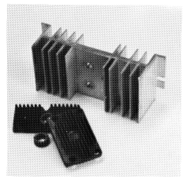
the device is mounted on some form of heat sink, its power handling capacity can approach the rated maximum value more closely. A few heat sinks are shown in Fig. 16.22. When the heat sink is used, the heat produced by the transistor dissipating power has a larger area from which to radiate (transfer)
the heat into the air, thereby holding the case temperature to a much lower value than would
result without the heat sink. for which the case temperature is held at the ambient (air) temperature, the junction will be heated above the case temperature and a maximum power rating must be considered.

Slide 10
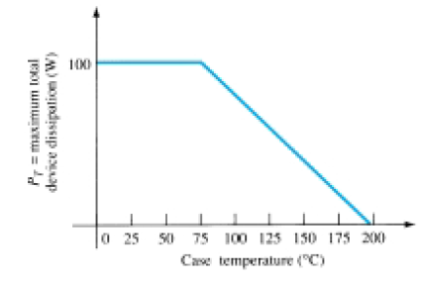
Figure 16.23 shows a typical power derating curve for a silicon transistor. The curve shows that the manufacturer will specify an upper temperature point

Slide 11
where the value of Temp0 is the temperature at which derating should begin,
the value of Temp1 is the particular temperature of interest (above the value Temp0),
PD(temp0) and PD(temp1) are the maximum power dissipations at the temperatures specified,
and the derating factor is the value given by the manufacturer in units of watts (or milliwatts) per degree of temperature.

Slide 13
It is interesting to note what power rating results from using a power transistor without a heat sink.
For example, a silicon transistor rated at 100 W at (or below) 100°C is rated only 4 W at (or below) 25°C, the free-air temperature.
Thus, operated without a heat sink, the device can handle a maximum of only 4 W at the room temperature of 25°C.
Using a heat sink large enough to hold the case temperature to 100°C at 100 W allows operating at the maximum power rating.

Slide 14
CLASS C AND CLASS D AMPLIFIERS
class D amplifiers are popular because of their very high efficiency.
Class C amplifiers, while not used as audio amplifiers, do find use in tuned circuits as used in communications.

Slide 15
Class C Amplifier
A class C amplifier, as that shown in Fig. 16.25, is biased to operate for less than 180° of the input signal cycle. The tuned circuit in the output,
however, will provide a full cycle of output signal for the fundamental or resonant frequency of the tuned circuit (L and C tank circuit) of the output.
This type of operation is therefore limited to use at one fixed frequency, as occurs in a communications circuit, for example.
Operation of a class C circuit is not intended primarily for large-signal or power amplifiers.

Slide 16
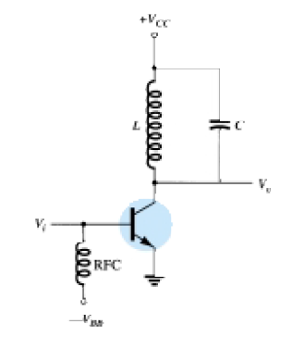

Slide 17
Class D Amplifier
class D amplifier is designed to operate with digital or pulse-type signals. An efficiency of over 90% is achieved using this type of circuit, making it quite desirable in power amplifiers.
to convert any input signal into a pulse type waveform before using it to drive a large power load and to convert the signal back to a sinusoidal-type signal to recover the original signal.

Slide 18
Figure 16.26 shows how a sinusoidal signal may be converted into a pulse-type signal using some form of sawtooth or chopping waveform to be applied
with the input into a comparator type op-amp circuit so that a representative pulse-type signal is produced.
While the letter D is used to describe the next type of bias operation after class C, the D could also be considered to stand for “Digital,”

Slide 19
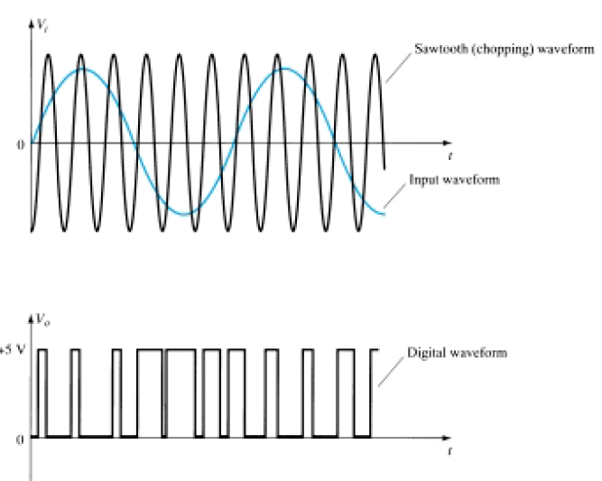

Slide 20
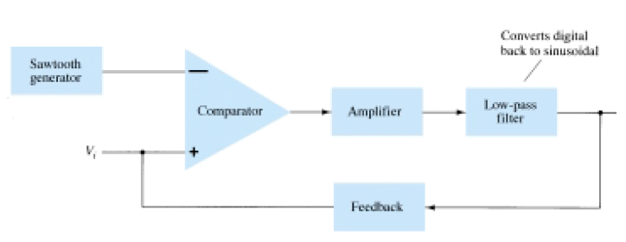
Figure 16.27 shows a block diagram of the unit needed to amplify the class D signal and then convert back to the sinusoidal-type signal using a low-pass filter.
Since the amplifier’s transistor devices used to provide the output are basically either off or on, they provide current only when they are turned on, with little power loss due to their low on-voltage. Since most of the power applied to the amplifier is transferred to the load, the efficiency of the circuit is typically very high. Power MOSFET devices have been quite popular as the driver devices for the class D amplifier.

Slide 22
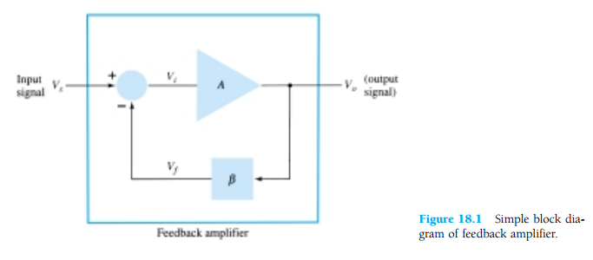
FEEDBACK CONCEPTS
Depending on the relative polarity of the signal being fed back into a circuit, one may have negative or positive feedback.
A typical feedback connection is shown in Fig. 18.1. The input signal, Vs, is applied to a mixer network, where it is combined with a feedback signal,Vf. The difference of these signals,Vi, is then the input voltage to the amplifier.

Slide 23
a number of improvements are obtained, among them being:
1. Higher input impedance.
2. Better stabilized voltage gain.
3. Improved frequency response.
4. Lower output impedance.
5. Reduced noise.
6. More linear operation

Slide 24
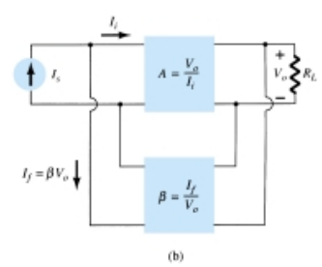
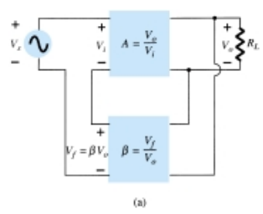
FEEDBACK CONNECTION TYPES
There are four basic ways of connecting the feedback signal.
1. Voltage-series feedback (Fig. 18.2a).
2. Voltage-shunt feedback (Fig. 18.2b).

Slide 25
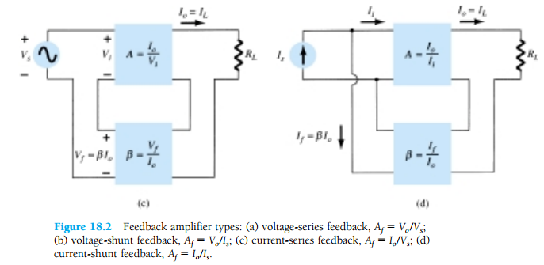
3. Current-series feedback (Fig. 18.2c).
4. Current-shunt feedback (Fig. 18.2d)

Slide 27
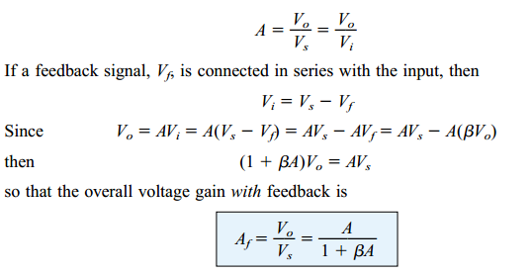
VOLTAGE-SERIES FEEDBACK
Figure 18.2a shows the voltage-series feedback connection with a part of the output voltage fed back in series with the input signal

Slide 28
VOLTAGE-SHUNT FEEDBACK

Slide 29
Input Impedance with Feedback VOLTAGE-SERIES FEEDBACK

Slide 31
VOLTAGE-SHUNT FEEDBACK

Slide 33
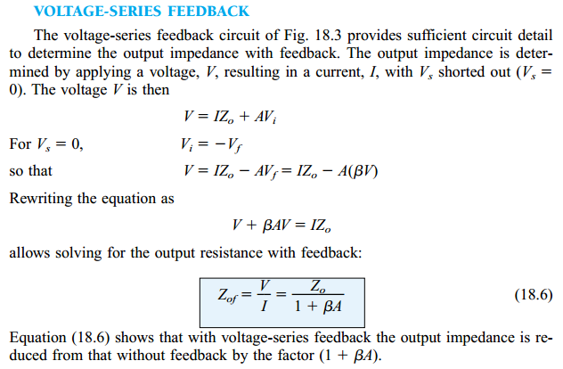
Output Impedance with Feedback
The output impedance for the connections of Fig. 18.2 are dependent on whether voltage or current feedback is used. For voltage feedback, the output impedance is decreased, while current feedback increases the output impedance.

Slide 34
.

