Slide 1



THE COORDINATE SYSTEMS
THE CARTESIAN COORDINATE SYSTEM ($x,y,z$)
THE CIRCULAR CYLINDRICAL COORDINATE SYSTEM ($ρ, φ, z$)
THE SPHERICAL COORDINATE SYSTEM ($r,θ,φ$)

Slide 2
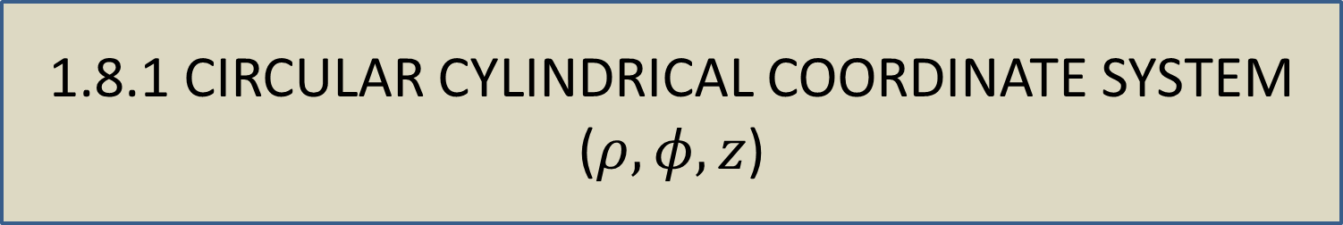
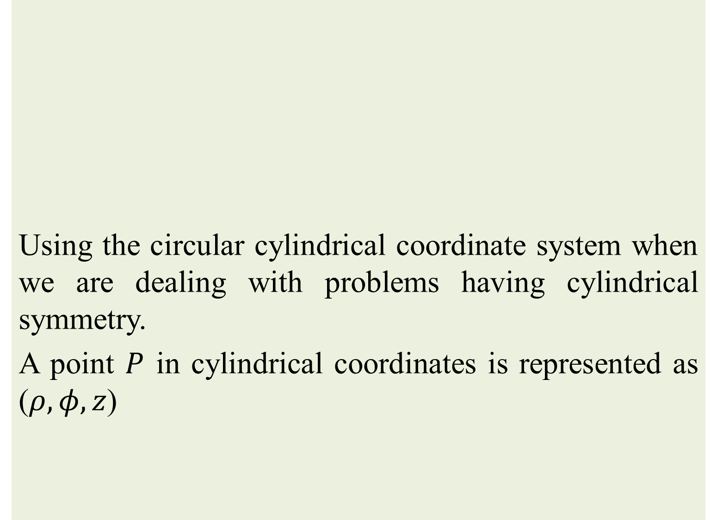
1.8 OTHER COORDINATE SYSTEM
Using the circular cylindrical coordinate system when we are dealing with problems having cylindrical symmetry.
A point $P$ in cylindrical coordinates is represented as ($ρ, φ, z$)
1.8.1 CIRCULAR CYLINDRICAL COORDINATE SYSTEM ($ρ, φ, z$)

Slide 3
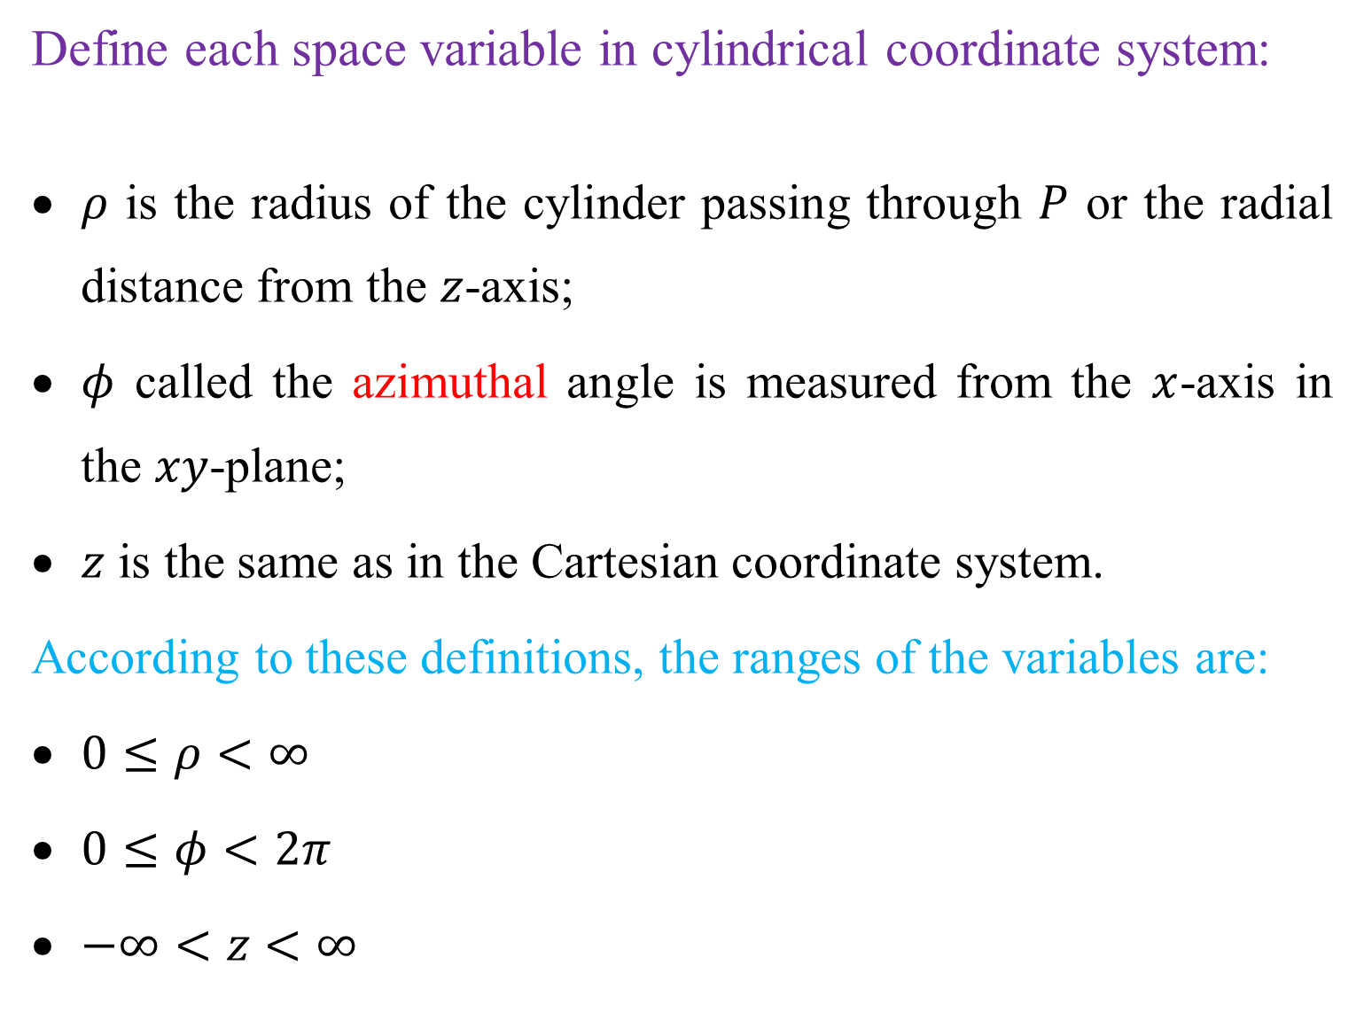
Define each space variable in cylindrical coordinate system:
$ρ$ is the radius of the cylinder passing through $P$ or the radial distance from the $z$-axis;
$φ$ called the azimuthal angle is measured from the $x$-axis in the $xy$-plane;
$z$ is the same as in the Cartesian coordinate system.
According to these definitions, the ranges of the variables are:
$0≤ρ<∞$
$0≤φ<2π$
$−∞<z<∞$

Slide 4
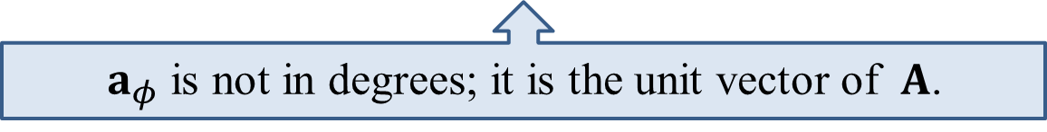
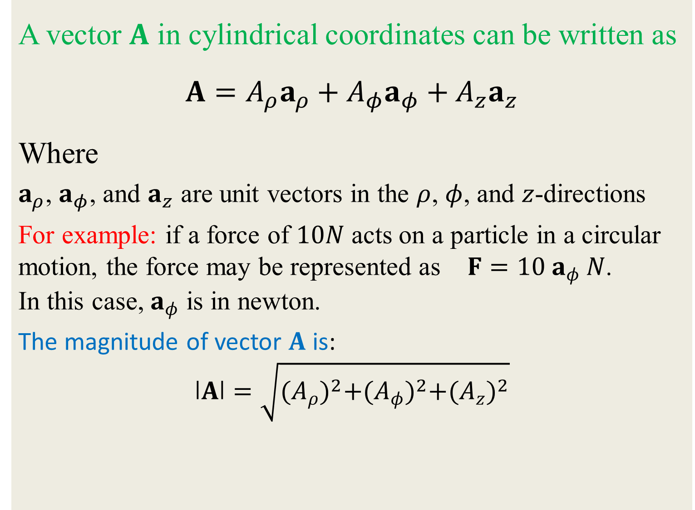
A vector $A$ in cylindrical coordinates can be written as
$$A=A_{ρ}a_{ρ}+A_{φ}a_{φ}+A_{z}a_{z}$$
Where
$a_{ρ}$, $a_{φ}$, and $a_{z}$ are unit vectors in the $ρ$, $φ$, and $z$-directions
For example: if a force of $10N$ acts on a particle in a circular motion, the force may be represented as $F=10 a_{φ} N$. In this case, $a_{φ}$ is in newton.
The magnitude of vector $A$ is:
$$ǀAǀ=\sqrt{{(A_{ρ})}^{2}+{(A_{φ})}^{2}+{(A_{z})}^{2}}$$
$a_{φ}$ is not in degrees; it is the unit vector of $A$.

Slide 5


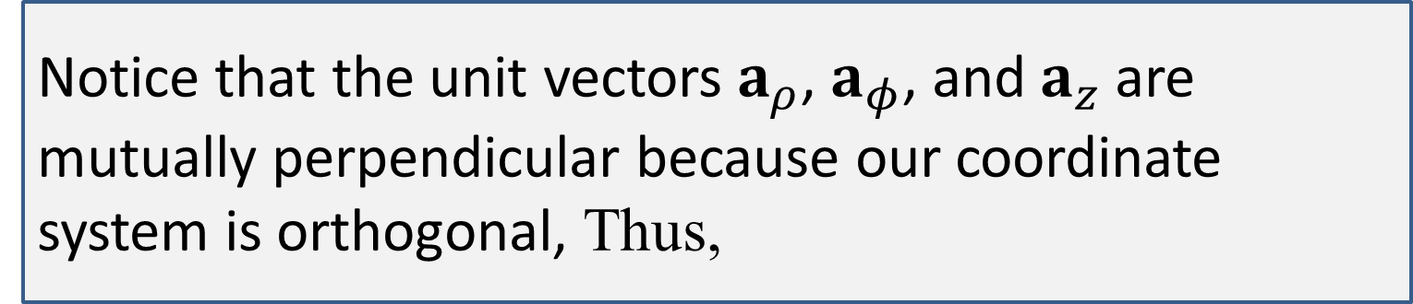

Notice that the unit vectors $a_{ρ}$, $a_{φ}$, and $a_{z}$ are mutually perpendicular because our coordinate system is orthogonal, Thus,
$$a_{ρ}.a_{φ}=0$$
$$a_{φ}.a_{z}=0$$
$$a_{z}.a_{ρ}=0$$
$$a_{ρ}.a_{ρ}=1$$
$$a_{φ}.a_{φ}=1$$
$$a_{z}.a_{z}=1$$
$$a_{ρ}×a_{φ}=a_{z}$$
$$a_{φ}×a_{z}=a_{ρ}$$
$$a_{z}×a_{ρ}=a_{φ}$$

Slide 6
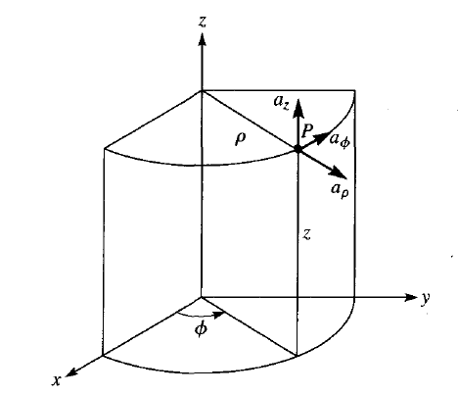
Fig. 1.10 point $P$ and unit vectors in the cylindrical coordinate system

Slide 7
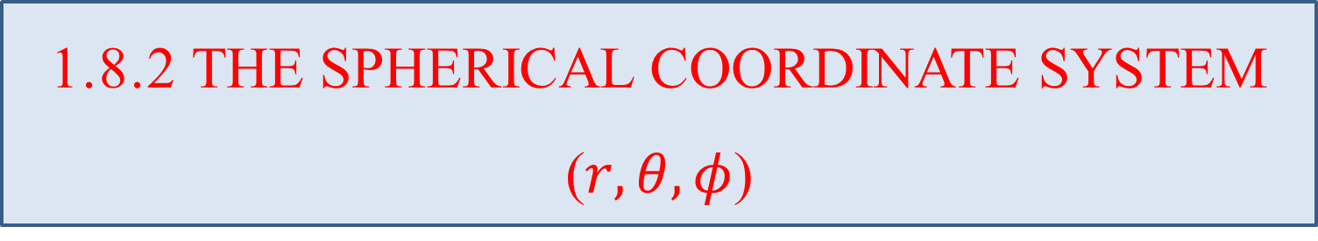
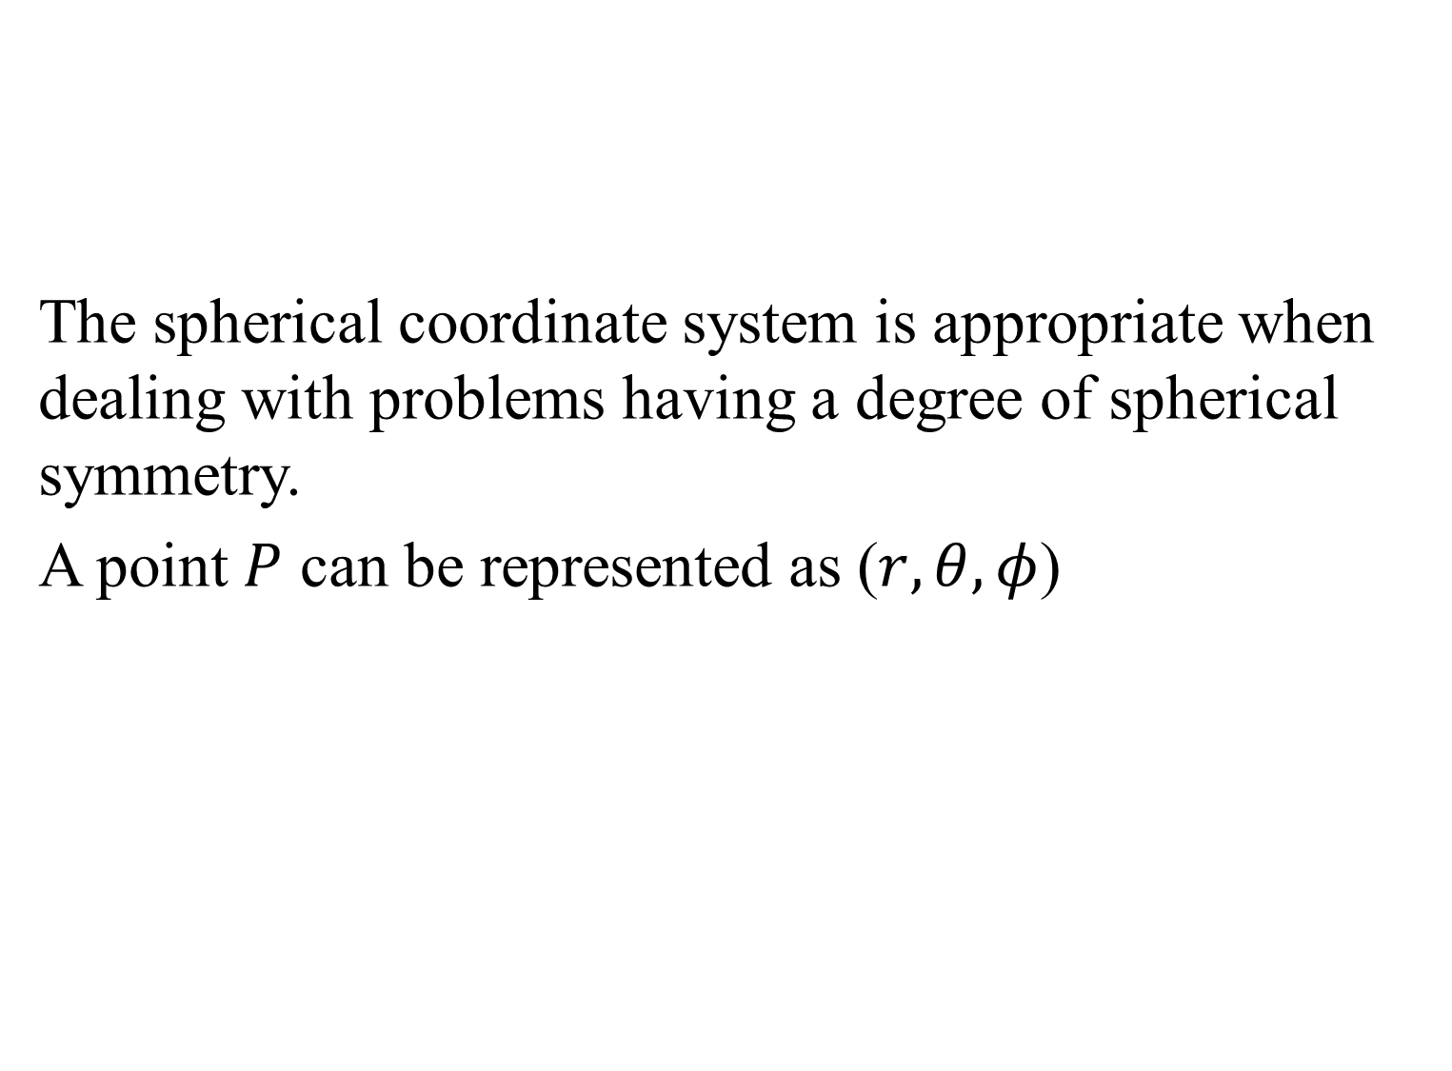
The spherical coordinate system is appropriate when dealing with problems having a degree of spherical symmetry.
A point $P$ can be represented as ($r,θ,φ$)
1.8.2 THE SPHERICAL COORDINATE SYSTEM ($r,θ,φ$)

Slide 8
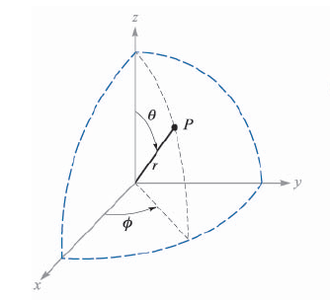
Fig. 1.11 the three spherical coordinates.

Slide 9

From Figure (1.11), we notice that:
$r$ is defined as the distance from the origin to point $P$ or the radius of a sphere centered at the origin and passing through $P$;
$θ$ called the colatitude is the angle between the $z$-axis and the position vector of $P$; and
$φ$ is measured from the $x$-axis (the same as in cylindrical coordinate system).
According to these definitions, the ranges of the variables are
$0≤r<∞$
$0≤θ≤π$
$0≤φ<2π$

Slide 10
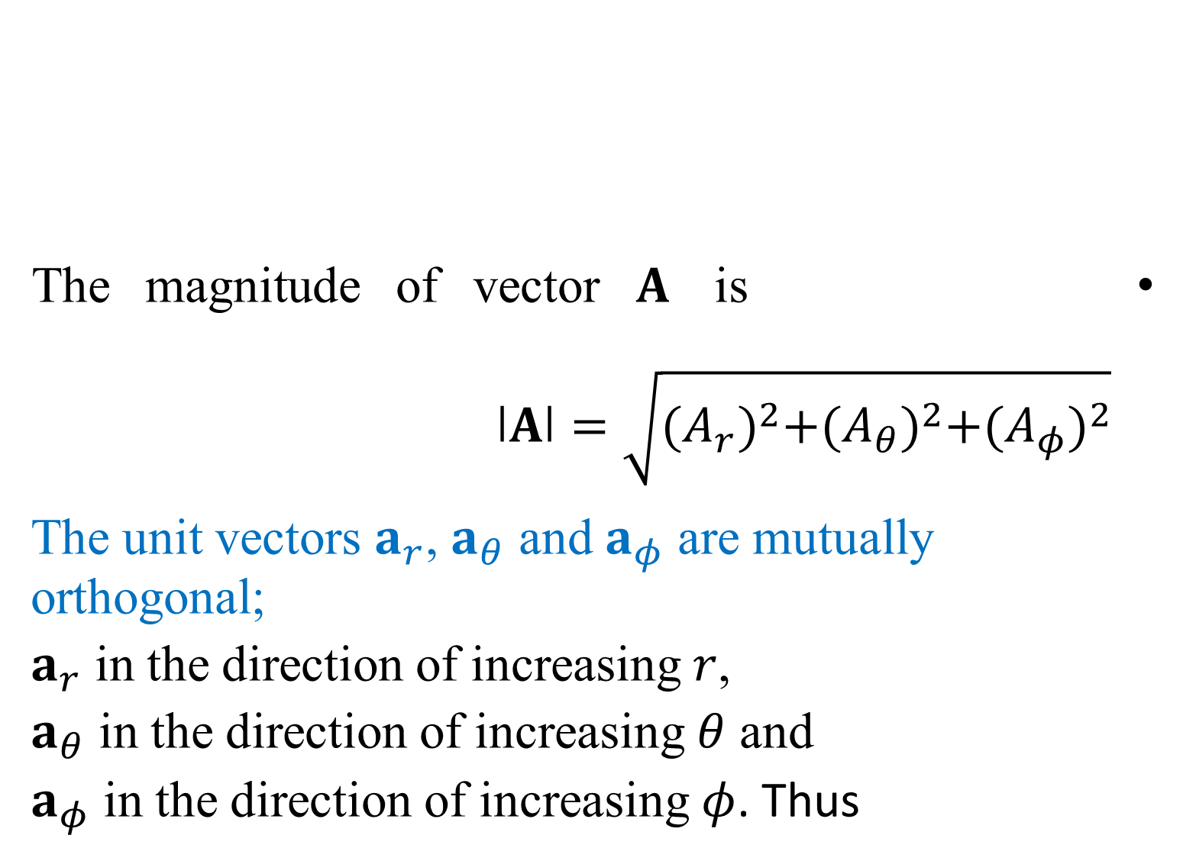
The magnitude of vector $A$ is $ǀAǀ=\sqrt{{(A_{r})}^{2}+{(A_{θ})}^{2}+{(A_{φ})}^{2}}$
The unit vectors $a_{r}$, $a_{θ}$ and $a_{φ}$ are mutually orthogonal;
$a_{r}$ in the direction of increasing $r$,
$a_{θ}$ in the direction of increasing $θ$ and
$a_{φ}$ in the direction of increasing $φ$. Thus
A vector $A$ in spherical coordinates may be written as
$$A=A_{r}a_{r}+A_{θ}a_{θ}+A_{φ}a_{φ}$$

Slide 11

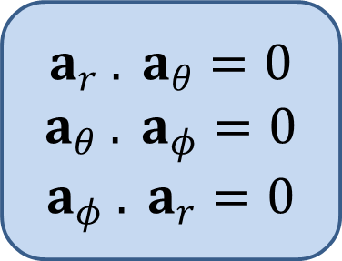
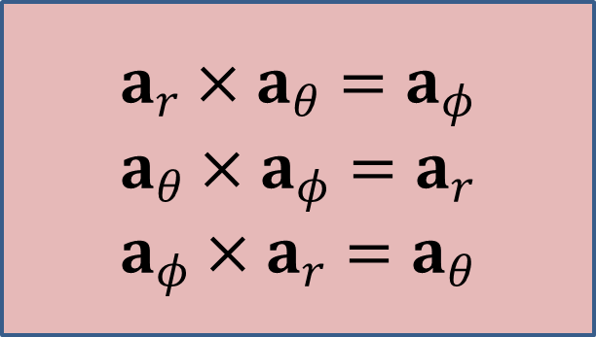

$$a_{r} . a_{θ}=0$$
$$a_{θ} . a_{φ}=0$$
$$a_{φ} . a_{r}=0$$
$$a_{r} . a_{r}=1$$
$$a_{θ} . a_{θ}=1$$
$$a_{φ} . a_{φ}=1$$
$$a_{r}×a_{θ}=a_{φ}$$
$$a_{θ}×a_{φ}=a_{r}$$
$$a_{φ}×a_{r}=a_{θ}$$

Slide 12
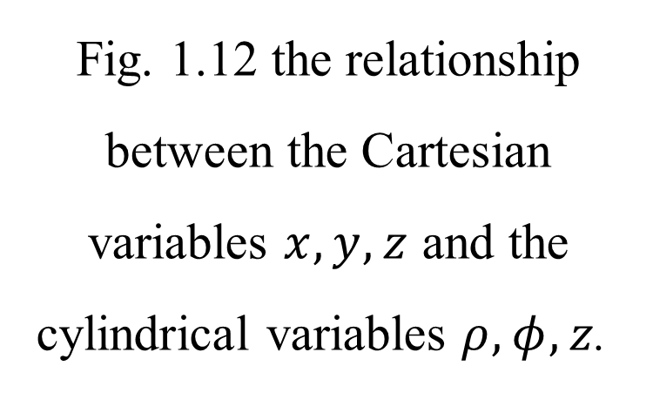
1.9 THE TRANSFORMATION BETWEEN COORDINATES
1.9.1 between Cartesian and cylindrical coordinate systems
The variables of the rectangular and cylindrical coordinate systems are easily related to each other. Figure (1.12), show that
Fig. 1.12 the relationship between the Cartesian variables $x, y, z$ and the cylindrical variables $ρ, φ, z$.

Slide 13

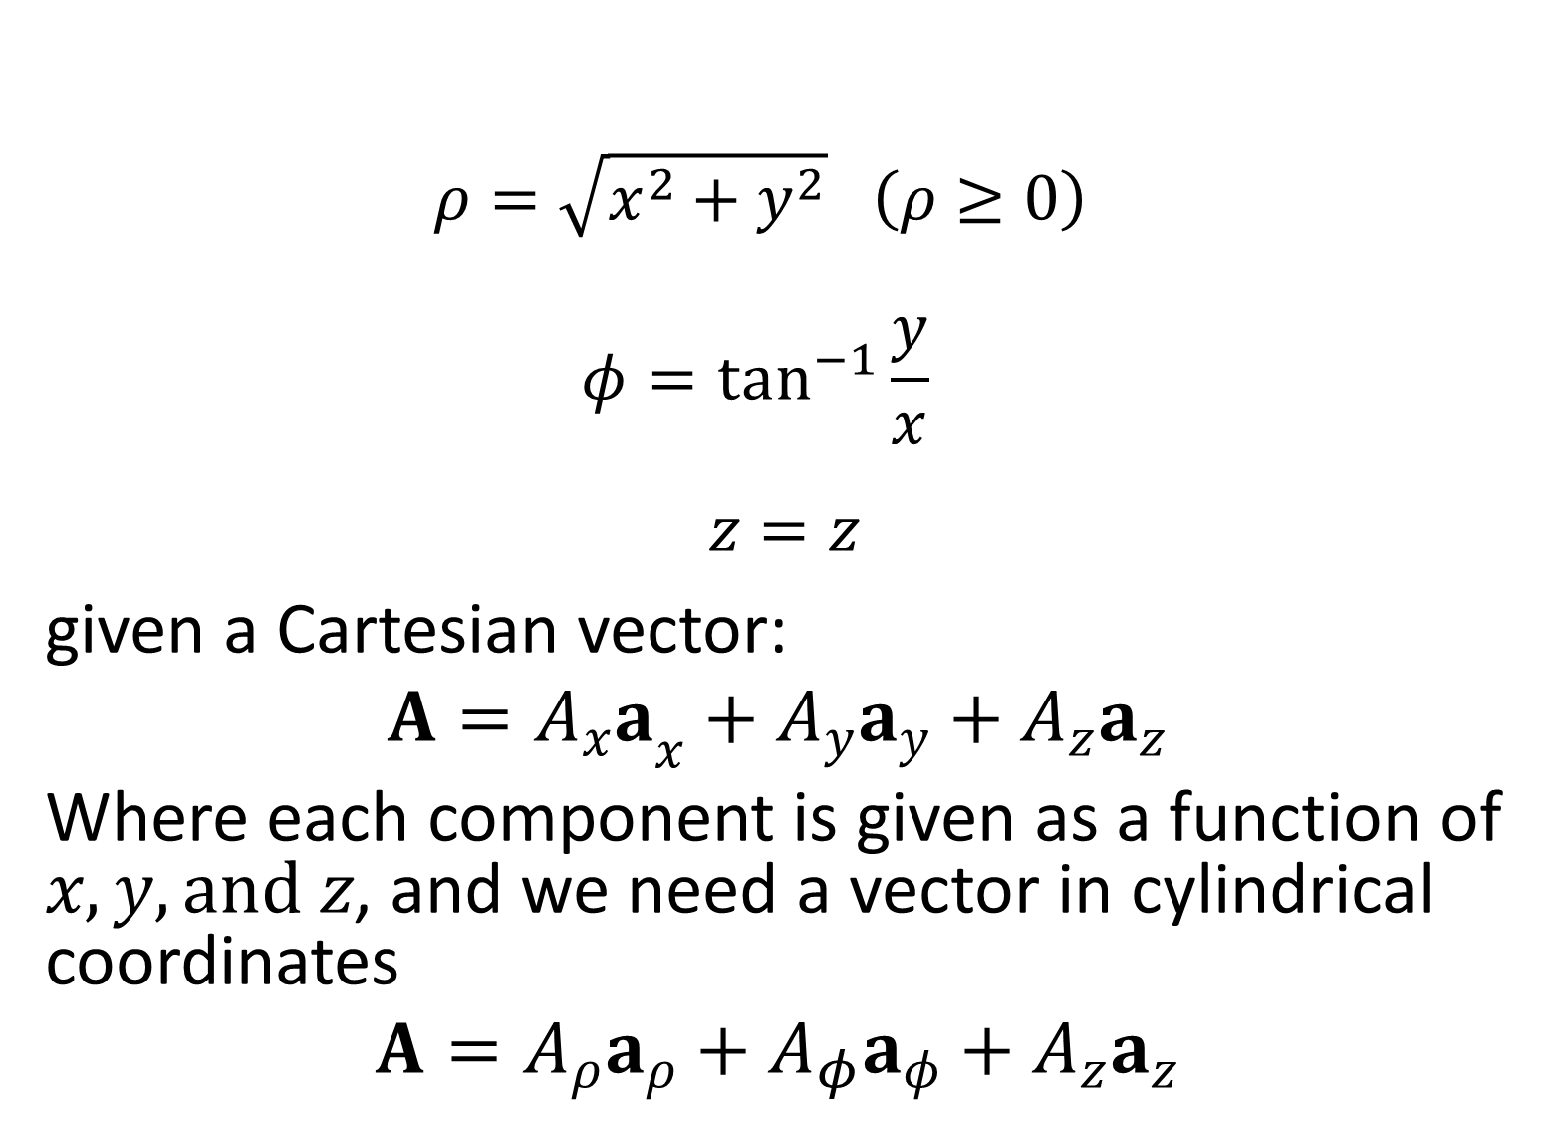
$$ρ=\sqrt{x^{2}+y^{2}} \left(ρ≥0\right)$$
$$φ=\tan^{−1}\frac{y}{x}$$
$$z=z$$
given a Cartesian vector:
$$A={A_{x}a}_{x}+A_{y}a_{y}+A_{z}a_{z}$$
Where each component is given as a function of $x, y, and z$, and we need a vector in cylindrical coordinates
$$A=A_{ρ}a_{ρ}+A_{φ}a_{φ}+A_{z}a_{z}$$
Express the cylindrical variables in terms of $x, y, and z$:

Slide 14
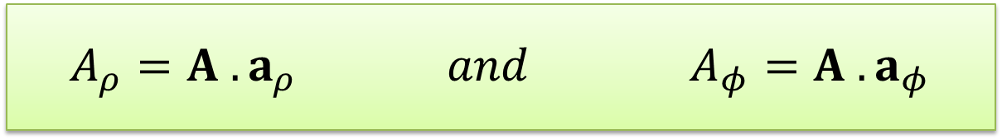
To find any desired component of a vector, from the discussion of the dot product that a component in a desired direction may be obtained by taking the dot product of the vector and a unit vector in that direction. Hence,
$$A_{ρ}=A .a_{ρ} and A_{φ}=A .a_{φ}$$

Slide 15
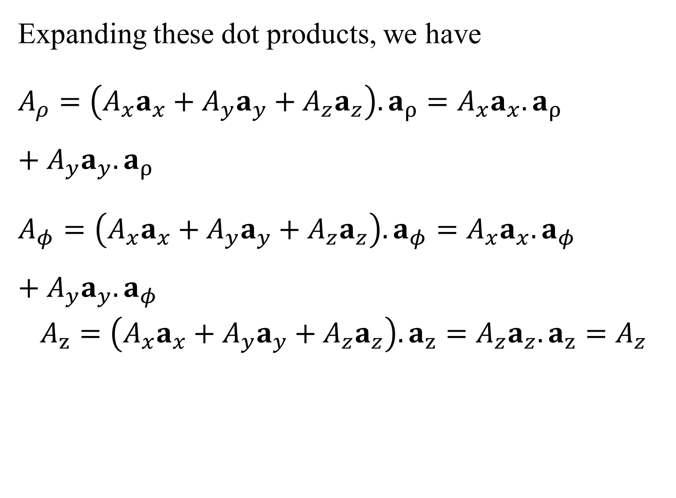
Expanding these dot products, we have
$A_{ρ}=\left({A_{x}a}_{x}+A_{y}a_{y}+A_{z}a_{z}\right).a_{ρ}={A_{x}a}_{x}.a_{ρ}+A_{y}a_{y}.a_{ρ}$
$A_{φ}=\left({A_{x}a}_{x}+A_{y}a_{y}+A_{z}a_{z}\right).a_{φ}={A_{x}a}_{x}.a_{φ}+A_{y}a_{y}.a_{φ}$
$$A_{z}=\left({A_{x}a}_{x}+A_{y}a_{y}+A_{z}a_{z}\right).a_{z}={A_{z}a}_{z}.a_{z}=A_{z}$$

Slide 16
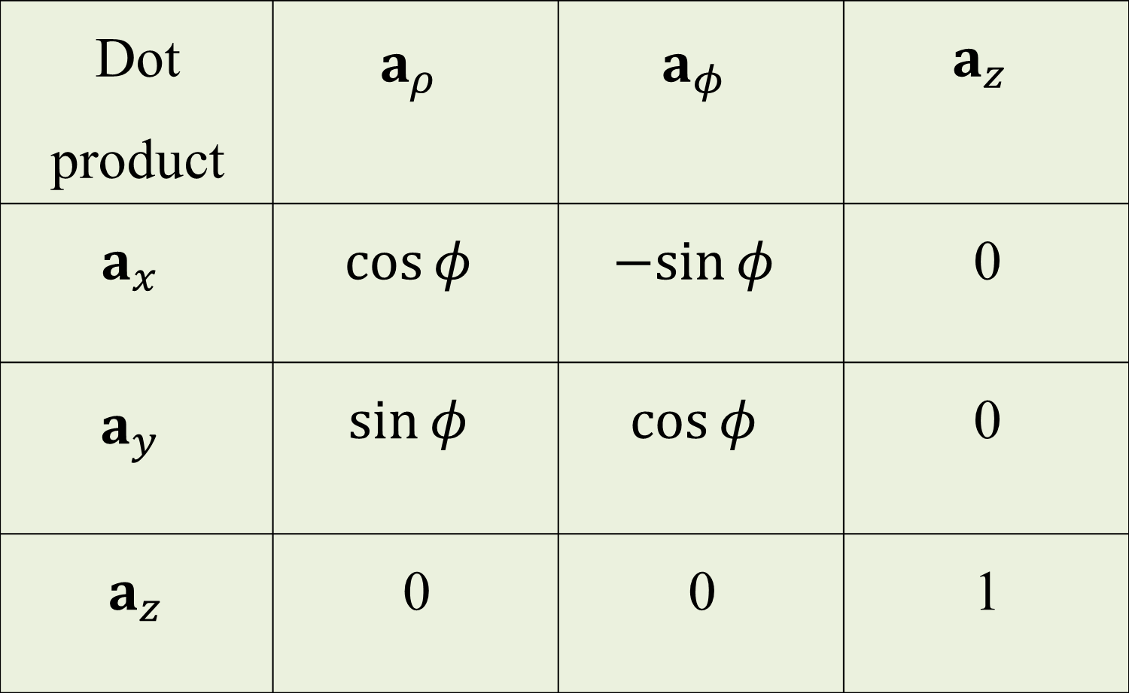
Applying the defini­tion of dot products of the unit vectors are given in Table (1.1)
Dot product | $$a_{ρ}$$ | $$a_{φ}$$ | $$a_{z}$$
$$a_{x}$$ | $$\cos{φ}$$ | $$−sin{φ}$$ | 0
$$a_{y}$$ | $$\sin{φ}$$ | $$\cos{φ}$$ | 0
$$a_{z}$$ | 0 | 0 | 1
Table (1.1)

Slide 17

1.9.2 between Cartesian and spherical coordinate system
The transformation of scalars from the Cartesian to the spherical coordinate system is made by using Figure (1.11) to relate the two sets of variables:
$$x=r sinθ cosφ$$
$$y=r sinθ sinφ$$
$$z=r cosθ$$
Table (1.2)

Slide 18


The transformation in the reverse direction is achieved by
$$r=\sqrt{x^{2}+y^{2}+z^{2}} \left(r≥0\right)$$
$$θ=\cos^{−1}\left(\frac{z}{\sqrt{x^{2}+y^{2}+z^{2}}}\right) \left(0^{o}≤θ≤180\right)$$
$$φ=\tan^{−1}\frac{y}{x}$$
Since the dot product of any spherical unit vector with any Cartesian unit vector is the component of the spherical vector in the direction of the Cartesian vector, the dot products with $a_{z}$ are found to be:
$$a_{z} .a_{r}=cosθ$$
$$a_{z} .a_{θ}=−sinθ$$
$$a_{z} .a_{φ}=0$$

Slide 19

1.10 Differential, volume, surface, and line elements
1.10.1 In the Cartesian coordinate system
If we visualize three planes intersecting at the general point $P$, whose coor­dinates are $x$, $y$ and $z$, we may increase each coordinate value by a differential amount and obtain three slightly displaced planes intersecting at point $P′$ whose coordinates are $x+dx$, $y+dy$, and $z+dz$

Slide 20

The six planes define a rectangular parallelepiped whose
(1) Differential displacement is given by
$$dL={dx a}_{x}+dy a_{y}+dz a_{z}$$
(2) Differential normal area (the surfaces areas $dS$) is given by
$$dS=dy dz a_{x}$$
$$dS=dx dz a_{y}$$
$$dS=dx dy a_{z}$$
(3) Differential volume is given by
$$dv=dx dy dz$$

Slide 21
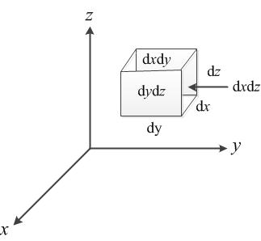
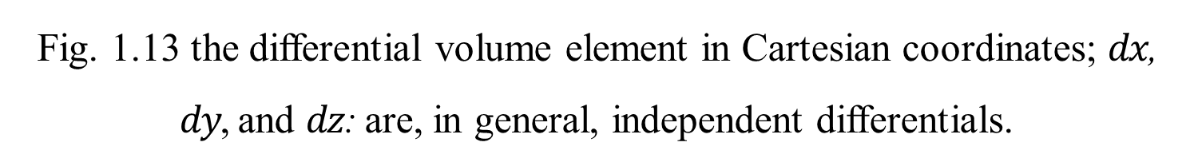
Fig. 1.13 the differential volume element in Cartesian coordinates; $dx$, $dy$, and $dz$: are, in general, independent differentials.

Slide 22
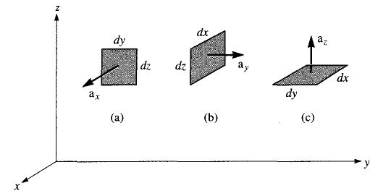
Fig. 1.14 Differential normal areas in Cartesian coordinates

Slide 23

1.10.2 In the cylindrical coordinates system
A differential volume element in cylindrical coordinates may be obtained by increasing $ρ$, $φ$, and $z$ by the differential increments $dρ$, $dφ$ and $dz$. The two cylinders of radius $ρ$ and $ρ+dρ$, the two radial planes at angles $φ$ and $φ+dφ$ and the two “horizontal” planes at “elevations” $z$ and $z+dz$
Note that $dρ$ and $dz$ are dimensionally lengths, but $dφ$ is not; $ρdφ$ is the length.

Slide 24
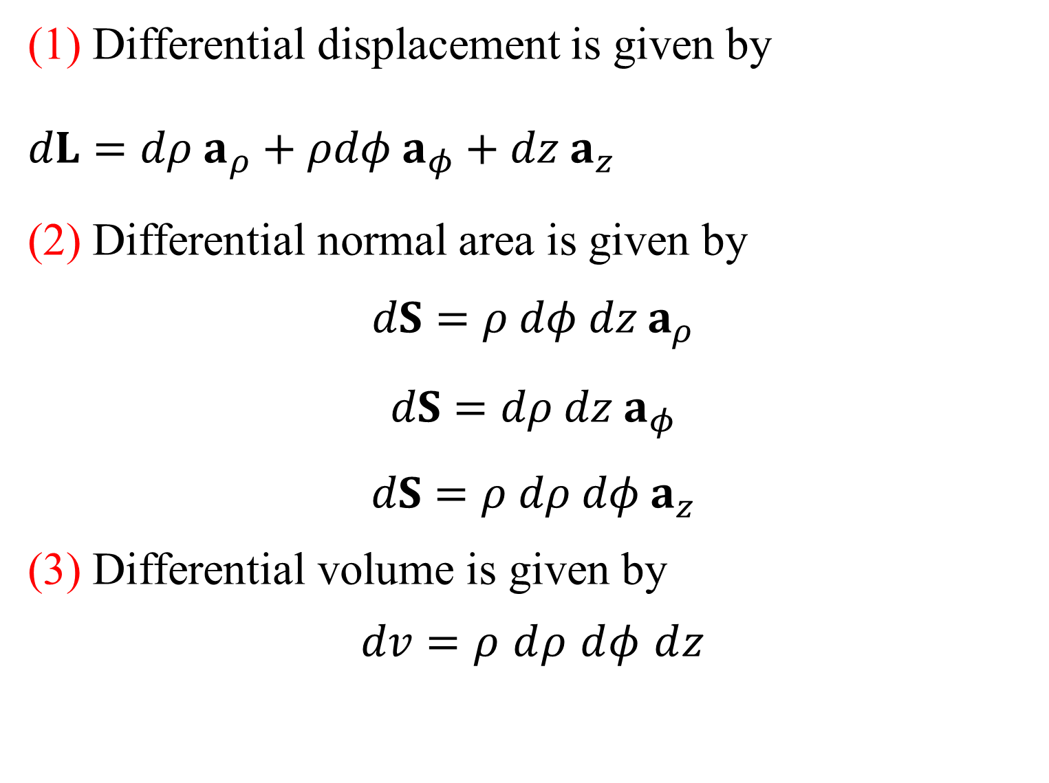
(1) Differential displacement is given by
$dL={dρ a}_{ρ}+ρdφ a_{φ}+dz a_{z}$
(2) Differential normal area is given by
$$dS=ρ dφ dz a_{ρ}$$
$$dS=dρ dz a_{φ}$$
$$dS=ρ dρ dφ a_{z}$$
(3) Differential volume is given by
$$dv=ρ dρ dφ dz$$

Slide 25
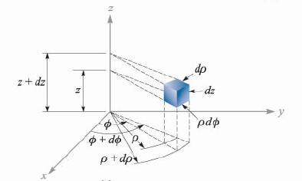
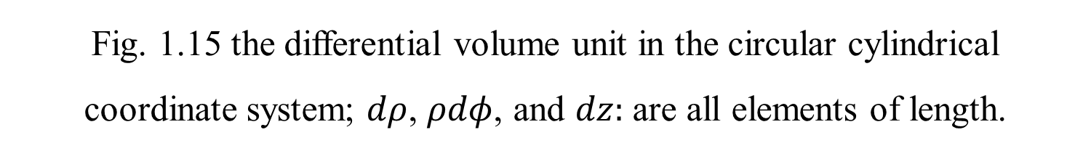
Fig. 1.15 the differential volume unit in the circular cylindrical coordinate system; $dρ$, $ρdφ$, and $dz:$ are all elements of length.

Slide 26
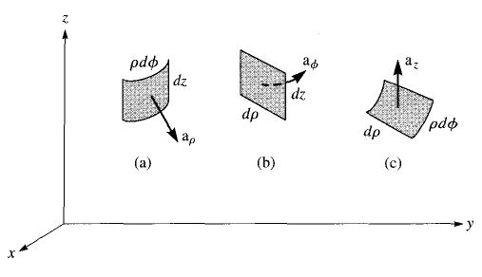
Fig. 1.16 Differential normal areas in cylindrical coordinates

Slide 27

1.10.3 In the spherical coordinate system
A differential volume element may be constructed in spherical coordinates by increasing $r$, $θ$, and $φ$ by $dr$, $dθ$, and $dφ$, as shown in Fig. 1.17. The distance between the two spherical surfaces of radius $r$ and $r+dr$ is $dr$; the distance between the two cones having generating angles of $θ$ and $θ+dθ$ is $rdθ$; and the distance between the two radial planes at angles $φ$ and $φ+dφ$ is found to be $r\sin{θ} dφ$.

Slide 28
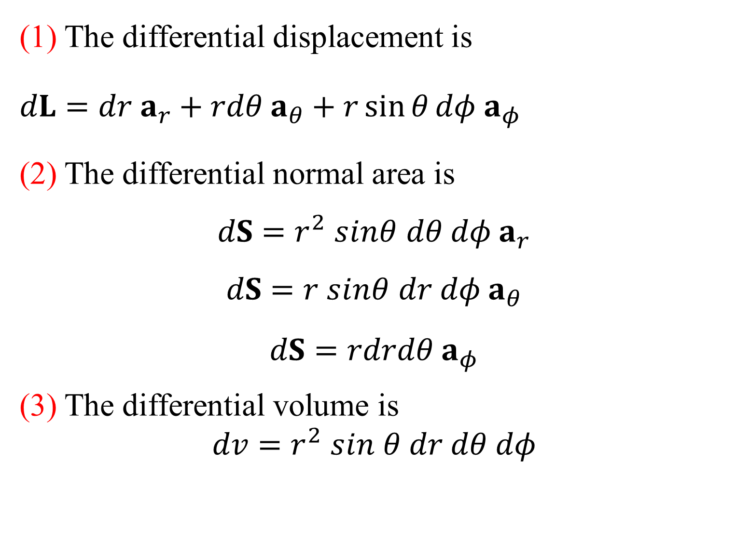
(1) The differential displacement is
$dL={dr a}_{r}+rdθ a_{θ}+r\sin{θ}dφ a_{φ}$
(2) The differential normal area is
$$dS=r^{2} sinθ dθ dφ a_{r}$$
$$dS=r sinθ dr dφ a_{θ}$$
$$dS=rdrdθ a_{φ}$$
(3) The differential volume is
$$dv=r^{2} sin θ dr dθ dφ$$

Slide 29
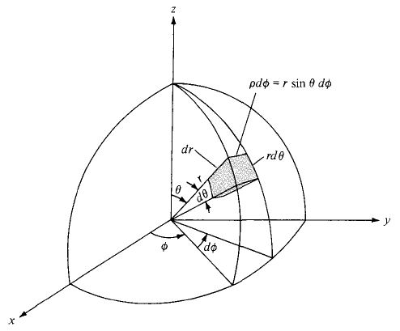
Fig. 1.17 the differential volume element in the spherical coordinate system.

Slide 30
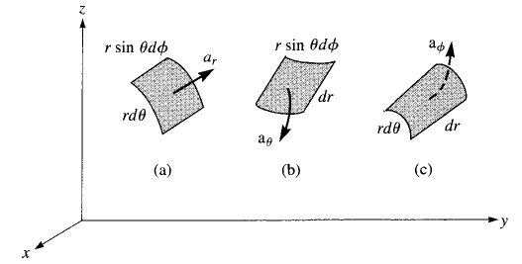
Fig. 1.18 Differential normal areas in spheriacl coordinates

Slide 31
Thank You

