Slide 1
ELECTRIC FLUX AND GAUSS’S LAW
3.1 INTRODUCTION
The Coulomb's law, electric field intensity, charge distributions and corresponding electric field intensities are discussed in the previous chapter.
If a unit test charge is placed near a point charge, it experiences a force. The direction of this force can be represented by the lines joined between them, radially coming outward from a point charge.
These lines are called streamlines or flux lines. Thus the electric field due to a charge can be imagined to be present around of it a quantity called electric flux.
The flux lines give the pictorial representation of distribution of electric flux around a charge.
This chapter will explain the concept of electric flux, electric flux density, Gauss’s law, applications of Gauss's law and the divergence theorem.

Slide 2
3.2 NET CHARGE IN A REGION
to obtain the net charge contained in a specified volume by integration.
if $ρ_{v}$ is exist:
$$Q=\int_{v}{ρ_{v}dv} \left(in C\right)$$
$ρ_{v}$ will not be constant throughout the volume $v$.

Slide 3
Example 2.1: Find the charge in the volume $1≤r≤2 m$ in the spherical coordinate if $$ρ_{v}=\frac{{5{cos}}^{2}ɸ}{r^{4}} (c/{m^{3}})$$
Solution:
$$Q=\int_{v}{ρ_{v}dv} ,dv=r^{2}\sin{θ}drdθdɸ$$
$$Q=\int_{0}^{2π}{\int_{0}^{π}{\int_{1}^{2}{(\frac{{5{cos}}^{2}ɸ}{r^{4}})r^{2}\sin{θ}}}}drdθdɸ=5π C$$

Slide 4
3.2 ELECTRIC FLUX AND FLUX DENSITY
The electric flux is defined as the total number of lines of force in any particular electric field. It is represented by the symbol ($ψ$). The unit of electric flux is similar to the unit of charge, is also Coulomb.
The electric flux density is the net flux passing through the unit surface area normally. denoted by $D$. It has a direction which is normal to the surface area under consideration.

Slide 5
The electric flux ($ψ$) due to the electric field $\left(E\right)$ originates (emanates) from positive charge and terminates on negative charge.
In the absence of negative charge, the flux line ($ψ$) terminates at infinity. While in the absence of positive charge, the electric flux terminates on the negative charge from infinity.
These flux lines are parallel and never cross each other.
The lines always enter or leave the charged surface normally.
By definition, one coulomb of electric charge gives rise to one coulomb of electric flux. Hence, $ψ=Q in (C)$

Slide 6
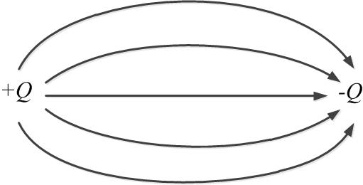
Fig. 3.1 the flux lines leave $+Q$ and terminate on $–Q$.

Slide 7
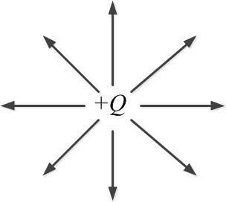
Fig. 3.2 The positive charge with no negative charge in the region

Slide 8
The electric flux $ψ$ is a scalar quantity the electric flux density $D$, is a vector field and its direction from the lines of flux
If an amount of flux $dψ$ crosses the differential area, $dS$, which is normal to a, then the electric flux density $D$ at $P$ is:
$$D=\frac{dψ}{dS}a in C/{m^{2}}$$

Slide 9
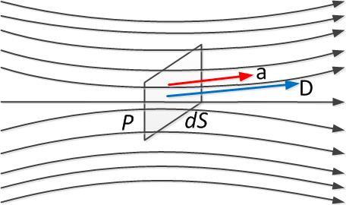
Fig. 3.3

Slide 10
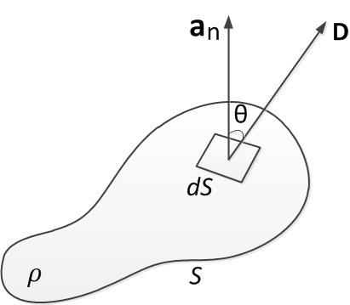
If at the surface element $dS$, $D$ makes an angle $θ$ with the normal, then the differential flux crossing $dS$ is given by
$dψ=D dS \cos{θ}$
$dψ=D. dS a_{n}$
$dψ=D. dS$
$dψ$ is the amount of flux passing from the interior of $S$ to the exterior of $S$ through $dS$.

Slide 11
3.3 GAUSS'S LAW- MAXWELL'S EQUATION
Gauss's law one of the fundamental laws of electromagnetism.
Gauss's law states that the total electric flux $ψ$ through any closed surface is equal to the total charge enclosed by that surface. Thus $ψ=Q_{enc}$
$$dψ=D. dS$$
$$ψ=\oint{dψ}=\oint{D . dS}$$
$$ψ =Total charge enclose=Q_{enc}=\int{ρ_{v} . dv}$$

Slide 12
$$∴ Q=\oint{D . dS}=\int{ρ_{v} . dv}$$
It will be seen that a great deal of valuable information can be obtained the application of Gauss's law without actually carrying out the integration.

Slide 13
3.4. RELATION BETWEEN FLUX DENSITY AND ELECTRIC FIELD INTENSITY
Consider a point charge $Q$ (assumed positive) at the origin Fig. 3.5. If this is enclosed by a spherical surface of radius $r$, then, by symmetry, $D$ due to $Q$ is of constant magnitude over the surface and is everywhere normal to the surface.

Slide 14
Figure 3.5

Slide 15
Gauss's law then gives
$$Q=\oint_{s}{D . dS}=D \oint_{s}{dS}=D \left(4πr^{2}\right)$$
$$∴ D=\frac{Q}{4πr^{2}}$$
$$∴ D=\frac{Q}{4πr^{2}}a_{n}=\frac{Q}{4πr^{2}}a_{r}$$

Slide 16
But, the electric field intensity due to $Q$ is
$$E=\frac{Q}{4{πε}_{o}r^{2}}a_{r}$$
$$∴ D=ε_{o}E$$
More generally, for any electric field in an isotropic medium of permittivity $ϵ$. $D=ε E$
∴ $D$ and $E$ fields will have exactly the same form, they differ only by a factor which is a constant of the medium. While the electric field $E$ due to a charge configuration is a function of permittivity $ε$, the electric flux density $D$ is not.

Slide 17
3.5 SPECIAL GAUSSIAN SURFACES
A special Gaussian surface in that satisfied the following defining conditions:
The surface is closed
At each point of the surface $D$ is either normal or tangential to the surface
$D$ has the same value at all points of the surface where $D$ is normal

Slide 18
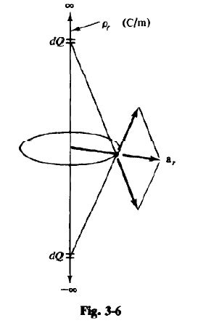
Ex. 3.2: Use special Gaussian surface to find $D$ due to a uniform line change $ρ_{l}$, ($C/m$).
Take the line charge as the z-axis of cylindrical coord. Fig. 3.6. By cylindrical symmetry, $D$ can only have an $r$ component, and this component can only depend on $r$.

Slide 19
Thus, the special Gaussian surface for this problem is a closed right circular cylinder whose axis is the z-axis Fig. 3.7. Applying Gauss's law.
Over surfaces 1 and 3. D and $dS$ are orthogonal and so the integrals vanish. Over 2. D and $dS$ are parallel or antiparallel if $ρ_{l}$ is negative and D is constant because $r$ is constant Thus,

Slide 20
$$Q=\oint_{1}{D . dS}+\oint_{2}{D . dS}+\oint_{3}{D . dS}$$
$$Q=D\oint_{2}{dS}=D (2πrl)$$
Where, $l$ is the length of the cylinder. But the enclosed charge is $Q=ρ_{l}l$. Hence
$D=\frac{ρ_{l}}{2πr}$ and $D=\frac{ρ_{l}}{2πr}a_{r}$

Slide 21
3.6 APPLICATIONS OF GAUSS'S LAW
Construct a mathematical closed surface (known as a Gaussian surface). The surface is chosen such that D is normal or tangential to the Gaussian surface.
When D is normal to the surface, $D.dS=D dS$ because D is constant on the surface.
When D is tangential to the surface, $D.dS=0$.

Slide 22
A. Point Charge
Let a point charge $Q$ is at the origin. To determine $D$ at a point $P$, it is easy to choosing a spherical surface containing $P$ will satisfy symmetry conditions. A spherical surface centered at the origin is the Gaussian surface in this case and is shown in Fig. 3.8.
$D$ is everywhere normal to the Gaussian surface, that is, $D=D_{r}a_{r}$

Slide 23
Applying Gauss's law gives, $ψ=Q_{enc}$
$$Q=\oint_{s}{D . dS}=D_{r} \oint_{s}{dS}=D_{r} \left(4πr^{2}\right)$$
$$\oint_{s}{dS}=\int_{0}^{2π}{\int_{0}^{π}{r^{2}\sin{θ}}}dθdɸ=4πr^{2}$$
is the surface area of the Gaussian surface. Thus
$$D=\frac{Q}{4πr^{2}}a_{r}$$

Slide 24
B. Infinite Line Charge
Suppose the infinite line of uniform charge $ρ_{l} C/m$ along the z-axis. To determine $D$ at a point P, choose a cylindrical surface containing P to satisfy symmetry condition as shown in Fig. 3.9. $D$ is constant on and normal to the cylindrical Gaussian surface; that is, $D=D_{ρ}a_{ρ}$. If we apply Gauss's law to an arbitrary length $l$ of the line

Slide 25
Fig. 3.9. Gaussian surface about an infinite line charge.
$$ρ_{l} l=Q=\oint_{s}{D . dS}$$
$$where, dS=ρdφdz$$
$$=D_{ρ} \oint_{s}{dS}=D_{ρ} (2πρl)$$
Where, $\oint_{s}{dS}=2πρl$ is the surface area of the Gaussian surface

Slide 26
Note: that $\int{D . dS}$ evaluated on the top and bottom surfaces of the cylinder is zero since $D$ has no z-component; that means that $D$ is tangential to those surfaces.
Thus
$$D=\frac{ρ_{l}}{2πρ}a_{ρ}$$

Slide 27
C. Infinite Sheet of Charge
Consider the infinite sheet of uniform charge $ρ_{s} C/m^{2}$ lying on the $z=0$, ($x$-$y plane)$. To determine $D$ at point P, choose a rectangular box that is cut symmetrically by the sheet of charge and has two of its faces parallel to the sheet as shown in Fig. 3.10. As D is normal to the sheet, $D=D_{z}a_{z}$

Slide 28
Fig. 3.10. Gaussian surface about an infinite line sheet of charge.

Slide 29
Applying Gauss's law gives
$$Q=\int{ρ_{s}}dS=\oint_{s}{D . dS}=D_{z} \oint_{s}{dS}$$
$$=D_{z}\left[\int_{top}{dS}+\int_{bottom}{dS}\right]$$
Note that $D . dS$ evaluated on the sides of the box is zero because $D$ has no components along $a_{x}$ and $a_{y}$.

Slide 30
If the top and bottom area of the box each has area $A$, equation above becomes $ρ_{s}A=D_{z}(A+A)$
Thus, $$D=\frac{ρ_{s}}{2}a_{z}$$ or $$E=\frac{D}{ε_{o}}=\frac{ρ_{s}}{2ε_{o}}a_{z}$$

Slide 31
D. Uniformly Charged Sphere
Consider a sphere of radius $a$ with a uniform charge $ρ_{v} С/m^{3}$. To determine $D$ everywhere, we construct Gaussian surfaces for $r≤a$ and $r≥a$ separately. Since the charge has spherical symmetry.
For $r≤a$, the total charge enclosed by the spherical surface of radius $r$, as shown in Figure 3.11(a), is

Slide 32
Fig. 3.11 Gaussian surface for a uniformly charged sphere : (a) $r≤a$ and (b) $r≥a$.

Slide 33
$$Q_{enc.}=\int{ρ_{v}}dv=ρ_{v}\int{dv}$$ $dv=r^{2}\sin{θ}$ $dr dθ dɸ$ $$Q_{enc.}=ρ_{v}\int_{ɸ=0}^{2π}{\int_{θ=0}^{π}{\int_{r=0}^{a}{r^{2}\sin{θ}}}dr dθ dɸ}$$
$$Q_{enc.}=ρ_{v}\frac{4}{3}πr^{3}$$
and
$$ψ=\oint{dψ}=\oint_{s}{D . dS}=D_{r}\oint_{s}{dS}$$

Slide 34
$$ψ=D_{r}\int_{ɸ=0}^{2π}{\int_{θ=0}^{π}{r^{2}\sin{θ}}}dθdɸ=D_{r}4πr^{2}$$
hence,
$ψ=Q_{enc.}$ gives, $D_{r}4πr^{2}=\frac{4πr^{3}}{3}ρ_{v}$
$$D_{r}=\frac{r}{3}ρ_{v}$$
or
$$D=\frac{r}{3}ρ_{v}a_{r} 0<r≤a$$

Slide 35
For $r≥a$, the Gaussian surface is shown in Figure 3.11(b). The charge enclosed by the surface is the entire charge in this case,
$$Q_{enc.}=\int{ρ_{v}}dv=ρ_{v}\int{dv}$$
$$Q_{enc.}=ρ_{v}\int_{ɸ=0}^{2π}{\int_{θ=0}^{π}{\int_{r=0}^{a}{r^{2}\sin{θ}}}dr dθ dɸ=ρ_{v}\frac{4}{3}πa^{3}}$$
$$ψ=\oint{dψ}=\oint_{s}{D . dS}=D_{r}4πr^{2}$$

Slide 36
$∵ ψ=Q_{enclosed}$ gives,
$$D_{r}4πr^{2}=\frac{4}{3}πa^{3}ρ_{v}$$
Or $D=\frac{a^{3}}{3r^{2}}ρ_{v}a_{r} r≥a$
Thus from equations above, $D$ everywhere is given by
$$D=\left\{\begin{aligned}\frac{r}{3}ρ_{v}a_{r} 0<r≤a \\ \\ \frac{a^{3}}{3r^{2}}ρ_{v}a_{r} r≥a\end{aligned}\right.$$

Slide 37
|D| is as sketched in Figure 3.12.
Sketch of |D| against $r$ for a uniformly charged sphere.

Slide 38
Thank you

