Slide 1
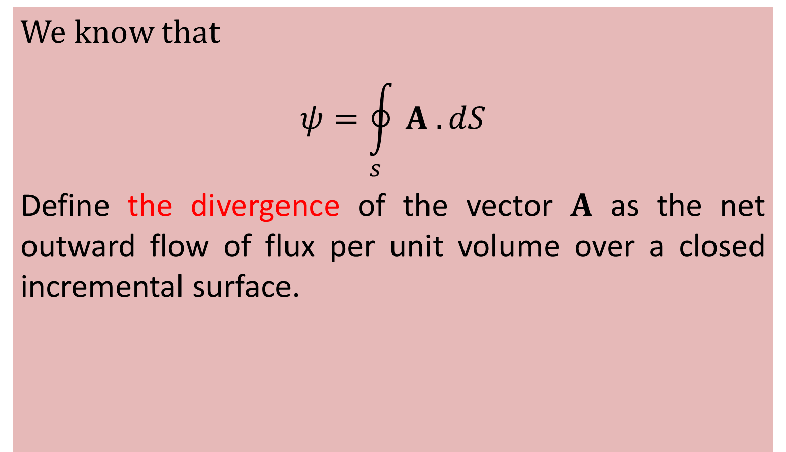
3.7 DIVERGENCE OF A VECTOR AND DIVERGENCE THEOREM
We know that
$$\text{ψ}=\oint_{s}{A . dS}$$
Define the divergence of the vector $A$ as the net outward flow of flux per unit volume over a closed incremental surface.

Slide 2
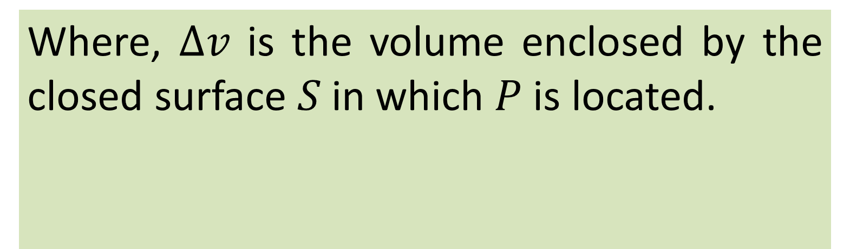
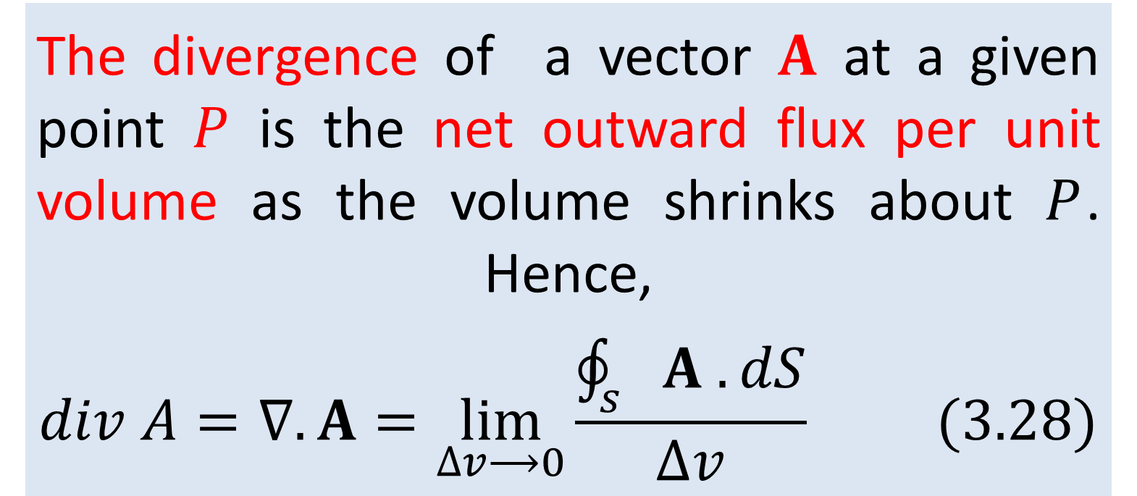
The divergence of a vector $A$ at a given point $P$ is the net outward flux per unit volume as the volume shrinks about $P$. Hence,
$$div A=∇. A=\lim_{∆v⟶0}\frac{\oint_{s}{A . dS}}{∆v} (3.28)$$
Where, $∆v$ is the volume enclosed by the closed surface $S$ in which $P$ is located.

Slide 3
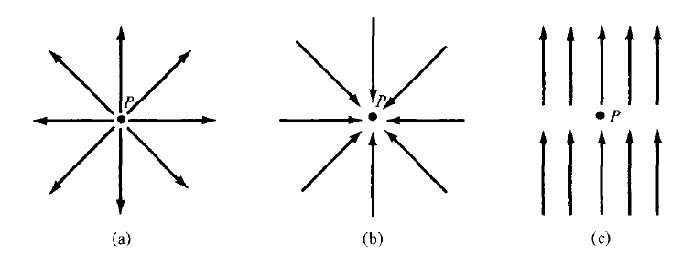
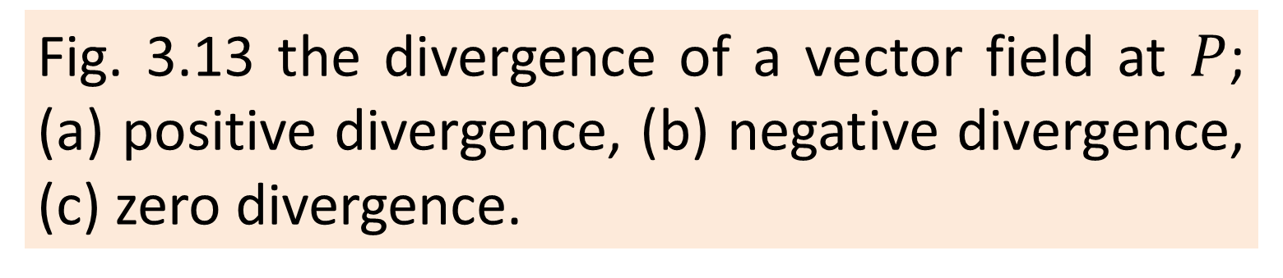
Fig. 3.13 the divergence of a vector field at $P$; (a) positive divergence, (b) negative divergence, (c) zero divergence.
the divergence is positive at a source point in the field, and negative at a sink point, or zero where there is neither sink nor source.

Slide 4
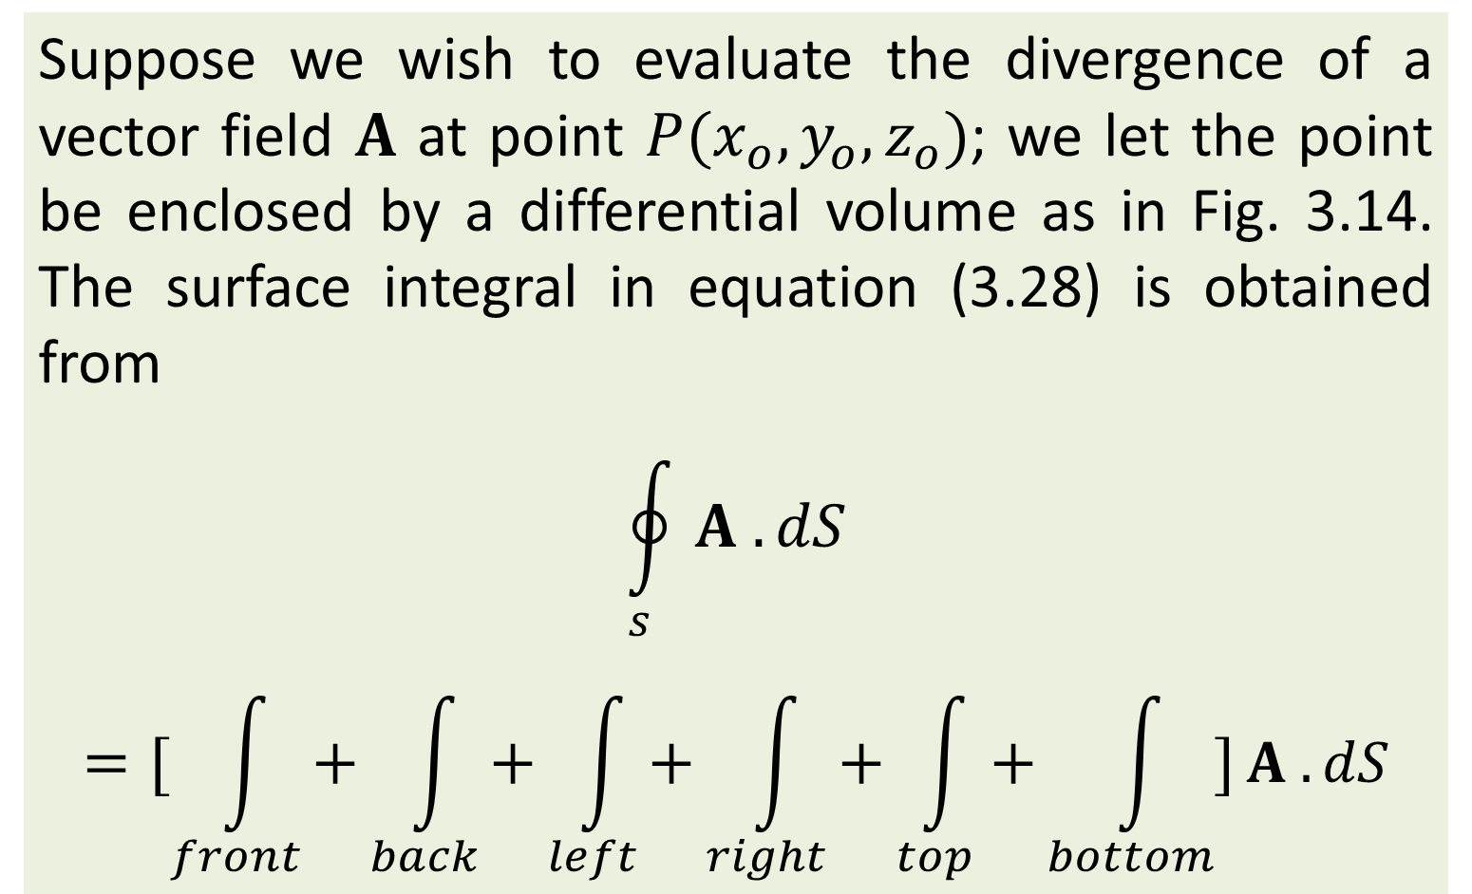
3.8 Divergence In Cartesian Coordinates
Suppose we wish to evaluate the divergence of a vector field $A$ at point $P(x_{o}, y_{o}, z_{o})$; we let the point be enclosed by a differential volume as in Fig. 3.14. The surface integral in equation (3.28) is obtained from
$$\oint_{s}{A . dS}$$
$$=[\int_{front}{+}\int_{back}{+}\int_{left}{+\int_{right}{+}}\int_{top}{+}\int_{bottom}{]}A . dS$$

Slide 5
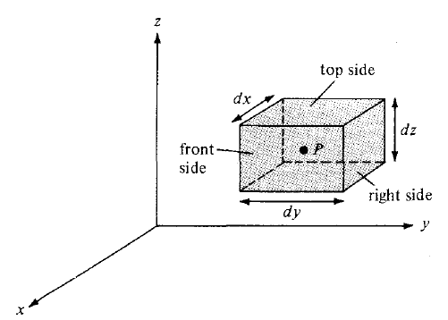
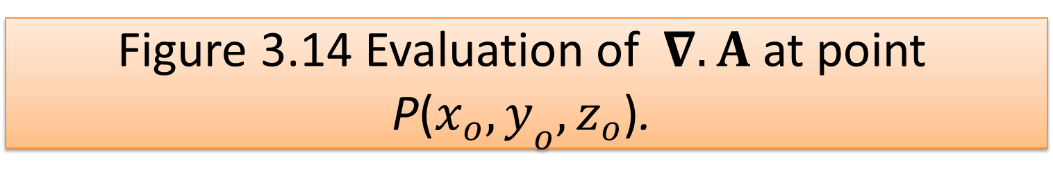
Figure 3.14 Evaluation of $∇.A$ at point P($x_{o}, y_{o}, z_{o}$).

Slide 6
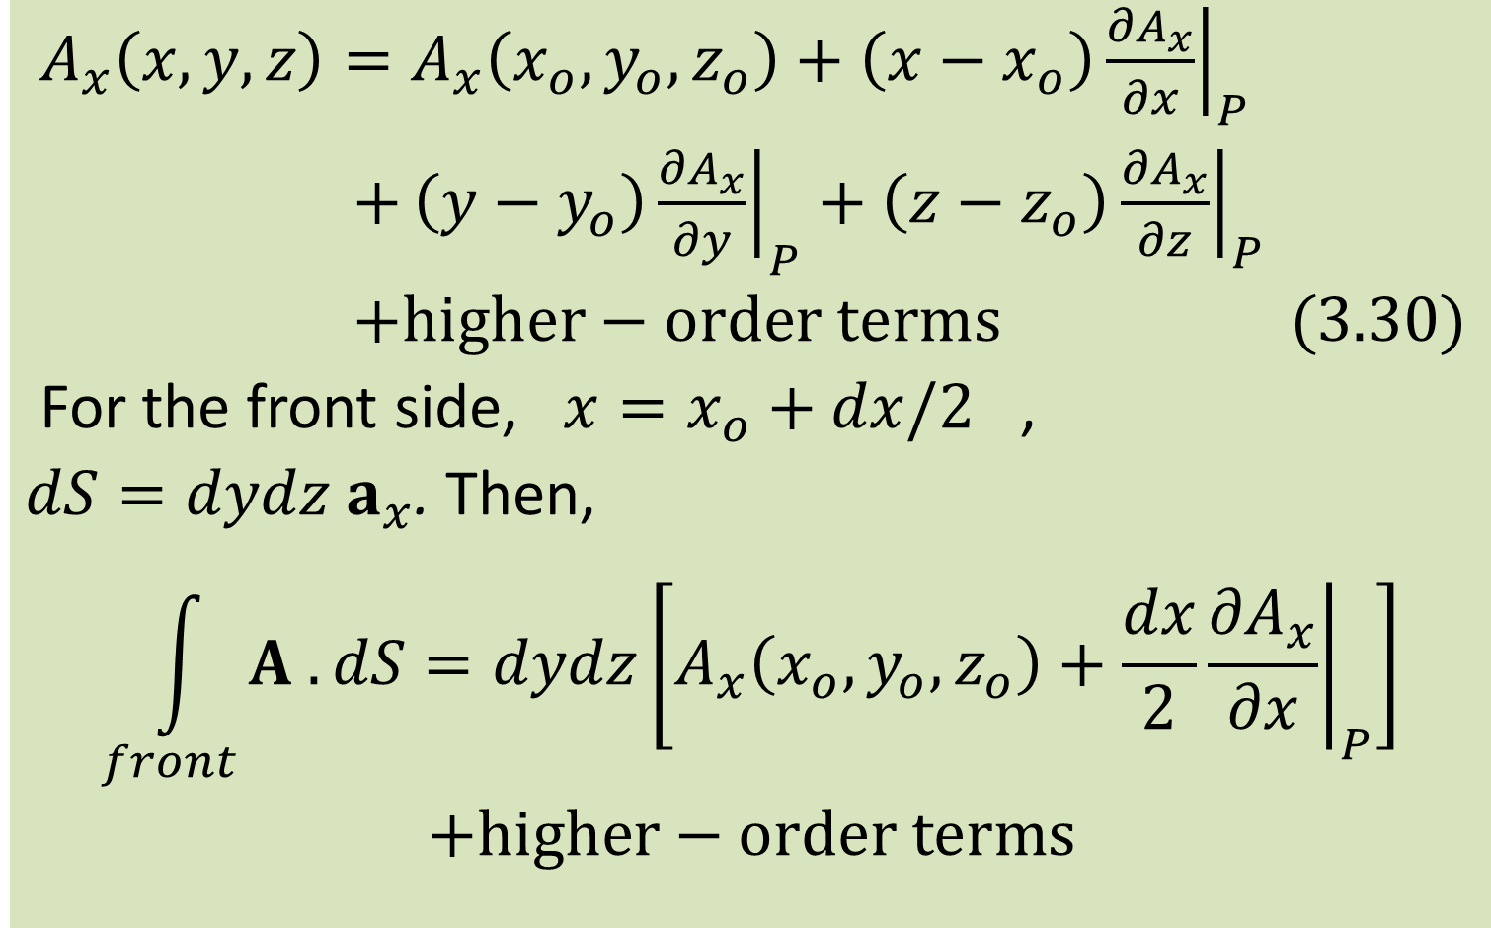
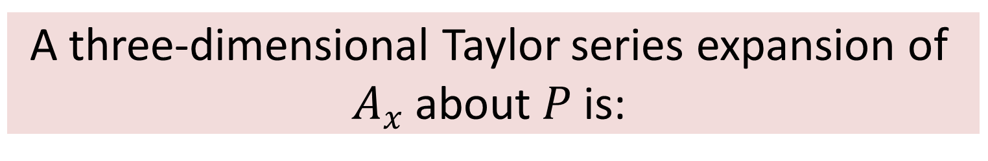
A three-dimensional Taylor series expansion of $A_{x}$ about $P$ is:
$A_{x}\left(x, y, z\right)=A_{x}\left(x_{o}, y_{o}, z_{o}\right)+{\left.\left(x−x_{o}\right)\frac{{∂A}_{x}}{∂x}\right|}_{P}$
$+{\left.\left(y−y_{o}\right)\frac{{∂A}_{x}}{∂y}\right|}_{P}+{\left.\left(z−z_{o}\right)\frac{{∂A}_{x}}{∂z}\right|}_{P}$
$+higher−order terms (3.30)$
For the front side, $x=x_{o}+dx/2$ ,
$dS=dydz a_{x}$. Then,
$$\int_{front}{A . dS}=dydz\left[A_{x}\left(x_{o}, y_{o}, z_{o}\right)+{\left.\frac{dx}{2}\frac{{∂A}_{x}}{∂x}\right|}_{P}\right]$$
$+higher−order terms$

Slide 7
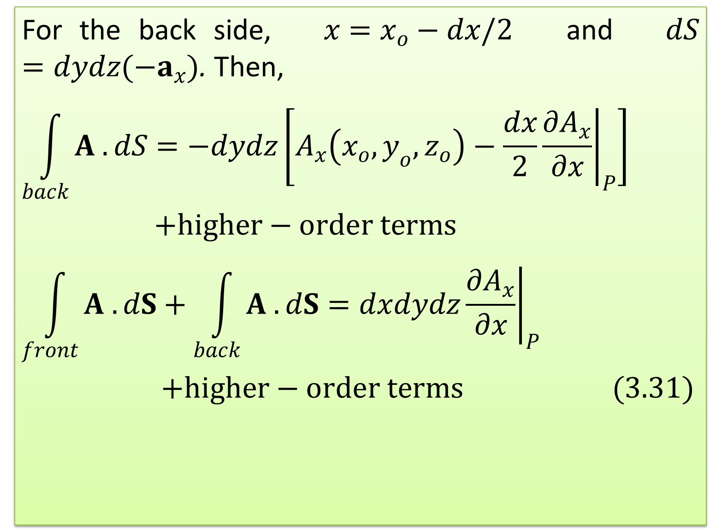
For the back side, $x=x_{o}−dx/2$ and $dS=dydz(−a_{x})$. Then,
$$\int_{back}{A . dS}=−dydz\left[A_{x}\left(x_{o}, y_{o}, z_{o}\right)−{\left.\frac{dx}{2}\frac{{∂A}_{x}}{∂x}\right|}_{P}\right]$$
$+higher−order terms$
$$\int_{front}{A . dS}+\int_{back}{A . dS}=dxdydz{\left.\frac{{∂A}_{x}}{∂x}\right|}_{P}$$
$+higher−order terms (3.31)$

Slide 8
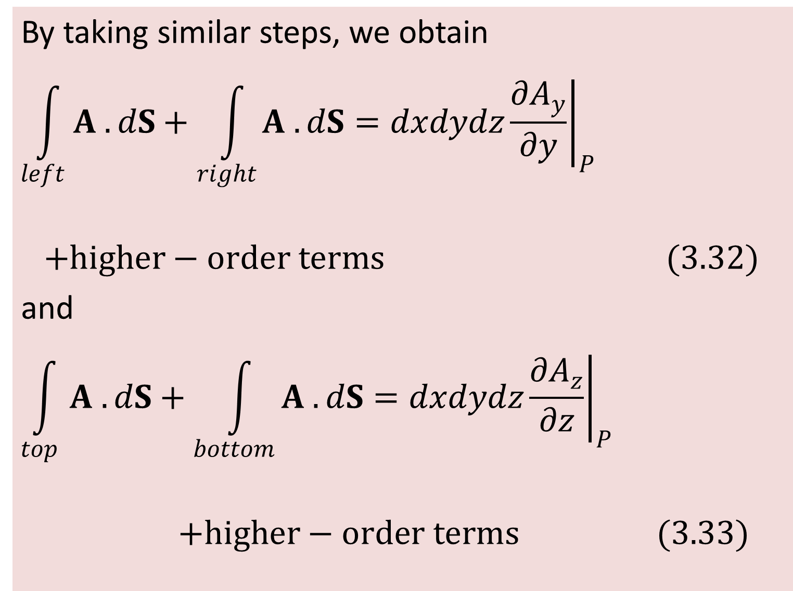
By taking similar steps, we obtain
$$\int_{left}{A . dS}+\int_{right}{A . dS}=dxdydz{\left.\frac{{∂A}_{y}}{∂y}\right|}_{P}$$
$+higher−order terms (3.32)$
and
$$\int_{top}{A . dS}+\int_{bottom}{A . dS}=dxdydz{\left.\frac{{∂A}_{z}}{∂z}\right|}_{P}$$
$+higher−order terms (3.33)$

Slide 9
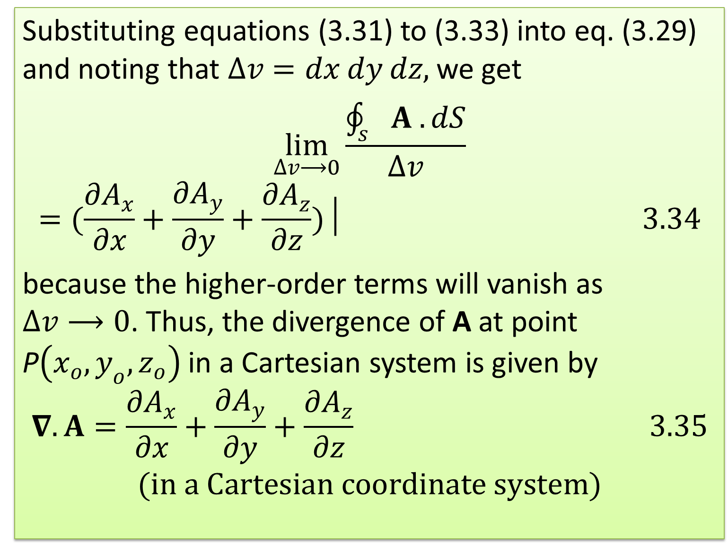
Substituting equations (3.31) to (3.33) into eq. (3.29) and noting that $∆v=dx dy dz,$ we get
$$\lim_{∆v⟶0}\frac{\oint_{s}{A . dS}}{∆v}$$
$$=(\frac{{∂A}_{x}}{∂x}+\frac{{∂A}_{y}}{∂y}+\frac{{∂A}_{z}}{∂z})│ 3.34$$
because the higher-order terms will vanish as $∆v⟶0$. Thus, the divergence of A at point P$\left(x_{o}, y_{o}, z_{o}\right)$ in a Cartesian system is given by
$$∇.A=\frac{{∂A}_{x}}{∂x}+\frac{{∂A}_{y}}{∂y}+\frac{{∂A}_{z}}{∂z} 3.35$$
$$(in a Cartesian coordinate system)$$

Slide 10
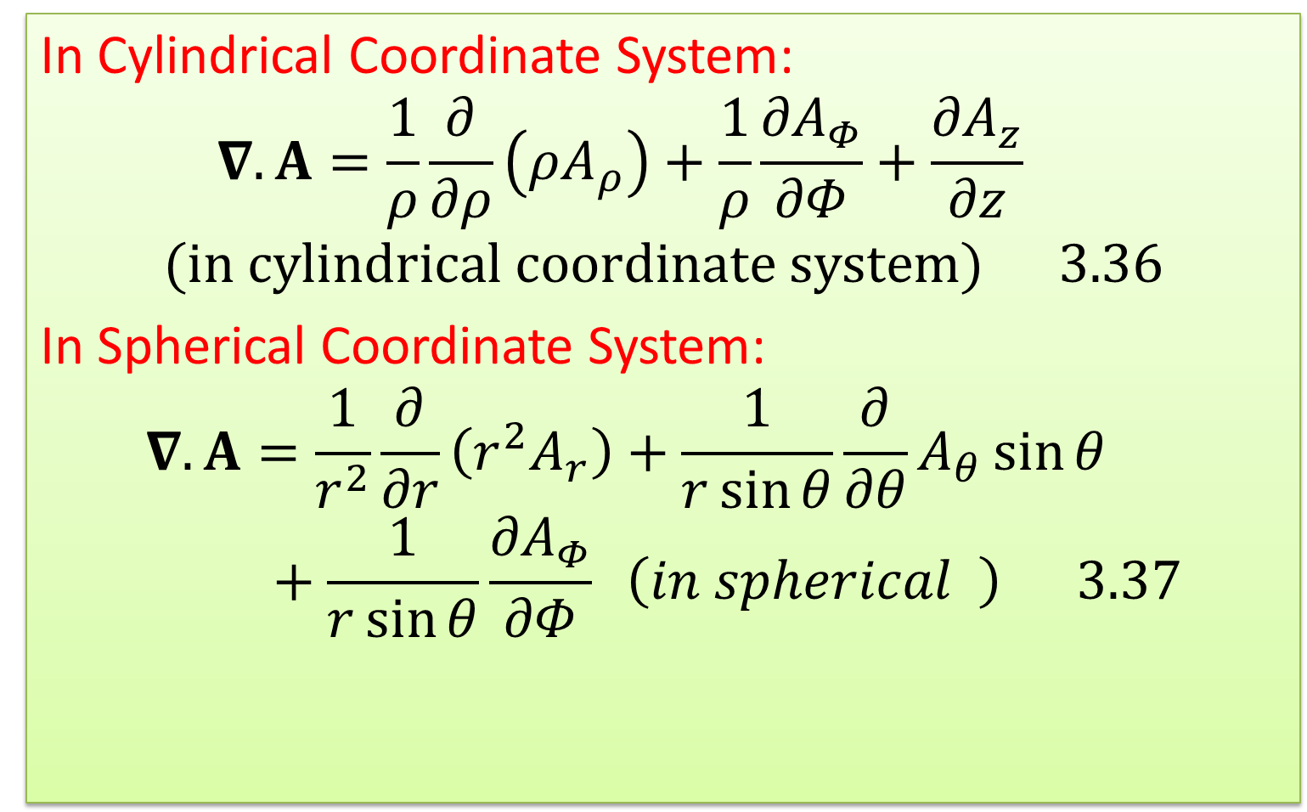
Divergence In Other Coordinates System
In Cylindrical Coordinate System:
$$∇.A=\frac{1}{ρ}\frac{∂}{∂ρ}\left({ρA}_{ρ}\right)+\frac{1}{ρ}\frac{{∂A}_{Φ}}{∂Φ}+\frac{{∂A}_{z}}{∂z}$$
$$(in cylindrical coordinate system) 3.36$$
In Spherical Coordinate System:
$$∇.A=\frac{1}{r^{2}}\frac{∂}{∂r}\left({r^{2}A}_{r}\right)+\frac{1}{r\sin{θ}}\frac{∂}{∂θ}A_{θ}\sin{θ}+\frac{1}{r\sin{θ}}\frac{{∂A}_{Φ}}{∂Φ} \left(in spherical \right) 3.37$$

Slide 11
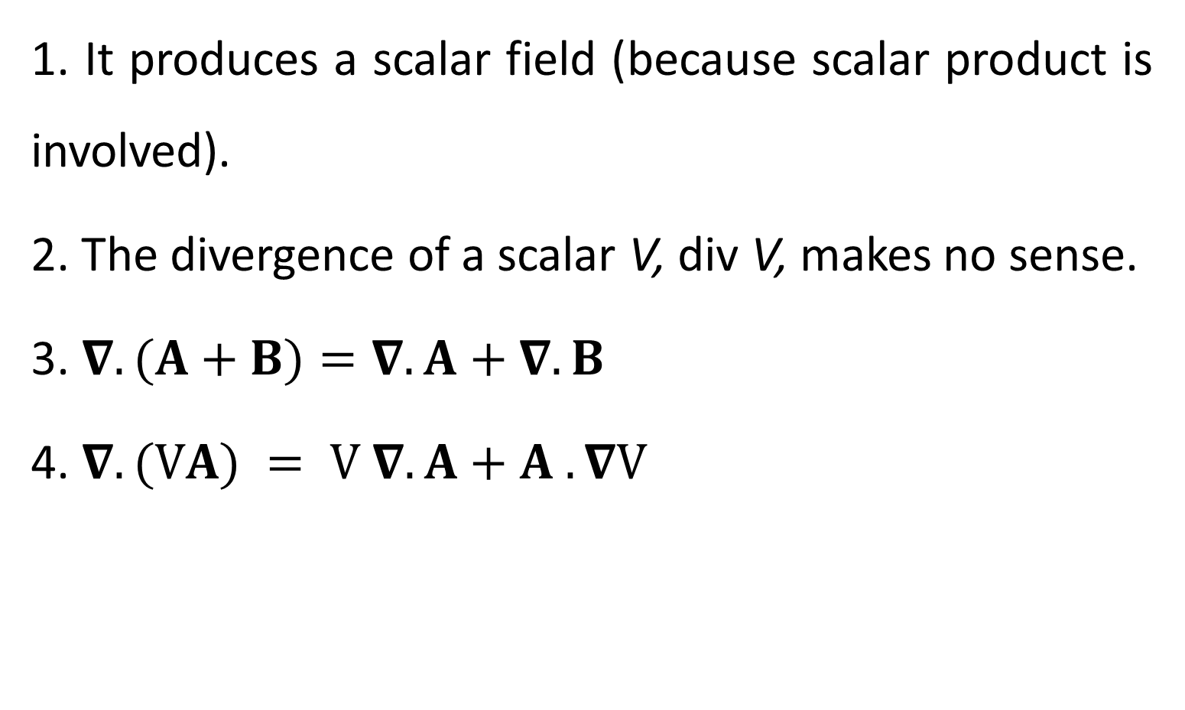
Note the following properties of the divergence of a vector field:
1. It produces a scalar field (because scalar product is involved).
2. The divergence of a scalar V, div V, makes no sense.
3. $∇.(A+B)=∇.A+∇.B$
4. $∇. (VA) = V ∇. A+A . ∇V$

Slide 12
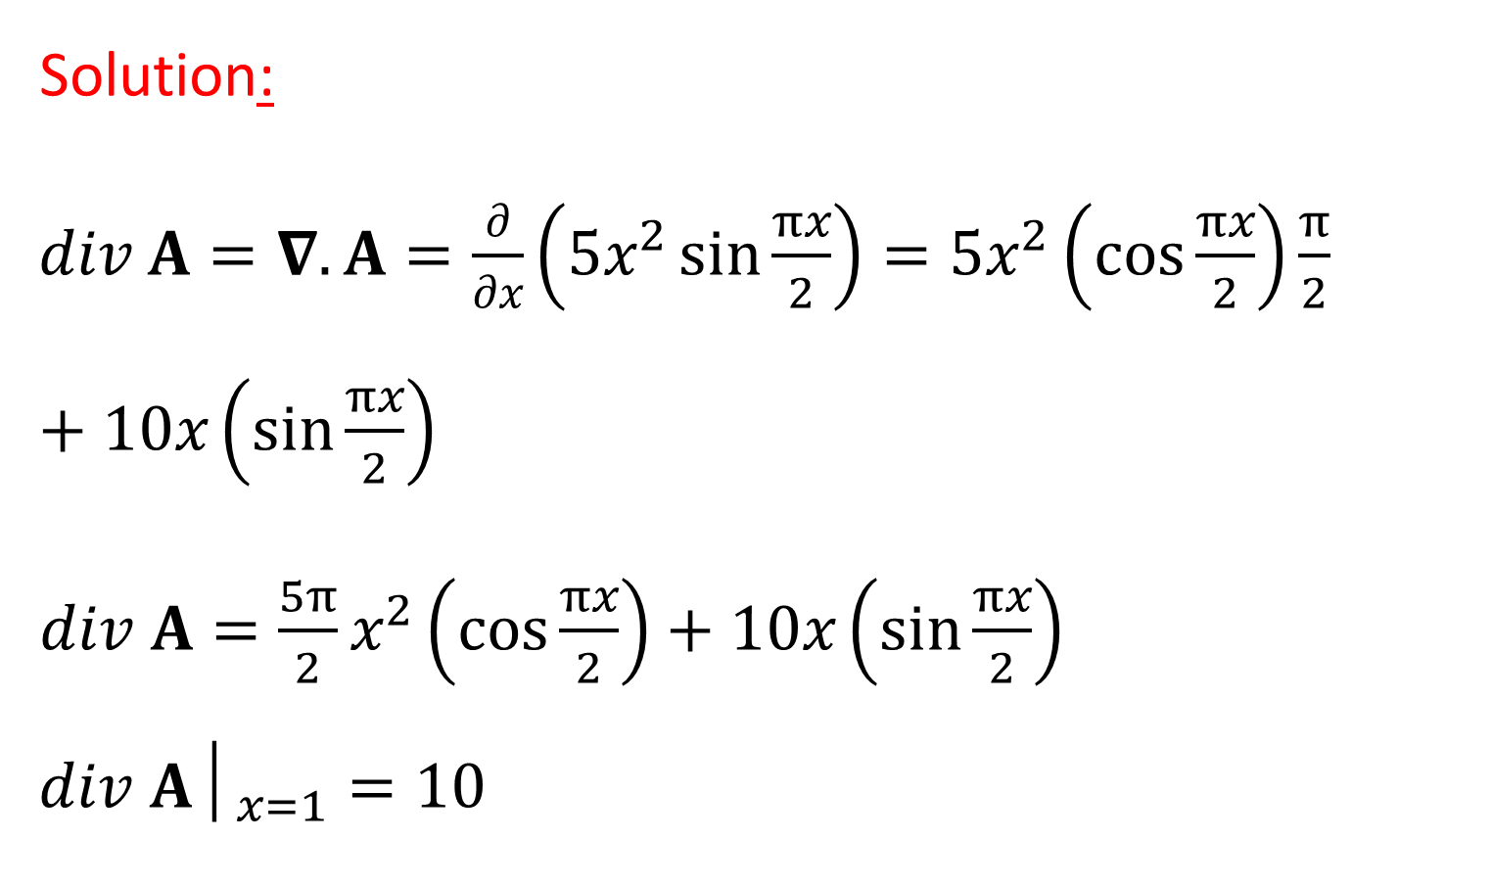
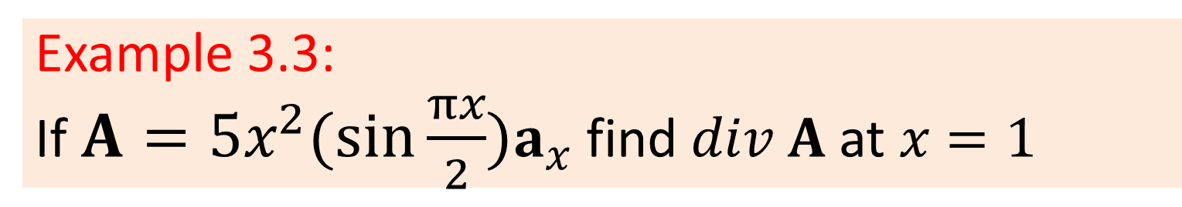
Example 3.3:
If $A=5x^{2}(\sin{\frac{πx}{2}})a_{x}$ find $div A$ at $x=1$
Solution:
$div A=∇.A=\frac{∂}{∂x}\left(5x^{2}\sin{\frac{πx}{2}}\right)=5x^{2}\left(\cos{\frac{πx}{2}}\right)\frac{π}{2}+10x\left(\sin{\frac{πx}{2}}\right)$
$div A=\frac{5π}{2}x^{2}\left(\cos{\frac{πx}{2}}\right)+10x\left(\sin{\frac{πx}{2}}\right)$
$${div A│}_{x=1}=10$$

Slide 13
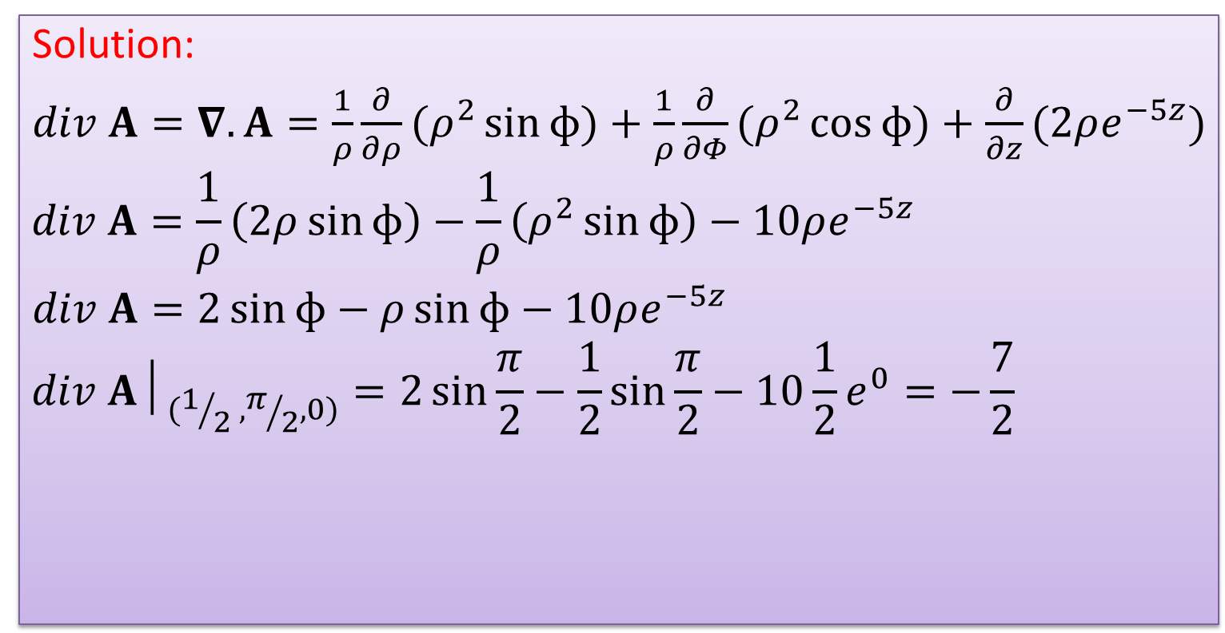
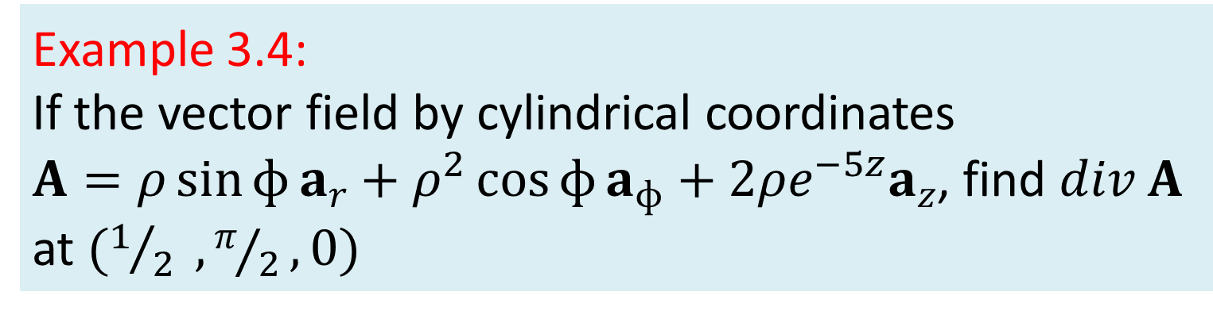
Example 3.4:
If the vector field by cylindrical coordinates
$A=ρ\sin{ɸ}a_{r}+ρ^{2}\cos{ɸ}a_{ɸ}+2ρe^{−5z}a_{z}$, find $div A$ at $(1/2 , π/2,0)$
Solution:
$div A=∇.A=\frac{1}{ρ}\frac{∂}{∂ρ}(ρ^{2}\sin{ɸ})+\frac{1}{ρ}\frac{∂}{∂Φ}(ρ^{2}\cos{ɸ})+\frac{∂}{∂z}(2ρe^{−5z})$
$$div A=\frac{1}{ρ}\left(2ρ\sin{ɸ}\right)−\frac{1}{ρ}\left(ρ^{2}\sin{ɸ}\right)−10ρe^{−5z}$$
$div A=2\sin{ɸ}−ρ\sin{ɸ}−10ρe^{−5z}$
$${div A│}_{(1/2 , π/2,0)}=2\sin{\frac{π}{2}}−\frac{1}{2}\sin{\frac{π}{2}}−10\frac{1}{2}e^{0}=−\frac{7}{2}$$

Slide 14
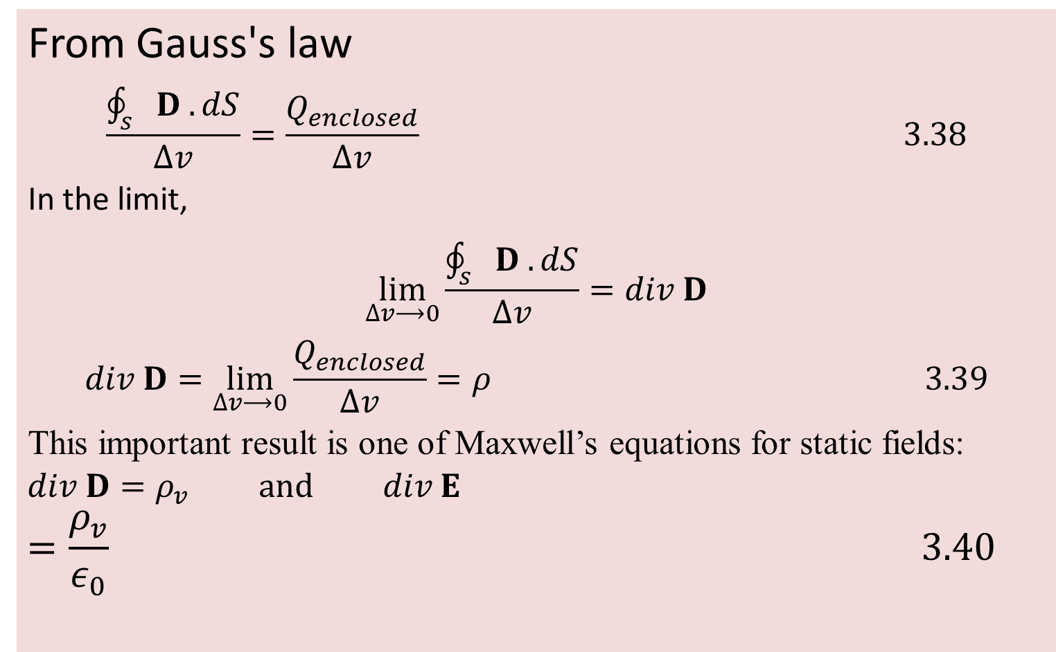
3.9 DIVERGENCE OF D (first Maxwell equation for electrostatic field)
From Gauss's law
$$\frac{\oint_{s}{D . dS}}{∆v}=\frac{Q_{enclosed}}{∆v} 3.38$$
In the limit,
$$\lim_{∆v⟶0}\frac{\oint_{s}{D . dS}}{∆v}=div D$$
$$div D=\lim_{∆v⟶0}\frac{Q_{enclosed}}{∆v}=ρ 3.39$$
This important result is one of Maxwell’s equations for static fields:
$$div D=ρ_{v} and div E$$
$$=\frac{ρ_{v}}{ε_{0}} 3.40$$

Slide 15
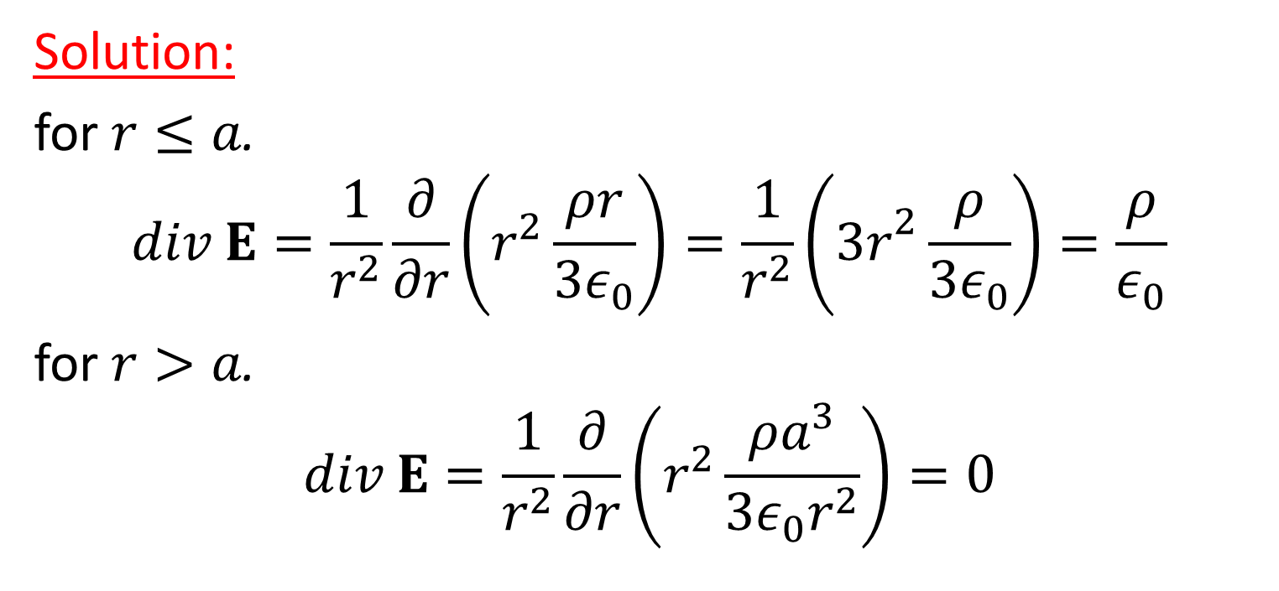
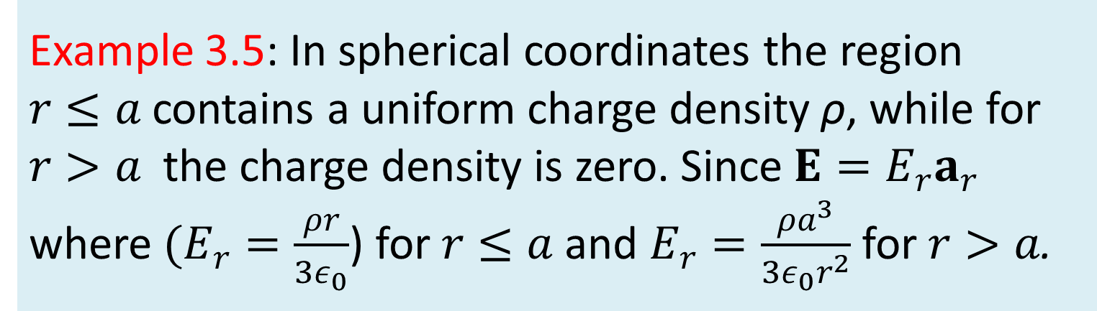
Example 3.5: In spherical coordinates the region $r≤a$ contains a uniform charge density ρ, while for $r>a$ the charge density is zero. Since $E=E_{r}a_{r}$ where $(E_{r}=\frac{ρr}{3ε_{0}}$) for $r≤a$ and $E_{r}=\frac{ρa^{3}}{3ε_{0}r^{2}}$ for $r>a$.
Solution:
for $r≤a$.
$$div E=\frac{1}{r^{2}}\frac{∂}{∂r}\left(r^{2}\frac{ρr}{3ε_{0}}\right)=\frac{1}{r^{2}}\left({3r}^{2}\frac{ρ}{3ε_{0}}\right)=\frac{ρ}{ε_{0}}$$
for $r>a$.
$$div E=\frac{1}{r^{2}}\frac{∂}{∂r}\left(r^{2}\frac{ρa^{3}}{3ε_{0}r^{2}}\right)=0$$

Slide 16
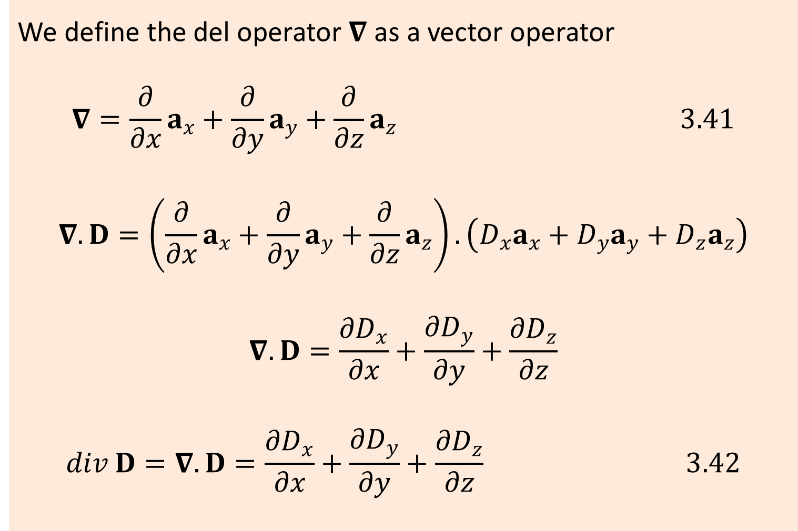
3.10 THE DEL OPERATOR
We define the del operator $∇$ as a vector operator
$$∇=\frac{∂}{∂x}a_{x}+\frac{∂}{∂y}a_{y}+\frac{∂}{∂z}a_{z} 3.41$$
$$∇.D=\left(\frac{∂}{∂x}a_{x}+\frac{∂}{∂y}a_{y}+\frac{∂}{∂z}a_{z}\right).\left(D_{x}a_{x}+D_{y}a_{y}+D_{z}a_{z}\right)$$
$$∇.D=\frac{{∂D}_{x}}{∂x}+\frac{{∂D}_{y}}{∂y}+\frac{{∂D}_{z}}{∂z}$$
$$div D=∇.D=\frac{{∂D}_{x}}{∂x}+\frac{{∂D}_{y}}{∂y}+\frac{{∂D}_{z}}{∂z} 3.42$$

Slide 17
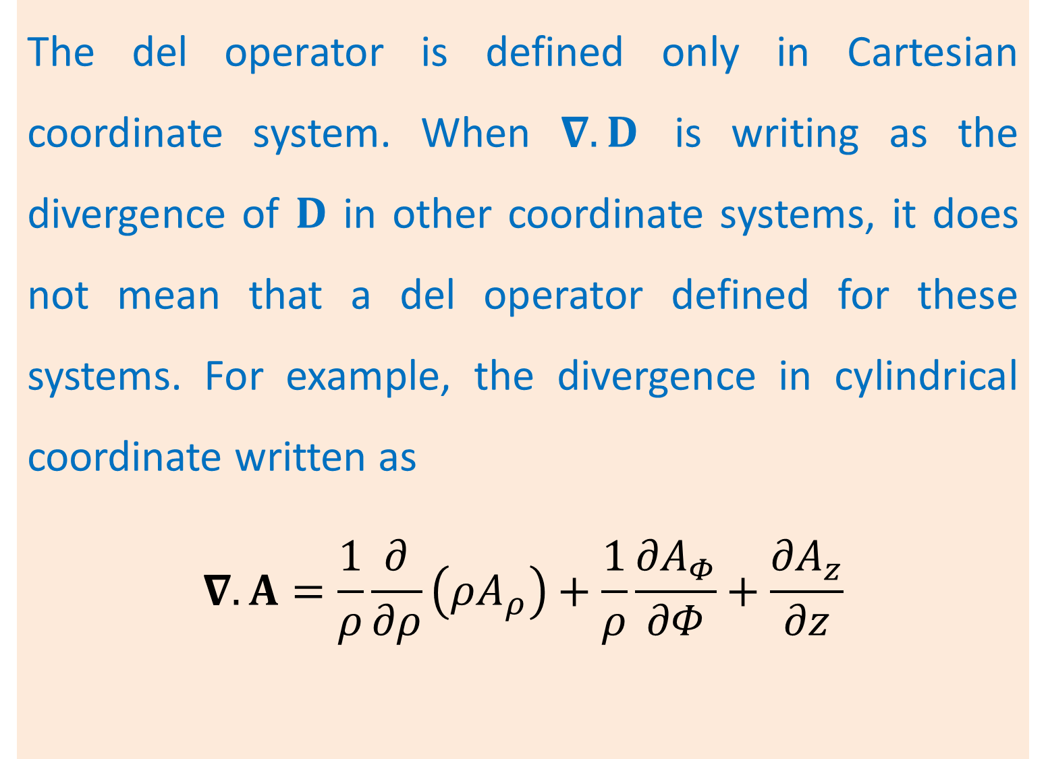
The del operator is defined only in Cartesian coordinate system. When $∇.D$ is writing as the divergence of $D$ in other coordinate systems, it does not mean that a del operator defined for these systems. For example, the divergence in cylindrical coordinate written as
$$∇.A=\frac{1}{ρ}\frac{∂}{∂ρ}\left({ρA}_{ρ}\right)+\frac{1}{ρ}\frac{{∂A}_{Φ}}{∂Φ}+\frac{{∂A}_{z}}{∂z}$$

Slide 18
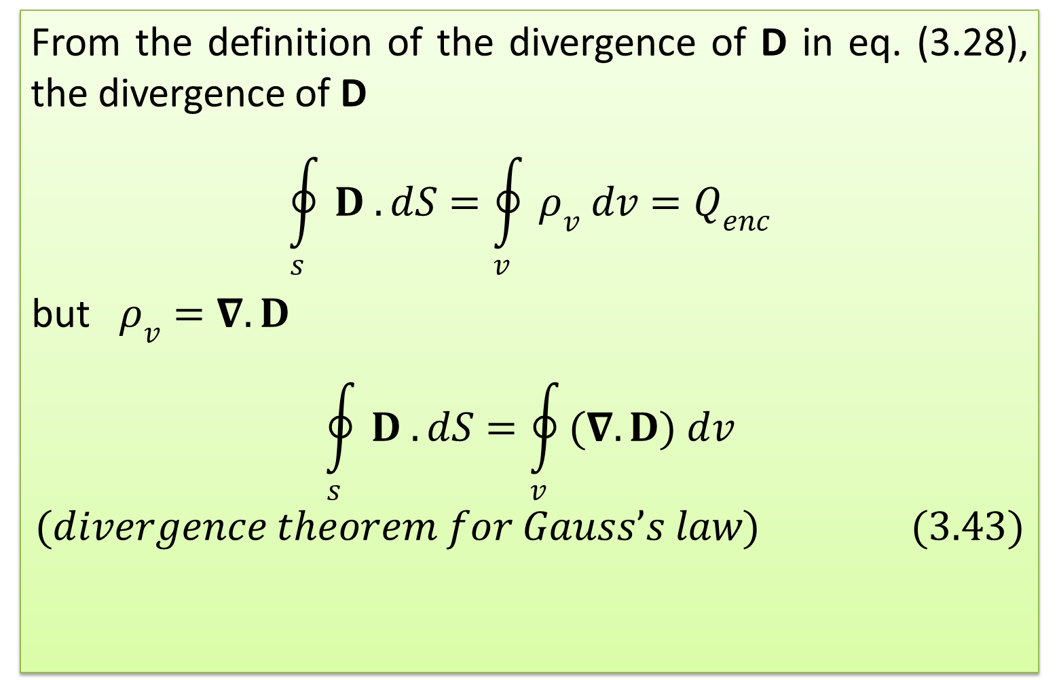
3.11 THE DIVERGANCE THEOREM
From the definition of the divergence of D in eq. (3.28), the divergence of D
$$\oint_{s}{D . dS}=\oint_{v}{ρ_{v} dv}=Q_{enc}$$
but $ρ_{v}=∇.D$
$$\oint_{s}{D . dS}=\oint_{v}{(∇.D) dv}$$
$$(divergence theorem for Gauss’s law) (3.43)$$

Slide 19
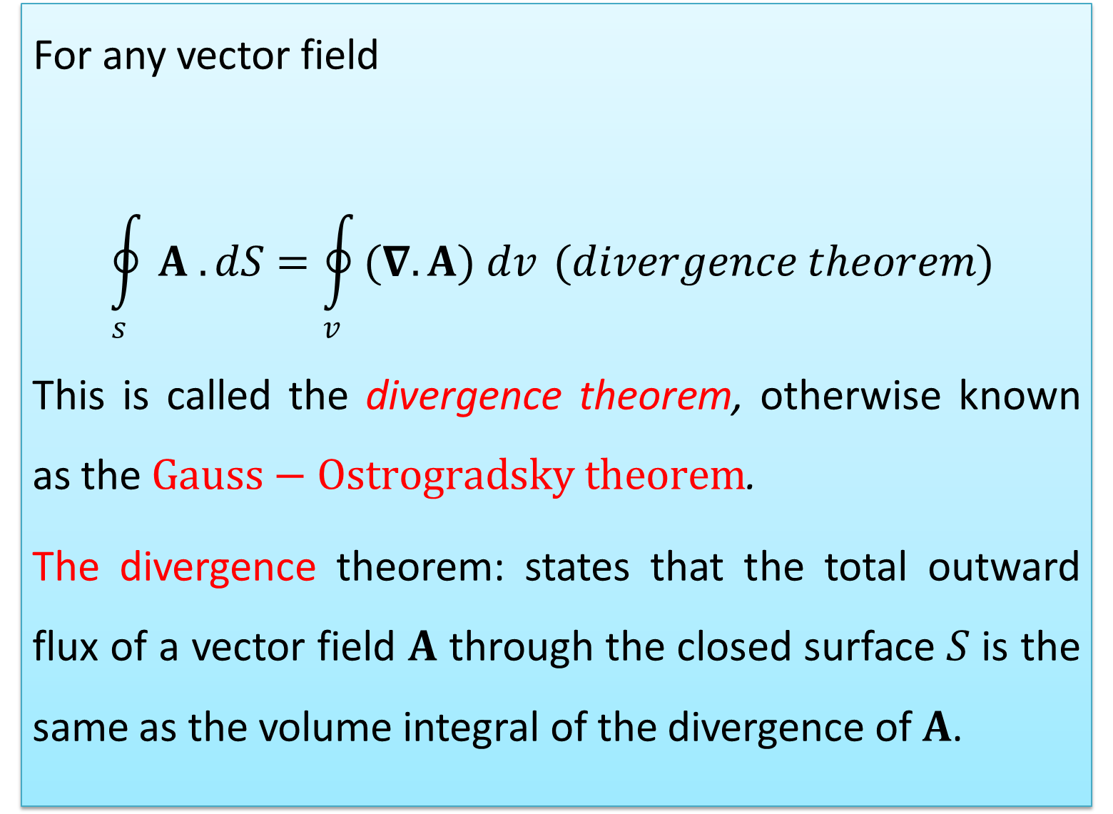
For any vector field
$$\oint_{s}{A . dS}=\oint_{v}{(∇.A) dv} (divergence theorem)$$
This is called the divergence theorem, otherwise known as the $Gauss−Ostrogradsky theorem$.
The divergence theorem: states that the total outward flux of a vector field $A$ through the closed surface $S$ is the same as the volume integral of the divergence of $A$.

Slide 20
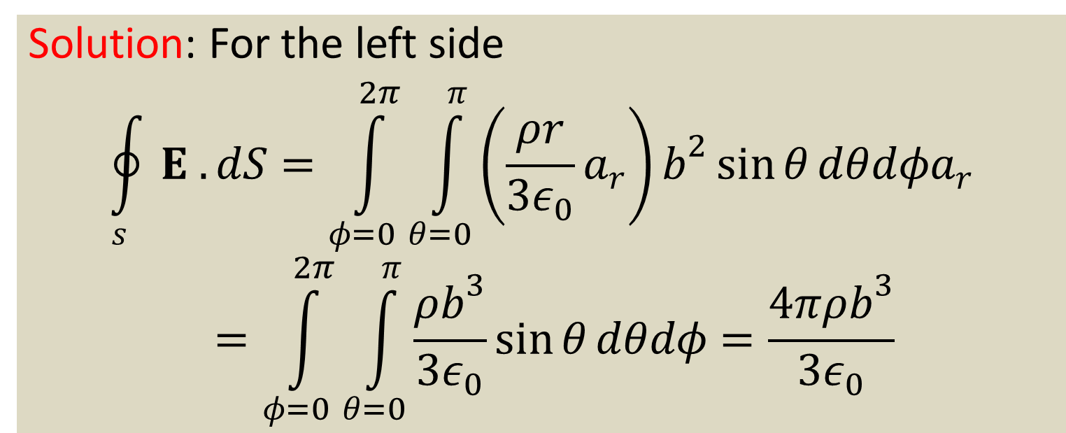
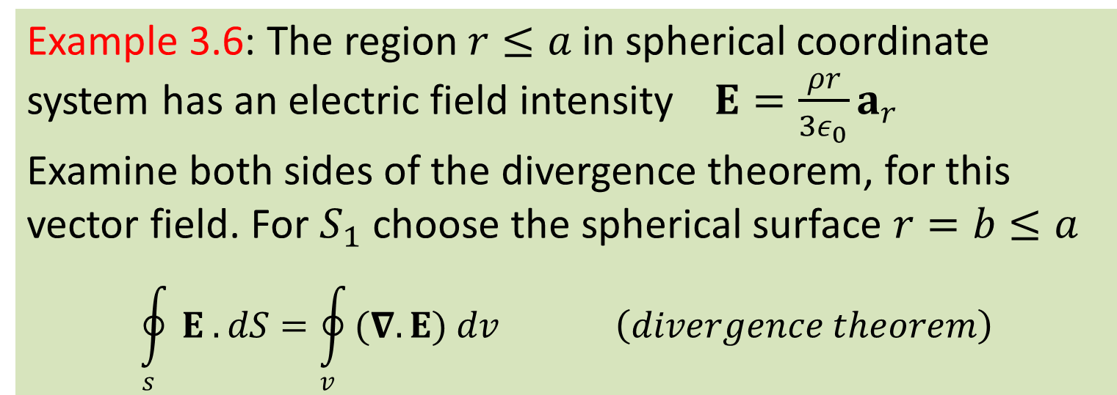
Example 3.6: The region $r≤a$ in spherical coordinate system has an electric field intensity $E=\frac{ρr}{3ε_{0}}a_{r}$
Examine both sides of the divergence theorem, for this vector field. For $S_{1}$ choose the spherical surface $r=b≤a$
$$\oint_{s}{E . dS}=\oint_{v}{(∇.E) dv} \left(divergence theorem\right)$$
Solution: For the left side
$$\oint_{s}{E . dS}=\int_{φ=0}^{2π}{\int_{θ=0}^{π}{\left(\frac{ρr}{3ε_{0}}a_{r}\right)}}b^{2}\sin{θ}dθdφa_{r}=\int_{φ=0}^{2π}{\int_{θ=0}^{π}{\frac{ρb^{3}}{3ε_{0}}}}\sin{θ}dθdφ=\frac{4πρb^{3}}{3ε_{0}}$$

Slide 21
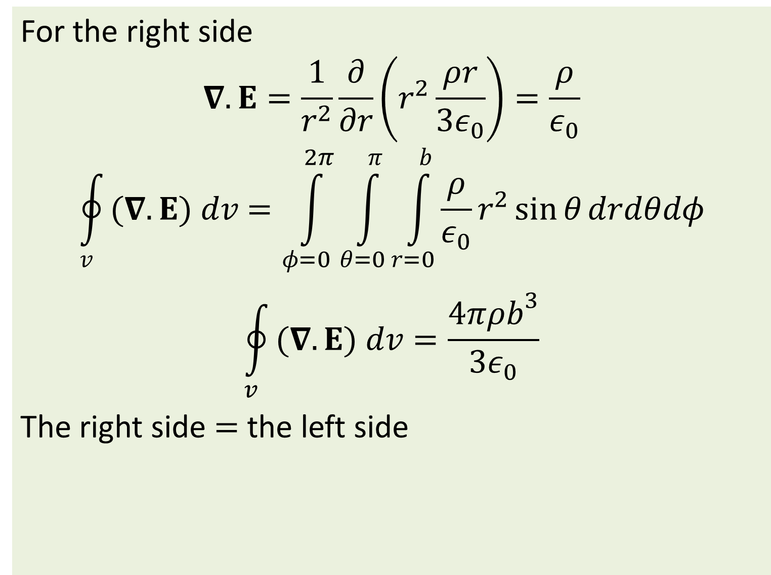
For the right side
$$∇.E=\frac{1}{r^{2}}\frac{∂}{∂r}\left(r^{2}\frac{ρr}{3ε_{0}}\right)=\frac{ρ}{ε_{0}}$$
$$\oint_{v}{(∇.E) dv}=\int_{φ=0}^{2π}{\int_{θ=0}^{π}{\int_{r=0}^{b}{\frac{ρ}{ε_{0}}}}}r^{2}\sin{θ}drdθdφ$$
$$\oint_{v}{(∇.E) dv}=\frac{4πρb^{3}}{3ε_{0}}$$
The right side $=$ the left side

Slide 22
Thank you

