Slide 1
7.5 AMPERE'S CIRCUIT LAW
Ampere's circuit law sometimes called Ampere's work law: states that the line integral of the tangential component of the magnetic field strength (intensity) $H$ around a closed path is exactly equal to the direct current enclosed by that path.
$$\oint{H.dL=I_{enc} (7.33)}$$
Ampere's law is a special case of Biot-Savart's law
Two conditions must be met:
1. At each point of the closed path the magnetic field intensity $H$ is either tangential or normal to the path.
2. The magnetic field intensity $H$ has the same value at all points of the path where $H$ is tangential.

Slide 2
By applying Stoke's theorem to the left-hand side of equation (7.33), we obtain
$$I_{enc}=\oint_{L}{H .dL}=\int_{s}{(∇×H)}.dS (7.34)$$
But
$$I_{enc}=\int_{s}{\overset{⃑}{J}}.dS (7.35)$$
By comparing these equations above yield.
$$∇×H=\overset{⃑}{J} (7.36)$$
This is the third Maxwell's equation to be derived; it is essentially Ampere's law in differential (or point) form whereas equation (7.33) is the integral form. From equation (7.36), we should observe that $∇×H=\overset{⃑}{J}≠0$; that is, magnetostatic field is not conservative .

Slide 3
7.6 APPLICATIONS OF AMPERE'S LAW
To determine components of $H$ are present by using the Biot-Savart law. The direction of $dH$ is perpendicular to the plane containing $dL$ and $R$ and therefore is in the direction of $a_{φ}$. Hence the only component of $H$ is $H_{φ}$, and the magnitude of the field is a function only of 𝜌 but not of 𝜙 and z. Since this path encloses the whole current $I$, according to Ampere's law. The streamlines are therefore circles about the filament, and the field may be mapped in cross section as in Figure (7.11).
7.6.1 Infinite Line Current

Slide 4
$$I=\oint_{L}{H .dL}=\int{\left(H_{φ} a_{φ}\right) . \left(ρdφ a_{φ}\right)}=H_{φ}\int{ρdφ}=H_{φ} . 2πρ$$
$$H_{φ}=\frac{I}{2πρ}$$
or
$$H=\frac{I}{2πρ}a_{φ} (7.37)$$

Slide 5
Fig. (7.11) Ampere's law applied to an infinite filamentary line current

Slide 6
7.6.2 Infinite Sheet of Current
an infinite sheet of current flowing in the positive $y$-direction and located in the plane $z=0$. A sheet has a uniform surface current density $K=K_{y}a_{y}$ $A/m$ as shown in Figure (7.12), the magnetic field $H$ cannot vary with $x$ or $y$. If the sheet is subdivided into a number of filaments, it is evident that no produced an $H_{y}$ component. The Biot-Savart law shows that the contributions to $H_{z}$ produced by a symmetrically located pair of filaments cancel ($H_{z}=0$). Therefore only an $H_{x}$ component is present. Applying Ampere's law to the rectangular closed path 1-2-3-4-1 which are either parallel or perpendicular to $H_{x}$ gives.

Slide 7
$$\oint{H .dL=I_{enc}}=K_{y}b (7.38)$$
Due to the infinite extent of the sheet, the sheet can be regarded as consisting of such filamentary pairs so that the characteristics of $H$ for a pair are the same for the infinite current sheets, that is$H$ on one side of the sheet is the negative of that on the other side.
$$H=\left\{\begin{aligned}H_{o} a_{x} z>0 \\ \\ −H_{o} a_{x} z<0\end{aligned}\right. (7.39)$$

Slide 8
Fig. (7.12) Application of Ampere's law to an infinite sheet for closed path 1-2-3-4-1

Slide 9
$$\oint{H.dL=(\int_{1}^{2}{+\int_{2}^{3}{+\int_{3}^{4}{+\int_{4}^{1}{)}}}}}H.dL$$
$$\oint{H.dL}=0\left(−a\right)+\left(−H_{o}\right)\left(−b\right)+0\left(a\right)+H_{o}\left(b\right)=2H_{o}b$$
From equations (7.38) and (7.40), we obtain $H_{o}=\frac{1}{2}K_{y}$. Substituting $H_{o}$ in equation (7.39) gives:
$$H=\left\{\begin{aligned}\frac{1}{2}K_{y} a_{x} z>0 (above the sheet) \\ \\ −\frac{1}{2}K_{y} a_{x} z<0 (below the sheet)\end{aligned}\right. (7.41)$$
In general, for an infinite sheet of current density $K A/m$,
$$H=\frac{1}{2}K×a_{n} (7.42)$$
$a_{n}$ is a unit vector normal to the current sheet directed from the current sheet to the point of H.

Slide 10
7.6.3 Infinitely Long Coaxial Transmission Line
An infinite long transmission line.
It has two concentric cylinders having their axes along the z-axis.
The line and its cross section is shown in Figure (7.13).
The inner conductor has radius $a$ and carries current $I$.
the outer conductor has inner radius $b$ and thickness $t$ and carries return current $−I$.
To determine $H$ everywhere assuming that current is uniformly distributed in both conductors.

Slide 11
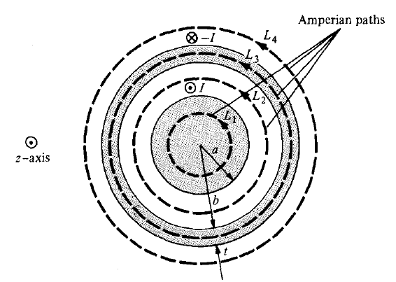
Fig. (7.13) the line and cross section of the transmission line
apply Ampere's law along the Amperian path for each of the four possible regions:
$0≤ρ≤a$; $a≤ρ≤b$; $b≤ρ≤b+t$; and $ρ≥b+t$.

Slide 12
For region $0≤ρ≤a$, we apply Ampere’s law to path $L_{1}$ giving
$$\oint_{L_{1}}{H . dL}=I_{enc}=\int_{s}{\overset{⃑}{J} . dS} (7.43)$$
$$\overset{⃑}{J}=\frac{I}{πa^{2}}a_{z} and dS=ρdφdρ a_{z}$$
$$I_{enc}=\int_{s}{\overset{⃑}{J} . dS}=\int_{s}{\left(\frac{I}{πa^{2}}a_{z}\right). \left(ρdφdρa_{z}\right)}=\frac{I}{πa^{2}}\int_{0}^{ρ}{\int_{0}^{2π}{ρdφdρ}}$$
$$I_{enc}=\frac{I}{πa^{2}}\left(2π\right)\left(\frac{ρ^{2}}{2}\right)=\frac{I ρ^{2}}{a^{2}}$$
$$\oint_{L_{1}}{H . dL}=\int{\left(H_{φ} a_{φ}\right) . \left(ρdφ a_{φ}\right)}=H_{φ}\int{dl}=H_{φ}\int{ρdφ}=H_{φ} . 2πρ=I_{enc}=\frac{I ρ^{2}}{a^{2}}$$
or
$$H_{φ}=\frac{I ρ}{{2πa}^{2}} (7.44)$$

Slide 13
For region $a≤ρ≤b$ we use path $L_{2}$ as the Amperian path,
$$\oint_{L_{2}}{H . dL}=\int{\left(H_{φ} a_{φ}\right) . \left(ρdφ a_{φ}\right)}=H_{φ}\int{dl}=H_{φ}\int{ρdφ}$$
$$H_{φ} . 2πρ=I_{enc}=I$$
$$H_{φ} 2πρ=I or$$
$$H_{φ}=\frac{I }{2πρ} (7.45)$$
Since the current $I$ is enclosed by $L_{2}$. Notice that equation (7.45) is the same as equation (7.14) and it is independent of $a$.

Slide 14
For region $b≤ρ≤b+t$, we use path $L_{3}$ getting
$$\oint_{L_{3}}{H . dL}=H_{φ}.2πφ=I_{enc} (7.46)$$
where
$$I_{enc}=I+\int_{s}{\overset{⃑}{J} . dS}$$
$\overset{⃑}{J}$ is the current density of the outer conductor and is along ${−a}_{z}$ that is,
$$\overset{⃑}{J}=−\frac{I}{π\left[{\left(b+t\right)}^{2}−b^{2}\right]} a_{z}$$
Thus
$$I_{enc}=I−\frac{I}{π\left[{\left(b+t\right)}^{2}−b^{2}\right]}\int_{0}^{2π}{\int_{ρ=b}^{ρ}{ρdφdρ}}=I\left[1−\frac{ρ^{2}−b^{2}}{t^{2}+2bt}\right]$$

Slide 15
Substituting this in equation (7.46), we have
$$H_{φ}=\frac{I }{2π ρ}\left[1−\frac{ρ^{2}−b^{2}}{t^{2}+2bt}\right] (7.47)$$
For region $ρ≥b+t$, we use path $L_{4}$, getting
$$\oint_{L_{4}}{H . dL}=I_{enc}=I−I=0 or$$
$$H_{φ}=0 (7.48)$$

Slide 16
Putting equation (7.44) to (7.48) together gives
$$H=\left\{\begin{aligned}\frac{I ρ}{{2π a}^{2}} a_{φ} 0≤ρ≤a \\ \\ \frac{I }{2π ρ} a_{φ} a≤ρ≤b \\ \\ \frac{I }{2π ρ}\left[1−\frac{ρ^{2}−b^{2}}{t^{2}+2bt}\right] a_{φ} b≤ρ≤b+t \\ \\ 0 ρ≥b+t\end{aligned}\right. (7.49)$$

Slide 17
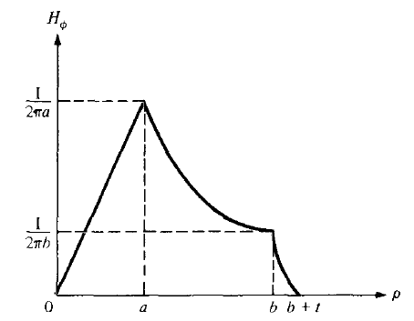
The magnitude of $H$ is sketched in Figure (7.14).
Fig. (7.14) The magnetic field intensity as a func­tion of radius $ρ$ in an infinitely long coax­ial transmission line.

Slide 18
7.6.4 $N$-turn solenoid carrying filamentary current.
applying Ampere’s circuital law to an infinitely long solenoid of radius $a$
uniform current density $K_{a}a_{φ}$
the center of the solenoid is the z-axis as shown in Figure (7.15a)
$$H=K_{a}a_{z} \left(ρ<a\right) (7.50)$$
$$H=0 \left(ρ>a\right) (7.51)$$
If the solenoid has a finite length $d$ and consists of $N$ closely wound turns of a filament that carries a current $I$ Figure (7.15b), then the magnetic field intensity $H$ at points well within the solenoid is given closely by.
$$H=\frac{NI}{d}a_{z} \left(within the solenoid\right) (7.52)$$

Slide 19
Fig. (7.15)(a) An ideal solenoid of infinite length with a circular current sheet. (b) An $N$-turn solenoid of finite length $d$.

Slide 20
7.6.5 An $N$-turn toroid carrying filamentary current.
For the toroid shown in Figure (7.16a), the magnetic field intensity for the ideal case is:
$$H=K_{a}\frac{ρ_{o}−a}{ρ}a_{φ} \left(inside toroid\right) (7.53)$$
$$H=0 \left(outside toroid\right) (7.54)$$
A toroid whose dimensions are shown in Figure (7.16b) has $N$ turns and carries filamentary current $I$. To determine the magnetic field intensity $H$ inside and outside the toroid apply Ampere's circuit law to the Amperian path, which is a circle of radius $ρ$ show in Figure (7.16b).

Slide 21
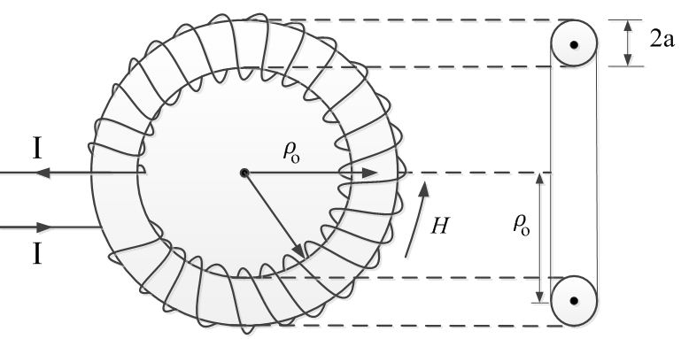
Fig. 7.16 a toroid with a circular cross section.

Slide 22
Since $N$ wires cut through this path each carrying current $I$, the net current enclosed by the Amperian path is $NI$. Hence,
$$\oint_{L}{H .dL}=I_{enc} ⇒ H.2πρ=NI$$
$$H=\frac{NI}{2πρ} for ρ_{o}−a<ρ<ρ_{o}+a (7.55)$$
where $ρ_{o}$ is the mean radius of the toroid. An approximate value of $H$ is
$$H_{approx.}=\frac{NI}{2πρ_{o}}=\frac{NI}{𝓁} (7.56)$$
Notice that this is the same as the formula obtained for $H$ for points well inside a very long solenoid ($𝓁≫a$). Thus a straight solenoid may be regarded as a special toroidal coil for which $ρ_{o}→∞$. Outside toroid, the current enclosed by an Amperian path is $NI−NI=0$, hence.
$$H=0 (7.57)$$

Slide 23
7.7 MAGNETIC FLUX AND MAGNETIC FLUX DENSITY:
7.7.1 Magnetic Flux Density $B$
In free space, the magnetic flux density $B$ is related to the magnetic field intensity $H$ according to
$$B=µ_{o}H (7.58)$$
$B$ is measured in weber per square meter ($Wb/m^{2}$) or in the (IS) International System of Units is tesla (T).
The older unit of the magnetic flux density is the gauss (G), where 1T or 1$Wb/m^{2}$ is equal to $10,000$G.
$µ_{o}$ is a constant is not dimensionless known as the permeability of free space in henrys per meter $(H/m)$.
$$µ_{o}=4π×{10}^{−7} \left(\frac{H}{m}\right) (7.59)$$

Slide 24
7.7.2 Magnetic Flux $Φ$
The magnetic flux represented by $Φ$ and define as the flux passing through any designated area, Thus, the magnetic flux through a surface $S$ is given by.
$$ψ=Φ=\int_{s}{B . dS} (7.60)$$
The magnetic flux $Φ$ is measured in webers ($Wb$). The sign on $Φ$ may be positive or negative depending upon the choice of the surface normal in $dS$.
The magnetic flux lines due to a straight long wire are formed concentric circles about the filament wire Figure (7.18). For a straight, current-carrying conductor, it is true that magnetic flux lines are closed and do not cross each other regardless of the current distribution.

Slide 25
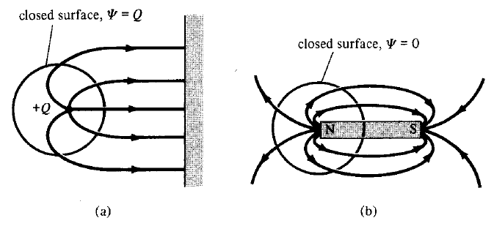
Fig. (7.18) Magnetic flux lines due to a straight wire with current coming out of the page.
Fig. (7.19) Flux leaving a closed surface due to: (a) isolated electric charge, (b) magnetic charge

Slide 26
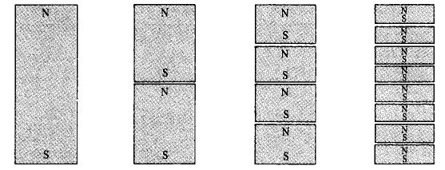
If we desire to have an isolated magnetic pole by dividing a magnetic bar into two, we end up with pieces each having north and south poles as illustrated in Figure (7.20).
We find it impossible to separate the north pole from the south pole.
Fig. (7.20) Successive division of a bar magnet results in pieces with north and south poles.

Slide 27
Unlike electric flux lines, magnetic flux lines always close upon themselves as in Figure (7.19). This is due to the fact that it is not possible to have isolated magnetic poles or magnetic charges. For this reason Gauss’s law for the magnetic field is.
$$\oint_{s}{B .dS}=0 (7.61)$$
By applying the divergence theorem to equation (7.61), we obtain
$$\oint_{s}{B .dS}=\int_{v}{∇ .}B dv=0 : or$$
$$∇ .B=0 (7.62)$$
This equation is the fourth Maxwell's equation to be derived. Equation (7.61) or (7.62) shows that magnetostatic fields have no sources or sinks. Equation (7.62) suggests that magnetic field lines are always continuous.

Slide 28
7.8 MAXWELL'S EQUATIONS FOR STATIC E.M. FIELDS
derived Maxwell's four equations for static electromagnetic fields, we may take a moment to put them together as in Table.
Table (7.2) Maxwell's Equations for Static EM Fields
No. | Differential or Point Form | Integral Form | Remarks
1 | $$∇ .D=ρ_{v}$$ | $$ψ=\oint_{s}{D .dS}=\int_{v}{ρ_{v}} dv=Q$$ | Gauss's law
2 | $$∇ .B=0$$ | $$\oint_{s}{B .dS}=0$$ | Nonexistence of magnetic monopole
3 | $$∇×E=0$$ | $$\oint_{L}{E .dL}=0$$ | Conservativeness of electrostatic field
4 | $$∇×H=\overset{⃑}{J}$$ | $$\oint_{L}{H . dL}=I_{enc}=\int_{s}{\overset{⃑}{J} . dS}$$ | Ampere's law

Slide 29
7.9 MAGNETIC SCALAR AND VECTOR MAGNETIC POTENTIALS
The magnetic potential could be scalar $V_{m}$ or vector $A$. To define $V_{m}$ and $A$ involves recalling two important identities.
$$∇×\left(∇V\right)=0 (7.63)$$
$$∇.\left(∇×A\right)=0 (7.64)$$

Slide 30
7.9.1 MAGNETIC SCALAR
As in electric field ($E=−∇V$) the magnetic scalar potential $V_{m}$ in amperes is related to magnetic field intensity $H$. The scalar magnetic potential, whose negative gradient gives the magnetic field intensity.
the magnetic field intensity $H$ is to be defined as the gradient of a scalar magnetic potential, then current density must be zero throughout the region in which the scalar magnetic poten­tial is defined.
$$H=−∇V_{m} If (\overset{⃑}{J}=0) (7.65)$$
where $\overset{⃑}{J}=∇×H$ equation (7.36). Substitution equation (7.65) in equation (7.36) we get.
$$\overset{⃑}{J}=∇×H=∇×\left(−∇V_{m}\right)=0 (7.66)$$
The magnetic scalar potential $V_{m}$ is only defined in a region where ($\overset{⃑}{J}=0$). We should also note that $V_{m}$ satisfies Laplace's equation just as $V$ does for electrostatic fields. Thus.
$$∇ . B=0 ⇒ µ_{o}∇ . H=0 ⇒ µ_{o}∇ . \left(−∇V_{m}\right)=0 or$$
$$∇^{2} V_{m}=0 If (\overset{⃑}{J}=0) (7.67)$$
We shall see that $V_{m}$ continues to satisfy Laplace’s equation in homoge­neous magnetic materials; it is not defined in any region in which current density is present.

Slide 31
7.9.2 MAGNETIC VECTOR POTENTIAL
Our choice of a vector magnetic potential is indicated by noting that. $∇ . B=0$
We can define the vector magnetic potential $A$ in ($Wb/m$) such that.
$$B=∇×A \left(7.68\right); V=\int{\frac{dQ}{4π ε_{o} r}} \left(7.69\right); \text{We} \text{can} \text{define}$$
$$A=\int_{L}{\frac{µ_{0} IdL}{4πR}} for line current \left(7.70\right);$$
$$A=\int_{S}{\frac{µ_{0} KdS}{4πR}} for surface current (7.71)$$
$$A=\int_{v}{\frac{µ_{0} \overset{⃑}{J}dv}{4πR}} for volume current (7.72)$$

Slide 32
we can obtain equations (7.70) to (7.72) from equations (7.6) to (7.8). And, we can derive equation (7.70) from equation (7.6) in conjunction with equation (7.68). To do this, we write equation (7.6) as
$$B=\frac{µ_{0}}{4π}\int_{L}{\frac{IdL×R}{R^{3}}} (7.73)$$
where $R$ is the distance vector from the line element $dL$ at the source point ($x_{1}$, $y_{1}$, $z_{1}$) to the field point ($x$, $y$, $z$) Figure (7.22) and $R=\left|R\right|$, that is,
$$R=\left|r_{1}−r_{2}\right|={\left[\left(x−x_{1}\right)+\left(y−y_{1}\right)+\left(z−z_{1}\right)\right]}^{1/2}$$
Hence,
$$∇\left(\frac{1}{R}\right)=−\frac{\left(x−x_{1}\right)a_{x}+\left(y−y_{1}\right)a_{y}+\left(z−z_{1}\right)a_{z}}{{\left[{\left(x−x_{1}\right)}^{2}+{\left(y−y_{1}\right)}^{2}+{\left(z−z_{1}\right)}^{2}\right]}^{\frac{3}{2}}}=−\frac{R}{R^{3}}$$
$$\frac{R}{R^{3}}=−∇\left(\frac{1}{R}\right)=\frac{a_{R}}{R^{2}} (7.74)$$

Slide 33
Fig. (7.22) Illustration of the source point ($x_{1}$, $y_{1}$, $z_{1}$) and the field point ($x$, $y$, $z$).
The differentiation with respect to $x$, $y$, and $z$. Substituting this into equation (7.54), we obtain.
$$B=−\frac{µ_{0}}{4π}\int_{L}{IdL×∇\left(\frac{1}{R}\right)} (7.75)$$
By applying the vector identity
$$∇×\left(fF\right)=f∇×F+\left(∇f\right)×E (7.76)$$

Slide 34
Where $f$ is a scalar field and $F$ is a vector field. Taking $f=1/R$ and $F=dL$, we have
$$dL×∇\left(\frac{1}{R}\right)=\frac{1}{R}∇×dL−∇×\left(\frac{dL}{R}\right)$$
Since $∇$ operates with respect to ($x$, $y$, $z$) while $dL$ is a function of ($x_{1}$, $y_{1}$, $z_{1}$), $∇×dL=0$. Hence,
$$dL×∇\left(\frac{1}{R}\right)=−∇×\left(\frac{dL}{R}\right) (7.77)$$
With this equation, equation (7.75) reduces to
$$B=∇×\int_{L}{\frac{µ_{0} IdL}{4πR}} (7.78)$$

Slide 35
Comparing equation (7.78) with equation (7.68) shows that
$$A=\int_{L}{\frac{µ_{0} IdL}{4πR}}$$
By substituting equation (7.68) into equation (7.65) and applying Stokes's theorem, we obtain
$$ψ=\int_{s}{B . dS}=\int_{s}{\left(∇×A\right) . dS}=\oint_{L}{A . dL}$$
$$ψ=\oint_{L}{A . dL} (7.79)$$
Thus, the magnetic flux through a given area can be found using either equation (7.60) or (7.79). Also, the magnetic field can be determined by using either $V_{m}$ or $A$. The $V_{m}$ can only be used in a source-free region. The use of the magnetic vector potential provides a powerful, elegant approach to solving EM problems.

