Slide 1
Sanitary Engineering
Water supply Engineering
By
Dr. Muhanad M. Abbas

Slide 2
TODAY TOPICS
Quality Of water supply
Impurities of water :
1-microorganisms: cause disease.
2-Alagae :cause disagreeable odor .
3- certain salts :cause unpleasant tastes, hardness, corrosiveness .
4-Gases :cause odor and corrosiveness .

Slide 3
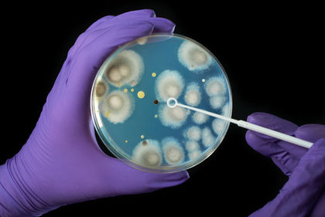
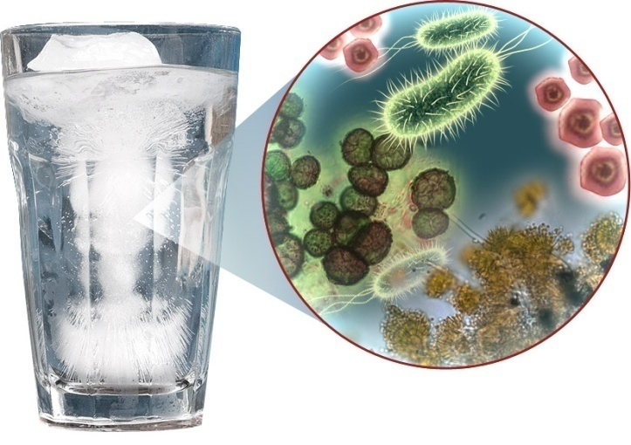
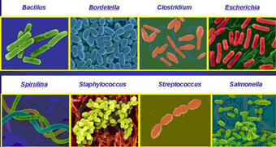
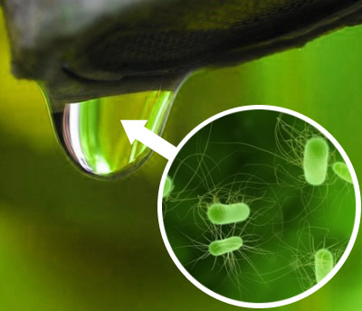
Bacteria:

Slide 4
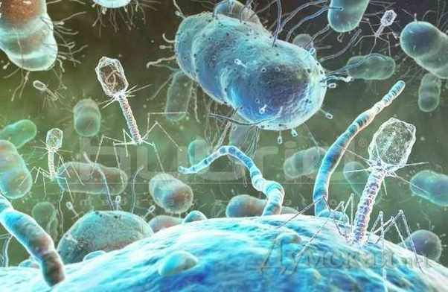
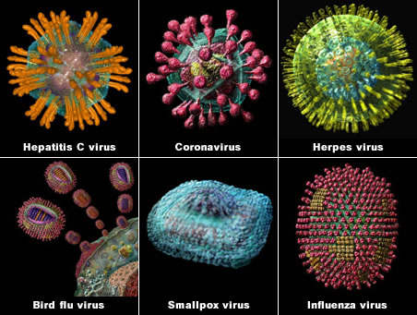
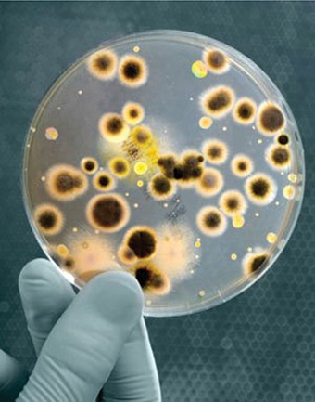
viruses:

Slide 5
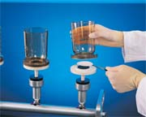
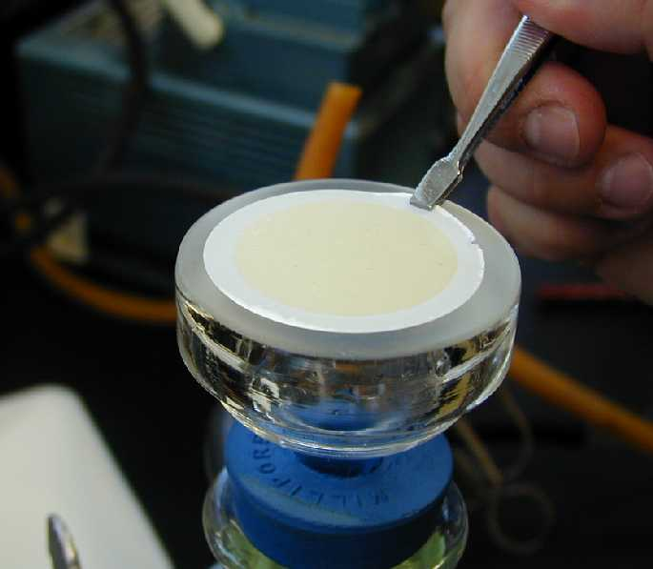
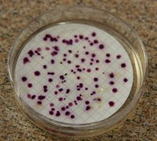
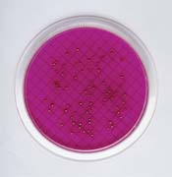
Determination of bacterial number:
1- Memberance Filter Technique:

Slide 6
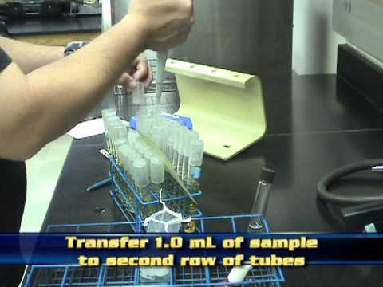
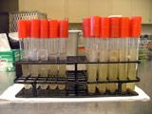
2-Multiple tube fermentation :

Slide 7
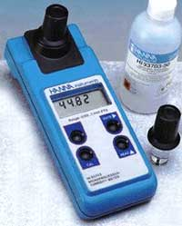
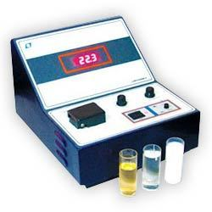
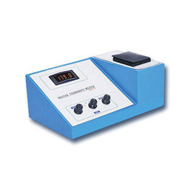
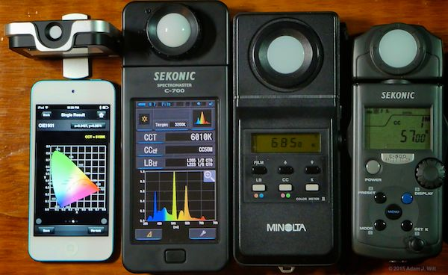
Turbidity meter
Color meter

Slide 8
Q-A- City population 40000 capita in year 2000 and the population
in year 2009 is 65000 capita Find K” ? If P_{sat}. = 100000 capita.
Q-B- City population 50000 capita in year 2008 and the population
in year 2018 is 80000 capita Find P_{sat}. ? If K”=0.08.

Slide 9
Q-A- City population 50000 capita in year 2008 and the population
in year 2018 is 75000 capita Find K” ? If P_{sat}. = 100000 capita.
Q-B- City population 60000 capita in year 2000 and the population
in year 2009 is 80000 capita Find P_{sat}. ? If K”=0.06.

