Slide 1
Sanitary Engineering
Water supply Engineering
By
Dr. Muhanad M. Abbas

Slide 2
TODAY TOPICS
Treatment Of Water Supply
Clarification:
Screening.
Plain Sedimentation.

Slide 3
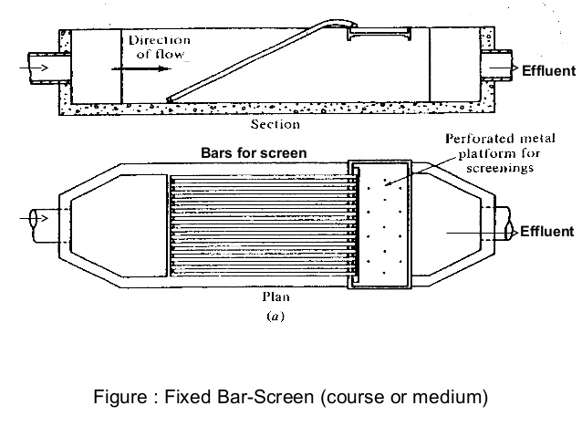
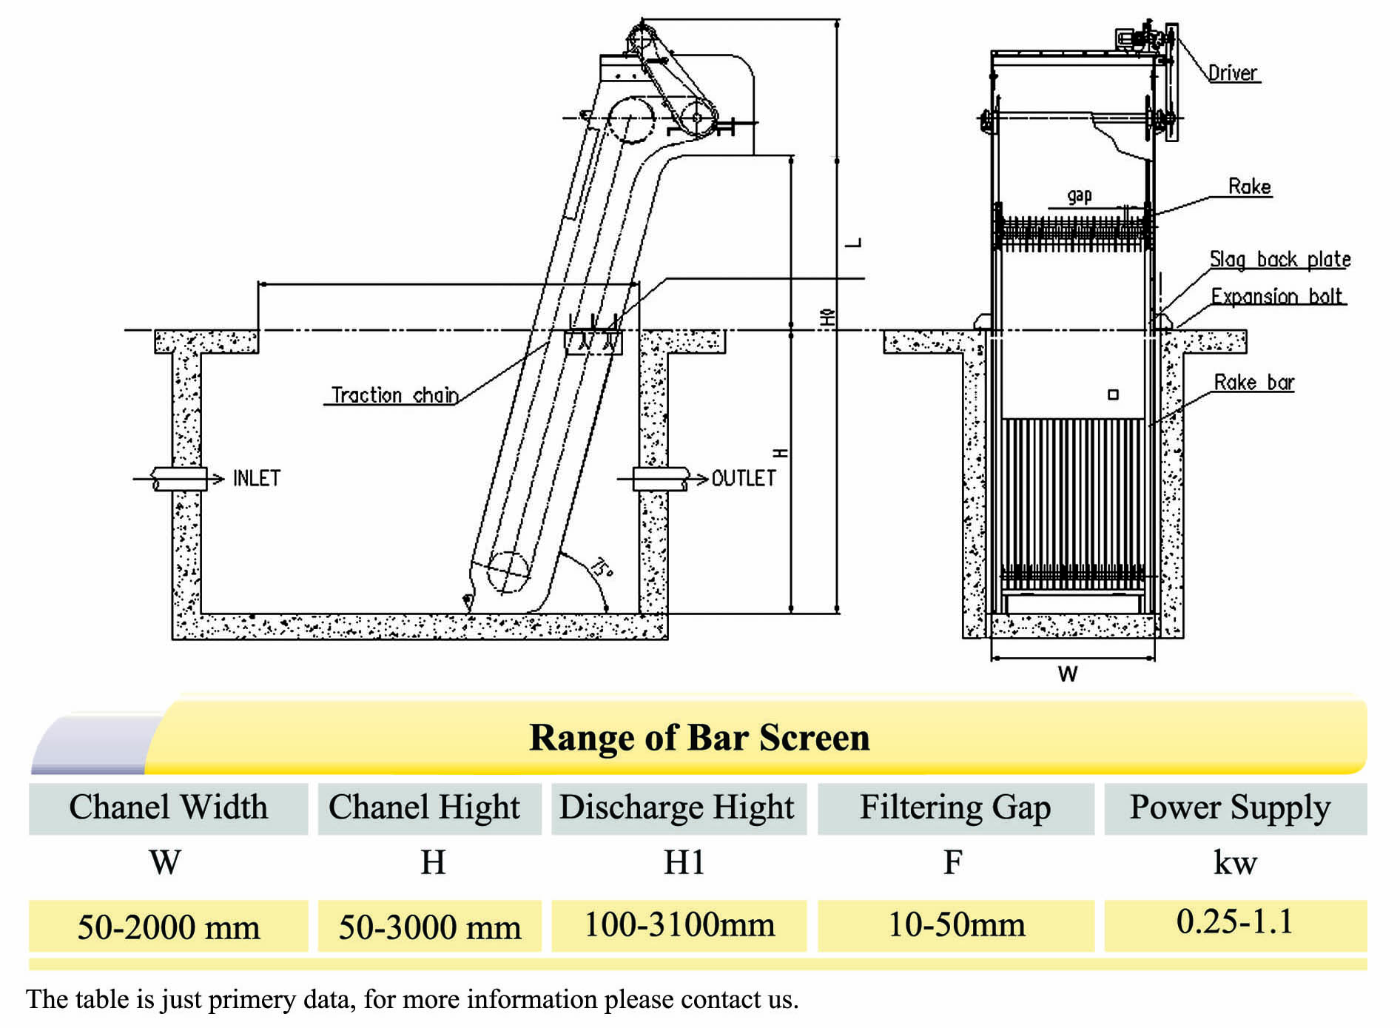
Screen:

Slide 4
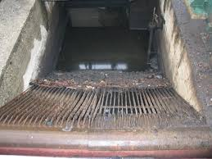
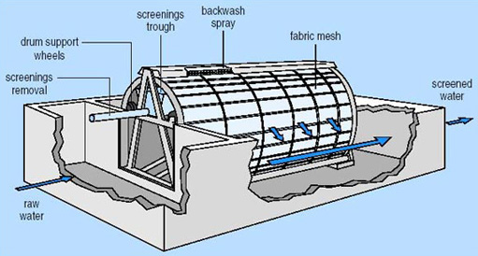

Slide 5
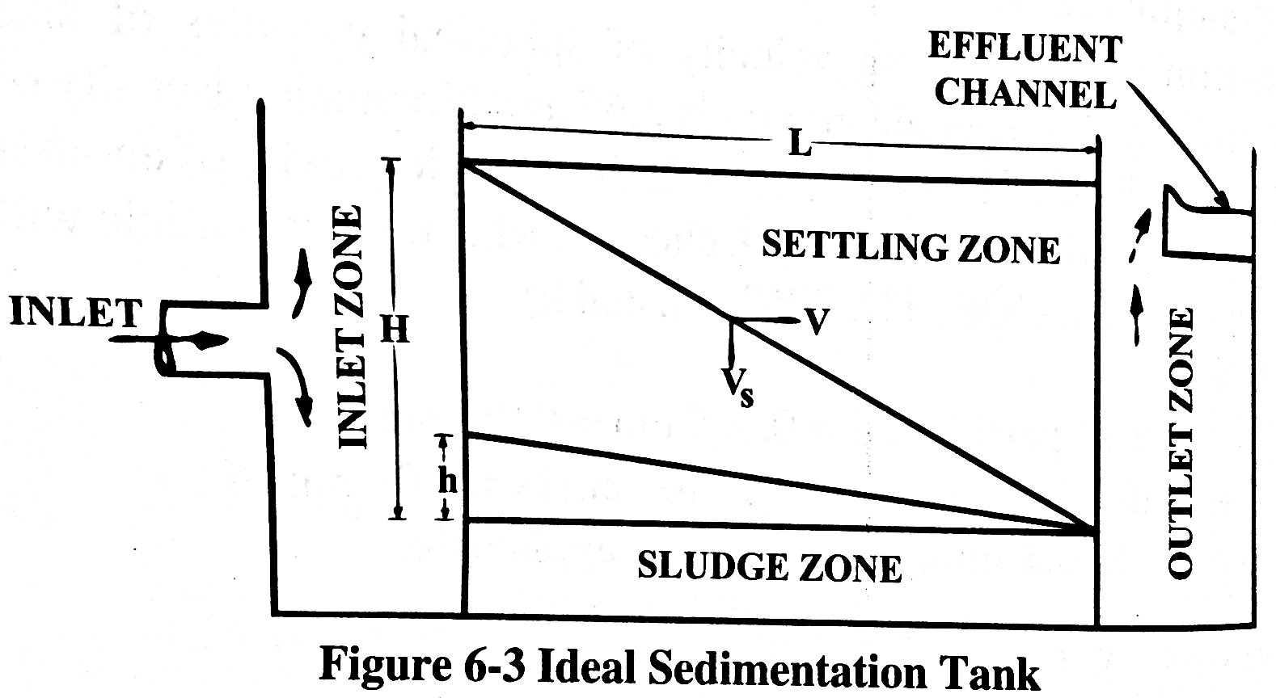
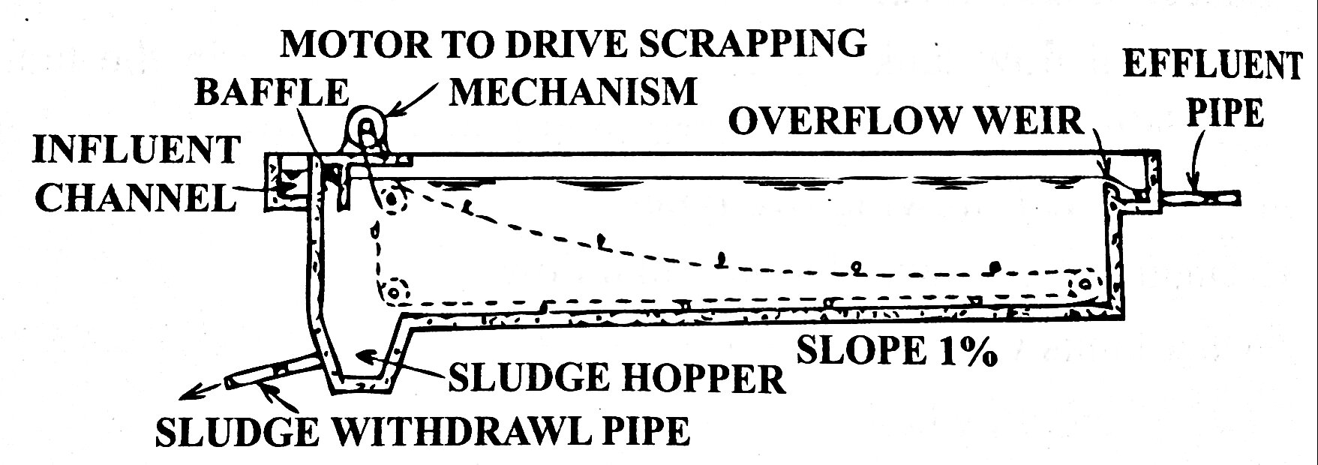
Plain Sedimentation

Slide 6
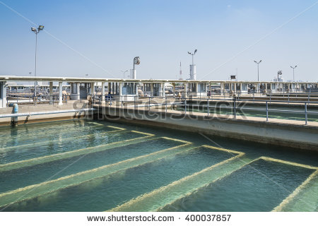
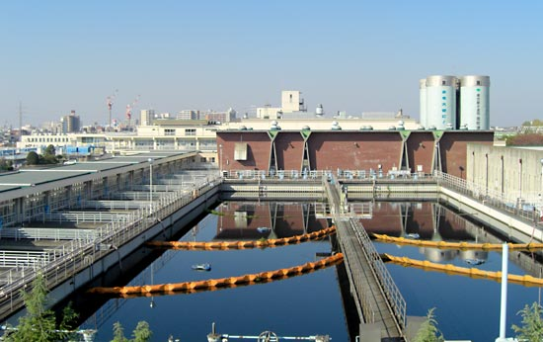

Slide 7
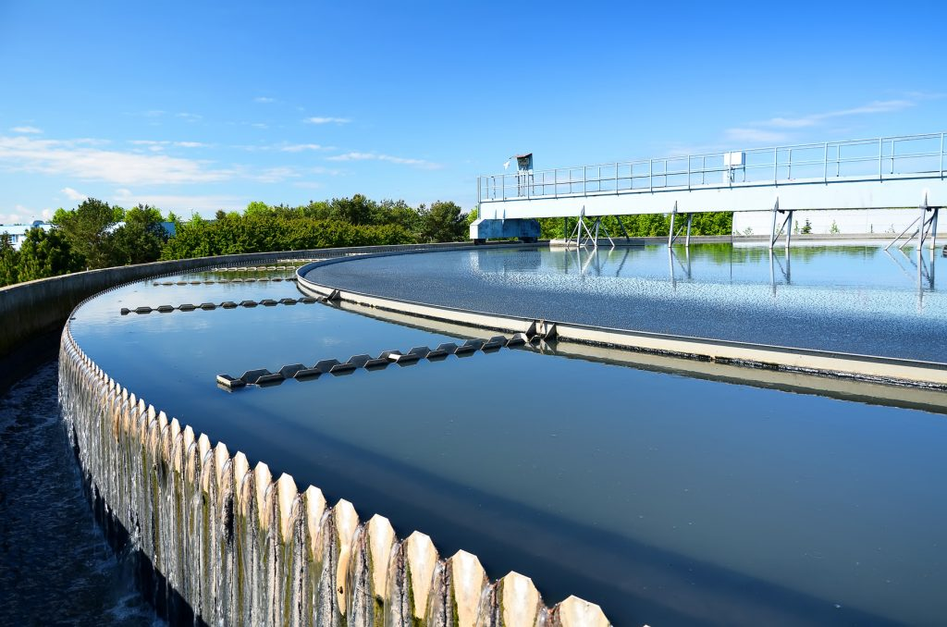
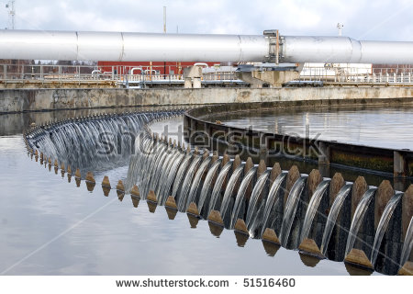

Slide 8
Q-A- City population 40000 capita in year 2000 and the population
in year 2009 is 65000 capita Find K” ? If P_{sat}. = 100000 capita.
Q-B- City population 50000 capita in year 2008 and the population
in year 2018 is 80000 capita Find P_{sat}. ? If K”=0.08.

Slide 9
Q-A- City population 50000 capita in year 2008 and the population
in year 2018 is 75000 capita Find K” ? If P_{sat}. = 100000 capita.
Q-B- City population 60000 capita in year 2000 and the population
in year 2009 is 80000 capita Find P_{sat}. ? If K”=0.06.

