Slide 1
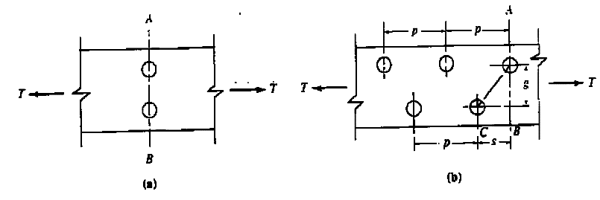
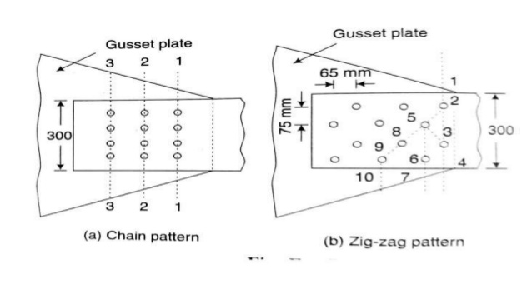
2.5 Effective of staggered holes on net area
Whenever there is more than one hole and the holes are not lined up transverse to the loading direction, more than one potential failure line may exist. See figures below:
In Figure (a) the failure line is along the section A-B. In Figure (b) showing two lines of staggered holes, the failure line might be through one hole (section A-B) or it might be along a diagonal path A-C.
The net lengths of path AC would be:
Net length of AC = length of (AB) – 2(width of hole + 1/16 in) + s^2/4g
S : is the stagger or spacing of adjacent holes parallel to the loading direction g : is the gage distance transverse to the loading direction

Slide 2
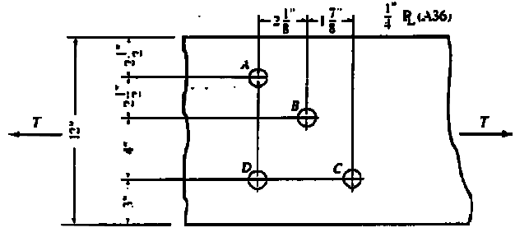
Example 3
Determine the minimum net area of the plate shown in Figure Assuming 15/16 in diameter holes is located as shown.
Solution
The width used in deducting holes is the hole diameter plus 1/16 in, and the staggered correction is S2/4g:
Path AD (two holes): [12- 2(15/16+ 1/16)]0.25=2.50 〖in〗^2
Path ABD (three holes; two staggers): [12- 3(15/16+ 1/16)+ 〖2.125〗^2/(4(2.5))+ 〖2.125〗^2/(4(4))]0.25=2.43 〖in〗^2
Path ABC (three holes; two staggers): [12- 3(15/16+ 1/16)+ 〖2.125〗^2/4(2.5) + 〖1.875〗^2/4(4) ]0.25=2.42 〖in〗^2 controls

Slide 3
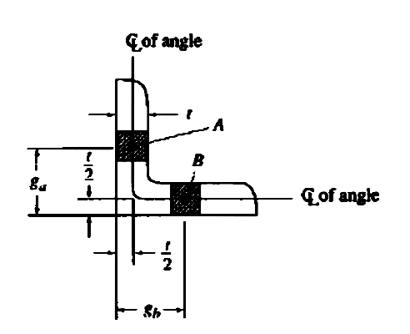
Angles
When holes staggered on two legs of an angle, the gage length g for use in the S2/4g expression is obtained by using a length between the centers of the holes measured along the centerline of the angle thickness.
Thus the gage distance g is:
g = ga- t/2 + gb - t/2 = ga + gb - t

Slide 4
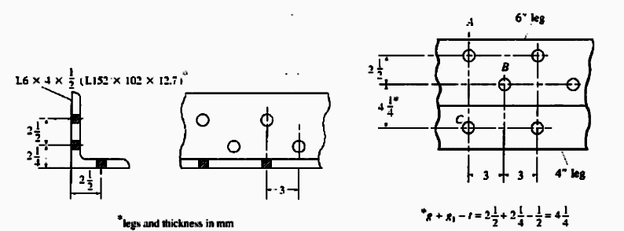
Example 4
Determine the net area An for the angle given in figure below. If 15/16 in. diameter holes are used.
Solution
For net area calculation the angle may be visualized as being flattened into a plate as shown in figure
An = Ag - ∑Dt + ∑s^2/4g t
Where :
D : is the width to be deducted for the hole.
Path AC:
An = 4.75 - 2(15/16+ 1/16)0.5=3.75 〖in〗^2
Path ABC:
An = 4.75 – 3(15/16+ 1/16)0.5+ [3^2/4(2.5) +3^2/4(4.25) ]0.5=3.96 〖in〗^2
Since the smallest An is 3.75 〖in〗^2, that value governs.

Slide 5
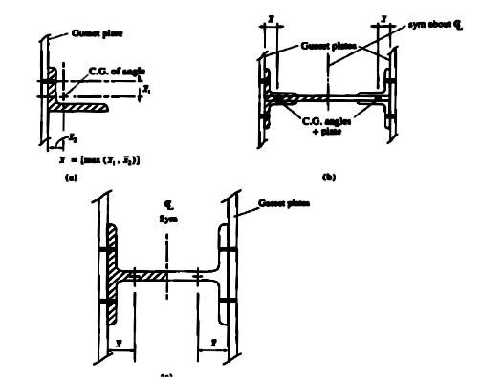
Effective net area
The net area as computed previously give the reduced section that resists tension but still may not correctly reflect the strength.
An angle section having connection to one leg only is an example of such a situation. For such cases the tensile force is not uniformly distributed over the net area.
Ae = U.An
U : reduction coefficient
U=1- x ̅/L ≤0.9
x ̅ : distance from centroid of element being connected eccentrically to plane of load transfer
L : length of connection in the direction of loading.

Slide 6
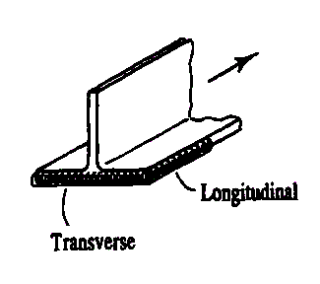
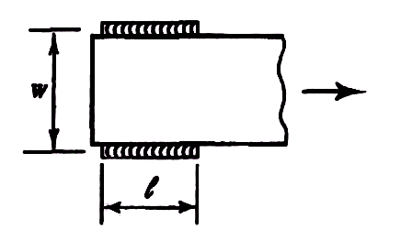
For welded tension connections:
Case 1: Load transmitted to a member other than a plate by longitudinal welds, or longitudinal welds in combination with transverse welds
Ae = UAn = UAg
Case 2: Load transmitted only by transverse welds
Ae = UAn = UAcon
Where :
Acon : area of directly connected elements.
Case 3: Load transmitted to a plate by longitudinal welds along both sides of the plate spaced apart such that L ≥ w
Ae = UAg
Where :
L : length of weld along one side of plate
w : distance between longitudinal welds (i.e., plate width)
U = 1.00 For L ≥ 2w
= 0.87 For 2w > L ≥ 1.5w
= 0.75 For 1.5w > L ≥ w
Note: If all cross-section is connected then, U = 1

Slide 7
For bolted connections :
Case 1: For W, M and S shapes (and T shapes cut from them) that have a (bf/d)>2/3 are connected through the flanges with at least 3 bolts per line.
U = 0.9
Case 2: For all other shapes with at least 3 bolt per line
U = 0.85
Case 3: For all members with only two bolts per line.
U = 0.75

Slide 8
THANKS FOR YOUR ATTENTION

