Slide 1
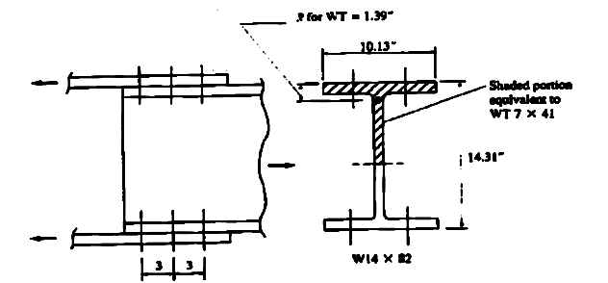
Example 5
Determine the reduction factor U to be applied in computing the effective net area for a W14x82 section connected by plates at its two flanges, as shown in Figure. There are three bolts along each connection line.
Solution:
bf/d=10.13/14.31
=0.71>0.67 ok
The half W shape corresponds to a structural tee WT7x14, whose centroidal distance x ̅ is given by the AISC Manual as 1.39 in
The length L of the connection is 6 in,
U = 1 – ( 1.39)/6.0= 0.77 ≤ 0.9 ok

Slide 2
Slenderness Limitations
There is no maximum slenderness limit for design of members in tension.
For members designed on the basis of tension, the slenderness ratio L/r preferably should not exceed 300.

Slide 3
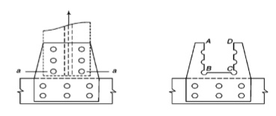
Block Shear
It is a tearing failure mode involving shear rupture along one path, such as through a line of bolt holes, and tensile rupture along a perpendicular line.
For example, the single angle tension member connected as shown in the Figure below is susceptible to the phenomenon of block shear.
For the case shown above,
shear failure will occur along the longitudinal section a-b
and tension failure will occur along the transverse section b-c

Slide 4
Block shear strength is determined as the sum of the shear strength on a failure path and the tensile strength on a perpendicular segment.
Block shear strength = net section fracture strength on shear path + gross yielding strength on the tension path
OR
Block shear strength = gross yielding strength of the shear path + net section fracture strength of the tension path
Which of the two calculations above governs?
If FuAnt ≥ 0.6FuAnv , then ϕRn = ϕ (0.6FyAgv + FuAnt)
If 0.6FuAnv ≥ FuAnt , then ϕRn = ϕ (0.6FuAnv + FyAgt).
Where :
ϕ =0.75,
Fu (ksi) is the tensile strength of the material,
Fy (ksi) is the yield stress of the material,
Agv (in2) is the gross area subject to shear,
Agt (in2) is the gross area subject to tension,
Anv (in2) is the net area subject to shear, and
Ant (in2) is the net area subject to tension.

Slide 5
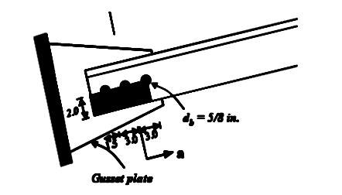
Example 6
Calculate the block shear strength of the single angle tension member L 4 x 4 x 3/8in. made from A36 steel is connected to the gusset plate with 5/8 in. diameter bolts as shown below. The bolt spacing is 3 in. center-to-center and the edge distances are 1.5 in and 2.0 in.
Solution:
Step I. Assume a block shear path and calculate the required areas
• Agt = gross tension area = 2.0 x 3/8 = 0.75 in2
• Ant = net tension area = 0.75 – 0.5 x (5/8 + 1/8) x 3/8 = 0.609 in2
• Agv = gross shear area = (3.0 + 3.0 +1.5) x 3/8 = 2.813 in2
• Anv = net tension area = 2.813 – 2.5 x (5/8 + 1/8) x 3/8 = 2.109 in2
Step II. Calculate which equation governs
• 0.6 Fu Anv = 0.6 x 58 x 2.109 = 73.393 kips
• Fu Ant = 58 x 0.609 = 35.322 kips
0.6Fu Anv > Fu Ant
Therefore, equation with fracture of shear path governs
Step III. Calculate block shear strength
ϕRn = 0.75 (0.6 Fu Anv+ FyAgt)
ϕRn = 0.75 (73.393 + 36 x 0.75) = 75.294 kips

Slide 6
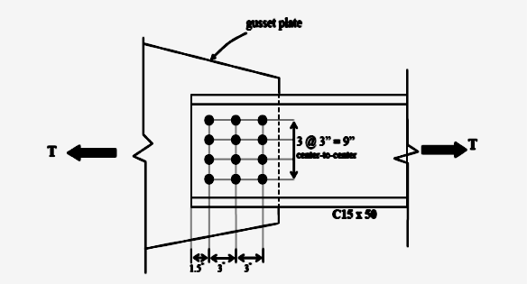
Example 7
Determine the design tension strength for a single channel C15 x 50 connected to a 0.5 in. thick gusset plate as shown in Figure. Assume that the holes are for 3/4 in. diameter bolts and that the plate is made from structural steel with yield stress (Fy) equal to 50 ksi and ultimate stress (Fu) equal to 65 ksi.
Solution:
Limit state of yielding due to tension:
∅t Pn=0.9x50x14.7=662 kips
Limit state of fracture due to tension:
An = Ag – n(dh)t = 14.7 – 4(3/4+1/8)(0.716) = 12.19 in2
Ae = UAn = (1- x ̅/L)A_n= (1- 0.789/6)x 12.19=10.57 〖in〗^2
Check: U = 0.867 ≤ 0.85 say o.k.
Note: The connection eccentricity, x, for a C15X50 can be found on page 1-51 (LRFD).
∅t Pn=0.75x65x10.57=515 kips
Limit state of block shear rupture:
0.6 Fu Anv = 0.6 * 65 [2*(7.5-2.5*7/8)]*0.716 = 269.6925 kips
FuAnt = 65 [9-3(7/8)]*0.716 = 296.6925 kips
.
FuAnt ≥ 0.6 Fu Anv
ϕRn = ϕ [0.6FuAnv + FuAnt]
ϕRn = 0.75[0.6*50*15*0.716+65 269.6925/65] = 464 kips
Block shear rupture is the critical limit state and the design tension strength is 464kips.

Slide 7
THANKS FOR YOUR ATTENTION

