Slide 1
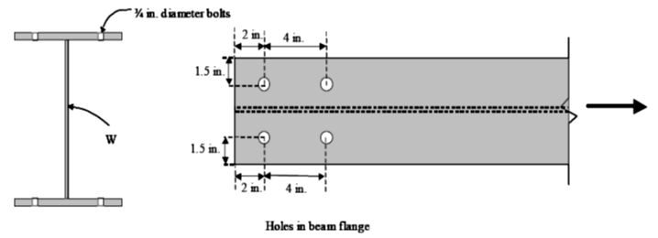
Example 11: Design a member to carry a factored maximum tension load of 100 kips. Assume that the member is a wide flange connected through the flanges using eight ¾ in. diameter bolts in two rows of four each (see Figure). The center-to-center distance of the bolts in the direction of loading is 4 in. The edge distances are 1.5 in. and 2.0 in. as shown in the figure below. Steel material is A992
Solution:
Step 1: Select a section from the Tables
Step 2: Check gross yielding strength
ϕt Pn = ϕt FyAg =0.9 (50) (2.96)
=133 kips< 100kips
Ag ≥ Pu/(0.9 Fy ), Ag ≥ 100/(0.9x50) =2.22in2
Ae ≥ Pu/(0.75 Fu), Ag ≥ 100/(0.75x65) =2.05in2
From table (1-42) select W 8x10------Ag=2.96in2
Step 3: Calculate the net section fracture strength for the actual connection
- According to the Figure above, An = Ag - 4 (db + 1/8) x tf
- An = 2.96 - 4 (3/4 + 1/8) x 0.205 = 2.24 in2
Calculate U : of a WT 4 x 5 , x ̅= 0.953 U = 1- x ̅/L = 1 - 0.953 / 4 = 0.76
Ae = 0.76 An = 0.76 x 2.24 = 1.70 in2
∅t P_n= 0.75 x Fu x Ae = 0.75 x 65 x 1.70 = 82.9 kips >100 kips;
Step 4: Redesign Many ways to redesign. One way is shown here:
- Assume ∅t Pn > 100 kips , - Therefore, 0.75 x 65 x Ae > 100 kips , - Therefore, Ae > 2.051 in2
- Assume, Ae = 0.76 An (based on previous calculations, step 3)
- Therefore An > 2.7 in2
But, Ag = An + 4 (db + 1/8) x tf (based on previous calculations, step 3) , - Therefore Ag > 2.7 + 3.5 x tf
For W 8 x 13, tf = 0.255 in. Therefore, Ag > 2.7 + 3.5 x 0.255 = 3.59 in2
From Table 1-42, W8 x 13 has Ag = 3.84 in2 > 3.59 in2 Therefore, W8 x 13 is acceptable and is chosen.

Slide 2
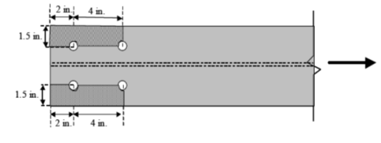
Step 5: Check selected section for net section fracture
- Ag = 3.84 in2
- An = 3.84 - 3.5 x 0.255 = 2.95 in2
- From dimensions of WT4 x 6.5, x = 1.03 in.
- Therefore, U = 1- x ̅/L = 1-1.03/4 = 0.74
- Therefore, Ae = U An = 0.74 x 2.95 = 2.19 in2
- Therefore, net section fracture strength = 0.75 x 65 x 2.19 = 106.7 kips
- Which is greater than 100 kips (design load). Therefore, W 8 x 13 is acceptable.
Step 6: Check the block shear rupture strength
Identify the block shear path
- Agv = [(4+2) x tf ] x 4 = 6 x 0.255 x 4 = 6.12 in2 - for four tabs
- Anv = {4+2 - 1.5 x (db+1/8)} x tf x 4 = 4.78 in2
- Agt = 1.5 x tf x 4 = 1.53 in2
- Ant = {1.5 - 0.5 x (db+1/8)}x tf x 4 = 1.084 in2
Identify the governing equation:
FuAnt = 65 x 1.084 = 70.4 kips
0.6 FuAnv = 0.6 x 65 x 4.78 = 186.42 kips , which is > FuAn
Calculate block shear strength
- ∅t Rn = 0.75 (0.6 FuAnv + FyAgt) = 0.75 (186.42 + 50 x 1.53) = 197.2 kips
Which is greater than Pu = 100 kips.
Therefore W8 x 13 is still acceptable
Summary of solution

Slide 3
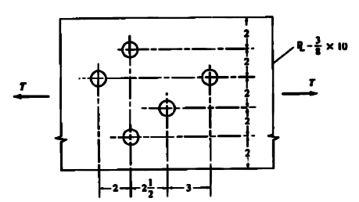
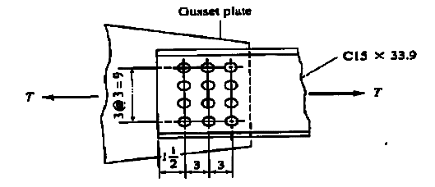
Problems
1. Compute the maximum acceptable tensile service load that may act on a single angle L6x4x3/4in 7 that is welded along only one leg to gusset plate, thus there are no holes. The service live load is three times the dead load. Solve for (a) A36 steel and (b) A572Grade 50 steel.
2. Compute the maximum acceptable tensile service load the angle in Problem (1) may carry when connected on both legs. The 4-in leg contains a single gage line of ( 7)/8 in diam. Bolts, and the 6-in leg contains a double gage line of 7/8 in-diam. Bolts. Assume no stagger of bolts, and that all bolts participate in carrying load.
3. Compute the maximum acceptable service load on an A36 steel plate tension member 1/4 in x 12in having a single line of holes parallel to the direction of loading. The load is 25% dead load and 75% live load and 7/8in diam. Blots are used..
4. Compute the net area An for the plate (a connecting element according to LRFD) shown in the accompanying Figure below . Then compute the maximum value of service load T when A36 steel is used, the live load is four times the dead load and the holes are 13/16 in diameter.
5. Determine the maximum allowable tensile load (20% dead load, 80% live load) for a single C15x33.9 fastened to a 1/2 in gusset plate as in the accompanying as shown in Figure below. Use A36 steel and assume holes are for 3/4 in diam. bolts. Base answer on tension strength of the channel and include shear rupture strength.

Slide 4
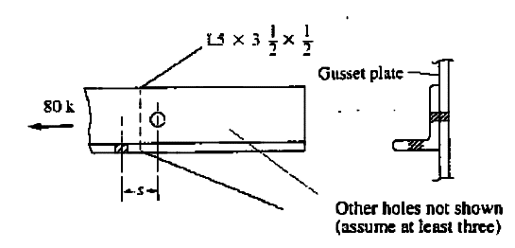
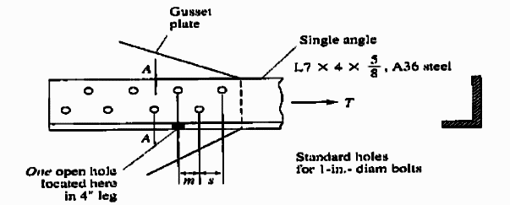
6. An L5 X 31/2 X 1/2 angle, as shown in Figure below is to carry 20 kips dead load and 70 kips live load using the shortest length of connection using two gage lines of bolts in the 5 in leg. What is the minimum acceptable stagger, theoretical and specified (1/2 in multiples) using A572 Grade 50 steel
7. Compute the minimum value of s that could theoretically be used as shown in Figure below. Such that the maximum factored tensile force Tu may be carried. Assume m is Large enough so that a failure pattern through the open hole will not govern include consideration of shear rupture strength.
8. Assuming that s for the angle of Prob.7 is made as large as required in Prob.7, compute the minimum distance m required so that the open hole in the 4 in leg will not reduce the strength below its maximum possible value. If Prob. 7 is not solved assume s is 3.75 in.

Slide 5
THANKS FOR YOUR ATTENTION

