Slide 1
Design of Bolted Connections
Introduction:
Failure of structural member is not common, but most structural failures are caused by poorly designed or detailed connections. In past time, the pin device most often used was the rivet. Since the 1950 the high strength bolts have substituted. The rivet as the primary connector for structural steel connection.
There are different types of bolted connections. They can be categorizes based on the type of loading:
The tension member lap splice shown in Figure 1, produces forces that lend to shear the shank of the fastener.
The hanger connection shown Figure 2 subjects the fastener to tension.
The connection shown in Figure 3 subjects the upper row of fastener to both shear and tension.
Figure(1)
Figure(2)
Figure(3)

Slide 2
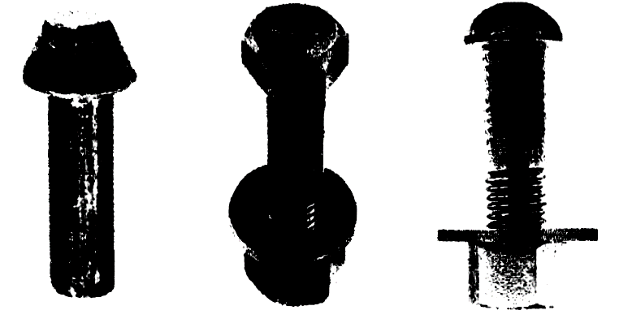
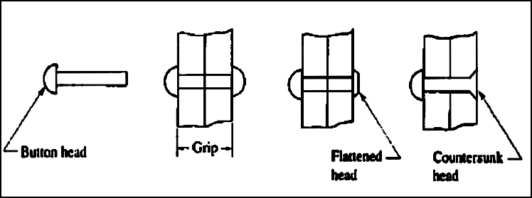
Simple Connection considerations:
1. Simple connection: If the line of action of the force acting on the connection passes through the center of gravity of the connection, then each bolt can be assumed to resist an equal share of the load.
2. The strength of the simple connection will be equal to the sum of the strengths of the individual bolts in the connection.
Most common types of fasteners in structural joints
A. High-Strength Bolts:
The two basic types of high-strength bolts are designated as ASTM A325 and A490
A325 bolts are of heat-treated medium carbon steel having an approximate yield strength of 81 to 92 ksi (560 to 630 MPa) depending on diameter.
A490 bolts are also heat-treated but are alloy steel having an approximate yield strength of 115 to 130 ksi (790 to 900 MPa) depending on diameter
B. Rivets
Rivet steel is a mild carbon steel designated by SATM as A502 (Fy = 28 ksi) (190 MPa) and (Fy = 38 ksi) (260 MPa) with the minimum specified yield strength based on bar stock as rolled.
C. Unfinished Bolts
Bolts of low-carbon steel designated ASTM A307 are the least expensive bolt..

Slide 3
Connections Classification: Connections may be classified according to:
1- Method of fastening, such as rivets, bolts or welding.
2- Connection rigidity
Type 1 : rigid connections that develop the full moment capacity
Type 2 : simple framing with no moment transfer assumed between the connected parts.
Type 3 : semi rigid connections with less than the full moment capacity of the connected members being transferred.
3-Type of forces transferred across the structural connection.
A. Shear forces common for floor beams and joints.
B. Moment : either bending or torsion.
C. Shear and moment : as in type 1 or 3 connection.
D. Tension or compression : as for column splices and for "pinned" truss member.
E. Tension or compression with shear : as for diagonal bracing.
4- Fabrication location
A. Shop connections
B. Field connections.
5. Joint resistance: Friction connection.

Slide 4
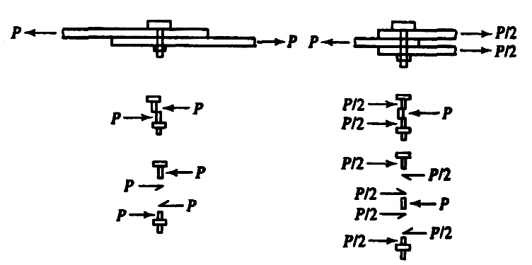
Bolted Shear Connections
Possible failure modes are:
a. Shear failure of the bolts
b. Failure of member being connected due to fracture or block shear or ….
c. Edge tearing or fracture of the connected plate
d. Tearing or fracture of the connected plate between two bolt holes
e. Excessive bearing deformation at the bolt hole
Shear failure of bolts
Average shearing stress in the bolt :
fv = P/A = P/(π db^2/4)
P is the load acting on an individual bolt
A is the area of the bolt and db is its diameter
Strength of the bolt = P = fv x (π db^2/4)
Where:
fv = shear yield stress = 0.6Fy.
.

Slide 5
THANKS FOR YOUR ATTENTION

