Slide 1
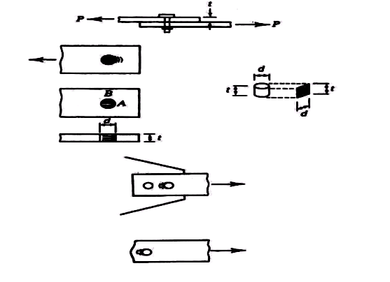
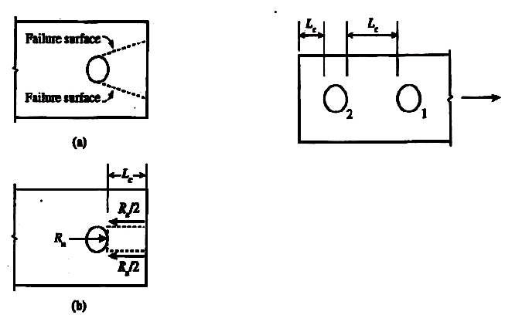
Failure of connected member
Member can fail due to tension fracture or block shear.
Bearing failure of connected/connecting part due to bearing from bolt holes.
This type of shear tear-out can also occur between two holes in the direction of the bearing load.
Rn = 2 x 0.6 Fu Lc t = 1.2 Fu Lc t
This upper limit is proportional to the fracture stress times the projected bearing area
Rn = C x Fu x bearing area = C Fu db t
C = 2.4 corresponds to a deformation of 0.25 in.
∅ = 0.75
Rn = 1.2 Lc t Fu < 2.4 db t Fu
Lc = is the clear distance in the load direction,
Fu = tensile strength of the plate material
t = thickness of the plate material
d= diameter of the bolt

Slide 2
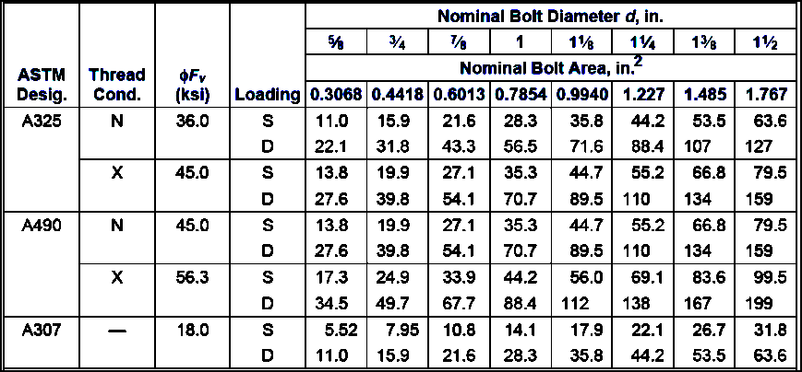
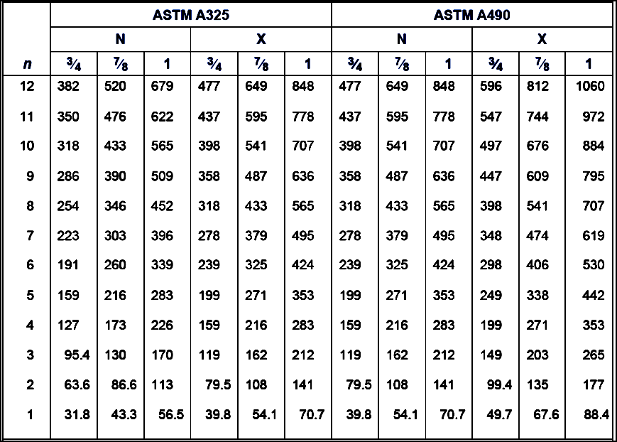
Table 5.5 Design Shear Strength of One Bolt, kips.
Table 5.6. Design Shear Strength of n Bolts in Double Shear

Slide 3
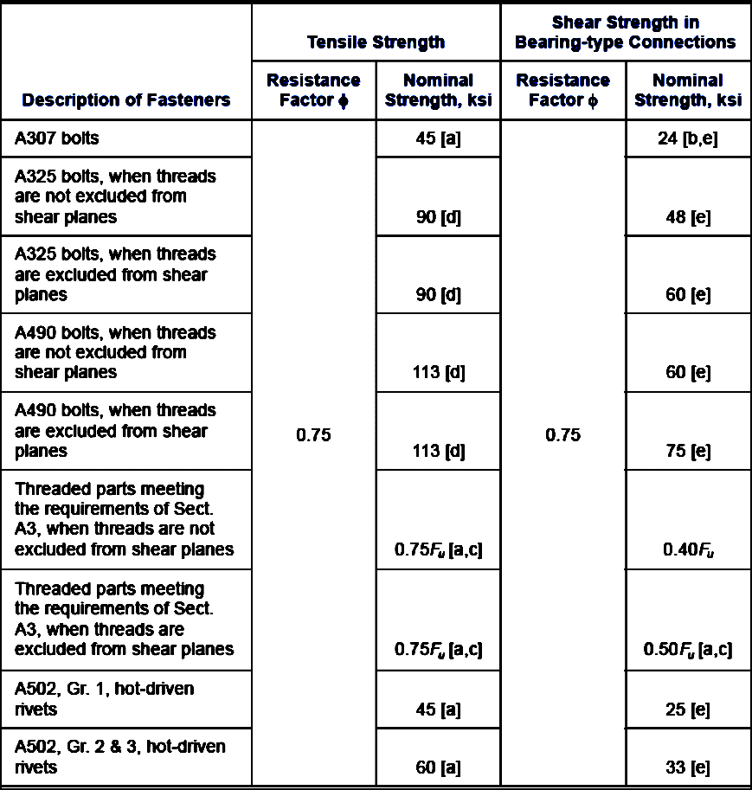
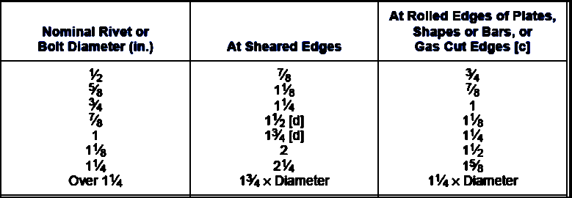
Table 5.7 Design Strength of Fasteners
Table 5.9 Minimum Edge Distance,[a] in.
Note: the minimum distance (s) between the centers of bolt holes is 2 2/3db . A distance of 3db is preferred.

Slide 4
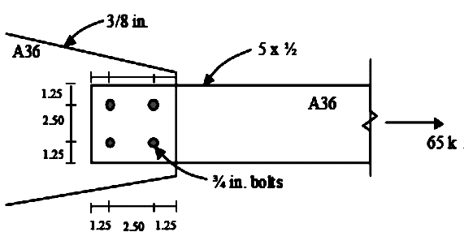
Example: Calculate and check the design strength of the connection shown in Figure. Is the connection adequate for carrying the factored load of 65 kips.
Solution
Step 1: Shear strength of bolts
The design shear strength of one bolt in shear =
∅ Fn Ab = 0.75 x 48 x π x 0.752/4
∅ Fn Ab = 15.9 kips per bolt (See Table 5.6)
Shear strength of connection = 4 x 15.9 = 63.6 kips
Step 2:. Minimum edge distance and spacing requirements
See Table 5.9, minimum edge distance = 1 in. for rolled edges of plates
The given edge distances (1.25 in.) > 1 in. Therefore, minimum edge distance requirements are satisfied
• Minimum spacing = 2.67 db = 2.67 x 0.75 = 2.0 in.
• Preferred spacing = 3.0 db = 3.0 x 0.75 = 2.25 in.
The given spacing (2.5 in.) > 2.25 in. Therefore, spacing requirements are satisfied.
.
Step 3: Bearing strength at bolt holes.
• Bearing strength at bolt holes in connected part (5 x ½ in. plate)
At edges, Lc = 1.25 – hole diameter/2 = 1.25 – (3/4 + 1/16)/2 = 0.844 in.
∅Rn = 0.75 x (1.2 Lc t Fu) = 0.75 x (1.2 x 0.844 x 0.5 x 58) = 22.02 kips
- But, ∅Rn ≤ 0.75 (2.4 db t Fu) = 0.75 x (2.4 x 0.75 x 0.5 x 58) = 39.15 kips
- Therefore, ∅Rn = 22.02 kips at edge holes
At other holes, S = 2.5 in, Lc = 2.5 – (3/4 +1/16) = 1.688 in.
∅Rn = 0.75 x (1.2 Lc t Fu) = 0.75 x (1.2 x 1.688 x 0.5 x 58) = 44.05 kips
- But, ∅Rn ≤ 0.75 (2.4 db t Fu) = 39.15 kips. Therefore ∅Rn = 39.15 kips
- Therefore, ∅Rn = 39.15 kips at other holes
Therefore, bearing strength at holes = 2 x 22.02 + 2 x 39.15 = 122.34 kips

Slide 5
• Bearing strength at bolt holes in gusset plate (3/8 in. plate)
At edges, Lc = 1.25 – hole diameter/2 = 1.25 – (3/4 + 1/16)/2 = 0.844 in.
∅Rn = 0.75 x (1.2 Lc t Fu) = 0.75 x (1.2 x 0.844 x 0.375 x 58) = 16.52 kips
- But, φRn ≤ 0.75 (2.4 db t Fu) = 0.75 x (2.4 x 0.75 x 0.375 x 58) = 29.36 kips
- Therefore, ∅Rn = 22.02 kips at edge holes
- At other holes, S = 2.5 in,
Lc = 2.5 – (3/4 +1/16) = 1.688 in.
∅Rn = 0.75 x (1.2 Lc t Fu) = 0.75 x (1.2 x 1.688 x 0.375 x 58) = 33.04 kips
But, ∅Rn ≤ 0.75 (2.4 db t Fu) = 29.36 kips
- Therefore, ∅Rn = 29.36 kips at other holes
- Therefore, bearing strength at holes
= 2 x 16.52 + 2 x 29.36 = 91.76 kips
Connection Strength
Shear strength = 63.3 kips
Bearing strength (plate) = 122.34 kips
Bearing strength (gusset) = 91.76 kips

Slide 6
THANKS FOR YOUR ATTENTION

