Slide 1
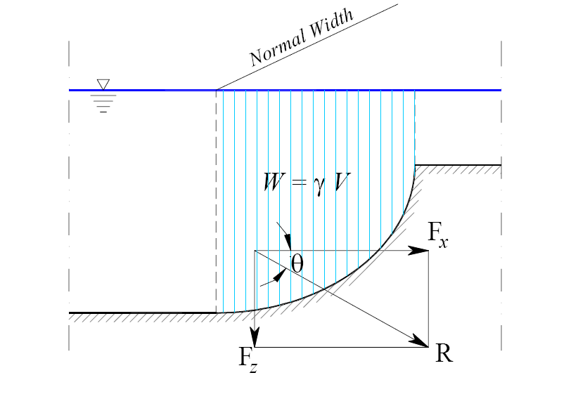
Fluid Mechanics Class Note
Dr. Qassem Hamed Jalut Associate Professor
Hydrostatic Force on a Curved Submerged Surface
Because of the curvature of the surface, the direction of the resultant force is not pre-determined as in the previous case. One needs to decompose the force to its horizontal and vertical components
(Fx, and Fz) and find the points of application for each.
The horizontal component, F_{x} (of the resultant force on a curved submerged surface) is found by taking the projection of the curved surface onto a vertical place and finding the force and its point of application based on the formulation above.
Where A is the vertical projection area of the curved surface.

Slide 2
Fluid Mechanics Class Note
Dr. Qassem Hamed Jalut Associate Professor
The vertical component, F_{z} (of the resultant force on a curved submerged surface) is the weight of the fluid above the curved surface up to the free surface.
Where V is the volume of water over the curved surface up to the water surface.
Resultant force
The angle the resultant force makes to the horizontal is

Slide 3
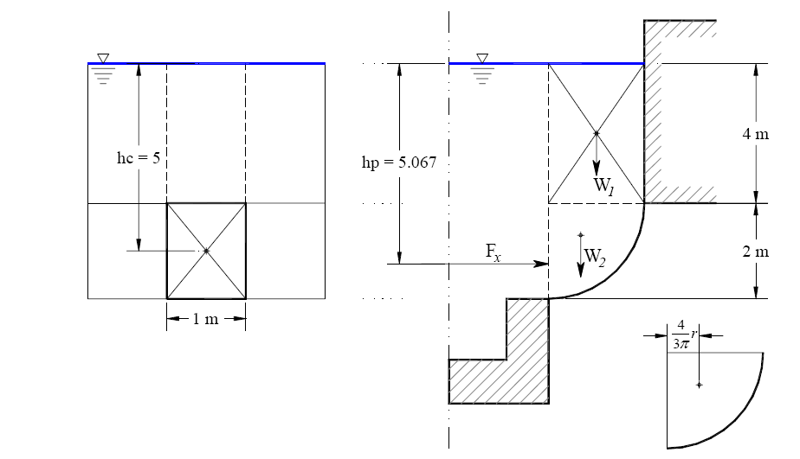
Fluid Mechanics Class Note
Dr. Qassem Hamed Jalut Associate Professor
Example 1: Hydrostatic force on a curved surface.
Given: R = 2.0 m and h = 4.0 m Find: The resultant force on the curved surface per unit length.
Solution:
60

Slide 4
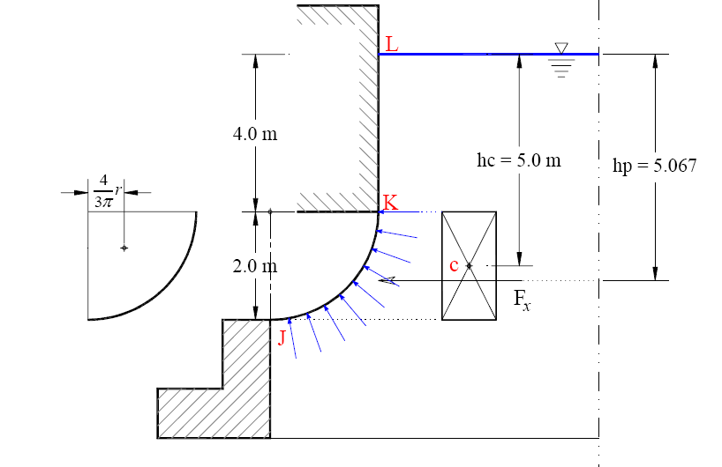
Fluid Mechanics Class Note
Dr. Qassem Hamed Jalut Associate Professor
Example 2: Hydrostatic force on a curved surface.
Given: R = 2.0 m and h = 4.0 m . Find: The resultant force on the curved surface per unit length
Solution:
Note that water is on the right side this time

Slide 5
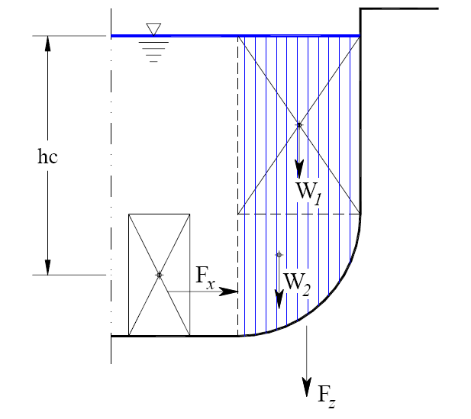
Fluid Mechanics Class Note
Dr. Qassem Hamed Jalut Associate Professor
Summary of pressure on curved surfaces
Case 1: Liquid overtop the curved surface:
1- Horizontal component of the hydrostatic force: Treat the problem as if it was a plain, vertical surface Magnitude:
Acting at location:

Slide 6
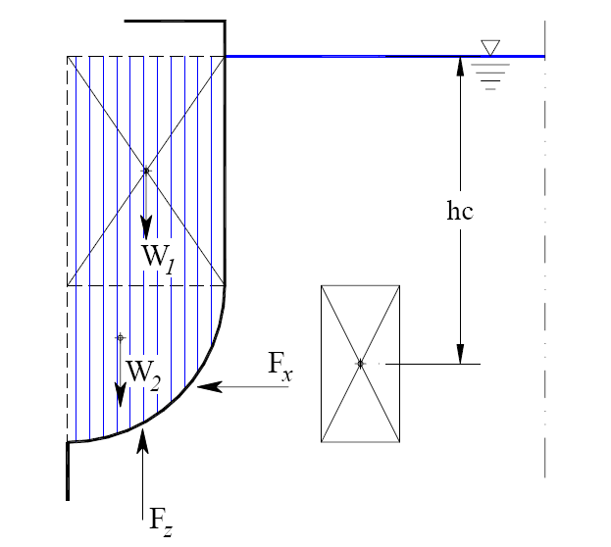
Fluid Mechanics Class Note
Dr. Qassem Hamed Jalut Associate Professor
2- Vertical component of the hydrostatic force
Calculate weight of the block of fluid above the surface Magnitude
Acting at location datum)
(distance of the resultant of water weight to a specific
Case 2: Liquid underneath the curved surface:

Slide 7
Fluid Mechanics Class Note
Dr. Qassem Hamed Jalut Associate Professor
1- Horizontal component of the hydrostatic force:
Treat the problem as if it was a plain, vertical surface Magnitude:
Acting at location:
2- Vertical component of the hydrostatic force
Calculate the weight of the block of fluid displaced by the surface Magnitude
Acting at specific datum)
location (distance of the resultant of water weight to a

