Slide 1
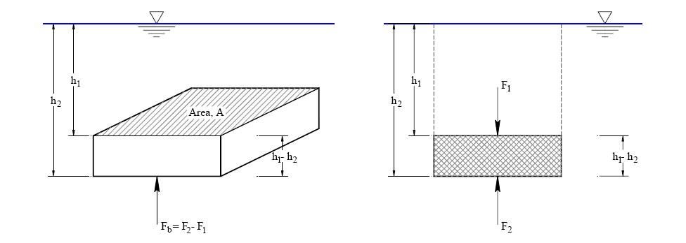

Fluid Mechanics Class Note
Dr. Qassem Hamed Jalut Associate Professor
Buoyancy
FB = buoyant force = net vertical force exerted by fluid on an immersed or floating body
Case 1: Submerged object
The water pressure is equally distributed all over the submerged body, but because the direction of moving force (gravity) is downward, we take the balance of the acting forces in the vertical direction.
The water pressure force acting on the top surface (F1) is equal to the weight of the volume of fluid above the top surface.
F2 is equal to the weight of the volume of fluid above the bottom surface.

Slide 2


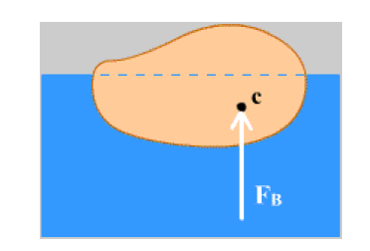
Fluid Mechanics Class Note
Dr. Qassem Hamed Jalut Associate Professor
The difference between the two forces is equal to the buoyancy force Fb.
The difference between the volumes is equal to the volume of the submerged body, which is equal to the volume of the displaced fluid.
The basic principle of buoyancy is Archimedes’ Principle: The buoyant force acting on a submerged body is equal to the weight of the fluid displaced by the body.

Slide 3
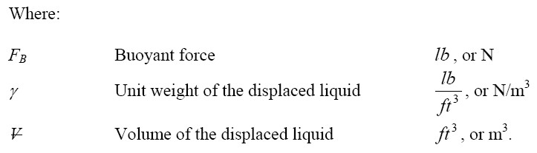

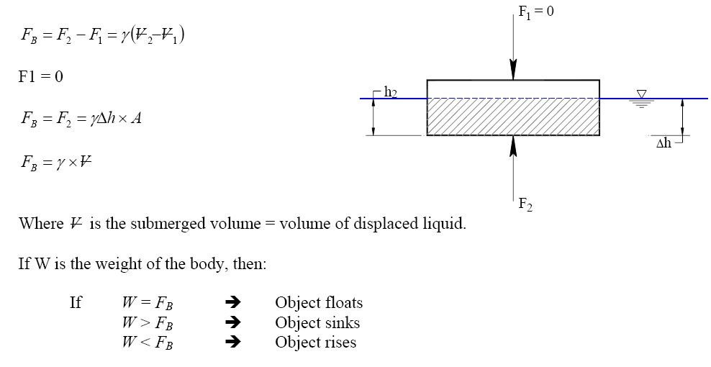
Fluid Mechanics Class Note
Dr. Qassem Hamed Jalut Associate Professor
Archimedes made use of the principle to find out if the crown of the king was made of pure gold, or made of gold and silver. Can you tell how??
He weighted the crown (W1), and then got an equivalent weight of pure gold. Assuming that the density of both the crown, and the pure gold are the same, the volume of them should be the same:
So, he placed them in water, and watched for the displaced volume. If the two objects displaced the same volume of water, then they are made of the same material.
Case 2: Floating object

Slide 4
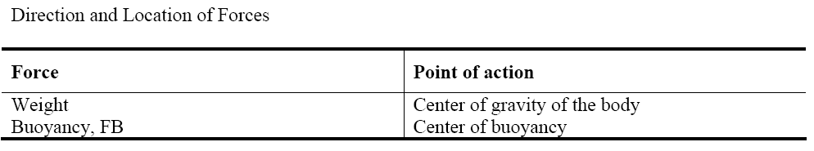
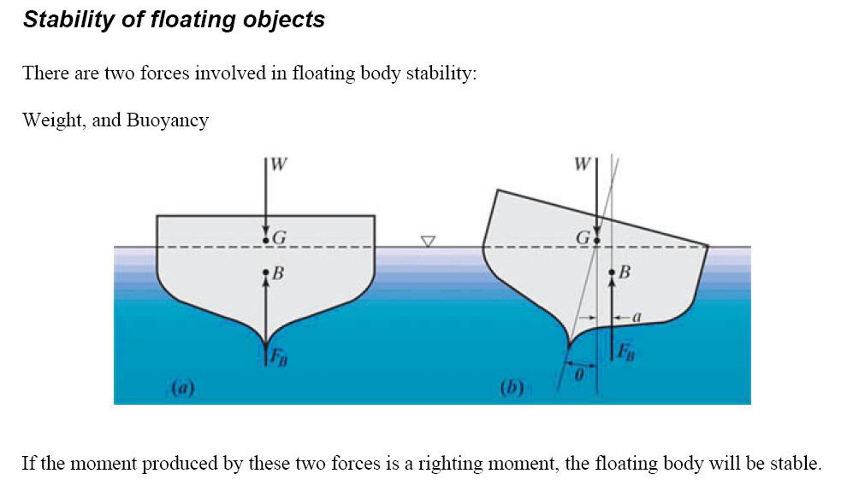
Fluid Mechanics Class Note
Dr. Qassem Hamed Jalut Associate Professor
Example Problem: Buoyancy Force
Given: A buoy is attached to the floor of a bay with a flexible cable. The buoy is designed to float
in seawater (γ = 10.1 kN/m3) during both high and low tide. During a storm surge, however, the spherical buoy may become completely submerged.
Find: The tension in the cable, if the 1.50 m diameter buoy weighs 8.5kN becomes
submerged.

Slide 5
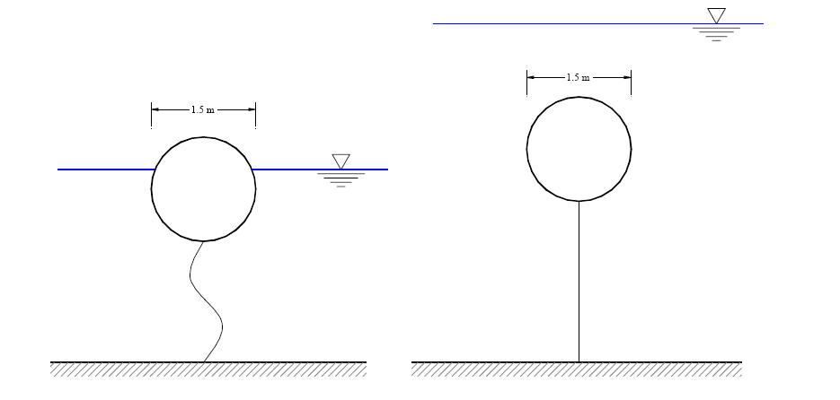
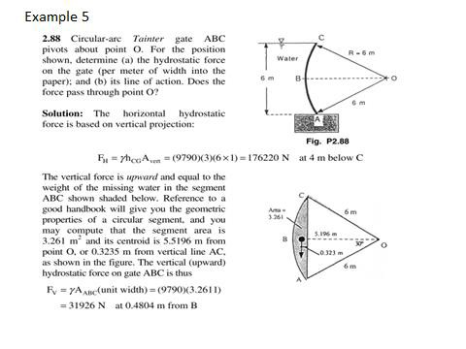
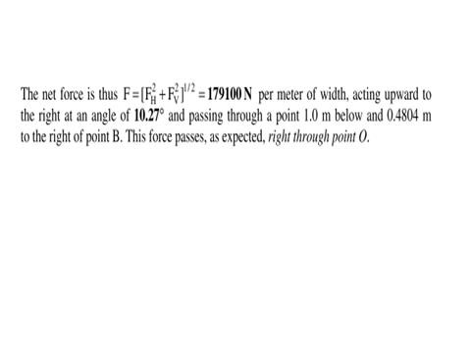
Fluid Mechanics Class Note
Dr. Qassem Hamed Jalut Associate Professor

Slide 6
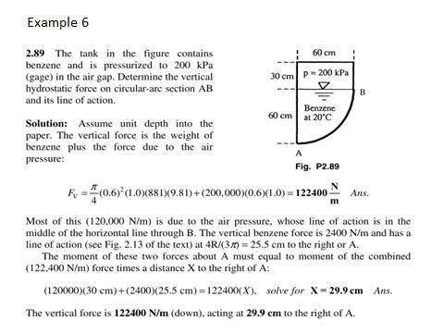
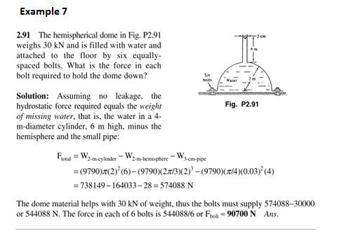
Fluid Mechanics Class Note
Dr. Qassem Hamed Jalut Associate Professor
70

Slide 7
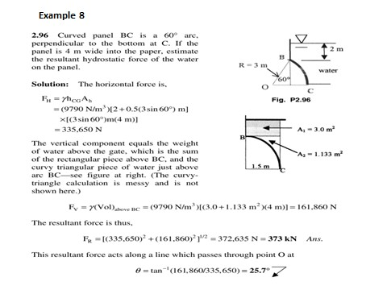
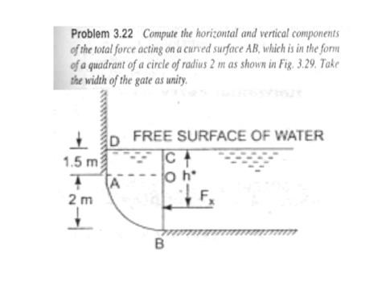
Fluid Mechanics Class Note
Dr. Qassem Hamed Jalut Associate Professor

Slide 8
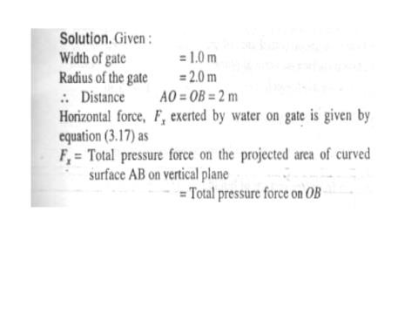
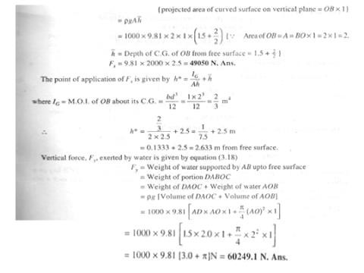
Fluid Mechanics Class Note
Dr. Qassem Hamed Jalut Associate Professor

Slide 9
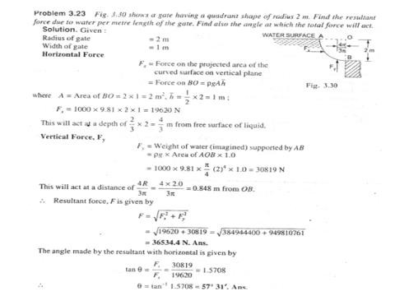
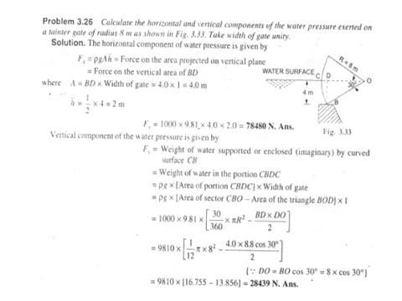
Fluid Mechanics Class Note
Dr. Qassem Hamed Jalut Associate Professor

Slide 10
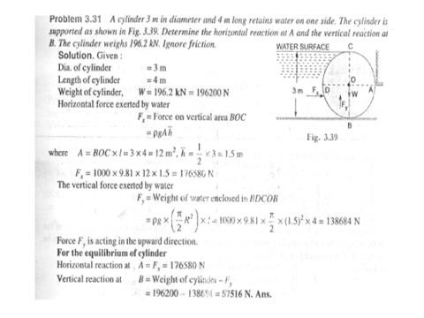
Fluid Mechanics Class Note
Dr. Qassem Hamed Jalut Associate Professor

Slide 11
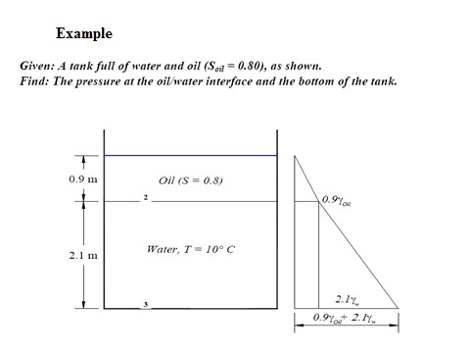
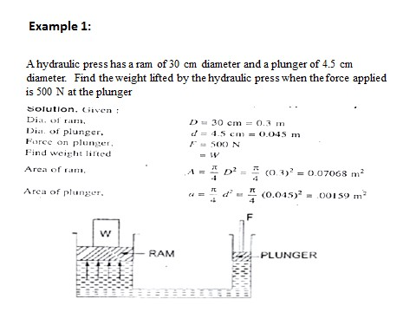
Fluid Mechanics Class Note
Dr. Qassem Hamed Jalut Associate Professor

Slide 12
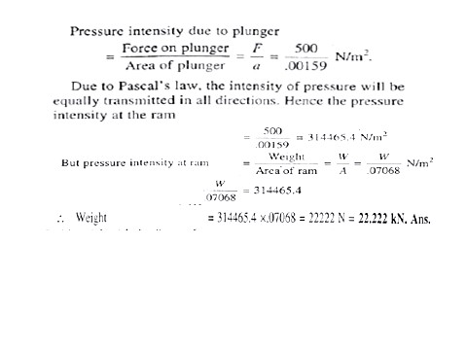
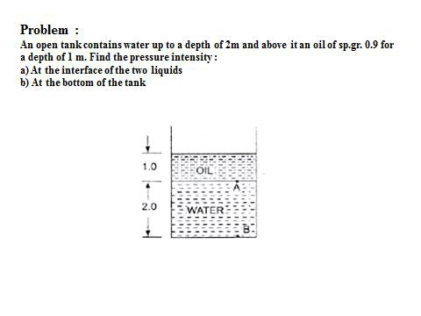
Fluid Mechanics Class Note
Dr. Qassem Hamed Jalut Associate Professor

Slide 13
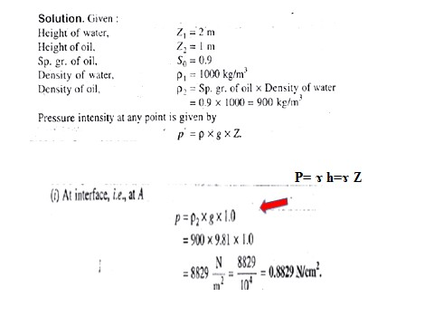
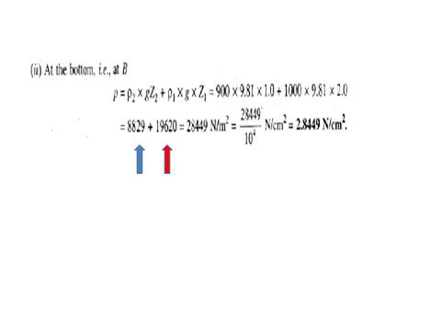
Fluid Mechanics Class Note
Dr. Qassem Hamed Jalut Associate Professor

Slide 14
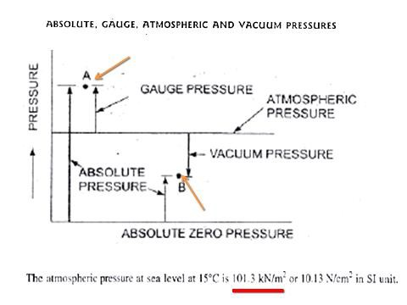
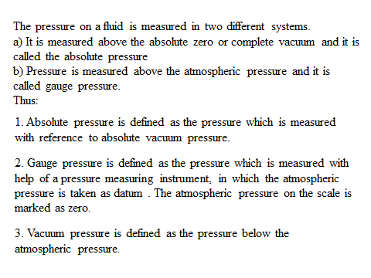
Fluid Mechanics Class Note
Dr. Qassem Hamed Jalut Associate Professor

Slide 15
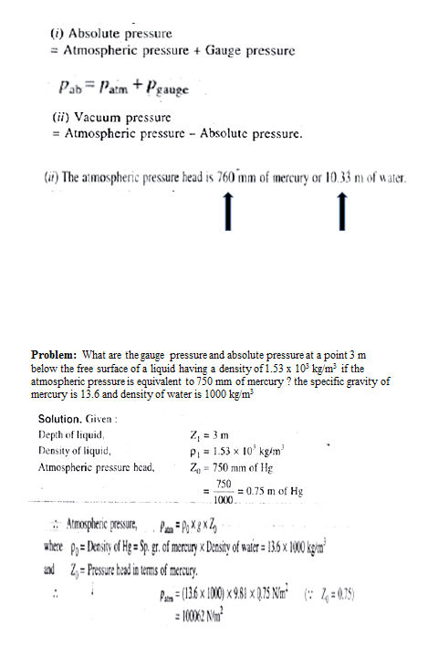
Fluid Mechanics Class Note
Dr. Qassem Hamed Jalut Associate Professor

Slide 16
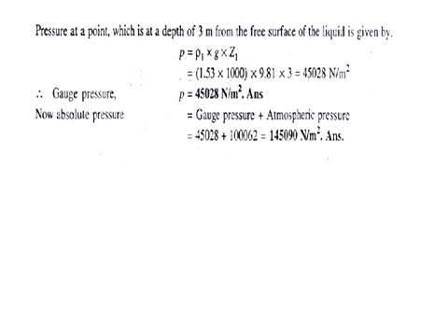
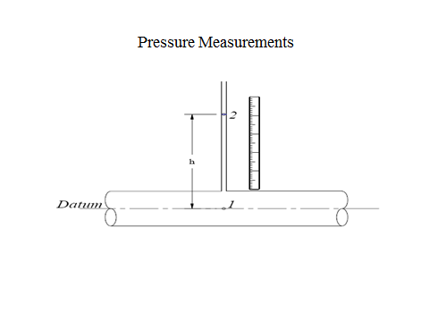
Fluid Mechanics Class Note
Dr. Qassem Hamed Jalut Associate Professor
80

Slide 17
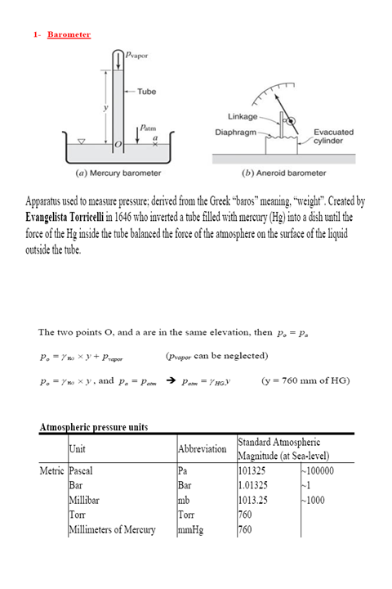
Fluid Mechanics Class Note
Dr. Qassem Hamed Jalut Associate Professor

Slide 18
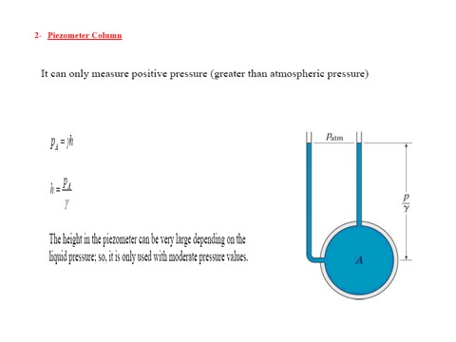
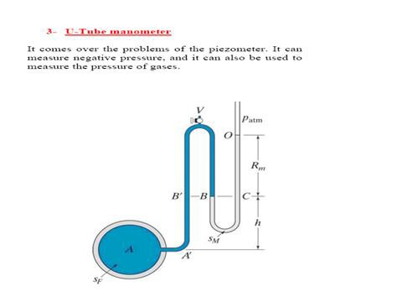
Fluid Mechanics Class Note
Dr. Qassem Hamed Jalut Associate Professor

Slide 19
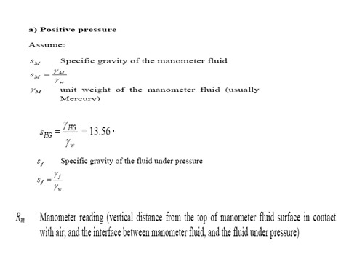
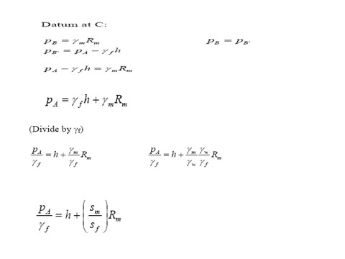
Fluid Mechanics Class Note
Dr. Qassem Hamed Jalut Associate Professor

Slide 20
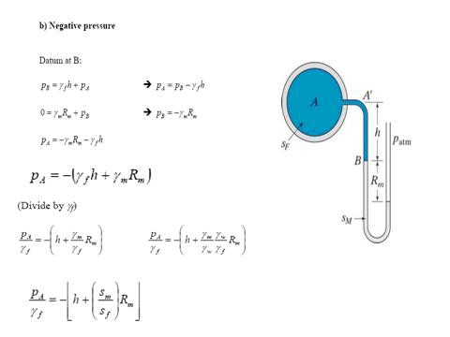
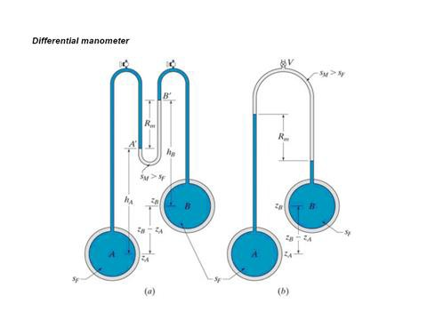
Fluid Mechanics Class Note
Dr. Qassem Hamed Jalut Associate Professor

Slide 21
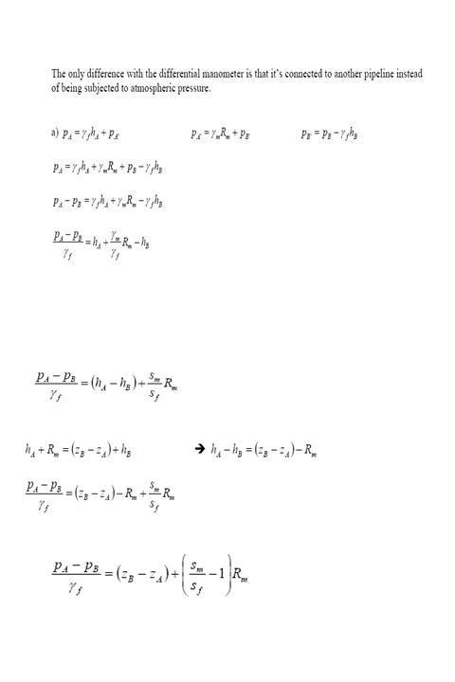
Fluid Mechanics Class Note
Dr. Qassem Hamed Jalut Associate Professor

Slide 22
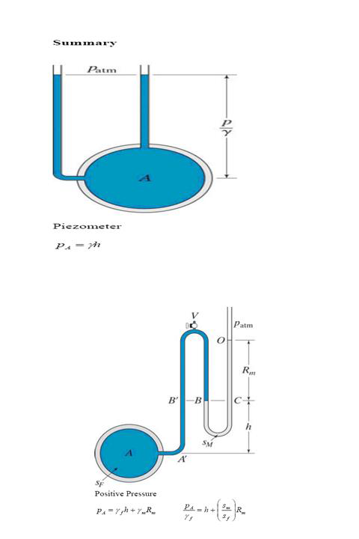
Fluid Mechanics Class Note
Dr. Qassem Hamed Jalut Associate Professor

Slide 23
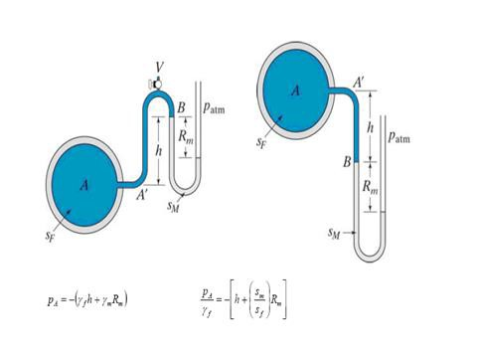
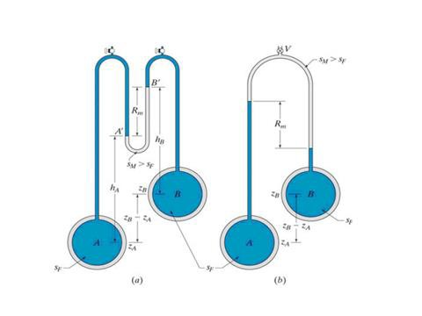
Fluid Mechanics Class Note
Dr. Qassem Hamed Jalut Associate Professor

Slide 24
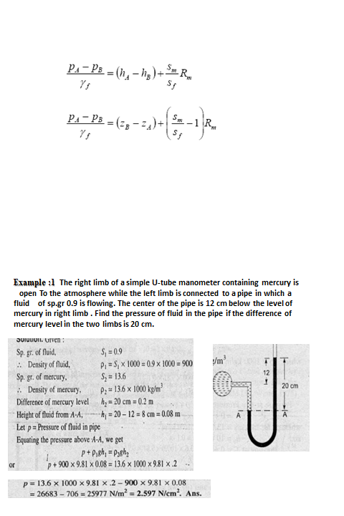
Fluid Mechanics Class Note
Dr. Qassem Hamed Jalut Associate Professor

Slide 25
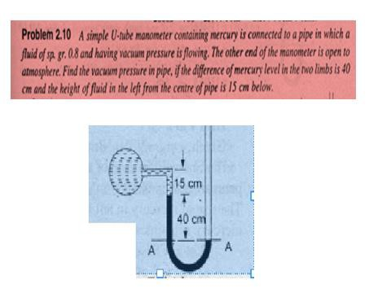
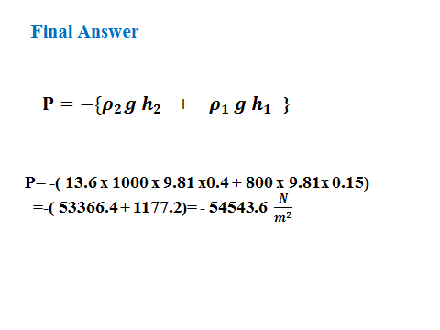
Fluid Mechanics Class Note
Dr. Qassem Hamed Jalut Associate Professor

Slide 26
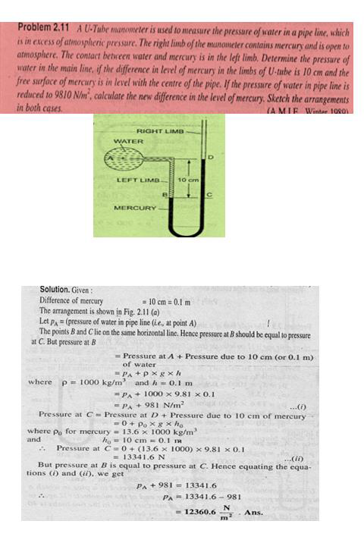
Fluid Mechanics Class Note
Dr. Qassem Hamed Jalut Associate Professor
90

Slide 27
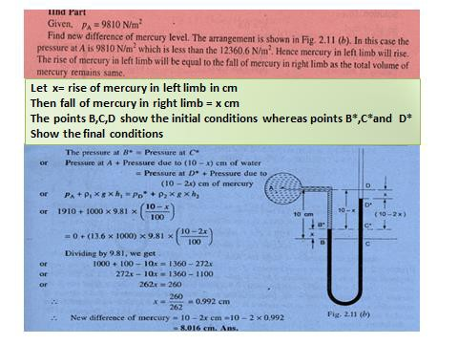
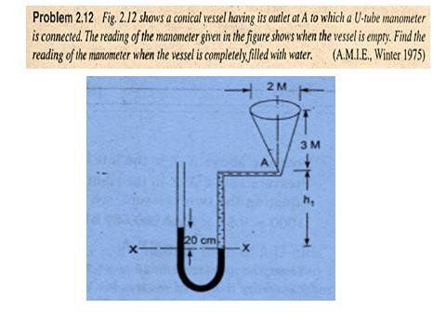
Fluid Mechanics Class Note
Dr. Qassem Hamed Jalut Associate Professor

Slide 28
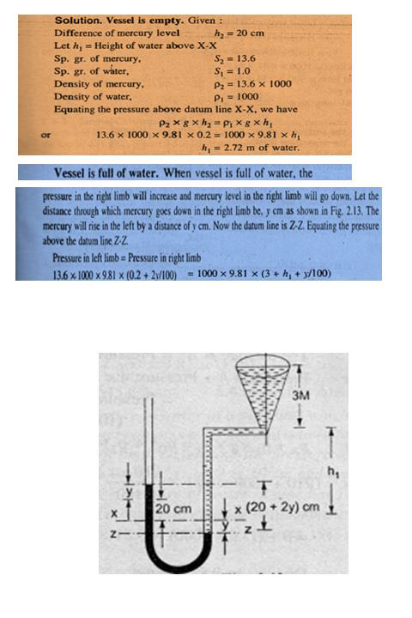
Fluid Mechanics Class Note
Dr. Qassem Hamed Jalut Associate Professor

Slide 29
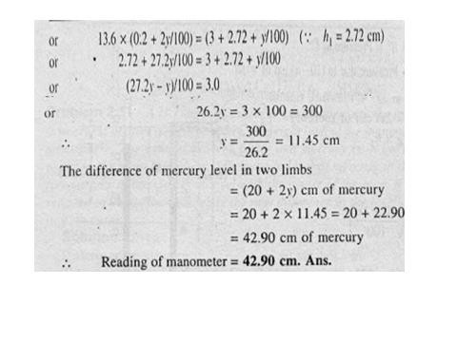
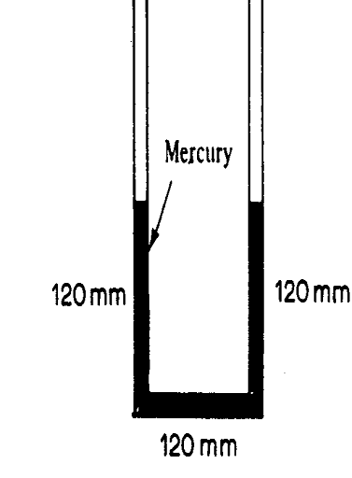
Fluid Mechanics Class Note
Dr. Qassem Hamed Jalut Associate Professor
problems
Q1) The U-tube shown below is 10 mm in diameter and contain mercury. If 12 ml of water is poured into the right-hand leg. What are the ultimate heights in the two legs.
Q2)
A Tank is constructed of a series of cylinders having diameters of 0.3, 0.25, and 0.15 m as shown in fig. below. The tank contains oil (s.g =0.89

Slide 30
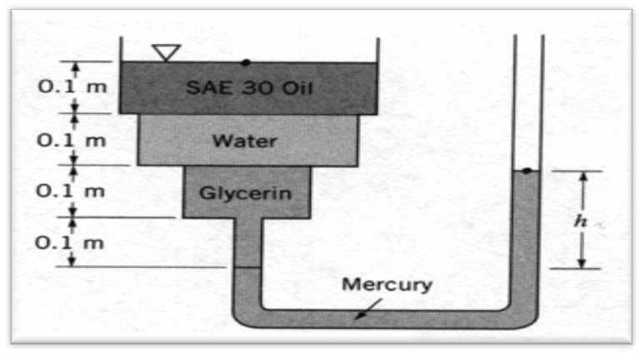

Fluid Mechanics Class Note
Dr. Qassem Hamed Jalut Associate Professor
), water and glycerin (s,g= 1.2) and mercury manometer is attached to the bottom as illustrated. Calculate the manometer reading (h).
Q3) A differential manometer is connected at the two points A and B as shown below. At B air pressure is 7.848 N/cm2 (abs). Find the absolute pressure at A.
Ans. 6.91 N/cm2

