Slide 1
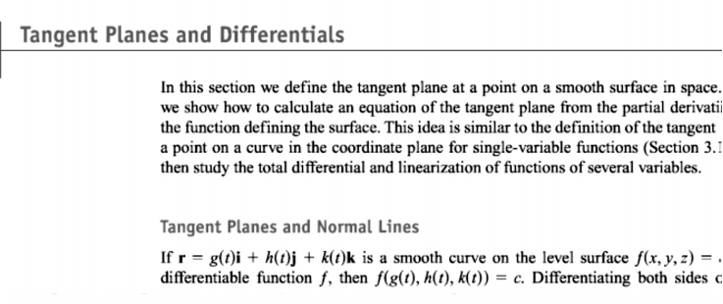
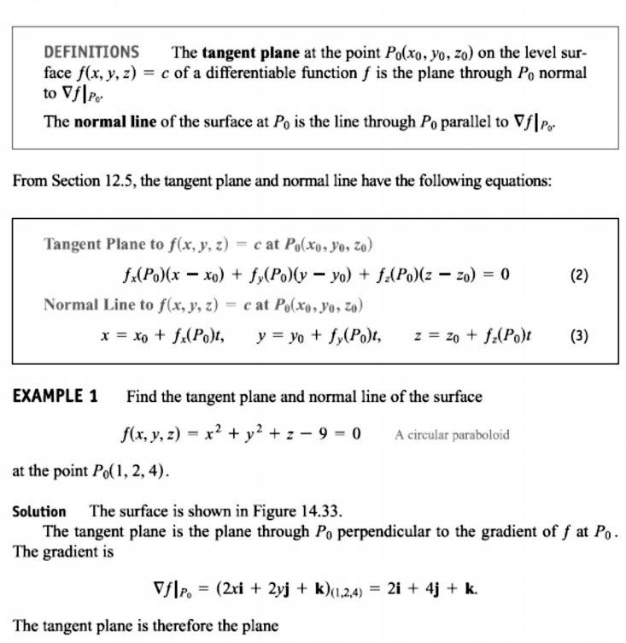
22 / Dep. Of Engineering Mechanics
th
Class: 2 AMTHMATICS / T he Partial Derivatives

Slide 2
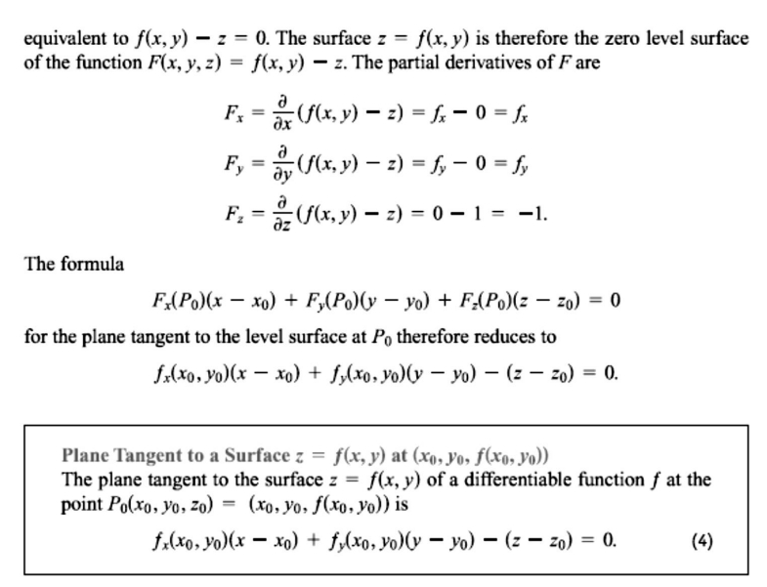
23 / Dep. Of Engineering Mechanics
th
Class: 2 AMTHMATICS / T he Partial Derivatives

Slide 3
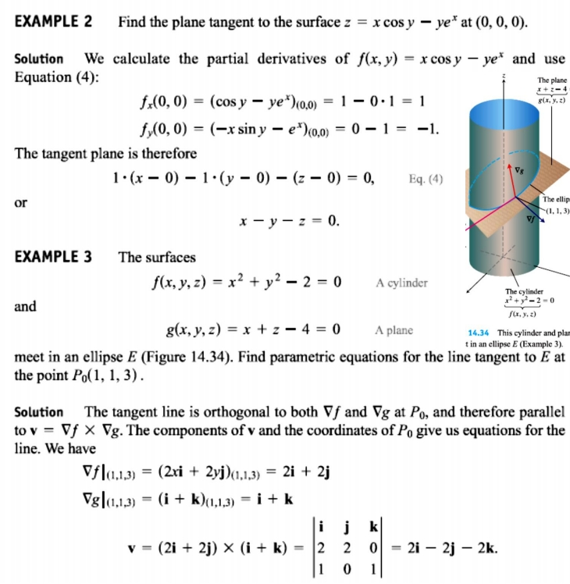
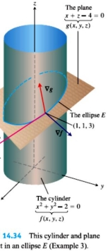
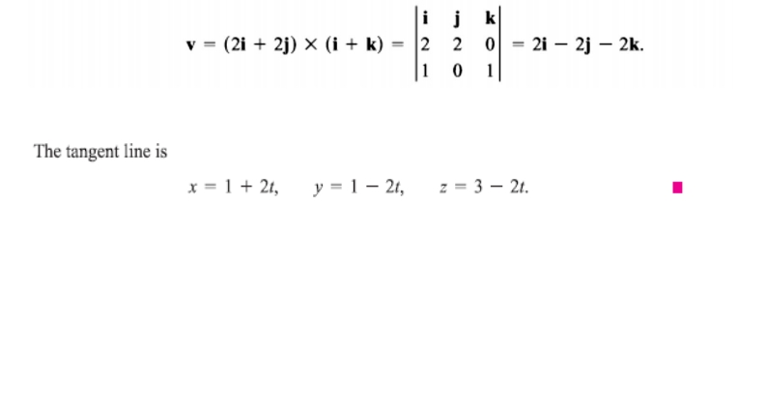
24 / Dep. Of Engineering Mechanics
th
Class: 2 AMTHMATICS / T he Partial Derivatives

Slide 4
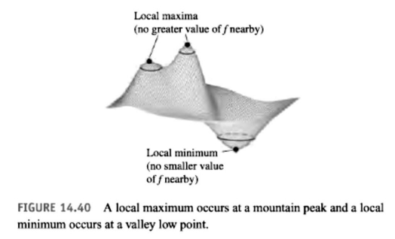
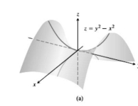
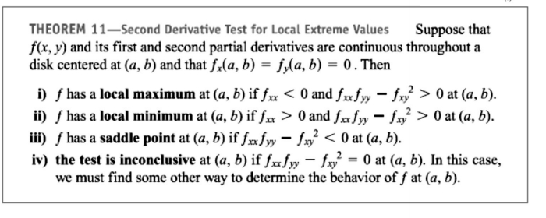
25 / Dep. Of Engineering Mechanics
th
Class: 2 AMTHMATICS / T he Partial Derivatives

Slide 5
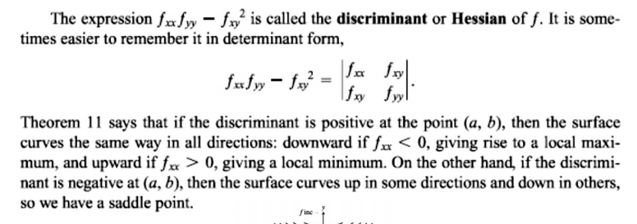
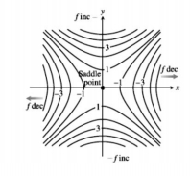
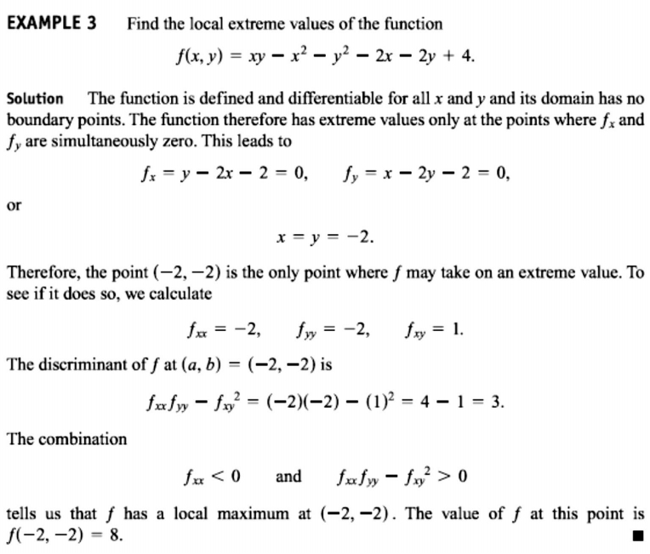
26 / Dep. Of Engineering Mechanics
th
Class: 2 AMTHMATICS / T he Partial Derivatives

Slide 6
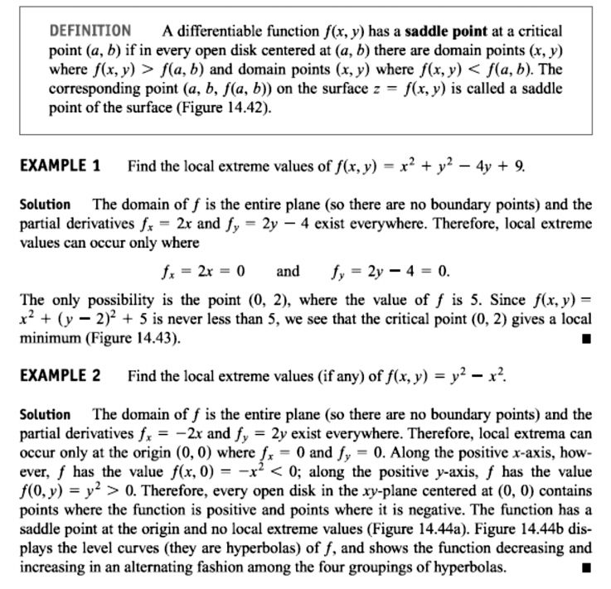
27 / Dep. Of Engineering Mechanics
th
Class: 2 AMTHMATICS / T he Partial Derivatives

Slide 7
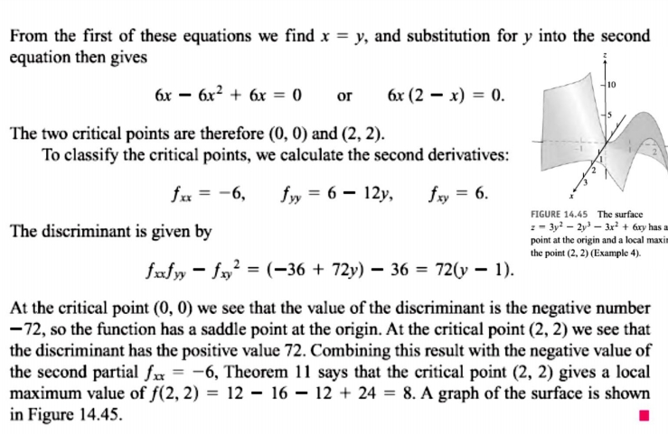
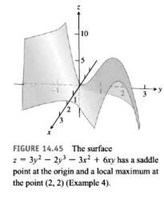
28 / Dep. Of Engineering Mechanics
th
Class: 2 AMTHMATICS / T he Partial Derivatives

