Slide 1
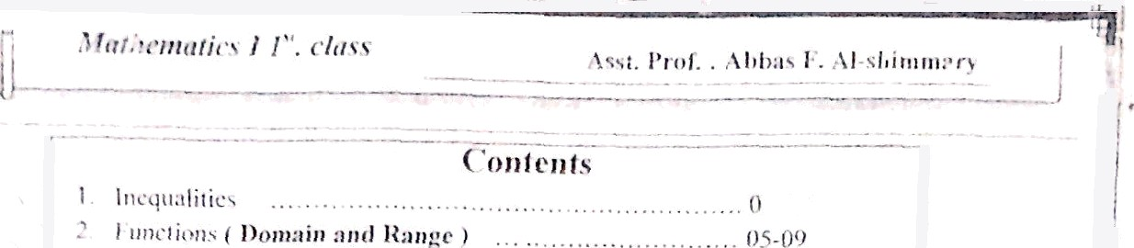
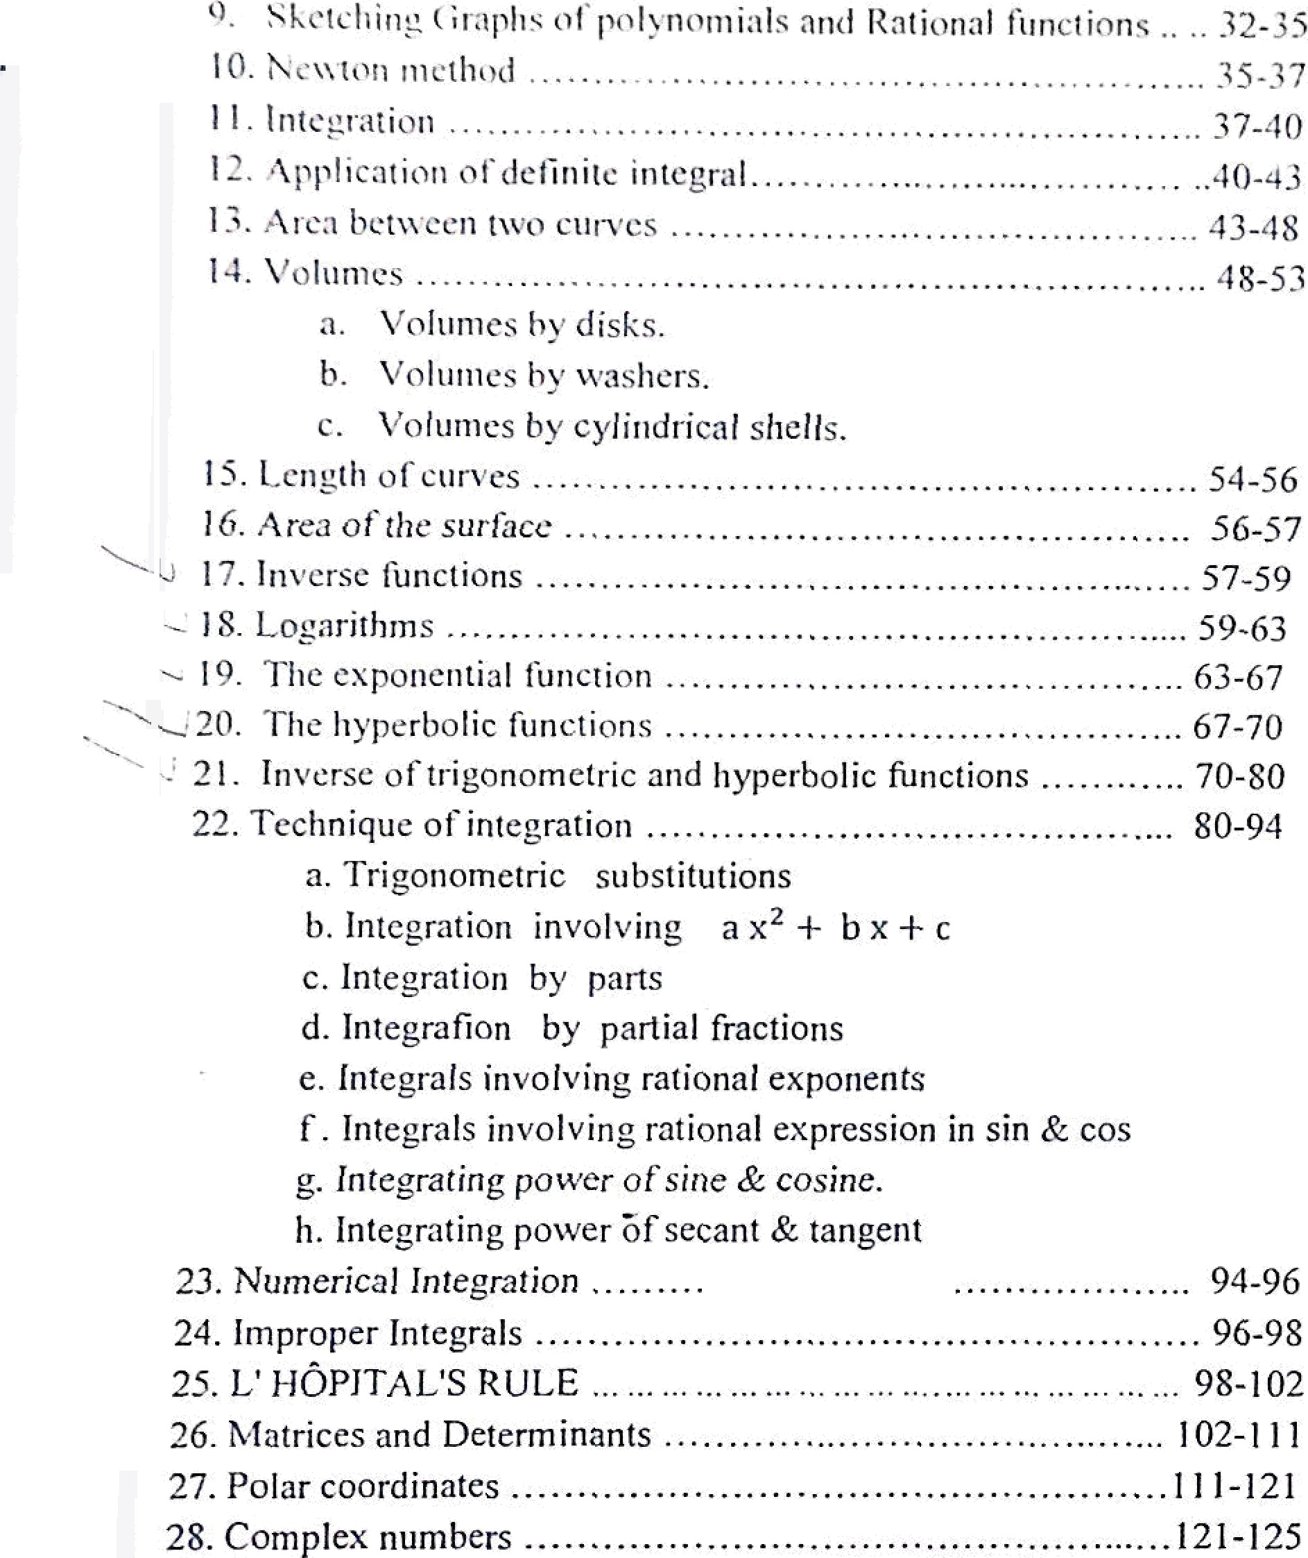




l -05
* *ñ ›*

Slide 2
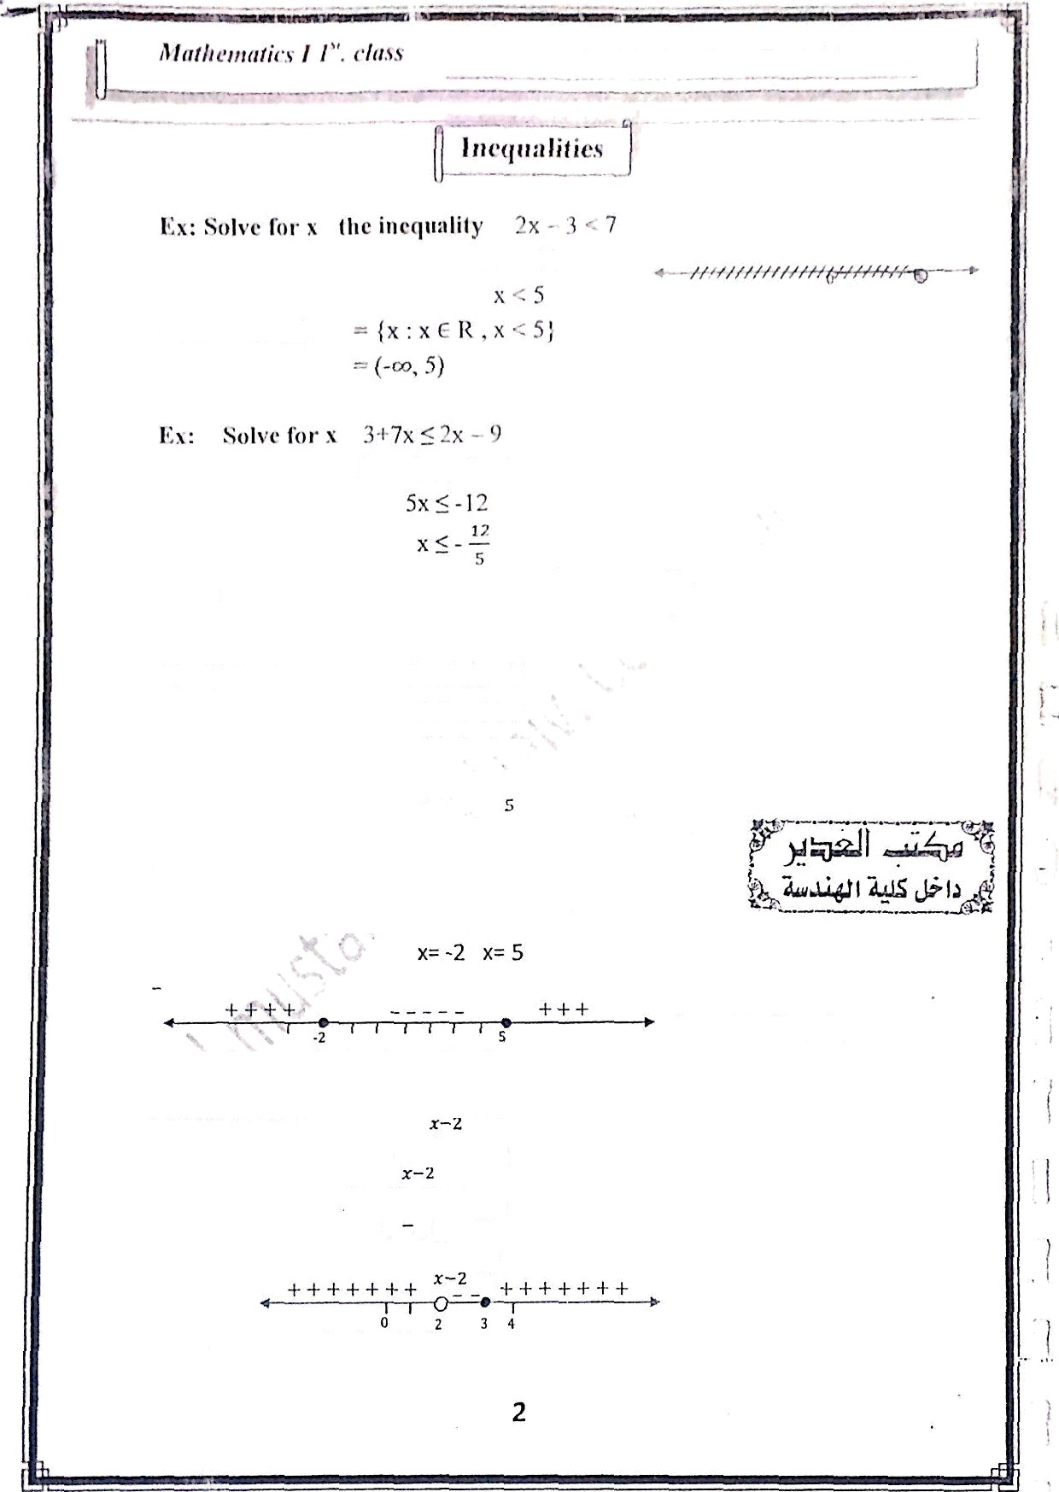



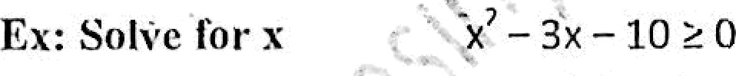

z\all. )'t ‹›f. : z\ lxl›:ts )'”. ,S î sÎii Frl fzt•ï r}’
ix: Snlvc fer x
7 r 2-Sx < 9
5 < -S x < 7
-5 a S x > -7
•- the set of sol. = (x : x E. R, - -⁷ <
s -1ï" (-, . - )
5
set of sol. = {-
Ex: Solve foi• x
, -2] U (5, œ)
' S 1
sign
f (x+2) (x-5)
^{2 -S} - 1 S 0
(2x-S]- (z-2]
(T 2)
o
••• the set of sol. = (2,3]

Slide 3
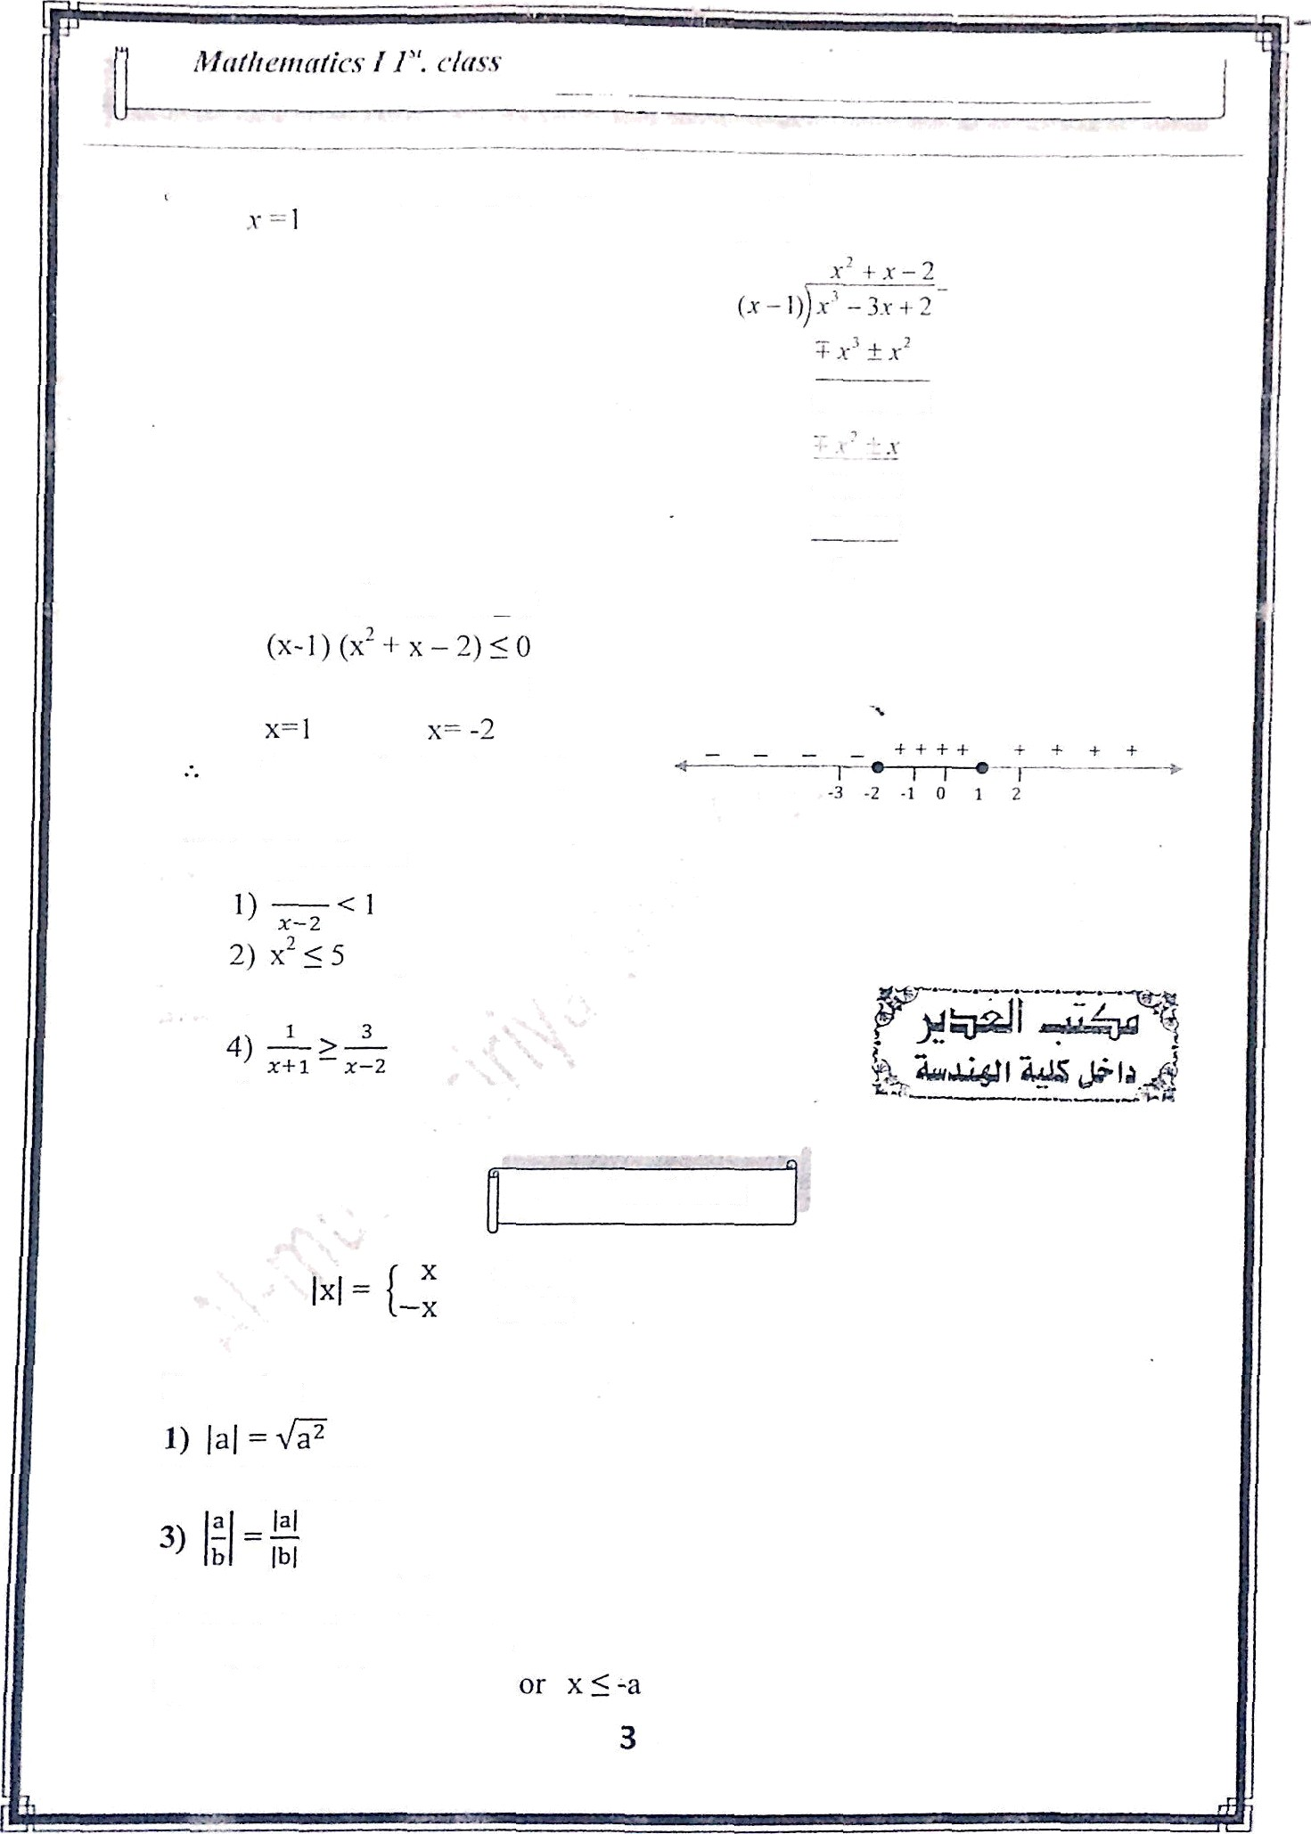


It»: fii›lve foi• x llic iiie‹jiiiiIitj' x’ — 3« j 2 < p
is a solution for the equalion so (.vY .). is a f;ictor
0+0
(x-1) (x-1) (x+2) ;5 0
the set of sol. = (-o*, -2]
UW: Solve for x
3x-I- 1
3) 2 — 3x +•x² ?: 0
5) x3 — x2 — x — 2 > 0
Absolute Value
x ;? 0
Properties:
2) Ja. b[ = }a} JbJ
4) }a + bJ ;¿ [aJ + [b}
If {x] ;S a then —a 5 x ;3 a
If }xJ 2•_ a eiler x ?'_ a

Slide 4
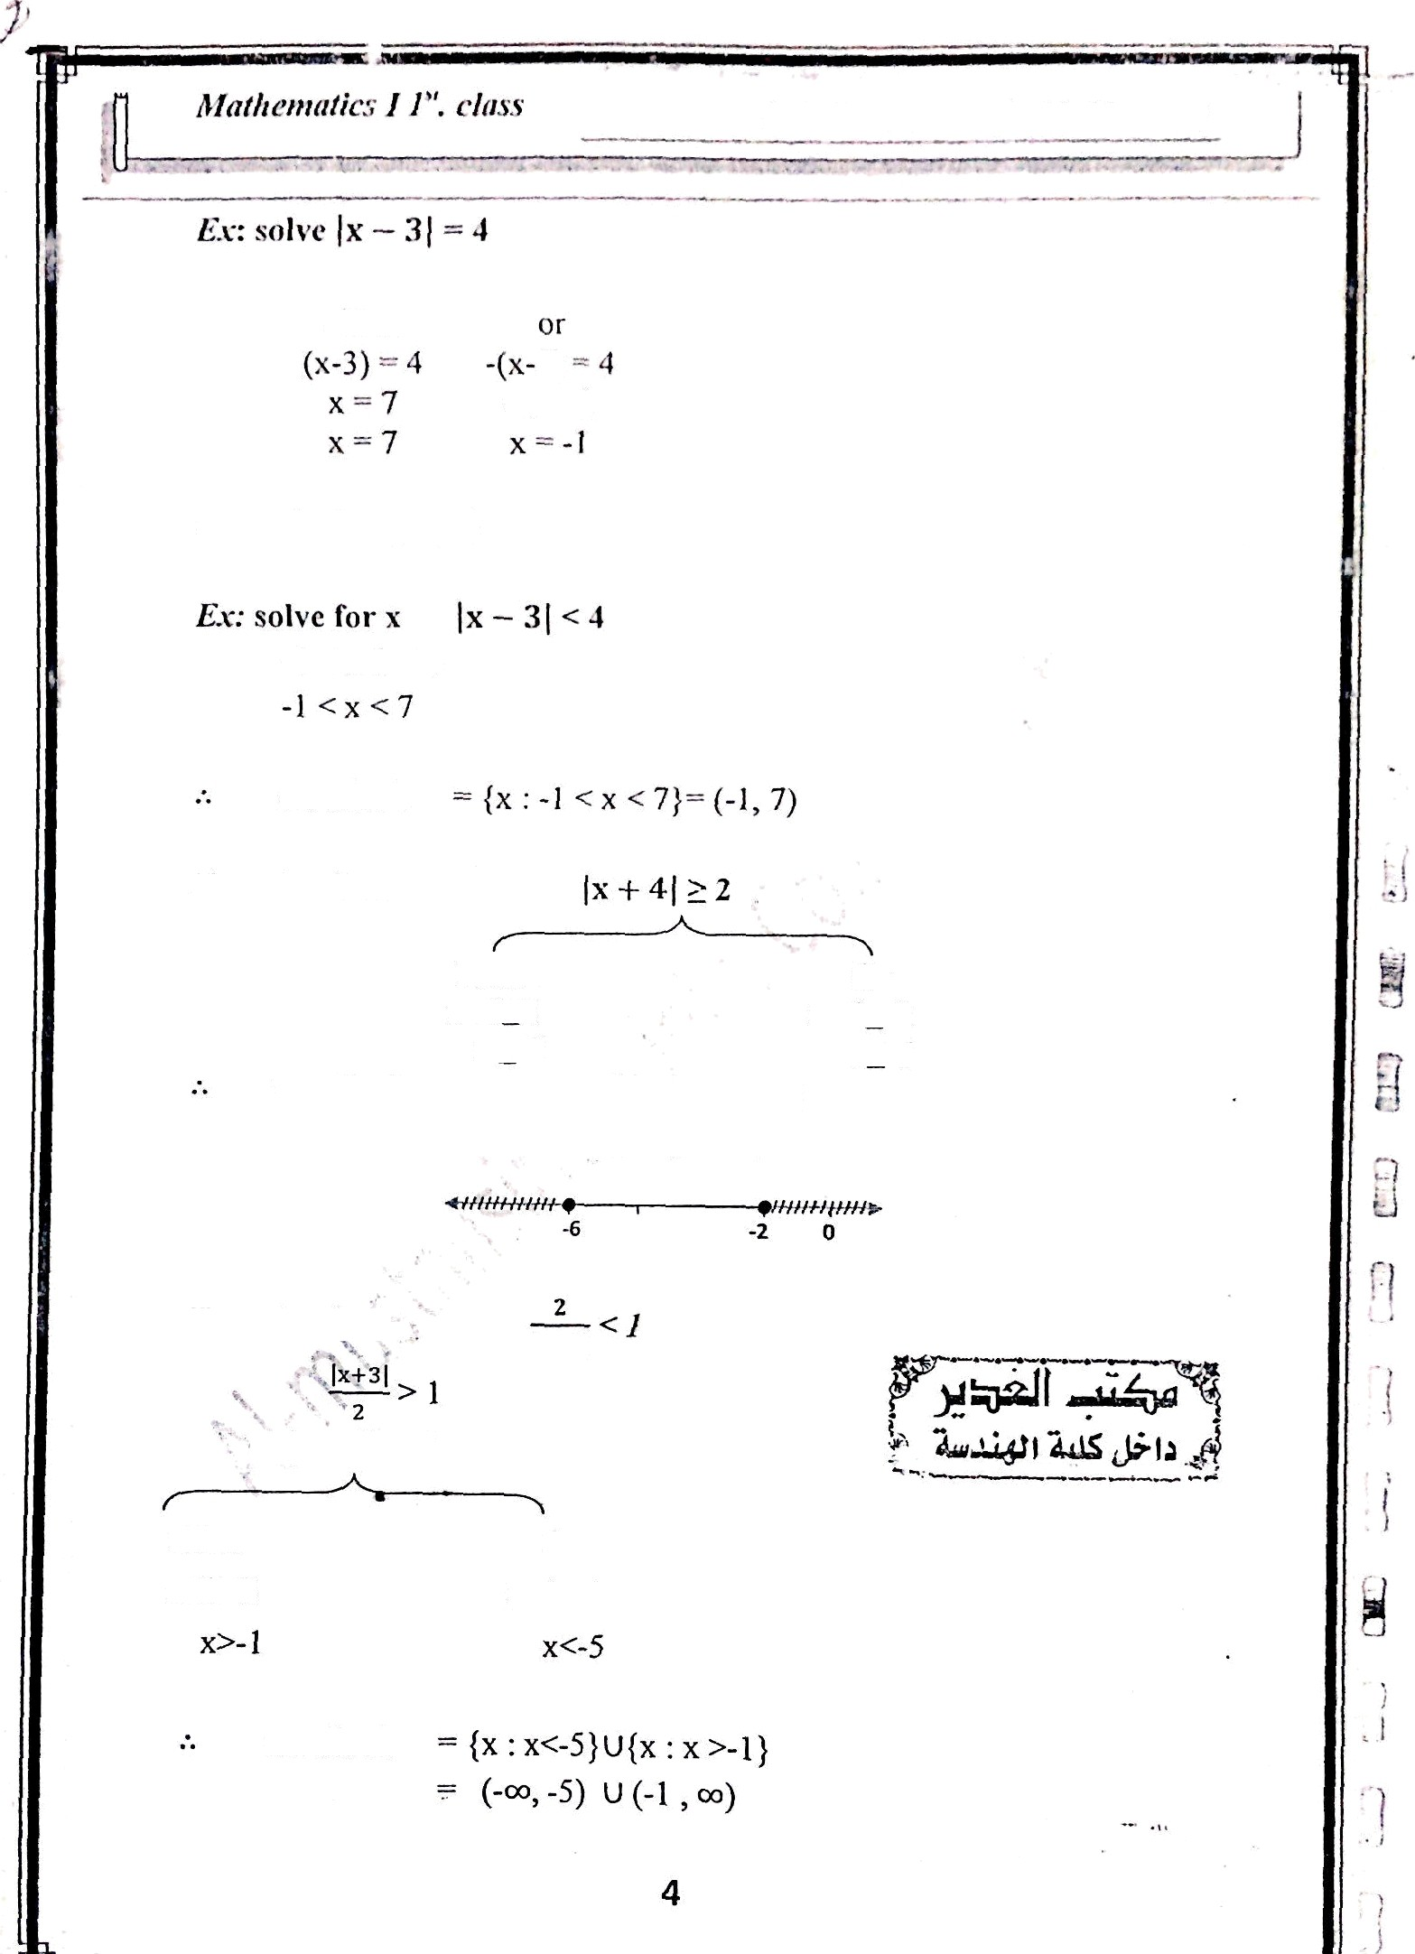


Asso. l’rof. : A lil›iis 1'’. t 1-sIi ini mrs’
3)
- x = I
.‘- set ot’sol. - {-1, 7)
-4 < x-3 < 4
set of sol.
€z: solve for x
Either
x+4>2
x *-2
= (x: x
Or x+4s-2
x<-6
set of so1.
-2} U (x : xc-6) U [-2, )
Ex: sofve far x:
either x+3>2
Or x+3<-2
set of sol.

Slide 5
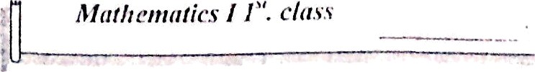

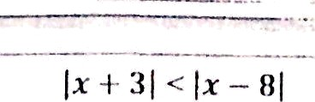
















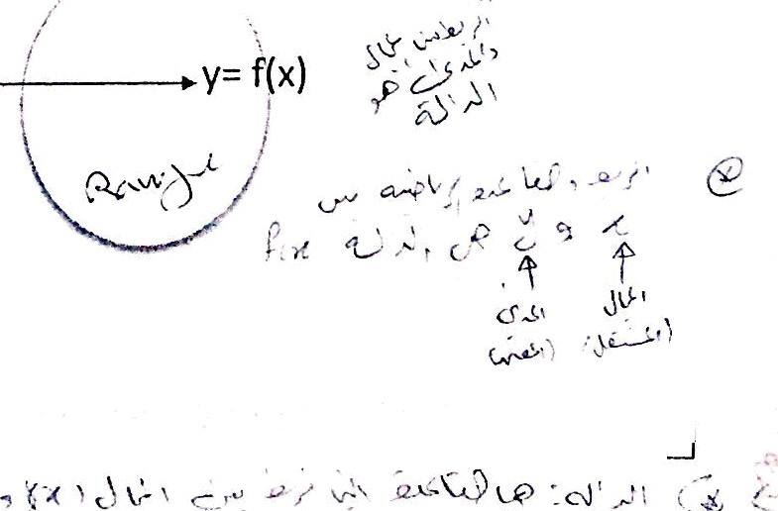

Mafhemniics I J“. ¢I«s•
( + 3) < ( 8
(x+ 3)'
i*inu lat -
< (x-8)²
x' +6x +9 < x²-16x+64 22x <55
set of sol. = (-> , $)
Eg: solve for x ( + 5
2
= x + 5
using
— )a J
x+5 * 0
x _> -5 set of sol.
HW: solve for x
1) )3x) : )2x - 5)
3 2
2) ?4
4)
1 1
5) Solve l x — 3 ] ²
- 4 I• — 3 l 12
iFcon‘‘ ’"
Defy is’a‘rule that assigns to each element in a set A (domain) one and only one element in a set B (range) pgp
A
f
B
5

Slide 6
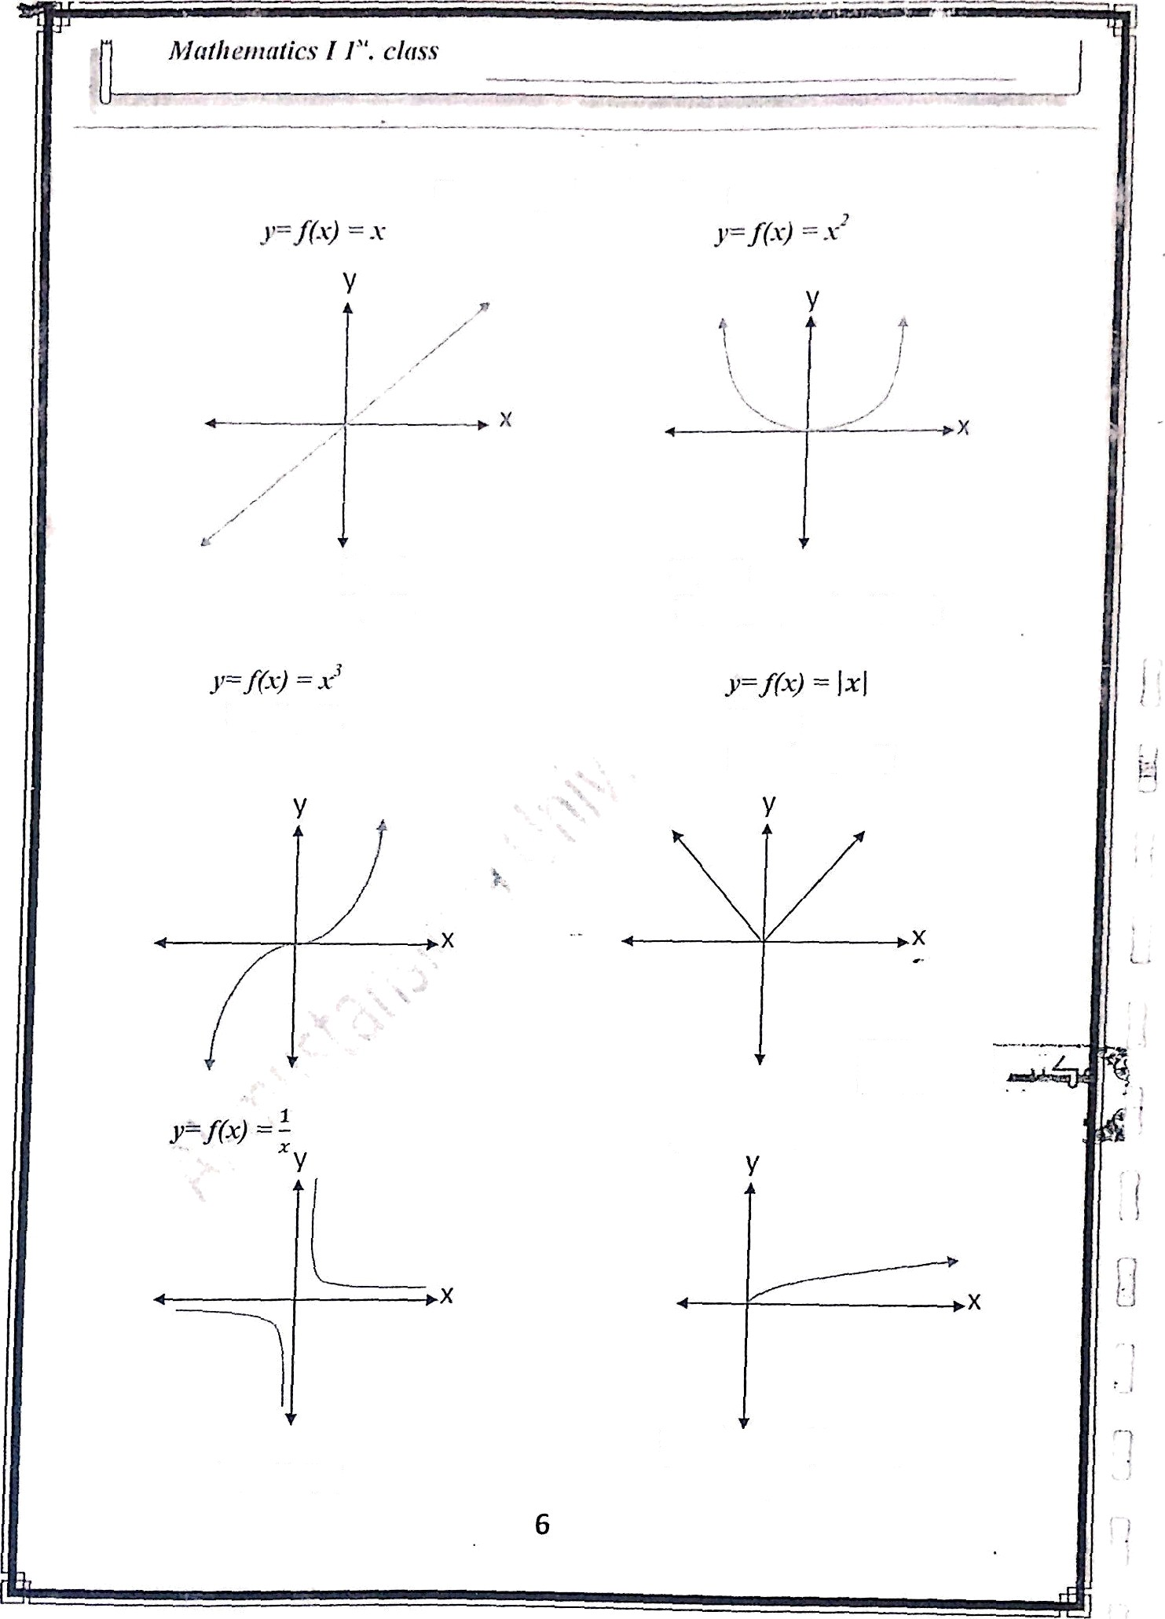
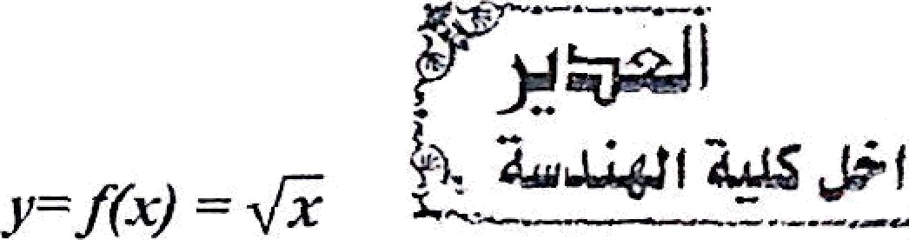
Asso. l'rof. : Alphas F. Al-sliiiiiiiiar;'
Some inipoltanl Auctions
I f
D t = R
' R
Rt = R
Rf
(y : y s0}= [0, co)
:
I f' R¿= R
Dt= R
Rf = (y : y 20)
Df Rf
D f'
( : x C R, x ?_ 0}
\ (0)
Rf= ly : y e R, y 2 0}

Slide 7
f‹.) s.'—«--* ° — "
f(x)
E.v: Fiiid the domniii of f(x) —
‘*' » 0
“ 9 ”
-1 0 1 2 3
f --(-3,-1)U(3, )
Ex r Fiiid the domaiii 8 rnnge of
z+1
x+I = xy — 3y
x (1-y) = - (3y + I)
- (3y+1)
R r' RI {1}
Ex: let
!› f+glz› ——fl•1+ txt ——¥•+•’
3) f. g (x) — f(x) . g(x) — >fx . x

Slide 8
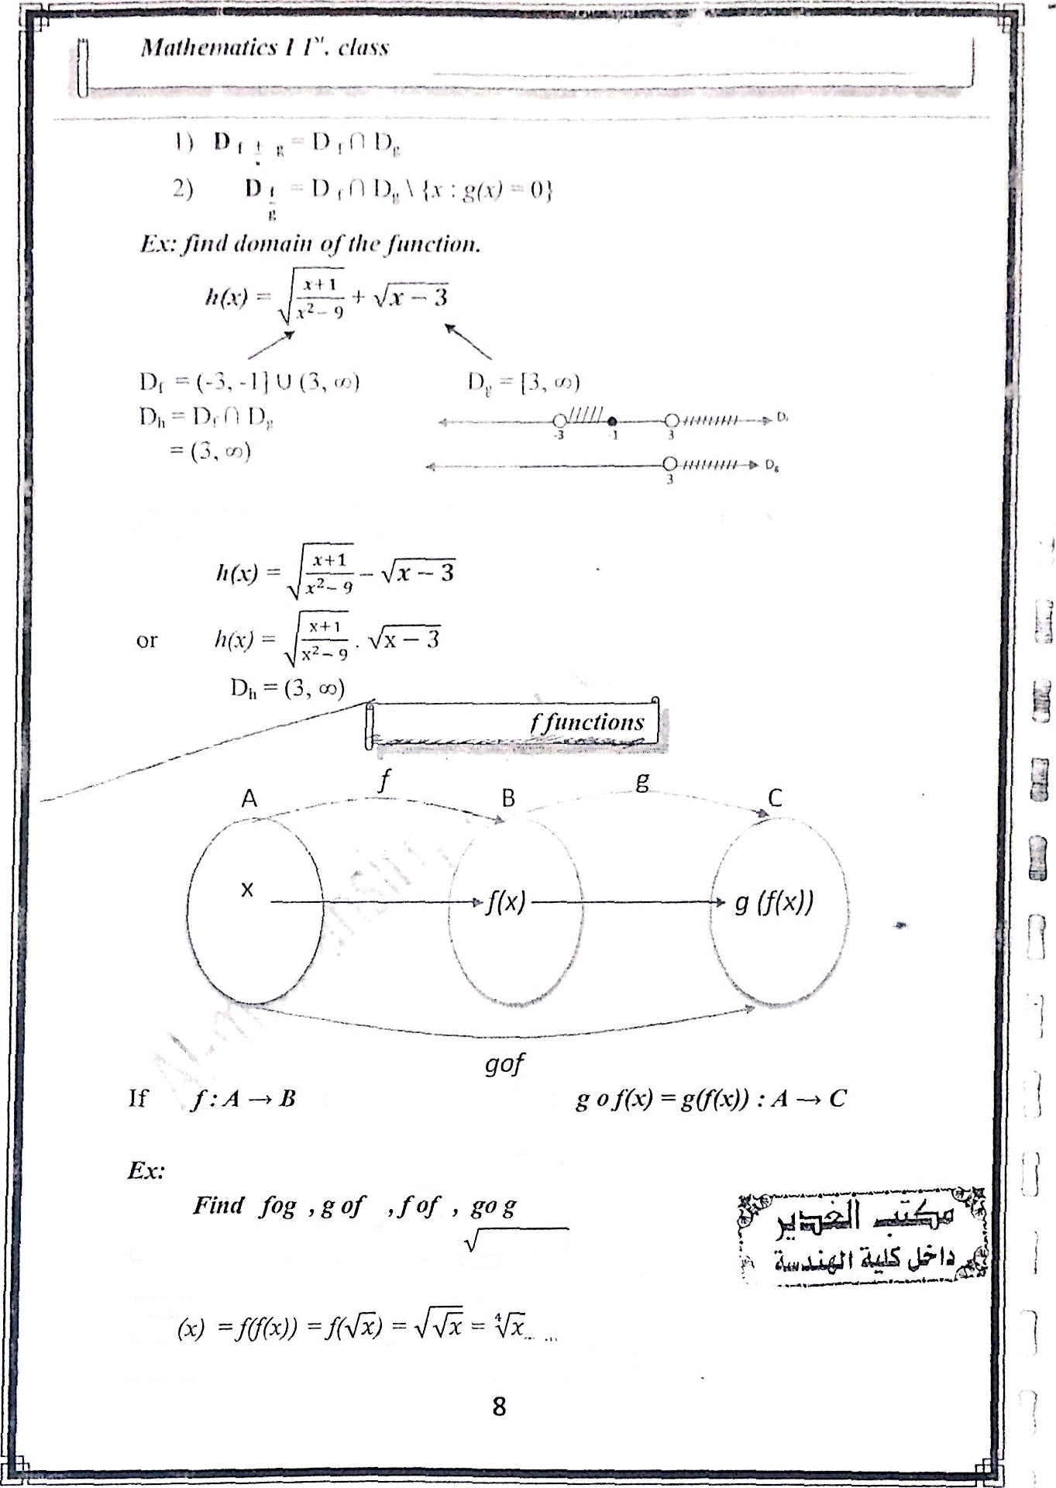
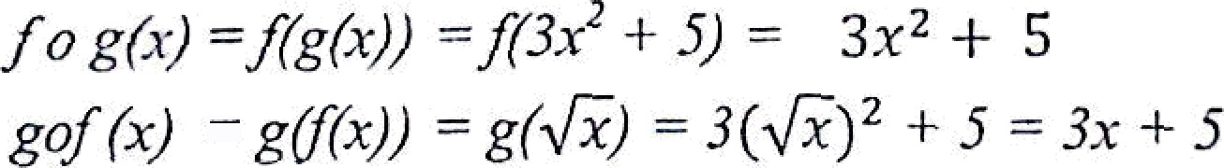
and g : B —•
' then
fof
g•g í=)
g(z(x)-)
g(3x’+ !)— 3
(3x’ * $)‘’+ 5

Slide 9
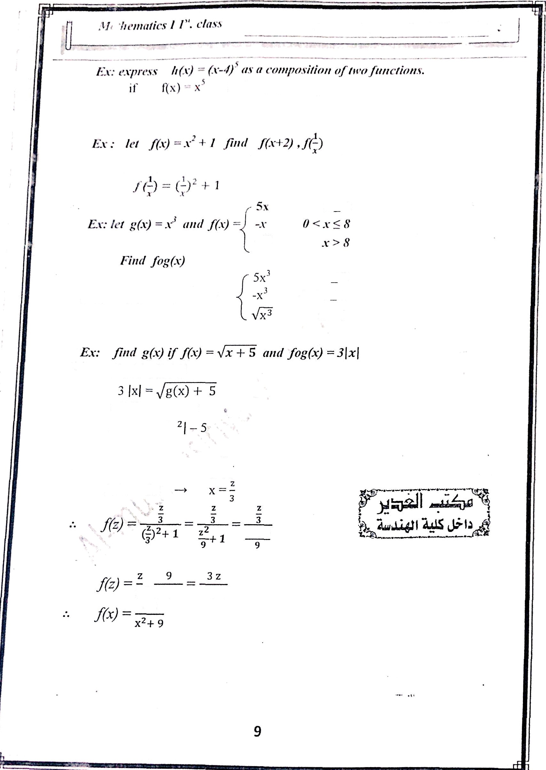








.oiøl
Jl.cl ))
g(x) — x-4
tł c'i f*ș(x)
Cr-4ì I ì5
f(.v+2)
(x I ż)'
+ 1 x' I 4x + 4 + 1 — x'
‹- 4x + 5
X<Û
f•.•.'‹•› —7/ečYż/ —/•›
« <
0 < x < 8
fog(x) -f(g(.z))
9 țx'] ‘= g(x) + 5
••• g(x) ’— 9 Jx
3x
* 2₊₁
Let z 3x
3 z°+ 9 z°+ 9
3x

Slide 10

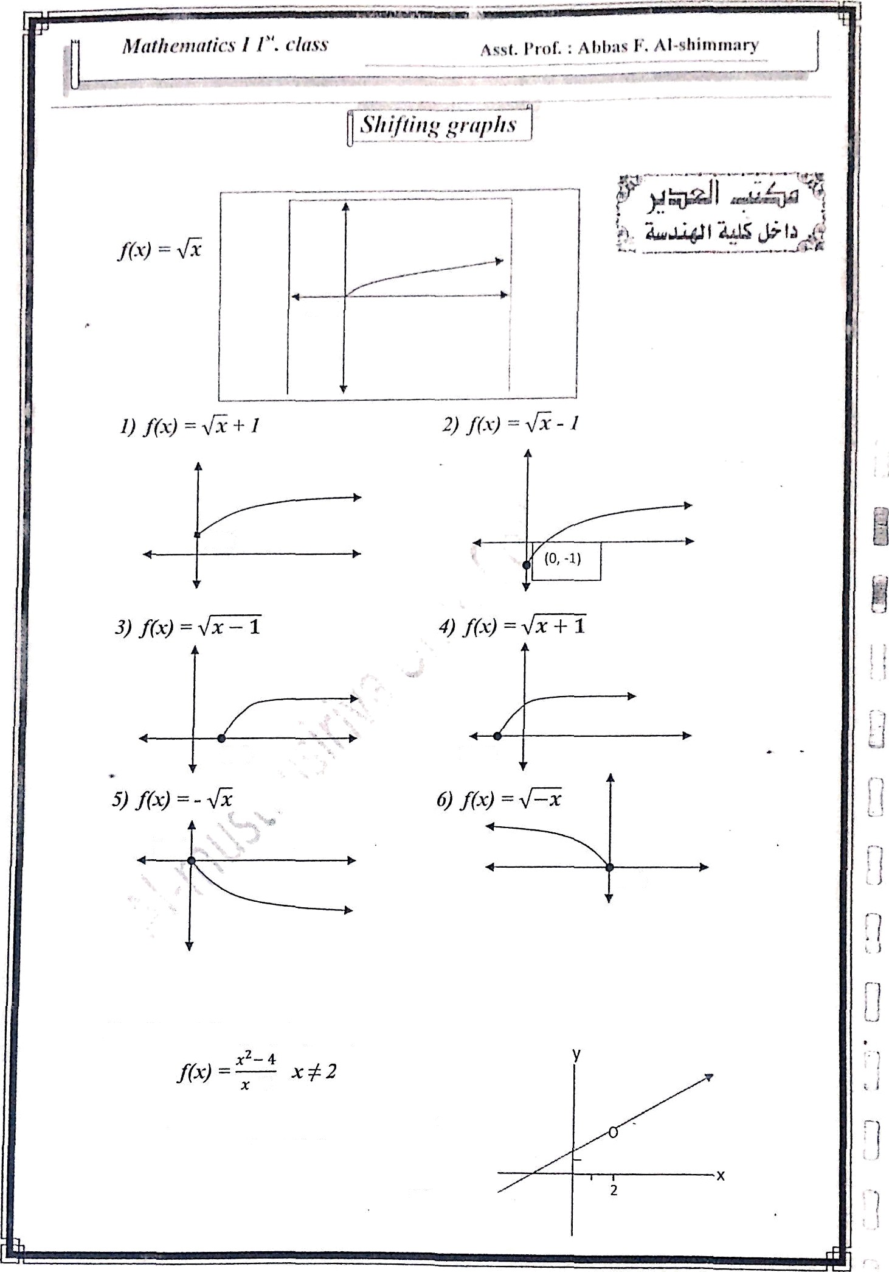



(0,1)
ț1, 0)
(O,O)
(0,0)
Ext Sketch ïhe graph of the function
-2
(
^{2)(x+2)} = (x+2), x / 2
2) „.
10

