Slide 1

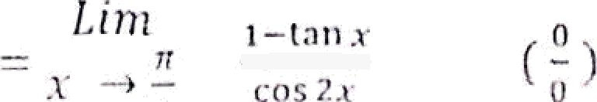
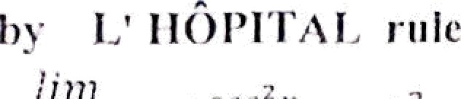

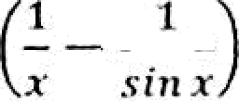
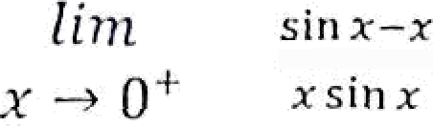

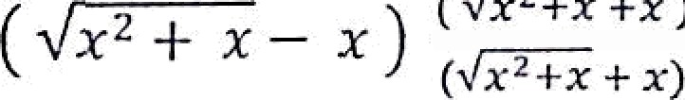



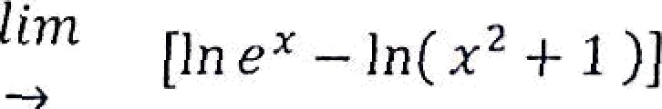
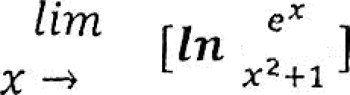
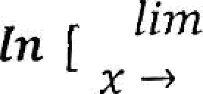
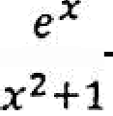
2) The foi in —' - nr —
lÏlTt
x 0+
0
0
by L’ HÔPITAL riile
IÏITI cos x— 1 0
x —› 0 z cos z+sin z 0
J¡ — sin x
x 0 —x sin x
by L’ HÔPITAL rule
0
cos x + com x
— x)
0
E M Fiitd
(
2
8
.
.
8
1
+1
1
8
'
Ex / Find '
x — I n(z² 1 1 )]
8
8
8
by L' ïïÔ.PITAL rule
101

Slide 2
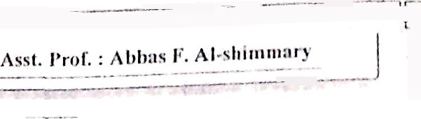

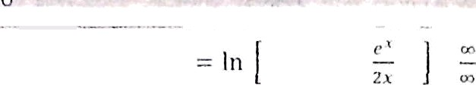











by L' I4OI'ITAL rule
= In = In m
3) The form
( 00 ,
0
, \ )
ex/ Find g
, ( 1 + z)''• (1‘)
Let y = ( 1 -I- x )'* take in for both sides
let y —— lit (1 -J- x)
^{him} In y =g '
0
x
In (1 + z)
0
(o
(0 .
f fm In (1 -+s j
o
by L' HOPITAL rule
In
lim
— 1
také*e for both sides
f
)1
ieC y — (e’ -P
Iny =1 In(e’ z)
lvi ( e ^ + x )
( 0 . m )
_{x}"”+ fn y =
by L' HOPITAL rule
102

Slide 3


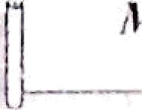

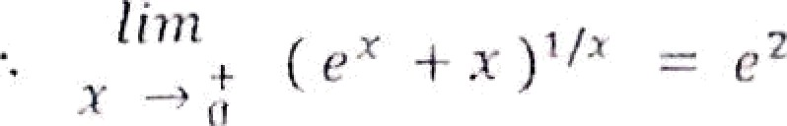
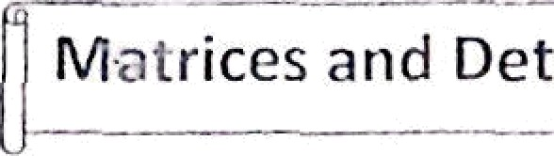


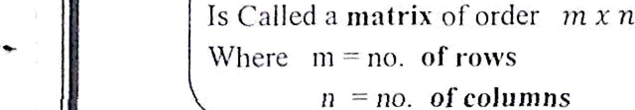
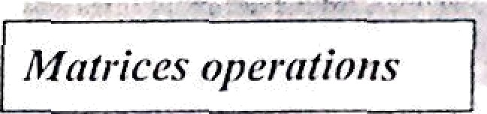
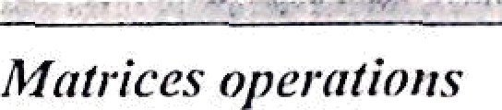
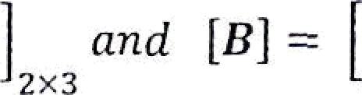

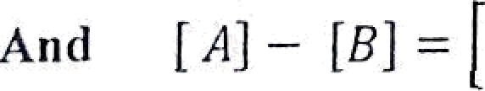
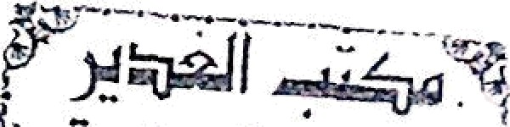

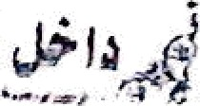
fn
lien₊
y 2
M•atrices and Oeterminants
ll ef : any ari•angcmciii of” die elements in the fo1 lowi»s !^••^
^{n}o›
app
1- Addition & subtraction :
cal Let [A -
2 0 —1
7 1 4
—3 0 —1
0 1 2
—1 0 —2
7 2
2x3
5 0
7 0
6 ’2x3
0'2 3
be of the same order .
Note : JA] and {B must
2- Multiplication by a constant.
—1
0 5 2
ex/ Let A —— ( ²
’ )
find 2fi
2 A — 2
2 —1
0 5
4 —2
84)
—2) ( o io
103

Slide 4
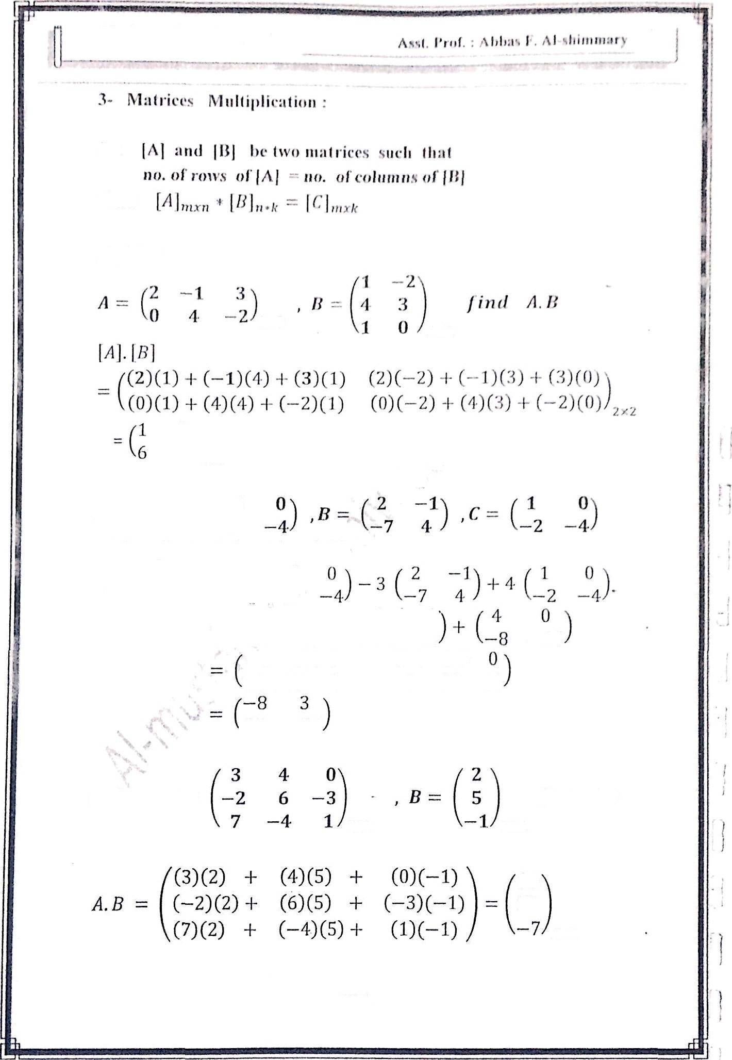

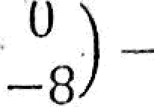
£ct
Then
Ex / Let
1
'2x2
Ex / Let A ——
Then find
—3
7
2 A — 3A -t 4£ ?
2A — 3B + 4t? = 2 ( ^{—3}
/—6
7
/ 6
\—21 12
0 + 3 +
\ 14
—6 — 6 + 4
14 + 21 — 8
—16
—8 — 12 — 16
•27 —36
Yx / Let A —-
Jind A.B
3 x3
3 X 1
1
1
26
i
3 x 1
104

Slide 5
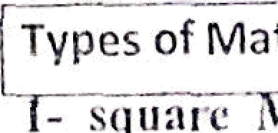
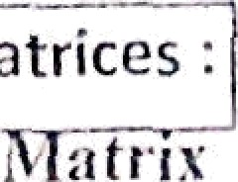
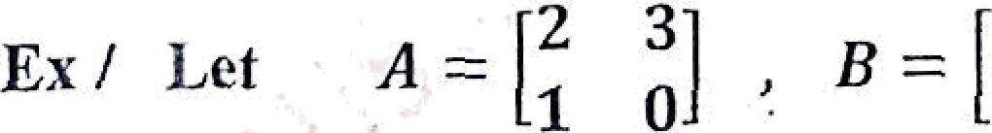



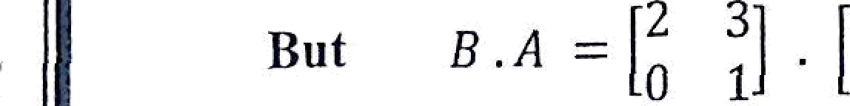


Asst. Prof. : A hh:is F. AU-sliimm $t
,
.. . . .. . . .. . -- .. --- -. .
Types of Matrices :
- squzrc *i ztrix : if ›x = r
matrix .
. — .. .. ...-. .. - -. - . .- -- - —
thcn [N) i» exlled square
r.› ï | o | — | 4 | ls a sq uzYC Htalrix of orJcr
 | —1 | () | 3 „,
3 .
2- lt › v ri a rix : if m = I
Km —- 3 — 1 2 7 _{l1x4}
- Calumn matrix : if - 1
(A) ——
0
— 1
33,i
Identity matrix : it is a square matrix with unity main
diagonal .
1 o 0
exï I — 0 1 0
0 0 1
ZePO lflàtfiix : iÍ is a matrií with Zero entries
 |  |  | 0 | 0 | 0 | 0
exï | [A] | —— | 0 | 0 | 0 | 0
 |  |  | 0 | 0 | 0 | 0
Note : In general
A . B B .‘A
2
0
3j
1Î
(2)(3) + (3) 1
(1)(3) + (0 )
Then
A . B — ^{[ 2}
3j [ 2
1 1 0Î 10
2 2 + 3 (0
4
1)(2) + (0)(0)
2
(2) ) 3- (3)(1)
' (0)(2) + (l)(1
A . B x B . A
(1)(3) + (3)(0) 6)
(0)(3) + (l)(0) 1 1 0J
Hence
105

Slide 6


M ‹ıthemnli‹-s I I“. rlass
*- §'m ntctı”ic n•ltri1 : is t squ:mc mili ı”ix ılltcl r/,/
*fj, /.j
 |  |  | 2 | 3 | —S
ex/ | [dj | = | 3 | 1 | 2 | is syııınıetric iılıııııt the mil*n tl*nP•‹"' | 1
 |  |  | —5 | 2 | —1
7- Skew syııınletric ıntılrix : is a squiırc matrix
Ann ‹tüy = rt , \f; ın.ain tliagoniıl :ırc Ktr‹›
 |  | 0 | 3 | —Ii
ex/ | [ A ] = | —3 | 0 | 2
 |  | 5 | —2 | 0
8- Upper triangular matrix : is a squarc matrix with *lc''ncnta fi '° ”
below the main diagonal .
 |  | 1 | 4 | —6
ex/ | [ A ] — | 0 | —2 | 1
 |  | 0 | 0 | 3
9- Lower triangular ıııatrix: is a square matrix with elenıenls 7ero above the main diagonal .
3 | 0 | 0
Ex / [A] = 7 | 2 | 0
10- Truııspose of a matrix : the transpose of a matrix [A] is denoted by [A]’
3 5
Ex / Let , [jj = 6 4
—2 l 3*2
then [A] ^{T}
Rbprésentation
of a set of linear equations by Matrices :
Ex: Write the following equation in matrix form
z + y + 2z = 1
z + 5 z = 7
2 x —y + 4z = 3
i i z x i
1 0 5 y 7
2 —1 4 z 3
Or ( A ] [ X J = [ B ]
106

Slide 7




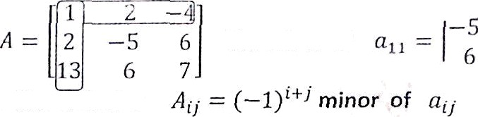

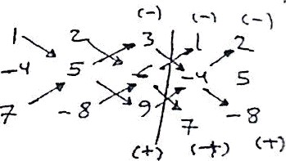

r
4fnJli 'matics I I”. cliiss
IJcterminsnts:
Sf A is a sqtiarc mali’ix then dcl d or ]d } calctlfated from A and found as follows .
is a nuivber
( n b )
I c dJ
then ad - h¢
I^l
ex/ Let ‹]
S
y) r*'g° l‹I (/ (—*J
(i)(*) —*<
A
Min”ors : is a cłctci iuirinnt of“oidei rt — 1 nbtaincd fr‹›iu
aher deleling tlle i tll row and j th coluivln
Ex / Łet the minor of
7(
Cofactor
: the ćófactor
Hence
^{A}rt
_{(—1})1-F1
—5
6
det A —— \,¿-j a¡_{k} A¡y
to find det A , find the cofactor of
any row or any column that has maximum Zero and malt and sum note : for n = 3 only quick oalcufation of det A
 |  | 1 | 2 | 3
ex:if | A | —4 | 5 | 6 | then | \ A J
- 4S -F 84 -Ł 96 — 105 — (—48) — (—72)
= 240
+-
Ex / find det(A) if A
-
2 | 3 | 1 —1
3 | 0 | 2 0
—1 | 0 | 1 | 3
5 | 0 | 4 | 0
3 2 0
det Z -— 3(—i)"' —1 2 3 — —3(3)(— ⁾ ²⁴³ ³
5 4 0
= 9(12 — 10) = 18
107

Slide 8
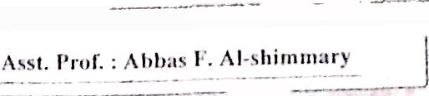
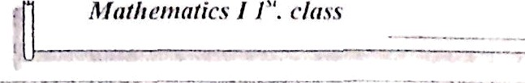








Propci”ties rif meter Itt in ii n ts:
1- If two rows (or columns) are identical then clef — !
1 2 3 2 — f\ 1
3 0 2 = 0
2 — S 1
2- interchanging any two rows (or columns) changes the sign of the determinant.
 | 2 | -1 | 3 |  |  | 3 | 1 | 0
ex/ | 3 | 1 | 0 | = | — | 2 | — 1 | 3
 | 2 | 5 | 7 |  |  | 2 | 5 | 7
3- \ A*\ = \ A\
4- if arrow (or columns) is multiplied by k (sector) then the determinantmultiplied by k.
2 | —4 | 18 |  | 1 | —2 | 9 |  | 1 |  |  | —2 | 3
Ex 1 1 | 0 | 6 | = 2 | 1 | 0 | 6 |  | = (2)(3) 1 |  |  | 0 | 2
5 —1 |  | 3 |  | 5 .. | —1 AB | = | 3 Al |  | B | 5 | —1 | 1
 |  | — 1 | 2 | 3
Ex /evaluate |  | 3 | 0 | 2
 |  | —1 | 3 | 0
thoosing i-—3
= ‹—i)(—i)“') $] + ‹3›(—*›"'
= —4 + (3) (—1)(—2 — 9) = 29
—1
3
II + ‹ ›I
1
3
Crammed’s rule method.
for solving system of Linear equations
ex/SoIve the following system of Linear eqs. using crammed’s rule:
—2s + 3y — z = 1
x + 2z — z -— 4
—2t — y + z — -3
108

Slide 9
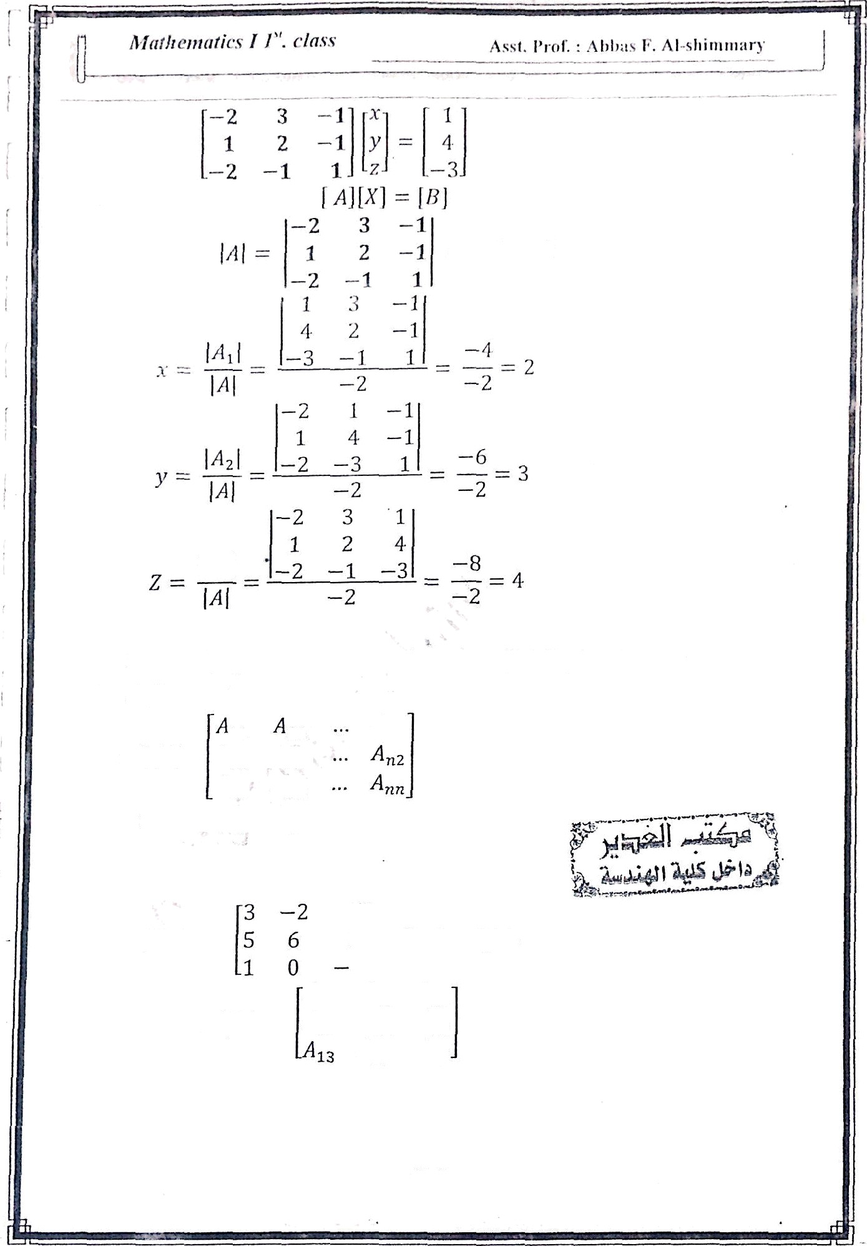


= —2 x 0
Det• Let[A] be nxn matrix, then the adjoint of matrix A is defined by
 | 11 | 21
odj (A) -- | ^{A}i 2 | Az2
 | A | A2g
or ad j (A ) —— [co f A]^{T}
exf tet | A—— | 1 2 | find adj A.
 | ad j A — | 3 Az A i A₁₂ fi ₂₂ | A_{n} A32
 |  | 23 | A 33
109

Slide 10

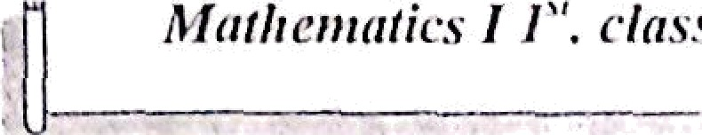
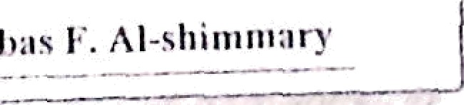
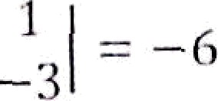

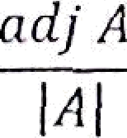




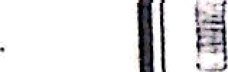



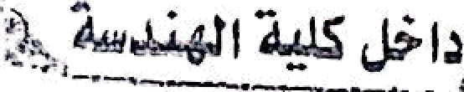








= (--1)^{,+, -2}
I '
0
..
 | --18 | --t3 | --10
md j A --- | 17 | --10 | --1
 | --6 | --2 | --28
Inverse of n squirm iitulr’tv.•
[›t] ¹ --
- find \ A\ =h 0
ź!- (ind co f A
S [ind adj A ---- [cof A)
ex3' find A | i f | A -- | S | 6 | 2
) AJ -- --94 | T | 0 | 1 ' check | 0 | --3
p co f A --
--18 17 --6
--6 --10 --
--to --
iĄ adj A ---- [co f A J^{T}
--18
-- - 0
j
= | 17 | --10 | --1
 | --6 | --2 | 28
-18 --6 --10 17 --10 --1
-6 | --2 | 28
ad j A
I A )
1
-94
-
A- ¹ -
To check
č A .A = A-* .A ---- I
3 -2 1
5 6 2 '
1 0 --3
--18 --6 --10
17 -10 -1
--6 --z 8
1 0
= 0 1 0
ú “o 1

