Slide 1
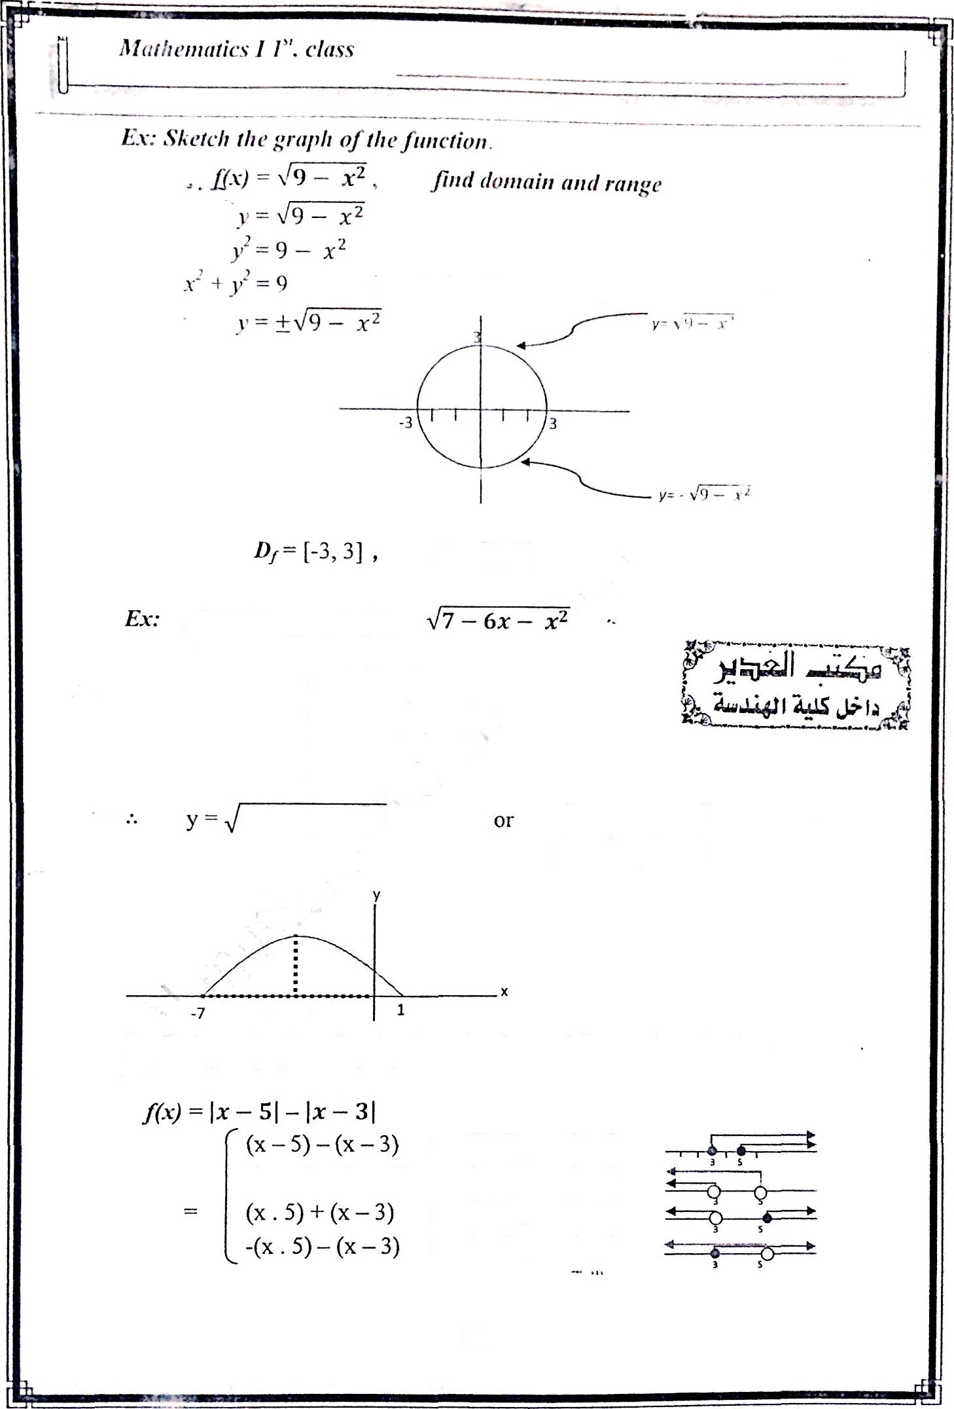
- Pr‹'f. : A l›liin r’. I 1-sliiiii inary
is a circle of center (0,0) and radius r = a
süetcli the grnpli of y ——
7 — 6x — x' = - [x² + 6x] + 7
= - [x² + 6x + 9 — 9] + 7
= - [(x+3)' — 9] + 7
= - (x+3)² + 9 + 7
= 16 — (x+$)°
16 — (x + 3)°
y² = 16 — (x+3)' (x+3)' + y² = 16
(-3, 0)
Ex.• express the fiinctíon in piecewüe from without using tibsolute
values. Skffcú the graph of
x — 5 2; 0 , x — 3 2 0
x — 5 < 0 , x — 3 < 0
x — 5 ?: 0 , x — 3 < 0
x — 5 < 0 , x — 3 2 0O
-(x — 5) + (x — 3)
11

Slide 2
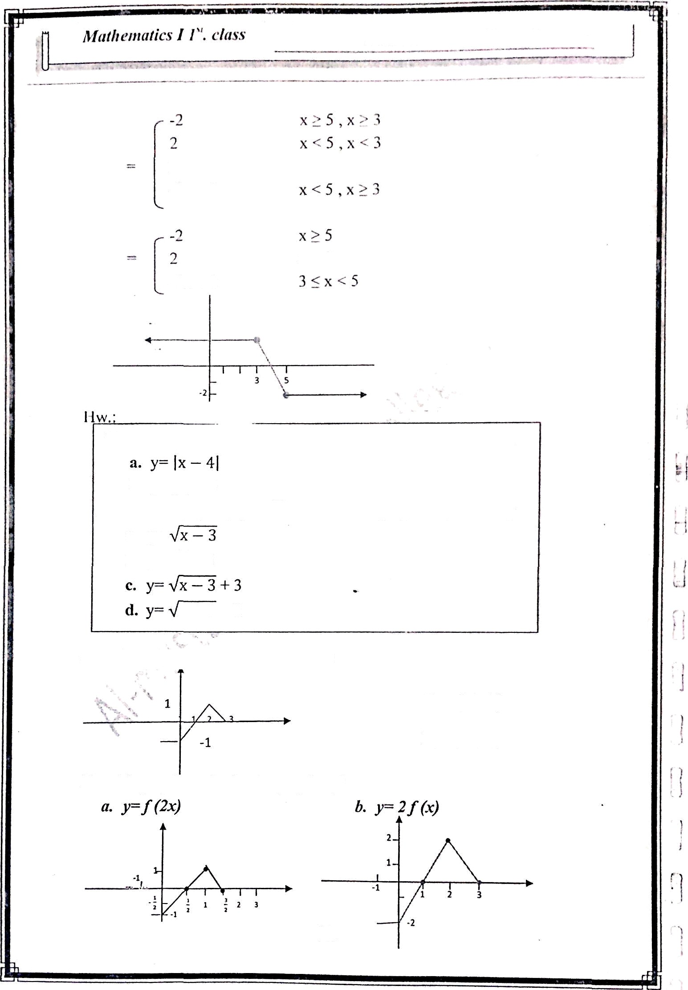
2x — g
x >5 , x -.. J ncgleci bccausc rio ^* •
x • 3
use the çraph of y- l=i to sketch the graph the follosving
b. y= ]x] + 4
HSC lltc gt•apli of y= •,fx io sketch ff7r grapll the folloiving
^• y'
b. y= JÑ + 3
x + 1 — ?
ex: n fcinctioit y —f(x) Iras the graph
f
[-1, 3]
Rt= [-1, 1]
Use this graph to obtniii the grnplis of.-
12

Slide 3


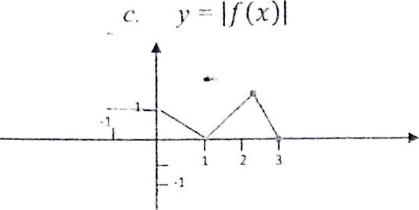
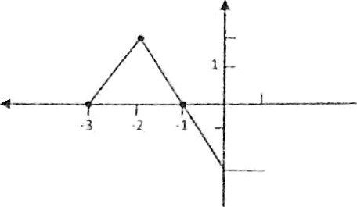







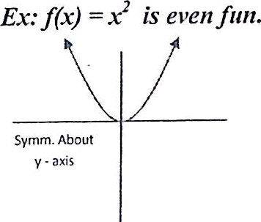
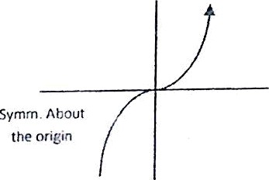
d/‹////‹•/›rn7i‹*s UI". c'*"^*
Ex: ilie fiuiction f(x) —— x’ + F — 3 is even function. f(-x) - (-x)’ + (-x)’ - 3
= + x’ — 3
Since
f(-x) —f(x)
f(x) is even fun.
‘
“ ‘°
Def• a function f(x) is“ said to be odd function If f(-x) —= - f(x) and it i’s symmetric about the origin
Ex: The function f(x)
f(-x)
—= sin x — 3x³ + x is odd function.
—= sin (-x) -3(-x)’ + (-x)
-= - sin x + 3 x - x - - [sin x - 3x + x]
.-. fts odd fun.
Since
f(-x) — - f(x)
13

Slide 4
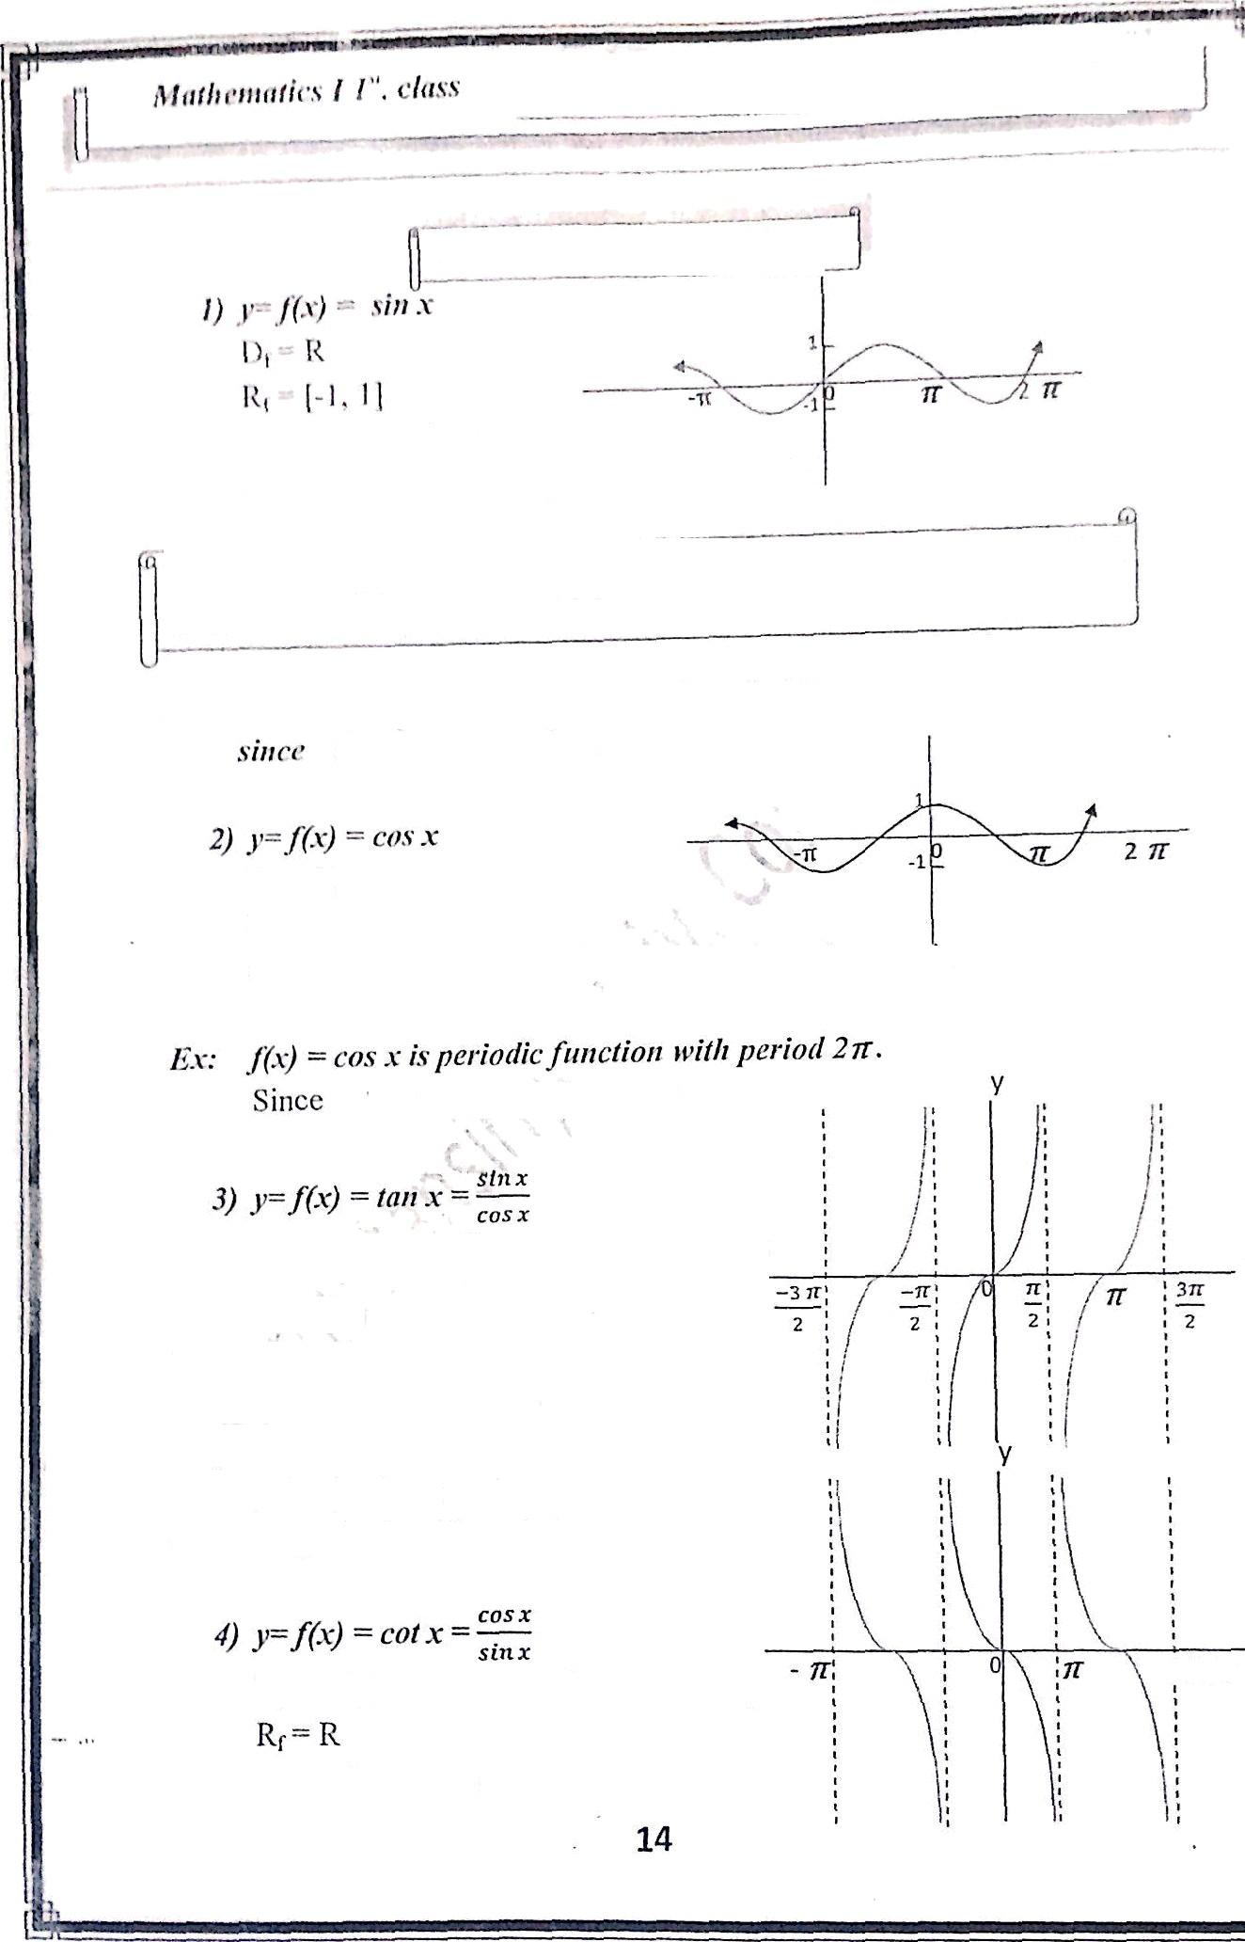

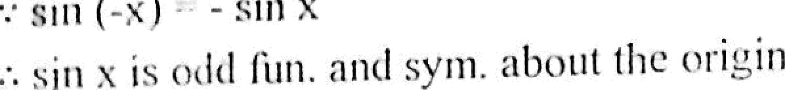
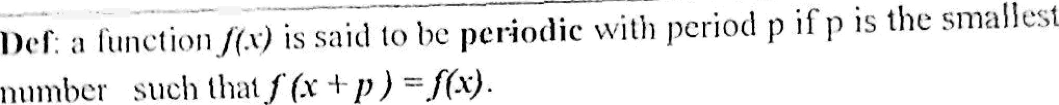



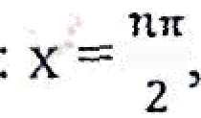

cos x is evan function and symmetr le about the y- ^{axis}
cos (x + 2 ) — COS X
Df — RI (x
n= 1, 3, 5, ... }
R_{f}
R
-• tan (-x) — - tan x
.- Ïän .x is odd function and- sytnmetr ic about the origin
v tan ( x+ ) tac X
•• tan x is periodic with period v
! 2 7Y

Slide 5
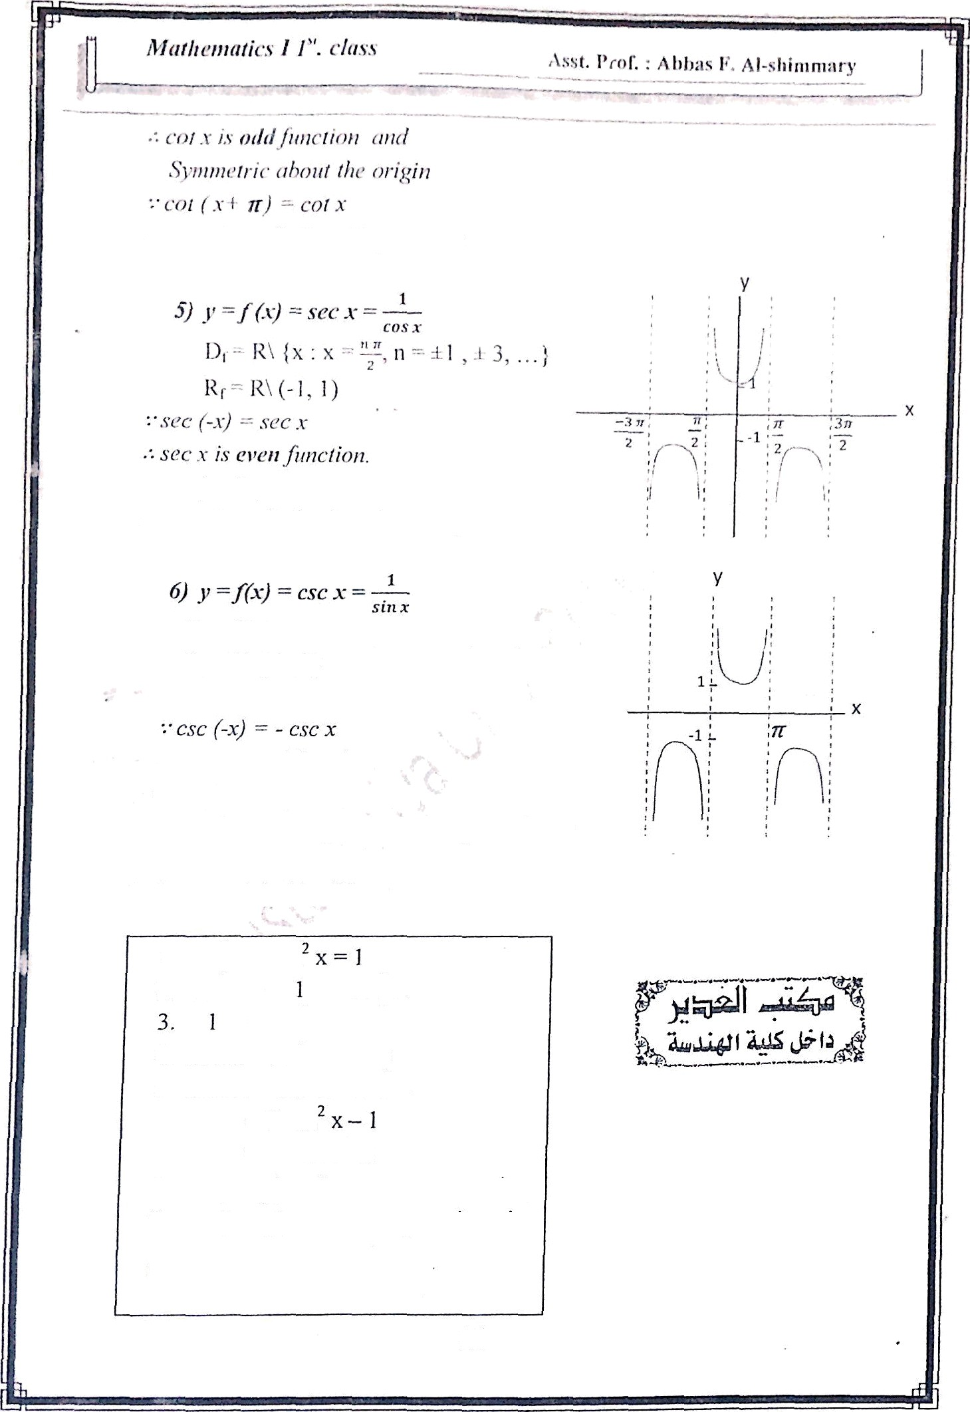
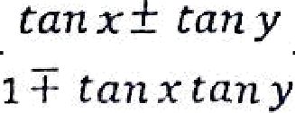
sec (x«-2 1 — sec x
sc•c .v is pcl‘iotlic ftmclioit willt period 2
Dt = R\ {x : x = n ir, n= 0, a 1, T 2, .-} Rt = R\ (-1, 1)
• • csc x is otld function.
csc x 3- 2w) = csc x
csr x is periodic function with period 2tr
Trigonometric identities:
cos x + sin
coé x + = csc' x
+ tan' x = sec² x
4. sin 2x = 2 sin x cos x
S. cos 2x = cos² x — sin² x
= 2 cos
= 1 — 2 sin² x
sin (x a y) = sin x cos y + cos x sin y
cos (x a y) = cos x cos y i sin x sia y
tan (x a .¡/j,y
15

Slide 6
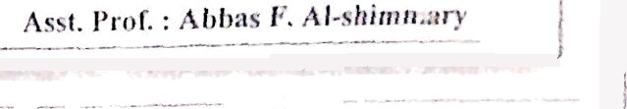






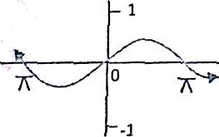
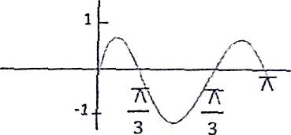
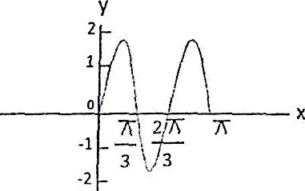
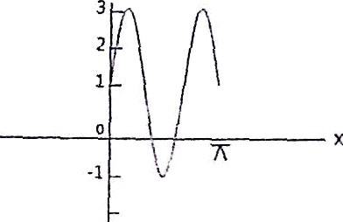
10. co.s' x = $— ( J + cos 2x)
l 1.sin x cos y = [ sin (x-y) + sin (x+ y) l2.sin x sin y = ( cos (x-y) - cos (xi y) 13.cos x cos y = [c(›s (x-y) + cos (x+ y)1 14.cos ( — x) = sin .x
l 5.sin ( y — x ) — cos x
sin 9+cos 2Q —1_ stu Q +(t— 2 sin Q)- 1 | sin Q ( i - 2 sin Q1 |  | stu q
cos Q -sin z9 cos Q -2 sin Q cos p | cos Q (1—2 sin Q) |  | cos 9
Ex- Prove that
sin Q
cos 9
- sec Q
L.H.S. “
S ’ sin 2 Q- sin Q cos 2Q
cos Q (2 siti p cos 9)— sin Q (2cos' —1)
sin Q cas Q
sin Q cos Q
* 2 cos' Q -2 cos°Q +s in Q
sin p cos Q
_{cos e} — sec ^{Q} = R.H.S.
dx.- Sketcli the grnph of
y-- sin x
y- 2 sin (3x) +I
i i
y--2 sizi (3s)
y— sin (3s) + 1
16

Slide 7

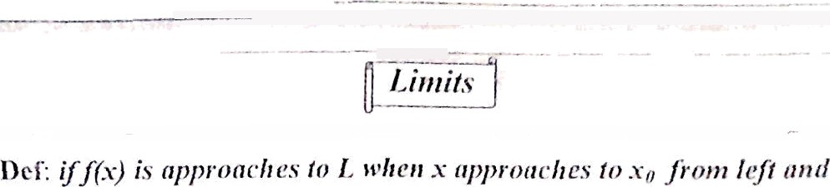

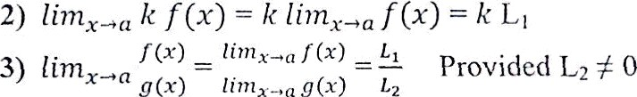
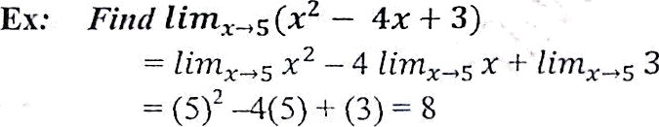







Theorem: if íim,<ø f x) —— £
then:
& fim,qø
(x) = £2 and k is constant
= 12
Ex:,
Fińd
fimøp
z— I
vT-1
+1
* ”
and the limit does not exist
17

Slide 8
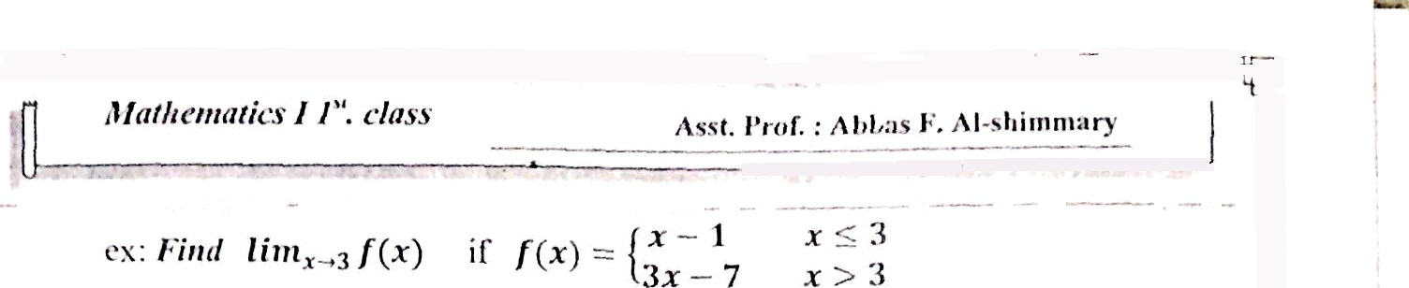






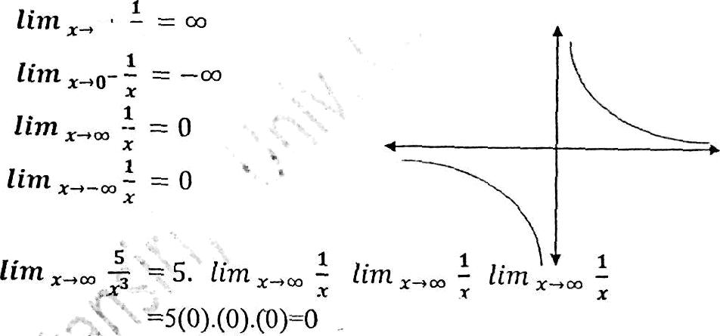



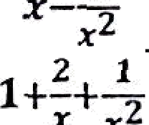

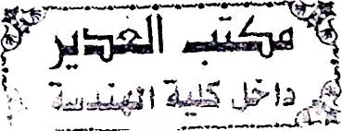



lim
g
>—•3+
^{liin} - 3/(=) —— 2
0
z'+ 4—4
= 0
*
2
4 + 2
Note :
L'
Ex: find
1
r
Ex: find
2
= lim * , =
z—i -m 3 +y+
3
Ex: find lim
*-2 _
z+g ¿
fim
and the limit docs not exist
0
18

Slide 9
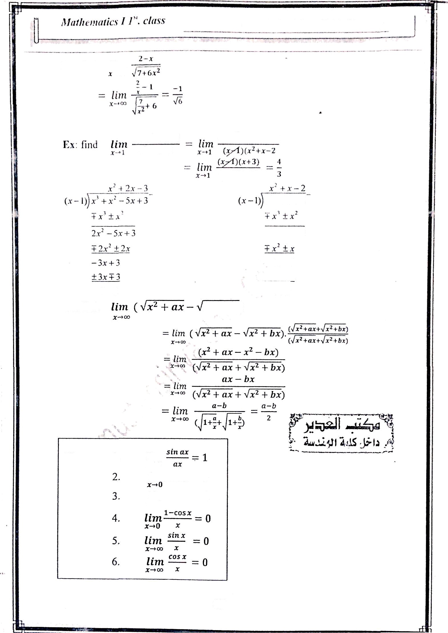


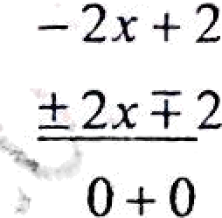
tssL l’i i›f. : .4bb:is F’. Al-.sliiiiirii.ir*
x"+x'—5x+3
*³—3 x+2
.r³ — 3.r + 2
x' —3x + 2
O+0
Ex: find
x° + bx)
Theorem : I.
lim
r-•0
finn sin x = 0
finn cos x = 1
19

Slide 10
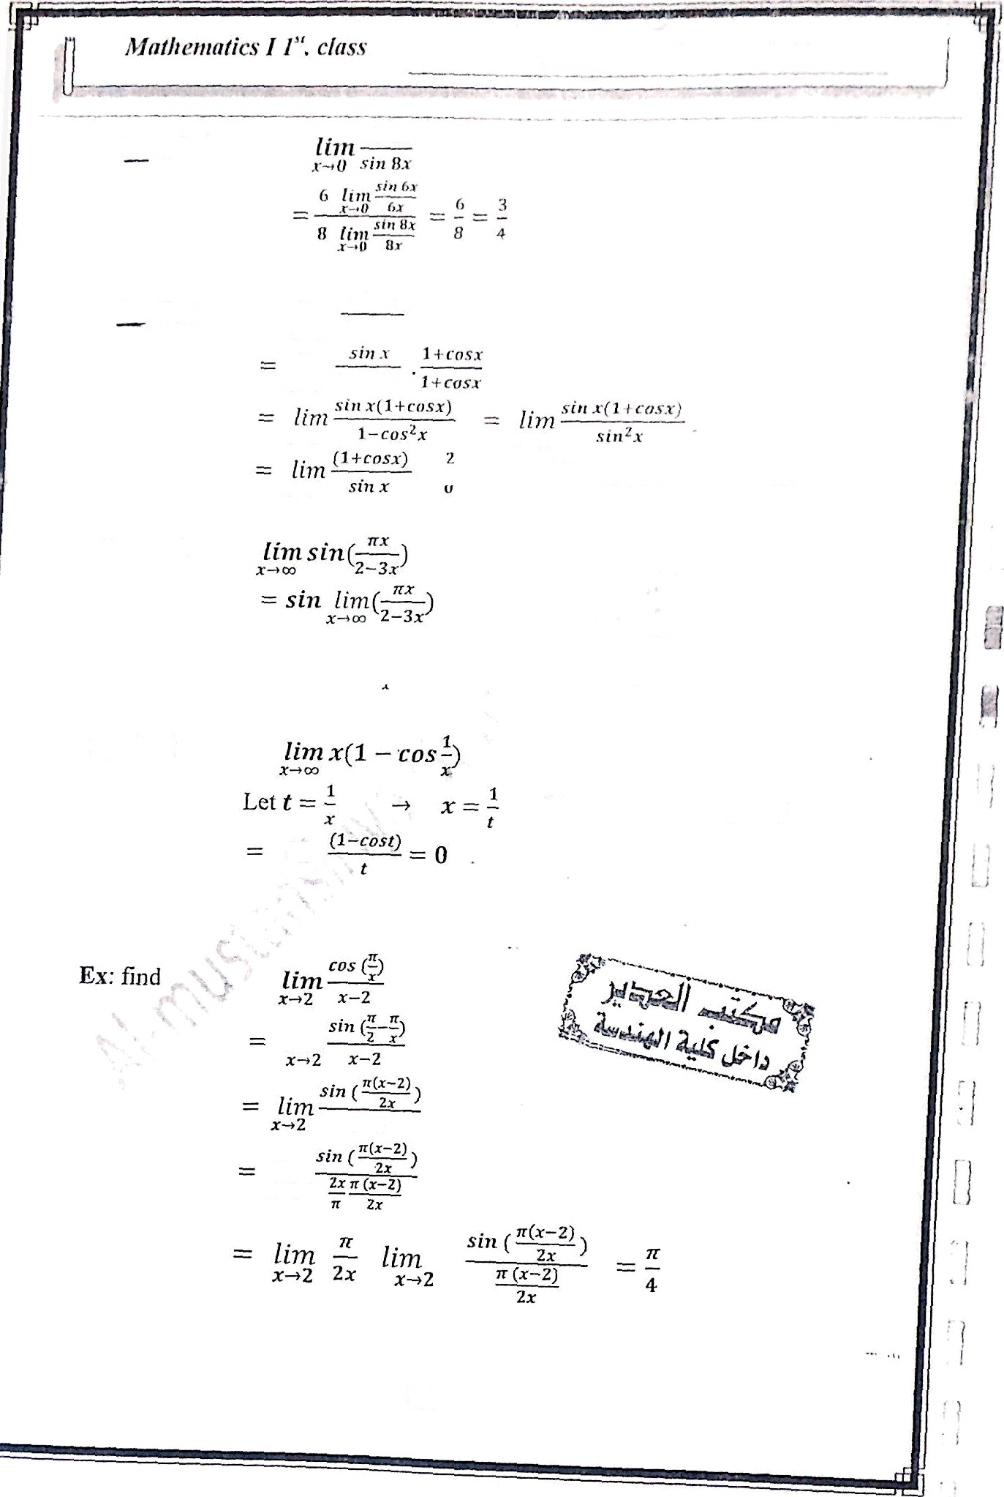






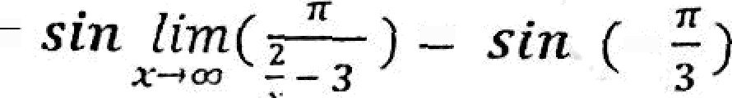


rx’ Lind
li›n
x•O
x*O
x+0
— and lhC llmit does not cxi.;f
Ex: find
2
Ex: fi‹id
!‘I x -• «•• then t —• o
t*0
lim
20

