Slide 1
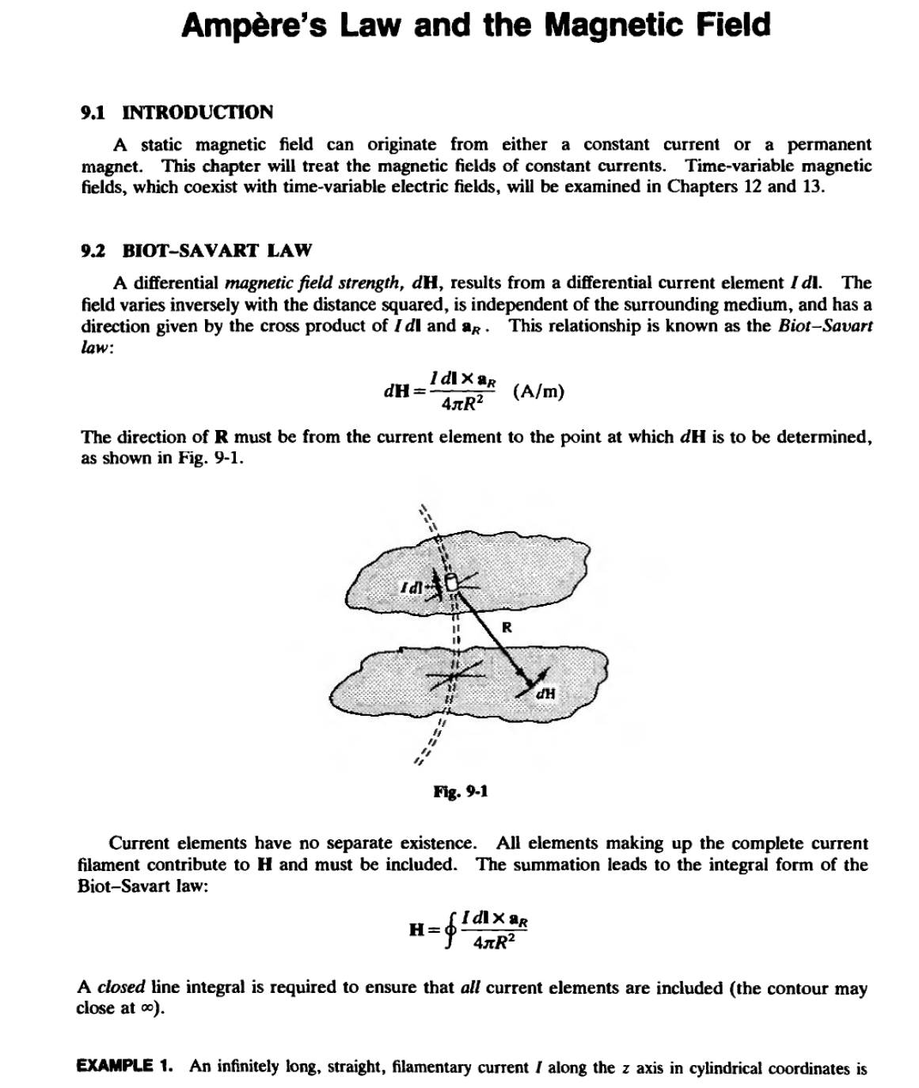
LECTURE NINE

Slide 2
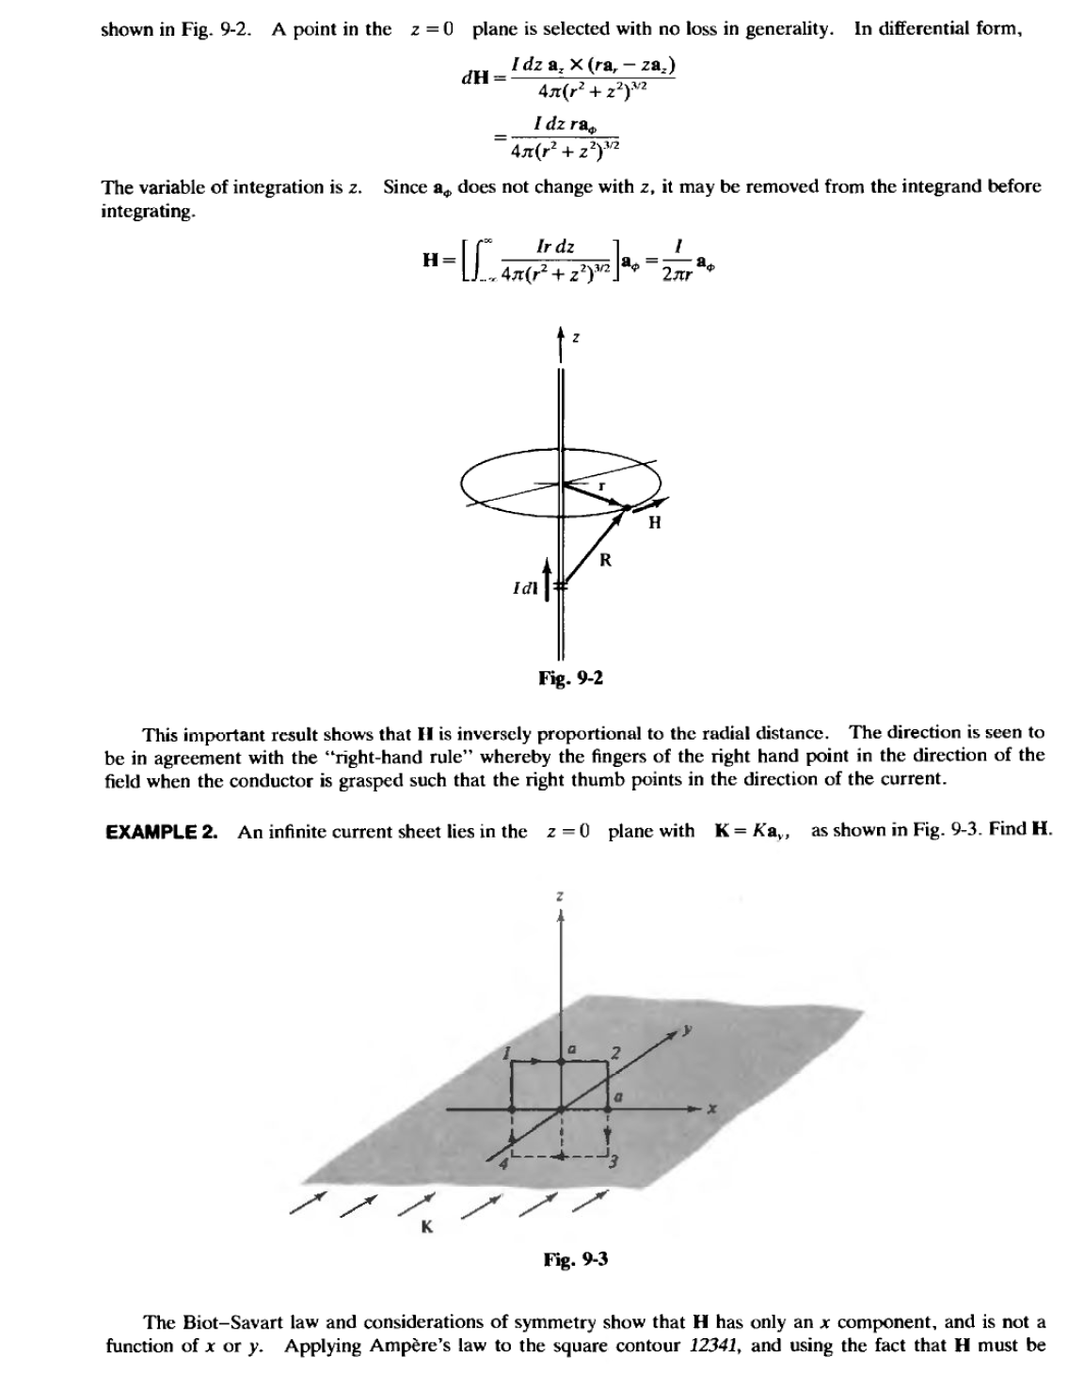
LECTURE NINE

Slide 3
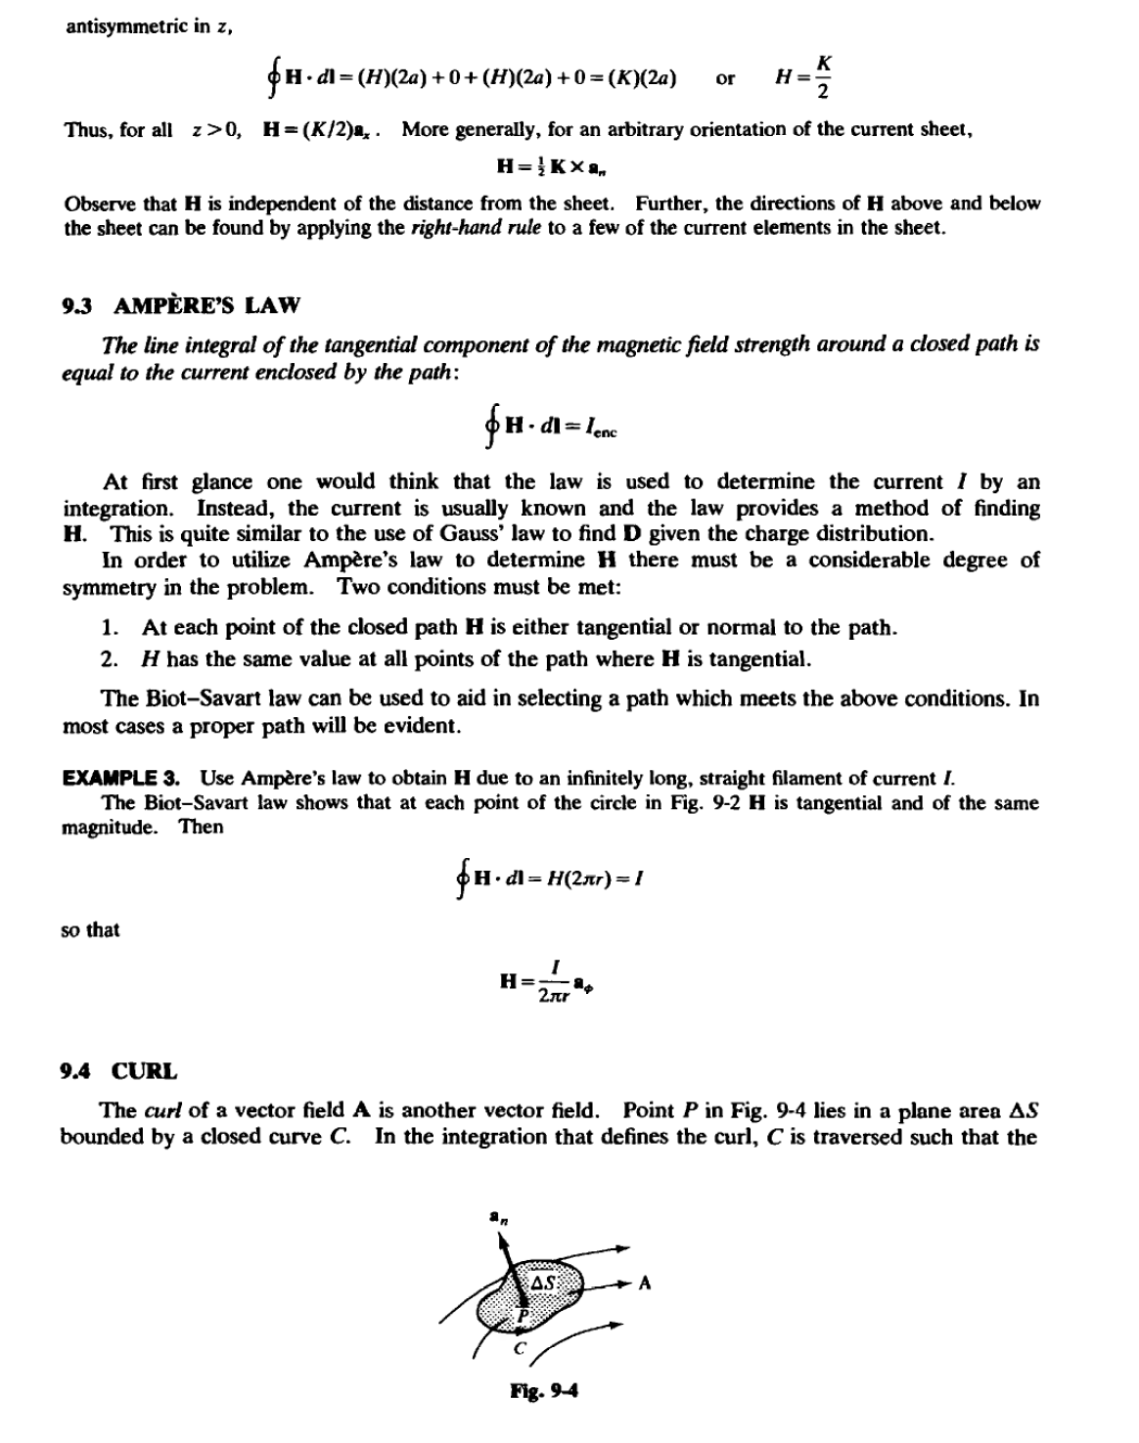
LECTURE NINE

Slide 4
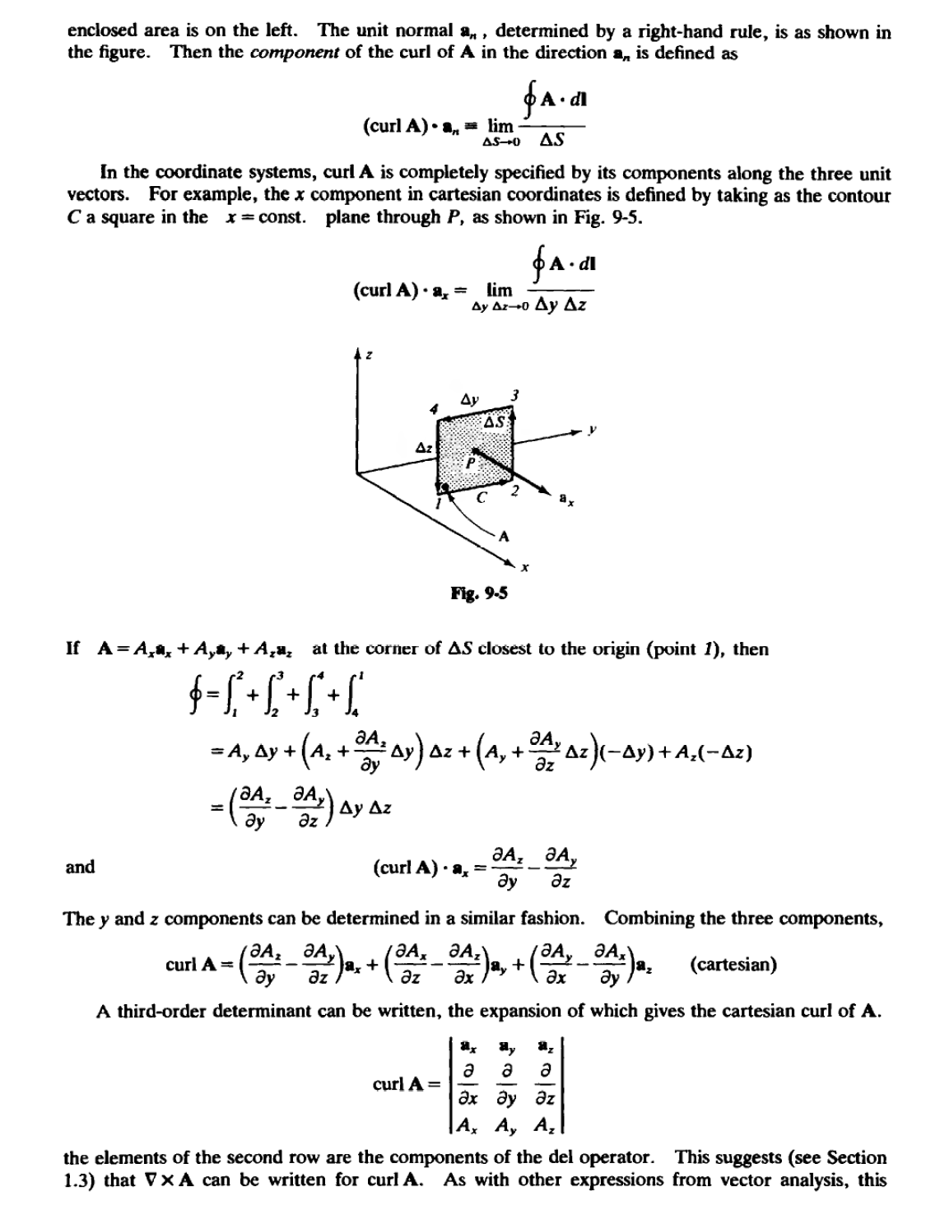
LECTURE NINE

Slide 5
LECTURE NINE

Slide 6
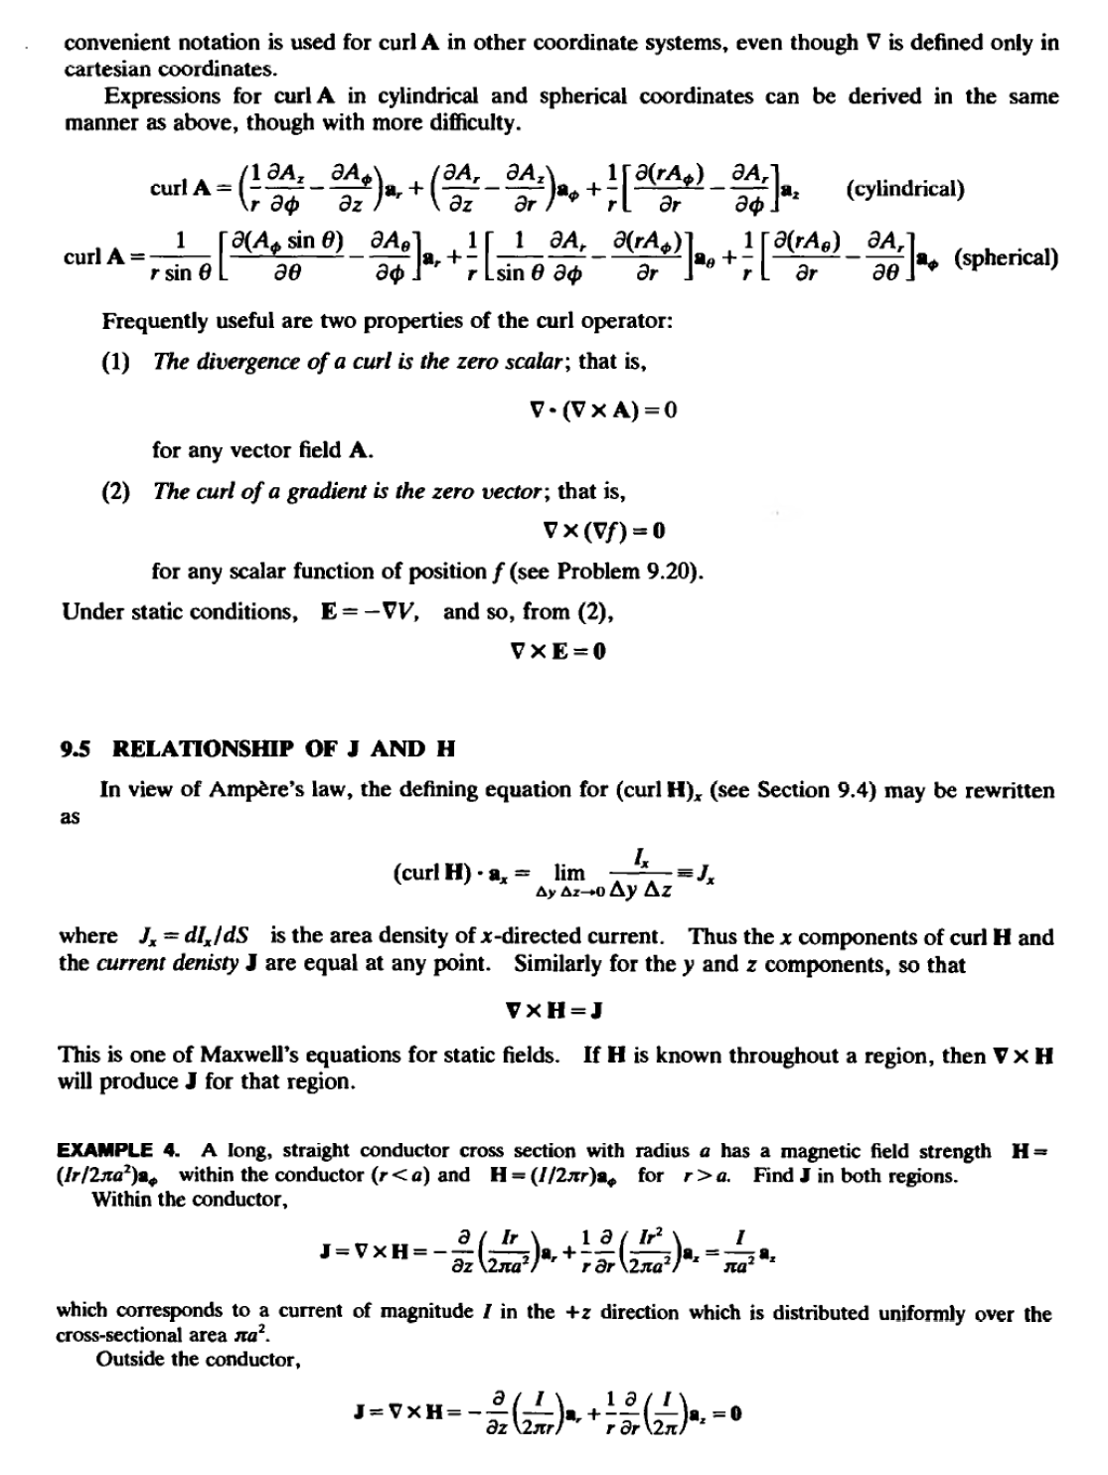
LECTURE NINE

Slide 7
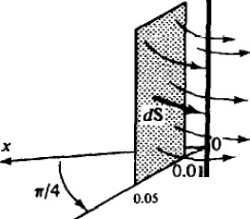
LECTURE NINE
9.6 MAGNETIC FLUX DENSITY B
LikeD, the magnetic field strength H depends only on (moving) charges and is independent of
the medium . The force field associated with H is the mtlgneticflux density B, which is given by
B=tJH
where 1-' == 1-'oJl, is the permeability of the medium . The unit of B is the tesla,
N
lT=l--
A ·m
The free-space permeability 1-'o has a numerical value of 4n- x w-¹ and has the units henries per meter, H/m; IJ,, the relative permeabilily of the medium, is a pure number very near to unity , except for a smaU group of ferromagnetic materials which will be treated in Chapter 11.
Magnetic flux, cl>, through a surface is defined as
cl> = LB ·dS
The sign on cl> may be positive or negative depending upon tbe choice of the surface normal in
dS. The unit of magnetic ftux is the weber, Wb . The various magnetic units are related by
1T = 1Wb/m² 1H = 1Wb/ A
EXAIIW'LE 5. Find the flux crossing the portion of the plane ¢= t/4 defined by 0.01 <r <
O.OS m and 0< z < 2m (see Fig.9-6). A current filament of 2.50 A along the z axis is in the a. direction.
B =J'oH = J'ol a
ltT •
CZ,= _{L}2r05-a.·drdza.
dS=drdza.
o.oo 2 tr
=21'olln O.OS 21t 0.01
= 1.61 x 10-⁶ Wb or 1.61 pWb
It should be observed that the lines of magnetic ftux cl> are closed curves, with no starting point
or termination point. This is in contrast with electric ftux 'I'. which originates on positive charge
B
t2.SOA

