Slide 1
Fundamentals of Communications Engineering
Department of Communications Engineering, College of Engineering, University of Diyala, 2016-2017
Class: Second Year
Instructor: Dr. Montadar Abas Taher
Room: Comm-02
Lecture: 06

Slide 2
Fundamentals of Communications Engineering
Department of Communications Engineering, College of Engineering, University of Diyala, 2016-2017
Class: Second Year
Instructor: Dr. Montadar Abas Taher
Room: Comm-02
Lecture: 06

Slide 3
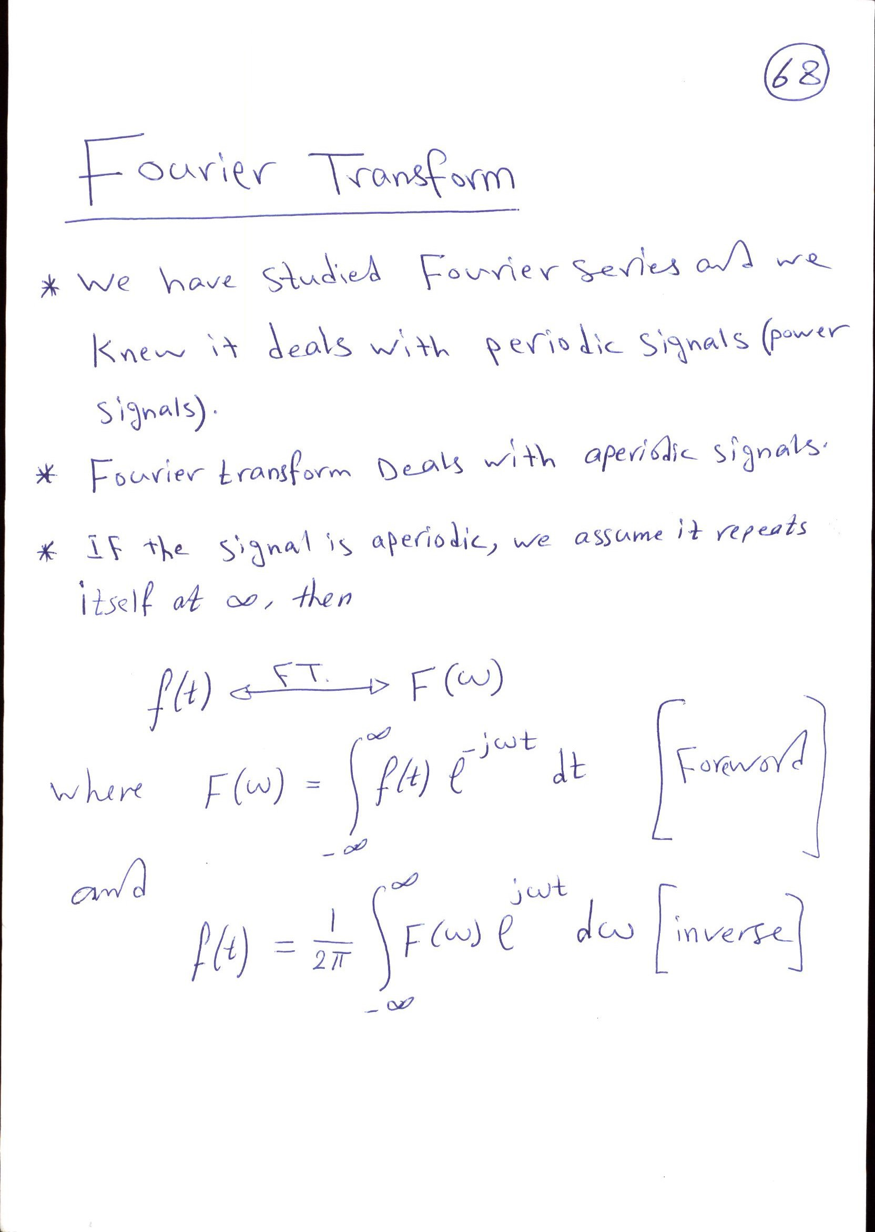

Slide 4
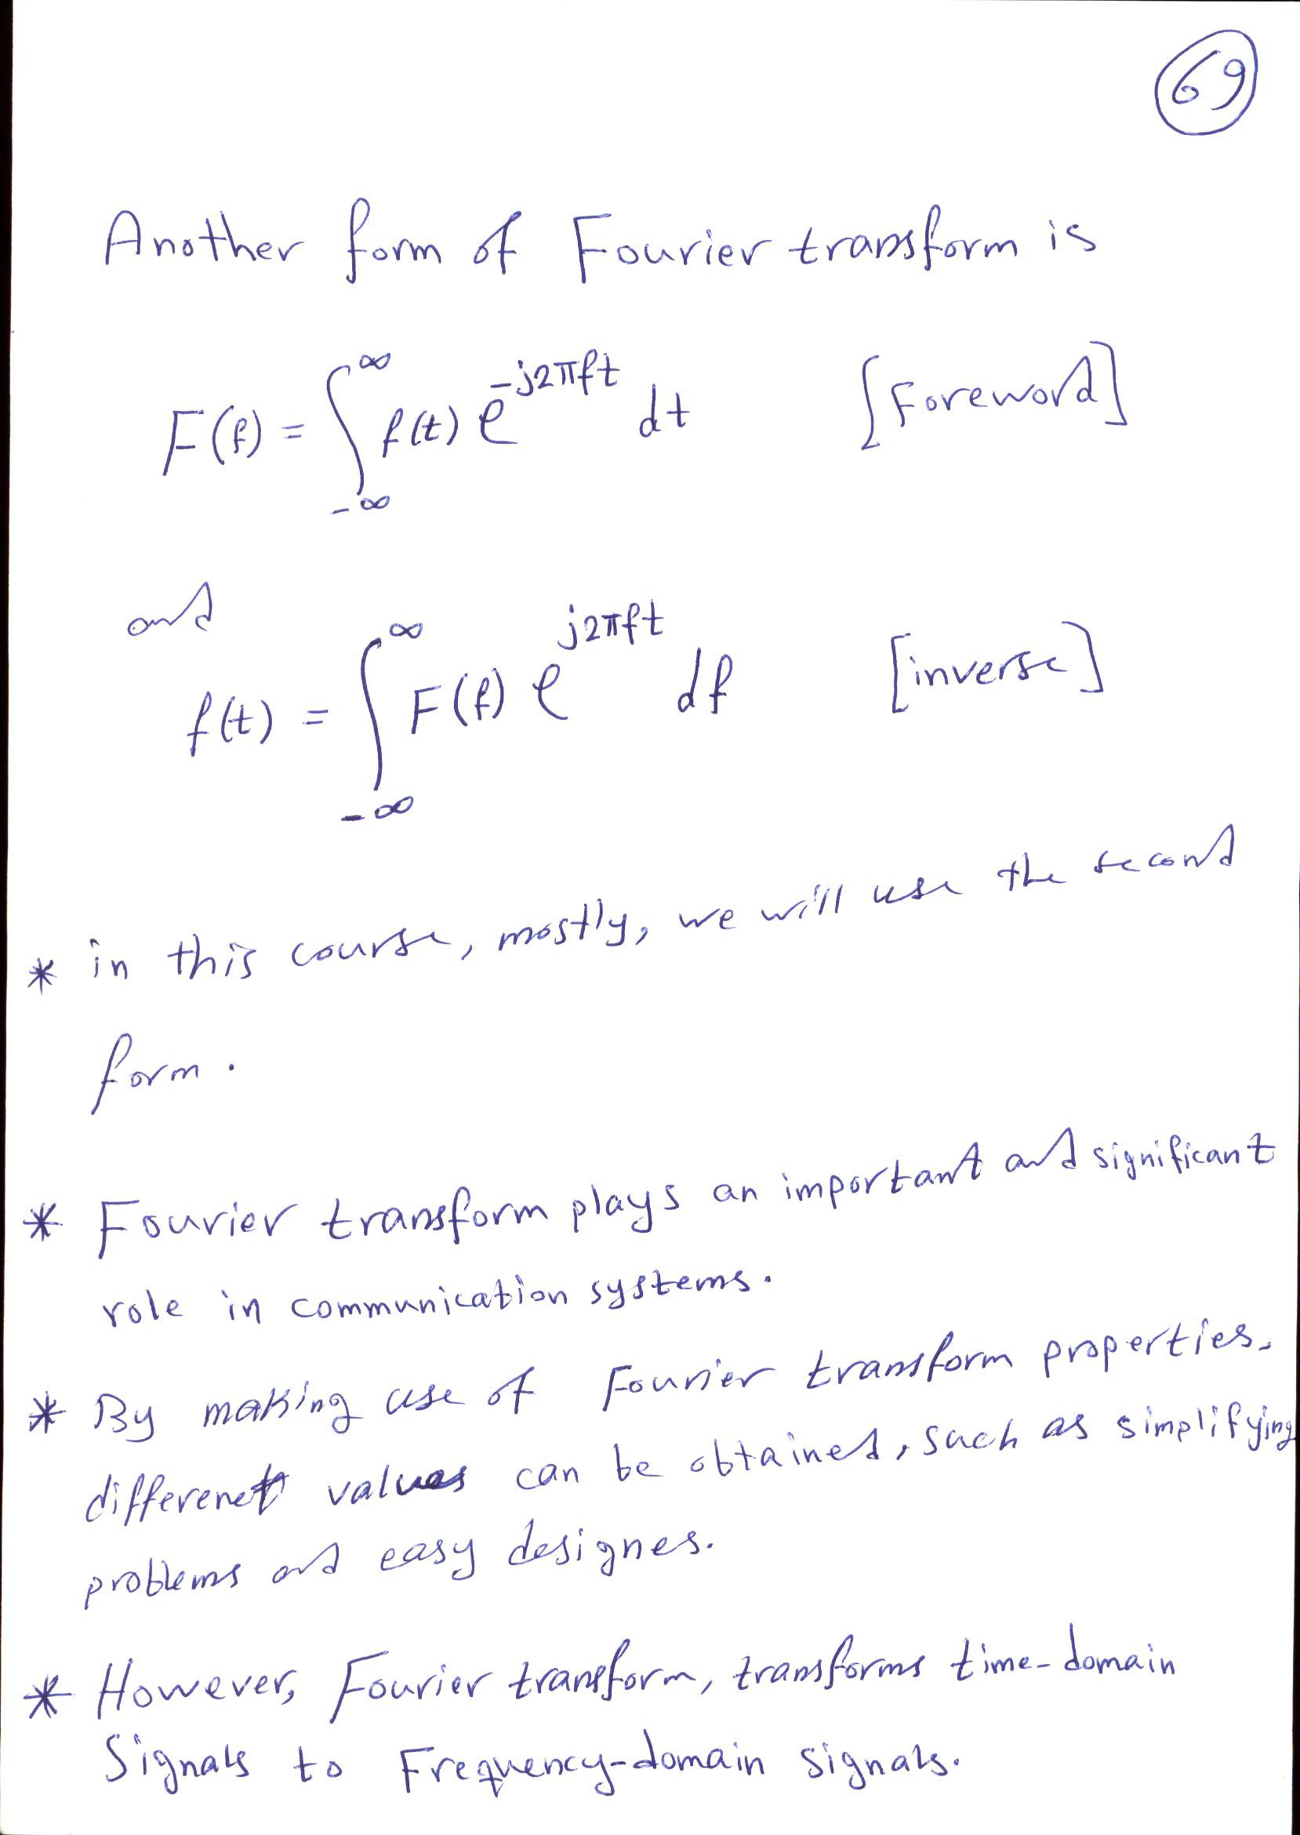

Slide 5
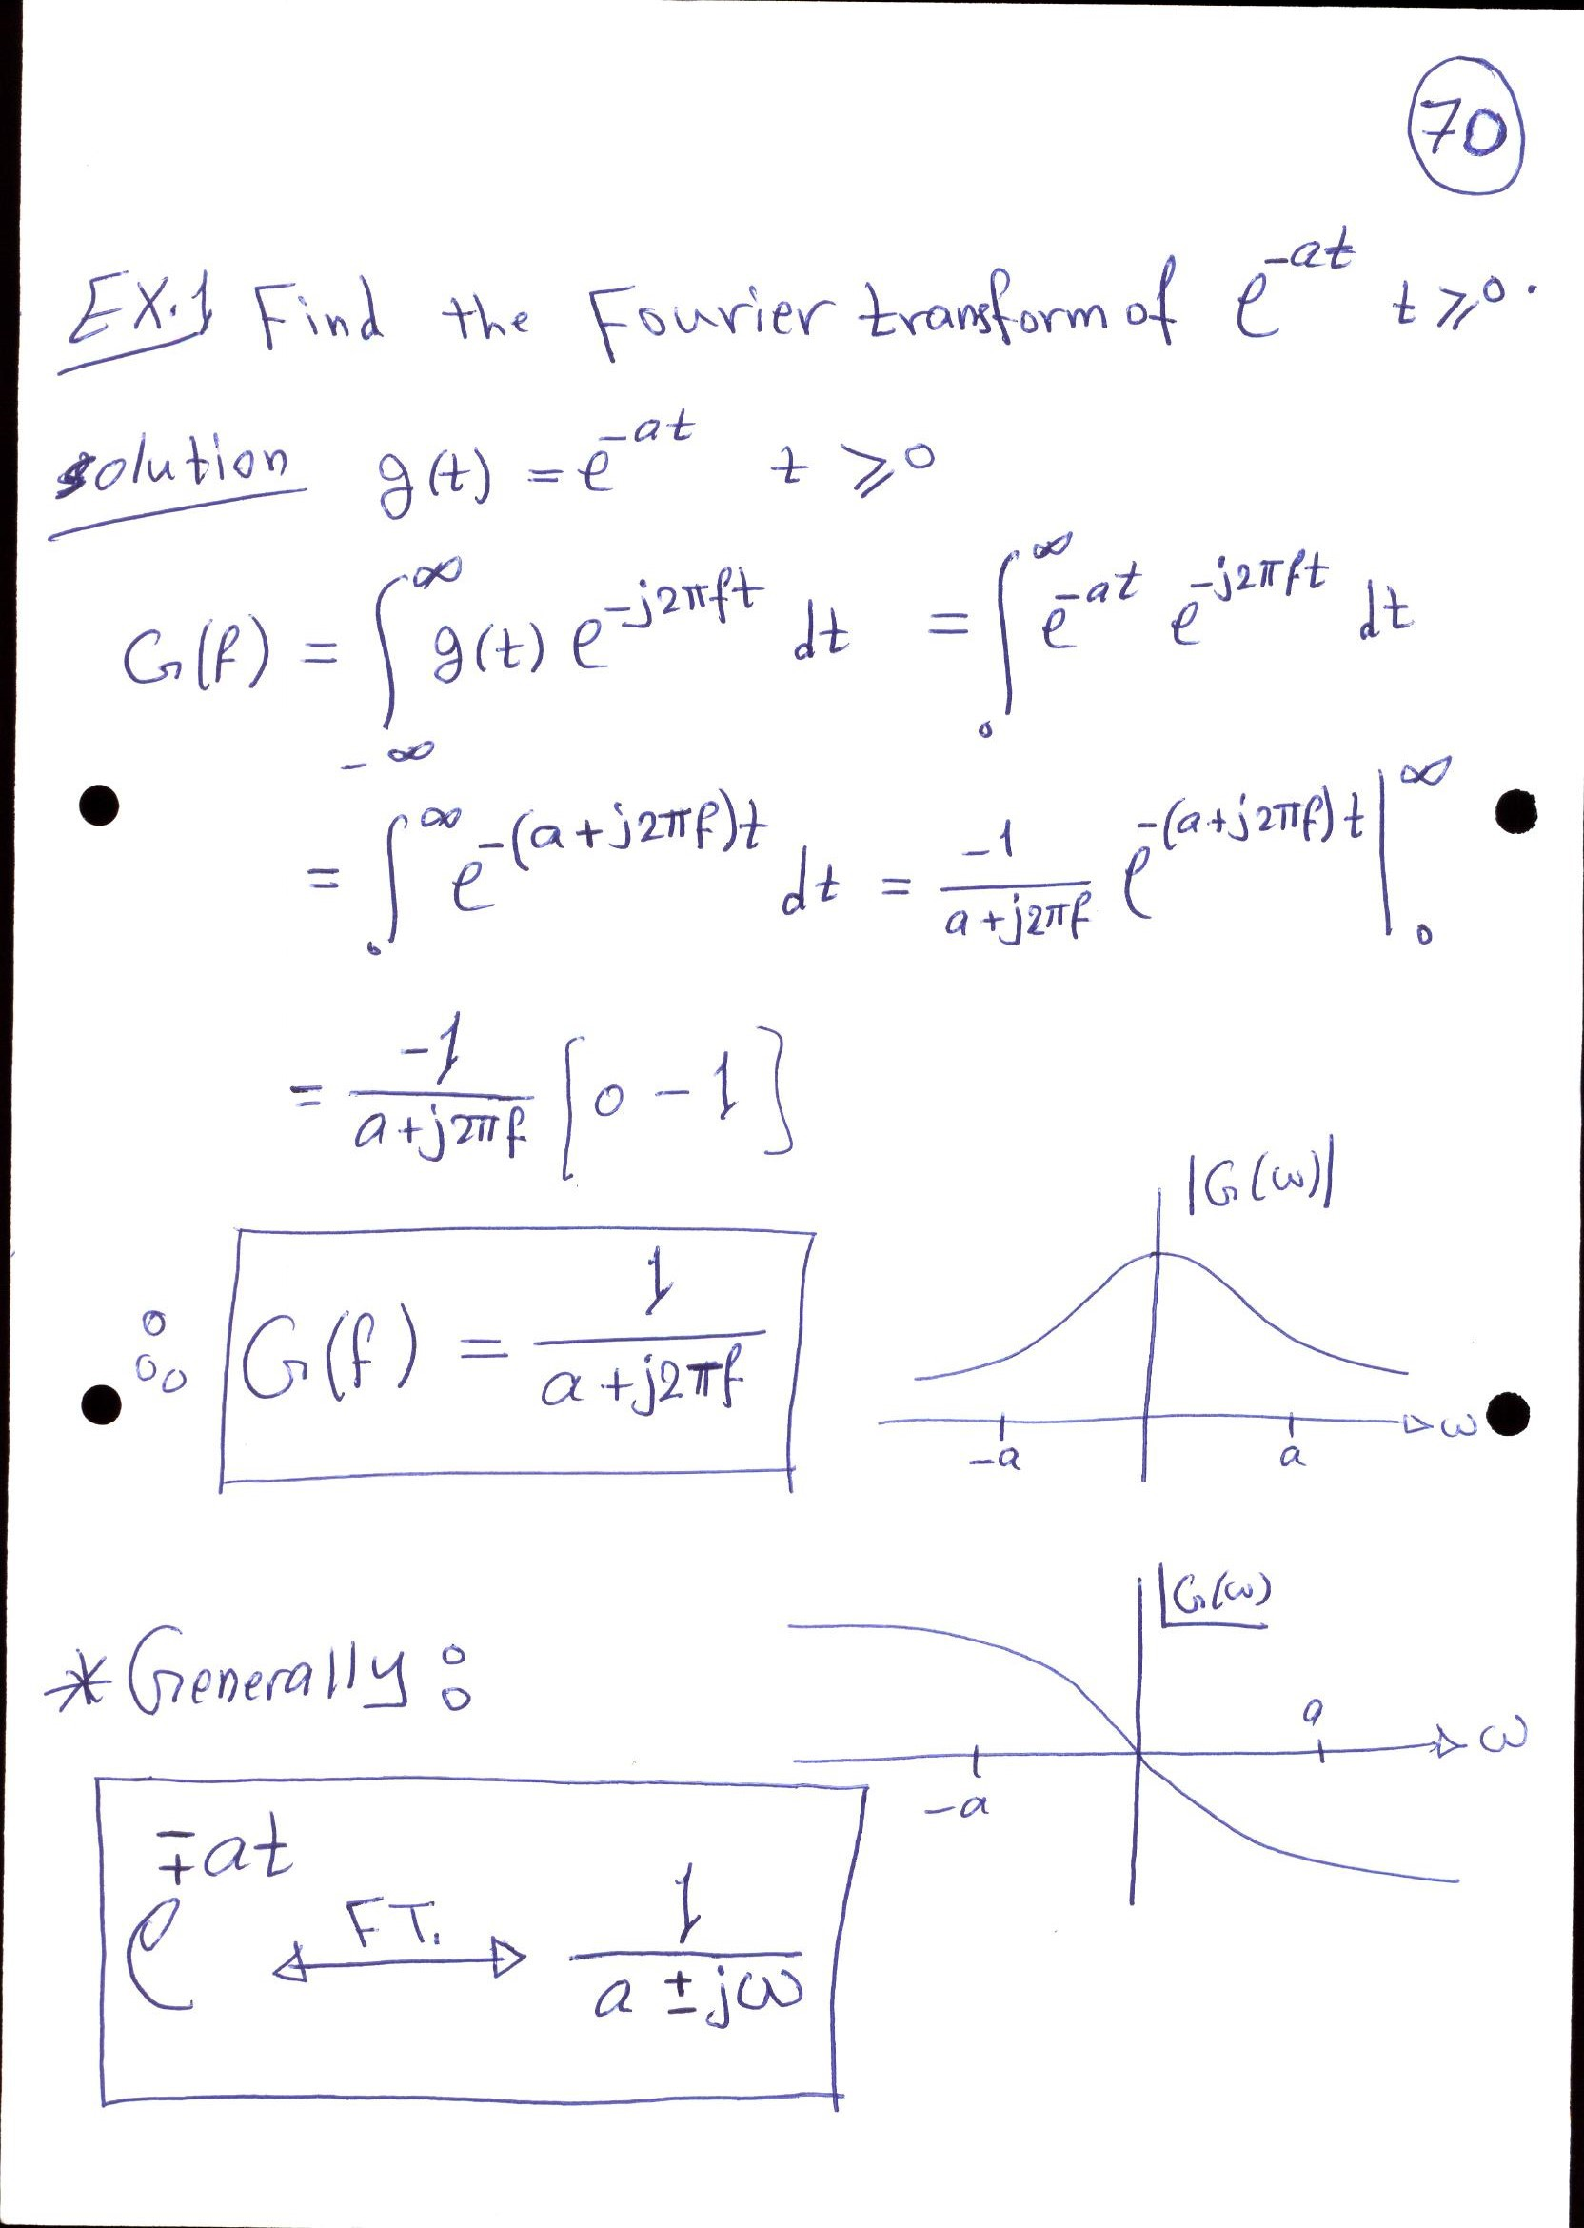

Slide 6
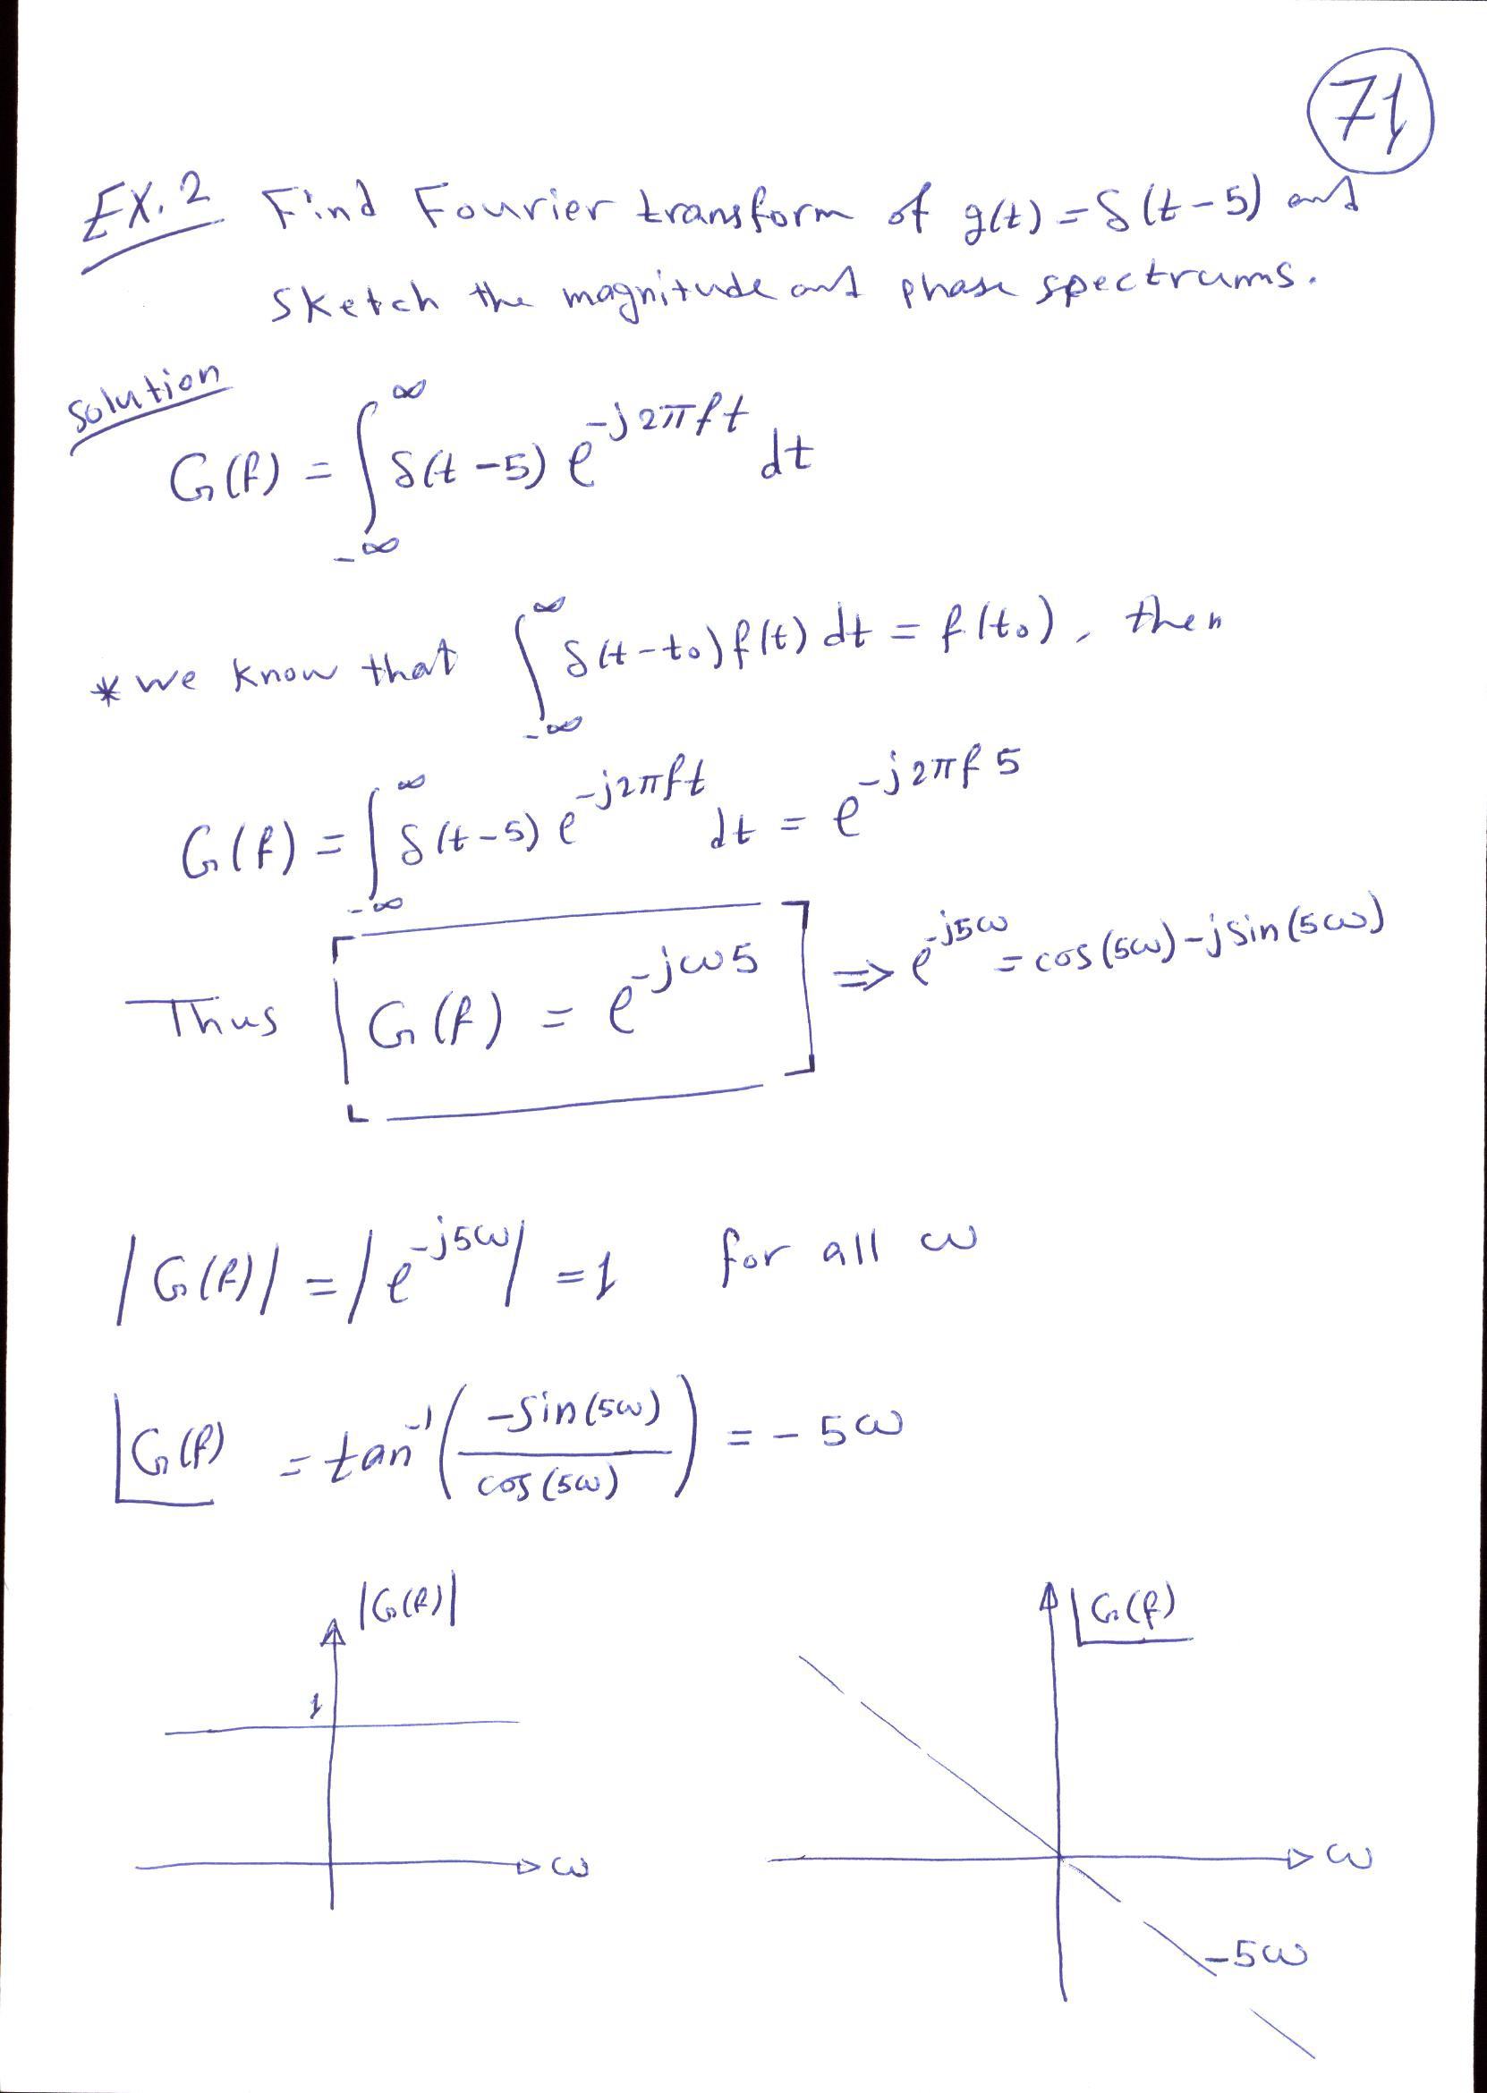

Slide 7
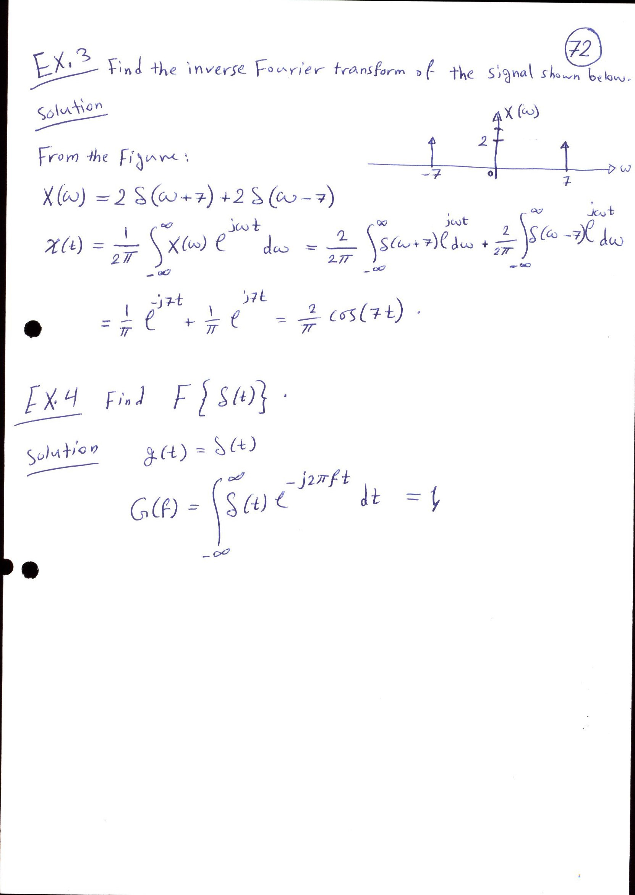

Slide 8
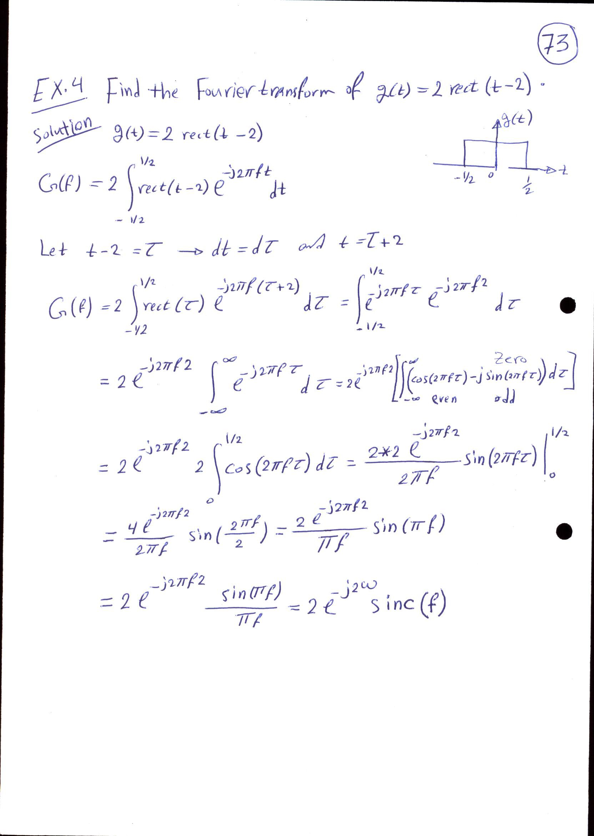

Slide 9
