Slide 1

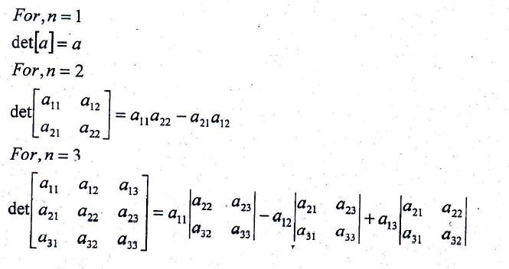
Matrix Analysis
Review
A matrix is a converting of great numbers of variables as a single quantity. A rectangular array of numbers like:
Is called a( 2x3) matrix.
A square matrix: it’s a matrix with the same number of rows and column. It is a matrix of order n if the number of rows and column is n. With each square matrix A, we associate a number det A, or a_{ij} , called the determinant of A, calculated from the elements of A.
Useful 'Facts about Determinants :
If two rows of a matrix are identical, the determinant is zero.
Interchanging two rows of a matrix changes the sign of its determinant.
If each element of same row or column of a matrix is multiplied by a constant c, the determinant is

Slide 2
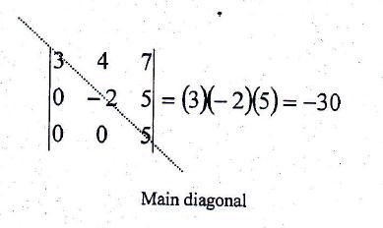
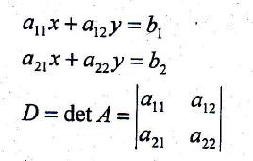
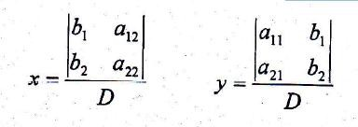
multiplied by c.
4. If all elements of a matrix above the main diagonal (or below it) are zero, the determinant of a matrix is product of the element of the main diagonal, for example:
Cramer's Rule:
For the system of equation:
If D 0, the above system has unique solution, and Cramer's rule state that:

Slide 3
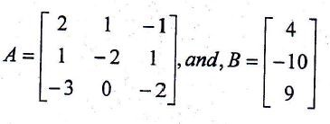
Example: Solve the system 2x₁+x₂-x₃=4
x₁-2x₂+x₃=-10
-3x₁-2x₃=9
Solution: First the matrix A and B:
Then, find the determinant of A :
|
det A=2 | | | | ( ) |
( ) ( ) ( )
|
| |
| |
| |
|
₌
| | |
| | | |
|
₌ ₃
| | | | |
| |
|
₌ ₃
Example :Use Cramer's rule to solve the system: 3tan²x+y=3
2tan² x-3y =l3
Solution: Let u=tan²x, then the system becomes: 3u+y=3 .

Slide 4
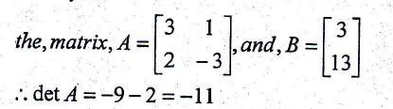
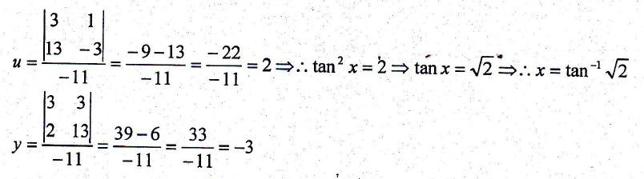
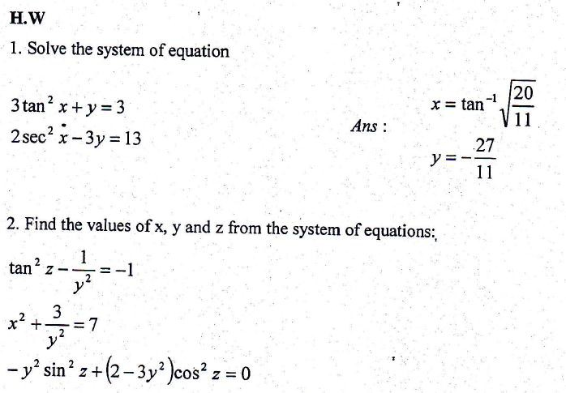
2u -3y =13

Slide 5
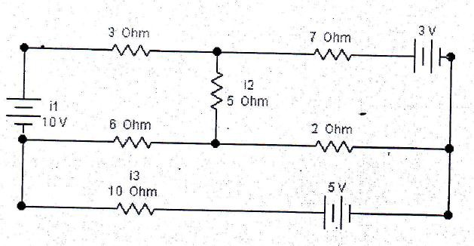
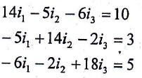
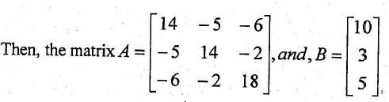
Example: Application. For a simple electrical circuit
Where i in amperes, V in volts and R in ohm.
Solution: From the basic Kirchhoff's laws:
For each closed circuit the total algebraic sum of e.m.f is zero.
At each nodal point there is continuity of current.
10 = 6(i₁ -i₃)+ 5(i₁ –i₂)+3i₁
3 =7i₂+5(i₂-i₁)+2(i₂-i₃)
5 =2(i₃-i₂)+6(i₃-i₁)+l0i₃
The set of equation reduced to the following:
We now can find each current i₁, i₂, and i₃ by Cramer's Rule

Slide 6

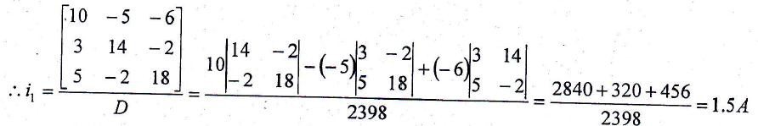
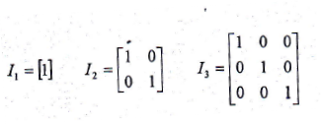

In the same way we can calculate the values of other currents', then i₂ = 0.8lA, and, i₃ = 0.82A .
properties of Matrix
Equality of Matrices: Two matrices are equal if and only if they are of the same order and their elements are equal.
If A is a matrix of mxn and B is another matrix of mxn then A+B=B+A
Multiplication Scalar: If a matrix is multiplied by a scalar then
every element is multiplied by the same scalar.
Zero Matrix: The subtraction of two equal matrices of order mxn gives a zero matrix of order mxn.
Multiplication of matrices: Given a matrix A of order mxn and a second matrix B of order nxp, the product AB is a third matrix C
of order mxp. And AxB BxA.
Unit matrix: It is matrix whose elements in the main diagonal are equal one, and denoted by I_{n} for example:

Slide 7


The Inverse Matrix: To find the inverse of matrix whose determinant is not zero:
  Construct the matrix of cofactors of A
  Construct the transposed matrix of cofactors (called the adjoin of A)
  Then, the inverse is:
Example: Find the inverse of the matrix
Solution:
|
| |
| ( ) |
|
since, the determinant not zero, then the matrix have inverse. First find the matrix of cofactors of A:
The cofactor of a_{ij} is the determinant A_{ij} that is (-l)^{i+j} times the minor of a_{ij}
( ) |
| ( ) ( )
( ) |
| ( ) ( )
( ) |
| ( ) ( )
( ) |
| ( ) ( )

Slide 8

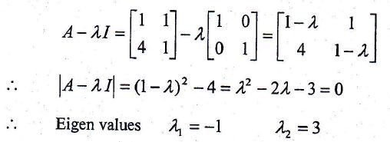
( ) |
| ( ) ( )
[ ]
adjA= ( ) [
]
[
]
Note that: AA⁻¹= A⁻¹ A = I
8. Eigen Vector and Eigen Value
The analysis of linear differential equations is simplified by the use of matrix and vector method.
Example: Find Eigen values and Eigen vectors of the matrix
Solution:

Slide 9
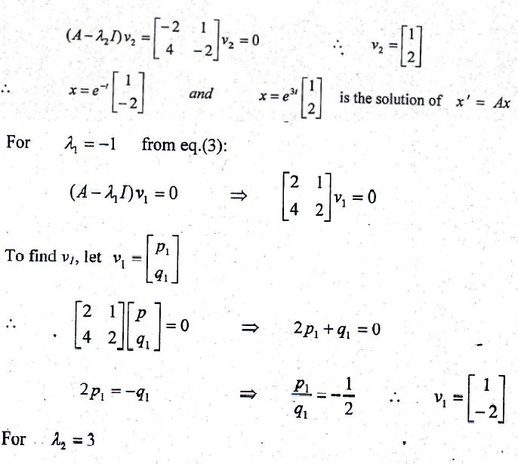
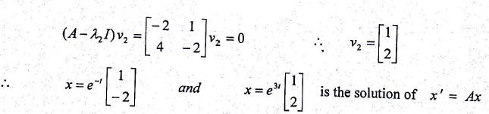

Example: Find the Eigen values and Eigen vectors of the matrix

Slide 10
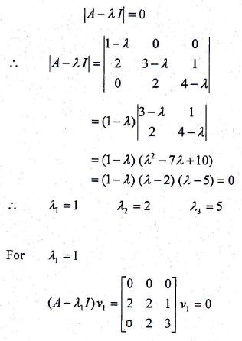
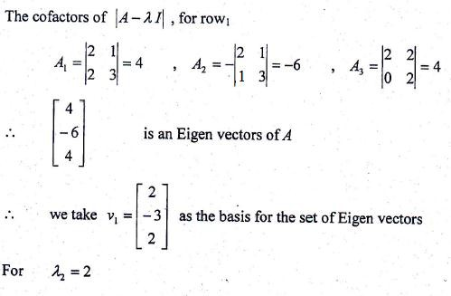
Solution :
10

Slide 11
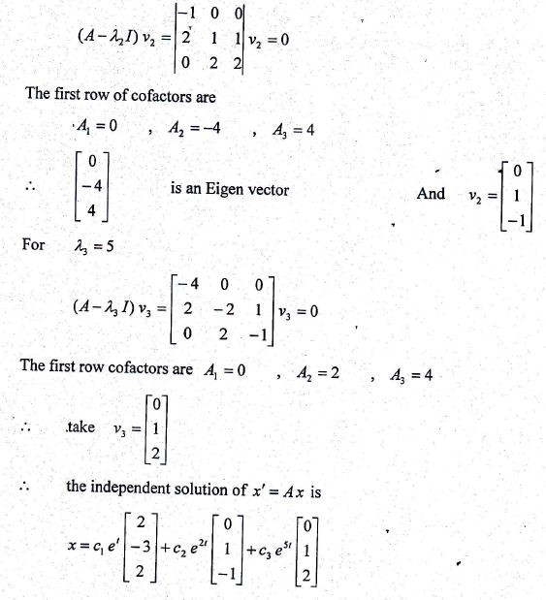
Repeated Eigen Values:
for the solution x' = Ax and if is repeated twice ( ). The first solution is
And for second solution:
( )
But ( ) ( )
Where w₁ is a vector. And the solution is :-
( ( ) )

Slide 12

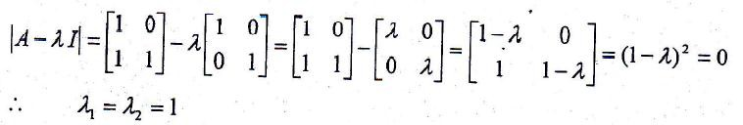
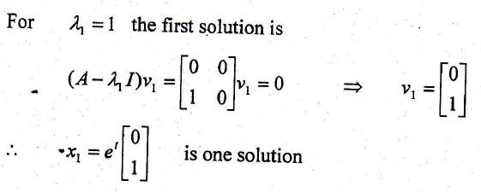
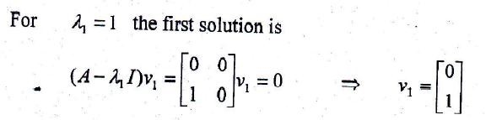
v₁ is Eigen vector, but w₁ not Eigen vector.
This method also can be used when Eigen value is repeated three times. ( )
( )
But
( ) ( )
And the third solution is:
[ ( ) ( ) ]
Where z1 is a vector Example: solve

Slide 13

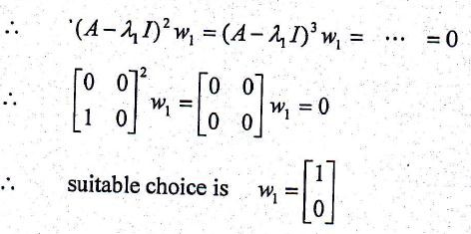
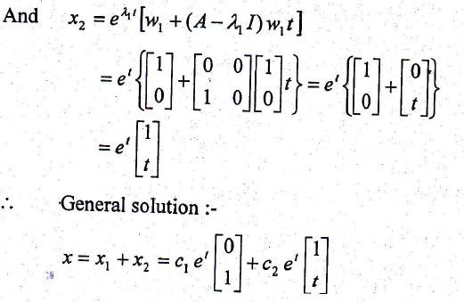
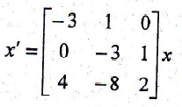
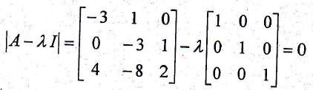
Example: solve
Solution:

Slide 14
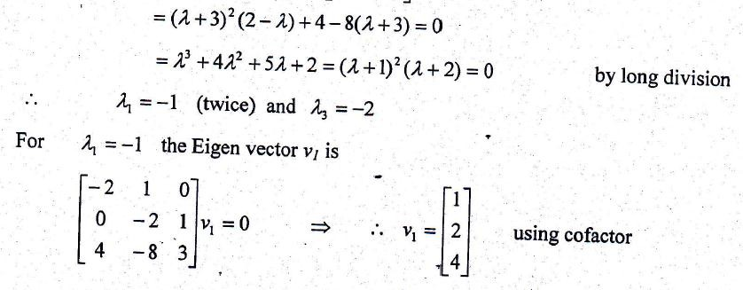
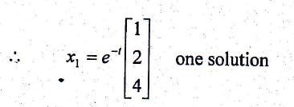
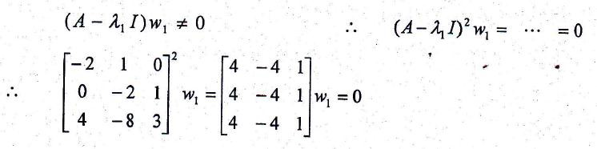
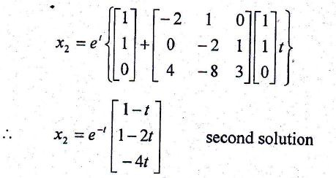
To obtain a second solution we must try to choose w₁
A suitable choice for w1is [ ]
And the second solution ( ( ) )

Slide 15
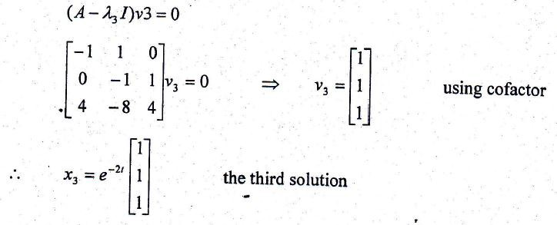

For = -2 the third solution
[ ] [ ] [ ]
Note that other form of solution are possible depending on the Eigen vector v and the vector w.
Complex Eigen Values and Eigen Vectors:
If A has Eigen values with corresponding Eigen vectors
then ⁽ ⁾( ) are solution of x' = Ax
The general solution is :-
⁽ ⁾ ( ) + ⁽ ⁾ ( )
Which can be simplified using
Example: Solve

Slide 16

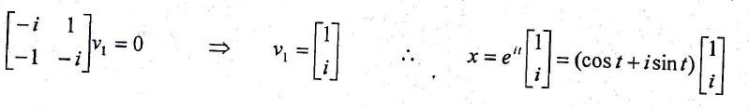
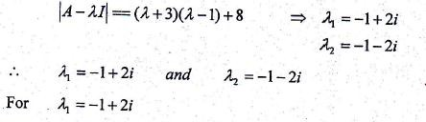
Solution:
To get Eigen Vector (A - I)v = 0 For
Theorem* if x(t) = X(t)+iY(t) is a solutions of x'=Ax then x(t)= X(t) and x(t)= Y(t) are also solutions.
According to this theorem* the real and imaginary parts are independent solutions.
[ ]
[ ] [ ]
the general solution is [ ] [
]
Example: Solve [ ]
Solution:

Slide 17
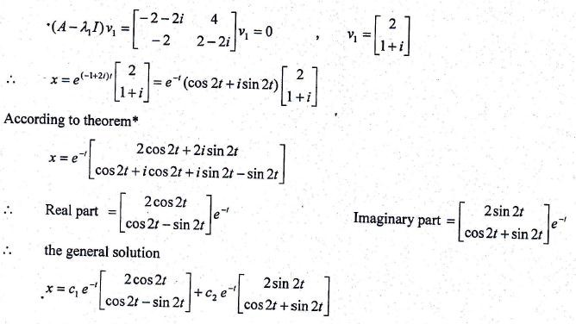
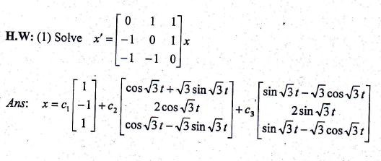
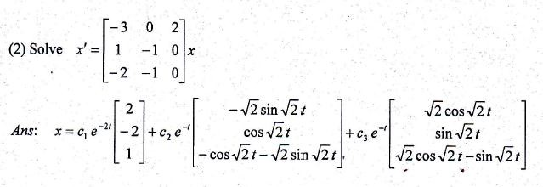

Slide 18
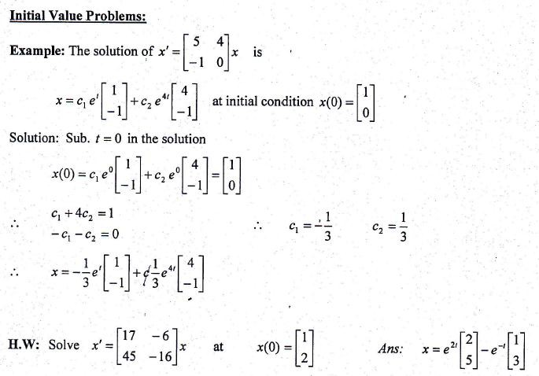
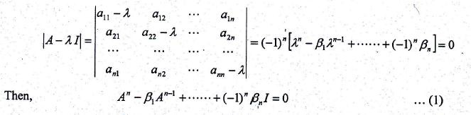
The Cayley- Hamilton Theorem
Cayley-Hamilton theorem state that, each squared matrix satisfied its own characteristic equation. Let A be an (n,n) matrix whose characteristic equation is
So, by this theorem , the n^{th} power of any squared matrix (A) can be expressed as a linear combination of lower powers of (A) . Also, Cayley- Hamilton theorem is a convenient method of obtaining the inverse of a matrix A. Therefore, by multiply eq. (1) by A⁻¹, we get:

Slide 19

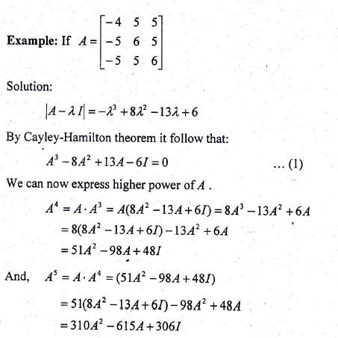
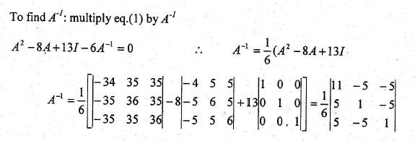

Then, solving for A⁻¹, we find:-

Slide 20
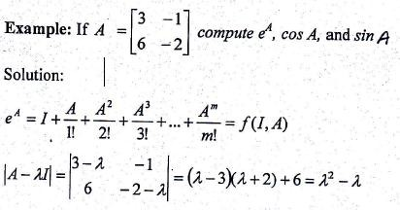
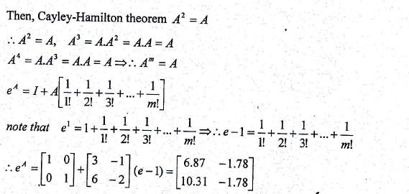
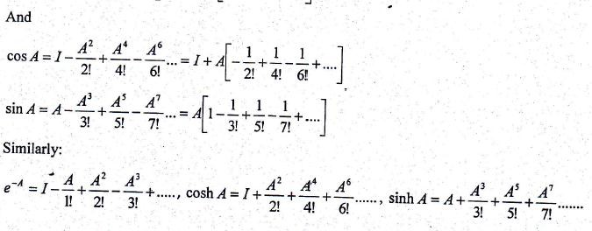
Function of Matrix
20

Slide 21
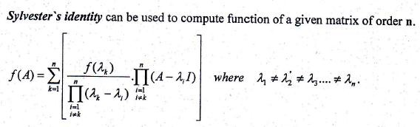
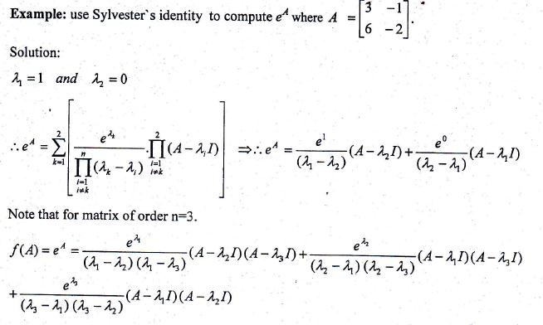
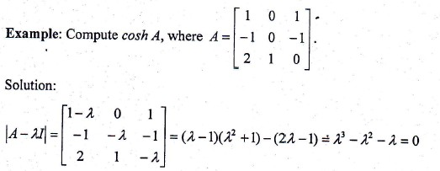

Slide 22
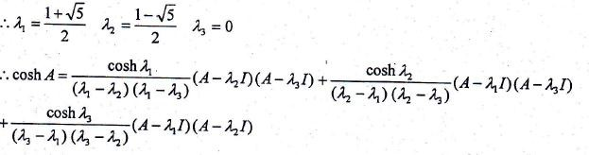
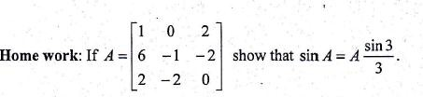

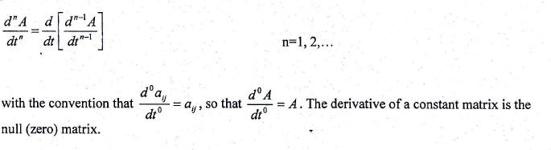
Derivative of matrix
When the elements of matrix A are differentiable functions of a single variable, say t, so that A = A[a_{ij} (t)], calculus can be performed on matrices, so it becomes necessary to define the derivative of a matrix. Let the mxn matrix A have elements a_{ij}(t) that are differentiable functions of the variable t. Then the first order derivative of A with respect to t, written dA/dt, is defined as:
and its nth order derivative with respect to t is defined recursively as:

Slide 23
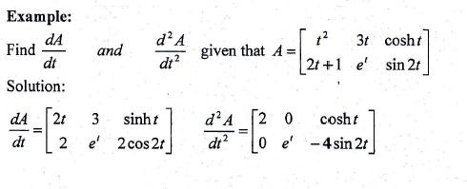



Derivative of the sum of two matrices
Let A(t) and B(t) be an mxn matrices, each with differentiable elements. Then
Derivative of a matrix product
Let A(t) be an mxn matrix and B(t) be an n x q, matrix, each with differentiable elements. Then, if the mx q matrix C(t)= A(t)B(t),
Integration of matrix
The integration of matrices is either definite or indefinite and can give by:

Slide 24




Special Matrices
Upper triangular matrices are matrices in which all elements below zero. A typical example of a 4 x 4 upper triangular matrix is
Lower triangular matrices are matrices in which all elements above zero. A typical example of a 4 x 4 lower triangular matrix is
Symmetric matrices A=[a_{ij}] are matrices in which a_{ij}=a_{ji} for all i and j. If A is symmetric then A=A^{T}. Atypical example of a symmetric matrix is
Skew-symmetric matrices A =[a_{ji} ] are matrices in which aij=-aji. . From the definition of an n x n skew-symmetric matrix we have aii =-aii for
i: 1,2, . .. , n, so the elements on the leading diagonal must all be zero. An equivalent definition of a skew-symmetric matrix A is that A^{T} = -A. A
typical example of a skew-symmetric matrix is

Slide 25



An orthogonal matrix Q is a matrix such that QQ^{T} = Q^{T}Q =I. A typical orthogonal matrix is
Diagonal matrix Such matrices are characterized by having non-zero elements only on the leading diagonal For example
is a3 x 3 diagonal matrix. Such a matrix is often denoted by A=diag (1, 2,-3).It is easily shown that the determinant of an NxN' diagonal matrix is equal to the product of the diagonal elements.
Rant of matrix
The definition of the rank of a matrix may be given and uses the concept of sub – matrices. A sub - matrix of A is any matrix that can be formed from the elements of A by ignoring one, or more than one, row or column. It may be shown that the rank of a general M x N matrix is equal to the size of the largest square sub matrix of A whose determinant is
non-zero. Therefore, if a matrix A has an rxr sub - matrix S with | | , but no (r+1)x(r+1) sub – matrix with non-zero determinant then the rank of the matrix is r. From definition it is clear that the rank of A is less than or equal to the smaller of M and N.
Example : Find the rank of matrix A.

Slide 26


Solution
The largest possible square sub- matrices of A must be of dimension 3x3. Clearly , A possesses four such sub- matrices, the determinants of which are given by
The next largest square sub-matrices of A are of dimension 2x2. Consider, for example, the 2x2 sub- matrix formed by ignoring the third row and the third and fourth columns of A; this has determinant
Since its determinant is non-zero, A is of rank 2 and we need not consider any other 2x2 sub-matrix.
In the special case in which the matrix A is a square NxN matrix, we see that | |=0 unless the rank of A is N. In other words, A is singular unless R(A)=N.

