Slide 1
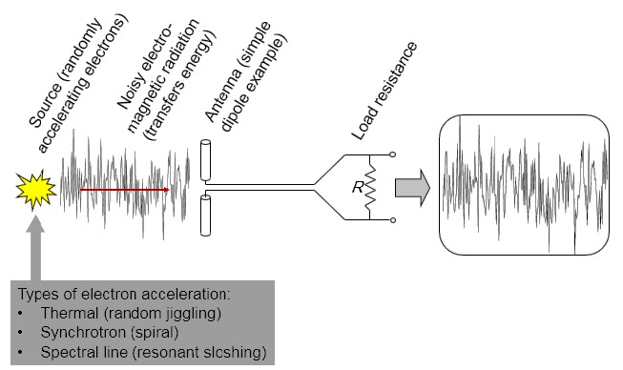
Dept. of Communication Engineering College of Engineering- University of Diyala Lecture No.: 5
3rd year Class
Antenna Theory and Design Lec. Jinan N. Shehab
Antenna temperature:-
Noise:- any unwanted signal.
All bodies at a finite temperature emit noise.
Noise due to random motion of electrons.
As temperature increases random motion increases.
As temperature increases noise increases.
Every object (e.g., a resistor R) with a physical temperature above zero (0° K = -273⁰ C) radiates energy.
For loss less antenna, antenna temperature has nothing to do with physical temperature of the antenna proper but is related to the temperature of distant regions of space (nearer surroundings) coupled to the antenna via radiation resistance.
Then, it can be defined as it is a parameter that describes how much noise an antenna produces in a given environment.
For an antenna with a radiation pattern, R(θ,Φ) the noise temperature is mathematically
defined as :-
1
2𝜋𝜋
∫ �(𝜃, 𝛷). �(𝜃, 𝛷) sin 𝜃𝑑�𝑑�
�_{𝐴}= _{4𝜋}∫
0 0
Antenna temperature is not so much inherent property of the antenna as it is a parameter that depends on the temperature of the region the antenna is " looking at". In this sense, a receiving antenna may be regarded as a remote sensing, temperature measuring device.
The noise power per unit band-width is available at the terminals of a resister of the resistance R and temperature Tr:-
𝑃= 𝐾. ��
Where P= power per unit bandwidth (watt/Hertz)
K=Boltzmann's constant = 1.38 × 10⁻²³(J/K) T=Absolute temperature of resistor (K).
Power per unit bandwidth P is independent of frequency. This mean the noise power per unit
bandwidth available at the terminal will unchanged if the resistor R is replaced by a lossless

Slide 2
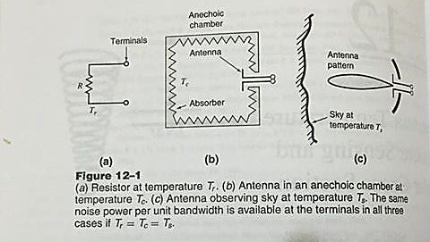
Dept. of Communication Engineering College of Engineering- University of Diyala Lecture No.: 5
3rd year Class
Antenna Theory and Design Lec. Jinan N. Shehab
antenna of radiation resistance R in an anechoic chamber at temperature, the noise power per unit bandwidth available at the antenna terminals is the same.
Now if the antenna is removed from the anechoic chamber and pointed at a sky of temperature the noise power per unit bandwidth is again the same as the above two cases then (Tr=Tc=Ts=TA) as shown in figure below.
The noise temperature TA of the antenna (assumed lossless) is equal to the sky temperature. And not the physical temperature of antenna,. Then the total power is obtained by multiplying by B (Bandwidth):-
𝑃= 𝐾�_{𝐴}�
If the antenna has an effective area Ae and that its beam is directed at a source of radiation which produces a power density per unit bandwidth or flux density (S) at the antenna, then the
power received from the source is given by:-
𝑃= �. �_{𝑒}. � Where S= power density / Bandwidth (W/m²Hz) Ae= effective aperture (m²).
B= bandwidth in Hz.
As 𝑃= 𝐾. �_{𝐴}. � then �. �_{𝑒}. � = 𝐾. �_{𝐴}. �
� =
𝐾�_{𝐴}
𝑊/�²𝐻�
�_{𝑒}
Where TA= antenna temperature due to source in K⁰.
�_{𝐴}=
� �_{𝑒}
𝐾
Dividing (receive power/bandwidth) by effective aperture (Ae) of antenna gives flux density "S":-
� = � =
𝑃𝐾�_{𝐴}
𝑒
�
𝑒

Slide 3
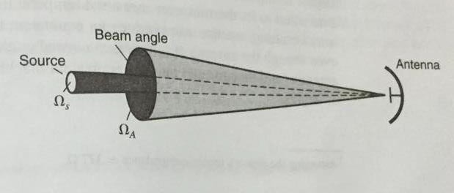
Dept. of Communication Engineering College of Engineering- University of Diyala Lecture No.: 5
3rd year Class
Antenna Theory and Design Lec. Jinan N. Shehab
Then
�_{𝐴}=
𝑆.𝐴_{𝑒}
𝐾
Any antenna irrespective of polarization characteristic can receive only half the incident power of unpolarized wave, so the actual flux density should be twice:-
� =
2𝐾�_{𝐴}
�
𝑒
If the angular size of the source (Ωs) is small compared to ΩA and it's magnitude is known, then it is possible to determine the source temperature Ts by:-
𝛺_{𝑆}
�_{𝐴}= _{𝛺}. ��
Where ΩA= antenna beam solid angle (Sr). Ωs= source solid angle (Sr)
TA= Antenna noise temperature. TS= source temperature (K).
𝐴
In case of receiver itself has a certain noise temperature Tr, due to thermal noise in the receiver components the system noise power at the receiver terminals is given by:-
�_{𝑆}= 𝐾(�_{𝐴}+ �� )�_{𝑁}
As Tsys = TA+ Tr then Ps= K.Tsys
Where Ps= system noise power of receiver terminal. TA= antenna noise temperature.
Tr= Receivers noise temperature.
Tsys= effective system noise temperature. BN= Bandwidth.

Slide 4
Dept. of Communication Engineering College of Engineering- University of Diyala Lecture No.: 5
3rd year Class
Antenna Theory and Design Lec. Jinan N. Shehab
Equipment noise temperature of antenna:-
The effective noise temperature of antenna is defined as that fictional temperature at the input of the network which would account for the noise ∆N at the output. ∆N is the additional noise introduced by the network itself. Sometimes other parameter noise figure is used:-
�_{𝑒}
𝐹= 1 + �
0
Where Te= noise temperature effective (in K). T0= 290⁰ K= (273+17) ⁰ k
F= noise figure (dimensionless) Or Te= T0 (F-1).
Noise figure in dBis given by (F)dB = 10 log F.
SNR( signal-to-noise ratio):-
SNR which part of a communication link. If a transmitter radiates a power Pt isotropically and uniformly over a bandwidth B, it produces a flux density at a distance r of Pt/ (4𝜋r²B) . A receiving antenna of effective aperture Aer at a distance r can collect a power:-
�� �𝑒� ��
^{�� =} 4𝜋𝑟²�
�
With a transmitting antenna of directivity D= ^{4𝜋𝐴𝑒�}, and it is assumed that B ≤ B the receiver
power become :-
_{𝜆}2
r t
�� =
�� �𝑒� �𝑒� ��
𝑟²𝜆² �
�
Where Pt= radiated transmitter power, W.
Aer= effective aperture of receiving antenna, m². Br= receiver bandwidth, Hz.
Bt= transmitter bandwidth, Hz.
r= distance between transmitter and receiver, m. λ= wavelength, m.
Aet= transmitter effective aperture, m².

Slide 5
Dept. of Communication Engineering College of Engineering- University of Diyala Lecture No.: 5
3rd year Class
Antenna Theory and Design Lec. Jinan N. Shehab
For Br=Bt (bandwidth match), is the Friis transmission formula (communication link).
The sensitivity of a receiving system ( antenna and receiver) depends not only on the antenna temperature TA but also on the temperature or noise contribution of the receiver and the transmission line connecting the antenna to the receiver. The resultant of these temperature is called the system temperature Tsys which is a factor in the signal-to-noise ratio (S/N or SNR) for a radio link as given by:-
�
�� �𝑒� �𝑒�
(�𝑁� ��𝑟𝑎𝑑𝑖� �𝑖��)
𝑁⁼ 𝑟²𝜆²���
�𝑦�

