Slide 1
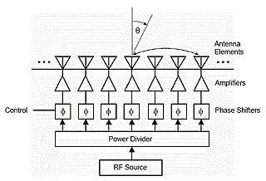
Dept. of Communication Engineering College of Engineering- University of Diyala Lecture No.: 6
3rd year Class
Antenna Theory and Design Lec. Jinan N. Shehab
Antenna Arrays:-
An antenna array (often called phased array) is asset of two or more antennas. The signals from the antennas are combined or processed in order to achieve improved performance over that of a single antenna working in the same environment.
Advantage:-
To increase the overall gain.
To provide diversity reception.
To cancel out interference/noise from a particular set of directions.
"Steer "the array so that it is most sensitivities in a desired direction and least in the undesired direction.
To determine the direction of arrival of the incoming signals. 6- To maximize the signal to interference/noise ratio (SNR).
There are three types of antenna arrays:-
Linear Array: in which the array elements lie along a straight line.
Planer Array: in which the array elements are located in a plane and can make any shape (circular, rectangular,)
Conformal array: in this application the array element location must conform to some non- planner surface such as found on aircraft or missile.
Linear Array:-
A typical linear array is shown in the figure below. The output of each element may be controlled by:-
1- Amplitude as indicated by attenuators | In|. 2- Phase as indicated by phase shifters (α).
3- The position of each element in space.
Array of Two Isotropic Point Sources:-

Slide 2
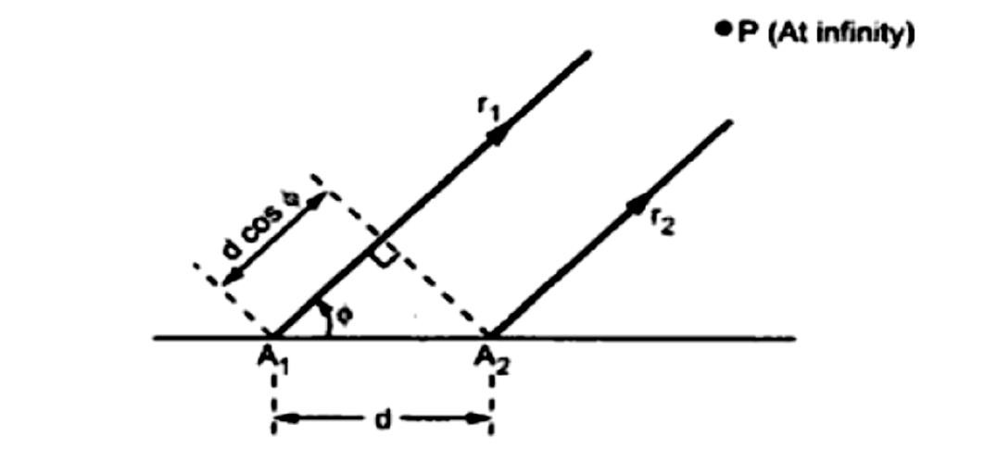
Dept. of Communication Engineering College of Engineering- University of Diyala Lecture No.: 6
3rd year Class
Antenna Theory and Design Lec. Jinan N. Shehab
We consider an antenna which acts as a point source. Assumed that the two point sources are separated by distance'd'. And the two point sources are assumed to have same polarization.
Case (1):- Two Isotropic Point Sources of Same Amplitude and Phase (Broadside Array):-
To calculate field at point P at distance (say r) from the origin "O" which is taken as the reference point for phase calculation. The fields due to source 1 lags while that due to source 2 leads, as shown in the figure:-
Path difference = (� ��� 𝛷+ � cos 𝛷) ������
2 2
�
= (� cos 𝛷) ������ = ( cos 𝛷) ���������ℎ.
𝜆
Ψ (phase angle) = 2𝜋(���ℎ ����������) + �
Here α=0 then
ψ=2𝜋(� cos 𝛷)
𝜆
Now if ^{2𝜋}= �
�ℎ�� 𝜓= �. �. cos 𝛷
𝜆
The total far field at distance point P:-
_{� = �1�}−��/2 _{+ �2�}��/2
Where E1= electric field at distance point P due to source 1. E2 = electric field at distance point P due to source 2.
The E0 = E1 = E2 then, the above equation become:-
����
� = �₀(�⁻ 2 + � 2 )
On multiplying the numerator and the denominator:-

Slide 3
Dept. of Communication Engineering College of Engineering- University of Diyala Lecture No.: 6
3rd year Class
Antenna Theory and Design Lec. Jinan N. Shehab
��
��
+ � 2
�− ₂
𝜓�
� = 2�₀ (
2
) = 2�₀ cos ₂ = 2�₀ cos(₂ � cos 𝛷)
The amplitude of the above equation is =2�₀, which is equal to the maximum value that is one.
�₀ = ₂
1 𝛽���� 𝛷
Then
����� = cos(
2
)
��� , �� ������������ � = ^{𝜆}
��� � = ^{2𝜋}In above equation we have:-
2 𝜆
2𝜋𝜆1 𝜋
� = cos( _{𝜆}. ₂ . ₂ cos 𝛷) = cos(₂ cos 𝛷)
Now by the help of the above equation we can draw the field pattern.
1- Maxima direction (maximum directivity or maximum field):-
E is maximum when:-
𝜋
+
cos(₂ cos 𝛷) = ₋1
(��������� �� ������)
𝜋
+
₂ cos �_{�𝑎𝑥}= ₋��
�ℎ��� � = 0,1,2 … … . . = 𝑁− 1
��� � = 0 cos �_{�𝑎𝑥}= 0 �ℎ�� �_{�𝑎𝑥}= 90 ��� 270
2- Minima direction (null direction):-
E is minimum when:-
𝜋
cos(₂ cos 𝛷) = 0
(��������� �� ������)
𝜋
+
𝜋
₂ cos 𝛷��� = ₋(2� + 1) ₂
�ℎ��� � = 0,1,2 … … ..
+
Let n=0 cos 𝜃��� = ₋1 𝛷��� = 0 ��� 180
3- Half power point direction:-
𝜋
+
cos(₂ cos 𝛷) = ₋1/√2
𝜋
+
𝜋
₂ cos 𝛷_{𝐻𝑃𝑃�} = ₋(2� + 1) ₄
Let k=0 then ^{𝜋}cos 𝛷
𝐻𝑃𝑃�
= ⁺𝜋⁄4
cos 𝛷
𝐻𝑃𝑃�
= ⁺1⁄2 𝛷
𝐻𝑃𝑃�
= 60, 120
2
−
−

Slide 4
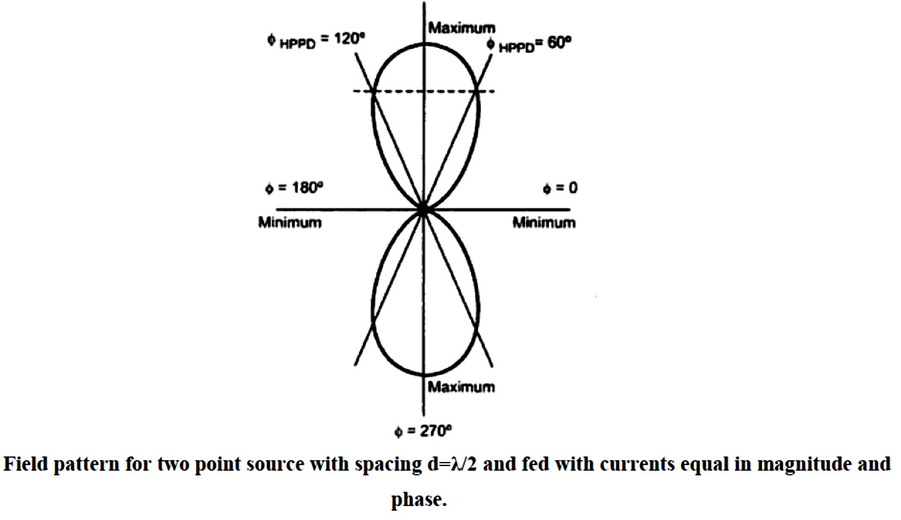
Dept. of Communication Engineering College of Engineering- University of Diyala Lecture No.: 6
3rd year Class
Antenna Theory and Design Lec. Jinan N. Shehab
Case (2):- Two Isotropic Point Sources of Same Amplitude but Opposite Phase (End- Fire Array):-
This situation is exactly similar to that as above one with the only difference that the source 1 is out of phase 180 to source 2.
_{� = −�1�}−��/2 _{+ �2�}��/2
�₀ = �₁ = �₂
����
� 2
� = �₀ 2� (
− �⁻ 2
𝜓��
2�
) = �₀ 2� sin ₂ = �₀ 2� sin( ₂ cos 𝛷)
� = ���������� �ℎ� ������� �ℎ��� �� 90
��� , �� ������������ � = ^{𝜆}
��� � = ^{2𝜋}. In above equation we have:-
2 𝜆
�� 2𝜋𝜆1 𝜋
� = �₀ 2� sin( ₂ cos 𝛷) = �₀ 2� sin( _{𝜆}. ₂ . ₂ cos 𝛷) = �₀ 2� sin(₂ cos 𝛷)
𝜋
����� = sin(₂ cos 𝛷)
Now by the help of the above equation we can draw the field pattern.
1. Maxima direction (maximum directivity):-
E is maximum when:-

Slide 5
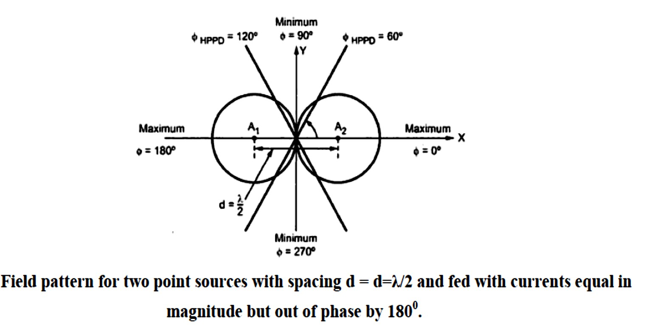
Dept. of Communication Engineering College of Engineering- University of Diyala Lecture No.: 6
3rd year Class
Antenna Theory and Design Lec. Jinan N. Shehab
𝜋
+
sin (₂ cos 𝛷) =
₋1 (��������� �� ������)
𝜋
+
𝜋
₂ cos �_{�𝑎𝑥}= ₋(2� + 1) ₂
�ℎ��� � = 0,1,2 … … ..
+
��� � = 0 cos �_{�𝑎𝑥}= ₋1 �ℎ�� �_{�𝑎𝑥}= 0 ��� 180
2. Minima direction (null direction):-
E is minimum when:-
𝜋
sin (₂ cos 𝛷) = 0 (��������� �� ������)
𝜋
+
₂ cos 𝛷��� = ₋��
�ℎ��� � = 0,1,2 … … ..
Let k=0 cos 𝛷��� = 0 𝛷��� = 90 ��� 270
3. Half power point direction:-
𝜋
+ ₁
sin( cos 𝛷) =
𝜋
2
₋√2
𝜋
+
₂ cos 𝛷_{𝐻𝑃𝑃�} = ₋(2� + 1) ₄
Let k=0 then ^{𝜋}cos 𝛷
𝐻𝑃𝑃�
= ⁺𝜋⁄4
cos 𝛷
𝐻𝑃𝑃�
= ⁺1⁄2 𝛷
𝐻𝑃𝑃�
= 60, 120
2
−
−
Case (3):- Two Isotropic Point Sources of Same Amplitude but In-Phase Quadrature:-
Let source 1 be retarded by 45 and source 2 advanced by 45 . Then the total field in the direction Φ is given by:-
[�(
𝛽���� 𝛷𝜋𝛽���� 𝛷𝜋
� = �₀�
+ )] [−�(
+ )]
2 4
+ �₀�
2 4

Slide 6
Dept. of Communication Engineering College of Engineering- University of Diyala Lecture No.: 6
3rd year Class
Antenna Theory and Design Lec. Jinan N. Shehab
� = 2�₀(
����� 𝛷𝜋
+ ₄)
2
��� , �� ������������ � = ^{𝜆}
��� � = ^{2𝜋}. In above equation we have:-
2 𝜆
𝜋𝜋
����� = (₂ cos 𝛷+ ₄)
H.W/ 𝜱���, 𝜱���, 𝜱_{𝑯𝑷𝑷�}, and plot pattern
Case (4):- General Case of Two Isotropic Point Sources of Same Amplitude and Any Phase:-
�� ��
� = �₀ (�⁻ ² + � ² ) = 2�₀ cos
𝜓 2
𝜓
����� = cos ₂
Where ψ= �� cos 𝛷+ �, the three cases we have discussed are obviously special cases from equation above, when α=0 get case (1), α=180 case (2) and α=90 case (3).
Case (5):- Most General Case of Two Isotropic Point Sources of Unequal Amplitude and Any Phase:-
If the two isotropic are excited with unequal amplitude of current and with any phase differences.
Here, �₁ > �₂ and 𝜓= 2 _{𝜆}� cos 𝛷+ �
Where, α= phase by which current I2 leads I1 of any value.
𝜋
� = �₁�^{�0} + �₂���= �₁(�^{�0} +
�₂
�₁
���₎
� = �₁(1 + ����) �ℎ��� � =
�₂
�₁
�ℎ�� � < 1 �� 0 ≤ � ≤ 1
� = |�₁{1 + � cos 𝜓+ �� sin 𝜓}| = �₁√(1 + ���� 𝜓)² + (���� 𝜓)² < �
� sin 𝜓
𝛷= ���⁻¹
1 + � cos 𝜓

Slide 7
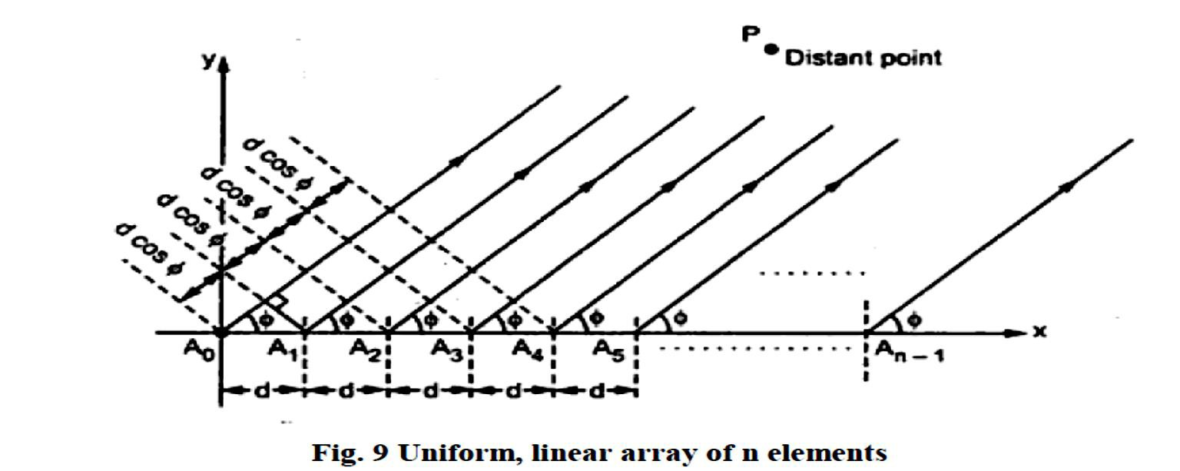
Dept. of Communication Engineering College of Engineering- University of Diyala Lecture No.: 6
3rd year Class
Antenna Theory and Design Lec. Jinan N. Shehab
Linear Arrays Of N Isotropic Point Sources Of Equal Amplitude And Spacing:-
Let us now proceed to the case of n isotropic point sources of equal amplitude and spacing arranged as a linear array:-
�₀ = �₁ = �₂ = ⋯ = �_{𝑁−1} Uniformly currents, from �₀ = �₁ = �₂ = ⋯ = �_{𝑁−1}
Equal spaced, (d) constant
Let (α) is the phased shift between the current of the n^{th} element and (n+1)^{th} as shown:- Similarly, the electric field produced at point P due to element An-1 is given by:-
�_{�−1} = �₀. ���
The total electric field at point P is given by:-
�_{𝑇}= �₀ + �₁ + �₂+. . +�_{�−1}
�_{𝑇}= �₀ + �₀. ���+ �₀. �^{�2𝜓}+. . +�₀. �^{�(�−1)𝜓}
�_{𝑇}= �₀(1 + ���+ �^{�2𝜓}+. . +�^{�(�−1)𝜓})
^{�𝑇}= (1 + ���+ �^{�2𝜓}+. . +�^{�(�−1)𝜓})
�₀
^{�𝑇}= �ℎ� ����� ����� � �� � ����� �������� �� �ℎ� ��������� 𝛷.
�₀
Multiply above equation by ���
����= ���+ �^{�2𝜓}+ �^{�2𝜓}. . +����) .Now subtract this equation from above equation and divide by 1-���, yielding:-

Slide 8
Dept. of Communication Engineering College of Engineering- University of Diyala Lecture No.: 6
3rd year Class
Antenna Theory and Design Lec. Jinan N. Shehab
� =
_{1 − �}���
1 − ���
Above equation may be rewritten as:-
𝜓
𝜓𝜓
� �� ₂
��� _{2 − �}−�� ₂
sin(� ^{𝜓}⁄ )
� =
(
) = �
�� 2 sin(^{𝜓}⁄₂)
𝜓𝜓
� � _{2 �}� _{2 − �}−� ₂
𝜓
When δ is referred to the field from source 1, and δ= (n-1)ψ/2 , then if δ=0, get:-
� =
sin(� ^{𝜓}⁄₂)
sin(^{𝜓}⁄₂)
For ψ=0, we have the relation that E=n. this is the maximum value of E can attain, the normalized value of the total field for Emax=n is:-
� = �
1 sin(� ^{𝜓}⁄₂)
𝜓
sin( ⁄₂)
The field as given by above equation will be referred to as the "array factor".
Case (1):- Broadside Array (Sources In Phases):-
Linear array of n isotropic sources
The same amplitude (I).
The same phase (α =0).
Because of all sources in the same phase, then α=0, and ψ= βd cos Φ.
1. Major lobe (Direction of principle maximum):- The field is maximum when ψ=0, then maximum directivity requires that :-
𝝅 𝜱��� = (�� + �) � , ���� � = �, �, | … ..
𝝅
�𝝅
��������� ��� ����� �� ������� ���� 𝜱= , ��� .
� �
Magnitude of major lobe= |major lobe|=Emax = n (where, n is the number of elements in the array).
2. Null direction:- the null direction for an array of n isotropic point sources occur when E=0:-

Slide 9
Dept. of Communication Engineering College of Engineering- University of Diyala Lecture No.: 6
3rd year Class
Antenna Theory and Design Lec. Jinan N. Shehab
 | ⁺�� 𝜱� = ���^{−�}( ) ₋��
Where: -
n= number of elements in the array d= spacing between elements in meter λ= wavelength in meter
k=constant =1,2,3,…..
if 𝜱� is replaced by its complementary angle �� then get:-
+
₋��
�� = ���^{−�}( )
��
If the array is long, so that nd>> kλ , then
�� = | ⁺�� −
 | ��
The first nulls either side of the maximum occur for k=1, these angles will be designated:-
��� = | +_{𝝀} −
 | ��
3. Side Lobes Maxima (minor lobe maximum):- The directions of the maxima can be obtained from equation:-
side lobes
+
𝜱���� = ���^{−�} {[
₋(�� + �)𝝅
𝝀
�
− �] }
�𝝅�
In this case α=0, then
𝜱���� = ���^{−�} [⁻
⁺(��+�)𝝀
]
���
The relative amplitude of the field at the minor-lobe maximum is:-
� � ⁺ �_{����𝑳}= � . _{𝝍}, ����� 𝝍= 𝐬𝐢�( �) ⁻ | (�� + �)𝝅
 | �
4. Beam width of Major Lobe:- Beam width is defined as the angle between first nulls.
Alternatively, beam width is the angle equal to twice the angle between first null and the major lobe maximum direction. Hence beam width between first nulls is given by:-
+
₋2𝜆
𝐵𝑊�𝑁= 2�₀₁ = �� ���
And Half- power beam width of long uniform broad-side array, thus:-
𝑯𝑷�𝑾=
�𝑾�𝑵𝝀
= = 𝜱_{𝑯�}��� ��� 𝜽_{𝑯�}= �𝝅���
� ��

Slide 10
Dept. of Communication Engineering College of Engineering- University of Diyala Lecture No.: 6
3rd year Class
Antenna Theory and Design Lec. Jinan N. Shehab
5. Directivity(D):-
�𝝅 � = _{𝜽𝜱}= 𝑯�𝑯� | ���
 | 𝝀
Case (2):- Ordinary End-Fire Array:-
Linear array of n isotropic sources
The same amplitude.
The phase is variable.
Find the phase angle (α) between adjacent sources that is required to make the field a maximum in the direction of the array (Φ=0).
βdcosΦ=-α, since Φ=0, we get ; α = - βd rad (the phase between sources).
Major lobe: - For the end fire array where currents supplied to the antennas are equal in amplitude but the phase changes progressively through array. In case of the end fire array, the condition of principle maxima is given by:-
�����𝜱��� − � = � , ���� ���𝜱��� = �, ���� ����
Magnitude of major lobe= |major lobe|=n (where, n is the number of elements in the array).
Nulls:-
The null direction Φ0 for this case (α= -βd) is:-
 | �_{�𝑎𝑥}= 0 (indicates the direction of principle maxima)
+
𝐜�𝐬𝜱� = (
₋���
+
�𝝅� 𝝀
𝝀⁾ �𝝅�
�
+
₋��
𝐜�𝐬𝜱� = �� + �
+
₋��
�
�
𝐜�𝐬𝜱� − � = ��
, ���� ���� ��� 𝜽= � (� − 𝐜�𝐬�𝜽)
+
��
𝜱� = � ���^{−�}( √
���
)
−
For a long array (nd>> kλ):-
+
���
𝜱� ≈
√
��
−
The first null 𝛷₀₁ either side of the main lobe occur for k=1 is:-

Slide 11
Dept. of Communication Engineering College of Engineering- University of Diyala Lecture No.: 6
3rd year Class
Antenna Theory and Design Lec. Jinan N. Shehab
 | + 𝜱�� ≈ √ −
 |  | �𝝀
 |  | ��
3. Side Lobes Maxima ( or minor lobe maximum):-
The direction of the minor-lobe maxima (𝛷���� ) for α= -βd
+
𝜱���� = ���^{−�} [
₋(�� + �)𝝀
+ �]
���
+ (�� + �)𝝀 �� 𝜱���� = ����^{−�} [ √ ] ����� � = �, �, �, ��� − | … …
The relative amplitude of the field at the minor-lobe maximum is:-
� � ⁺ �_{����𝑳}= � . _{𝝍}, ����� 𝝍= 𝐬𝐢�( � ) ⁻ | (�� + �)𝝅
 | �
4. Beam width of Major Lobe:-
�𝑾�𝑵= �𝜱�� ≈ �√ | �𝝀
 | ��
Note: - to make the field of maximum in the direction of the array Φ=180, then α=+βd rad.The Half-power beam width:-
𝐵𝑊�𝑁2𝜆
180
�𝑃𝐵𝑊=
= √
��� = 𝛷_{𝐻�}≈ 𝜃_{𝐻�}��� ∗
������
2 �� 𝜋
5. The directivity:- the directivity of an ordinary end-fire array is approximately:-
4𝜋�� � = = 4𝜋= 2𝜋 𝜃_{𝐻�}𝛷_{𝐻�}2𝜆 | ��
 | 𝜆
Case (3):- Increased Directivity , End-Fire Array:-
Large directivity is obtained by increasing the phase change between sources, so that:-
Since Φ=0, we get; α = - (βd+ ^{𝝅}) rad (this condition will be refered to as the condition for
increased directivity).
�

Slide 12
Dept. of Communication Engineering College of Engineering- University of Diyala Lecture No.: 6
3rd year Class
Antenna Theory and Design Lec. Jinan N. Shehab
𝝍= ��(𝐜�𝐬𝜱− �) −
𝝅
�
A normalized field pattern given by:-
𝝅
� = 𝐬𝐢� ( ��)
𝐬𝐢�(��
� )
����� ������
𝝍
𝐬𝐢�( � )
1. Major lobe:-
𝝅𝝅
𝝍= − � , ��� �� 𝜱��� = �, 𝝍= + � , ��� �� 𝜱��� = �𝟖�
Magnitude of major lobe= |major lobe|=n (where, n is the number of elements in the array).
𝝅
2. Nulls:- The null direction Φ0 for this case (α= -(βd+ )) is:-
+
�
𝝍= ��(𝐜�𝐬𝜱� − �) − � =
𝝅₋���
+
�
𝜱� = � ���^{−�}[
√
𝝀
(�� − �)]
−
���
For a long array (nd>> kλ):-
+
𝜱� ≈
√
𝝀
(�� − �)]
−
��
The first null 𝛷₀₁ either side of the main lobe occur for k=1 is:-
+
^{𝜱}��
≈
√
𝝀
−
��
3. Side Lobes Maxima ( or minor lobe maximum):- The direction of the minor-lobe
𝜋
maxima (𝛷���� ) for end-fire with increased directivity α= -(βd+ ) rad then:-
�
+
��𝜱���� − �� − � =
𝝅₋(�� + �)𝝅
�
𝝀
+
𝐜�𝐬𝜱���� − � = ��� [�₋(�� + �)]

Slide 13
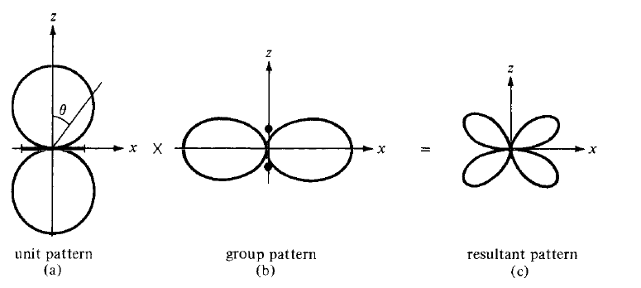
Dept. of Communication Engineering College of Engineering- University of Diyala Lecture No.: 6
3rd year Class
Antenna Theory and Design Lec. Jinan N. Shehab
𝜱���� = ���^{−�}{
𝝀
+
�
�
���
[�₋(�� + �)] + �}
�� �� ����� ��� 𝜽= (� − ����𝜽)
�
���� 𝜱���� = � ���^{−�}[ √
𝝀
+
���
₋(�� + �) − �
The relative amplitude of the field at the minor-lobe maximum is
𝝅�
�_{����𝑳}= 𝐬𝐢� �� . , ���� 𝝍= ��(𝐜�𝐬𝜱���� − �) − � =
𝝅⁺(�� + �)𝝅
𝝍
−
�
𝐬𝐢�( � )
4. Beam width of Major Lobe:-
 | �𝑾�𝑵= �𝜱�� ≈ �√ | 𝝀
 |  | ��
�𝑾�𝑵𝝀 𝑯𝑷�𝑾= � = √�� ��� = 𝜱_{𝑯�}≈ 𝜽_{𝑯�}
5. The directivity:- the directivity of an ordinary end-fire array is approximately:-
� = _{𝜽}
�𝝅
��
= �𝝅_{𝝀}
𝜱
𝑯�𝑯�
Case (4):- Scanning Arrays:-
Maximum field in an arbitrary direction Φmax , then ψ=0 and 0= βd cos Φmax+α, known , that phase difference α is determined.
Pattern multiplication:-
if (d)
The total field pattern of an array of non-isotropic but similar sources is the multiplication of the individual source patterns and the pattern of an array of isotropic point sources each located at the phase center of individual source and having the relative amplitude and phase.
Resultant pattern= unit pattern × group pattern (array factor)

