Slide 1
Dept. of Communication Engineering College of Engineering- University of Diyala Lecture No.: 1
2nd year Class
MATLAB programming language Lec. Jinan N. Shehab
The MATLAB Programming Language
1. History of MATLAB Language:
MATLAB is a powerful computing system for handling the calculations involved in scientific and engineering problems. The name MATLAB shorts for MATrix LABoratory, because the system was designed to make matrix computations particularly easy. This is a numerical computing environment and programming language originally developed by a numerical analyst called Cleve Moler wrote the first version of Matlab in the 1970s. It has since evolved into a successful commercial software package.
Features of MATLAB
High-level language for numerical computation, visualization, and application development
Interactive environment for iterative exploration, design, and problem solving
Mathematical functions for linear algebra, statistics, Fourier analysis, filtering, optimization, numerical integration, and solving ordinary differential equations
Built-in graphics for visualizing data and tools for creating custom plots
Development tools for improving code quality and maintainability and maximizing performance
Tools for building applications with custom graphical interfaces
Functions for integrating MATLAB based algorithms with external applications and languages such as C, Java, .NET, and Microsoft Excel.
Uses of MATLAB
MATLAB is widely used as a computational tool in science and engineering encompassing the fields of physics, chemistry, math and all engineering streams. It is used in a range of applications including: Signal Processing and Communications. Image and Video Processing. Control Systems. Test and Measurement. Computational Finance. Computational Biology.
MATLAB is now employed in more than two thousand universities and the user community throughout the world numbers in the thousands. Continued growth will be fueled by decreasing hardware costs and more people familiar with advanced analytical methods.
2. Starting MATLAB :-
You start MATLAB as you would any other software application. On a PC you access it via the Start menu, in Programs under a folder such as MatlabR13a . Alternatively, you may have an icon set up that enables you to start MATLAB with a simple double-click.
Start Programs MATLAB 8.1
Or in desktop Double clock

Slide 2
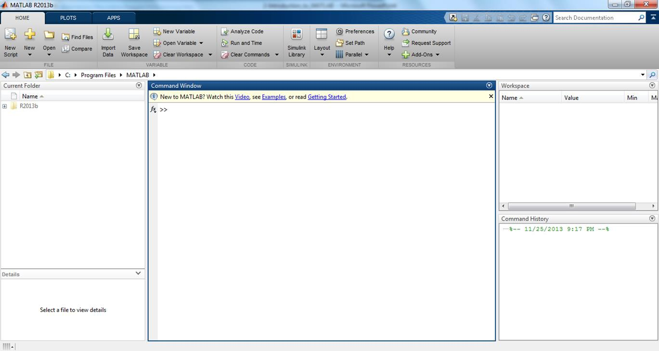
Dept. of Communication Engineering College of Engineering- University of Diyala Lecture No.: 1
2nd year Class
MATLAB programming language Lec. Jinan N. Shehab
However you start MATLAB, you will briefly see a window as shown in figure (1) that displays the MATLAB logo as well as some MATLAB product information, and then a MATLAB Desktop window will launch. That window will contain a title bar, a menu bar, a tool bar, and four embedded windows (the Command Window, the Command History, the Current Folder (Directory Browser) and the Workspace Browser).
Command window
Workspace
Current Folder
Command history

Slide 3
Dept. of Communication Engineering College of Engineering- University of Diyala Lecture No.: 1
2nd year Class
MATLAB programming language Lec. Jinan N. Shehab
The largest and most important window is the Command Window on the middle. At the top of the Command Window , you may see some general information about Matlab, perhaps some special instructions for getting started or accessing help, but the most important of all, you will see a command prompt (>> ) which indicates Matlab is ready to begin. Click in the Command Window to make it active. When a window becomes active, its title bar darkens. It is also likely that your cursor (a vertical line or box, usually blinking) will change from outline form to solid, or from light to dark, or it may simply appear that is the place where you will enter your MATLAB commands. Now you can begin entering commands. Try typing 1+1; then press ENTER. Figure(1) contains an example of a newly launched MATLAB Desktop.
MATLAB desktop:-
When you start Matlab, the Matlab desktop appears, containing tools (graphical user interfaces) for managing files, variables, and applications associated with Matlab. The first time Matlab starts, the desktops appears as shown in Figure (1). Your desktop looks by opening, closing, moving, and resizing the tools in it.
The entire desktop tools provide common features such as context menus and keyboard shortcuts. You can specify certain characteristics for the desktop tools by preference form
the file menu. For example, you can specify the font characteristics for command window text.
Command window:-
Use command window to enter variables and run functions and M-files and controlling input and output data. You can clear the Command window with the clc or with edit then choose clear command window. They are usually of the form:
>> Variable = expression. Ex:-
>> x=3 then enter
Expressions are usually composed from operators, functions, and variable names
Command History:-
This window lists the commands typed in so far (lines you enter in the command window). You can re-execute a command from this window by double clicking or dragging the command into the Command window.
Workspace Browser:-
This lists variables (named array) that you have either entered or computed in your MATLAB session. You add variable to the workspace by using function, running M-files, and loading saved workspace. To view the workspace and information about each variable, use the workspace browser or use the function who or whos. To delete variables from the workspace, select the variable and select delete from edit menu. Or use the clear function. When you log

Slide 4
Dept. of Communication Engineering College of Engineering- University of Diyala Lecture No.: 1
2nd year Class
MATLAB programming language Lec. Jinan N. Shehab
out or exit MATLAB, all variables are lost. However, invoking the command save (select save Workspace from the file menu or use the save function) before exiting causes all variables to be written to a machine-readable file named math.mat. When you later reenter MATLAB, the command load will restore the workspace to its former state. Commands save and load take file names and variable names as optional arguments.
Current Folder:-
Access your files. Your current directory is where MATLAB looks for your M-files, and for workspace (.mat) files that you save and load.
Array Editor:-
Once an array exists, it can be modified with the Array Editor, which acts like a spreadsheet for matrices. Double- click on a variable in the workspace browser to see it in the array editor. Use the array editor to view and edit a visual representation of one or two dimensional numeric array, strings and cell arrays of strings that are in the workspace.
Example (1):- A steel bar of rectangular cross section area with length 3 cm width 2cm.
W.P in Matlab to calculate the average tensile stress over a normal cross section when 3000N load is applied?
Where:-
Area = length × width, Stress= load / cross section area
Solution: - write the following statements in command window
>> L= 3/100;
>> D= 2/100;
>> A=L*D;
>> P=3000;
>> S=P/A S= 5000000
4. Opening M-files:-
iles are the file that will write our programs on it. From the Matlab command window select the File menu and choose New/ M-file. MATLAB allows writing two kinds of program files:-
Scripts - script files are program files with .m extension. In these files, you write series
of commands, which you want to execute together. Scripts do not accept inputs and do not return any outputs. They operate on data in the workspace.
Functions - functions files are also program files with .m extension. Functions can accept inputs and return outputs. Internal variables are local to the function.
This action opens a Notepad (Untitled) window. From the M-file save menu you can save your program after typing any name instead of Untitled. Also you can run this program by choosing Run from the M-file Debug menu (or press F5). The result will appear on the Matlab desktop.

Slide 5
Dept. of Communication Engineering College of Engineering- University of Diyala Lecture No.: 1
2nd year Class
MATLAB programming language Lec. Jinan N. Shehab
Example (2):- This example solved in M-file. Write this code in M-file.
% This program will calculate the value of Amper when the value of voltage and
% resistance are known
1- disp ('This program will applied Ohm law') 2- V= input (' input the value of voltage');
R= input ('input the value of resistant');
I= V/R
The result will appear in command window as:-
This program will applied Ohm law Input the value of voltage 220 Input the value of resistant 10
I = 22
Note: The % symbol is a flag that indicates all information to the right is not part of the command. It is a comment.
Use disp to display strings. Strings are written between single quotes, like 'This is a string'
Input and Output:-
You input commands to MATLAB in the MATLAB Command Window. MATLAB returns output in two ways: Typically, text or numerical output is returned in the same Command Window, but graphical output appears in a separate graphics window. To generate this screen on your computer:-
First type
>> 1/2 + 1/3
Then type
>> x=5;
>> ezplot(’xˆ3 - x’).
Input :-
Variable name= input (' prompt text'); EX:- as mentioned in example a bove:- V= input (' input the value of voltage');
R= input ('input the value of resistant');
Output:-
disp( variable name or 'text')
EX:- as mentioned in example a bove:- ezplot(’xˆ3 - x’).

Slide 6
Dept. of Communication Engineering College of Engineering- University of Diyala Lecture No.: 1
5.3 The format command:-
2nd year Class
MATLAB programming language Lec. Jinan N. Shehab
The format command controls the numeric format of the values displayed by Matlab. The command affects only how numbers are displayed, not how Matlab or computer saved them. By default, MATLAB displays numbers with four decimal place values. This is known as short format. However, if you want more precision, you need to use the format command. Here are different formats, together with the resulting output produced from a vector x with components different magnitude:-
>> x= [4/3 1.2345e-6]
>> format short
>>x x=
%fixed point, with 5 digits (default format).
1.3333
>>format long
>>x x=
0.0000
% fixed point, with 15 digits.
1.333333333333333
>>format short e
>>x x=
0.000001234500000
% scientific notation, with 5 digits.
1.3333e+000 1.2345e-006
>>format long e
>>x x=
1.333333333333333e+000
% scientific notation, with 15 digits.
>>format hex
>>x x=
3ff555555555555
>>format bank
>>x x=
1.33 0.00
0.000001234500000e-006
% hexadecimal format.
3eb4b6231abfd271
% dollars and cents.
>>format rate
>>x x=
4/3
% approximate ratio of small integers.
1/810045
5.4 Use of Semicolon (;) in MATLAB
Semicolon (;) indicates end of statement. However, if you want to suppress and hide the MATLAB output for an expression, add a semicolon after the expression.
For example,

Slide 7
Dept. of Communication Engineering College of Engineering- University of Diyala Lecture No.: 1
2nd year Class
MATLAB programming language Lec. Jinan N. Shehab
>>x =3; % store in workspace only, without output in command window.
>>
>>y = 5 % store in workspace and also print output in command window.
>> y= 5
Adding comments:-
The percent symbol (%) is used for indicating a comment line (does not appear in command window). For example:-
>> x =9 % assign the value 9 to x
Command line editing:-
Various arrow and control keys on your keyboard allow you to recall, edit, and reuse commands you have typed earlier. For example, suppose you mistakenly
>>rho= (1+sqt (5))/2
??? undefined function or method 'sqt' for input arguments of type ' double'.
You have misspelled sqrt. Matlab responds with. So instead of retyping the entire line, simply press the ↑ key. The misspelled command is redisplayed. Use the ← key to move the cursor over and insert the missing r. you can also copy previously executed commands from command history.
The list of variable command line editing keys is different on different computers.
↑ | Ctrl +p | Recall previous line
↓ | Ctrl +n | Recall later line
← | Ctrl +b | Move back one character
→ | Ctrl +f | Move forward one character
Ctrl+→ | Ctrl +r | Move right one word
Ctrl+ ← | Ctrl +l | Move left one word
Home | Ctrl +a | Move to beginning of line
End | Ctrl +e | Move to end of line

Slide 8
Dept. of Communication Engineering College of Engineering- University of Diyala Lecture No.: 1
2nd year Class
MATLAB programming language Lec. Jinan N. Shehab
Esc | Ctrl +u | Clear line
Del | Ctrl +d | Delete character at cursor
Backspace | Ctrl +h | Delete character before cursor
5.7 Entering long command line:-
If a statement does not fit on one line, use three periods, …, followed by Enter to indicate that the statement continues on the next line.
Example:-
>>s= 1-1/2+1/3+1/4+1/5+1/6+…
-1/7-1/8+1/9;
5.8 Help :-
The command help is very powerful and useful to returns information on MATLAB features:
>>help clear
clear - Remove items from workspace, freeing up system memory
This MATLAB function removes all variables from the current workspace, releasing them from system memory.
clear
clear name1 ... nameN
clear -regexp expr1 ... exprN clear ItemType
Reference page for clear
See also clc, clearvars, close, delete, import, inmem, load, mlock, persistent, whos, workspace
Other functions named clear
simulink/clear, daq/clear, imaq/clear, instrument/clear, distcomp/clear, matlab/clear (serial), matlab/H5E.clear, simulink/Simulink.sdi.clear
>> help sin
sin - Sine of argument in radians
This MATLAB function returns the sine of the elements of X. Y = sin(X)
Reference page for sin
See also asin, asind, sind, sinh Other functions named sin
fixedpoint/sin, symbolic/sin

Slide 9
Dept. of Communication Engineering College of Engineering- University of Diyala Lecture No.: 1
5.9 Exit:-
2nd year Class
MATLAB programming language Lec. Jinan N. Shehab
You can quit MATLAB at any time with one of the following:-
Select Exit MATLAB from the desktop File menu.
Enter quit or exit at the Command Window prompt.
Do not click on the close box in the top right corner of the MATLAB desktop. This does not allow MATLAB to terminate properly and, on rare occasions, may cause problems with your computer operating software
Example :- W.P to calculate the area and the perimeter of the rectangular when the length
and width are found?
Where area= length* width , perimeter =2(length+width).
Solution:- if the length and width are given write the following statements in command window:
>> length= 0.3; width=0.2;
>>area = length* width, perimeter=2*( length+width) area=
0.0600
Perimeter= 1
And if the length and width are not given:-
Open new M-file and write the following statement:
1- Length=input('input the length of the rectangular:'); 2- Width=input(' input width of the rectangular:');
Area= length*width
Perimeter=2*(length+width)
Save the M-file in matlab folder with any name like(test).
Call(run) the M-file test by writing the word test in command window and press enter the program will executing as follow:
>> test
input the length of the rectangular: 0.3 input width of the rectangular: 0.2 area=
0.0600
Perimeter= 1

Slide 10
Dept. of Communication Engineering College of Engineering- University of Diyala Lecture No.: 1
2nd year Class
MATLAB programming language Lec. Jinan N. Shehab
Example:- W.p to find the current, while the circuit is series R1=5KΩ ,R2=2KΩ and E= 51V? Solution :-
>>R1=5; R2=2; E=51;
>>I=E/(R1+R2) I=
7.2857
In M-file
E=input('input the value of voltage: ');
R1=input( ' input the value of resistant one '); 3- R2= input (' input the value of resistant two');
4- I=E/(R1+R2)
After running the M-file input the value of voltage: 51
input the value of resistant one 5 input the value of resistant two 2 I=
7.2857
Example:- W.p to find the current, while the circuit is parallel R1=7KΩ ,R2=6 KΩ and E = 24V?
Solution:-
>>R1=7; R2=6; E=24;
>>Rt=R1*R2/(R1+R2);
>>I=E/Rt I=
7.4286
After running the M-file input the value of voltage: 24
input the value of resistant one 7 input the value of resistant two 6 I=
7.4286
10

