Slide 1
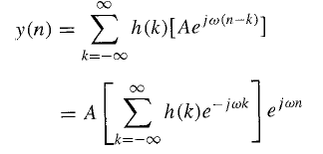
Signal Processing Lec. 6
Frequency Response Of Linear Time-Invariant Systems
In this section we develop the characterization of linear time-invariant systems in the frequency domain . The basic excitation signals in this development are the complex exponentials and sinusoidal functions. The characteristics of the system are described by a function of the frequency variable co called the frequency response, which is the Fourier transform of the impulse response h(n) of the system . The frequency response function completely characterizes a linear time invariant system in the frequency domain .
6.1 Response to Complex Exponential and Sinusoidal Signals: The Frequency Response Function
By substituting x(n) in to y(n) we obtain the response
In fact, this term is the Fourier transform of the unit sample response h{k) of the system . Hence we denote this function as
With the definition in above equation, the response of the system to the complex exponential will be
Example 1:Determine the output sequence of the system with impulse response

Slide 2
Signal Processing
Lec. 6
when the input is the complex exponential sequence
Solution:
and therefore the output is

Slide 3
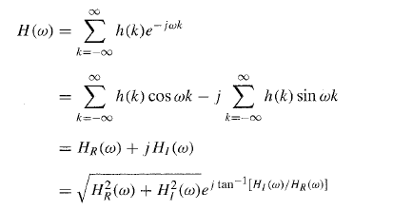
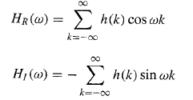
Signal Processing
Lec. 6
Hence, the magnitude and phase of H(w) can be expressed in terms of HR(w) and HI(w) as:

Slide 4
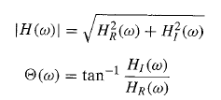
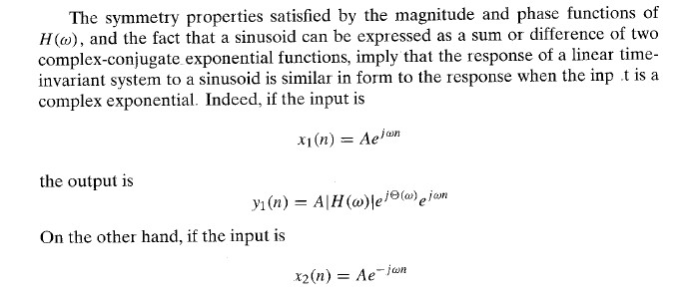
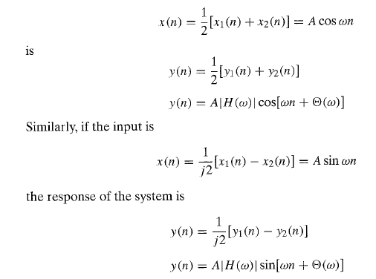
Signal Processing
Lec. 6

Slide 5
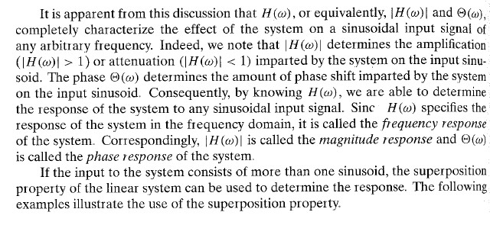
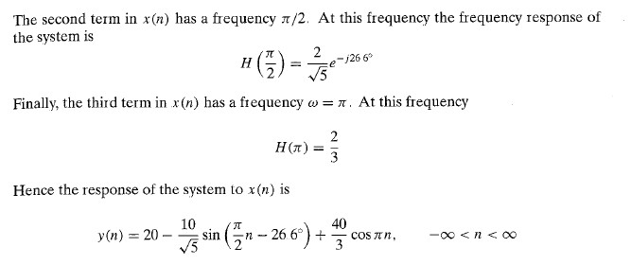
Signal Processing
Lec. 6
Example 2:Determine the response of the system in example 1 to input signal
Solution: the frequency response of the system is:

