Slide 1
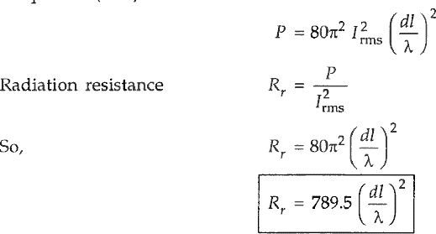
Antenna and Wave Propagation Electromagnetic Spectrum
Radiation Resistance
The radiation resistance is a fictitious (means false) resistance and not the actual measured resistance. The antenna will have a measured ohmic resistance.
Rt =Rr + Rl
Where
Rt = total antenna resistance. Rr = radiation resistance.
Rl = ohmic resistance. Ohmic resistance gives rise to power loss.
For efficient radiation purposes the radiation resistance must be very much higher than ohmic resistance.
In term of definition, the radiation resistance can be defined as "Radiation resistance is that fictitious resistance which when connected in series with the antenna will consume the same amount of power as when actually radiating".

Slide 2
Antenna and Wave Propagation Electromagnetic Spectrum
Antenna Effective length
We have assumed that the current in the doublet is uniform. This is not true in practice. In practice current will be either linear or sinusoidal. This effect reduces the amount of power radiated from the antenna and effectively makes aerial shorter than the one with same current throughout. By determining the mean value of current over the length concerned, the actual length of the equivalent shorter aerial may be assumed. This is called effective length of the antenna.
Determination of antenna effective length
a) Linear current distribution
𝑙
₌ 𝑙
b) Sinusoidal current distribution
𝑒𝑓𝑓
2
𝑙
₌ 2𝑙
𝑒𝑓𝑓
𝜋

