Slide 1
FLUID FLOW
DIMENSIONAL ANALYSIS

Slide 2
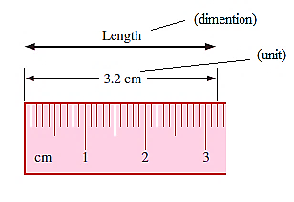
Dimensions and units
A dimension is a measure of a physical quantity (without numerical values).
unit is a way to assign a number to that dimension. For example, length is a dimension that is measured in units such as meters (m)
There are seven primary dimensions.
All nonprimary dimensions can be formed by some combination of the seven primary dimensions. For example,

Slide 3
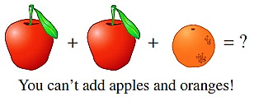
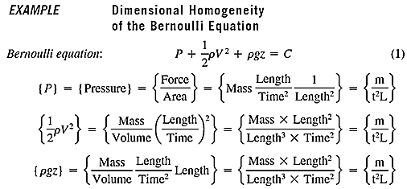
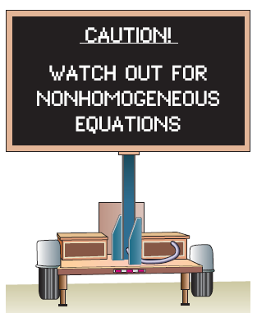
Dimensional Homogeneity
Every additive term in an equation must have the same dimensions

Slide 4
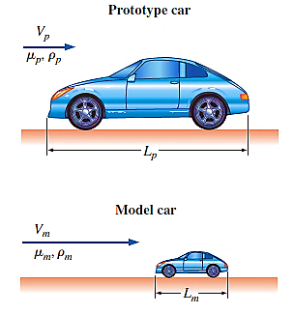
Dimensional analysis and similarity
There are three primary purposes of dimensional analysis:
To generate nondimensional parameters that help in the design of experiments
To obtain scaling laws so that prototype performance can be predicted from model performance
To (sometimes) predict trends in the relationship between parameters
In most experiments, to save time and money, tests are performed on a geometrically scaled model, rather than on the full-scale prototype.
There are three necessary conditions before applying the Dimensional analysis:
Geometric similarity—the model must be the same shape as the prototype, but may be scaled by some constant scale factor.
Kinematic similarity, which means that the velocity at any point in the model flow must be proportional (by a constant scale factor) to the velocity at the corresponding point in the prototype flow, the same relative direction.
Dynamic similarity: Dynamic similarity is achieved when all forces in the model flow scale by a constant factor
(All three similarity conditions must exist for complete similarity to be ensured)

Slide 5
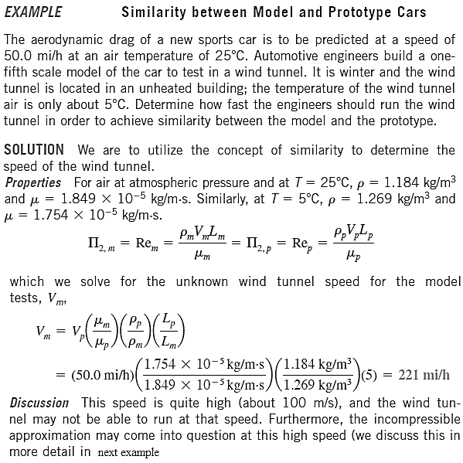

Slide 6
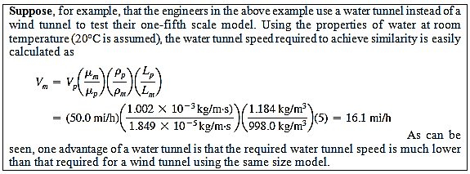

Slide 7
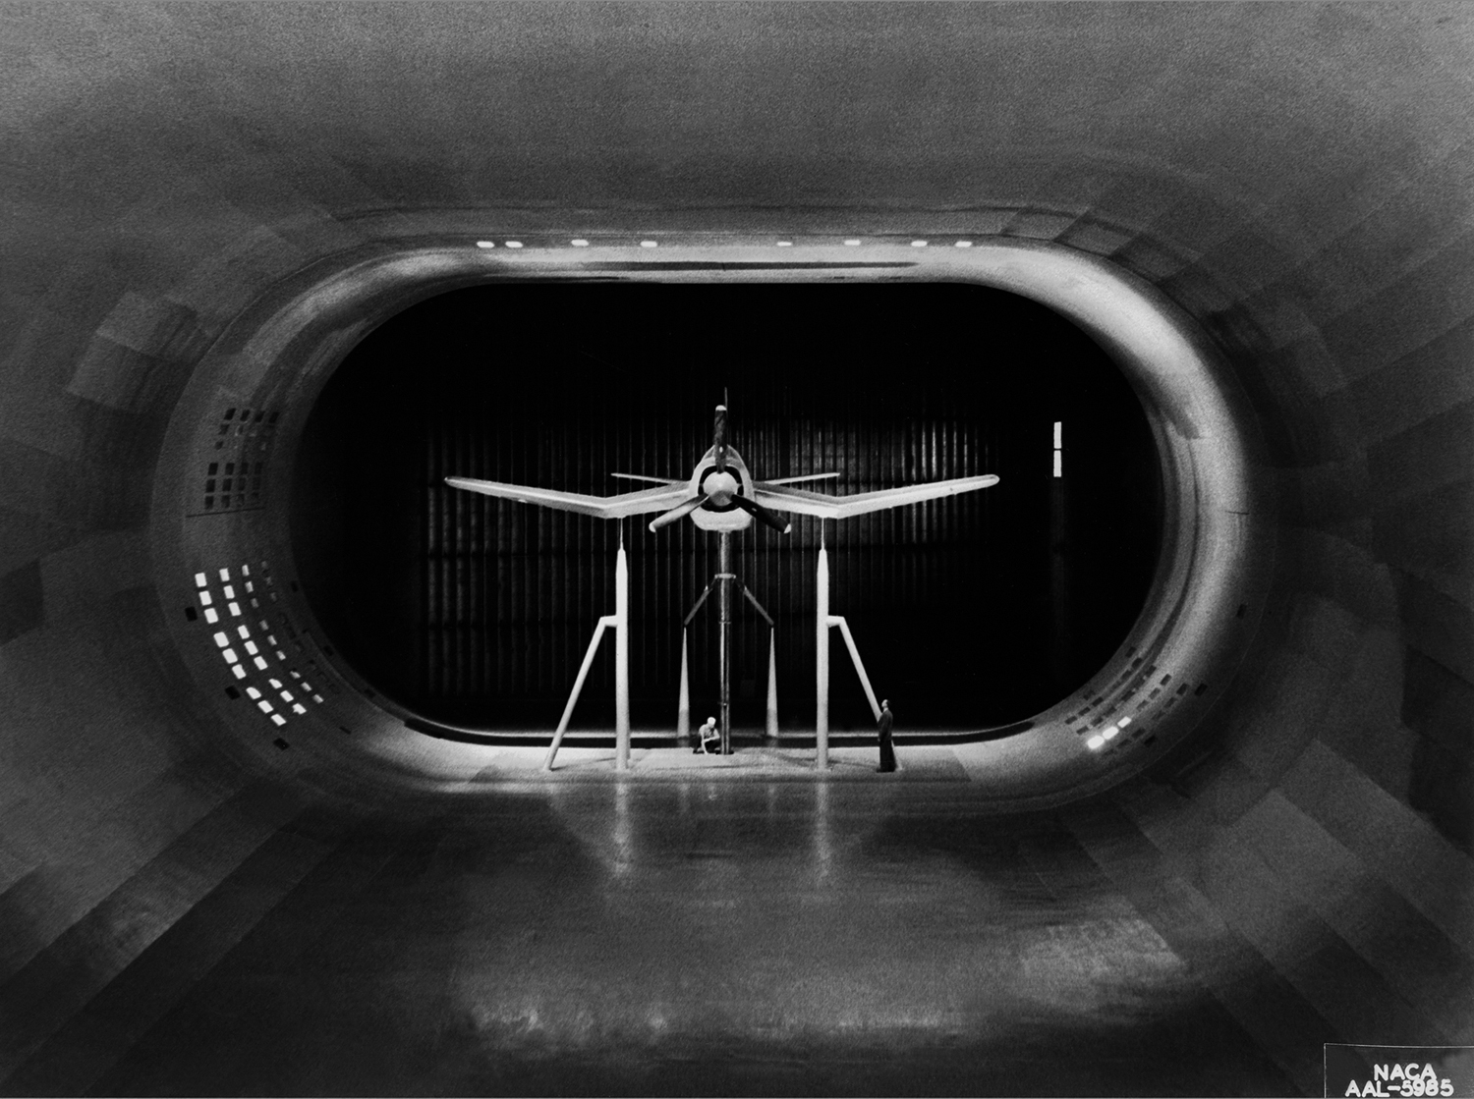
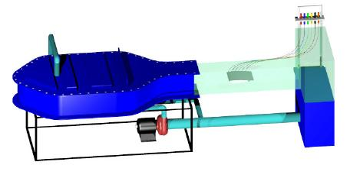
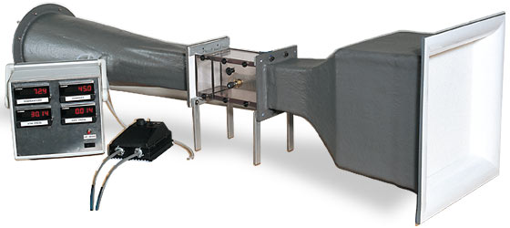

Slide 8
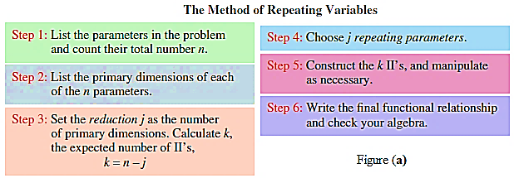
Buckingham pi theorem
We have seen the usefulness and power of dimensional analysis. Now we are ready to learn how to generate the nondimensional parameters, i.e., the П’s.
We can think of this method as a step-by-step procedure for obtaining nondimensional parameters.

Slide 9
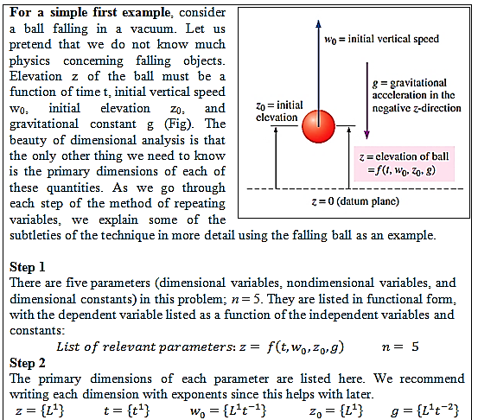

Slide 10
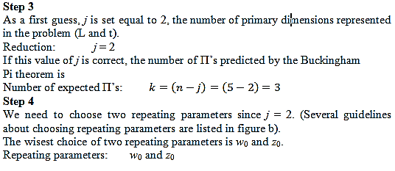

Slide 11
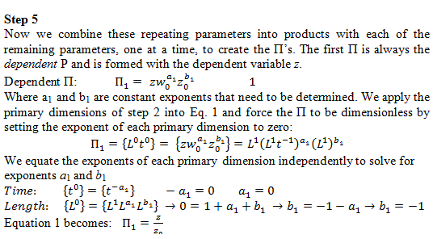

Slide 12
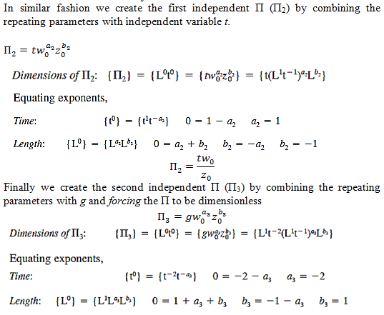

Slide 13
