Slide 1
Fundamentals of CRE
Chemical Reaction Engineering
By
Dr Salah N. Farhan
Senior lecturer. Chem. Eng. Dept.
College of Engineering
University of Diyala
Salah N. Farhan College of Engineering Diyala University

Slide 2
Fundamentals of CRE
Chapter 1: Mole Balances
Learning Resources
Learning Resources
Summary Notes
Chemical Identity
Reaction Rate
General Mole Balance Equation
Mole Balance on Different Reactor Types
Additional Self Test Exercises
Polymath Tutorial
Salah N. Farhan College of Engineering Diyala University

Slide 3
Fundamentals of CRE
Topics
Chemical Identity
Reaction Rate
General Mole Balance Equation
Mole Balance on Different Reactor Types
Self Test Exercises
Salah N. Farhan College of Engineering Diyala University

Slide 4
Fundamentals of CRE
A chemical species is said to have reacted when it has lost its chemical identity. The identity of a chemical species is determined by the kind, number, and configuration of that species' atoms.
Reaction YouTube Video: Carbon Dioxide and Magnesium
Three ways a chemical species can lose its chemical identity:
1. decomposition
2. combination
3. isomerization
Salah N. Farhan College of Engineering Diyala University

Slide 5
Fundamentals of CRE
Reaction Rate
The reaction rate is the rate at which a species looses its chemical identity per unit volume. The rate of a reaction can be expressed
as the rate of disappearance of a reactant or as the rate of appearance of a product. Consider species A:
A → B
r_{A} = the rate of formation of species A per unit volume -r_{A} = the rate of a disappearance of species A per unit volume r_{B} = the rate of formation of species B per unit volume
Example: A → B
If B is being created at a rate of 0.2 moles per decimeter cubed per second (i.e. the rate of formation of B is r_{B} = 0.2 mole/dm³/s), then A is disappearing at the same rate (-r_{A} = 0.2 mole/dm³/s). This also means that the rate of formation of A is r_{A} = -0.2 mole/dm³/s.
For a catalytic reaction, we refer to -r_{A}', which is the rate of disappearance of species A on a per mass of catalyst basis.
NOTE: dC_{A}/dt is not the rate of reaction
Salah N. Farhan College of Engineering Diyala University

Slide 6
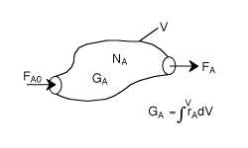
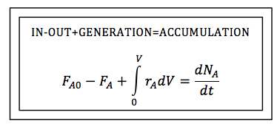
Fundamentals of CRE
General Mole Balance Equation | top
F_{A0}= Entering molar flow rate of A (mol/time) F_{A}= Exiting molar flow rate of A (mol/time) G_{A}= Rate of generation(formation) of A (mol/time) V = Volume (vol e.g. m³) r_{A}= rate of generation(formation) of A (mole/time•vol)
Salah N. Farhan College of Engineering Diyala University

Slide 7
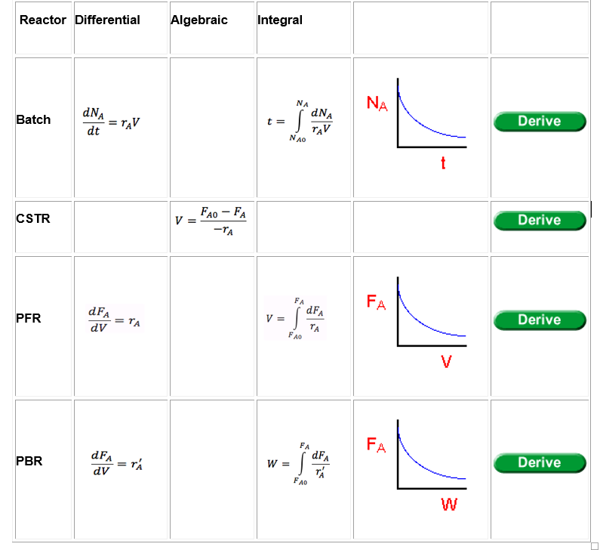
Fundamentals of CRE
Mole Balance on Different Reactor Types
N_{A}= number of moles of A inside the system Volume V (mol)
The General Mole Balance Equation (GMBE) applied to the four major reactor types (and the general reaction, A → B):
Salah N. Farhan College of Engineering Diyala University

Slide 8
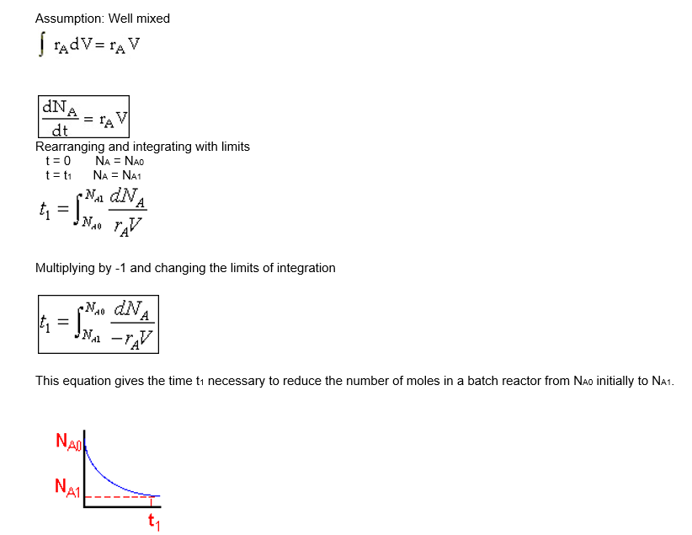
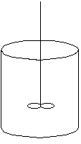
Fundamentals of CRE
Batch System Mole Balance Derivation
General Mole Balance on System with Volume, V:
No inflow or outflow-F_{A0}=F_{A}=0
Salah N. Farhan College of Engineering Diyala University

Slide 9
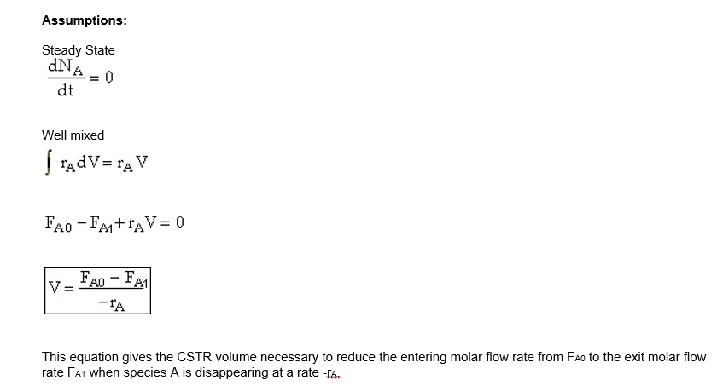
Fundamentals of CRE
Salah N. Farhan College of Engineering Diyala University

Slide 10
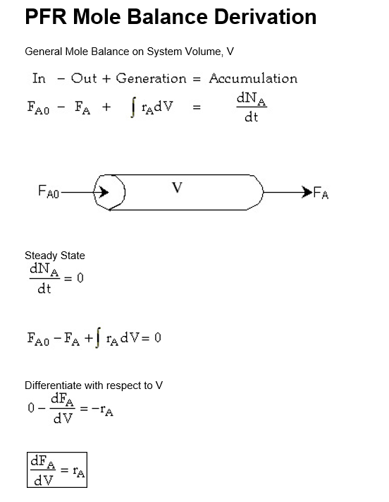
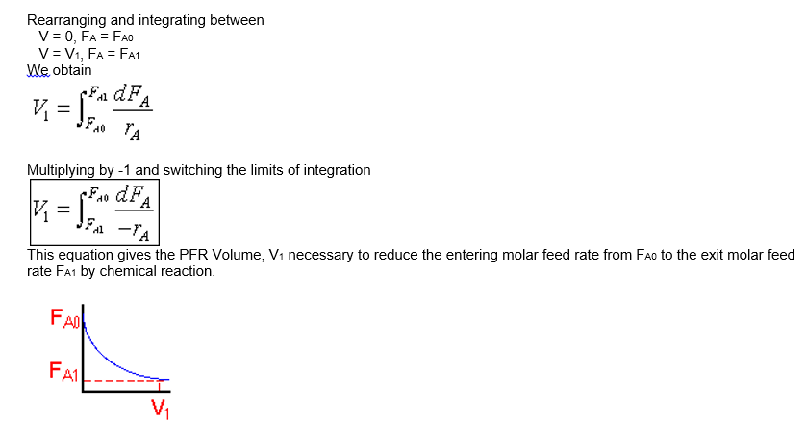
Fundamentals of CRE
Salah N. Farhan College of Engineering Diyala University

Slide 11
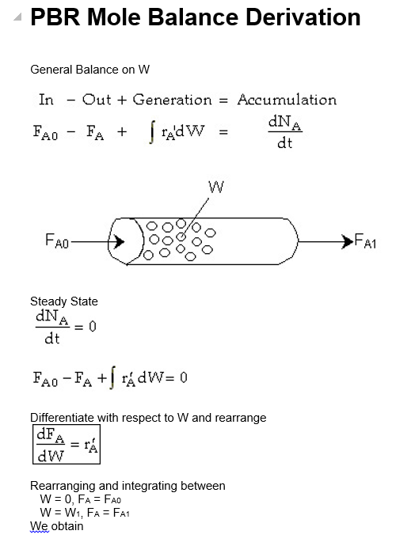
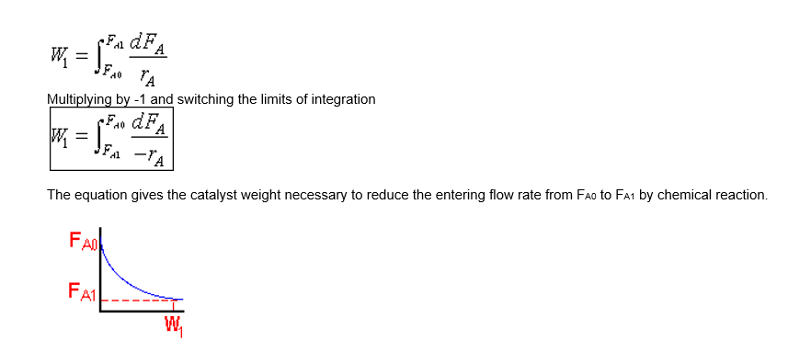
Fundamentals of CRE
Salah N. Farhan College of Engineering Diyala University

Slide 12
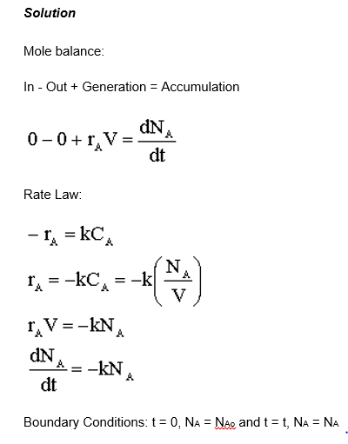
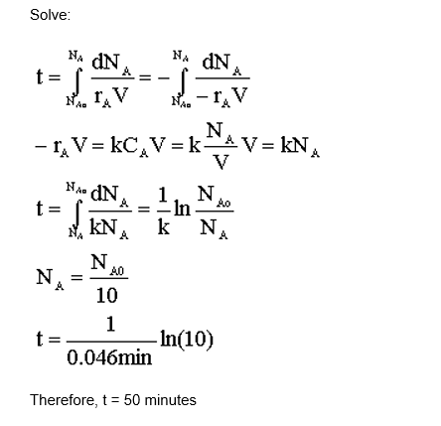
Fundamentals of CRE
Salah N. Farhan College of Engineering Diyala University

Slide 13
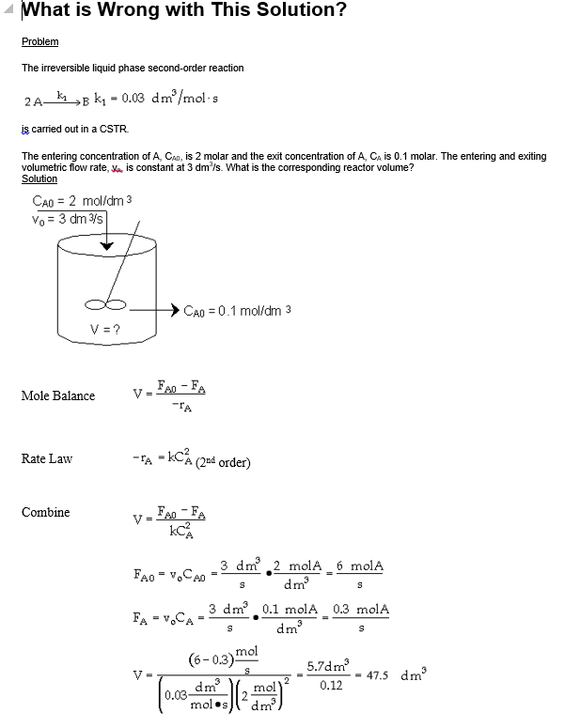
Fundamentals of CRE
Salah N. Farhan College of Engineering Diyala University

Slide 14
Fundamentals of CRE
Salah N. Farhan College of Engineering Diyala University

