Slide 1
Laser Material Processing(LMP) Lecture 6 Laser Cutting

Slide 2
Laser Cutting Videos
https://www.youtube.com/watch?v=K03wZbqf5AI

Slide 3
Laser Cutting System
1.Laser-beam generator
2.Beam delivery:
Circular polarizers, mirrors, beam splitters, focusing lenses and fiber optic couplings
3.Auxiliary devices: Laser head, safety equipment, etc.
4.Workpiece positioning
In addition, assist gases also required

Slide 4
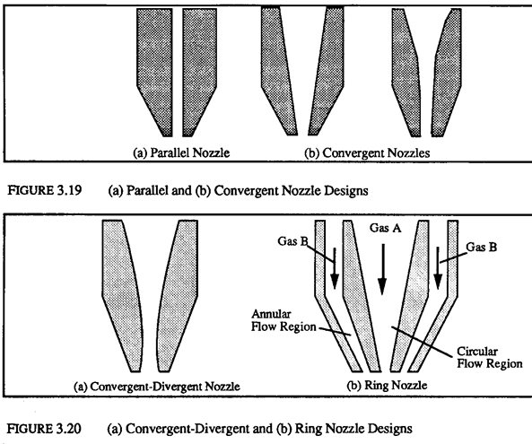
Laser Cutting System Gas Nozzle Designs

Slide 5
Laser Cutting Process
Laser Cutting

Slide 6
Material Removal Types of Laser Cutting
Vaporization: low vaporization temperature materials
Fusion: high vaporization temperature materials. Material is melted & ejected (by an inert gas jet)
Reactive Fusion:
Thermal stress cracking or controlled fracturing: for brittle materials
Scribing: Mechanical snapping along scribed line
Ablation (Excimer laser): breaking organic material bonds (e.g. polymer)
Burning in reactive gas

Slide 7
Different Type of Laser for Laser Cutting
1. CO₂ laser :
a. Have the highest Continuous Wave (CW) power
b. Capable to extract as much as 10k W
c. Have a high energy efficiency
d. Capable of both CW and Pulsed operation (5kHz)
2.Nd:YAG:
a. has the highest peak power for pulsed operation
b. May be operated in either CW or pulsed
3.Nd: Glass:
more economical but has lower thermal conductivity. Used for low pulse repetition rates & high pulse energies. Ideal for drilling.
4.Nd: Ruby:
low energy efficiency & power, Limited to pulsed laser operation

Slide 8
Different Type of Laser for Laser Cutting
5. Excimer:
a. High power pulsed beams
c. Used to machine solid polymer pieces, remove polymer films, micromachine ceramics, medical applications
d. Ablation material removal process
e. Higher precision & less heat affected zone vs. CO₂ & Nd:YAG lasers
f. Produces large area beams → use mask to produce series of holes. 5000 holes in a polymide sheet in 3 sec vs 50 sec using CO2 or Nd:YAG lasers.

Slide 9
Comparison of Major Material Machining Lasers

Slide 10
Effect of Laser Beam Temporal Modes
Continuous Wave (CW) commonly results in the highest cutting speed & better surface finish. Roughness is determined by thickness, alloy content, etc.
Pulsed beam results in the fewest thermal effects & least distortion of workpiece. With drilling overlapping holes (see right), it’s possible to cut with smoother surface.

Slide 11
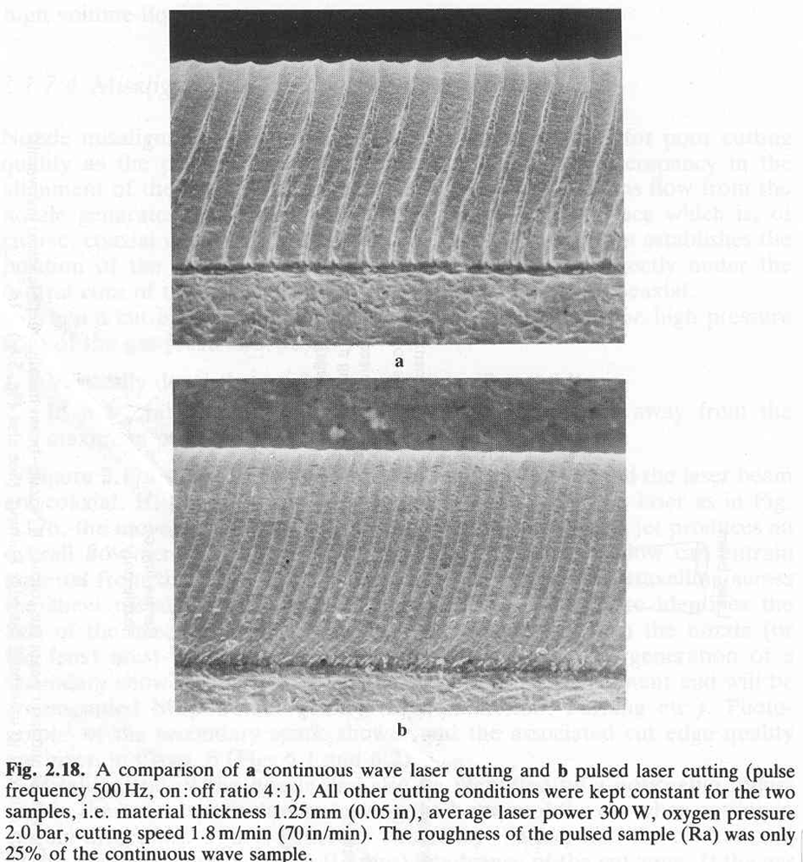
Effect of Laser Beam Temporal Modes

Slide 12
Cutting Considerations for Different Materials
Ferrous Metals:
High efficiency due to easy-to-remove oxide creation
One approximate rule:1.5kW laser power will cut
a. 1mm thick mild steel at approx 10m/min
b. 10mm thick mild steel at approx 1m/min
Non-Ferrous Metals:
Mostly less efficient than cutting steel, due to the higher reflectivity, thermal conductivity & less efficient oxidation reaction
Similar cut edge qualities to SS

Slide 13
Cutting Considerations for Different Materials
Non-Metal:
Most non-metallic materials are highly absorptive at CO2 laser wavelength. Cutting process:
i. Melt Shearing (mostly for thermoplastic): cut
very quickly & high quality edges
ii. Vaporization: usually only for acrylic
iii. Chemical degradation: slow cutting, high temperature, but flat & smooth result

Slide 14
Cutting Considerations for Different Materials
Cutting Speed on Mild Steel
Cutting Speed on Stainless Steel

Slide 15
Cutting Considerations for Different Materials
Cutting Speed on Acrylic
Cutting Speed on Aluminum
Max Cutting Speed for Polymer: V=PQt^{-B}
P = Laser Power (W) t = material thickness (mm)
Q = an experimentally derived constant for the polymer
B = an experimentally derived constant for the material

Slide 16
Cutting Considerations for Different Materials
Power setting for different cutting applications
Application Requirement | Recommended Laser Power | Cutting consideration
Thin materials: Non- metals | 150 Watt Average, 450 Watt peak | Up to 0.04” thick can be cut at full speed of 1200in/min with 150 watt
Thicker materials: Non-metals | 250 watt to 500 watt average - up to 1500 watt peak | Up to 1”: Power ↑ →Cutting Speed ↑ , cleaner result & lower HAZ
Metals | 150 watt to 500 watt average - up to 1500 watt peak | Al, Brass, SS use 500 W due to its reflectivity. As thickness ↑, also power need to be ↑

Slide 17
Laser Cutting Analysis
Cutting depth, s
s = 2.a.P/(π1/2.ρ.v.d.(cp.(Ts-To)+L))
a = absorbtivity of the material
P = Beam power
ρ = density
v = scanning velocity
d = spot diameter (=2.R)
cp = specific heat
Ts = surface temperature
To = ambient temperature
L = latent heat of fusion

Slide 18
Typical CO₂ Laser Cutting Parameters
Cutting Considerations for Different Materials

Slide 19
Comparison Of Laser Cutting To Other Methods

Slide 20
Advantages of Laser Cutting
Laser machining is a thermal process: depends on thermal and optical rather than the mechanical properties
Laser machining is a non-contact process: No cutting forces generated
Laser machining is a flexible process
Laser machining produces a higher precision and smaller kerf widths results (as small as 0.005mm dia hole)
5. Laser Cutting has ability to cut from curved workpieces
For cutting fibrous material (wood, paper, etc.) laser
cutting eliminates residue and debris

Slide 21
Disadvantage of Laser Cutting
Low energy efficiency
Material damage: Heat affected zone (HAZ)
Laser cutting effectiveness reduces as the workpiece thickness increases
Laser cutting produces a tapered kerf shape (due to divergence)

Slide 22
Home Work
Compare between Continuous Wave (CW) mode laser cutting process and Pulsed mode laser cutting process

