Slide 1
Laser Material Processing(LMP)
Lecture 3

Slide 2
Conclusions Remarks
From pervious lecture we can conclude that:
1. Laser is a light i.e. electromagnetic wave which has certain wavelength and frequency
2. Laser have two operation modes according to ejection of output power to target
with time
Continuous operation CW mod
[ejection of power to the target
is uniform(constant) with time].

Slide 3
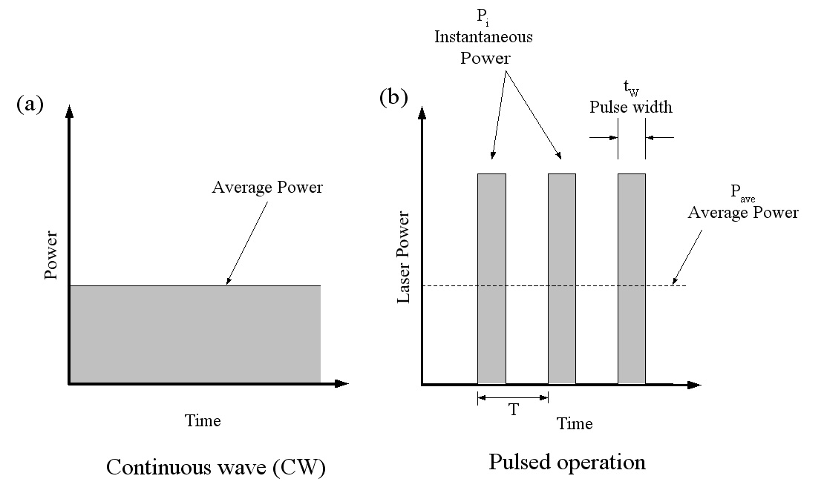
Conclusions Remarks
B. Pulse operation mod [ejection of power to the target is periodic with time].

Slide 4
The Basic Unit Of All Light
-A photon is the smallest discrete amount of (light) electromagnetic radiation. It is the basic unit of all light.
-Photons are always in motion and, in a vacuum, travel at a constant speed 3 X10⁸ m/s(speed of light).
-Photon can act both as a wave and particle i.e. has property of wave like wavelength and has property of particle like mass.

Slide 5
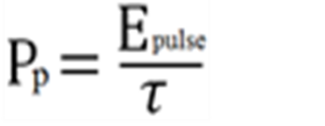
Laser Power Density
-Laser Power Density Pd ( Laser Intensity or Laser Irradiance): Is defined as the energy per unit per unit area (or power / area):
-For Continuous operation CW mod :
Pd =Pav / πr²
Where Pd is Power Density , Pav is average power,
r is laser beam radius at the surface of the target
-For Pulse operation mod
Pd =Pp / πr²
Where Pp is the peak instantaneous power ,
Ep is Eenergy of the pulse , Ʈ is the pulse duration(width).
Pulsed laser can achieve Pd < 10⁸ W/cm² while CW lasers can generate laser Pd> 10⁸ W/cm² .

Slide 6
Governing Factors For Material Processing
Depending on the absorbed laser intensity, and deposition times different physical phenomena such as heating, melting and vaporization, can be done by Laser during material processing.
- Laser material processing (LMP) involves :
Laser surface hardening, laser forming [heating]
laser melting, laser welding [melting]
laser cladding ,laser alloying, [melting]
laser grooving, laser drilling, [vaporization]
laser cutting, laser surface cleaning etc. [vaporization]

Slide 7
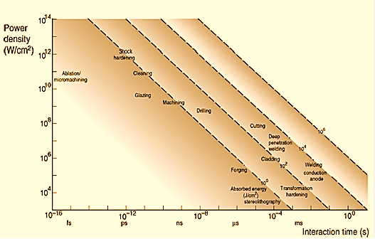
Governing Factors For Material Processing
-All LMP engineers use the Figure below to select the range of Governing Factors [laser power density (Y-axis , and deposition time X-axis) for certain process surface hardening, melting, welding, cladding , drilling, cutting, etc.].

Slide 8
Governing Factors For Material Processing
-Example: Use the previous Figure to select the range of Governing Factors [laser power density (Y-axis , and deposition time X-axis) for the following LMP:
1.Welding
2.Drilling
3.Cutting
4.Shock hardening.

Slide 9
Governing Factors For Material Processing
-Solution: The range of Governing Factors [laser power density (Y-axis , and deposition time X-axis) for the following LMP( see the next slide):
1.Welding :
Laser power density= 10⁵ W/cm²
Deposition time= 10⁻² s
2.Drilling:
Laser power density= 10⁹ W/cm²
Deposition time= 10⁻⁸ s
3.Cutting?? Home Work
4.Shock hardening??

Slide 10
Governing Factors For Material Processing

Slide 11
Focusing Area Effects
Power density (Pd) = P/Area P= Power (W)
Area = πr² Cm2
r= beam radius at the surface of the target
-If P= 10000 W Area= 1 Cm2 Pd1=10000 W/ 1Cm2
Pd1=10000 W/Cm2
-If P= 100 W Area= 0.01 Cm2 Pd2=100 W/ 0.01 Cm2
Pd2=10000 W/Cm2
Pd1=Pd2 !!!!!!!!

