Slide 1

By Dr. Ahmed S. Abdullah
د. احمد سليمان عبدالله

Slide 2
The current through, or voltage across, an element in a linear bilateral network is equal to the algebraic sum of the currents or voltages produced independently by each source.

Slide 3
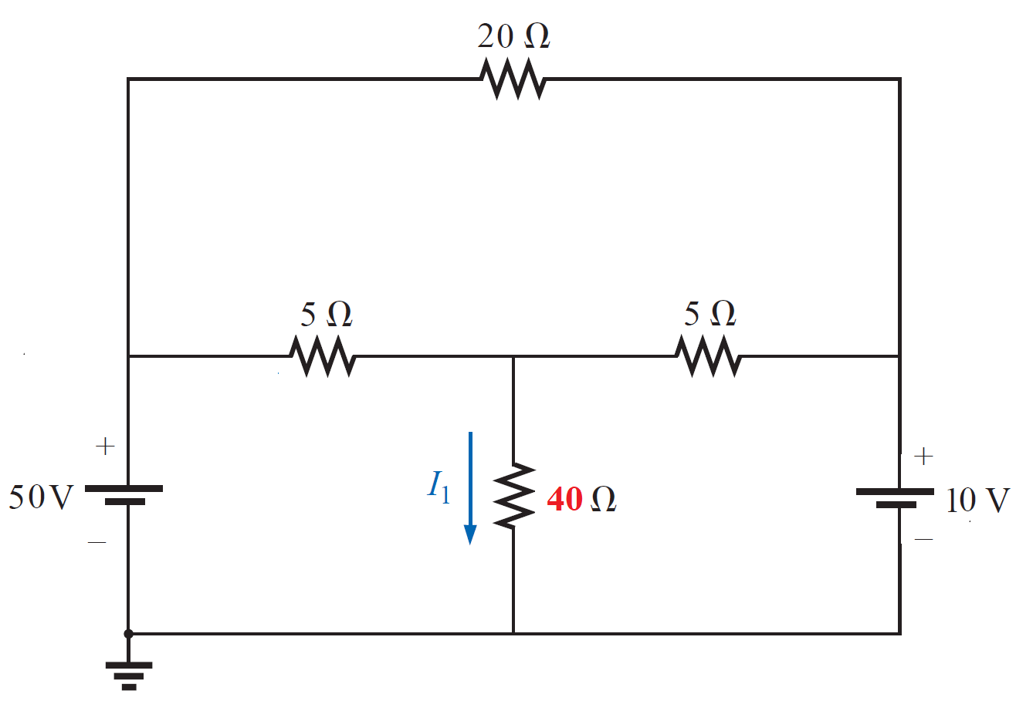
EXAMPLE 1:- Using superposition, determine the current in the 40 Ω resistor of the circuit showm

Slide 4
EXAMPLE 1:- Using superposition, determine the current in the 40 Ω resistor of the circuit showm
1- Considering the effects of a 50-V source

Slide 5
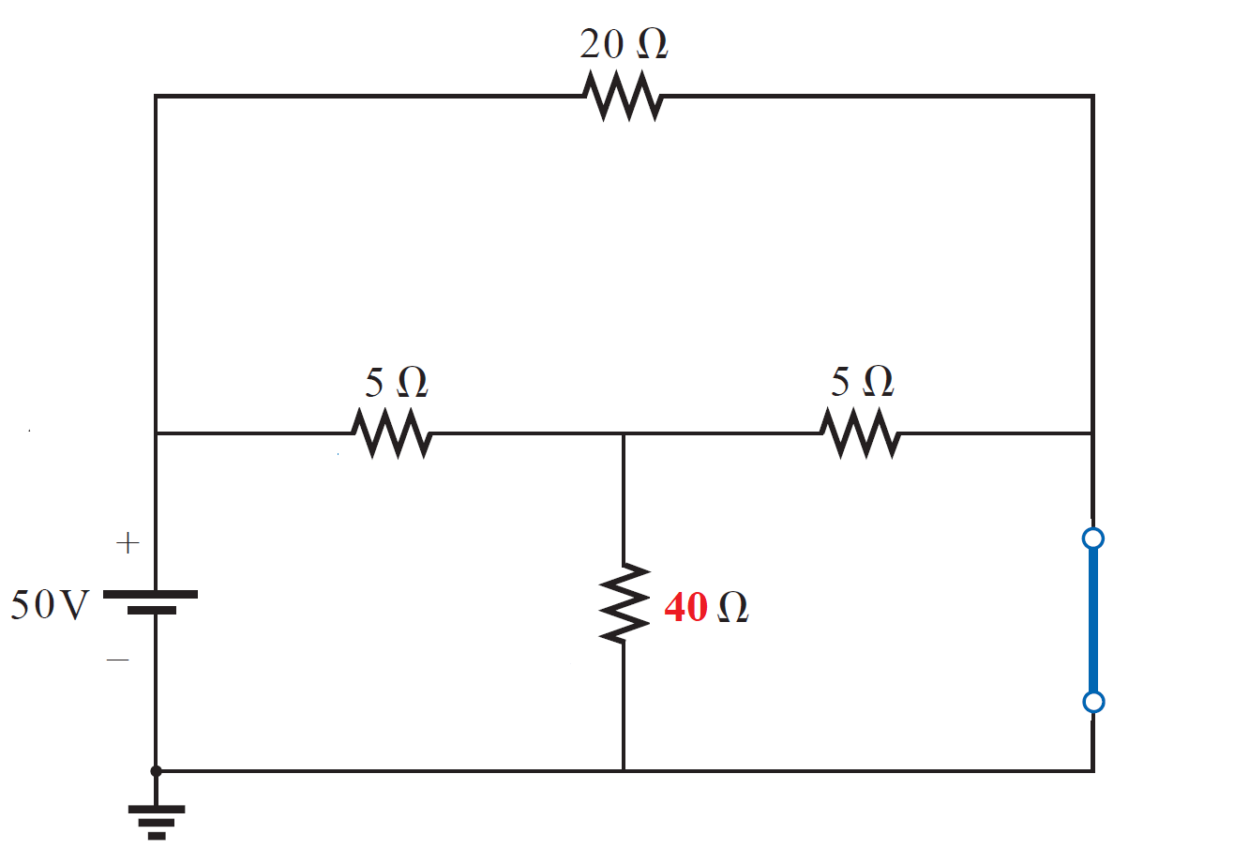
EXAMPLE 1:- Using superposition, determine the current in the 40 Ω resistor of the circuit showm
1- Considering the effects of a 50-V source

Slide 6
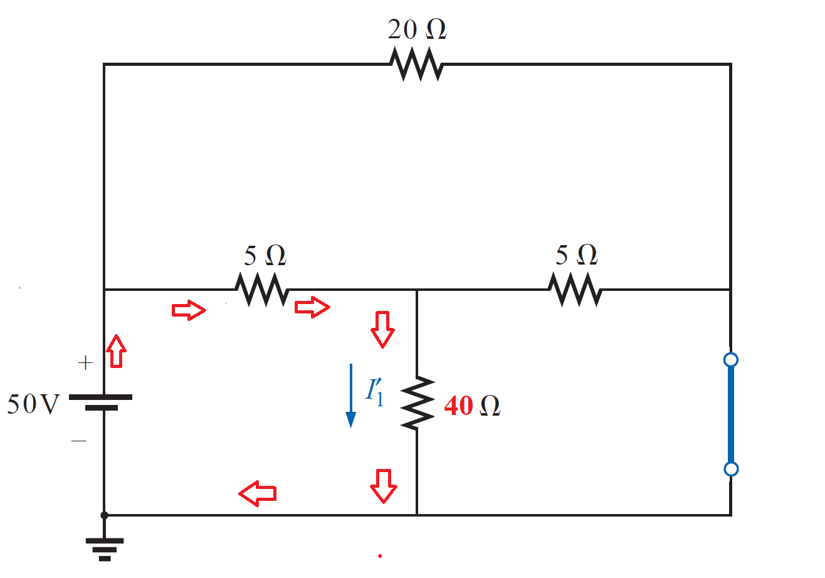
EXAMPLE 1:- Using superposition, determine the current in the 40 Ω resistor of the circuit showm
1- Considering the effects of a 50-V source

Slide 7
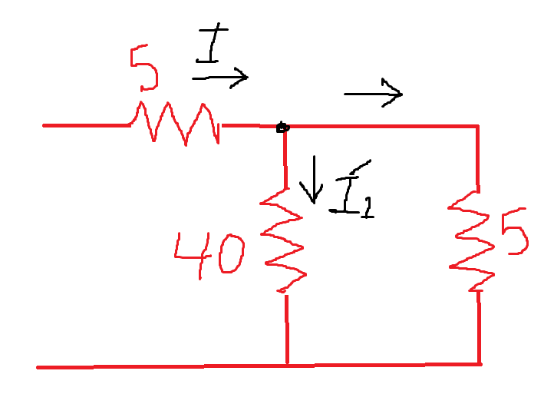
EXAMPLE 1:- Using superposition, determine the current in the 40 Ω resistor of the circuit showm
1- Considering the effects of a 50-V source

Slide 8
EXAMPLE 1:- Using superposition, determine the current in the 40 Ω resistor of the circuit showm
1- Considering the effects of a 50-V source
40//5

Slide 9
EXAMPLE 1:- Using superposition, determine the current in the 40 Ω resistor of the circuit showm
1- Considering the effects of a 50-V source
40//5

Slide 10
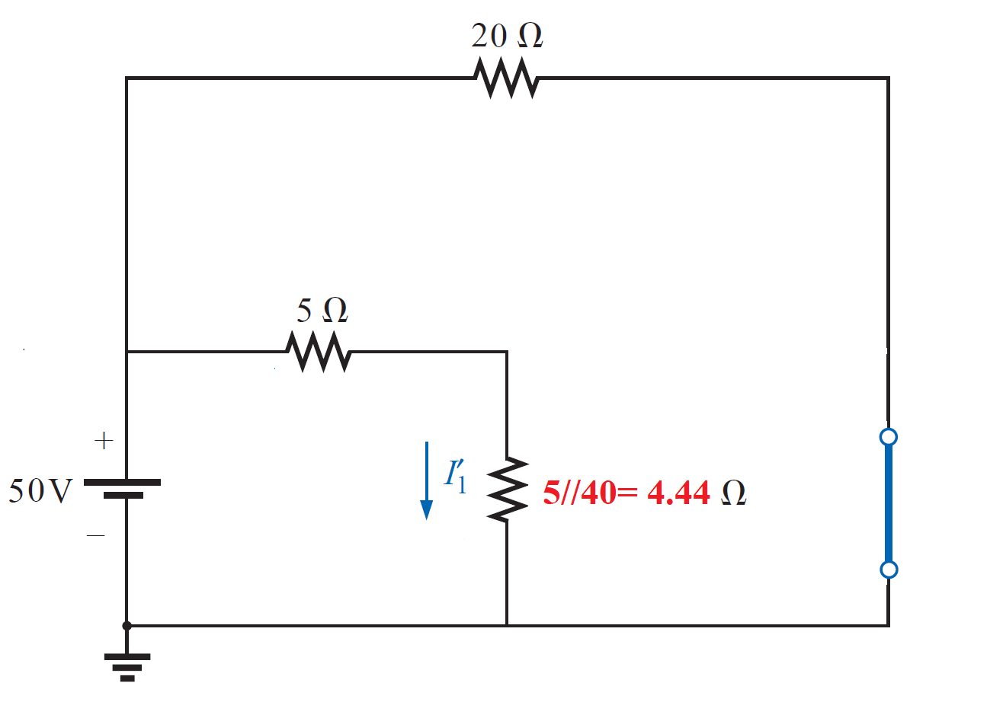
EXAMPLE 1:- Using superposition, determine the current in the 40 Ω resistor of the circuit showm
1- Considering the effects of a 50-V source

Slide 11
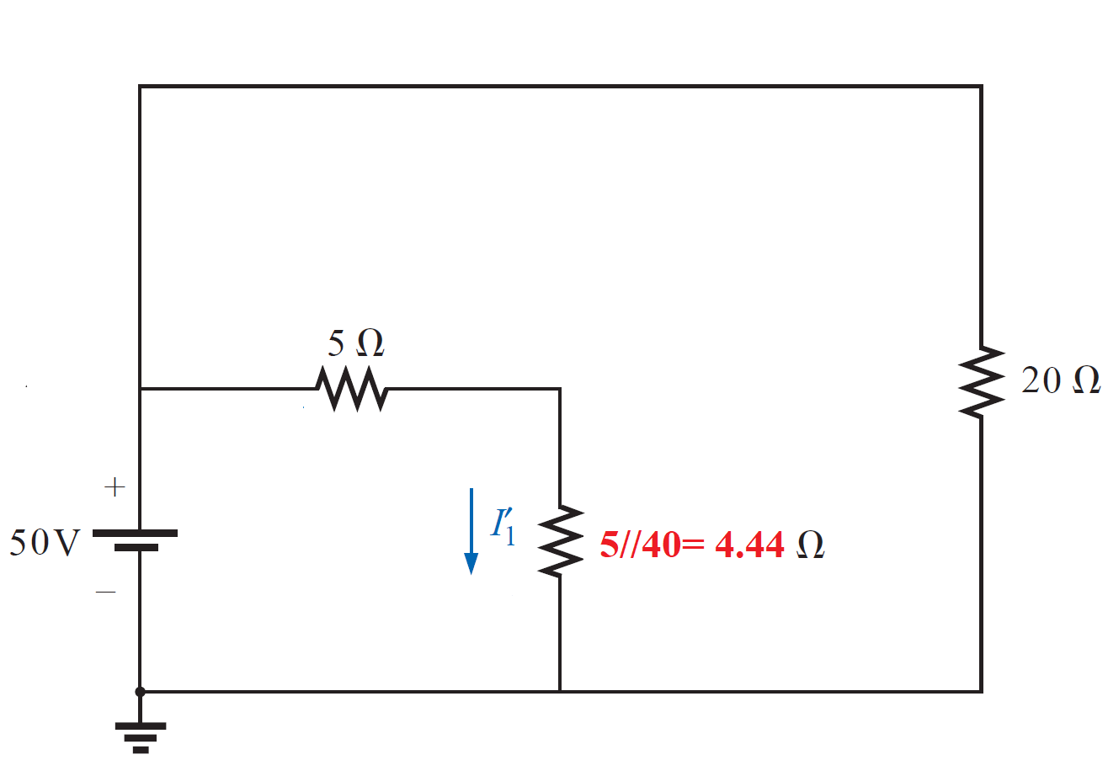
EXAMPLE 1:- Using superposition, determine the current in the 40 Ω resistor of the circuit showm
1- Considering the effects of a 50-V source

Slide 12
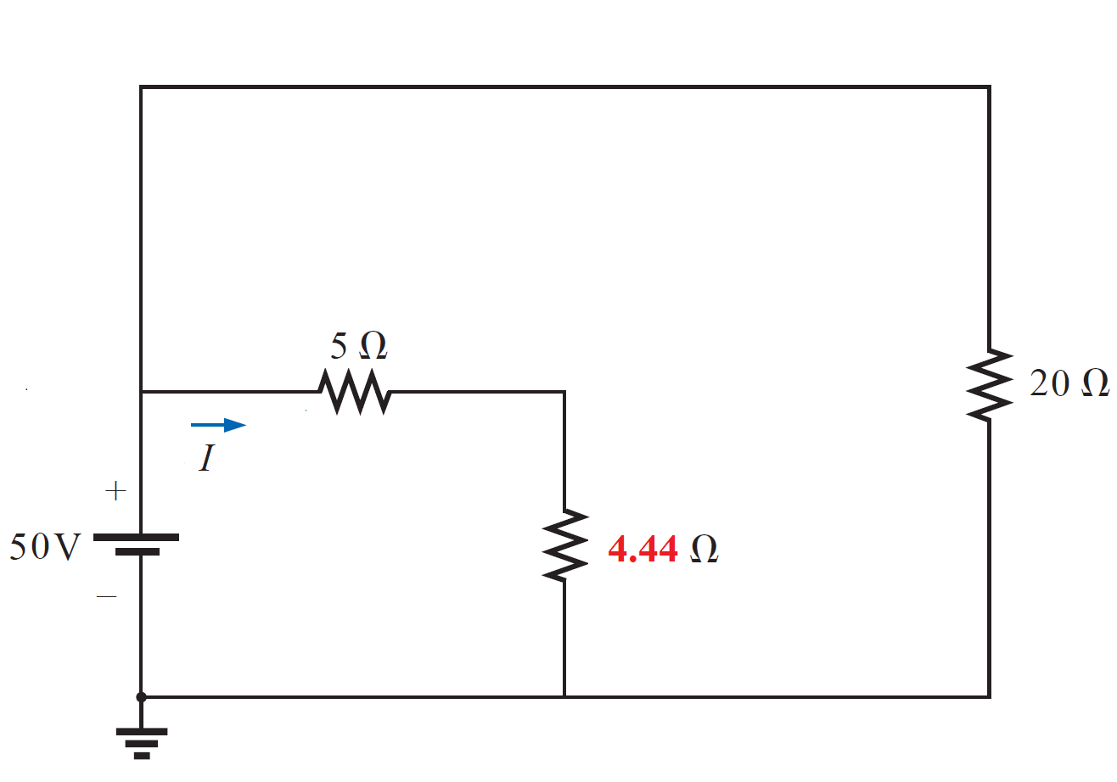
EXAMPLE 1:- Using superposition, determine the current in the 40 Ω resistor of the circuit showm
1- Considering the effects of a 50-V source

Slide 13
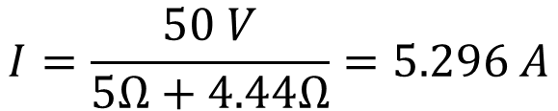
EXAMPLE 1:- Using superposition, determine the current in the 40 Ω resistor of the circuit showm
1- Considering the effects of a 50-V source
$$I=\frac{50 V}{5Ω+4.44Ω}=5.296 A$$

Slide 14
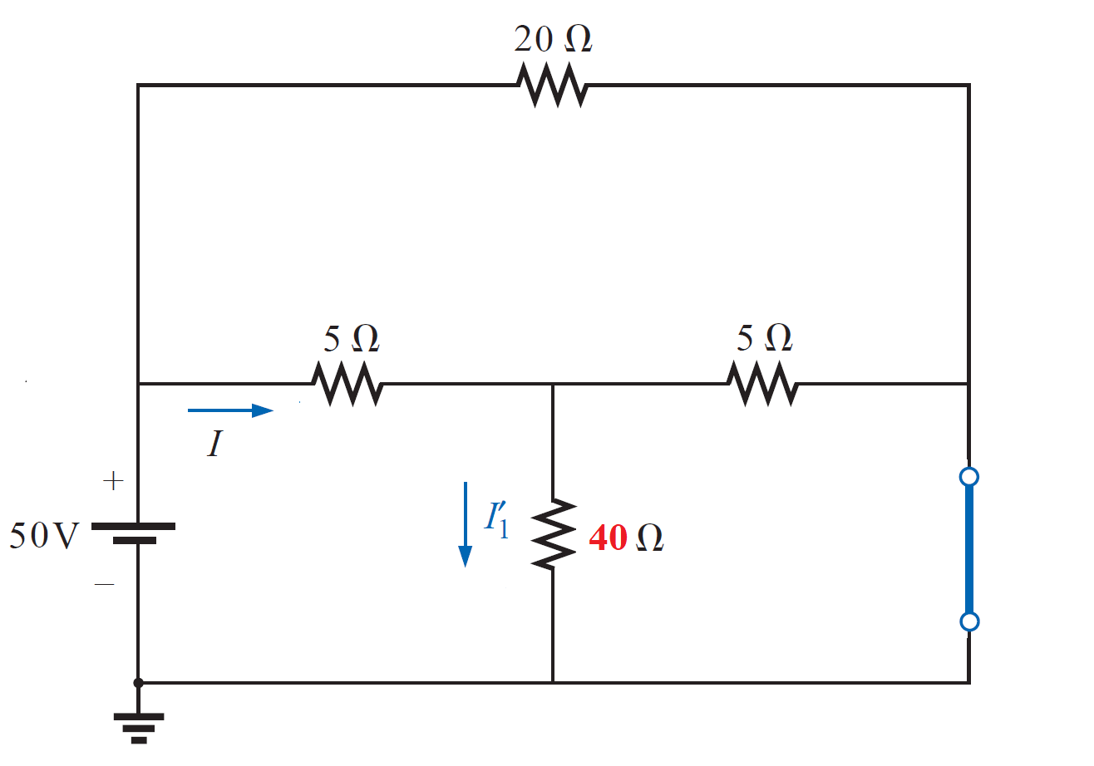
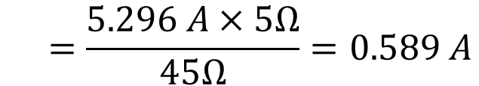
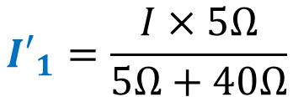
EXAMPLE 1:- Using superposition, determine the current in the 40 Ω resistor of the circuit showm
1- Considering the effects of a 50-V source
$$I=\frac{50 V}{5Ω+4.44Ω}=5.296 A$$
$${I′}_{1}=\frac{I×5Ω}{5Ω+40Ω}$$
$$=\frac{5.296 A×5Ω}{45Ω}=0.589 A$$

Slide 15
EXAMPLE 1:- Using superposition, determine the current in the 40 Ω resistor of the circuit showm
2- Considering the effects of a 10-V source

Slide 16
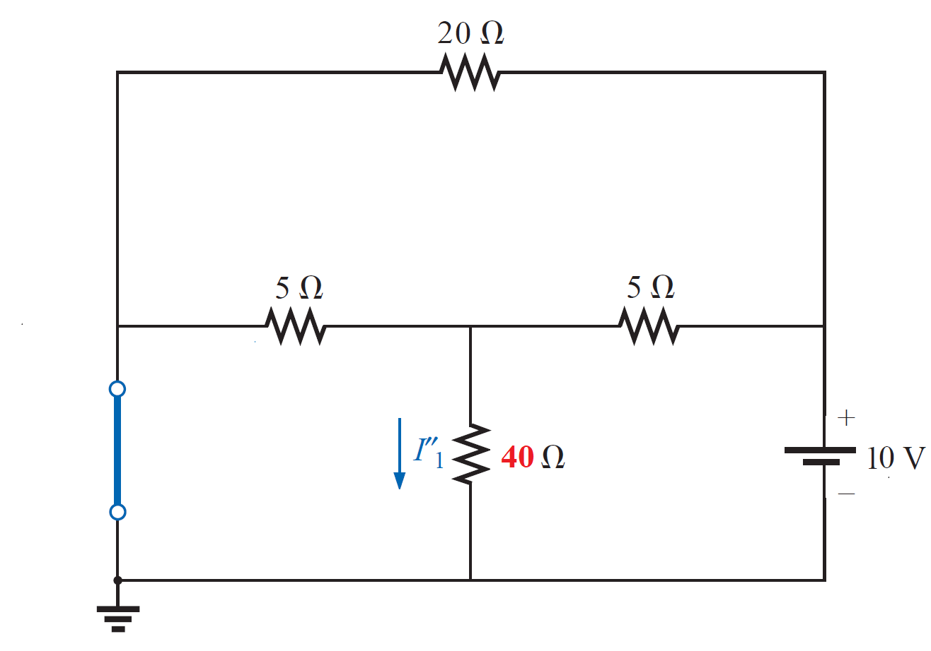
EXAMPLE 1:- Using superposition, determine the current in the 40 Ω resistor of the circuit showm
2- Considering the effects of a 10-V source

Slide 17
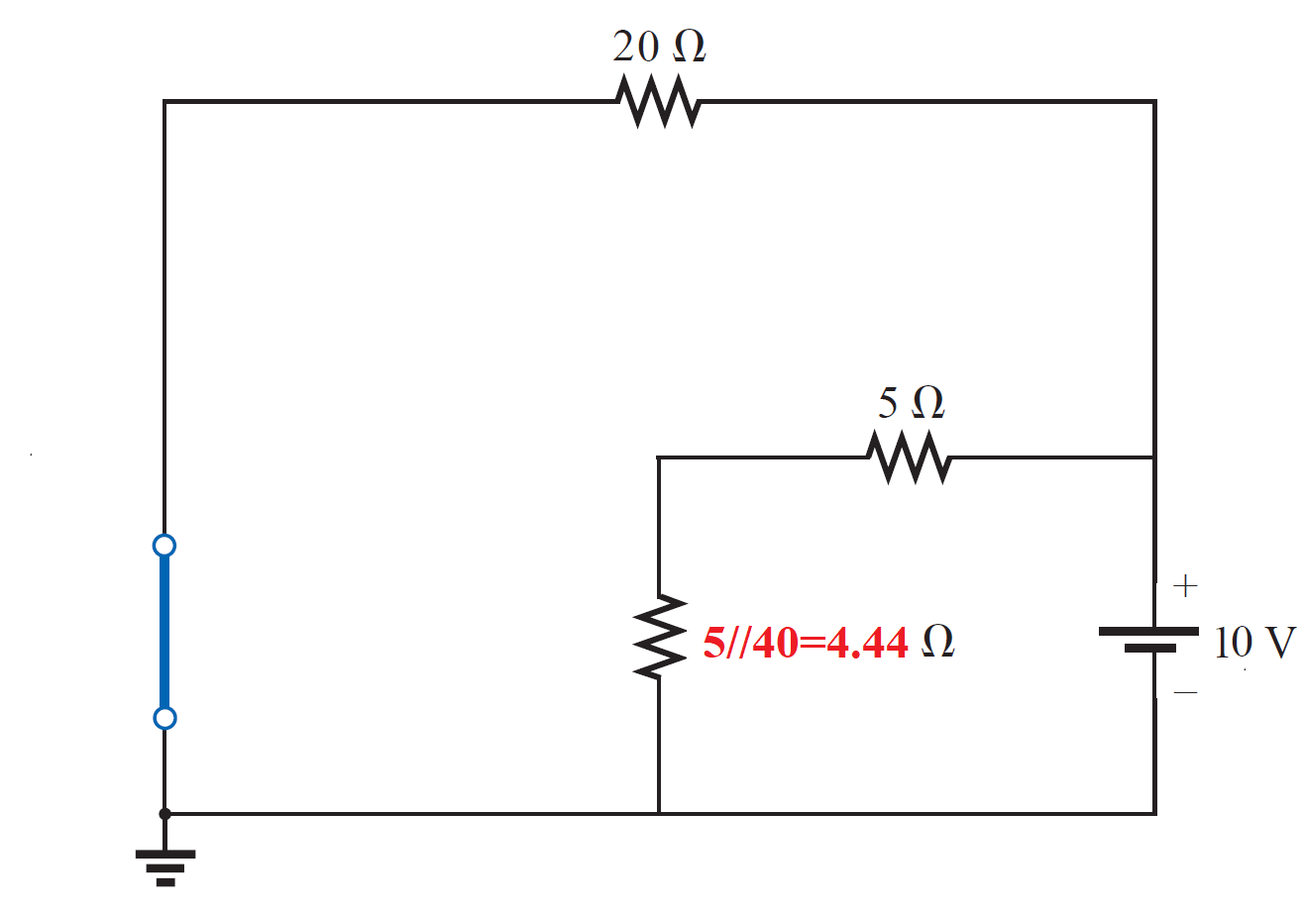
EXAMPLE 1:- Using superposition, determine the current in the 40 Ω resistor of the circuit showm
2- Considering the effects of a 10-V source

Slide 18
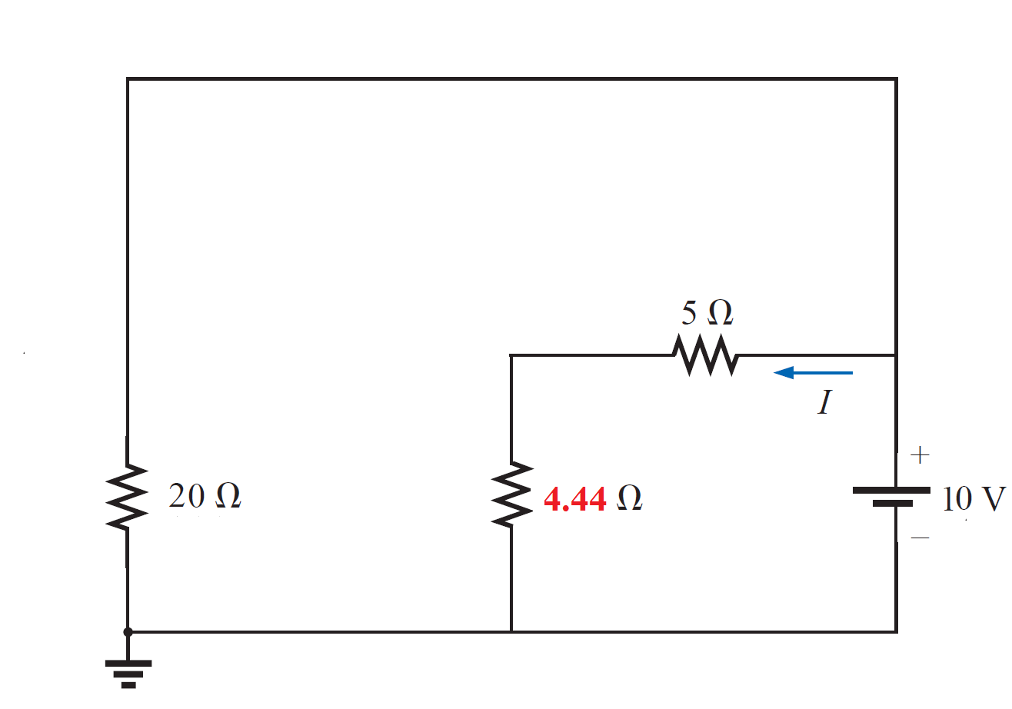
EXAMPLE 1:- Using superposition, determine the current in the 40 Ω resistor of the circuit showm
2- Considering the effects of a 10-V source

Slide 19
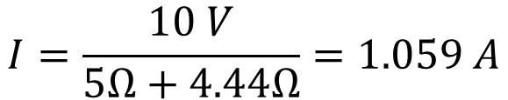
EXAMPLE 1:- Using superposition, determine the current in the 40 Ω resistor of the circuit showm
2- Considering the effects of a 10-V source
$$I=\frac{10 V}{5Ω+4.44Ω}=1.059 A$$

Slide 20
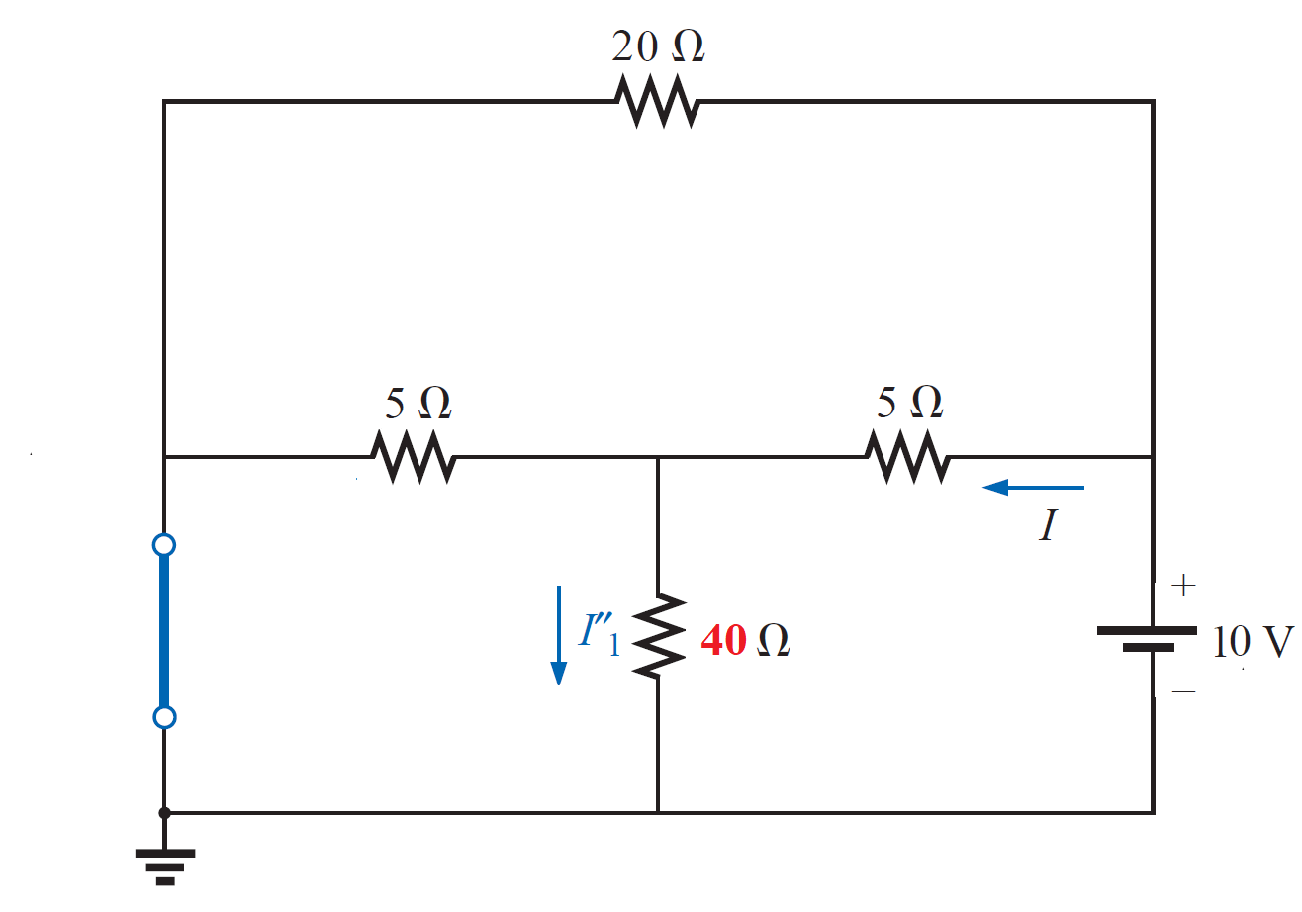
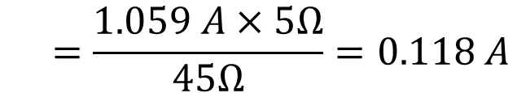
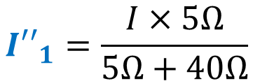
EXAMPLE 1:- Using superposition, determine the current in the 40 Ω resistor of the circuit showm
2- Considering the effects of a 10-V source
$$I=\frac{10 V}{5Ω+4.44Ω}=1.059 A$$
$${I′′}_{1}=\frac{I×5Ω}{5Ω+40Ω}$$
$$=\frac{1.059 A×5Ω}{45Ω}=0.118 A$$

Slide 21
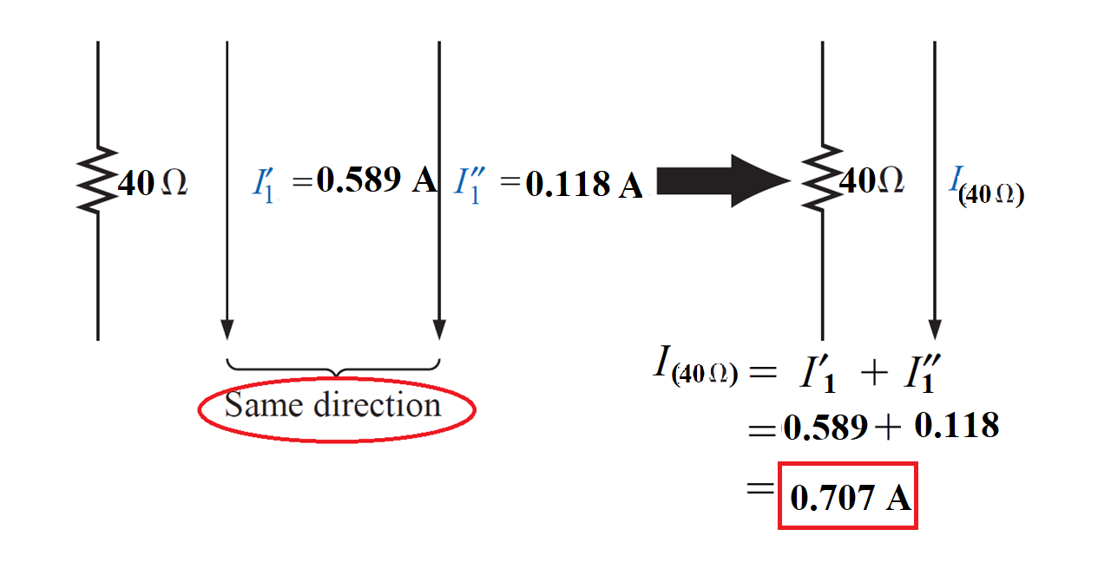

Slide 22
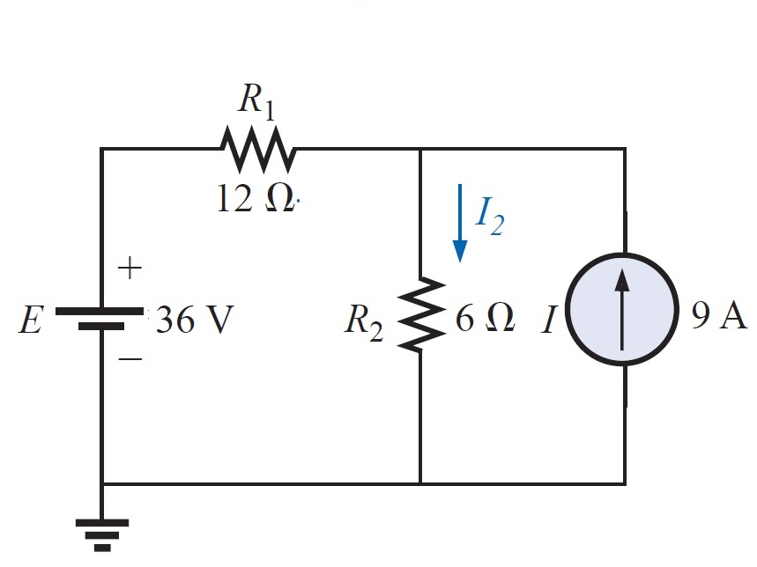
EXAMPLE 2:- Using superposition, determine the current through the 6 Ω resistor of Figure below

Slide 23
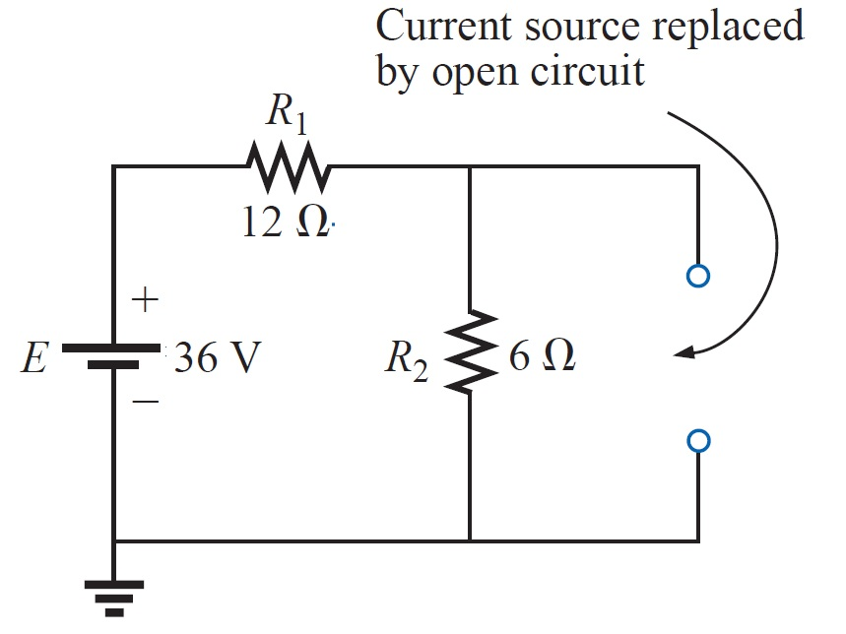
EXAMPLE 2:- Using superposition, determine the current through the 6 Ω resistor of Figure below
1- Considering the effects of the 36-V source

Slide 24
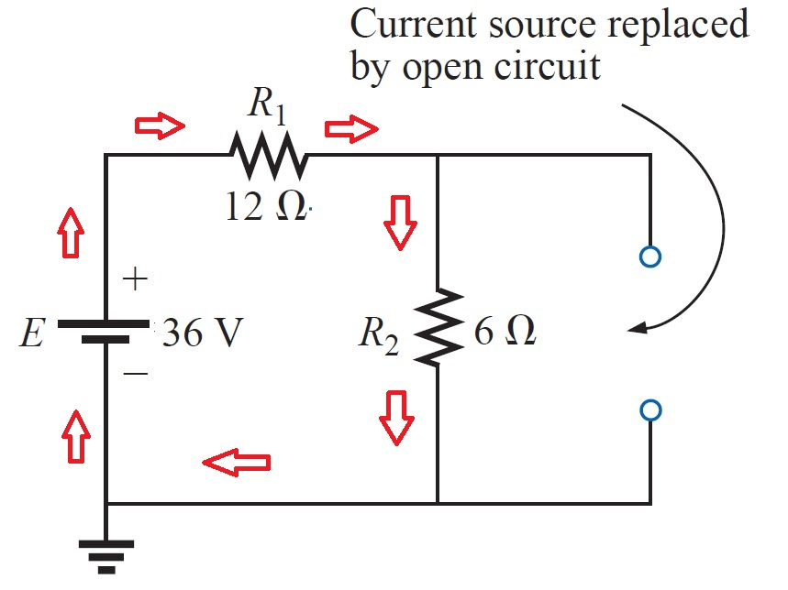
EXAMPLE 2:- Using superposition, determine the current through the 6 Ω resistor of Figure below
1- Considering the effects of the 36-V source

Slide 25
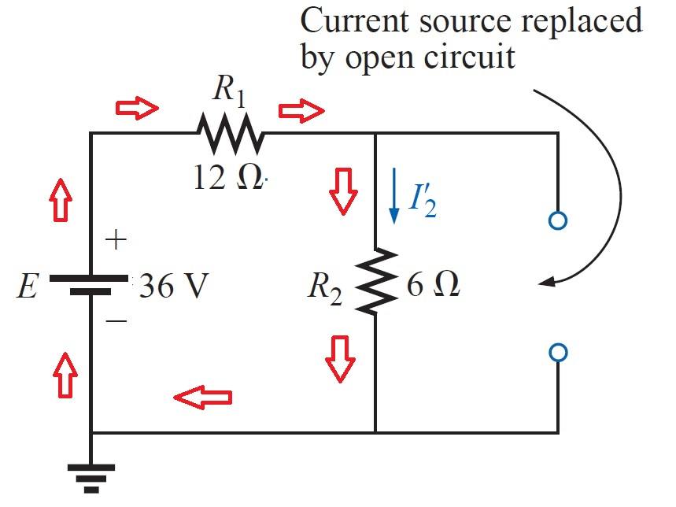
EXAMPLE 2:- Using superposition, determine the current through the 6 Ω resistor of Figure below
1- Considering the effects of the 36-V source

Slide 26
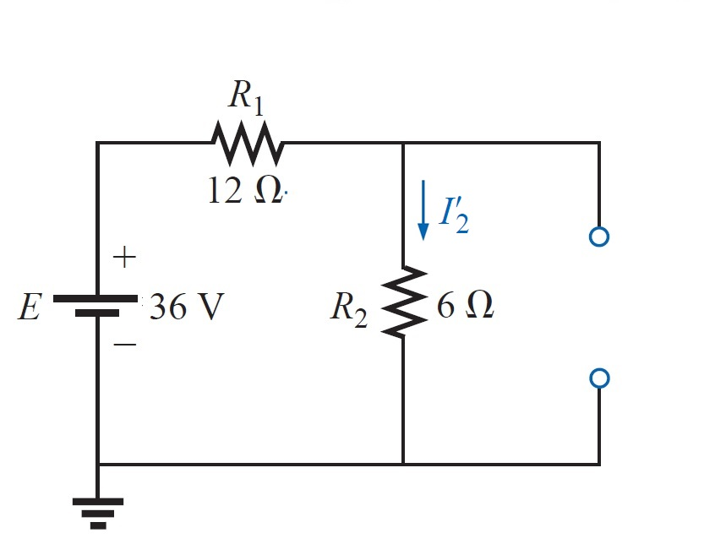
EXAMPLE 2:- Using superposition, determine the current through the 6 Ω resistor of Figure below
1- Considering the effects of the 36-V source

Slide 27
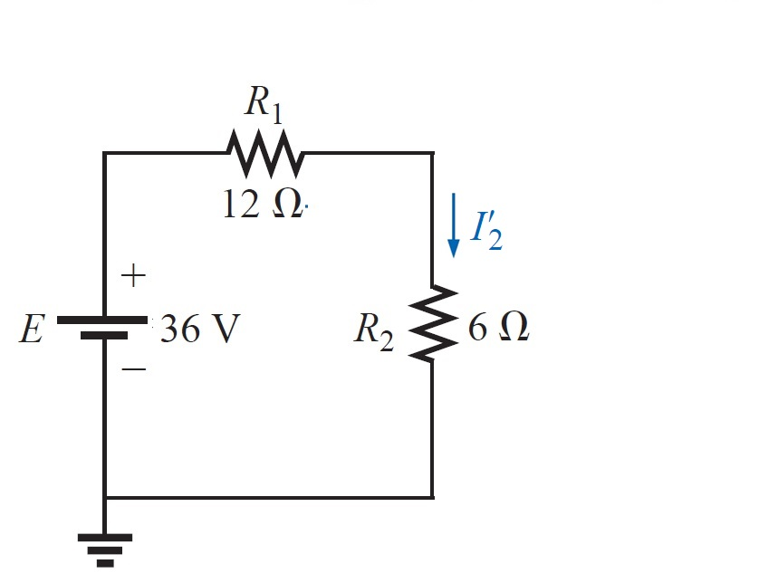
EXAMPLE 2:- Using superposition, determine the current through the 6 Ω resistor of Figure below
1- Considering the effects of the 36-V source

Slide 28
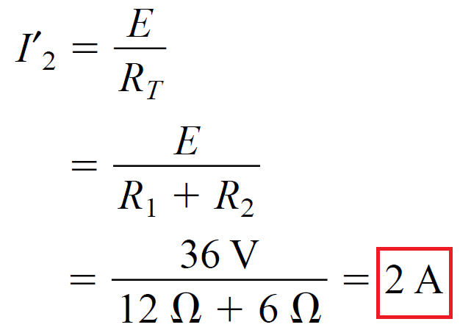
EXAMPLE 2:- Using superposition, determine the current through the 6 Ω resistor of Figure below
1- Considering the effects of the 36-V source

Slide 29
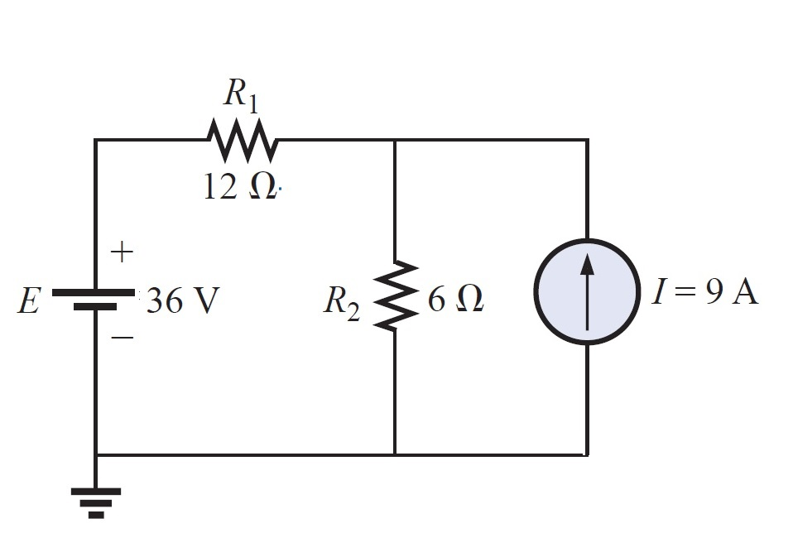
EXAMPLE 2:- Using superposition, determine the current through the 6 Ω resistor of Figure below
2- Considering the effects of the 9-A source

Slide 30
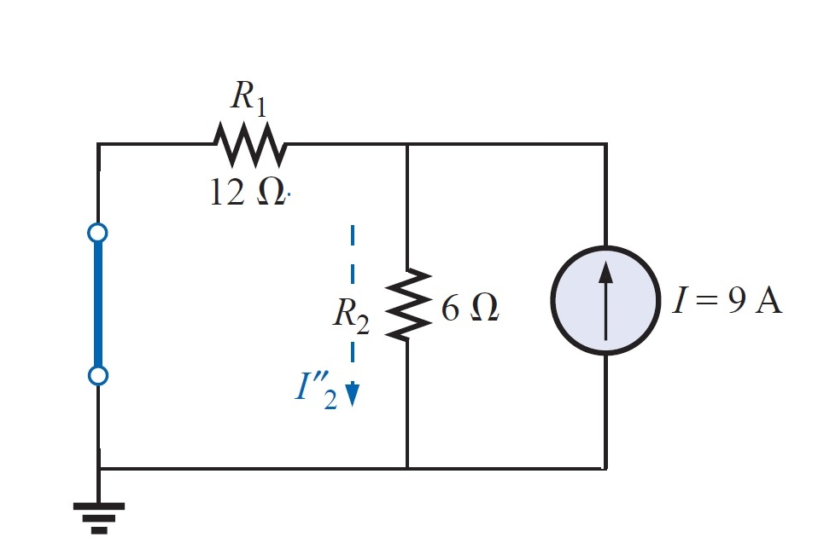
EXAMPLE 2:- Using superposition, determine the current through the 6 Ω resistor of Figure below
2- Considering the effects of the 9-A source

Slide 31
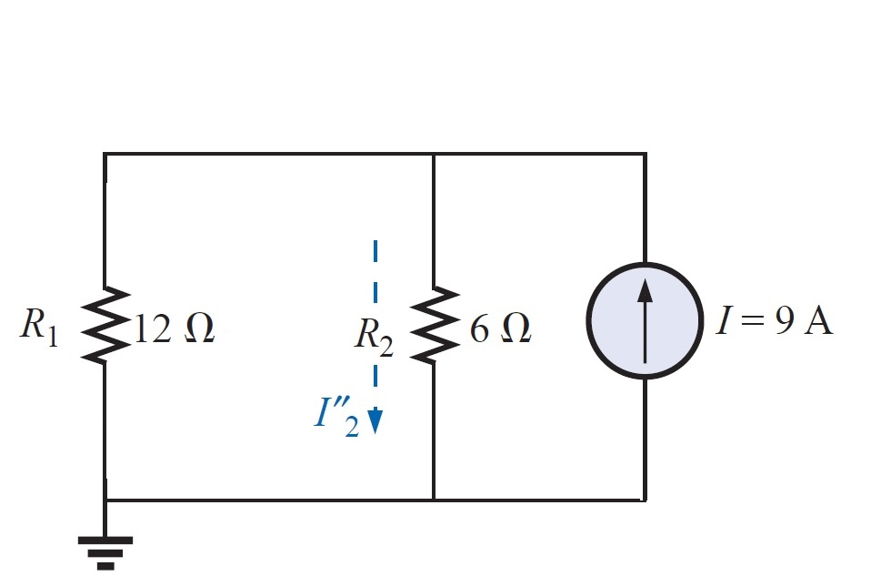
EXAMPLE 2:- Using superposition, determine the current through the 6 Ω resistor of Figure below
2- Considering the effects of the 9-A source

Slide 32
EXAMPLE 2:- Using superposition, determine the current through the 6 Ω resistor of Figure below
2- Considering the effects of the 9-A source

Slide 33

EXAMPLE 2:- Using superposition, determine the current through the 6 Ω resistor of Figure below
2- Considering the effects of the 9-A source

Slide 34
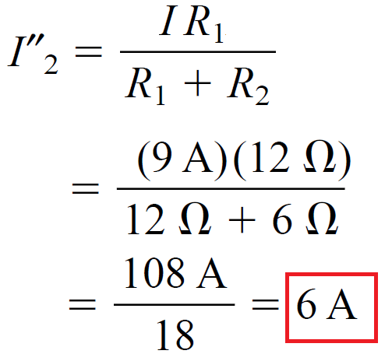
EXAMPLE 2:- Using superposition, determine the current through the 6 Ω resistor of Figure below
2- Considering the effects of the 9-A source

Slide 35
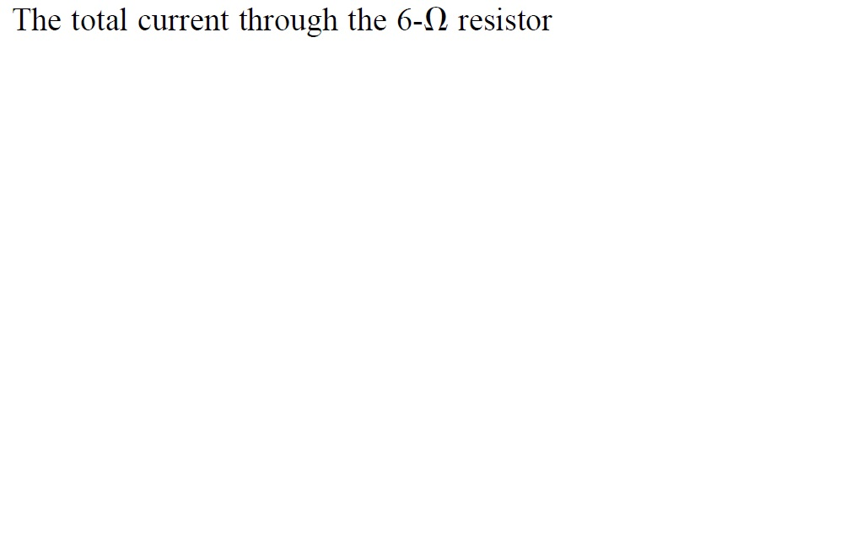
EXAMPLE 2:- Using superposition, determine the current through the 6 Ω resistor of Figure below

Slide 36
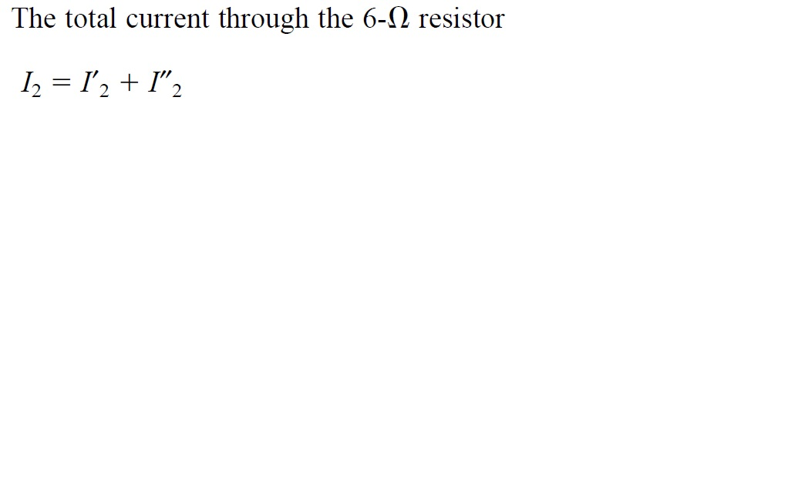
EXAMPLE 2:- Using superposition, determine the current through the 6 Ω resistor of Figure below

Slide 37
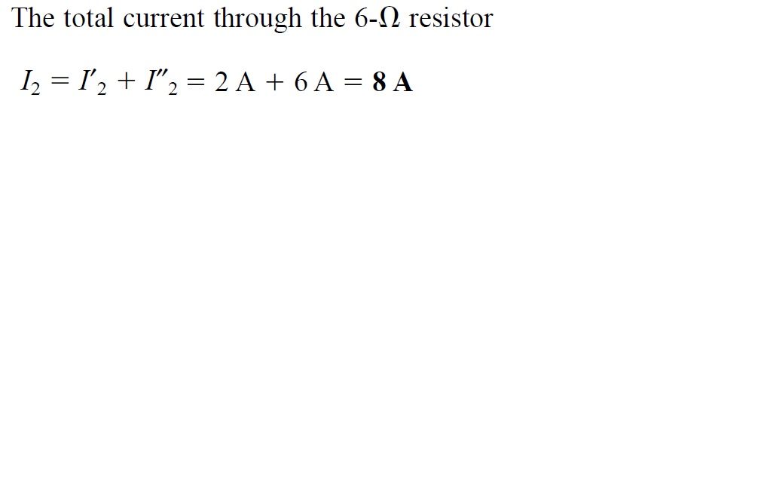
EXAMPLE 2:- Using superposition, determine the current through the 6 Ω resistor of Figure below

Slide 38
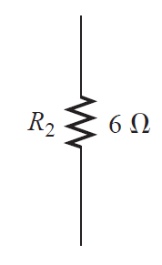
EXAMPLE 2:- Using superposition, determine the current through the 6 Ω resistor of Figure below

Slide 39
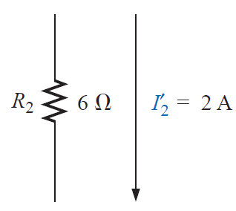
EXAMPLE 2:- Using superposition, determine the current through the 6 Ω resistor of Figure below

Slide 40
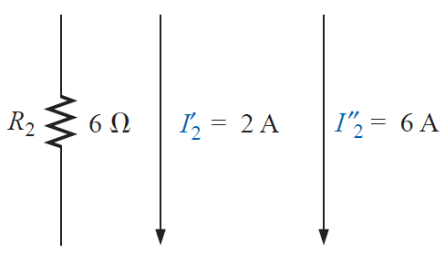
EXAMPLE 2:- Using superposition, determine the current through the 6 Ω resistor of Figure below

Slide 41

EXAMPLE 2:- Using superposition, determine the current through the 6 Ω resistor of Figure below

Slide 42

EXAMPLE 2:- Using superposition, determine the current through the 6 Ω resistor of Figure below

Slide 43
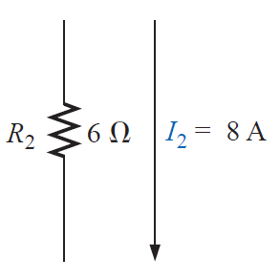
EXAMPLE 2:- Using superposition, determine the current through the 6 Ω resistor of Figure below

Slide 44
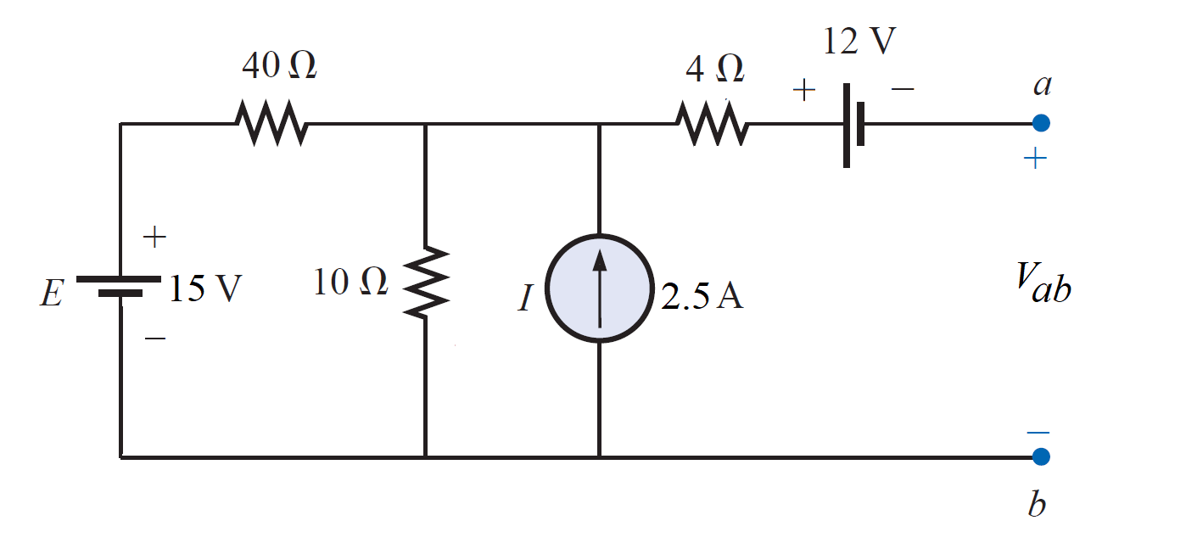
EXAMPLE 3:- Using superposition theorem to find the voltage V_{ab} in the circuit shown

Slide 45
EXAMPLE 3:- Using superposition theorem to find the voltage V_{ab} in the circuit shown
1- Considering the effects of the 15-V source

Slide 46
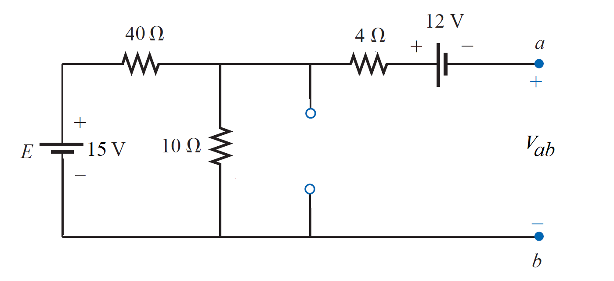
EXAMPLE 3:- Using superposition theorem to find the voltage V_{ab} in the circuit shown
1- Considering the effects of the 15-V source

Slide 47
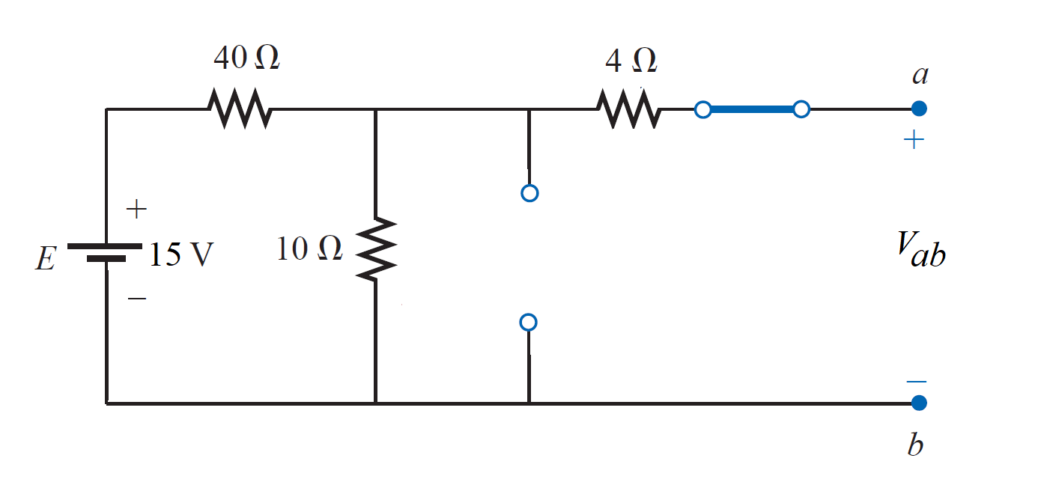
EXAMPLE 3:- Using superposition theorem to find the voltage V_{ab} in the circuit shown
1- Considering the effects of the 15-V source

Slide 48
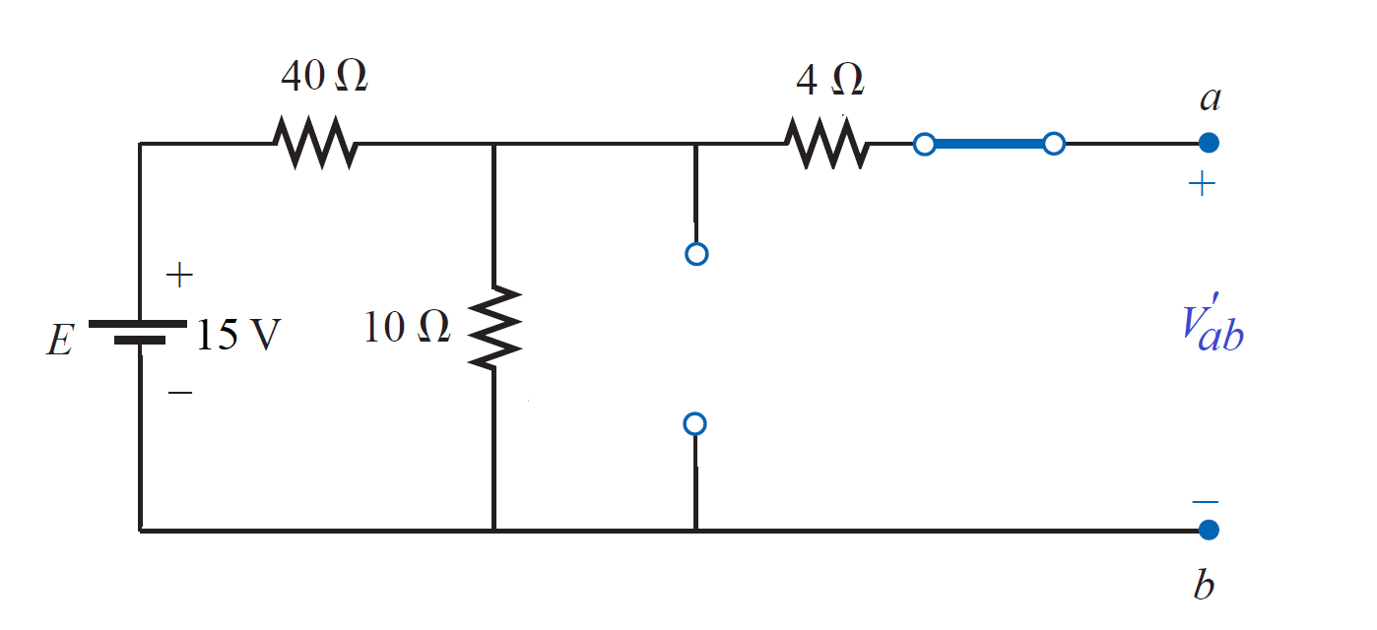
EXAMPLE 3:- Using superposition theorem to find the voltage V_{ab} in the circuit shown
1- Considering the effects of the 15-V source

Slide 49
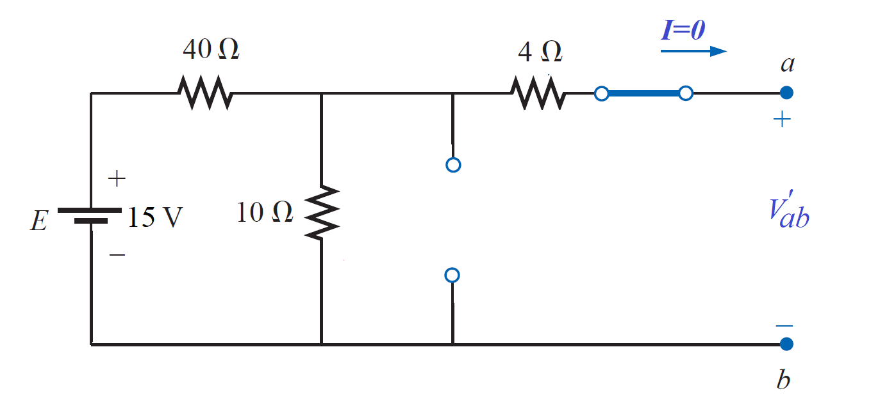
EXAMPLE 3:- Using superposition theorem to find the voltage V_{ab} in the circuit shown
1- Considering the effects of the 15-V source

Slide 50
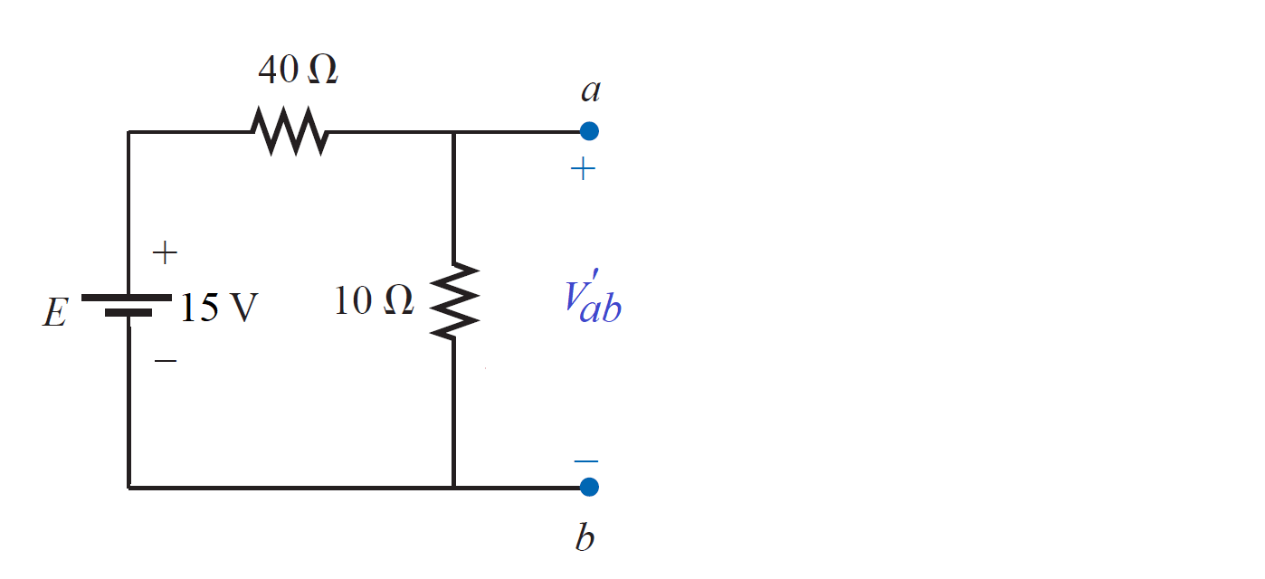
EXAMPLE 3:- Using superposition theorem to find the voltage V_{ab} in the circuit shown
1- Considering the effects of the 15-V source

Slide 51

EXAMPLE 3:- Using superposition theorem to find the voltage V_{ab} in the circuit shown
1- Considering the effects of the 15-V source
$${V′}_{ab}=\frac{(15V)(10Ω)}{10Ω+40Ω}=\frac{150}{50}=3 V$$

Slide 52
EXAMPLE 3:- Using superposition theorem to find the voltage V_{ab} in the circuit shown
2- Considering the effects of the 2.5-A source

Slide 53
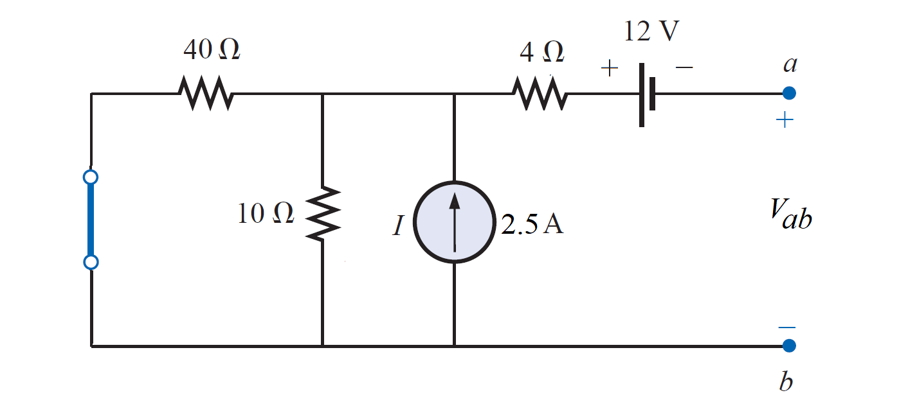
EXAMPLE 3:- Using superposition theorem to find the voltage V_{ab} in the circuit shown
2- Considering the effects of the 2.5-A source

Slide 54
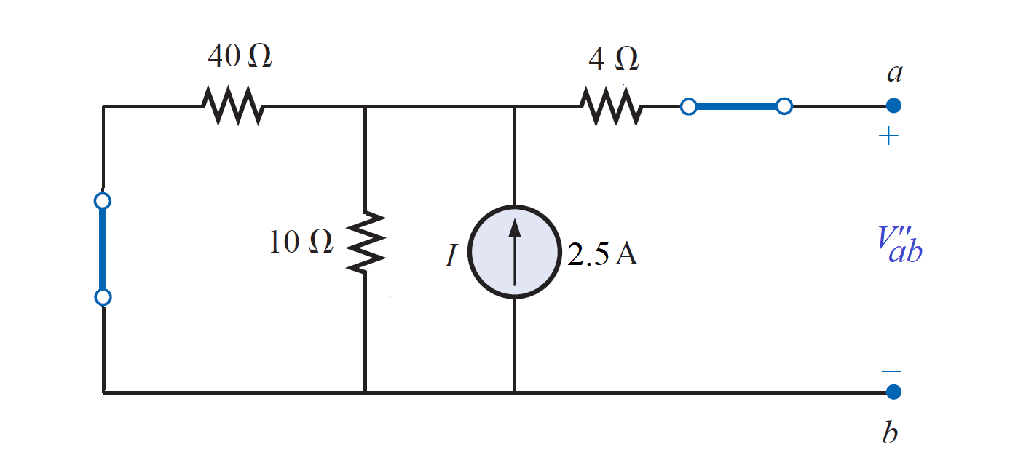
EXAMPLE 3:- Using superposition theorem to find the voltage V_{ab} in the circuit shown
2- Considering the effects of the 2.5-A source

Slide 55
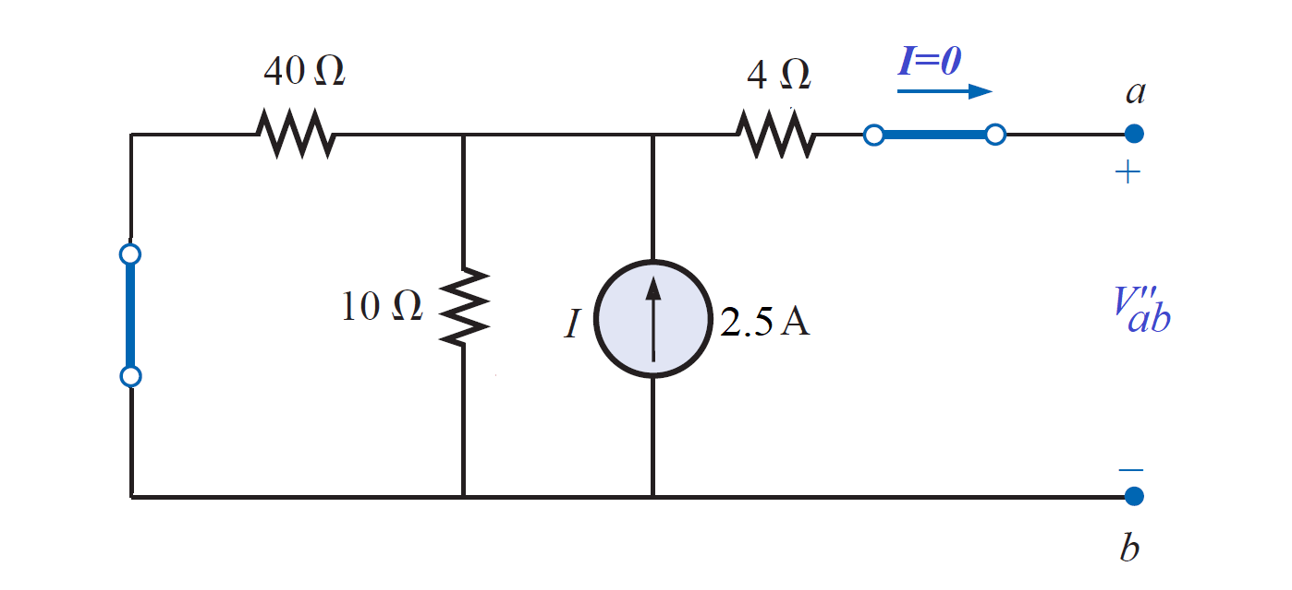
EXAMPLE 3:- Using superposition theorem to find the voltage V_{ab} in the circuit shown
2- Considering the effects of the 2.5-A source

Slide 56
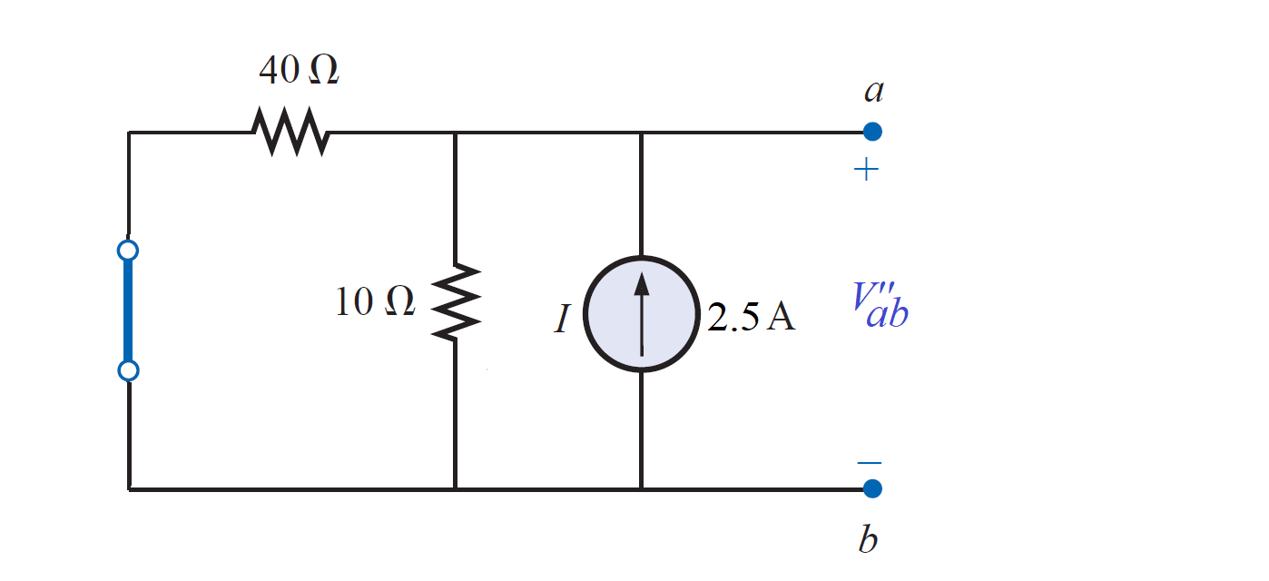
EXAMPLE 3:- Using superposition theorem to find the voltage V_{ab} in the circuit shown
2- Considering the effects of the 2.5-A source

Slide 57
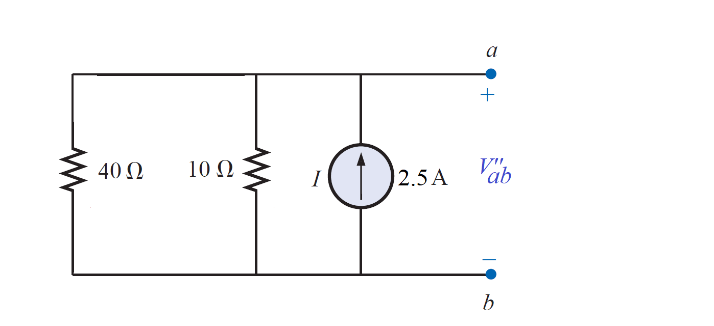
EXAMPLE 3:- Using superposition theorem to find the voltage V_{ab} in the circuit shown
2- Considering the effects of the 2.5-A source

Slide 58
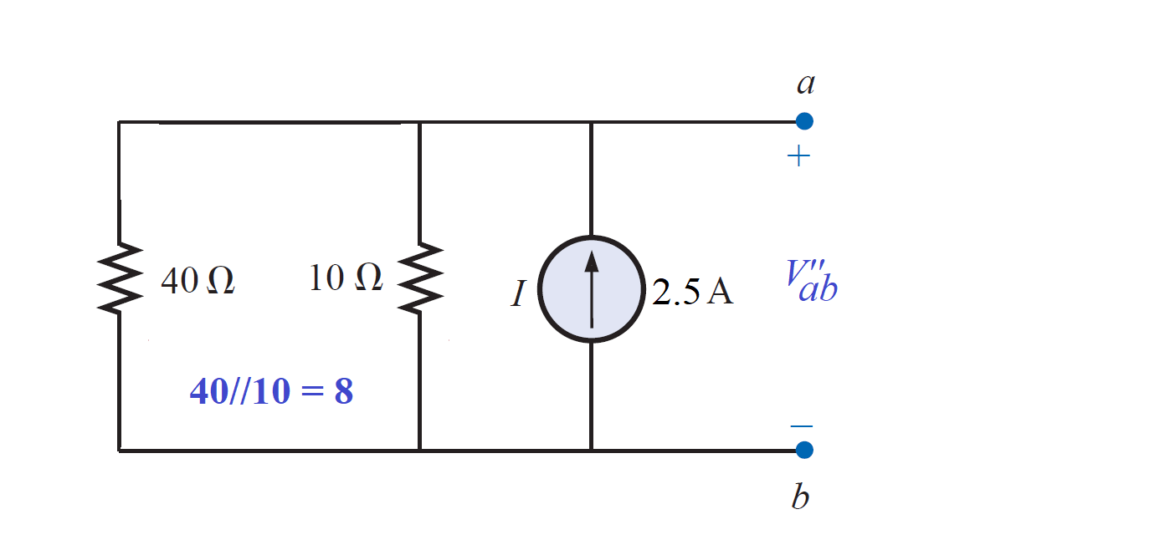
EXAMPLE 3:- Using superposition theorem to find the voltage V_{ab} in the circuit shown
2- Considering the effects of the 2.5-A source

Slide 59
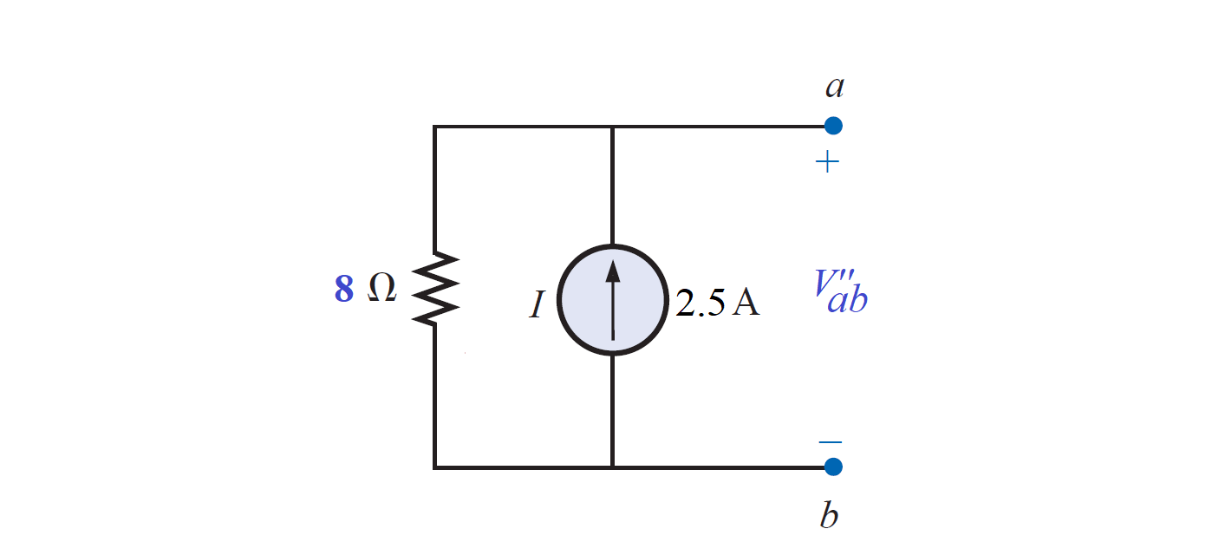
EXAMPLE 3:- Using superposition theorem to find the voltage V_{ab} in the circuit shown
2- Considering the effects of the 2.5-A source

Slide 60

EXAMPLE 3:- Using superposition theorem to find the voltage V_{ab} in the circuit shown
2- Considering the effects of the 2.5-A source
$${V′′}_{ab}=(2.5A)(8Ω)=20 V$$

Slide 61

EXAMPLE 3:- Using superposition theorem to find the voltage V_{ab} in the circuit shown
3- Considering the effects of the 12-V source

Slide 62

EXAMPLE 3:- Using superposition theorem to find the voltage V_{ab} in the circuit shown
3- Considering the effects of the 12-V source

Slide 63

EXAMPLE 3:- Using superposition theorem to find the voltage V_{ab} in the circuit shown
3- Considering the effects of the 12-V source

Slide 64

EXAMPLE 3:- Using superposition theorem to find the voltage V_{ab} in the circuit shown
3- Considering the effects of the 12-V source

Slide 65

EXAMPLE 3:- Using superposition theorem to find the voltage V_{ab} in the circuit shown
3- Considering the effects of the 12-V source

Slide 66

EXAMPLE 3:- Using superposition theorem to find the voltage V_{ab} in the circuit shown
3- Considering the effects of the 12-V source

Slide 67


EXAMPLE 3:- Using superposition theorem to find the voltage V_{ab} in the circuit shown
3- Considering the effects of the 12-V source
$$12 V$$

Slide 68

EXAMPLE 3:- Using superposition theorem to find the voltage V_{ab} in the circuit shown
3- Considering the effects of the 12-V source
$${V′′′}_{ab}=−12 V$$
$$12 V$$

Slide 69

EXAMPLE 3:- Using superposition theorem to find the voltage V_{ab} in the circuit shown

Slide 70
EXAMPLE 3:- Using superposition theorem to find the voltage V_{ab} in the circuit shown

Slide 71
EXAMPLE 3:- Using superposition theorem to find the voltage V_{ab} in the circuit shown

Slide 72
EXAMPLE 3:- Using superposition theorem to find the voltage V_{ab} in the circuit shown

Slide 73


EXAMPLE 3:- Using superposition theorem to find the voltage V_{ab} in the circuit shown
$$V_{ab}={V′}_{ab}+{V′′}_{ab}−{V′′′}_{ab}$$
$=3+20−12=11 V$

Slide 74
References
Boylestad, Robert L. Introductory circuit analysis. Pearson Education, 2010.
Robbins, Allan H., and Wilhelm C. Miller. Circuit analysis: Theory and practice. Cengage Learning, 2012.
Sadiku, Matthew NO, and Chales K. Alexander. Fundamentals of electric circuits. McGraw-Hill Higher Education, 2007.

