Slide 1


DIYALA UNIVERSITY
COLLEGE OF ENGINEERING
DEPARTMENT OF COMMUNICATION ENGINEERING
Electronic Circuits II
Second Year. Lecture 8
lecturer
Wisam Hayder
2021

Slide 2
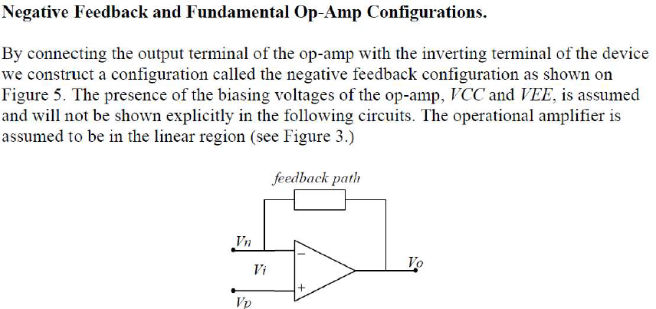
Operational Amplifiers (Op-Amp)
Notes:
aaa

Slide 3
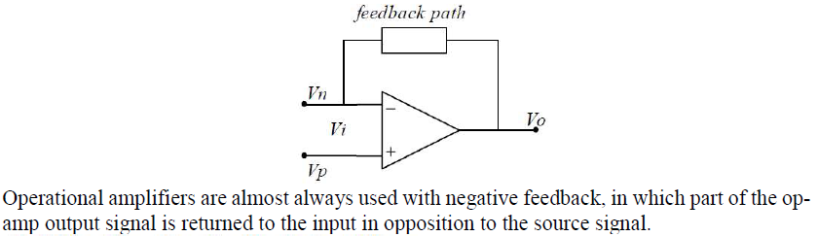
Operational Amplifiers (Op-Amp)
Notes:
aaa

Slide 4
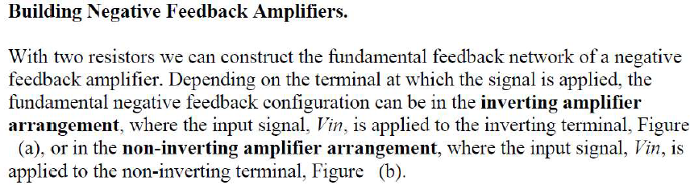
Operational Amplifiers (Op-Amp)
Notes:
aaa

Slide 5
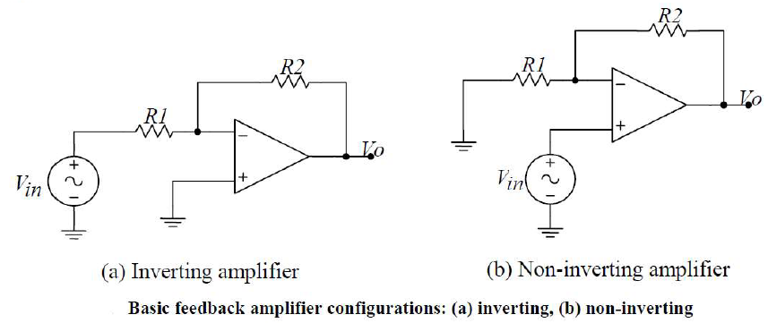
Operational Amplifiers (Op-Amp)
Notes:
aaa

Slide 6
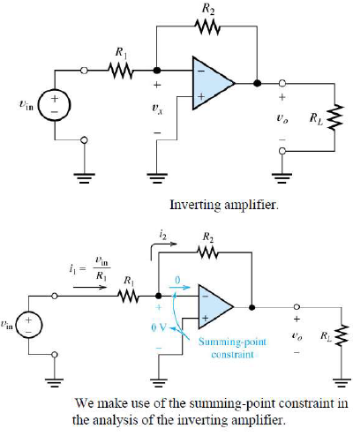
Operational Amplifiers (Op-Amp)

Slide 7
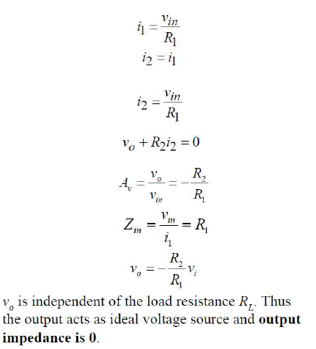
Operational Amplifiers (Op-Amp)
Notes:
aaa

Slide 8
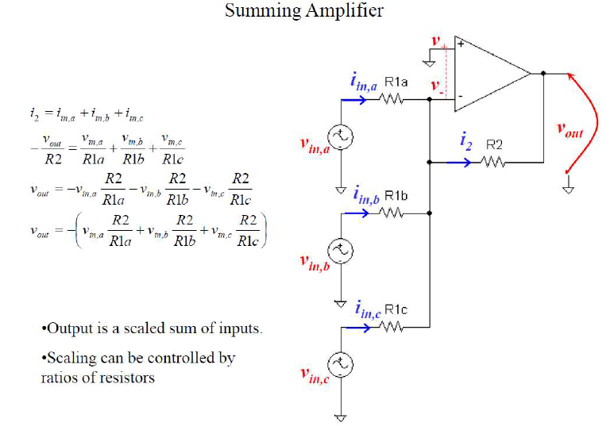
Operational Amplifiers (Op-Amp)
Notes:
aaa

Slide 9
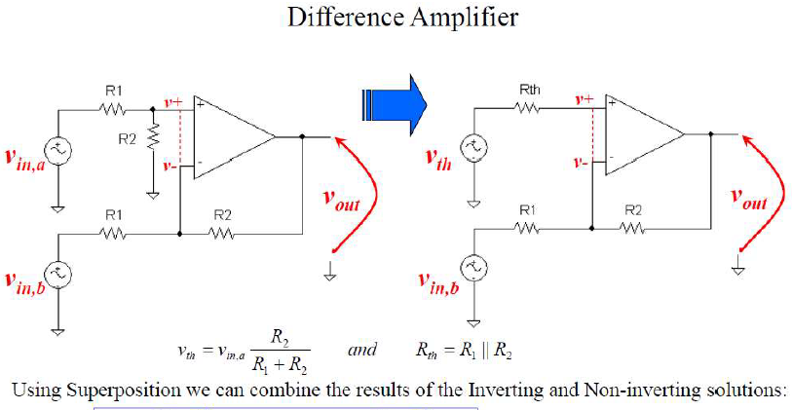
Operational Amplifiers (Op-Amp)
Notes:
aaa

Slide 10
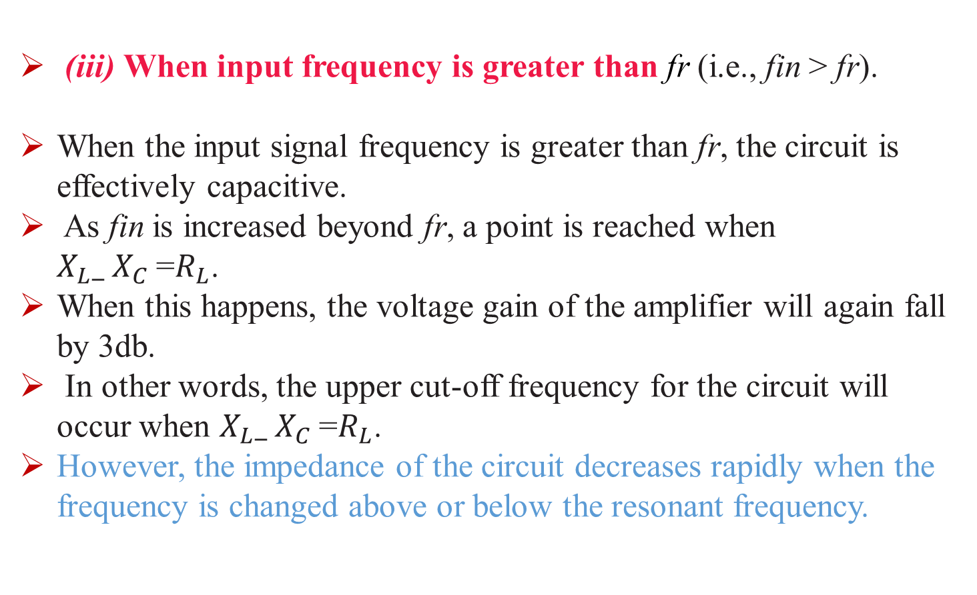
Operational Amplifiers (Op-Amp)
(iii) When input frequency is greater than fr (i.e., fin > fr).
When the input signal frequency is greater than fr, the circuit is effectively capacitive.
As fin is increased beyond fr, a point is reached when $X_{L}_{ X}_{C}$=$R_{L}$.
When this happens, the voltage gain of the amplifier will again fall by 3db.
In other words, the upper cut-off frequency for the circuit will occur when $X_{L}_{ X}_{C}$=$R_{L}$.
However, the impedance of the circuit decreases rapidly when the frequency is changed above or below the resonant frequency.
Notes:
aaa

Slide 11
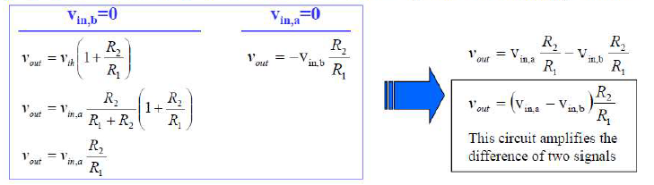
Operational Amplifiers (Op-Amp)
Notes:
aaa

Slide 12
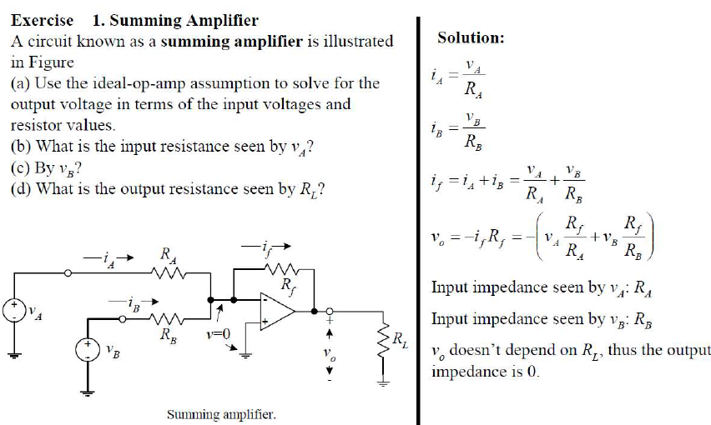
Operational Amplifiers (Op-Amp)
Notes:
aaa

Slide 13
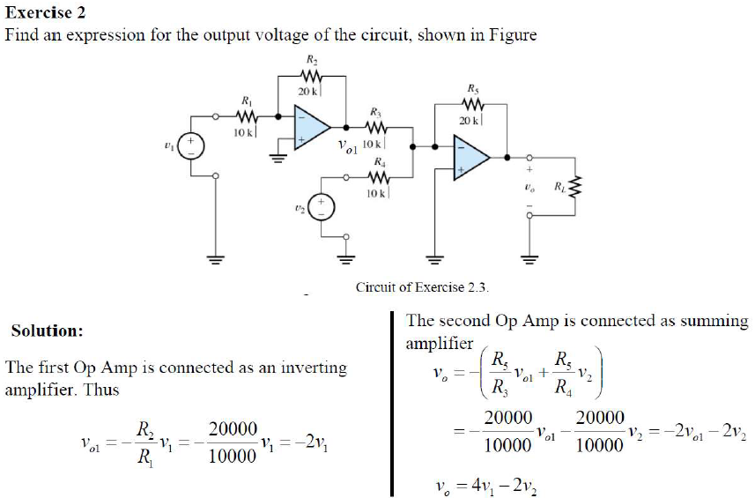
Operational Amplifiers (Op-Amp)
Notes:
aaa

Slide 14
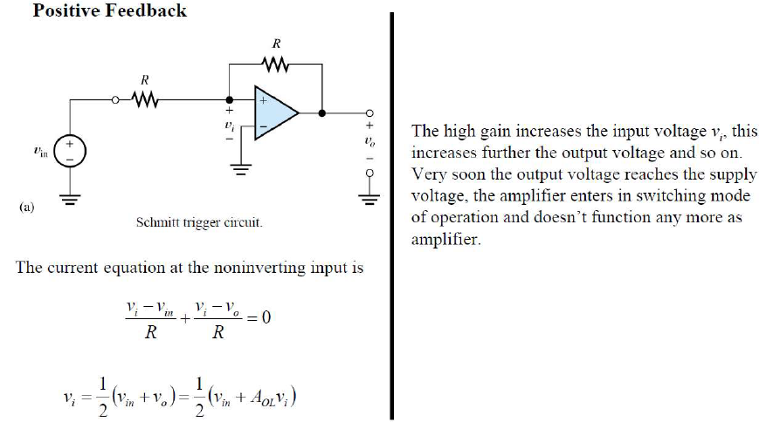
Operational Amplifiers (Op-Amp)
Notes:
aaa

Slide 15
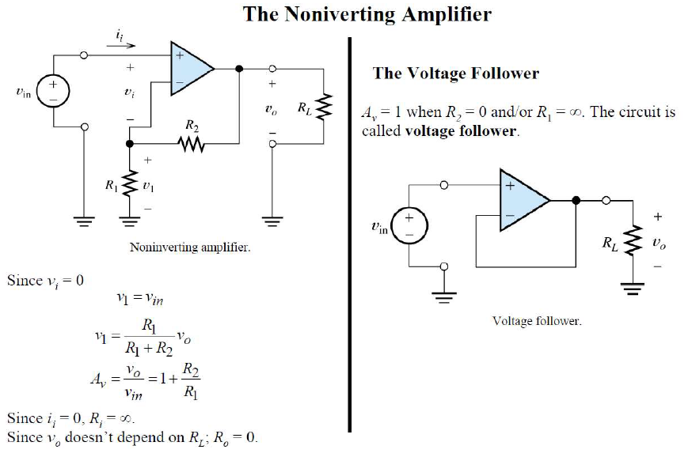
Operational Amplifiers (Op-Amp)
Notes:
aaa

Slide 16
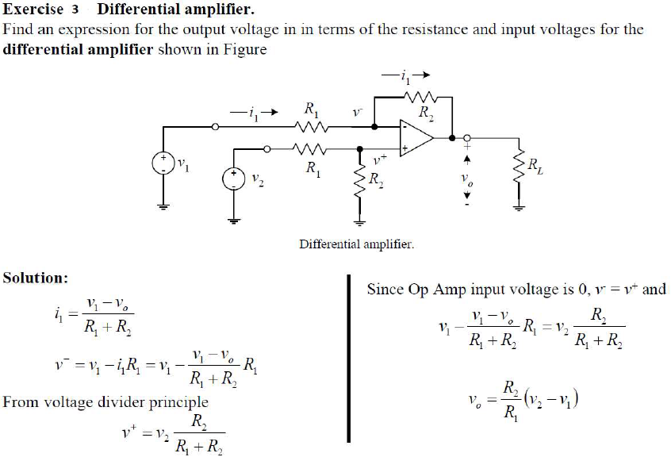
Operational Amplifiers (Op-Amp)
Notes:
aaa

Slide 17
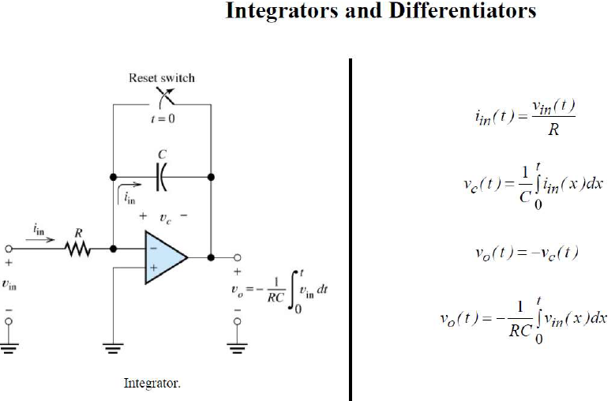
Operational Amplifiers (Op-Amp)
Notes:
aaa

Slide 18
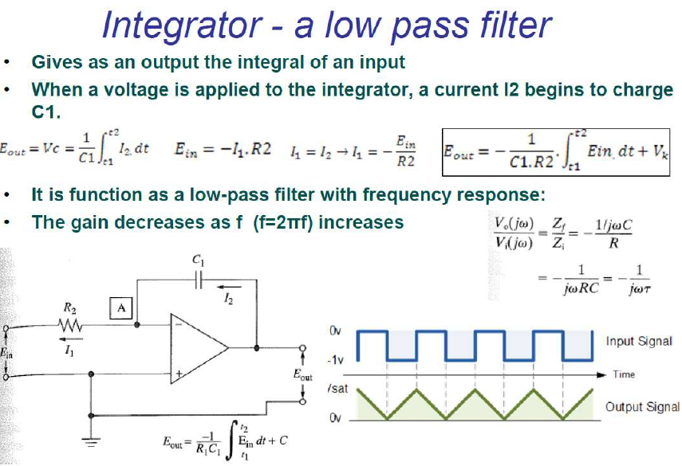
Operational Amplifiers (Op-Amp)

Slide 19
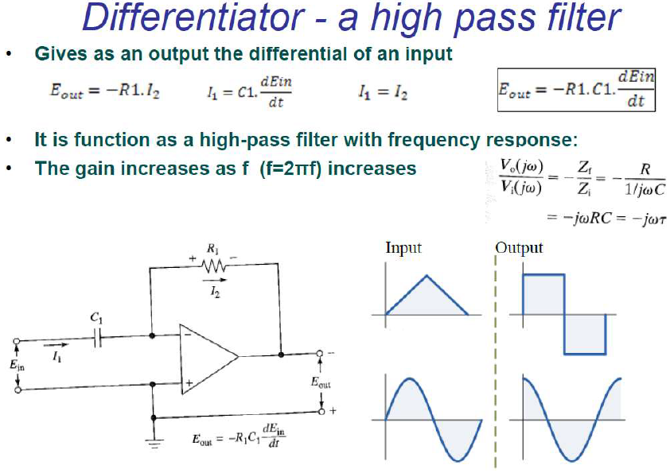
Operational Amplifiers (Op-Amp)

Slide 20
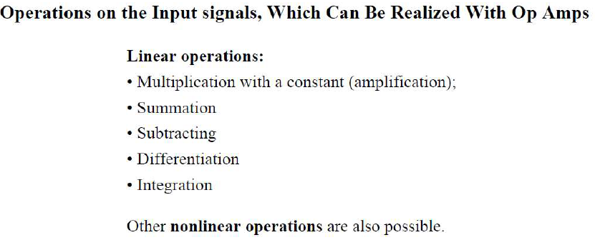
Operational Amplifiers (Op-Amp)
20

Slide 21
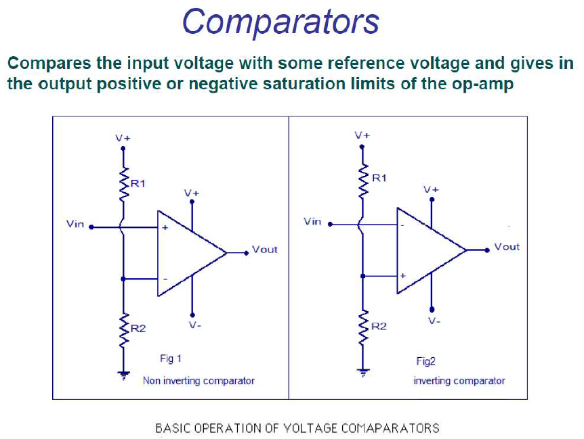
Operational Amplifiers (Op-Amp)

Slide 22
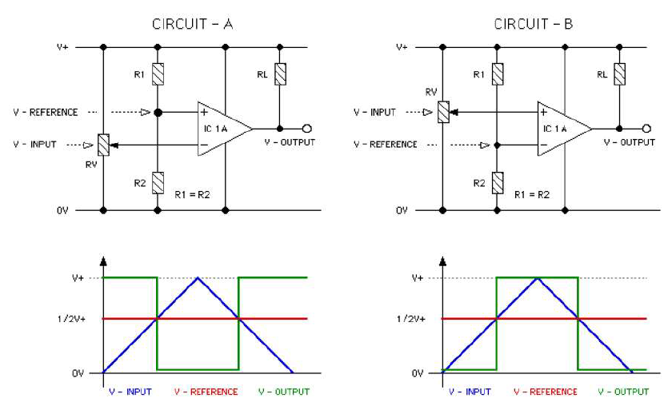
Operational Amplifiers (Op-Amp)

