Slide 1

DIYALA UNIVERSITY
COLLEGE OF ENGINEERING
DEPARTMENT OF COMMUNICATIONS ENGINEERING
Electronic Circuits I
Second Year_ Lecture 4
By
Asst. lecturer
Wisam Hayder
2020 - 2021

Slide 2
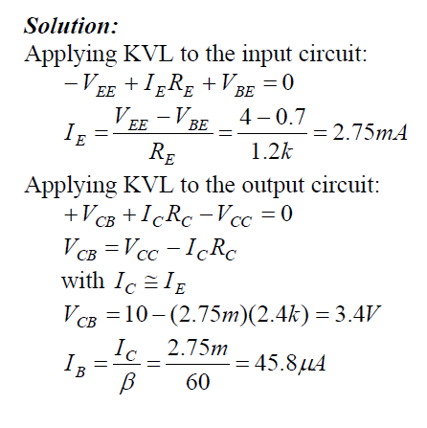
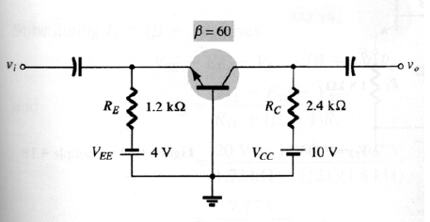

Examples
Example 1: (Common-Base)
Determine$V_{CB}$ and $I_{B}$for the common-base configuration of Fig. 1.
Fig. 1
Notes:
aaa

Slide 3
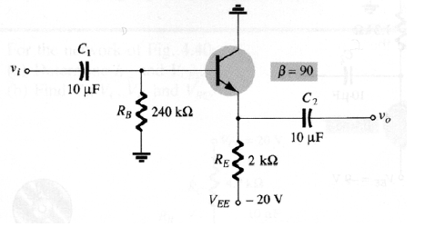
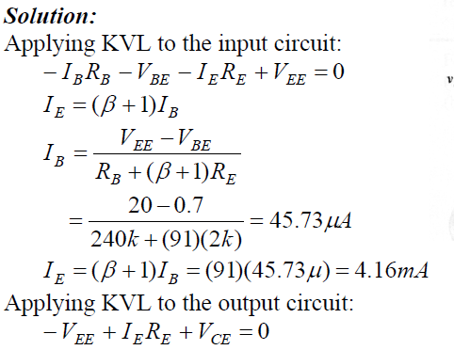

Examples
Example 2: (Common-Collector)
Determine $I_{E}$ and $V_{CE}$ for the common-collector (emitter-follower) configuration of Fig. 2.
Fig. 2
Notes:
aaa

Slide 4
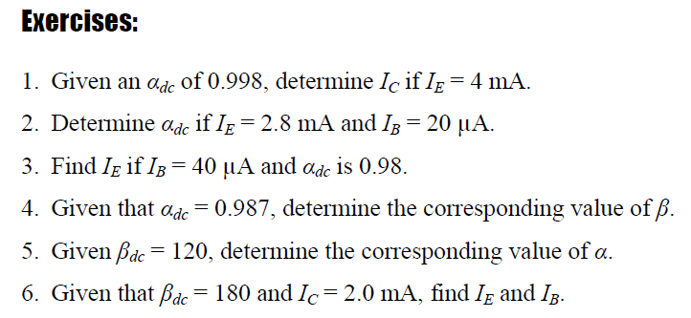
Different Exercises
Notes:
aaa

Slide 5
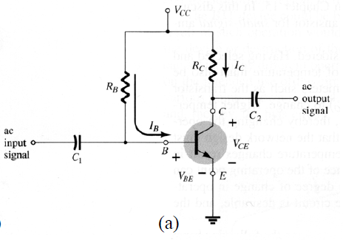
Standard Biasing Circuits:
1. Fixed-Bias Circuit:
Fig. 3-a shows a fixed-bias circuit.
Fig. 3
Notes:
aaa

Slide 6
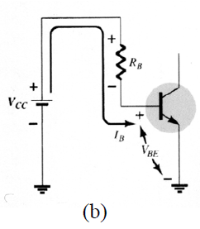
Analysis:
For the input (base-emitter circuit) loop
As shown in Fig. 3-b:
[3.1a]
Fig. 3
Notes:
aaa

Slide 7
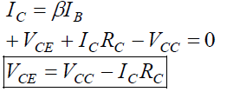
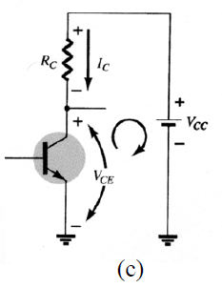
Analysis:
For the output (collector-emitter circuit) (a)
loop as shown in Fig. 3-c:
[3.1b]
Fig. 3
Notes:
aaa

Slide 8

Analysis:
For the transistor terminal voltages:
[3.1c]
Load-Line Analysis:
From Eq. [3.1b] and Fig. 4:
At cutoff region:
[3.2a]
Gökhan Görhan et al.[2016] studied the influence of curing procedures on the properties of fly ash based geopolymer paste containing metakaolin.
They used fly ash as the main binding material in the preparation of geopolymer paste and metakaolin replaced with fly ash between 10% to 40% in the mixture and sodium hydroxide was used as an alkali activator.
The samples were subjected to curing at 60°C and 80°C for 2 hours, 4 hours and 24 hours.
They were concluded that optimal curing temperature and time were 60°C and 2 hours.
Notes:
aaa

Slide 9

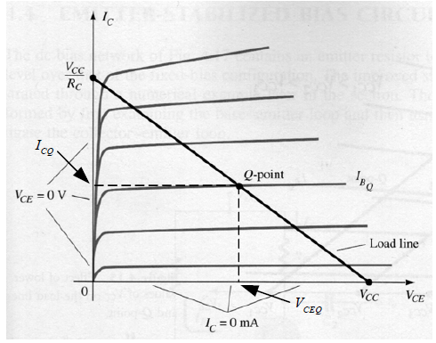
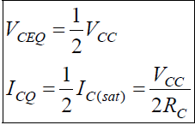
Load-Line Analysis:
At saturation region:
[3.2b]
Design:
For an optimum design:
[3.3]
Fig. 4
Notes:
aaa

Slide 10
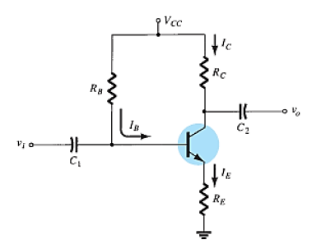
2. Emitter-Stabilized Bias Circuit:
Fig. 5a shows an emitter-stabilized bias circuit.
(a)
Fig. 5
Notes:
aaa

Slide 11
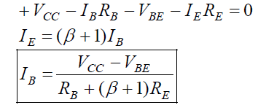
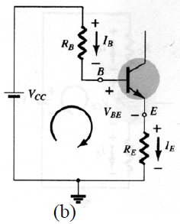
Analysis:
Analysis:
For the input (base-emitter circuit) loop as shown in Fig. 5b:
[ [5a]
Fig. 5
Notes:
aaa

Slide 12
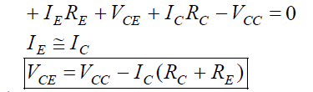
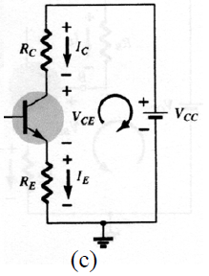
Analysis:
For the output (collector-emitter circuit) loop as shown in Fig. 5c:
[5b]
Fig. 5
Notes:
aaa

Slide 13
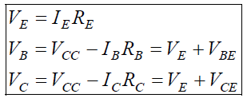
Analysis:
For the transistor terminal voltages:
[5 c]
Notes:
aaa

Slide 14
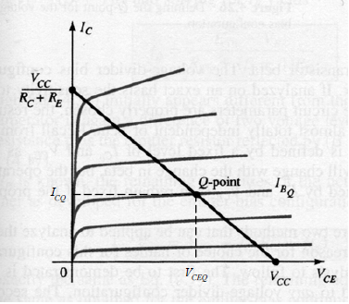

Load-Line Analysis:
From Eq. [5b] and Fig. 6:
At cutoff region:
At saturation region:
6 a
6 b
Fig. 6
Notes:
aaa

Slide 15
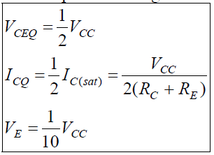
Design:
For an optimum design:
7
Notes:
aaa

Slide 16
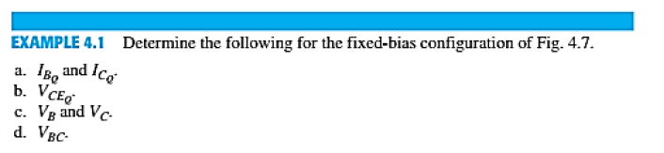
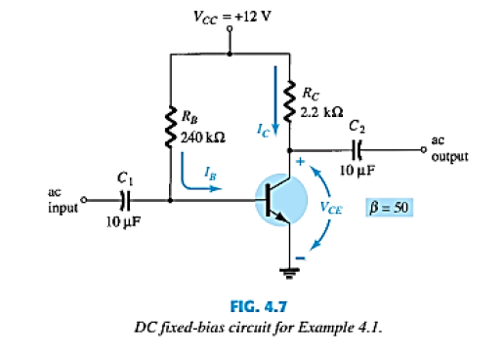
Examples
Notes:
aaa

Slide 17

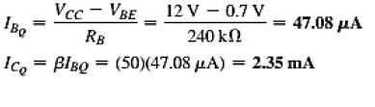
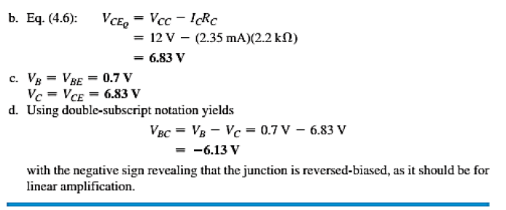
Examples
a
Notes:
aaa

Slide 18
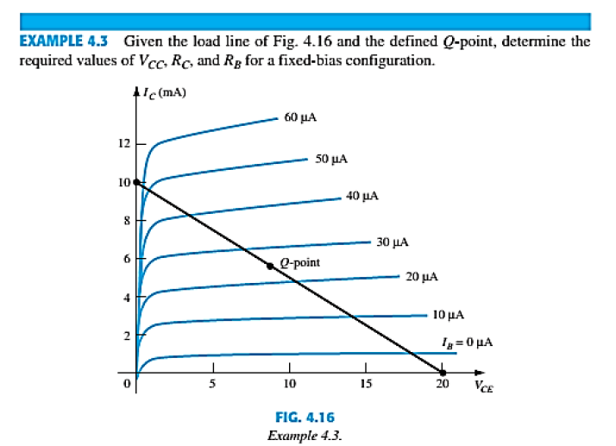
Examples
Notes:
aaa

Slide 19
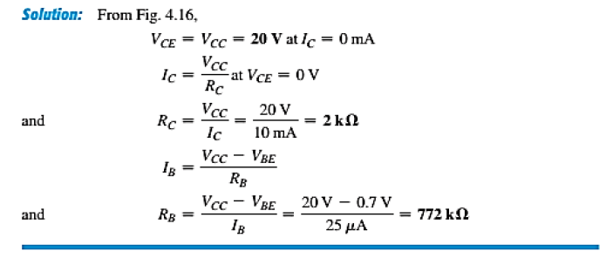
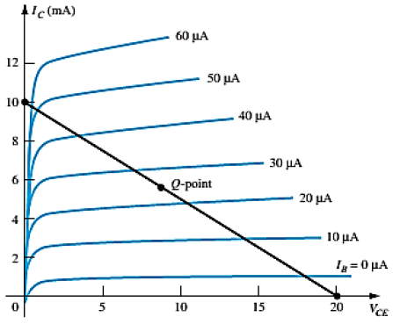
Examples
Notes:
aaa

Slide 20
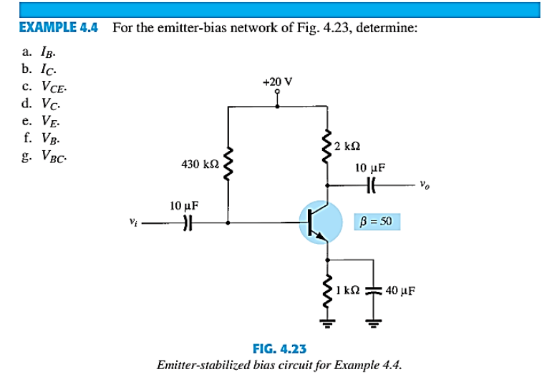
Examples
Notes:
aaa

Slide 21
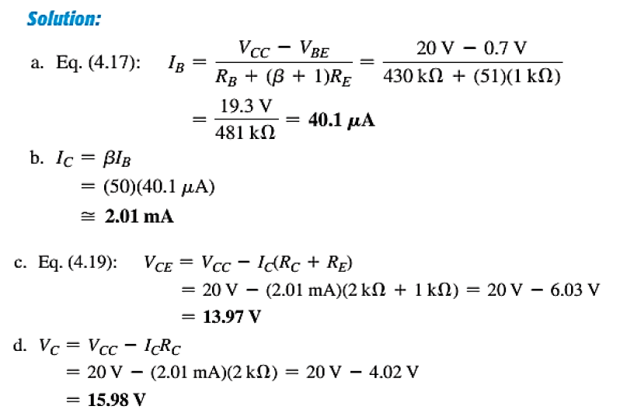
Examples
Test
Notes:
aaa

Slide 22
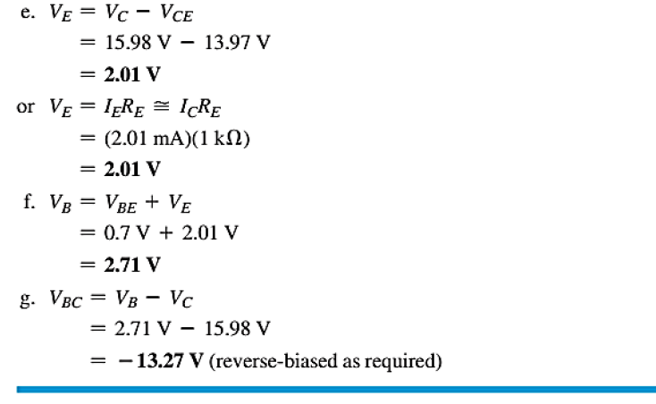
Examples
Test
Notes:
aaa

Slide 23
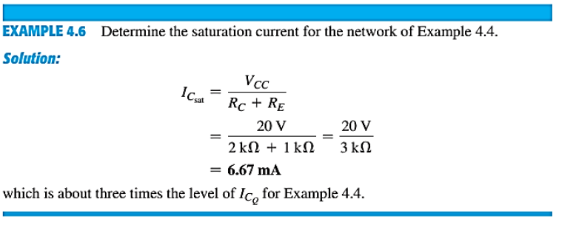
Examples
Notes:
aaa

Slide 24
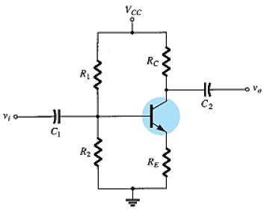
3. Voltage-Divider Bias Circuit:
Analyses:
Fig. 7 a shows a voltage-divider bias circuit.
For the input (base-emitter circuit) loop:
(a)
Fig. 7
Notes:
aaa

Slide 25
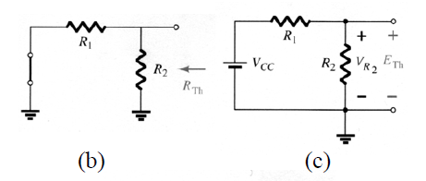


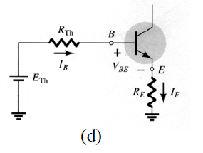
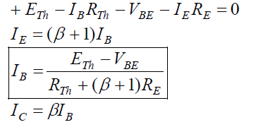
Exact Analysis
From Fig. 7 b:
From Fig. 7 c:
From Fig. 7 d:
7 a
7 b
7 c
Notes:
aaa

Slide 26
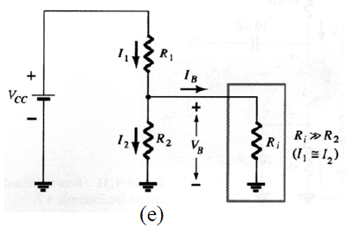
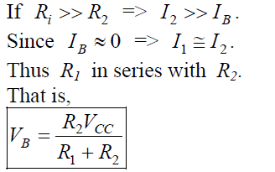
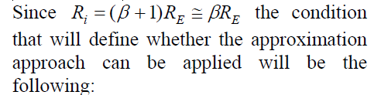
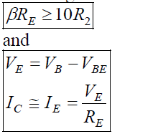
Approximate Analysis:
From Fig. 7e:
8 a
8 b
8 c
Notes:
aaa

Slide 27

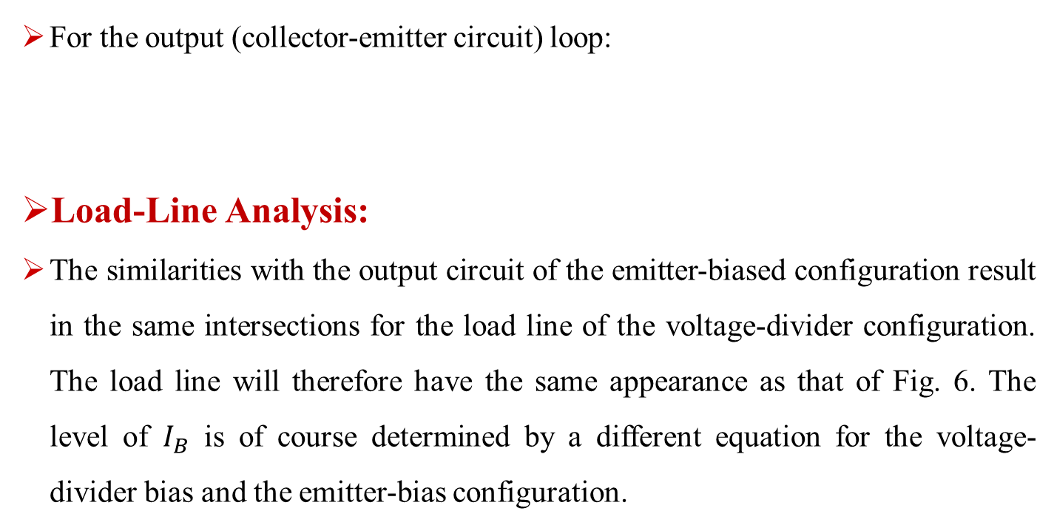
For the output (collector-emitter circuit) loop:
Load-Line Analysis:
The similarities with the output circuit of the emitter-biased configuration result in the same intersections for the load line of the voltage-divider configuration. The load line will therefore have the same appearance as that of Fig. 6. The level of $I_{B}$ is of course determined by a different equation for the voltage-divider bias and the emitter-bias configuration.
9
Notes:
aaa

Slide 28
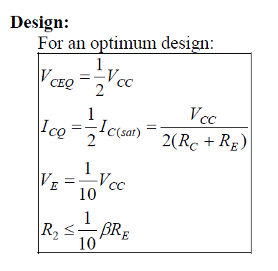
Design:
10
Notes:
aaa

Slide 29
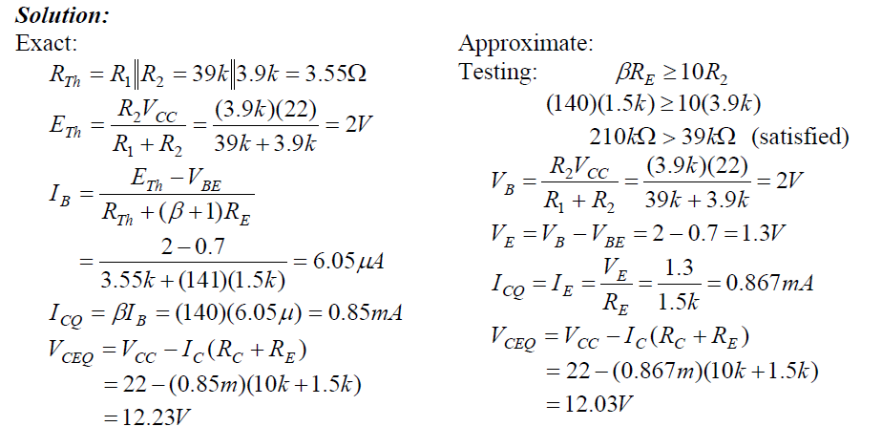
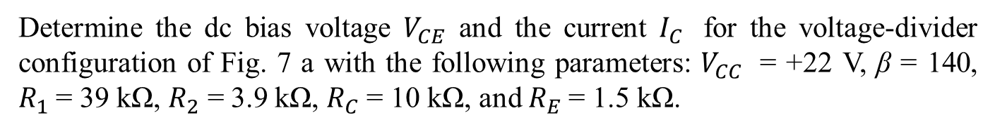
Example:
Determine the dc bias voltage $V_{CE}$ and the current $I_{C}$ for the voltage-divider configuration of Fig. 7 a with the following parameters: $V_{CC}$ = +22 V, β = 140, $R_{1}$= 39 kΩ, $R_{2}$ = 3.9 kΩ, $R_{C}$= 10 kΩ, and $R_{E}$= 1.5 kΩ.
Notes:
aaa

