Slide 1
Eighth Lecture Linux internals and services
Sabah Anwer Abdulkareem
University of Diyala, College of Engineering, Department of Computer Engineering

Slide 2
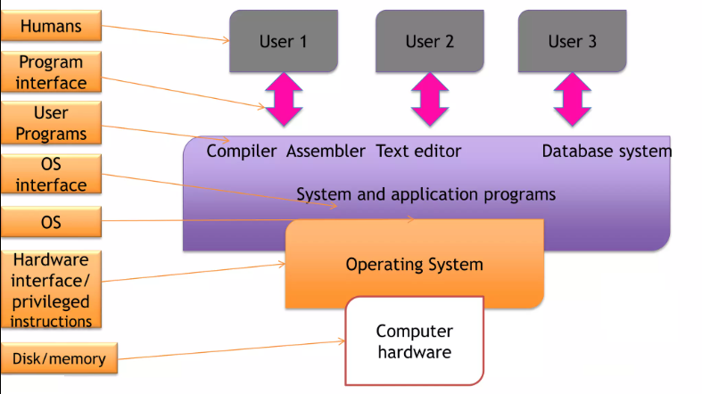
Operating System

Slide 3
Components
✓ Hardware Controllers: This subsystem is comprised of all the possible physical devices in a Linux installation
✓ Linux kernel: The kernel abstracts and mediates access to the hardware resources, including the CPU. A kernel is the core of the operating system
✓ O/S Services: These are services that are typically considered part of the operating system (e.g. shell)
✓ User Applications: The set of applications in use on a particular Linux system. (e.g. web-browser)

Slide 4
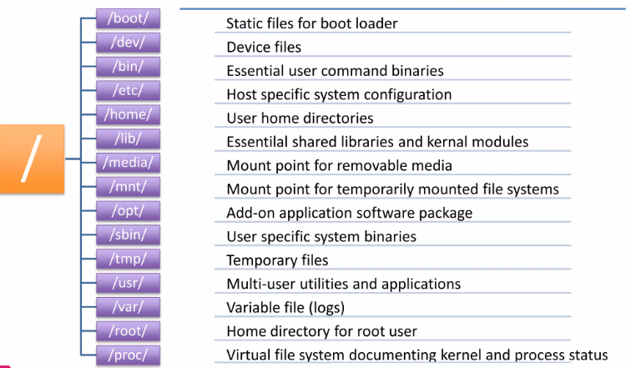
Directory Structure

Slide 5
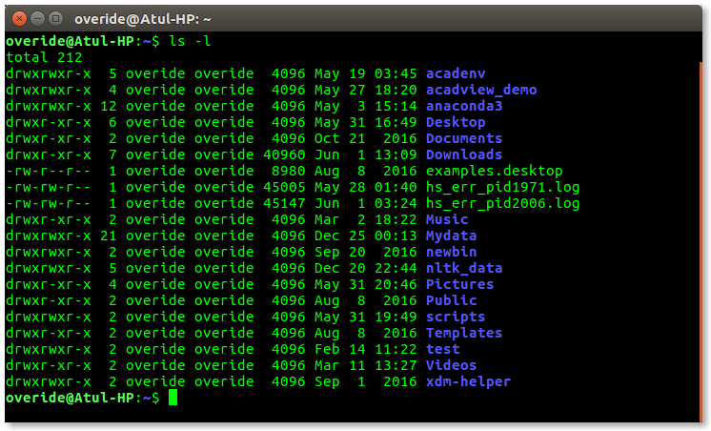
Shell: Shell is broadly classified into two categories –
1- Command Line Shell
Texture Mode
Executes requested command

Slide 6
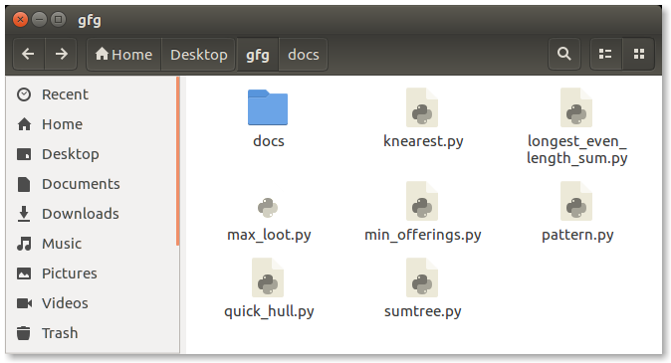
Shell: Shell is broadly classified into two categories –
2- Graphical shell
Mouse
Keyboard

Slide 7
Linux Services
A service is a program that runs in the background outside the interactive control of system users as they lack an interface. This in order to provide even more security, because some of these services are crucial for the operation of the operating system.
On the other hand, in systems like Unix or Linux, the services are also known as daemons. Sometimes the name of these services or daemons ends with the letter d. For example, sshd is the name of the service that handles SSH.

Slide 8
some of the Linux services are:
httpd
mysql
postgresql
proftpd
bluetooth
apparmor
cups
And many more applications are managed through a service.

Slide 9
How to List Services in Linux
First, we have to connect to our server using SSH.
we need to be the root user to list service in Linux.
we can list all services in Linux. To do it, run the command:
sudo systemctl list-unit-files --type service –all
SU

Slide 10
When the command is run, we will see all the services that are on the system. However, we will have a defined status.
Enabled services are currently running. They usually have no problems.
Disabled services are not active but can be activated at any time without a problem.
Masked services won’t run unless we take that property away from them.
Static services will only be used in case another service or unit needs it.
Finally, there are services generated through a SysV or LSB initscript with systemd generator.

Slide 11
In case we want to know only the services that are active, we have to use a command together with grep, like so:
sudo systemctl | grep running

Slide 12
Managing Linux Services
sudo systemctl stop [service_name]
Note that each service represents software that works differently. we will only show how to start, check the status of and stop services – the basic controls
To start a service on Linux, we need to run the following command:
If the service is correctly configured, it will start. if we want to stop it, we will use the following command:
sudo systemctl start [service_name]
sudo systemctl start [service_name]

Slide 13
to check the status of a service we can use:
It is also possible to have a service run while the operating system is being loaded
Or remove it from the initial load:
sudo systemctl status [service_name]
sudo systemctl enable [service_name]
sudo systemctl disable [service_name]

Slide 14
we will use netstat. To install it on Ubuntu, we just run:
Then, we run the following command:
The output will give us all the required network information.
sudo apt install netstat-nat
sudo netstat -plnt

