Slide 1
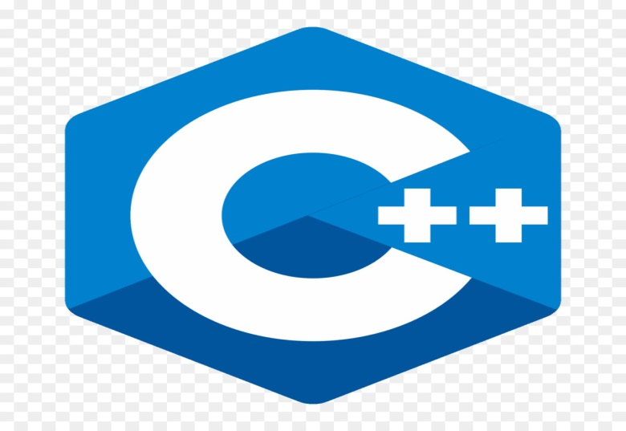
Introduction to programming with C++
C++ Introduction
Chapter Six

Slide 2
C++ Conditions and If Statements
C++ supports the usual logical conditions from mathematics:
Less than: a < b
Less than or equal to: a <= b
Greater than: a > b
Greater than or equal to: a >= b
Equal to a == b
Not Equal to: a != b
You can use these conditions to perform different actions for different decisions.

Slide 3
C++ Conditions and If Statements(cont'd.)
C++ has the following conditional statements:
Use if to specify a block of code to be executed, if a specified condition is true.
Use else to specify a block of code to be executed, if the same condition is false.
Use else if to specify a new condition to test, if the first condition is false.
Use switch to specify many alternative blocks of code to be executed.

Slide 4
The if Statement
Use the if statement to specify a block of C++ code to be executed if a condition is true.
Syntax:
if (condition )
{
// block of code to be executed if the condition is true
}
If boolean expression evaluates to false, then the first set of code after the end of the if statement (after the closing curly brace) will be executed.
Note that if is in lowercase letters. Uppercase letters (If or IF) will generate an error.

Slide 5
The if Statement(cont'd.)
In the example below, we test two values to find out if 20 is greater than 18. If the condition is true, print some text:
#include <iostream>
using namespace std;
int main()
{
if (20 > 18)
{
cout << "20 is greater than 18";
}
return 0;
}

Slide 6
The if Statement(cont'd.)
We can also test variables:
Example:
#include <iostream>
using namespace std;
int main()
{
int x = 20;
int y = 18;
if (x > y)
{
cout << "x is greater than y";
}
return 0;
}

Slide 7
The if Statement(cont'd.)
Example explained:
In the example above we use two variables, x and y, to test whether x is greater than y (using the > operator). As x is 20, and y is 18, and we know that 20 is greater than 18, we print to the screen that "x is greater than y".
Exercise:
Print "Hello World" if x is greater than y.

Slide 8
The if Statement(cont'd.)
#include <iostream>
using namespace std;
int main()
{
int x = 50;
int y = 10;
if(x>y)
{
cout << "Hello World";
}
return 0;
}

Slide 9
C++ else Statement
Use the else statement to specify a block of code to be executed if the condition is false.
Syntax:
if (condition)
{
// block of code to be executed if the condition is true
}
else
{
// block of code to be executed if the condition is false
}

Slide 10
C++ else Statement(cont'd.)
Example:
#include <iostream>
using namespace std;
int main()
{
int time = 20;
if (time < 18)
{
cout << "Good day.";
}
else
{
cout << "Good evening.";
}
return 0;
}

Slide 11
C++ else Statement(cont'd.)
Example explained.
In the example above, time (20) is greater than 18, so the condition is false. Because of this, we move on to the else condition and print to the screen "Good evening". If the time was less than 18, the program would print "Good day".

Slide 12
C++ else if Statement
Use the else if statement to specify a new condition if the first condition is false.
Syntax:
if (condition1) {
// block of code to be executed if condition1 is true
} else if (condition2) {
// block of code to be executed if the condition1 is false and condition2 is true
} else {
// block of code to be executed if the condition1 is false and condition2 is false
}

Slide 13
C++ else if Statement(cont'd.)
Example:
#include <iostream>
using namespace std;
int main()
{
int time = 22;
if (time < 10)
{
cout << "Good morning.";
}
else if (time < 20) {
cout << "Good day.";
} else {
cout << "Good evening.";
}
return 0;
}

Slide 14
C++ else if Statement(cont'd.)
Example explained
In the example above, time (22) is greater than 10, so the first condition is false. The next condition, in the else if statement, is also false, so we move on to the else condition since condition1 and condition2 is both false - and print to the screen "Good evening".
However, if the time was 14, our program would print "Good day."

Slide 15
C++ Switch Statements
Use the switch statement to select one of many code blocks to be executed.
Syntax:
switch(expression) {
case x:
// code block
break;
case y:
// code block
break;
default:
// code block
}

Slide 16
C++ Switch Statements(cont'd.)
This is how it works:
The switch expression is evaluated once.
The value of the expression is compared with the values of each case.
If there is a match, the associated block of code is executed.
The break and default keywords are optional, and will be described later in this chapter.

Slide 17
C++ Switch Statements(cont'd.)
The example below uses the weekday number to calculate the weekday name:
#include <iostream>
using namespace std;
int main()
{
int day = 4;
switch (day)
{
case 1:
cout << "Monday";
break;
case 2:
cout << "Tuesday";
break;

Slide 18
C++ Switch Statements(cont'd.)
case 3:
cout << "Wednesday";
break;
case 4:
cout << "Thursday";
break;
case 5:
cout << "Friday";
break;
case 6:
cout << "Saturday";
break;
case 7:
cout << "Sunday";
break;
}
return 0;
}

Slide 19
The break Keyword
When C++ reaches a break keyword, it breaks out of the switch block.
This will stop the execution of more code and case testing inside the block.
When a match is found, and the job is done, it's time for a break. There is no need for more testing.
A break can save a lot of execution time because it "ignores" the execution of all the rest of the code in the switch block.

Slide 20
The default Keyword
The default keyword specifies some code to run if there is no case match:
Note: The default keyword must be used as the last statement in the switch, and it does not need a break.
Example:
#include <iostream>
using namespace std;
int main()
{
int day = 4;

Slide 21
The default Keyword(cont'd.)
switch (day) {
case 6:
cout << "Today is Saturday";
break;
case 7:
cout << "Today is Sunday";
break;
default:
cout << "Looking forward to the Weekend";
}
return 0;
}

