Slide 1



محاضرة بمادة التقنيات الرقمية
م.د حسين فالح مهدي
جامعة ديالى
كلية الهندسة –قسم هندسة الحاسبات
2021-2022
Combinational Logic Circuits -4

Slide 2
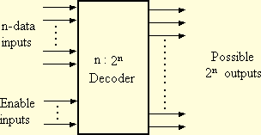
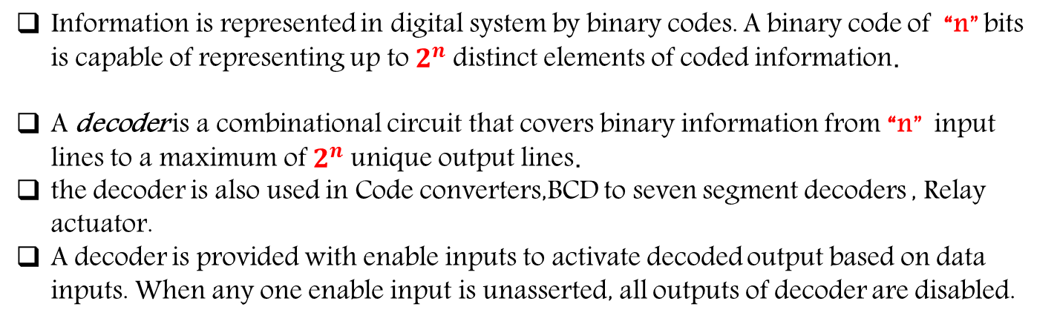
Decoder circuit
Information is represented in digital system by binary codes. A binary code of “n” bits is capable of representing up to $2^{n}$ distinct elements of coded information.
A decoder is a combinational circuit that covers binary information from “n” input lines to a maximum of $2^{n}$ unique output lines.
the decoder is also used in Code converters,BCD to seven segment decoders , Relay actuator.
A decoder is provided with enable inputs to activate decoded output based on data inputs. When any one enable input is unasserted, all outputs of decoder are disabled.

Slide 3
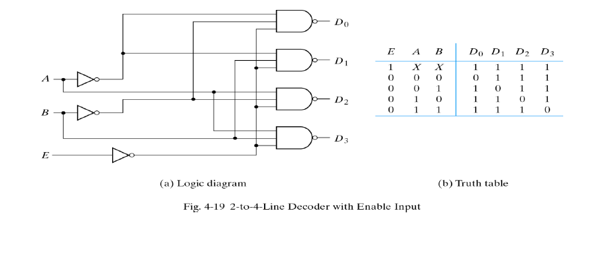
2 to 4 Line Decoder Active Low
Here the 2 inputs are decoded into 4 outputs, each output representing one of the minterms of the two input variables.
If enable input is (EN= 0 active Low or 1 active High ) only one of the outputs (Y0 – Y3), is active for a given input.

Slide 4
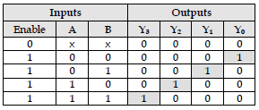
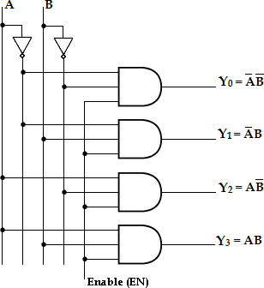

2 to 4 Line Decoder Active High

Slide 5
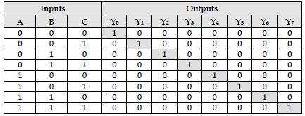
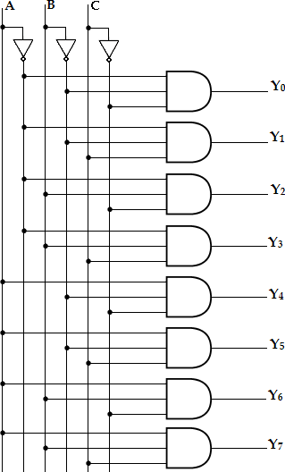
3-to-8 Line Decoder Active High Output
A 3-to-8 line decoder has three inputs (A, B, C) and eight outputs (Y0- Y7). Based on the 3 inputs one of the eight outputs is selected.
This decoder is used for binary-to-octal conversion.

Slide 6
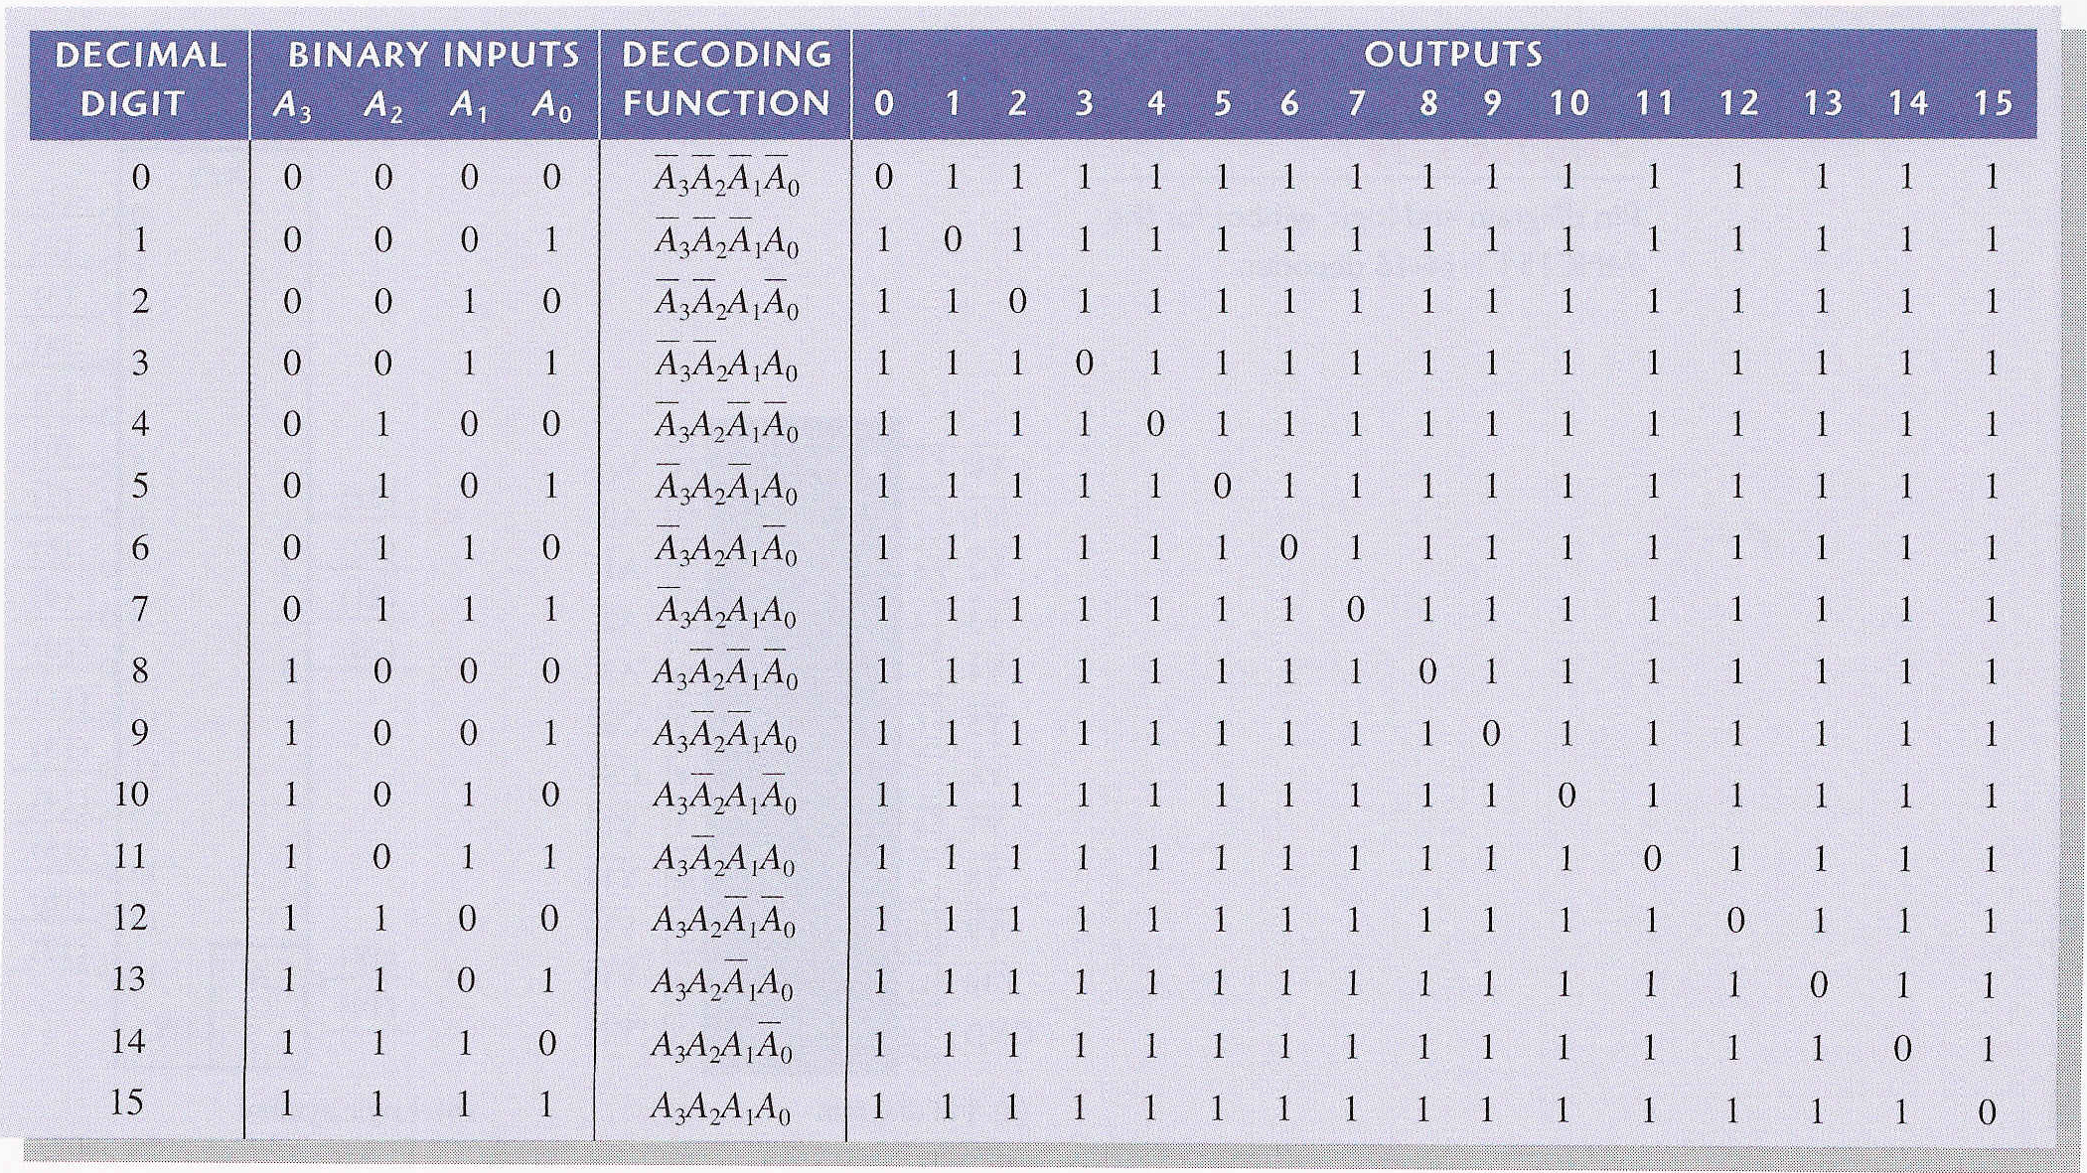
4- to-16 Line Decoder active low output

Slide 7
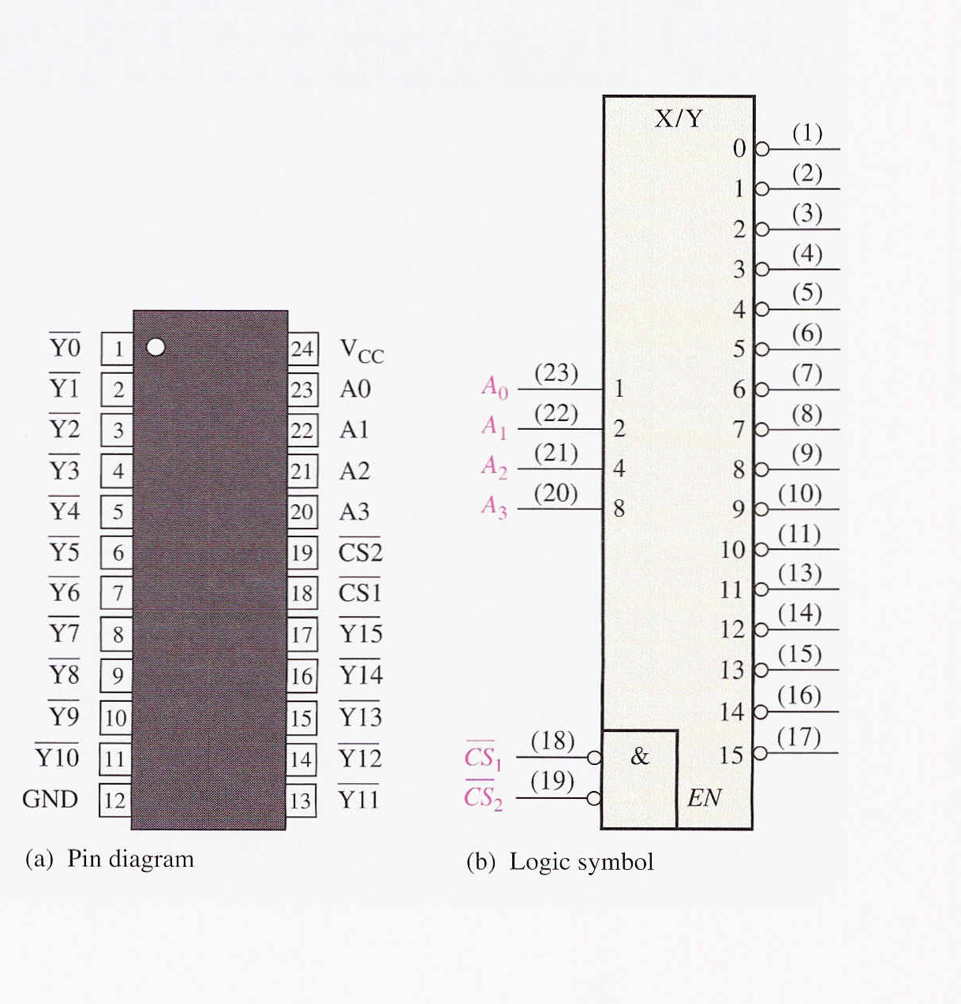

Slide 8
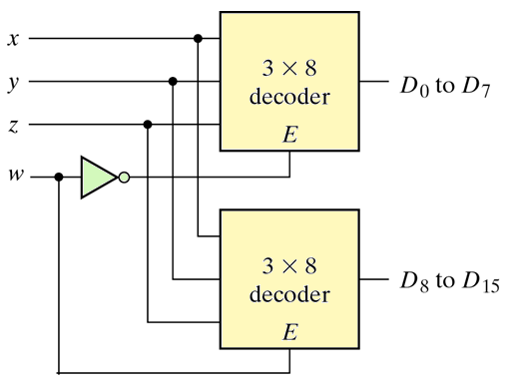
Decoder expansion
Example / Draw 4 to 16 Decoder using 3 to 8 Decoder?

Slide 9
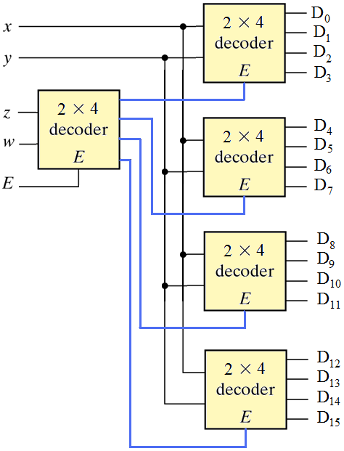
Decoder expansion
Example / Draw 4 to 16 Decoder using 2 to 4 Decoder?

Slide 10
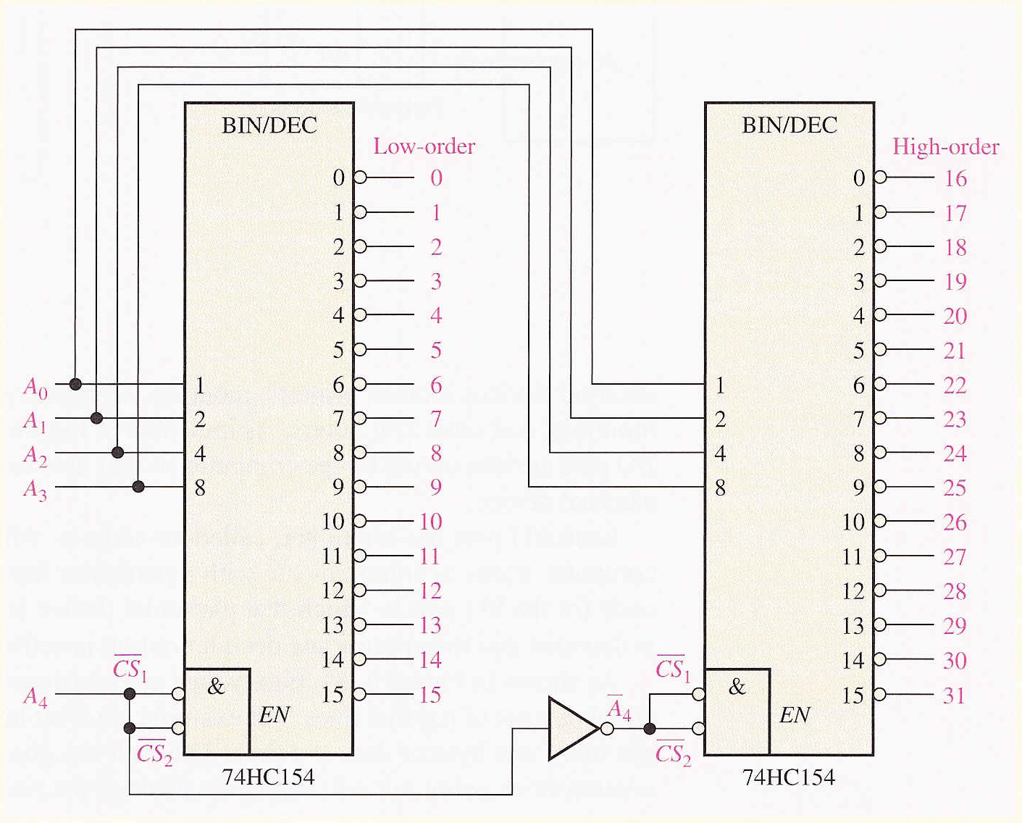
Decoder expansion
Example / Draw 5 to 32 Decoder using 4 to 16 Decoder active low output?

Slide 11
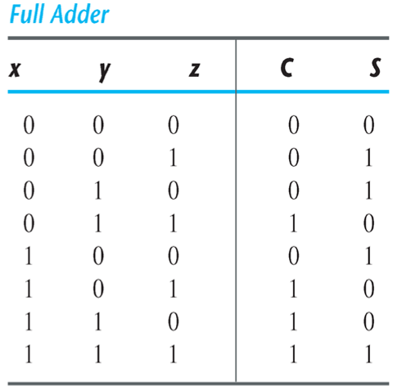
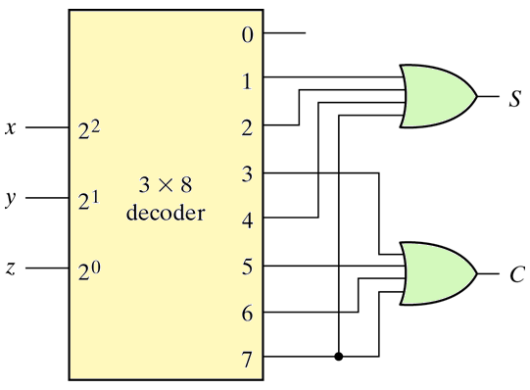
Circuit design using Decoder
Example/ Design Full Adder circuit using Decoder?
S = ∑(1,2,4,7)
C = ∑( 3,5,6,7)

Slide 12
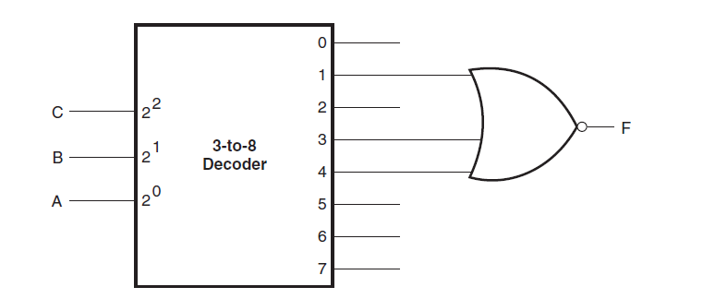
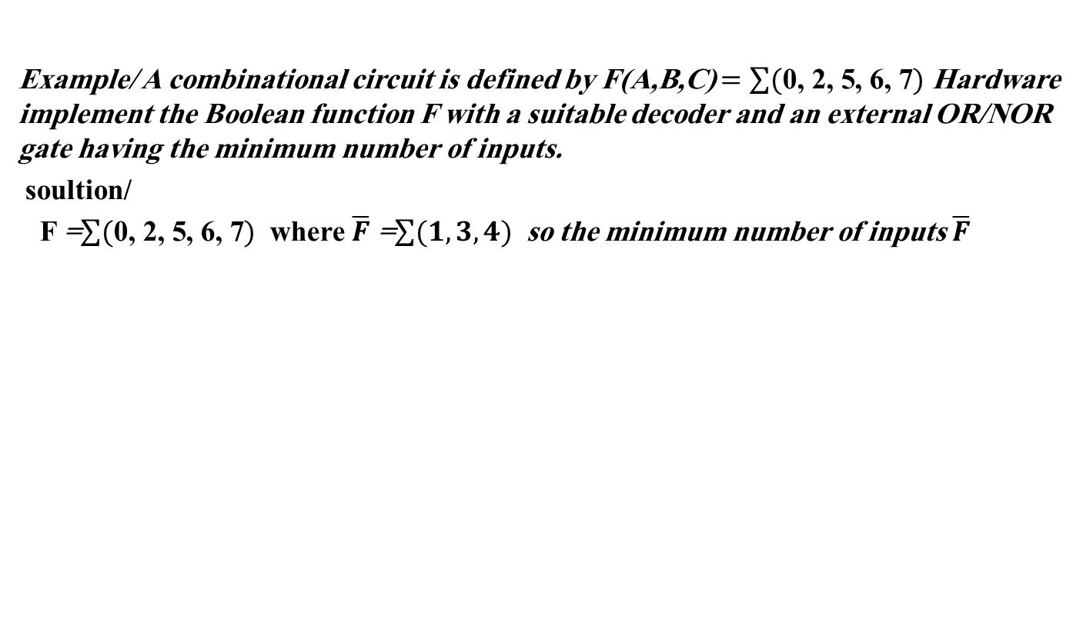
Circuit design using Decoder
Example/ A combinational circuit is defined by F(A,B,C) $=\sum{(\text{0}\text{, }\text{2}\text{, }\text{5}\text{, }\text{6}\text{, }\text{7})}$ Hardware implement the Boolean function F with a suitable decoder and an external OR/NOR gate having the minimum number of inputs.
soultion/
F =$\sum{(\text{0}\text{, }\text{2}\text{, }\text{5}\text{, }\text{6}\text{, }\text{7})}$ where $\overline{F}$ =$\sum{(1,3,4)}$ so the minimum number of inputs $\overline{F}$

Slide 13
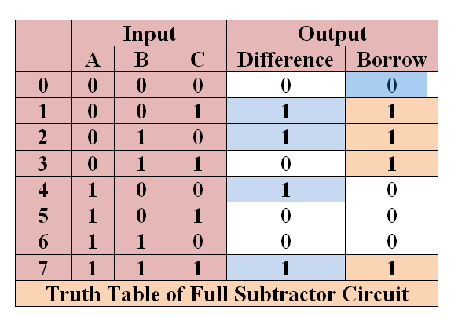
Circuit design using Decoder
Example/ Implement a full subtractor combinational circuit using a 3-to-8 decoder and external NOR gates.

Slide 14

Circuit design using Decoder
Example/ Implement a BCD to Decimal Decoder and draw the output waveform with active low.

Slide 15
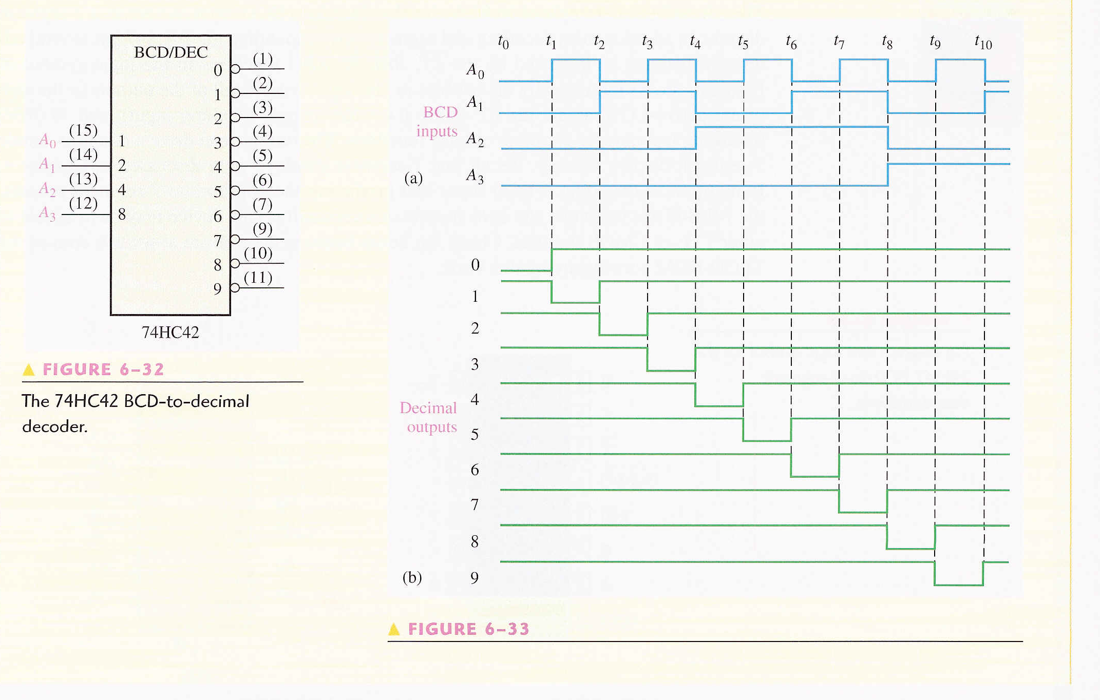

Slide 16

BCD to 7-Segment Display Decoder
A seven-segment display is normally used for displaying any one of the decimal digits, 0 through 9.
A BCD-to-seven segment decoder accepts a decimal digit in BCD and generates the corresponding seven-segment code.
Each segment is made up of a material that emits light when current is passed through it.

Slide 17
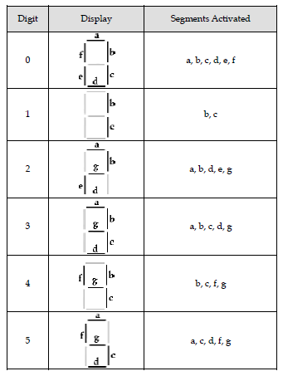
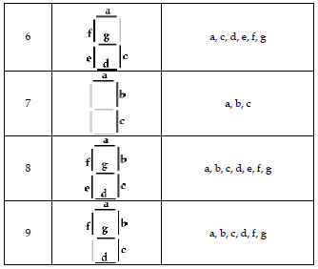
The segments activated during each digit display are tabulated as:

Slide 18
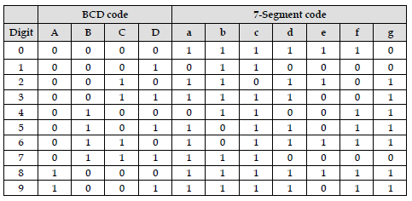
Truth table:

Slide 19
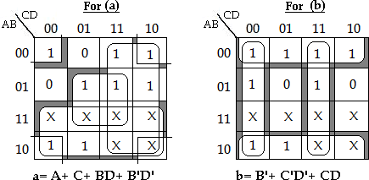
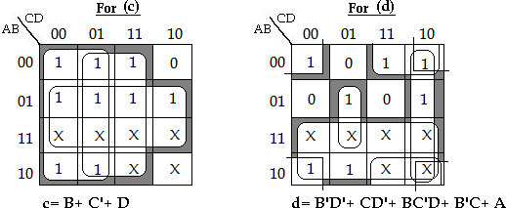
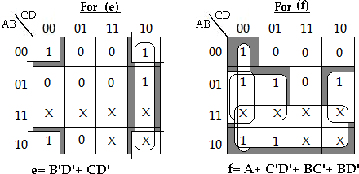
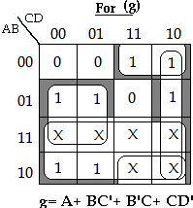
K-map Simplification

Slide 20
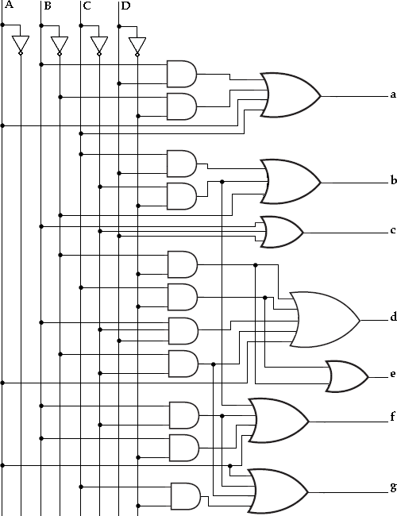
Logic Diagram of the
BCD to 7-segment display decoder

Slide 21
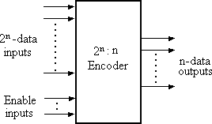
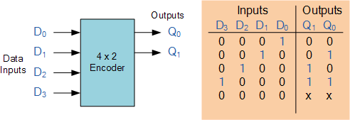
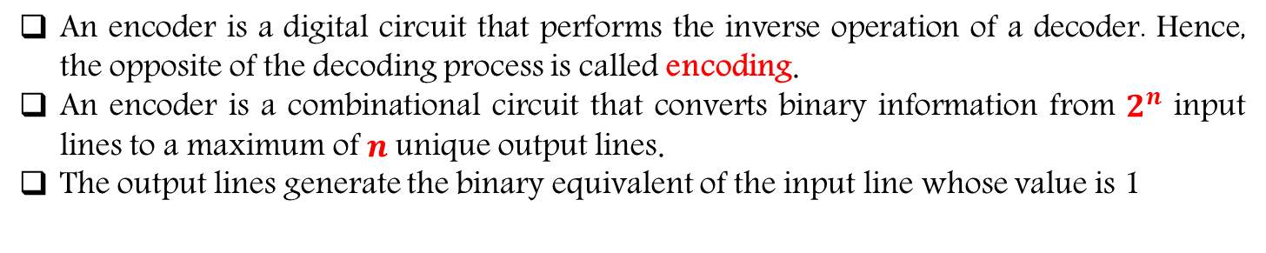
Encoders
An encoder is a digital circuit that performs the inverse operation of a decoder. Hence, the opposite of the decoding process is called encoding.
An encoder is a combinational circuit that converts binary information from $2^{n}$ input lines to a maximum of $n$unique output lines.
The output lines generate the binary equivalent of the input line whose value is 1
4 x 2 Encoder

Slide 22
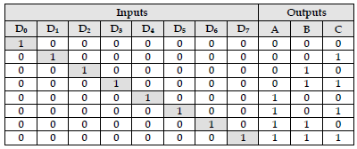
Octal-to-Binary Encoder:
It has eight inputs (one for each of the octal digits) and the three outputs that generate the corresponding binary number.
It is assumed that only one input has a value of 1 at any given time.
The encoder can be implemented with OR gates whose inputs are determined directly from the truth table.
Output C is equal to 1 when the input octal digit is 1 or 3 or 5 or 7. Output B is 1 for octal digits 2, 3, 6, or 7 and the output A is 1 for digits 4, 5, 6 or 7.
These conditions can be expressed by the following output Boolean functions.
C=D1+ D3+ D5+ D7
B=D2+ D3+ D6+ D7
A= D4+ D5+ D6+ D7

Slide 23
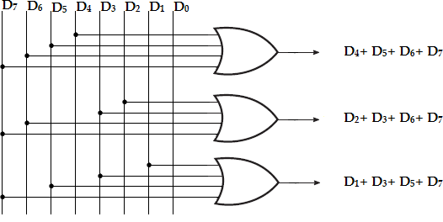
A=
B=
C=

Slide 24
Priority Encoder
With the design of a simple encoder:
Only one input can be active at any given time. If two inputs are active simultaneously, the output produces an undefined combination (for example, if D3 and D6 are 1 simultaneously, the output of then encoder will be 111.
In priority encoder, if two or more inputs are equal to 1 at the same time, the input having the highest priority will take precedence.
The higher the subscript number, higher the priority of the input. Input D3, has the highest priority. So, regardless of the values of the other inputs, when D3 is 1, the output for x y is 11.
D2 has the next priority level. The output is 10, if D2= 1 provided D3= 0. The output for D1 is generated only if higher priority inputs are 0, and so on down the priority levels.
In addition to the two outputs x and y, the circuit has a third output, V (valid bit indicator). It is set to 1 when one or more inputs are equal to 1. If all inputs are 0, there is no valid input and V is equal to 0.

Slide 25
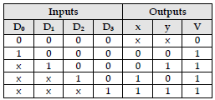
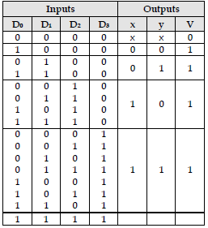
Priority Encoder
Modified Truth table:
The third row in the table with X100 represents minterms 0100 and 1100. The don‘t care condition is replaced by 0 and 1 as shown in the table .

Slide 26
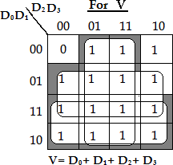
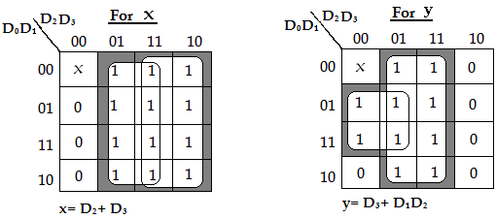
K-map Simplification:

Slide 27
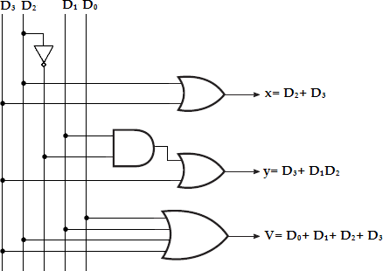
The priority encoder implemention

